Slide 1
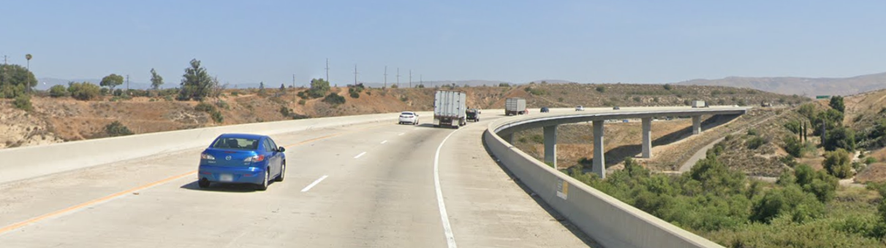
Arroyo Simi Bridge Suicide Prevention Task Force Update
Presentation to the Ventura County Transportation Commission
September 6, 2024

Slide 2
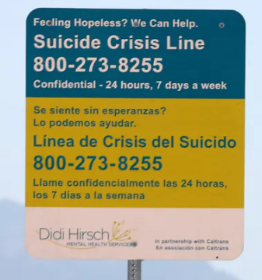
Origin & Purpose
Arroyo Simi Bridge built in 1993
Elevated number of suicides and suicide attempts
Informal efforts to address issue since at least 2014
Caltrans installed Crisis Line Signs in 2018
Task Force initiated in 2022 to give structure to suicide prevention efforts related to transportation infrastructure
Two-pronged approach
  Physical solutions
  Community-based solutions
Notes:
A very small percentage of suicides and suicide attempts occur on transportation infrastructure such as bridges, but when they do occur, they tend to be particularly highly visible to the community and cause trauma to witnesses and first responders.

Slide 3
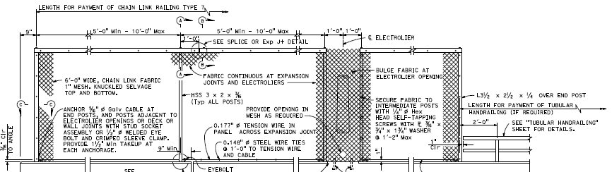
Physical Solutions
Notes:
Barrier fence purpose is not to stop all suicide attempts, but to provide additional time to intervene and for first responders to arrive

Slide 4

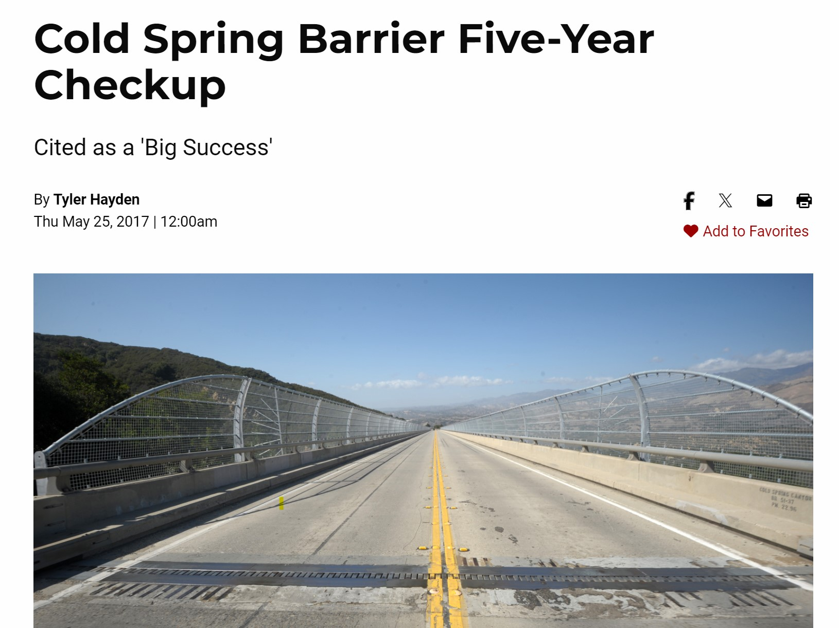
Physical Solutions
Barrier Fence Examples
Vincent Thomas Bridge (San Pedro)
Cold Springs Bridge (SR-154 Santa Barbara County)
Santa Barbara Independent
https://www.independent.com/2017/05/25/cold-spring-barrier-five-year-checkup/

Slide 5
Project Timeline Targets
Environmental/
Prelim Design
2
Final Design
3
Project Initiation
1
Start: Jan 2023
Construction Procurement
4
Finish: Oct 2023
Start: Sept 2023
Finish: August 2024
Start: November 2024
Finish: March 2025
Finish: Mid Nov 22
Start: July 22
Construction
5
Start: May 2025
Finish: November 2025
Barrier Fence
Project Schedule
100% PS&E: 07/03/2024 (A)
RW Certificate: 06/21/2024 (A)
Ready to List (RTL): 08/02/2024 (A)
Construction Funds Allocation by CTC: 10/18/2024 (T)
Advertise the Project: 11/19/2024 (T)
Bid Open: 01/08/2025 (T)
Award: 02/05/2025 (T)
Approve Contract: 03/05/2025 (T)
      Construction duration 95 Working Days, approximately 5 months
      Construction activities complete within 2025 Calendar year

Slide 6
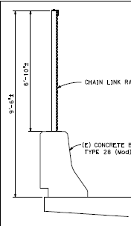
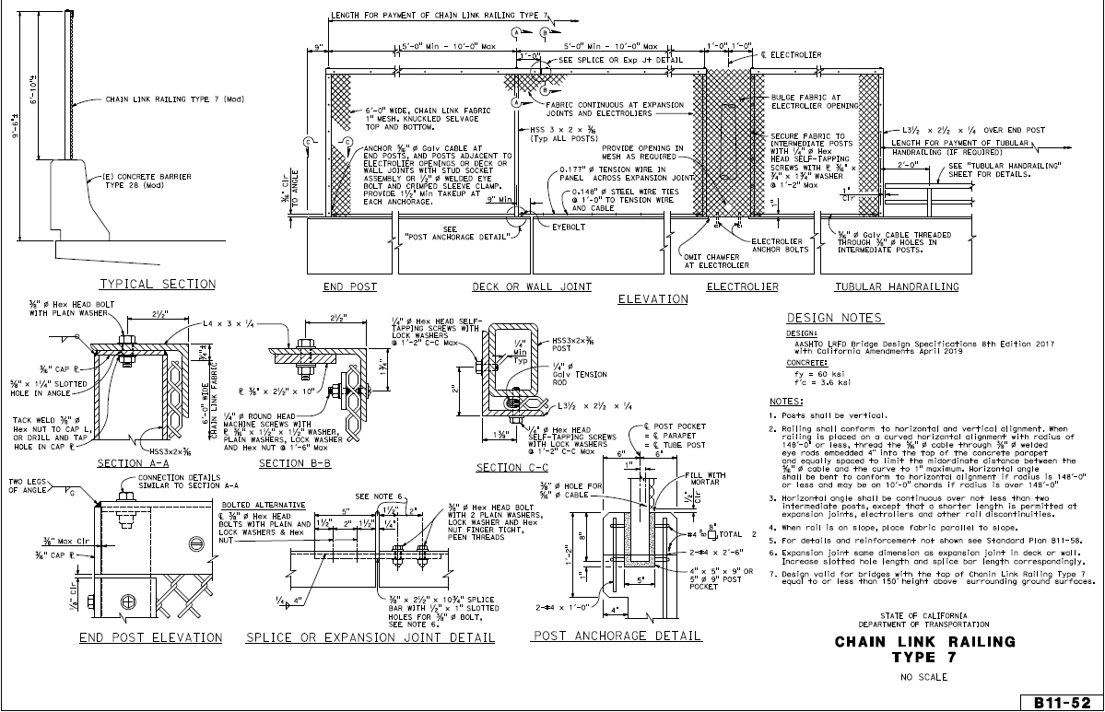
Safety Barrier System
Barrier Fence Design & Engineering

Slide 7



Community-Based Solutions

Slide 8
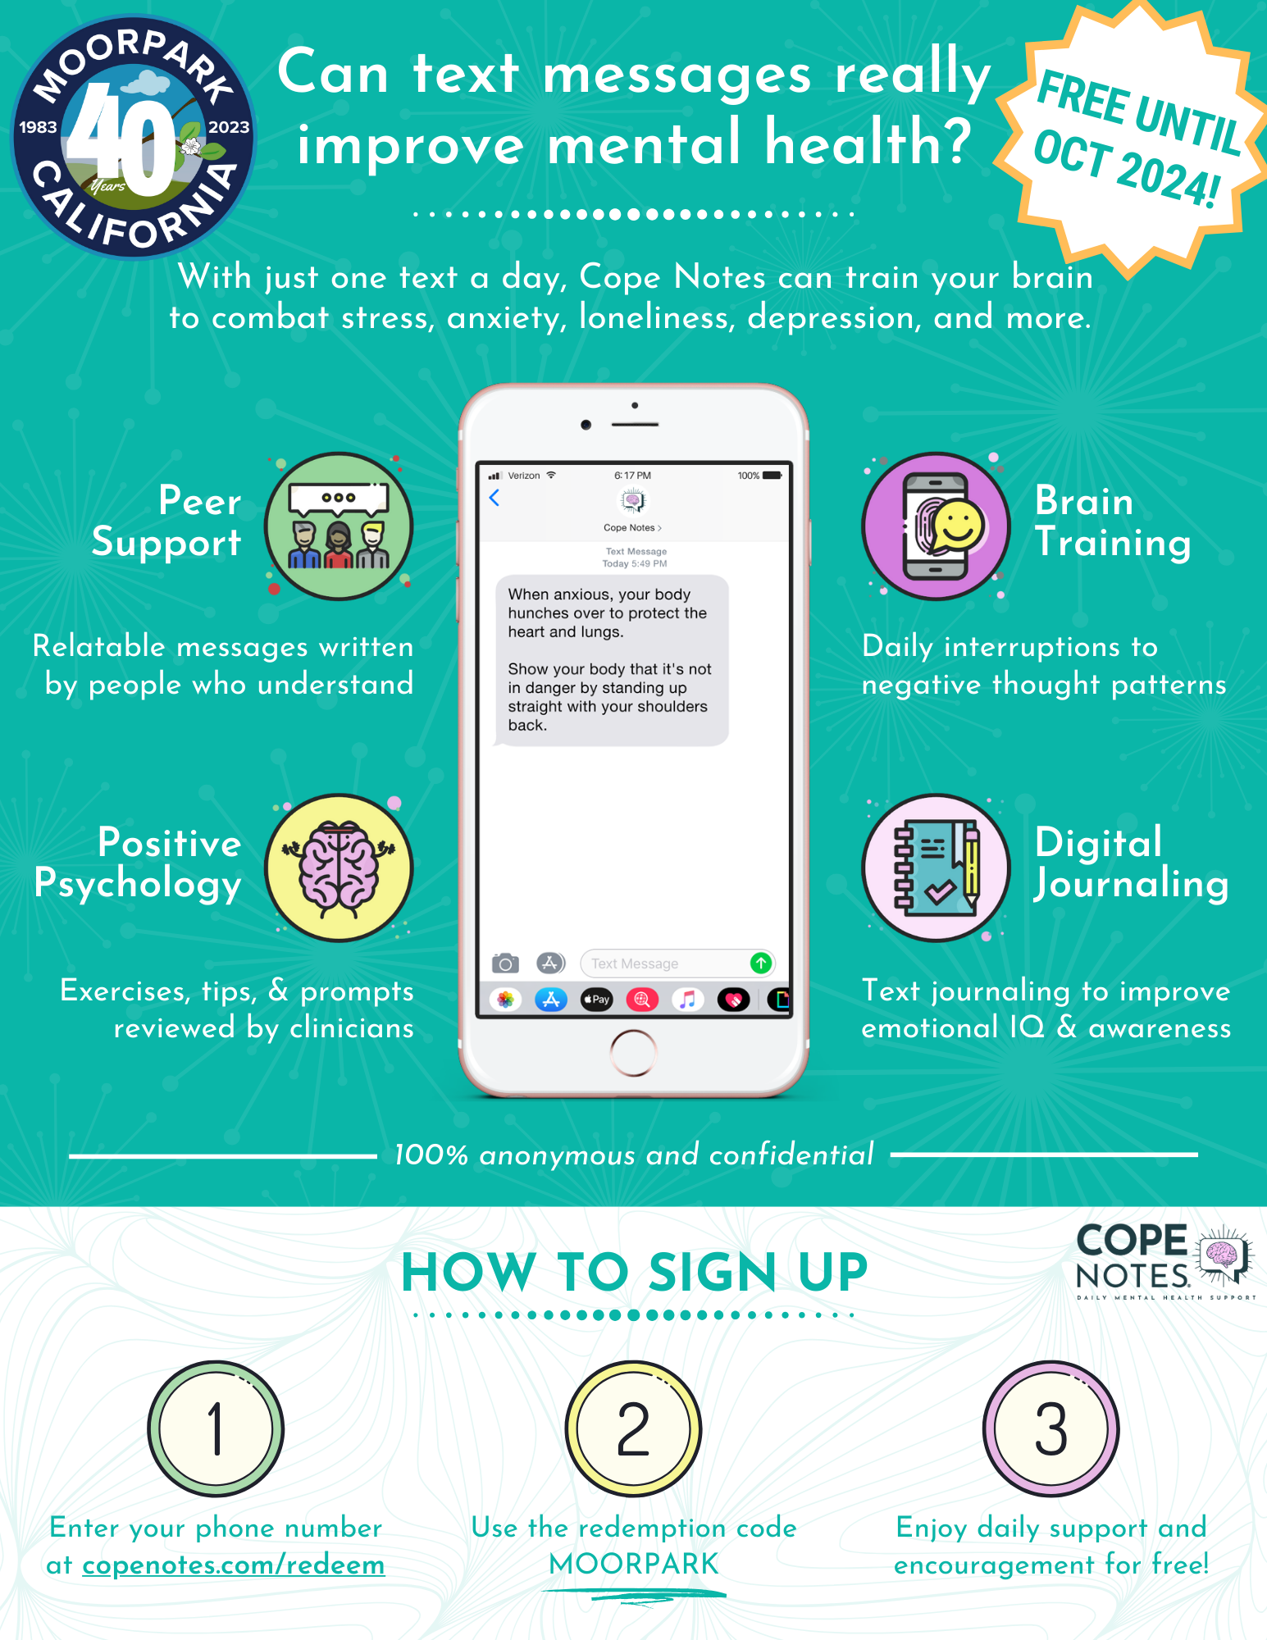
Community- Based Solutions
Raising Awareness
Partnership with Didi Hirsch Mental Health Services
Developed First Responders Training on Crisis De-Escalation and Intervention
  California Highway Patrol
  Freeway Service Patrol Drivers and Dispatchers
Developed Community Suicide Awareness, Prevention & Response Training
City of Moorpark focus on community mental health, including Cope Notes

Slide 9

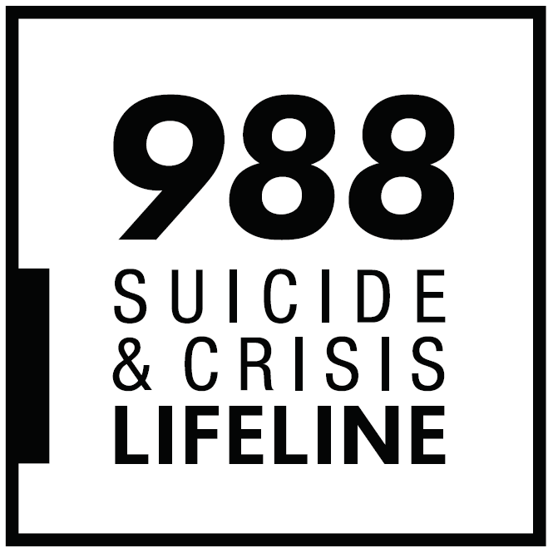

Community Based Trainings
Substance Abuse/Addiction
High co-morbidity rates
Increased risk
Trainings cover:
Suicide awareness
Suicide alertness
Suicide prevention & intervention
Suicide and crisis resources
Notes:
--Suicide affects us all.
Show of hands: How many of you have lost someone to suicide. you certainly do not need to answer this if it makes you uncomfortable. * READ SLIDE*
--Note family in the second row (mother in the middle, oldest son on the left, and youngest daughter on the right)
--All three died by suicide in a ten year time span
--Suicide contagion - individuals who lose a friend or relative to suicide are at greater risk for attempting or dying by suicide in the future
--Mental illness can run in families; mental illness is a risk factor for suicide
--Important to understand possible risk associated with family history of mental illness

Slide 10

Suicide Statistics: 2021
Suicide is the
On average
Suicide is the
11th
Leading cause of death in the US
128
People in the US die by suicide each day
3rd
Leading cause of death for youth (15-24)
Anyone can be at risk!
Statistics from CDC/SAVE.org and/or SAMHSA Health Survey

Slide 11

Three Steps: Suicide Prevention
1. Build Rapport
2. Assess Risk
3. Create Safety Plan
Notes:
THEN WHAT?
Say, “What do we do if they say yes, suicide is the issue, or they say something that makes us believe suicide might be the issue?”
Say, “There are 3 steps, and we’re going to talk about each of them”
READ THREE STEPS, then click to next slide

Slide 12
First Responder Trainings
Substance Abuse/Addiction
High co-morbidity rates
Increased risk
Trainings cover:
Suicide awareness & prevention
Crisis de-escalation
Suicide intervention
Suicide and crisis resources
Notes:
--Suicide affects us all.
Show of hands: How many of you have lost someone to suicide. you certainly do not need to answer this if it makes you uncomfortable. * READ SLIDE*
--Note family in the second row (mother in the middle, oldest son on the left, and youngest daughter on the right)
--All three died by suicide in a ten year time span
--Suicide contagion - individuals who lose a friend or relative to suicide are at greater risk for attempting or dying by suicide in the future
--Mental illness can run in families; mental illness is a risk factor for suicide
--Important to understand possible risk associated with family history of mental illness

Slide 13
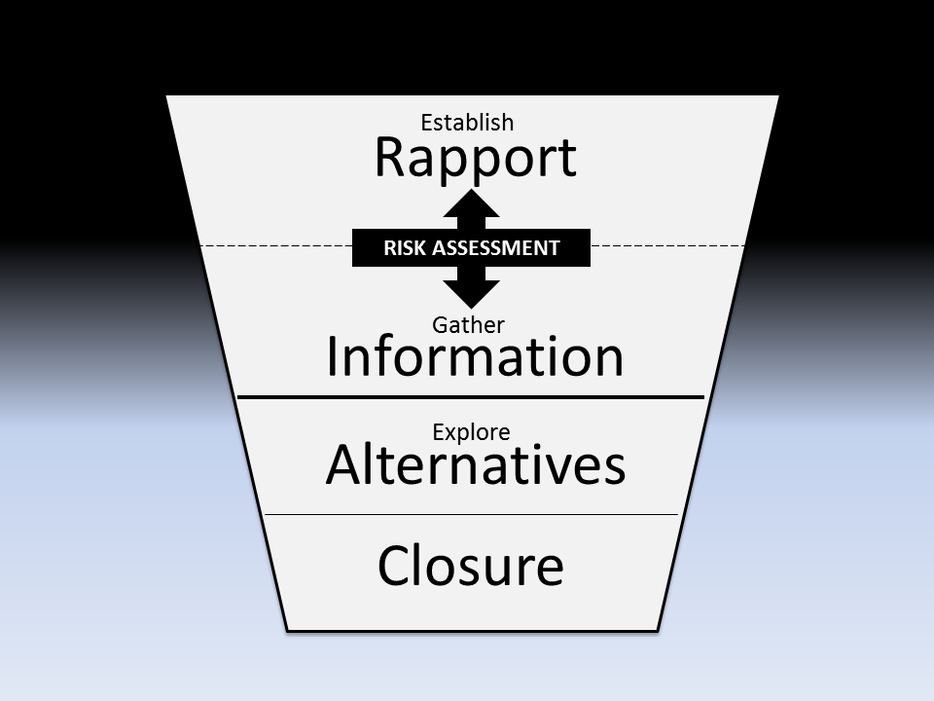
Crisis De-escalation Model
Substance Abuse/Addiction
High co-morbidity rates
Increased risk

Slide 14
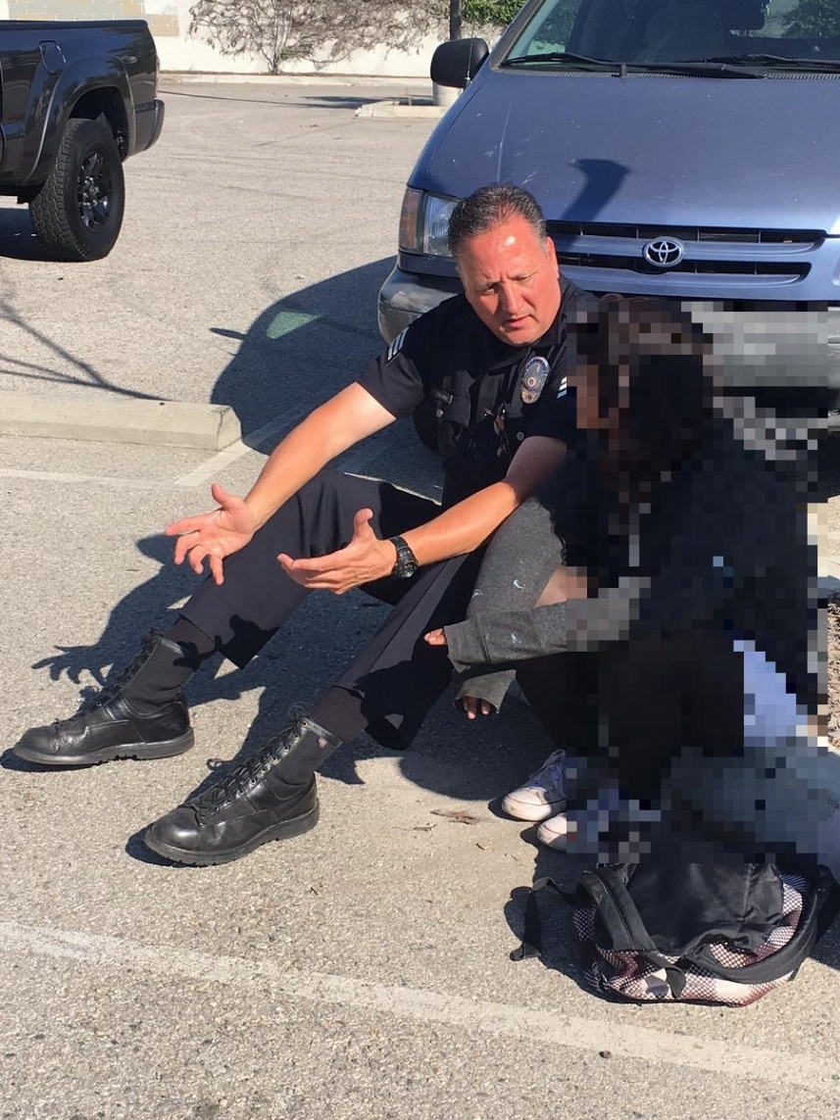
Suicide Risk Assessment: How to Respond
  RESPOND with EMPATHY and RESPECT:
  “Thank you for telling me.”
  “You must be in a lot of pain.”
  “I’m worried about you.”
  “Let’s talk about this…”

Slide 15
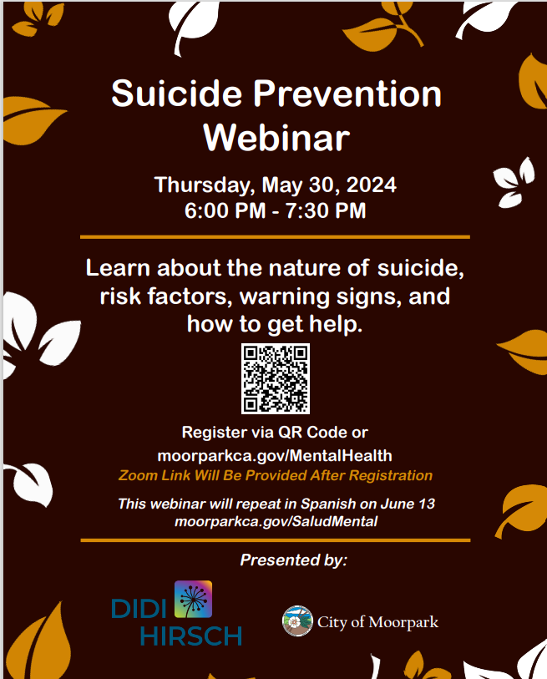
Raising Awareness
Mental Health Month, Suicide Prevention Awareness Month and Beyond
Suicide Prevention Webinar – May 30
Presentation to Simi Valley City Council – Sept. 9
Presentation to Moorpark City Council – Sept. 18
First Responders Training, Hosted by City of Moorpark – Oct. 24
Virtual Community Trainings – Dates TBD

Slide 16
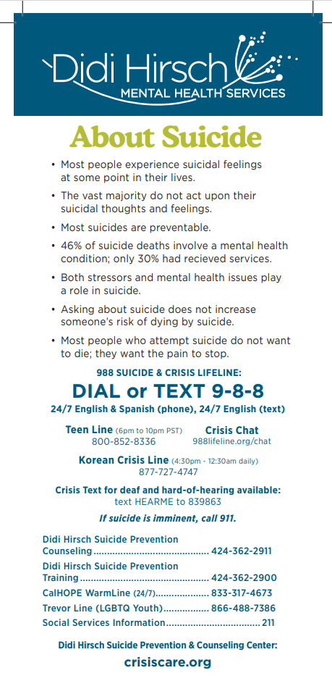
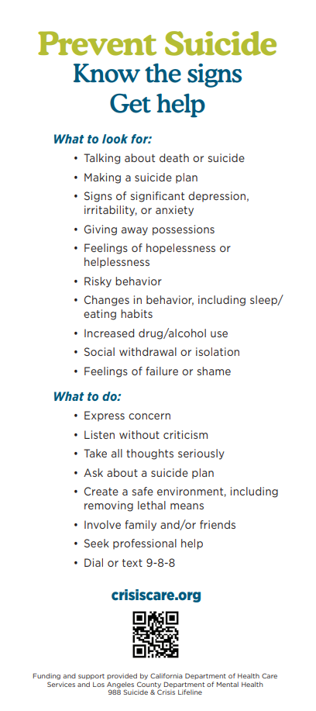
Community- Based Solutions

Slide 17
Questions?

