Slide 1
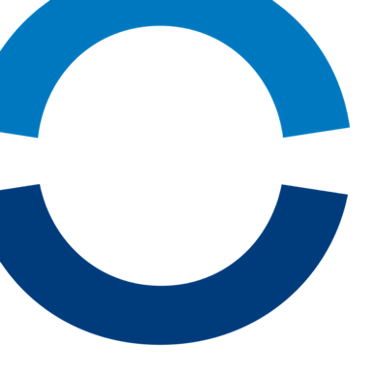
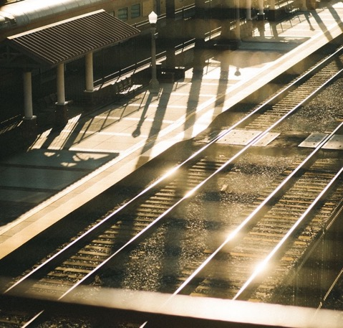
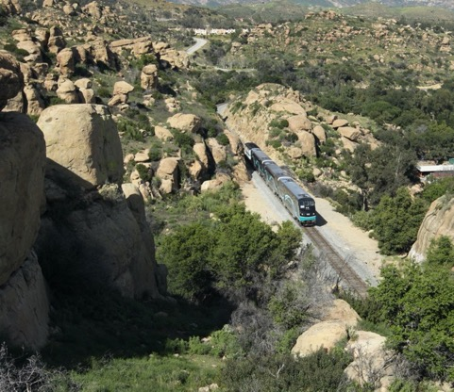

Metrolink Update
VCTC Board Meeting
September 6, 2024

Slide 2
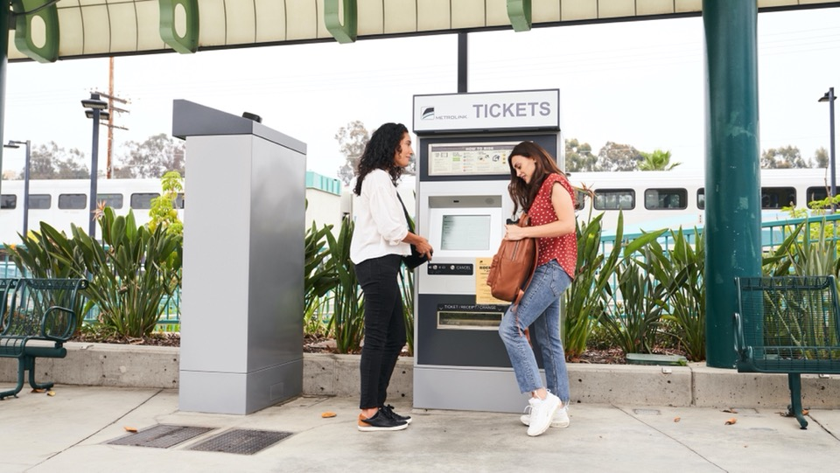

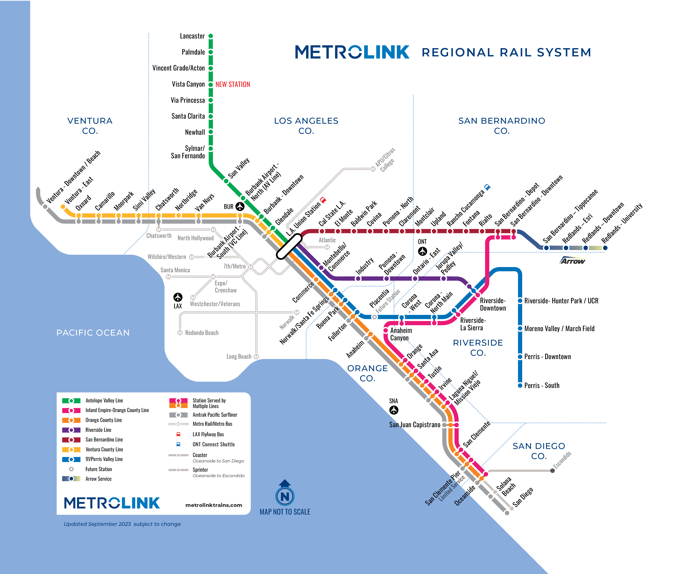

Metrolink System
6
Counties Served
7
Routes/Lines
545.6
Route miles
67
Stations
142
Trains we operate now
174
Trains we’ll operate beginning Oct 2024

Slide 3

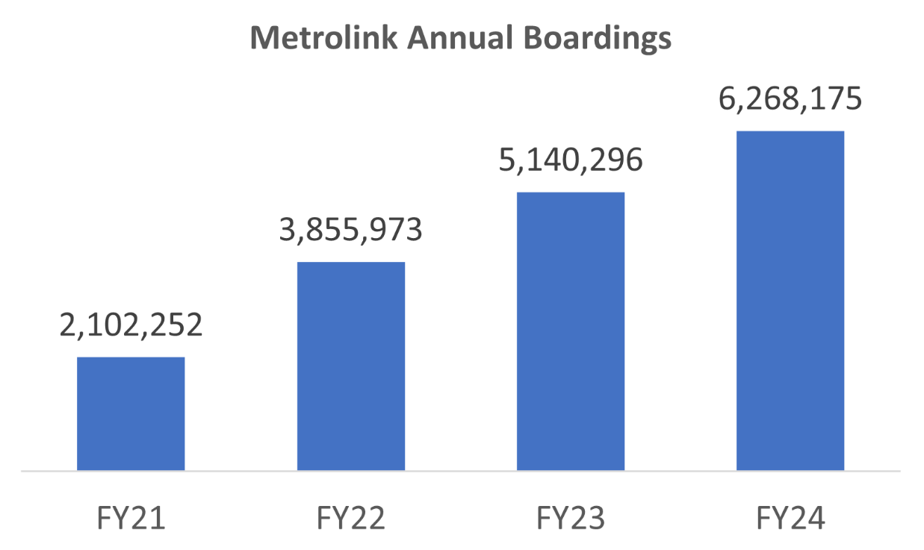

Systemwide Ridership Recovery
Notes:
Metrolink ridership reached 6,268,175 boardings in FY24.
That is an increase of 22% over FY23.
June 2024 was the 39th consecutive month with year-over-year ridership increases.
Ridership recovery in June 2024 was 56% of pre-pandemic levels – 6.2M boardings in '24 compared to 11.9M in record setting '19
Ridership in FY24 reached 52% of ridership in FY19.

Slide 4
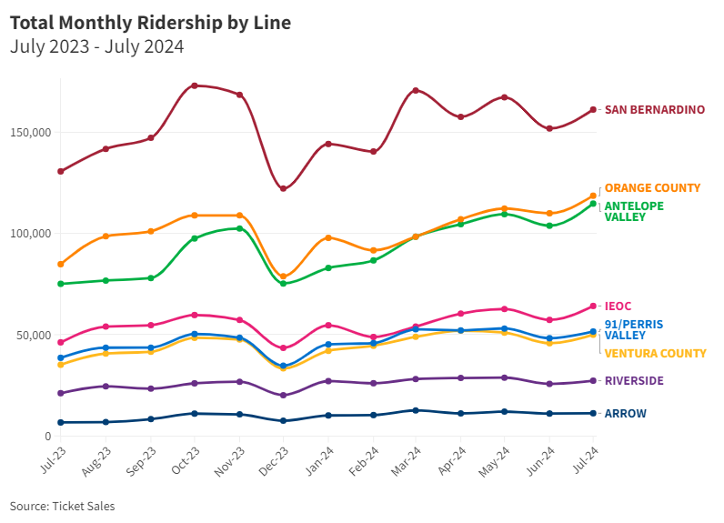
Systemwide Ridership by Line
Notes:
Ridership by line over a year (July 2023-July 2024) to show ridership trends over time

Slide 5
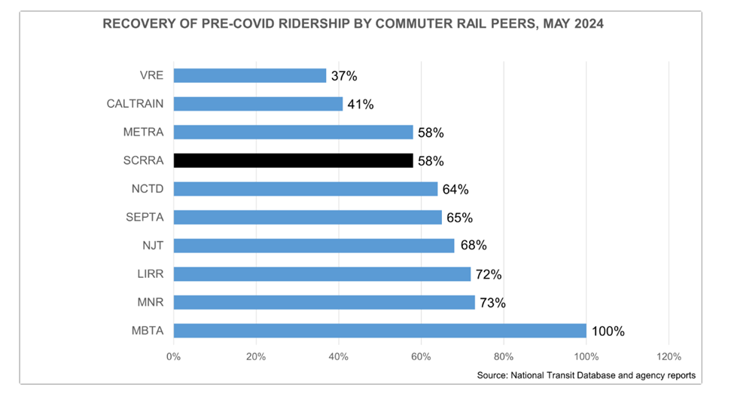
Post-Pandemic Commuter Rail Ridership
Notes:
Significantly higher recovery in NE corridor w/ greater population density and built out infrastructure; MBTA has more fully transitioned to regional rail.

Slide 6
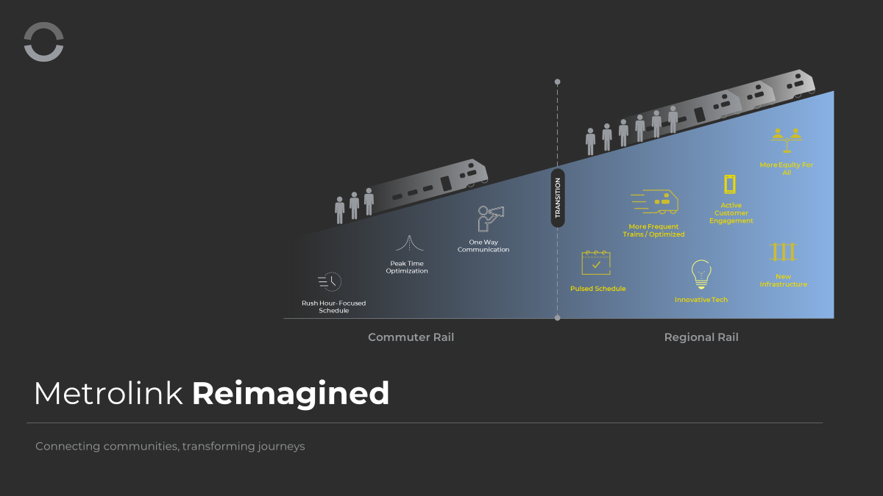

Slide 7

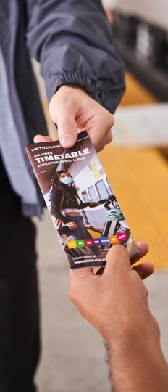

New Optimized Schedule
  Effective October 21, 2024
  Service will be increased by 22.5%
  Adding 32 trains (from 142-174) to our weekday service
  No changes to weekend service
  Adding more midday and evening options
  Optimizing trains, fuel, crews, and connectivity across all lines
  No additional changes being made to the AV Line (service enhancements made Oct 2023)

Slide 8
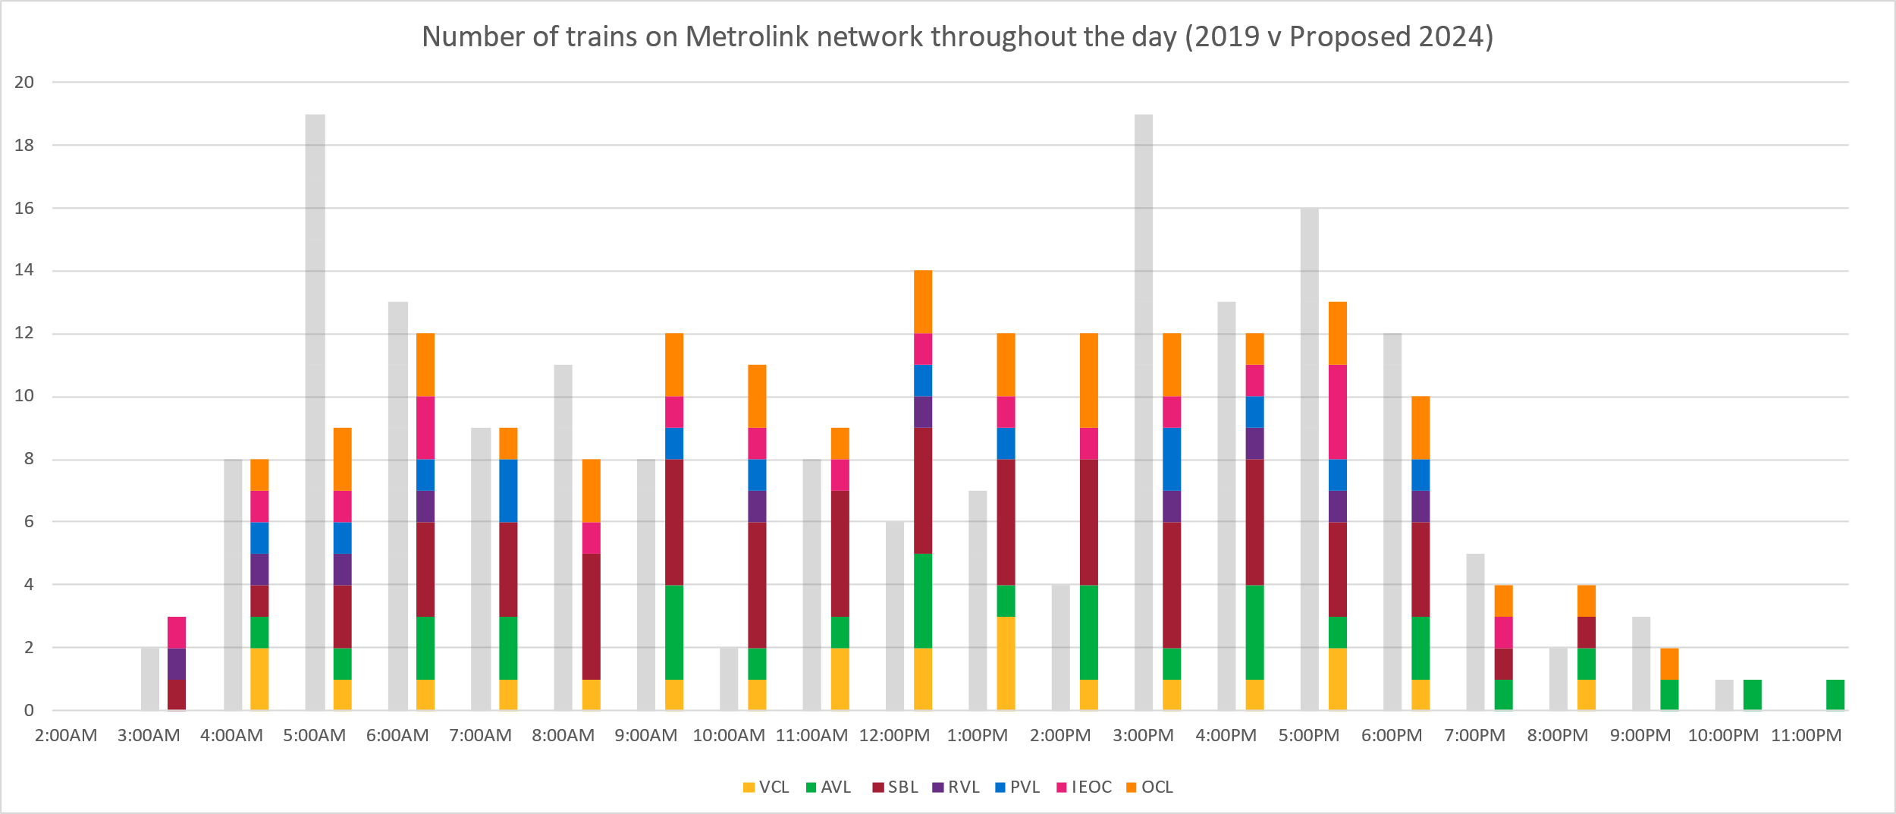
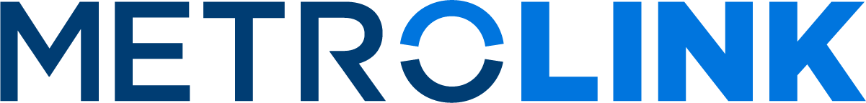
Schedule Development
October 2024 Schedule
Notes:
The gray line is the service we operate today
The dark blue line is what we hope to offer (some changes expected from when this slide was developed in May).
You’ll notice the extensive mid-day additions.
We are opening up service for those not on a typical 9 to 5.

Slide 9
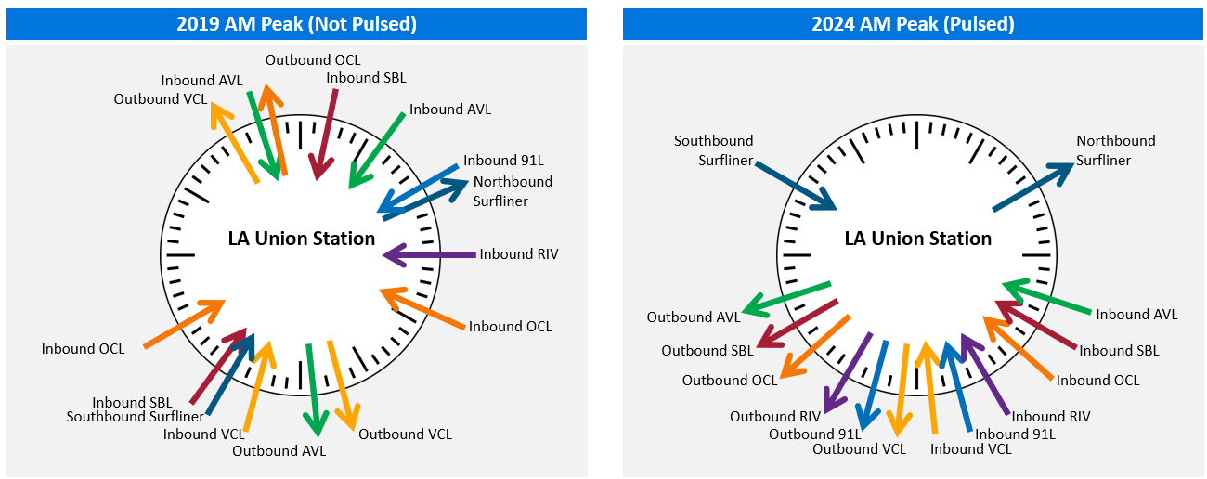
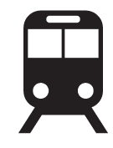
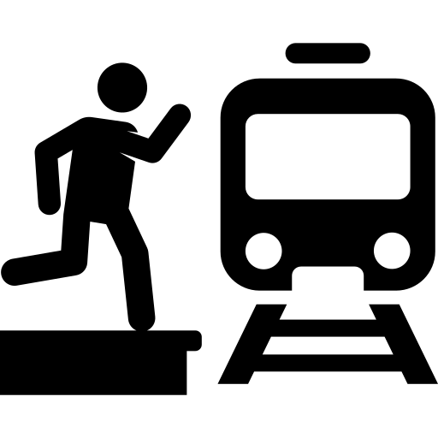
Schedule Development
4X Transfer Opportunities 10 to 20-Minutes
2023
67 connections
200+ connections
Notes:
2023: 67 connections
2024: 237 connections – or four times the amount
Connections counted here are transfers from one train line to another train line in 20 minutes or less
Pulsed schedule improves – with the new schedule, we’re looking at connection times between 10 and 20 minutes (average of 15)

Slide 10
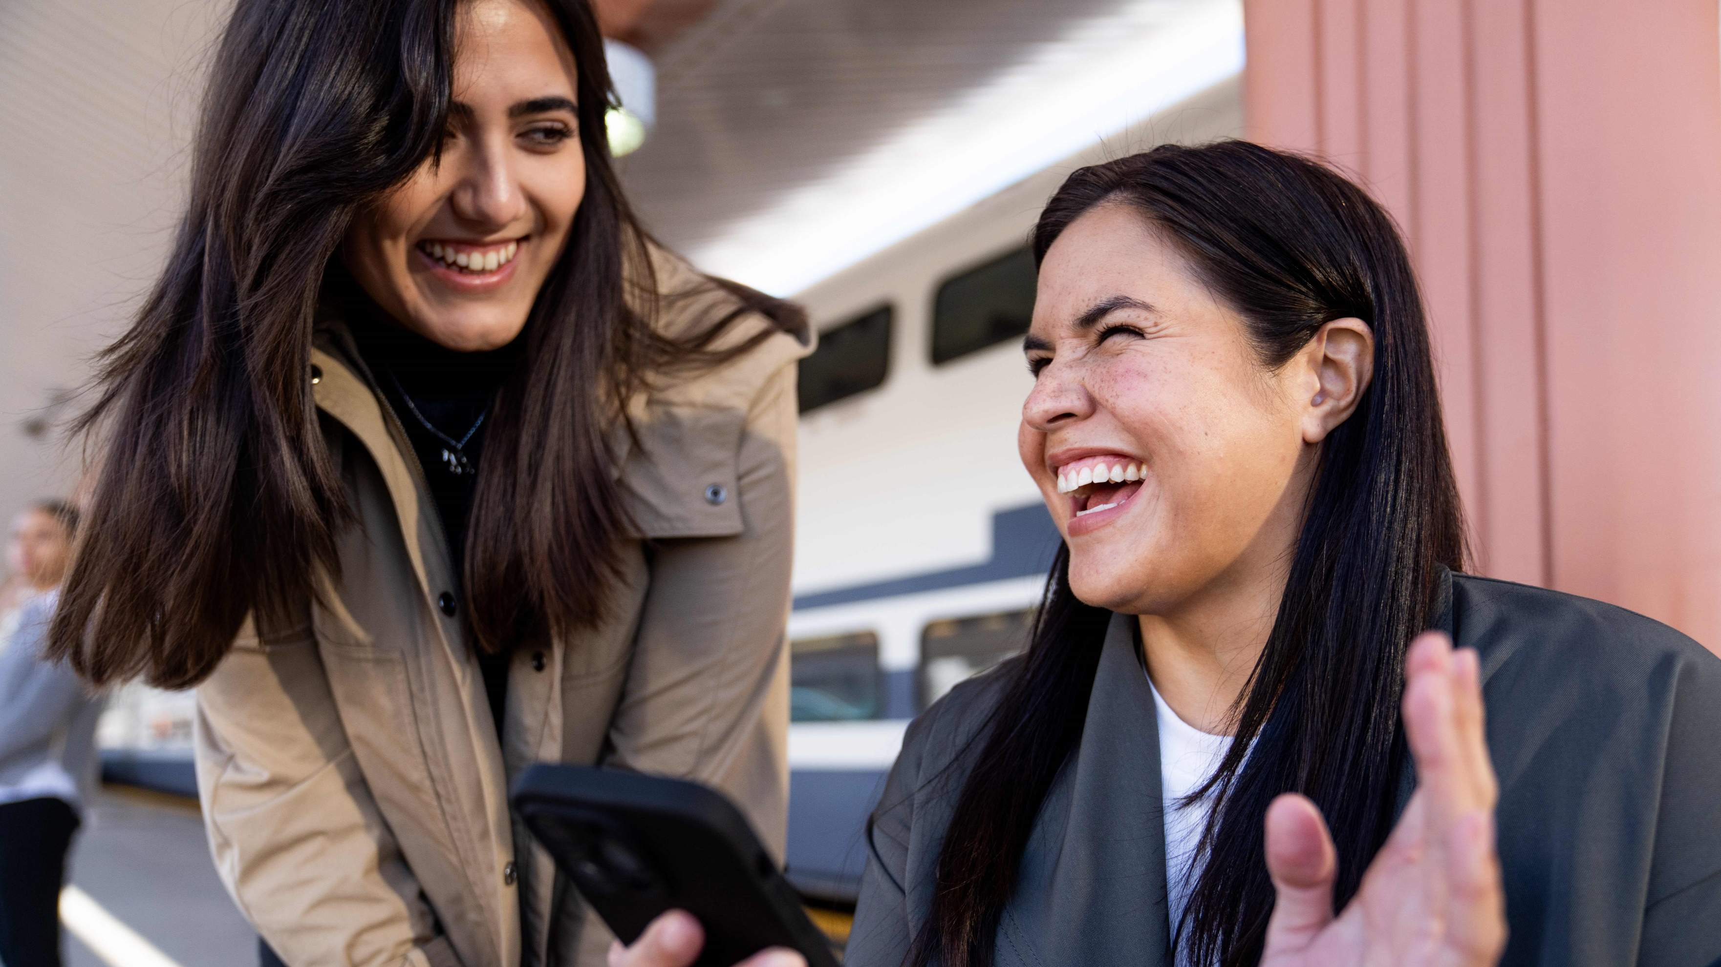
Ventura County Line Service Expansion
Optimized 22 trains for increased and better-timed connections at LAUS; more midday service
2 additional trains
Now 6 trains are going to Ventura-East, 10 to Moorpark and 6 to Chatsworth
Consistent departure times; all trains departing at regular intervals after the hour
Launching October 21, 2024
Notes:
Metrolink's new schedule optimized 22 trains for increased and better-timed connections at LA Union Station.
2 additional trains have been added to the Ventura County Line.
Now 6 trains are going to Ventura-East, 10 to Moorpark and 6 to Chatsworth.
The new schedule offers more midday service.
The new schedule features consistent departure times, with all trains departing at regular intervals after the hour.

Slide 11
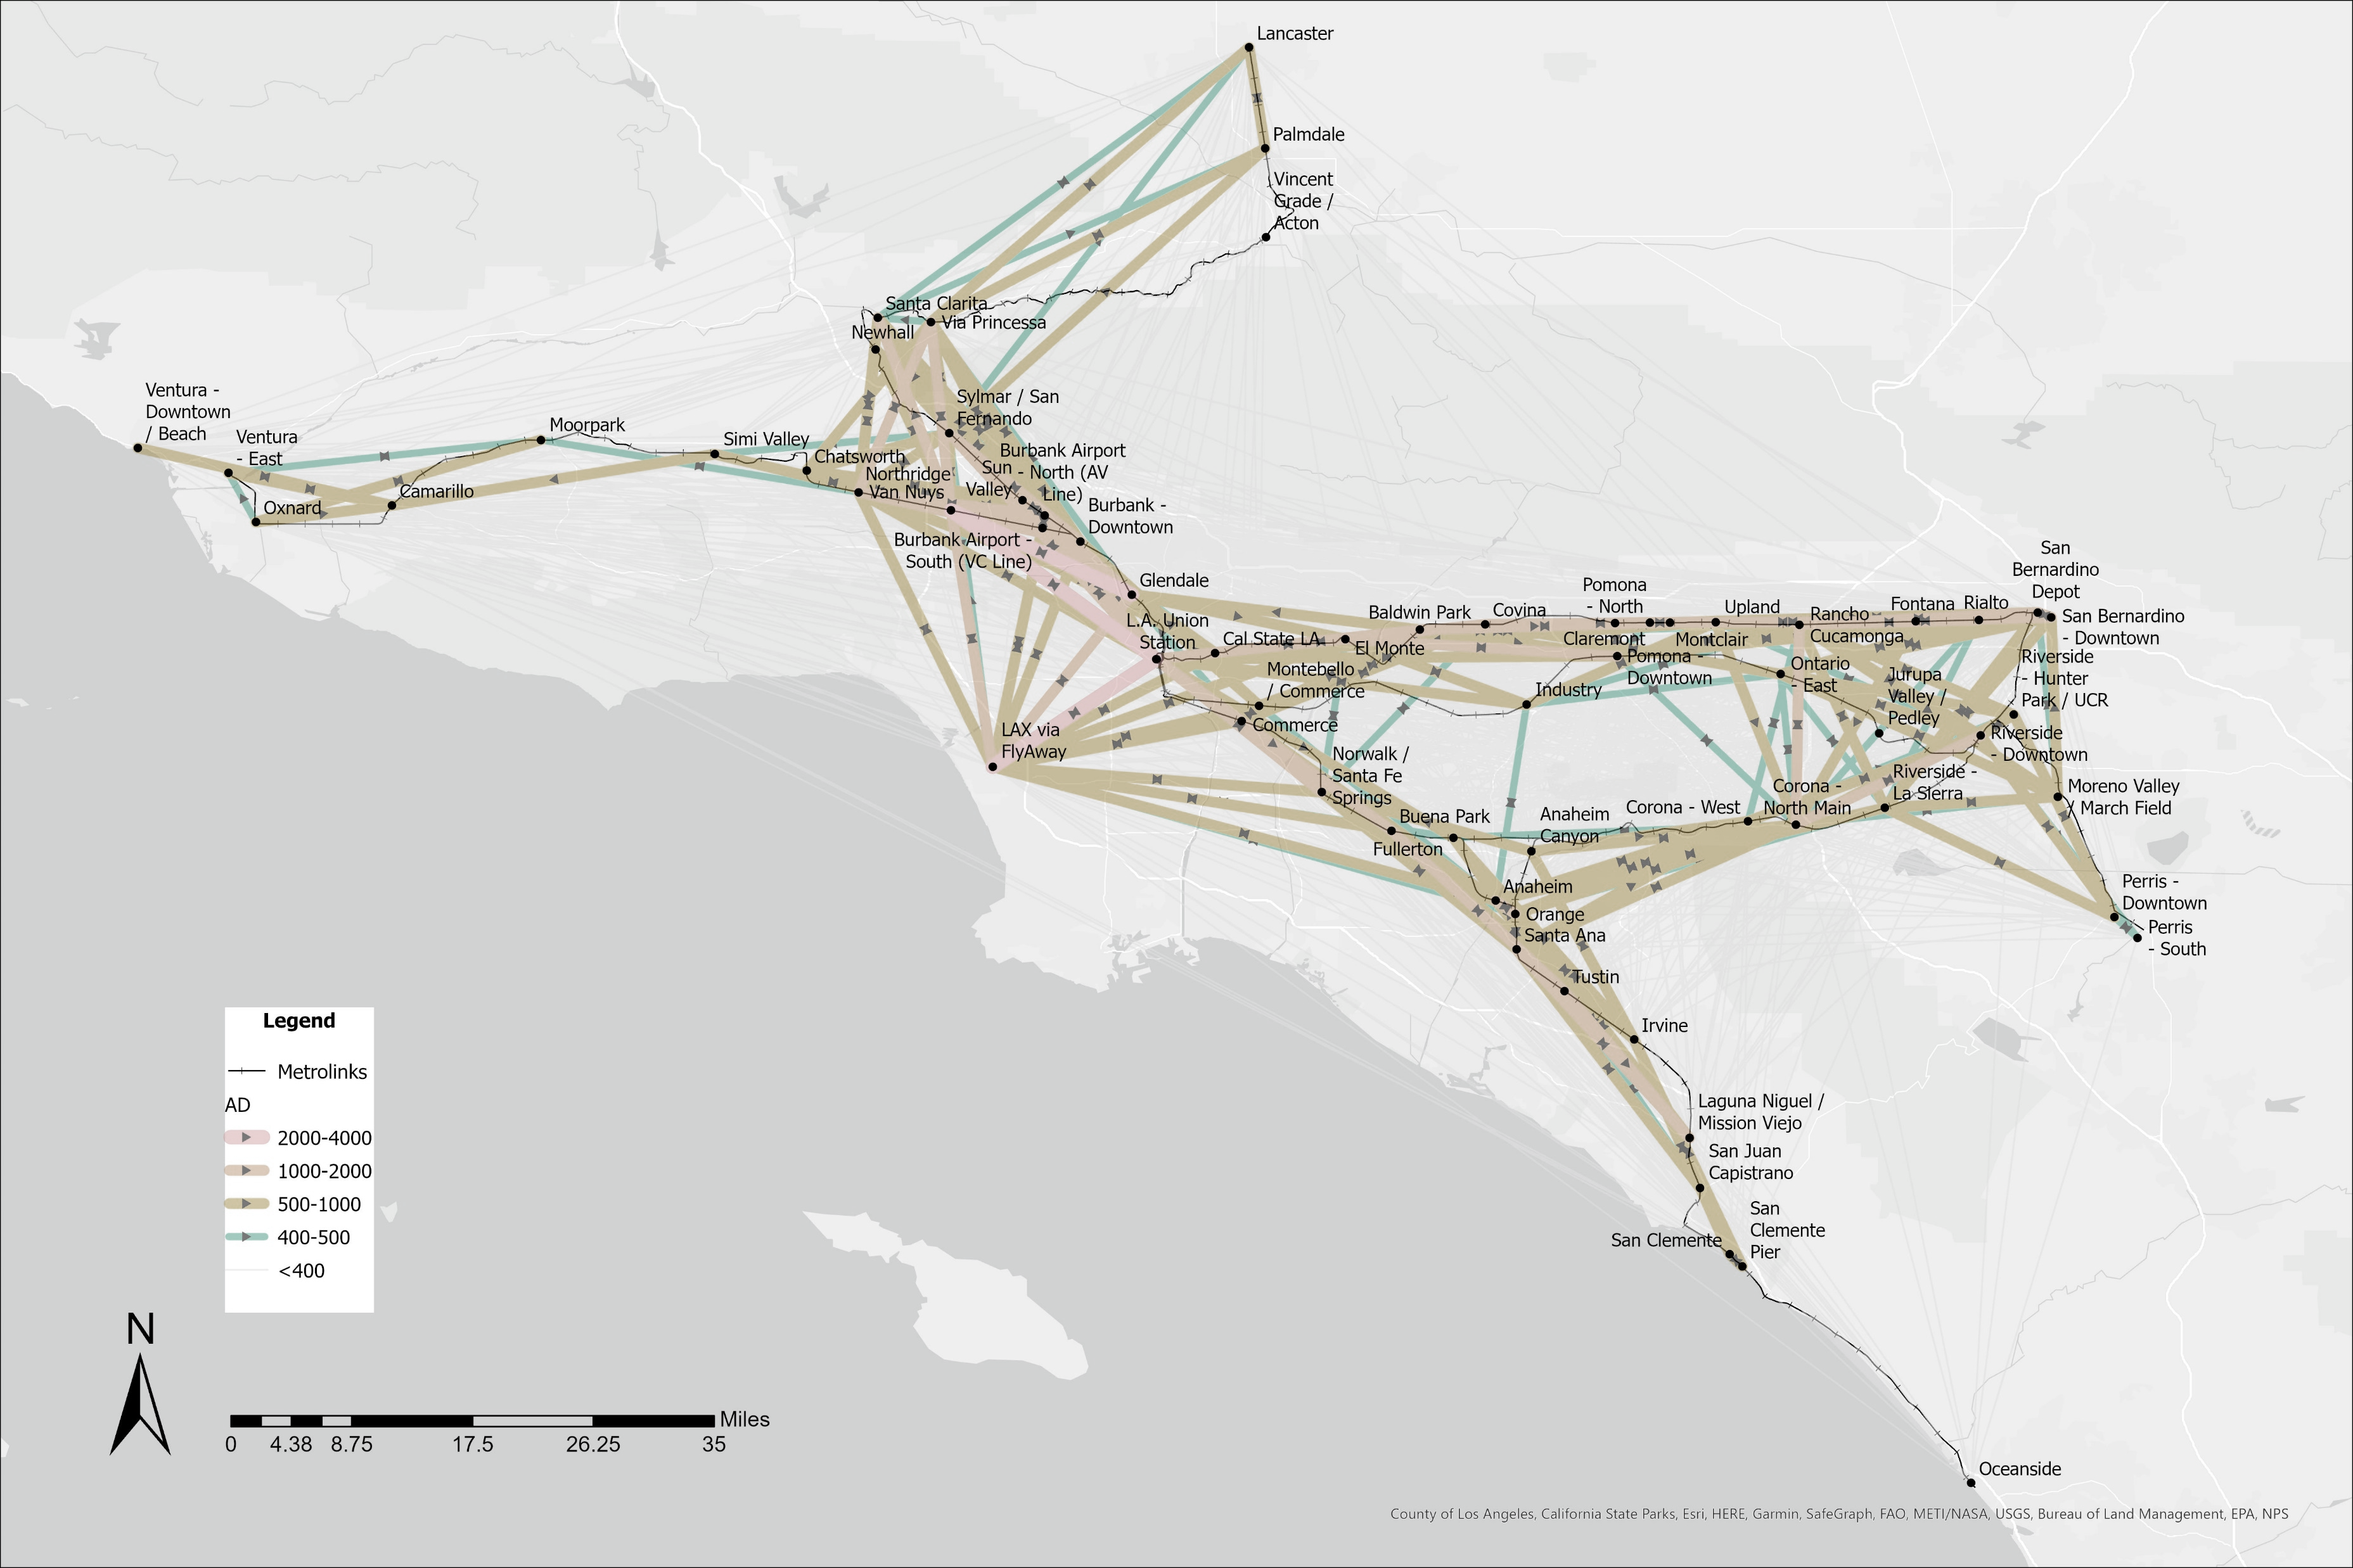
With current schedules: Moorpark to Anaheim trip
1. Moorpark to LAUS:
9:33AM – 10:45AM
2. LAUS transfer time:
10:45AM – 2:11PM
3. LAUS to Anaheim:
2:11PM – 2:55PM
Total trip time:
4 hours 10 minutes
Notes:
Currently someone leaving Moorpark around 9:30am does not have a morning connection from the VC Line to OC Line, with a long transfer time at LA Union Station.

Slide 12
Example trip with updated schedules: Moorpark to Anaheim trip
1. Moorpark to LAUS:
9:11AM – 10:30AM
2. LAUS transfer time:
10:30 – 10:40AM
3. LAUS to Anaheim:
10:40AM – 11:30AM
Total trip time:
2 hours 19 minutes
Notes:
Under the optimized schedule, the transfer time is reduced and a cohesive trip minimizes the overall trip time by nearly 2 hours.
What does this do for people that are transit dependent that are looking for jobs? Metrolink Reimagined opens a world of opportunity, you can expand your job search, go to school further away.

Slide 13
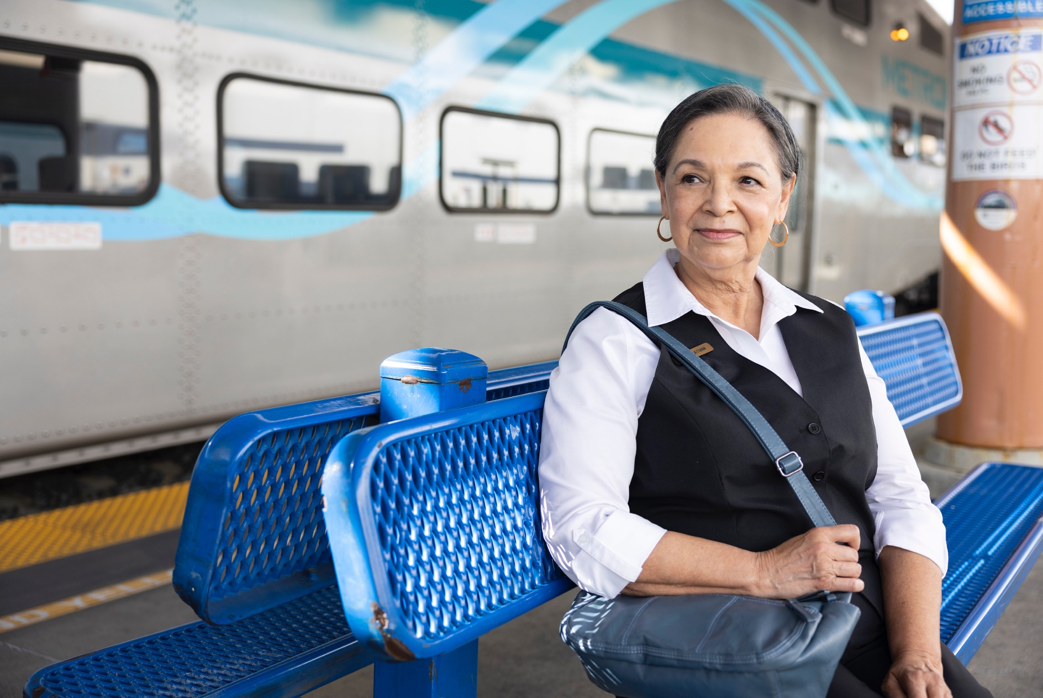


VCL Initiatives

Slide 14

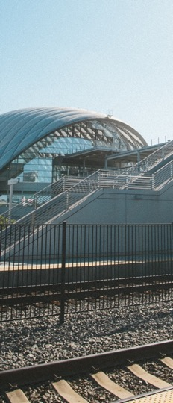
Codeshare Program
Partnership between Metrolink & LOSSAN
All Metrolink ticketholders can ride Pacific Surfliner trains between LAUS & Ventura.
Program increases service levels while running fewer trains.
Ridership between LAUS & Ventura was up 96% last year, from 30,000 to 60,000 riders.
Notes:
Codeshare is a program Metrolink created, in coordination with LOSSAN, that allows Metrolink ticketholders to ride all Pacific Surfliner trains between Union Station and Ventura.
This program is designed to increase service levels for our customers on the Ventura County Line where we run fewer Metrolink trains.
The launch of the codeshare program has proven highly successful. Ridership between Union Station and Ventura was up 96% the last 12 months, increasing from about 30,000 to 60,000 riders.

Slide 15
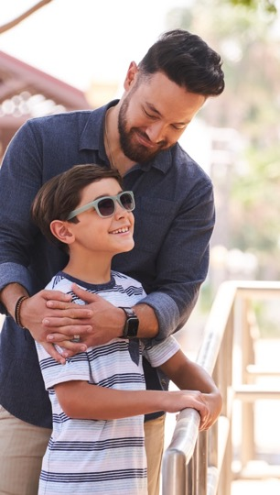

Santa Barbara
Service Expansion
A draft work plan and budget is being developed by SCRRA, VCTC and SBCAG
Initial proposal for one round-trip train per weekday
Anticipated start date in April 2025
Estimated O&M: $4,030,000 (exclusive of passenger fare revenue estimated at $500,000)
Notes:
Background: SCRRA has been working with SBCAG and VCTC for the past several months to develop a draft work plan and budget to develop and operate the initial com-muter train proposal identified by SBCAG and VCTC as one (1) round-trip train per weekday with an anticipated start date in April 2025 (assuming we can get reimbursement funds and all the proper agreements in place). Please note SCRRA has assumed that ticket pricing and revenue collection will be developed and arranged separately by VCTC, SBCAG and LOSSAN JPA with the assistance of SCRRA.
Estimated Cost:
1. Operating and Maintenance (1 weekday round-trip): $4,030,000*
* - Exclusive of passenger fare revenues, which are estimated to be $500,000
2. Start-up costs (One-time only): $405,000
3. Optional costs ( TVM Equipment purchase/maintenance, IT Support) ): $718,000
$3.8 million in SB 125 funding committed by VCTC to this effort

Slide 16
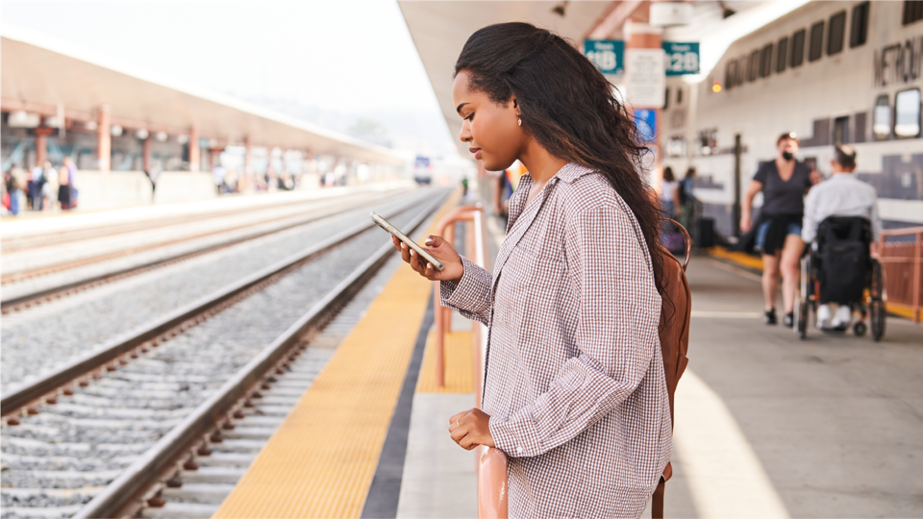
2028 Olympic & Paralympic Games

Slide 17
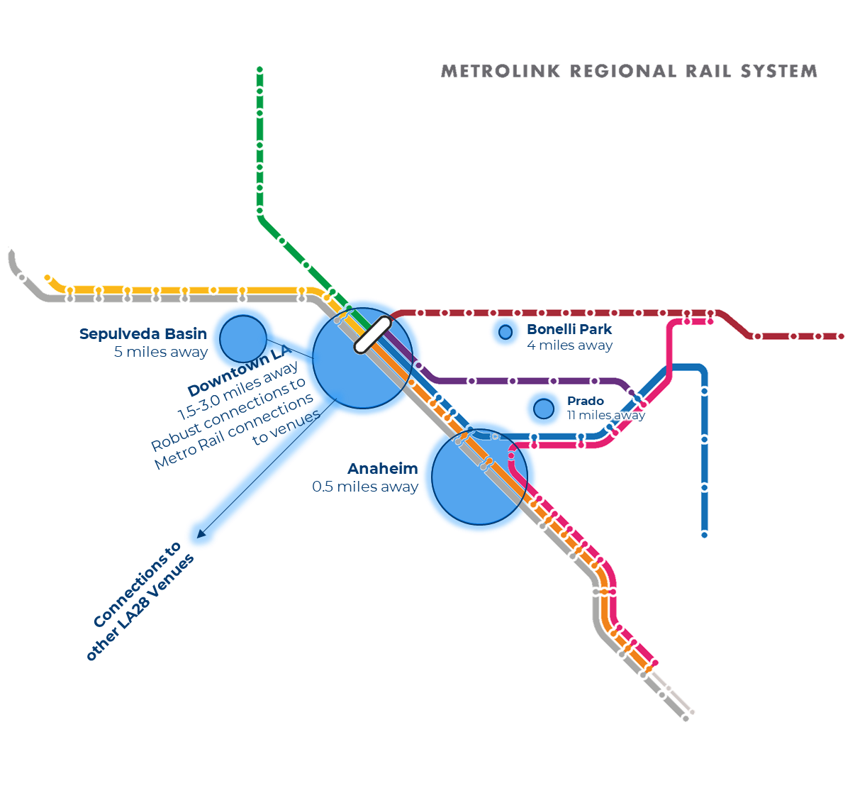
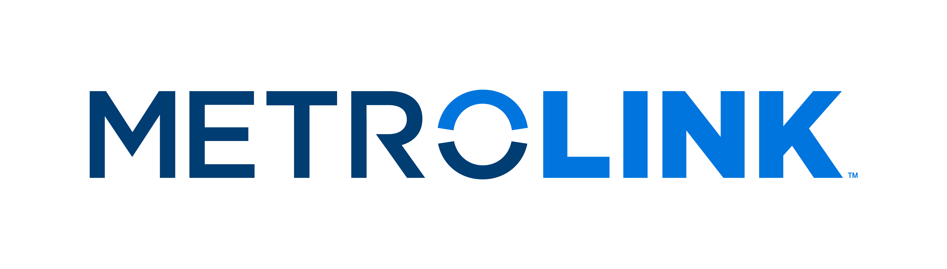
Olympic Venues​
LA Union Station and Anaheim are closest to the largest sports venues​
  Union Station connects to major venues via Metro bus and rail​
  Anaheim Station is within walking distance of Honda Center
Van Nuys Station offers connections to Sepulveda Basin
Notes:
Venues announced but agreements are still being negotiated
LA28 is developing and has not released a sport/competition schedule

Slide 18
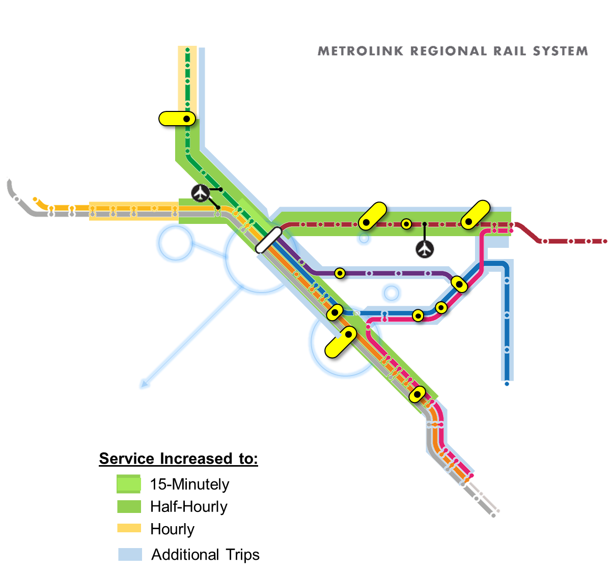
Olympics Service Levels
Half-hourly service on SBL, AVL and OCL and on VCL to Van Nuys
Additional service on all lines
Potential surge trains for high-demand times
Provisos
  Additional slots with freight railroads
  Qualified crews availability
  SCORE projects completed
Quarter-Hourly
Half-Hourly
Hourly
Additional Trips

Slide 19
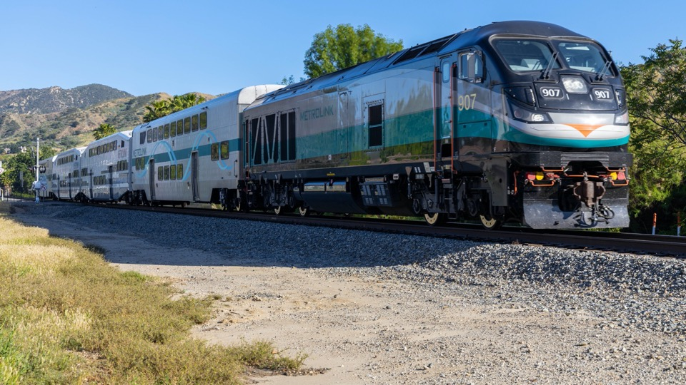
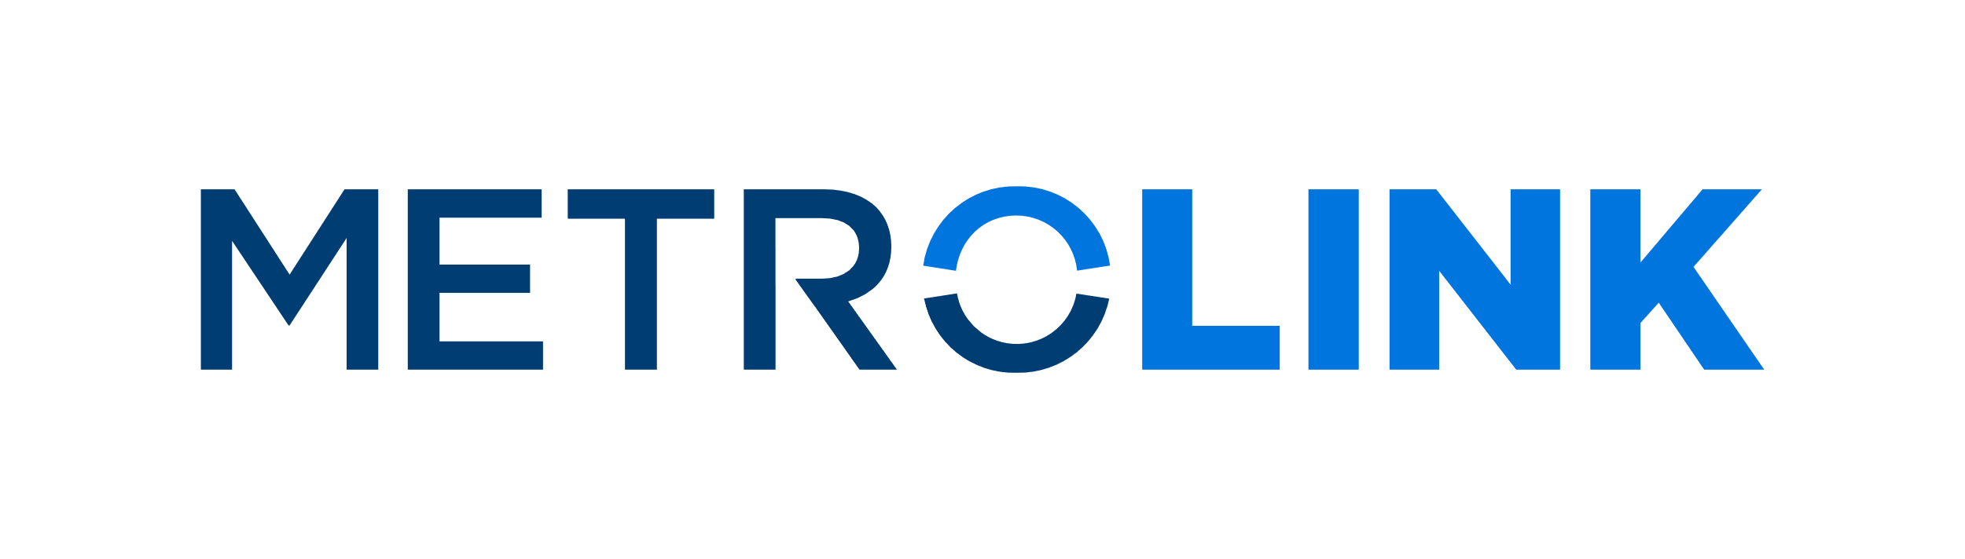
Thank you.

