Slide 1
Ventura County Vehicle Miles Traveled (VMT) Adaptive Mitigation Program (AMP) for CEQA Streamlining

Slide 2







REAP Project
Funded by State Department of Housing and Community Development Regional Early Action Planning (REAP) grant via SCAG.
Managed By
Consultants

Slide 3
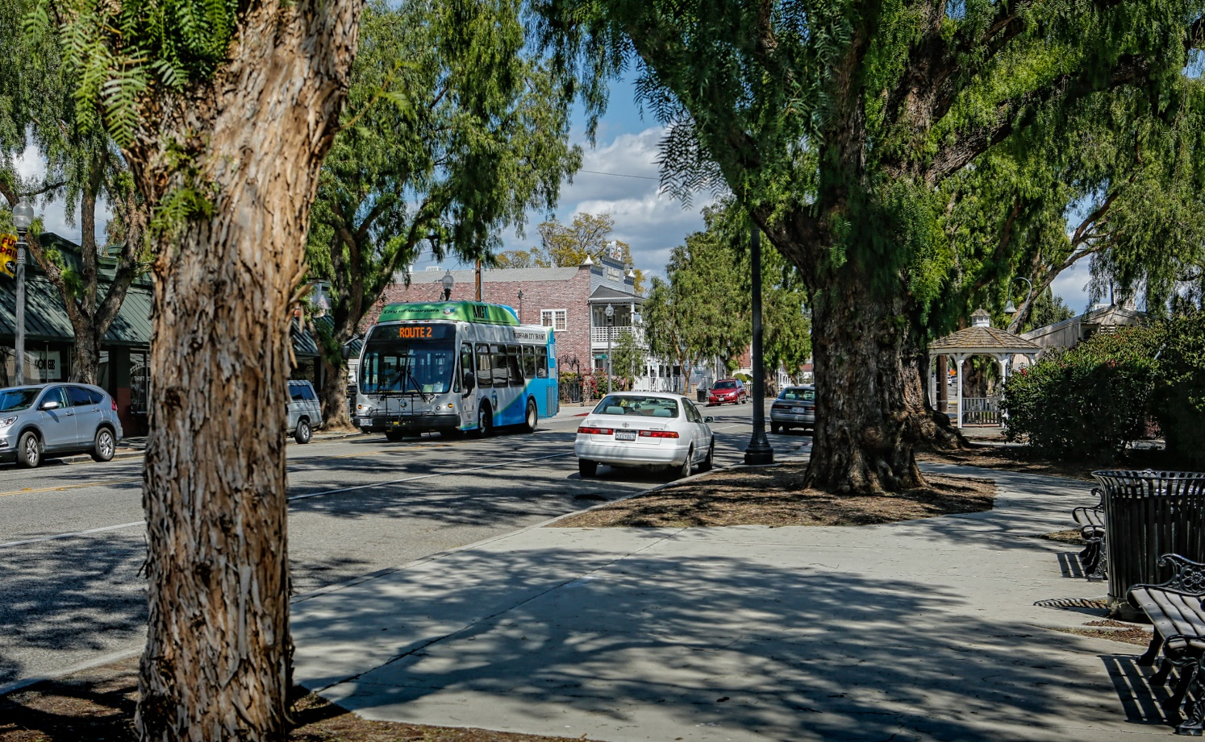
Presentation
Ventura County CEQA VMT AMP
Affordable Housing as VMT Mitigation
Capacity Building and Communication

Slide 4

1 Ventura County CEQA VMT AMP
Achieve REAP goals while streamlining CEQA for Housing Development in Ventura County (especially affordable housing)
  Accelerate infill development that facilitates housing supply, choice, and affordability
  Affirmatively further fair housing
  Reduce VMT

Slide 5

Challenges Facing Ventura County
Sea-level
rise
TRANSPORTATION
Public transit system
Traffic congestion
Traffic safety
High GHG emissions
Roadway infrastructure costs
Economic development
HOUSING
Housing affordability
Aging population
Disparity of housing needs and supply
Parking
Economic opportunities
Environmental justice
Climate Change
Open space & agriculture preservation

Slide 6
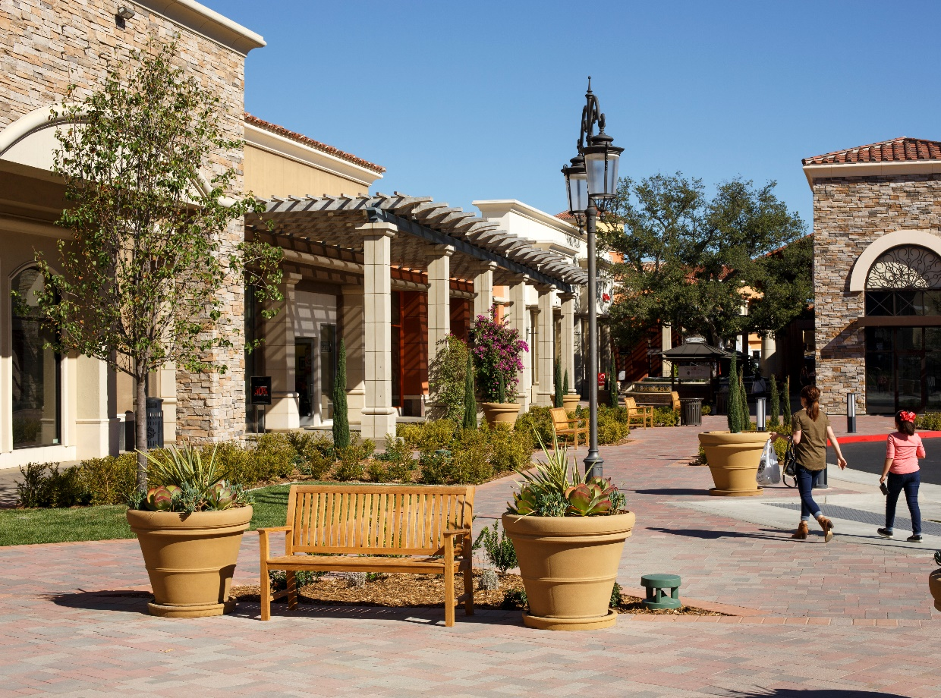
CEQA Adaptive Mitigation Program
Multifaceted, Capacity Building Tools for the County’s Lead Agencies
How to assess VMT
    Where development would have low VMT
What strategies can lower VMT
    Mitigation options
    A mechanism for fair share (partial) mitigation
Mitigation monitoring
Capacity building

Slide 7
CEQA Streamlining
Address VMT earlier = More streamlined process (time and $)
Outcome
VMT Reduction Strategies
Avoid
Onsite / Project-Level Element
Project Site Mitigation
Lead Agency Developed Mitigation
Multi-jurisdictional Transportation Investment
Increasing Scale of Strategy
Minimize
Rectify

Slide 8











CEQA Streamlining Roles – Lead Agencies
RHNA and Housing Element allocation to Low VMT Areas
75% of future housing allocated in HQTAs or areas below 85% of current VMT
Define VMT Thresholds for CEQA review
Can develop their own or rely on State Guidance for 85% of baseline VMT
Define Set of Multimodal Infrastructure Projects that can be funded as mitigation of development projects
Type to Reduce VMT - Nexus Requirement
Funds Not Previously Committed - Additionality Requirement

Slide 9
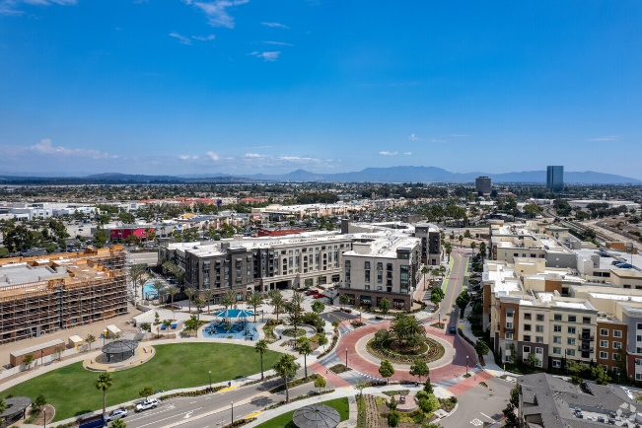
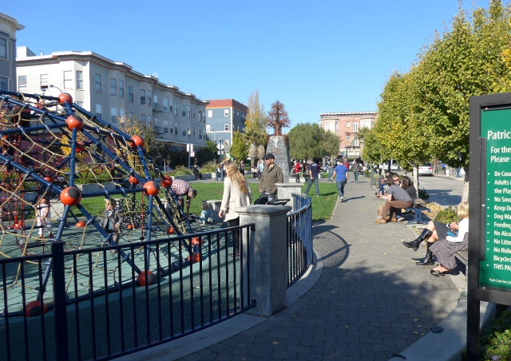
CEQA Streamlining Roles – Project Proponents
Review of Project Area VMT as part of due diligence
Determine VMT Characteristics and need for Project Elements to reduce VMT
Develop Projects to Avoid VMT Impacts
Focus on low VMT areas
Mixed-Use, Affordable Housing, On-Site elements to reduce vehicle use (e.g. bicycle parking)
Take credit for VMT-reducing elements
Include VMT Reduction in Early Discussions with Lead Agencies
Feasible VMT reducing elements

Slide 10
CEQA Streamlining Roles – VCTC and VCOG
Continue to Provide Technical Analysis
Maintain Travel Demand Model (VCTM) for the best quantitative VMT data source
Refine CEQA AMP as a Regional Standard of CEQA Transportation Assessment
Work with all parties to improve tools and processes
Provide Capacity and Support to Lead Agencies
Develop Regional Options for Avoidance/Mitigation
Feasible regional mitigation options

Slide 11


CEQA Streamlining Roles – Stakeholders
Develop Avoidance and Mitigation Options
Mechanisms for funding transit or affordable housing as VMT reduction strategies
Participate the in the Process
Help guide the next steps towards sustainable development

Slide 12
2 Affordable Housing as CEQA Mitigation
Recommendations of VMT assessment for affordable housing
  Numerous mechanisms for streamlining/screening
  Cities tend to use a few common approaches
Mechanism(s) for affordable housing funding for CEQA mitigation for VMT impacts
  Caltrans Mitigation Playbook
  Affordable Housing and Sustainable Communities Program
  How to take appropriate credit with concern for….additionality, double counting, proportionality, feasibility, consistency, substantial evidence.

Slide 13
2 Affordable Housing as CEQA Mitigation
Justifiable Nexus between VMT mitigation and affordable houting
Quantify the $/VMT to create a path for mitigation
Example of quantification - Ventura Area Housing Trust
  $28 M of funding for 1,200 affordable workforce housing units = $23.5 K per housing unit
  $23.5 K per housing Unit / 50 daily VMT per affordable housing unit = ~$500 per daily VMT
  Per Caltrans SB 743 Playbook – can take “credit” for as long as:
    Meets the requirements of CEQA (e.g. is enforceable, etc.)
    There is a mechanism in place to prevent “double counting” of the mitigation “credit.”
    With these assurances, a project can take the full mitigation credit of a housing development if it could be shown that “but for” the contribution, the housing project would not have been developed.

Slide 14
3 Capacity Building and Communication
Interviews of CEQA lead agencies, common themes:
  Need to provide guidance on CEQA exemptions and streamlining opportunities can be applied to a variety of project types
  Not clear understanding of VMT by general public and some decisionmakers
  Providing examples of how the Adaptive Mitigation Program guidance can be applied would increase its use
  VCOG/VCTC input, support, and peer review can drive the adoption of VMT guidance and thresholds at the local level
  The development of a Countywide VMT analysis tool for individual projects

Slide 15
3 Capacity Building and Communication
Bottom Line:
  Most Agencies have limited staff and limited capacity for CEQA administration, therefore assistance and the resources from peer agencies, the County, and regional agencies is important.

Slide 16
3 Capacity Building and Communication
Story Campaign
  Clear
  Consistent
  Multiple media (digital, fact sheet, presentation, branding, etc.)
Abridged version on following 10 slides

Slide 17

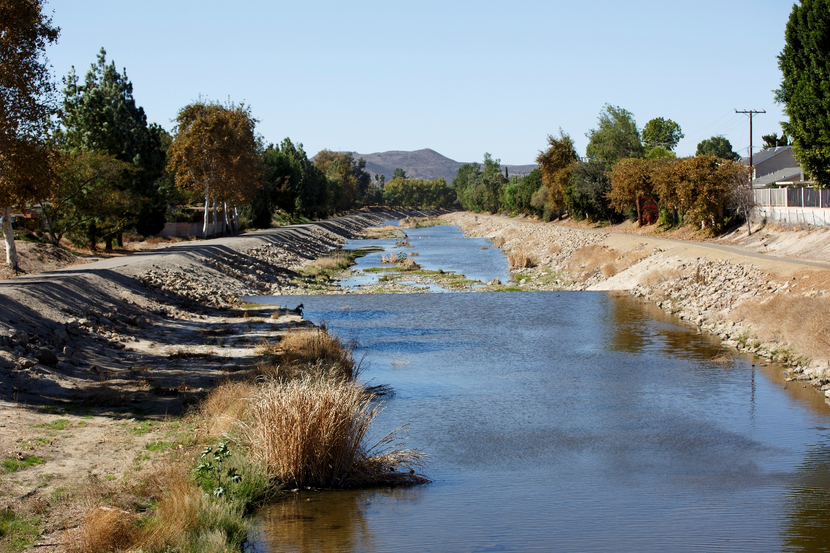
Ventura County Today

Slide 18
Housing Production Needs
23,425 low-income renter households in Ventura County do not have access to an affordable home.
Source: 2023 Ventura County Housing Report

Slide 19
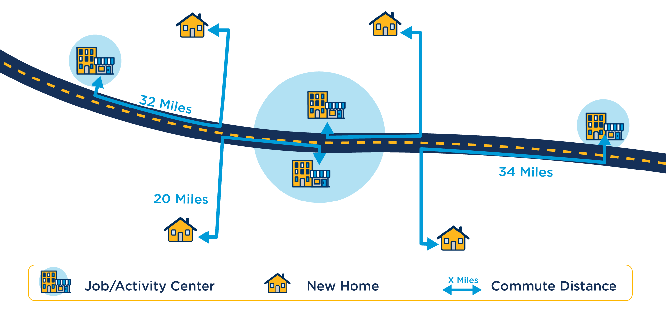
Four New Homes – How Location Effects VMT (Spread Out Development)
Total Commute VMT: 104 miles
Average Commute VMT: 26 miles

Slide 20
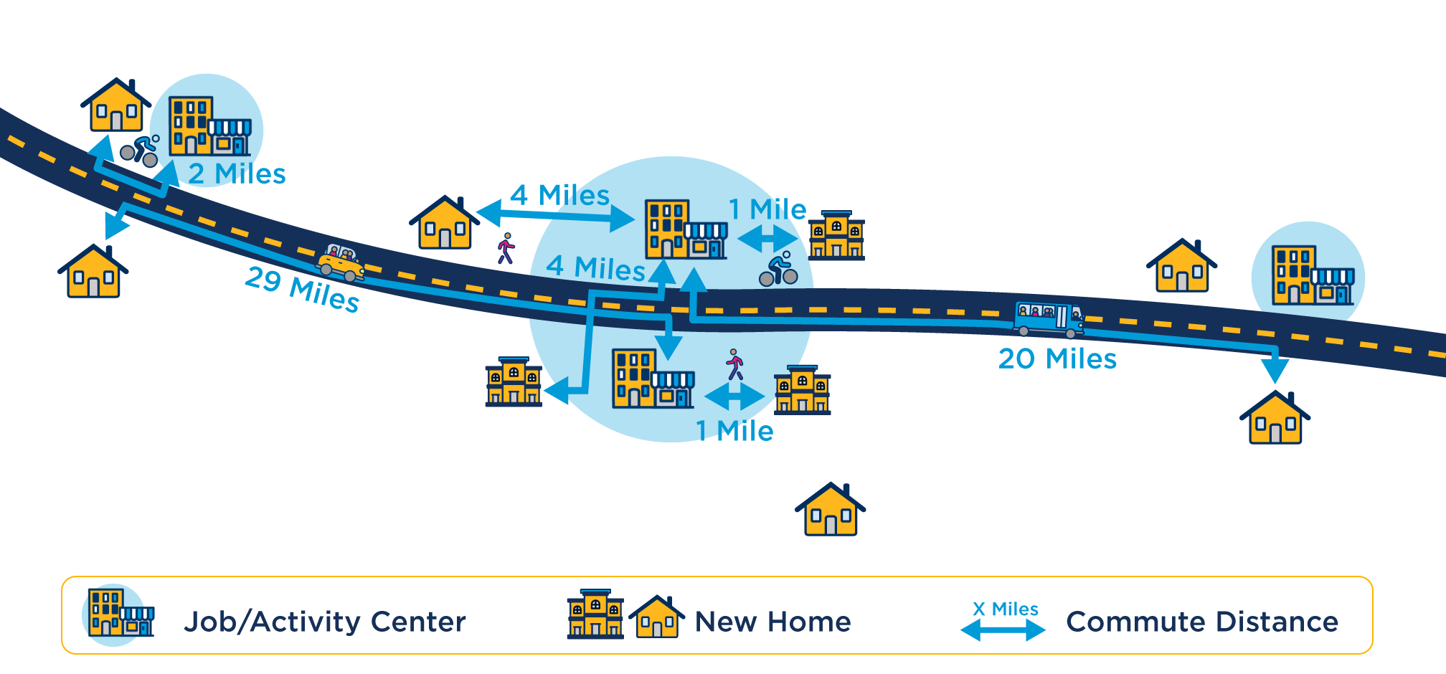
Seven New Houses – How Location Affects VMT (Infill Development)
Total Commute VMT: 61 miles
Average Commute VMT: 8.7 miles
>50% lower than spread out

Slide 21













Working Together
New Housing
Access to Multimodal Transportation
Close to Jobs and Services
Benefits
Reduced Auto Travel
Agricultural Preservation
Reduce GHG
Climate Resiliency
Improve Health

Slide 22
What Tools Help Us Achieve an Environment Where Housing and Mobility Work Together?

Slide 23
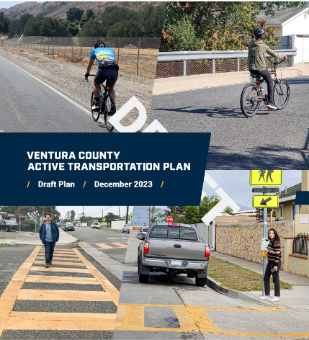



Effective City Plans & Policies Lay the Groundwork
  General Plans
  Housing Elements
  Bicycle Master Plans
  Pedestrian Master Plans
  Climate Action Plans
  Corridor Plans/Specific Plans
  Design Guidelines/Form-based Codes
  Design Standards
  Conditions of Approval

Slide 24
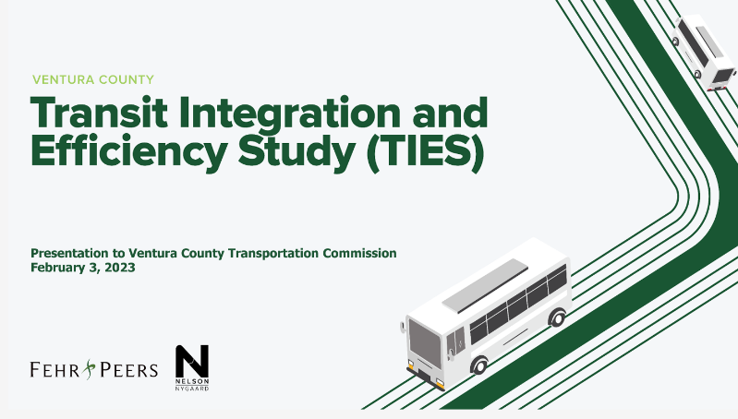


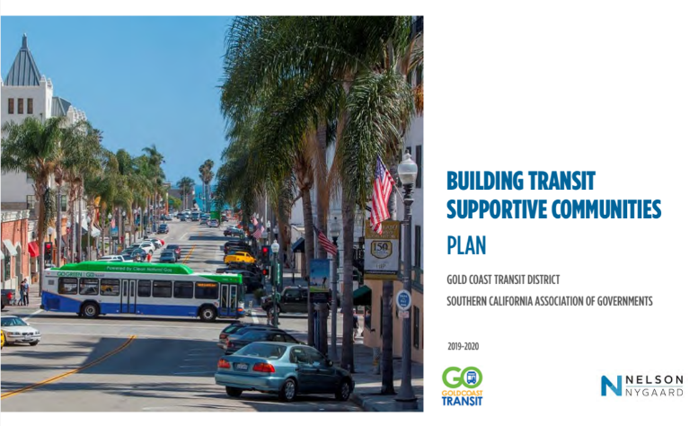
Regional Plans & Efforts
County Comprehensive Transportation Plan
Transit Integration and Efficiency Study
VCTC 101 Communities Connected
Gold Coast Transit District Building Transit Supportive Communities
Connect So Cal

Slide 25
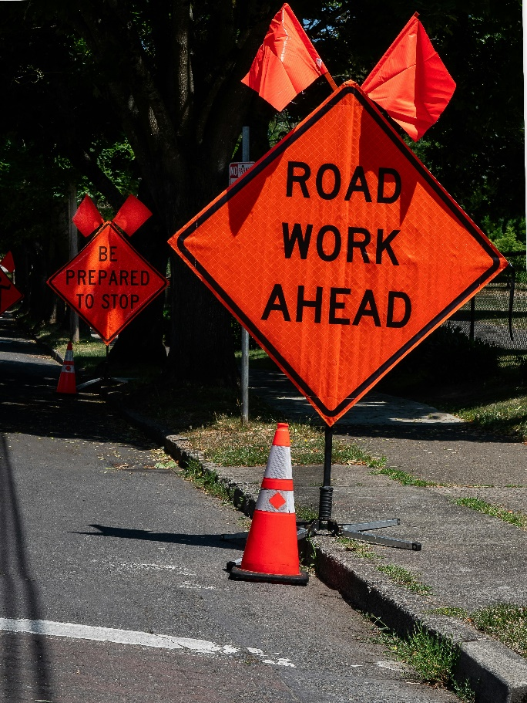
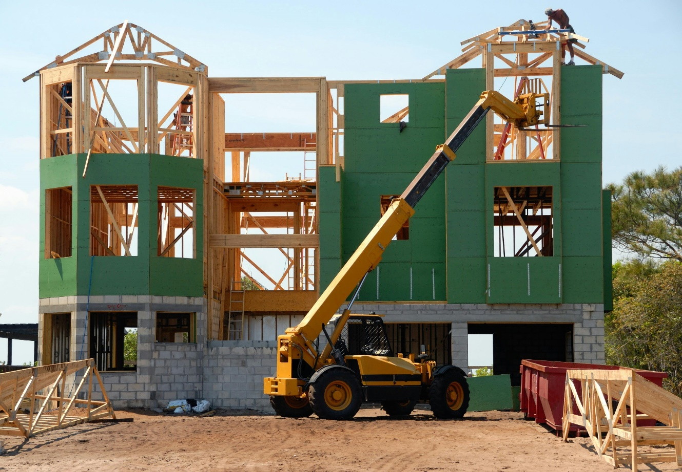
What Comes First? Transportation Improvements or New Housing?

Slide 26
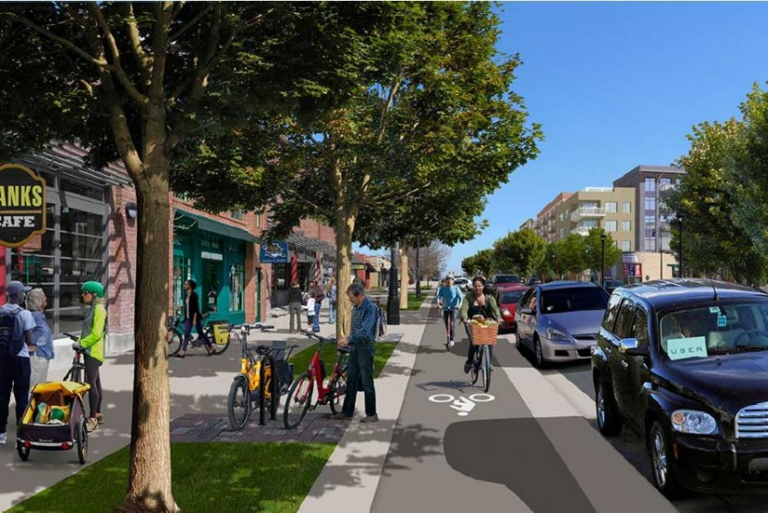

What Does Working Together Look Like?

Slide 27
Resources
VCTC website www.goventura.org
VCTC VMT Adaptive Mitigation Program www.goventura.org/work-with-vctc/vmt-amp
  101 Connected Communities www.goventura.org/wp-content/uploads/2020/12/VCTC_US-101_CC_Final_Report_12-4-20.pdf
Office of Planning Research (OPR) https://opr.ca.gov/
SCAG website https://scag.ca.gov
  Go Human https://scag.ca.gov/go-human
  Connect So Cal https://scag.ca.gov/connect-socal
Housing + Transportation Affordability Index https://htaindex.cnt.org/

Slide 28
Thank you!
Amanda Fagan afagan@goventura.org

