Slide 1
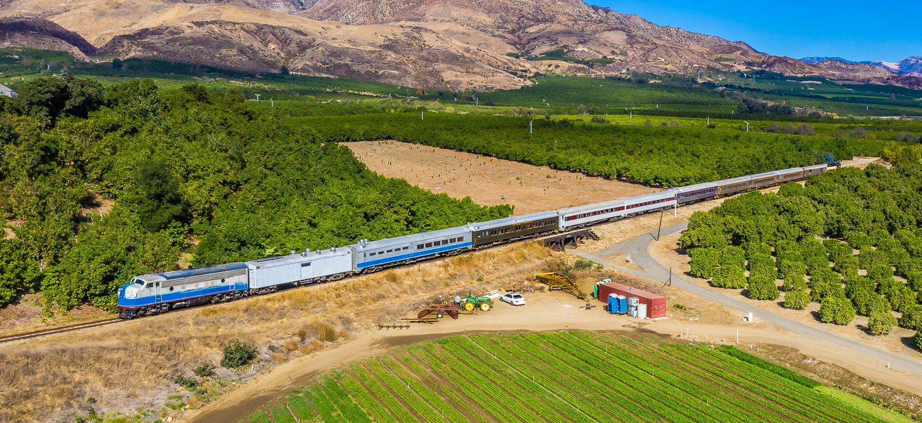
Santa Paula Branch Line Update
Presentation to the
Ventura County Transportation Commission
March 1, 2024
Notes:
Good Morning Chair LaVere and Members of the Commission, for the record, my name is Amanda Fagan, and I serve as the Director of Planning and Sustainability here at VCTC.
Our most recent verbal update to the Commission took place in January, with monthly consent or verbal reports provided each month since June 2023, so I will be focusing on the most recent activities during the month of January.

Slide 2
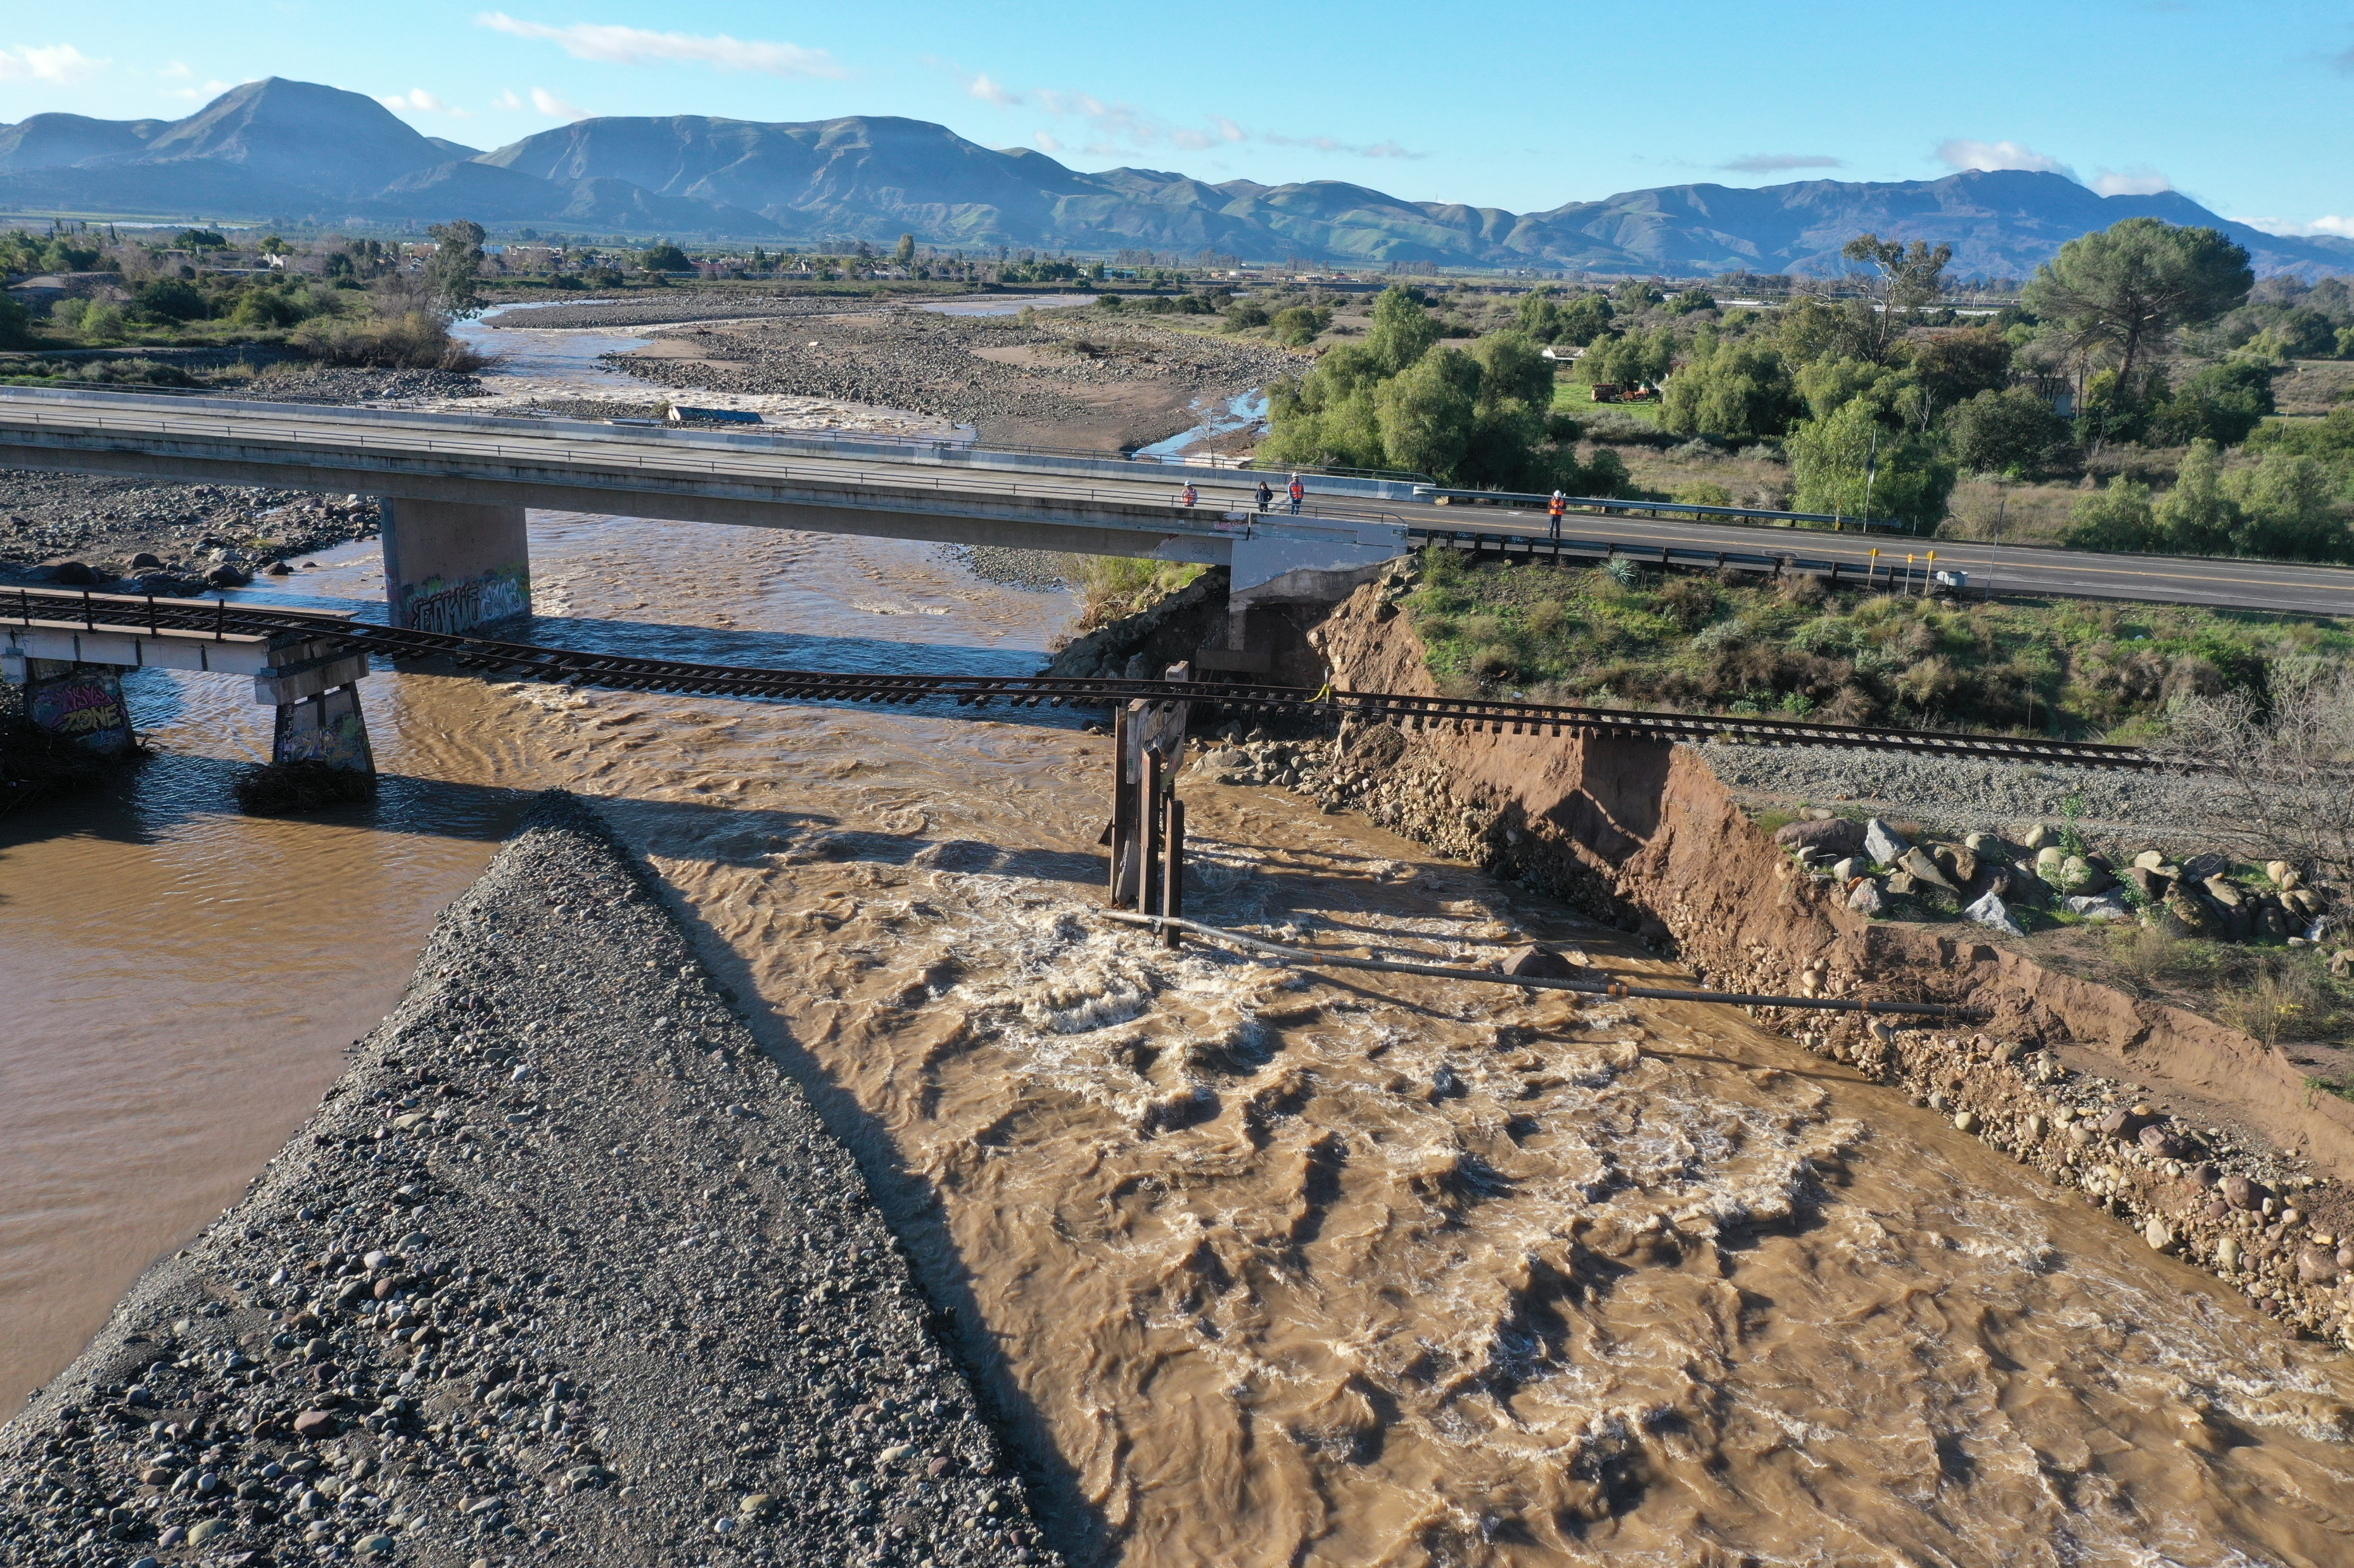
Sespe Creek Overflow Railroad Bridge Update
On Feb. 5, bridge sustained additional damage, resulting in ~50 feet of additional loss of earth and rock behind west abutment
Support to County of Ventura re: Old Telegraph Road Bridge damage
RailPros to prepare cost estimate for assessment of additional damage and impact to repair design plans and specifications
Subsequent storms (Feb. 18-19) did not result in significant additional damage to Sespe railroad bridge, though County-owned Old Telegraph Road reportedly suffered additional damage
FEMA Request for Information – pending response from FEMA
Sespe Creek Overflow – Looking South
February 2024
Photo Credit:
Dan Thompson, RailPros
Notes:
On February 5, the Sespe Creek Overflow Railroad Bridge sustained additional damage during a series of storms, resulting in approximately 50 feet of additional loss of earth and rock behind the west abutment of the bridge.
On February 5, during post-storm inspection of the railroad bridge, Sierra Northern identified and reported damage sustained to the west abutment of Old Telegraph Road. VCTC staff then reported the damage to the County of Ventura Public Works Agency. VCTC provided to the County the hydrological and geotechnical reports developed by VCTC’s design contractor for the railroad bridge design efforts.
VCTC requested the RailPros design team to prepare a cost estimate for an assessment of the additional damage and its impact to the repair design plans and specifications. VCTC anticipates bringing an amendment to the Commission to approve additions to the scope of work and budget to address the additional damage to the Sespe Creek Overflow railroad bridge and relative to repairs to the County’s Old Telegraph Road bridge.
Subsequent storms during the weekend of February 18-19 did not result in significant additional damage to the Sespe railroad bridge, though the County-owned Old Telegraph Road reportedly suffered additional damage.
VCTC staff spent considerable time and effort during February to respond to requests for information and to provide additional documentation to the Federal Emergency Management Agency (FEMA) in advance of a February 29 deadline to submit project information for the next round of FEMA project development and review. Staff completed and submitted two projects (District-wide Debris Removal and Non-Debris Small Projects at MP 412.65 and 417.85) for the next round of FEMA review. Staff also responded to a FEMA request for information related to legal responsibility for the repair of the Sespe Creek Overflow Railroad Bridge. As of the Commission Agenda deadline, the response is pending review by the FEMA Office of Legal Counsel.

