Slide 1
Proposed 2024 STIP Funding Summary
Project Name | Agency | Total Funds
Planning, Programming & Monitoring | VCTC | $2,393,000
Camarillo Central Avenue Bike Lanes | City of Camarillo | $4,667,000
 | TOTAL | $7,060,000

Slide 2
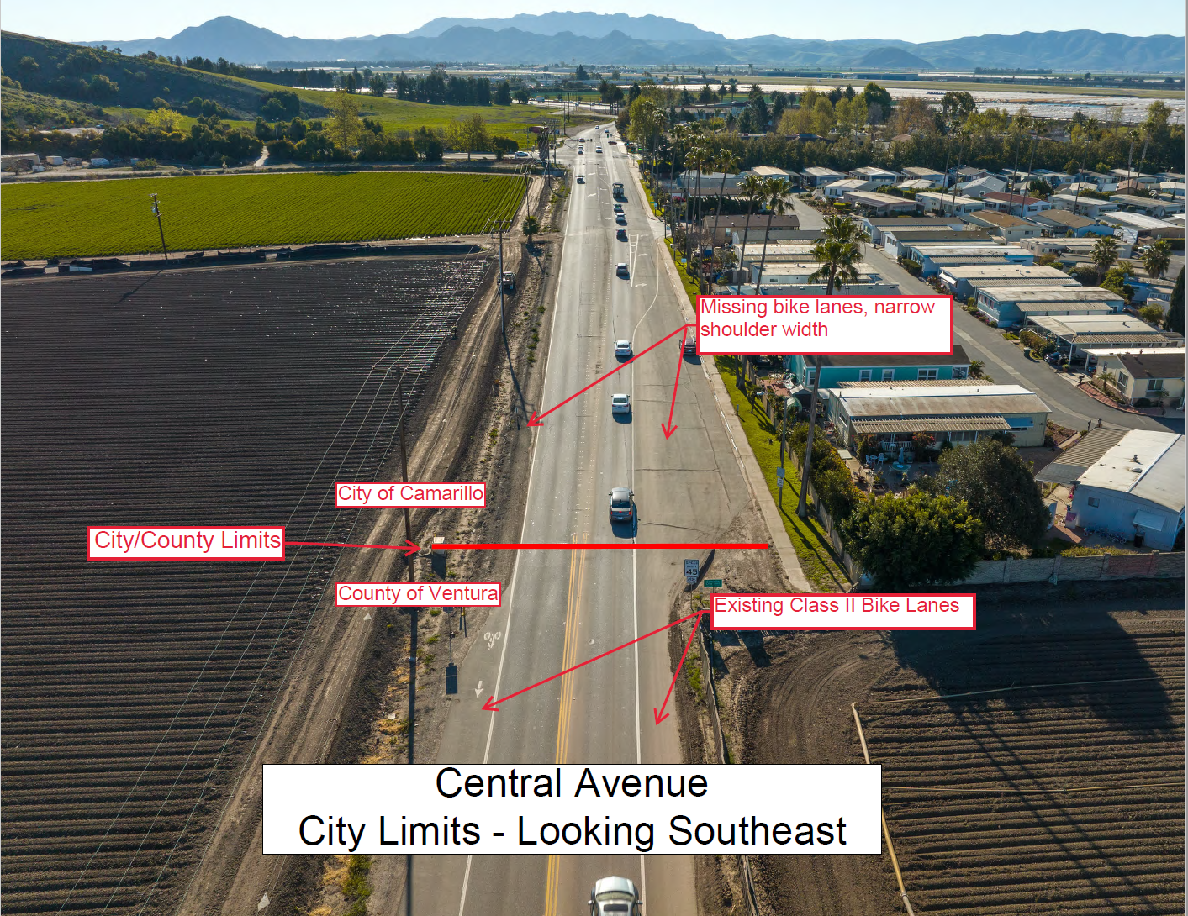
Central Avenue Bike Lanes in Camarillo
The project will
construct Class II bike lanes on both sides of Central Avenue, a high traffic volume arterial street, starting at the City limits and
extending to the US-101 Freeway Northbound off-ramp. The project will close a missing link in the region's east-west bikeway network on
Central Avenue also providing safer travel for students commuting to Rio Mesa High School

Slide 3
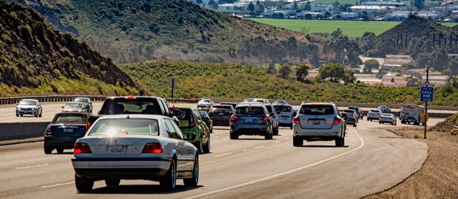
US 101 Improvements
Commission policy – Save STIP funds for future US 101 improvements
Current available US 101 balance = $146 million
This recommendation reserves another $19.8 million of future funds for US 101.
Early Action Plan being developed to identify a reduced work scope that can be accomplished with future available funds.

