Slide 1
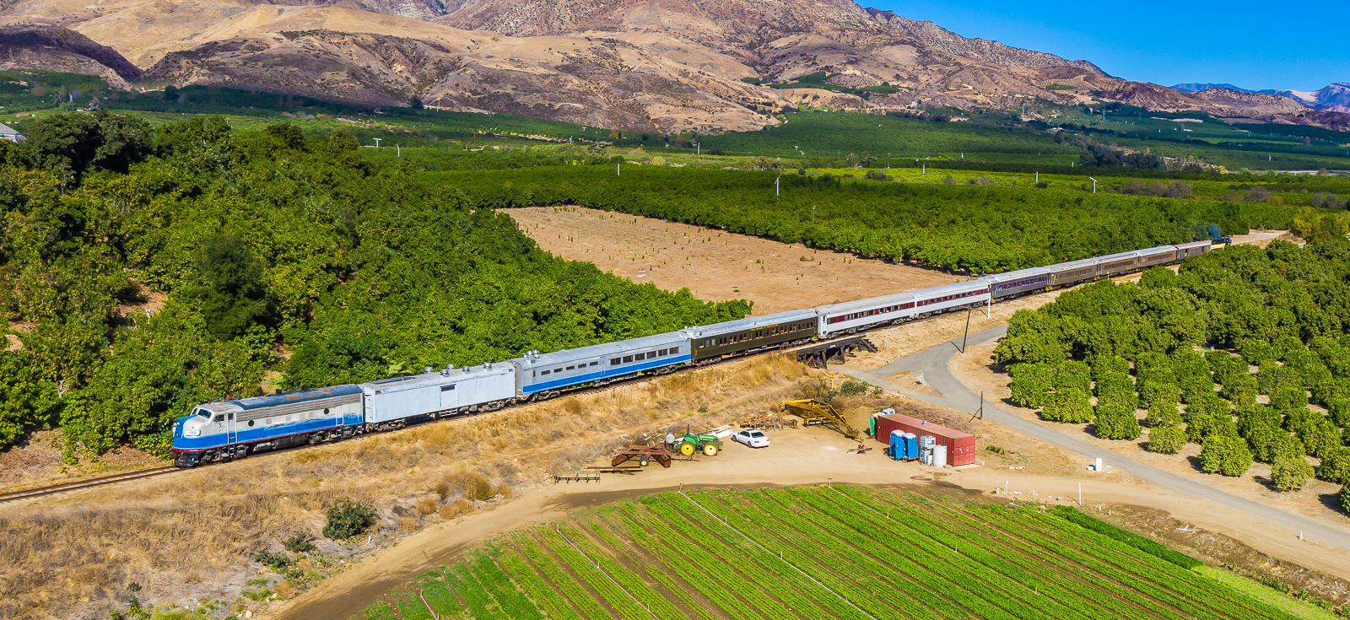
Santa Paula Branch Line Update
Presentation to the
Ventura County Transportation Commission
November 3, 2023
Notes:
Good Morning Chair MacDonald and Members of the Commission, for the record, my name is Amanda Fagan, and I serve as the Director of Planning and Sustainability here at VCTC.
Our most recent verbal update to the Commission took place in June, with monthly consent agenda written updates provided in July and September. With such recent discussion items presented, I will be focusing on the most recent activities and actions in the interest of time.

Slide 2
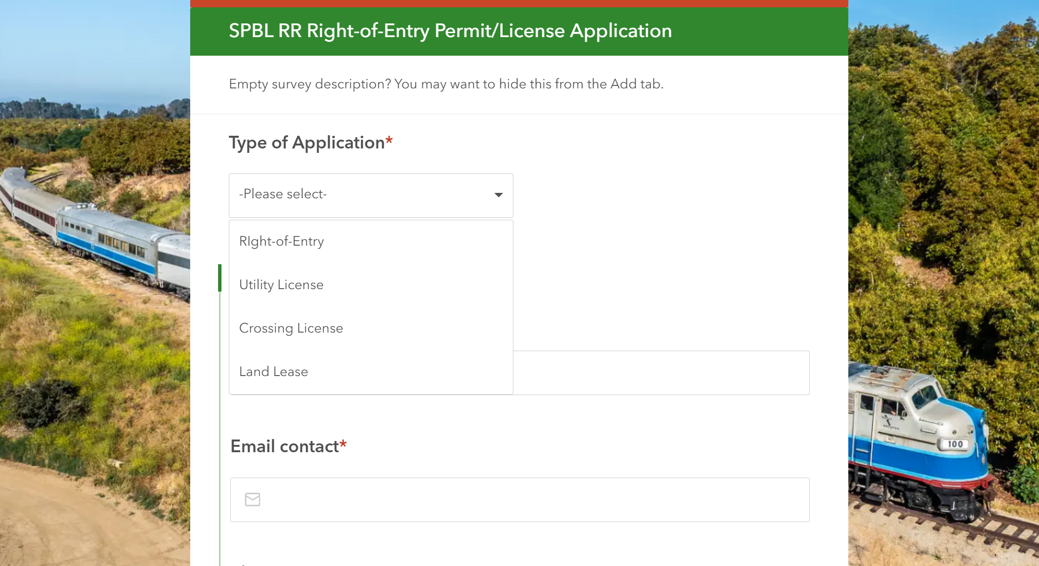
VCTC Administrative Actions for October 2023
Several ROE permits completed or pending
1 lease reassignment completed, 1 pending
1 new crossing agreement
1 new utility license agreement pending
Processing FY 2022/2023 SNR O&M invoices
Developing new online tool for receiving, tracking, and processing real estate actions on SPBL
DRAFT
Notes:
The most recent verbal update to the Commission was provided at the October 6th meeting, so this morning, I will focus on updates for the month of October. On the administrative actions side, VCTC staff continues to process rights of entry permits, lease reassignments, crossing agreements, utility license agreements, and invoices.

Slide 3
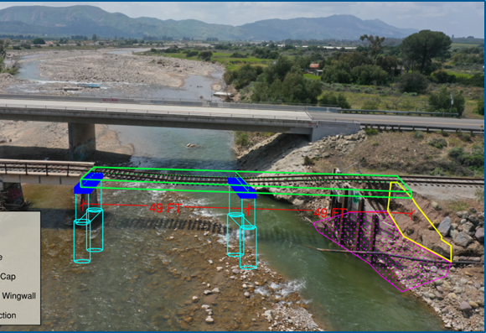
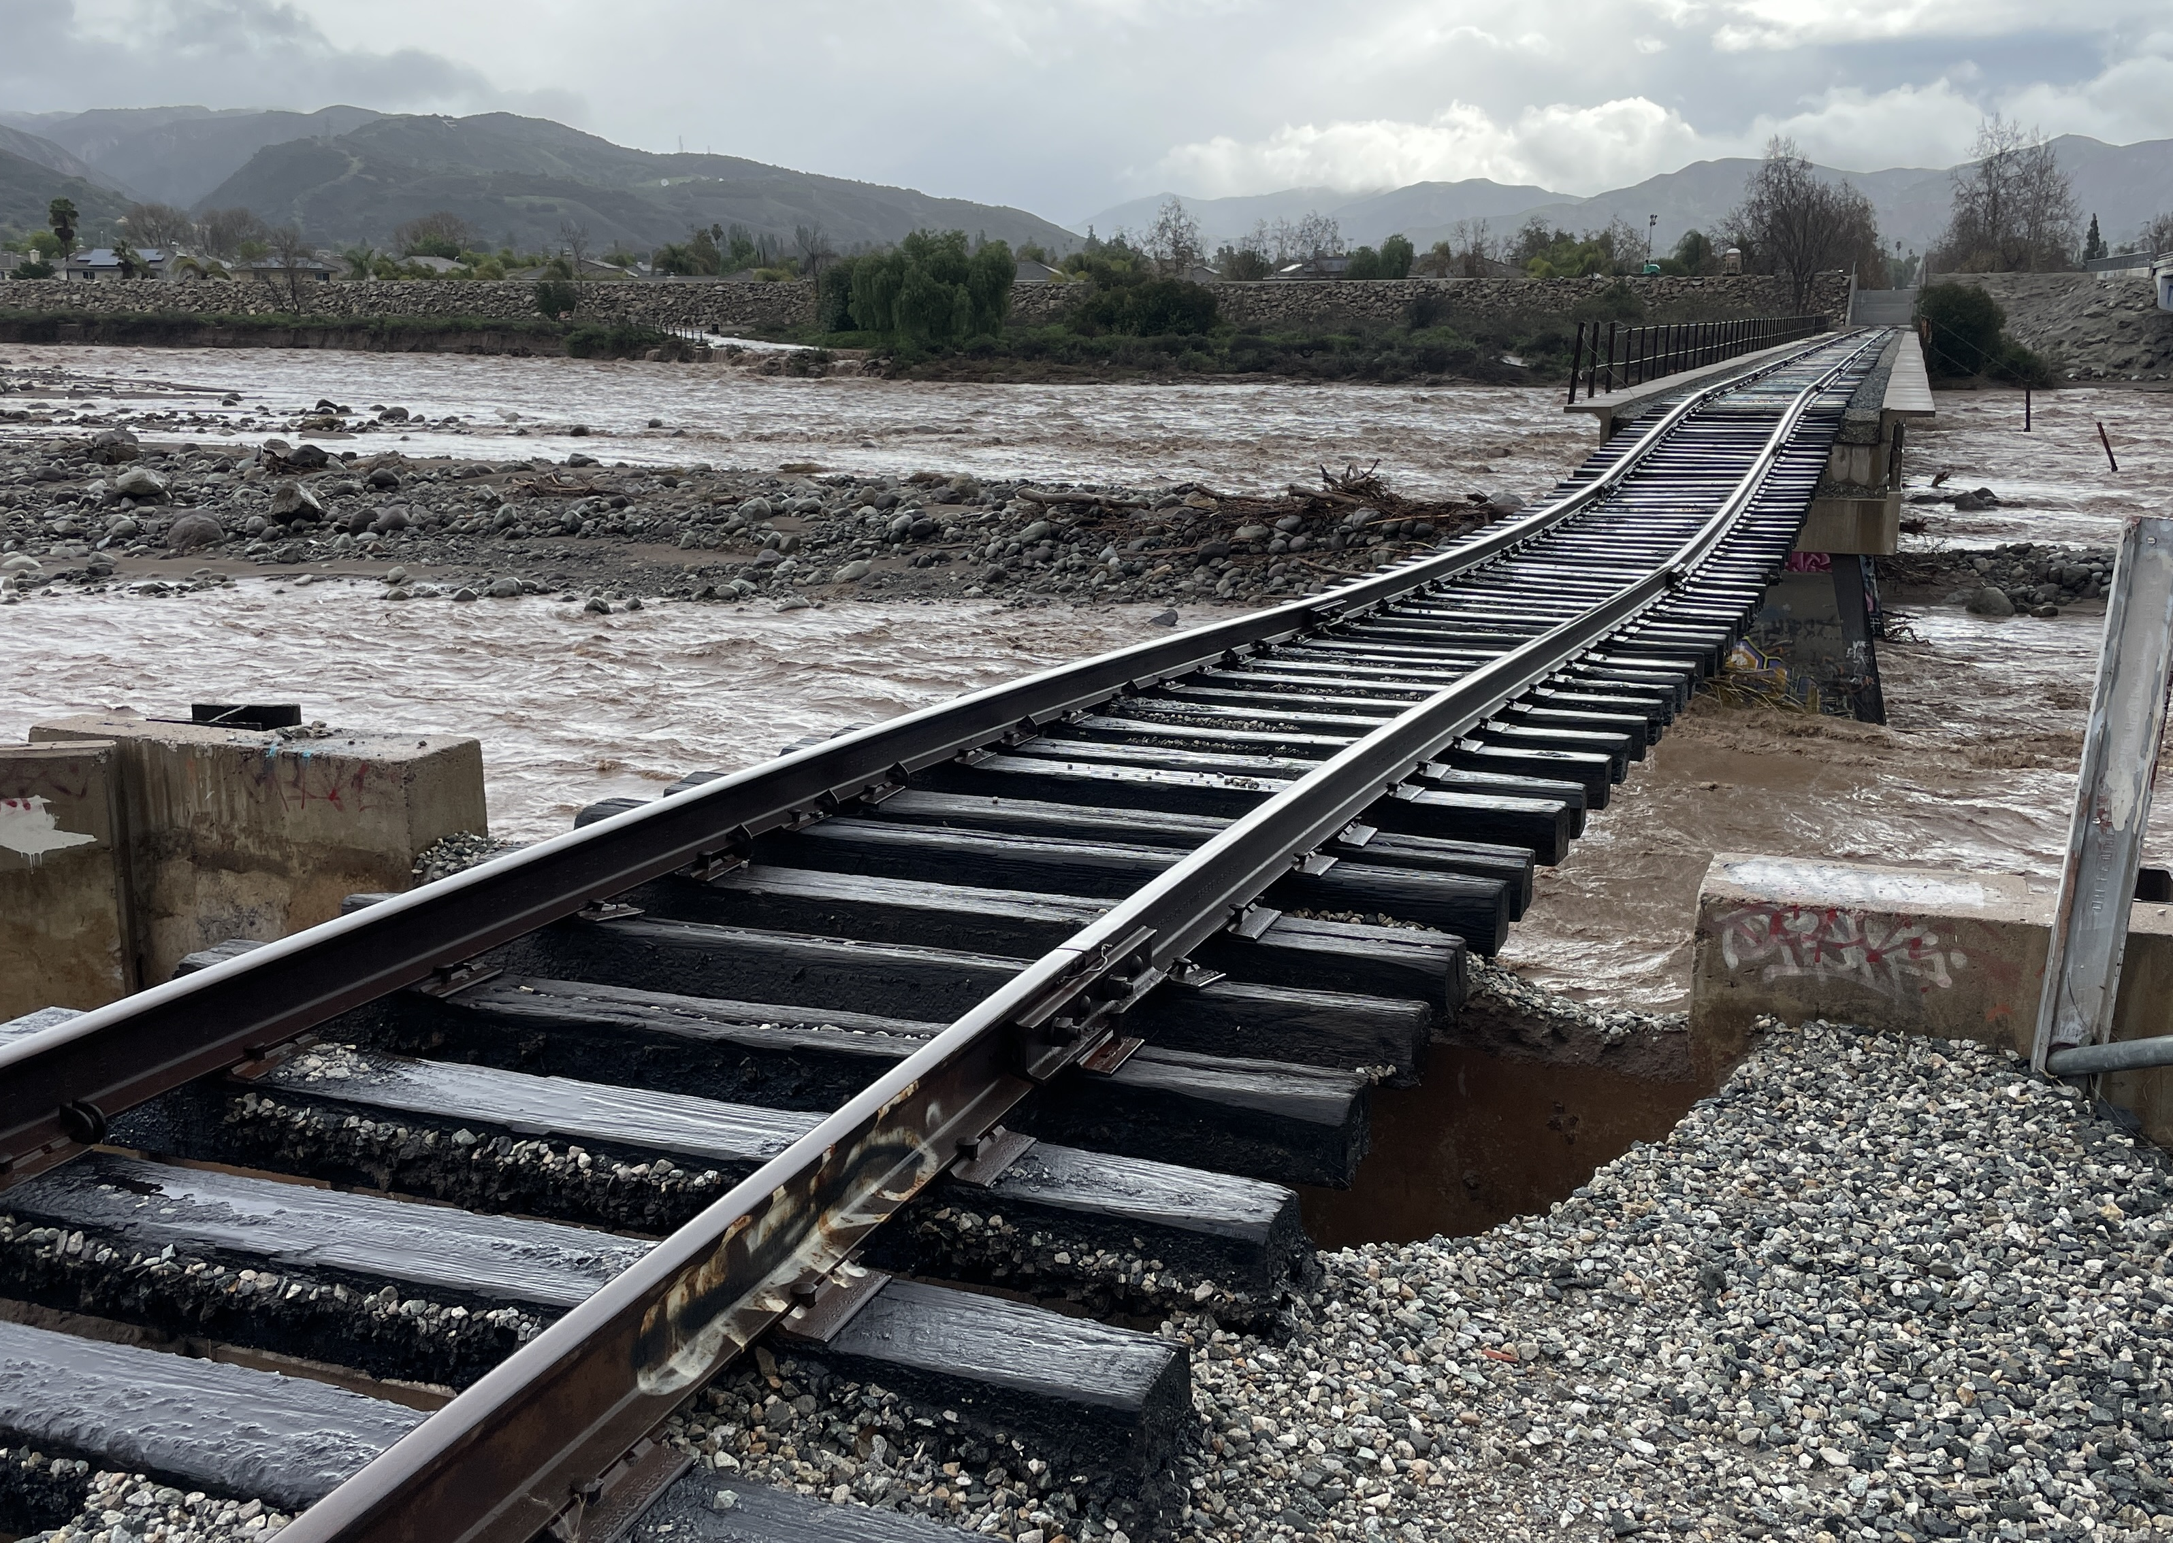
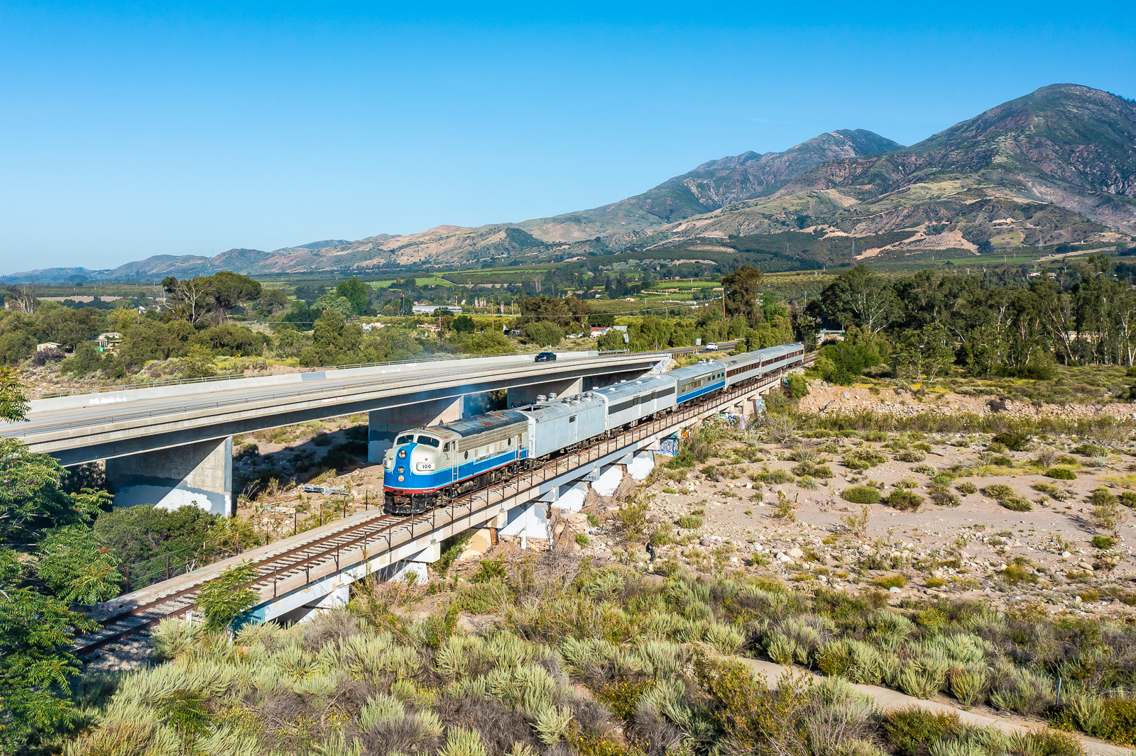
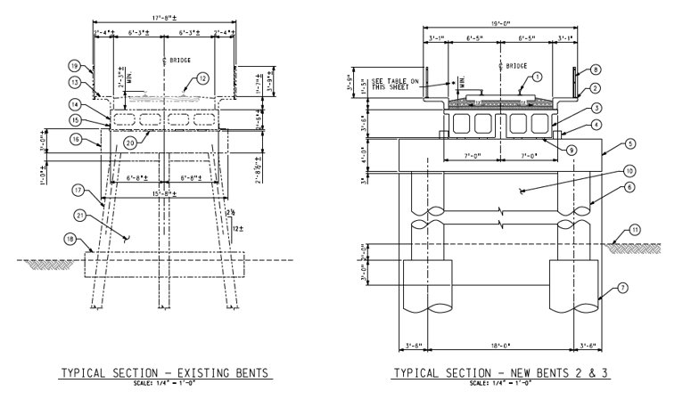
Sespe Creek Overflow Bridge Updates
Design team nearing completion of 90% design stage and submittal to VCTC for review (~11/6)
VCTC finalized Construction Management RFP with Counsel and Risk Manager review for Commission approval to release RFP at Nov. Commission meeting
Notes:
Planning, Design and Engineering to restore the pre-disaster design, capacity, and function of Sespe Creek Overflow railroad bridge is continuing. VCTC received the 90% design submittal on November 1st and will be reviewing the submittal in coordination with Sierra Northern Railway and the County of Ventura. The design team also prepared, and VCTC reviewed, a draft Hazard Mitigation Memo for discussion with FEMA.
The focus of the design and engineering process is to ensure safe and resilient bridge reconstruction that minimizes impacts to the environment and the community.
The bridge repair plans are designed to be modular and replicable, such that repairs and reconstruction for the remainder of the bridge could be completed as additional funding becomes available. The full bridge has been inspected by an independent railroad bridge engineer, with any recommended repairs to be completed by Sierra Northern.

Slide 4
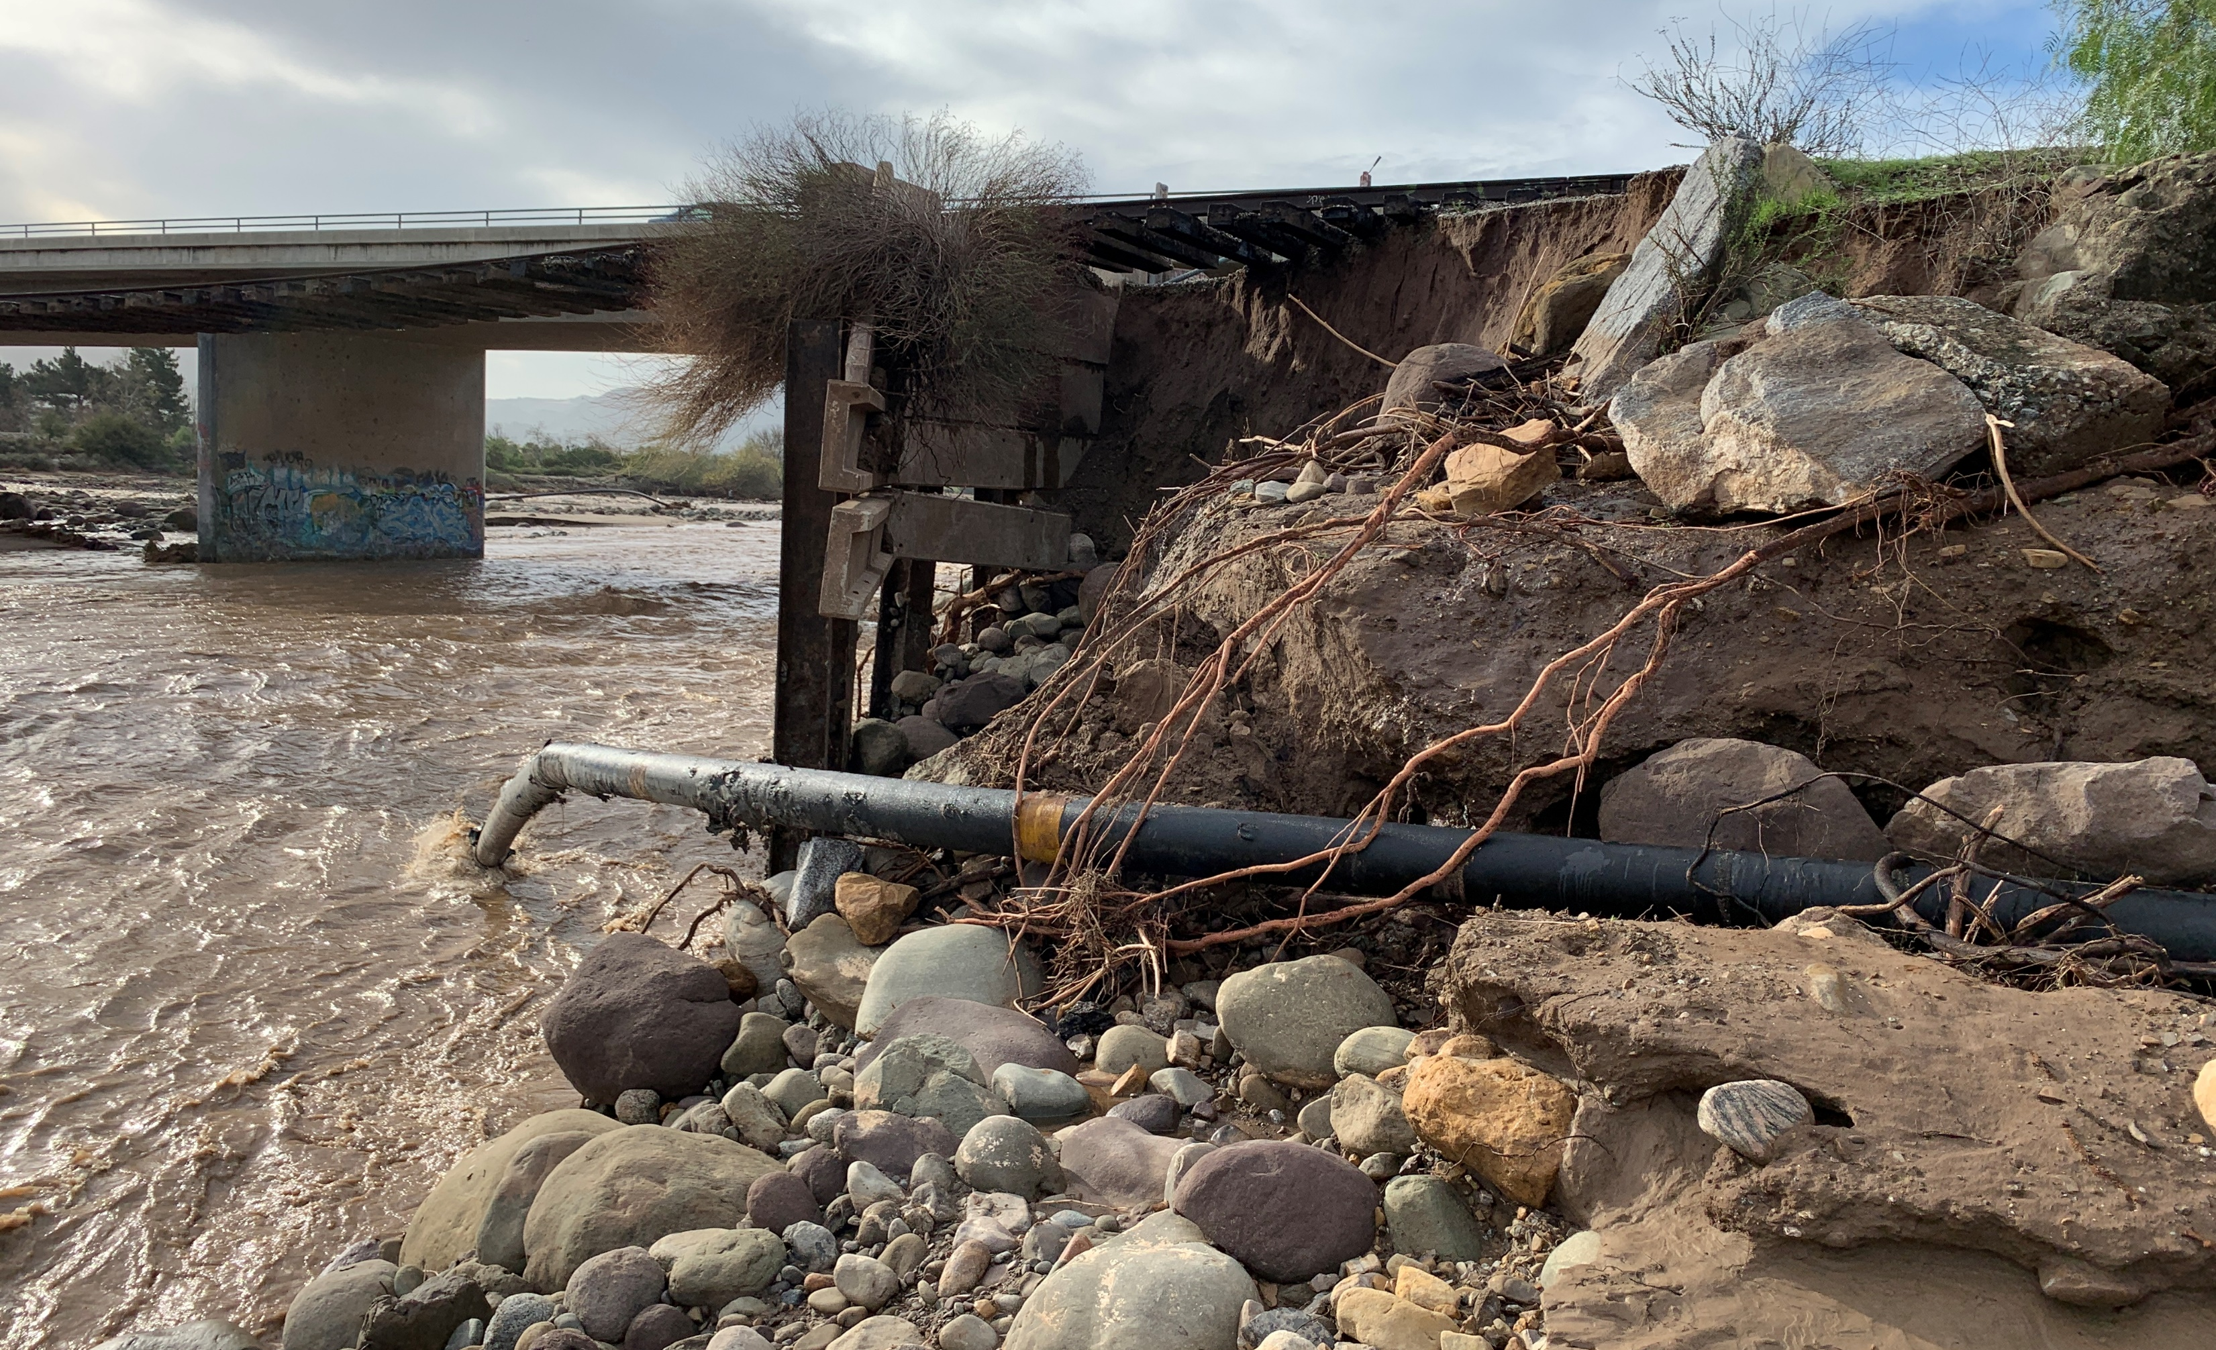
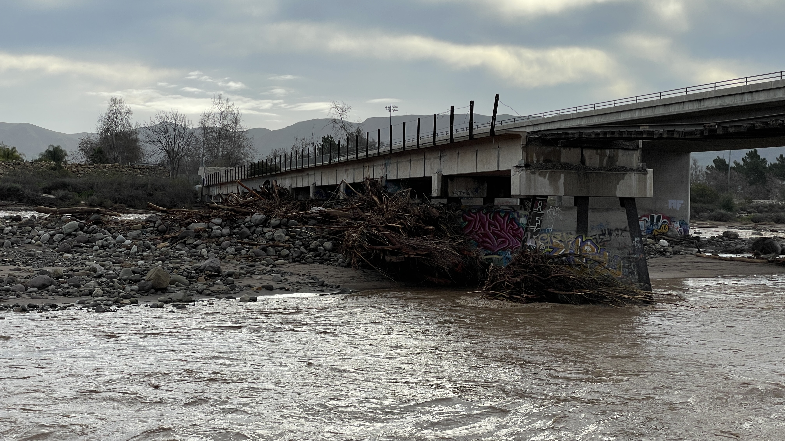
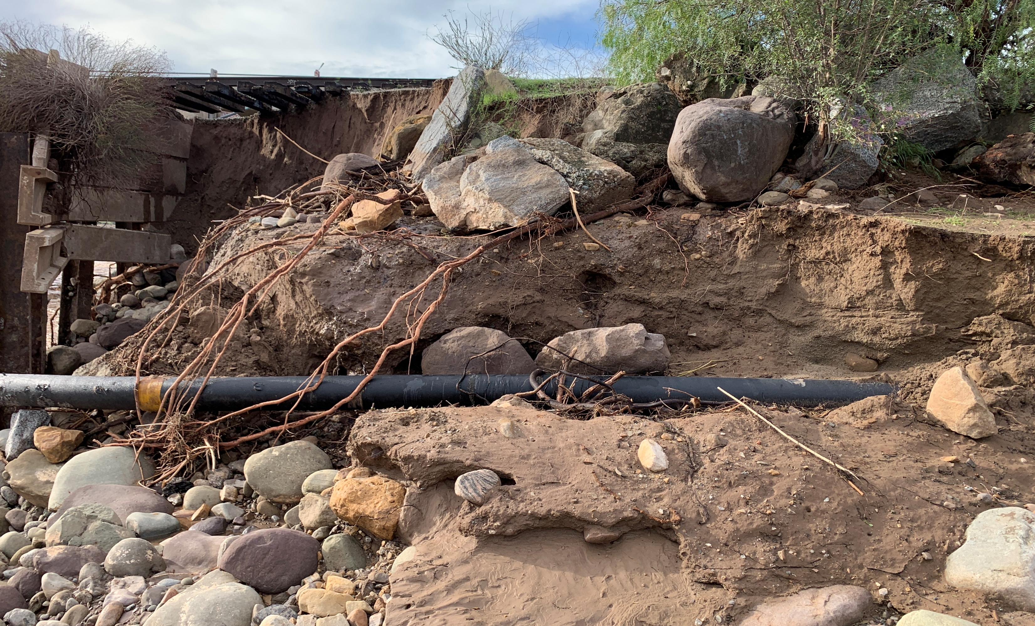
Sespe Overflow Bridge Reconstruction Timeline
Based on field study, environmental, geotechnical and hydrology findings, timeline to complete design with plans & specs (Received Nov. 1, 2023)
Release Request for Proposals for Construction Management Support: Nov. 2023
Release Request for Bids for Construction Firm: Dec. 2023/Jan. 2024
Construction period: May – Aug. 2024
Notes:
Given the urgent need to restore rail services and repair the bridge, VCTC is conducting an accelerated design and planning phase of the project. The current working schedule is to release a Request for Proposals for Construction Management support for Commission approval to release the RFP in November 2023, then to release the Request for Bids for a Construction Firm in the December/January timeframe. The goal is to commence on-site construction in May 2024 to allow construction to occur during the driest period of the year, to avoid and minimize impacts to the watershed. While we had initially hoped to complete reconstruction by the end of this calendar year, the hydrologic, geologic, and environmental conditions of the bridge and watershed are such that the construction window is from May – September.

Slide 5
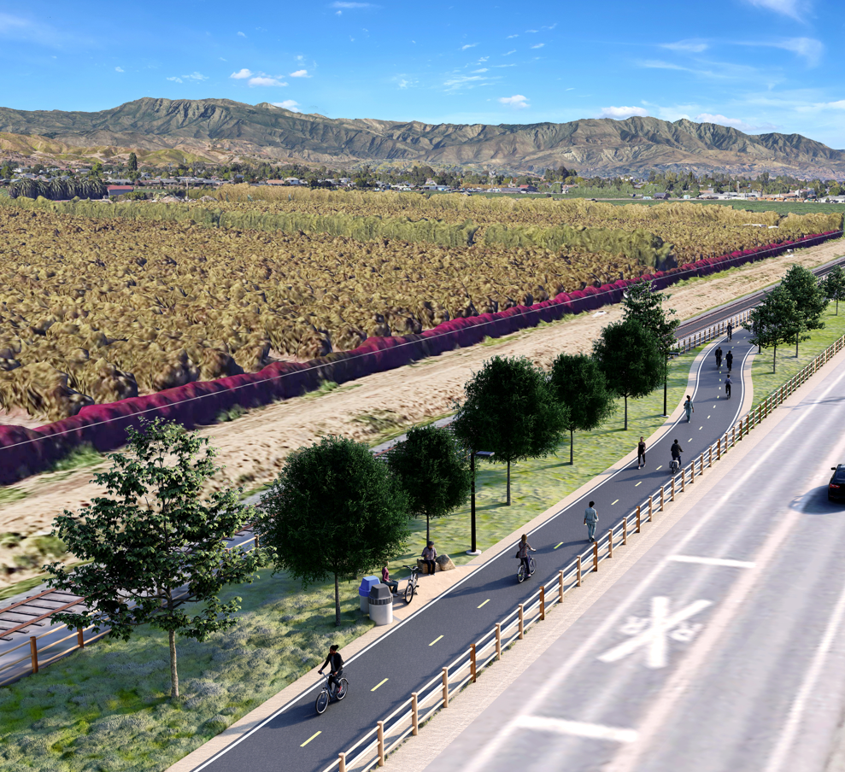
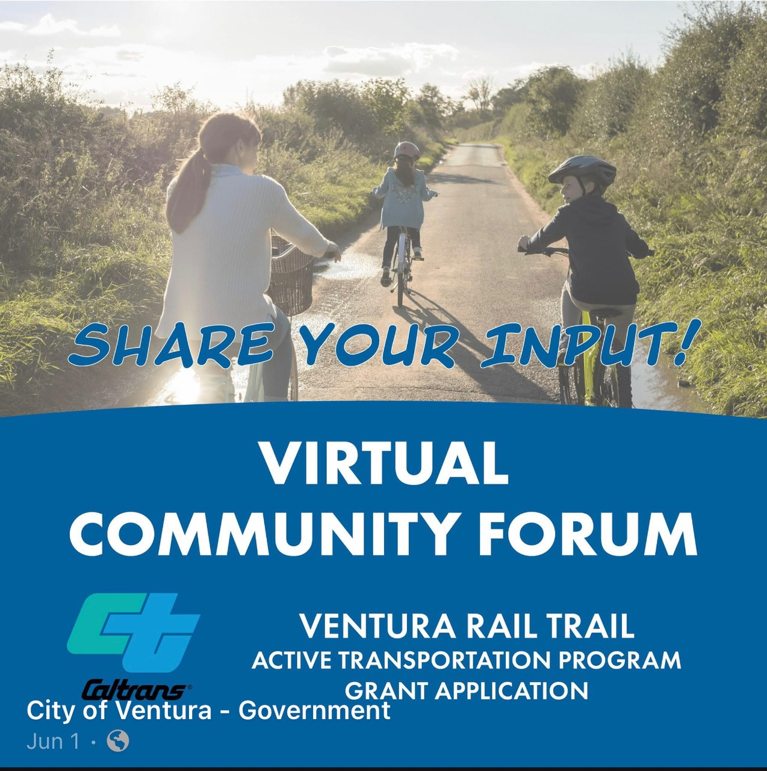
SPBL Trail Planning
On Oct. 5, VCTC facilitated Fall 2023 quarterly Cycle Cal Coast meeting: “Rails with Trails”
On Oct. 11, VCTC staff presented to Ventura County Agricultural Policy Advisory Committee (APAC) regarding SPBL railroad operations and trail planning efforts
Pending SCAG completion and VCTC Counsel review of REAP CTC Partnership Program MOU, VCTC anticipates consideration of SPBL Trail Master Plan Update grant award MOU at Dec. meeting
Notes:
On October 5th, VCTC facilitated the fall 2023 quarterly meeting of the Cycle Cal Coast group, with a focus on the Rails With Trails concept. We received a presentation from the U.S. Dept of Transportation’s Volpe Center on the recently updated Federal Railroad Administration Rails with Trails Best Practices and Lessons Learned Guidebook. Mendocino Railways President and CEO Robert Pinoli, Jr. shared a presentation on the Skunk Train Rails with Trails project in Mendocino County. VCTC Staff provided overview and updates on SPBL Trail Master Plan Update for the Saticoy to Piru sections of the trail, and the City of Ventura shared presentation on the East Ventura to Saticoy section of the SPBL Trail planning and design progress.
On October 11th, VCTC staff presented to the Ventura County Agricultural Policy Advisory Committee at the request of the Ag Commissioner’s Office regarding railroad operations and trail planning efforts. Committee members and public attendees from the agricultural community expressed concerns regarding compatibility of a bicycle and pedestrian trail within commercial agricultural areas, notably trespass, liability, food safety, security, potential loss of agricultural land, and possible negative economic impacts to agriculture. VCTC will continue this dialogue with the Agricultural Commissioner’s Office and APAC to address these concerns through the trail planning process, and to collaborate on other issues of mutual interest, such as goods movement. We anticipated that an Advisory Committee will be formed to help guide the Trail Master Plan and EIR update, and we welcome and appreciate participation from the Agricultural Commissioner’s Office and APAC.

Slide 6
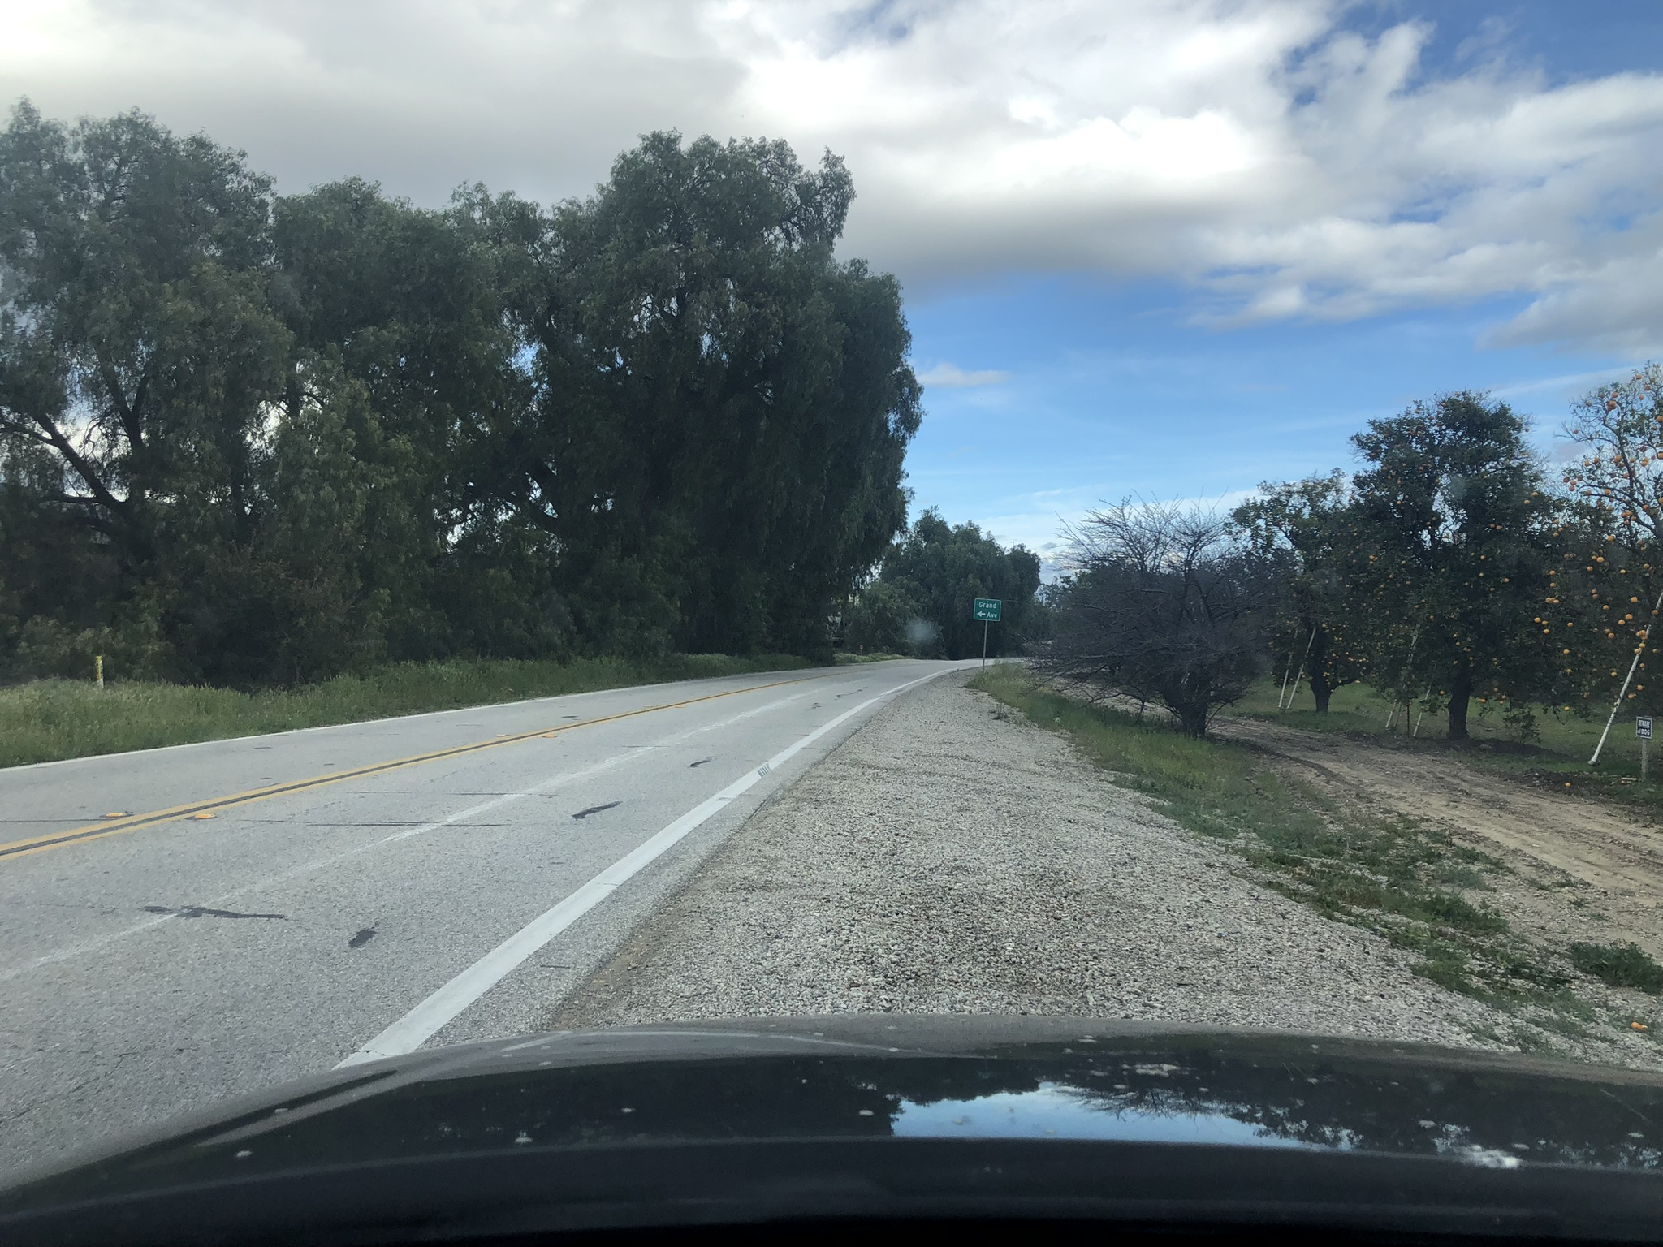
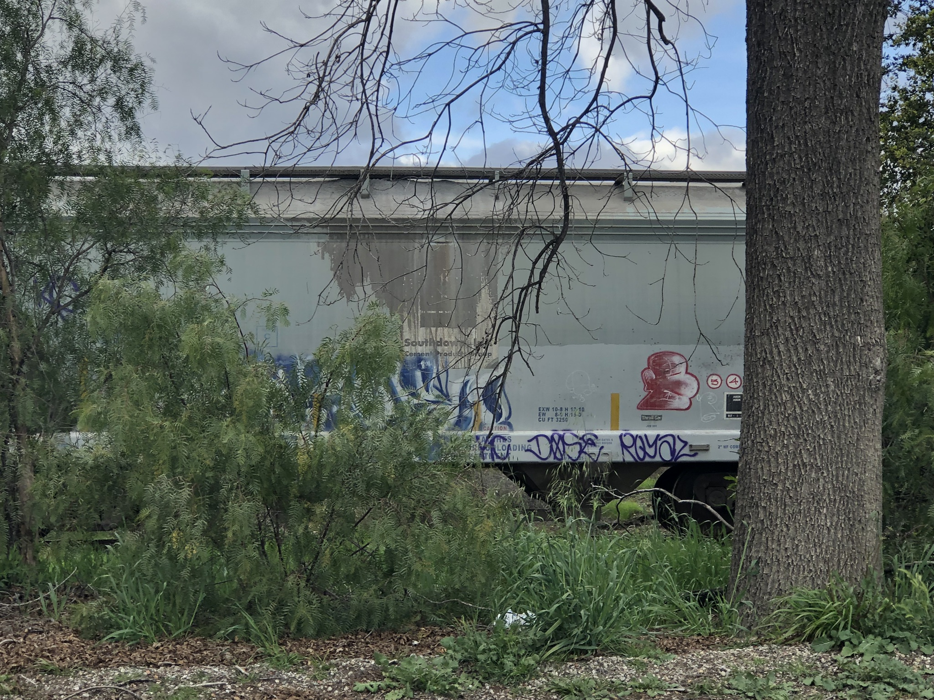
Rail Car Storage
Storage of third-party rail cars
Railroad Lease prohibits Rail Car Storage within incorporated cities and existing communities
Prohibits storage of rail cars containing hazardous materials
Revenue and operational benefits
Temporary storage west of Sespe Creek / Fillmore area
Notes:
At this time, approximately 84 rail cars remain stored on the SPBL west of Sespe Creek. VCTC continues a dialogue with Sierra Northern to identify an alternative site for the rail cars until they can be placed back in service by the owner of the rail cars or until the Sespe Bridge reconstruction is completed. VCTC continues to work with parent company Sierra Railroad to seek a path forward to address community concerns related to rail car storage in both the near and long term of the Railroad Lease and Operations Agreement.
BACKUP
Rail Car Storage refers to rail cars owned by a third party being stored on the SPBL. Rail Car Storage is anticipated to be used in the early stages of Sierra Northern operations to generate revenue while other business lines are further developed. To mitigate the impact of Rail Car Storage, the Agreement prohibits rail car storage within incorporated cities and existing communities as defined by the County of Ventura (namely Saticoy and Piru), or within 150 feet of legal public and private railroad crossings and prohibits Rail Car Storage of rail cars containing hazardous materials.
As a result of the severe winter storms in January 2023 and resulting damage to the Sespe Creek Overflow bridge, up to approximately 100 rail cars have been stored in an unincorporated area west of Fillmore. The storage of these cars is temporary, and every effort is being made to repair the bridge and restore service connectivity in a timely manner to allow the cars to be moved to another less visible location, until the rail cars are placed back in service by their owner.
Passenger and freight rail cars and locomotives owned by Sierra Northern Railway and its sister company, Mendocino Railway, may be parked on the railroad, including within incorporated cities, as part of regular railroad operations. These types of cars are not considered Railroad Car Storage.
Revenue from the storage of rail cars contributes to maintaining and improving the condition of the railroad and right-of-way. Rail car storage also contributes to efficient and safe operations of the national railroad network.

Slide 7
SPBL Next Steps / To Do List (Oct. Updates)
Complete review and payment of FY 2022/2023 invoices from Sierra Northern Railway - Ongoing
Review and approve Sespe Creek Overflow Bridge Design & Permits – Completed review and comments on Hazard Mitigation Report Draft
Prepare SOW & RFP for Record of Deed Survey procurement
Finalize SOW & RFP for Sespe Creek Overflow Bridge Construction Management procurement – Completed SOW, RFP, and Staff Report with Counsel and Risk Manager Review, On Commission Agenda for RFP release 11/3/2023
Prepare SOW & RFB for Sespe Creek Overflow Bridge Construction procurement
Continue to prepare and submit FEMA Project documentation and request for reimbursement - Ongoing
Multilingual rail safety outreach materials
Finalize MOU, SOW and Prepare RFP for SPBL Trail Master Plan Update & EIR/EIS – Revised timeline and budget per SCAG request, and prepared draft RFP
Secure Commission Approval of new Right of Entry Permit Template & Process
Continue to process ROE permits, leases, licenses, and crossing agreements – Ongoing (as described in Staff Report)
Continue to address neighbor complaints and encroachment issues along SPBL
Negotiate/execute any Commission-directed amendments to the Railroad Lease and Operations Agreement - Ongoing
Procure Plan Check & Engineering Review services for review of County Broadband project plans
Notes:
To give you a sense of ongoing and upcoming administrative and program management tasks for the Branch Line, this slide contains my running to-do list.

Slide 8
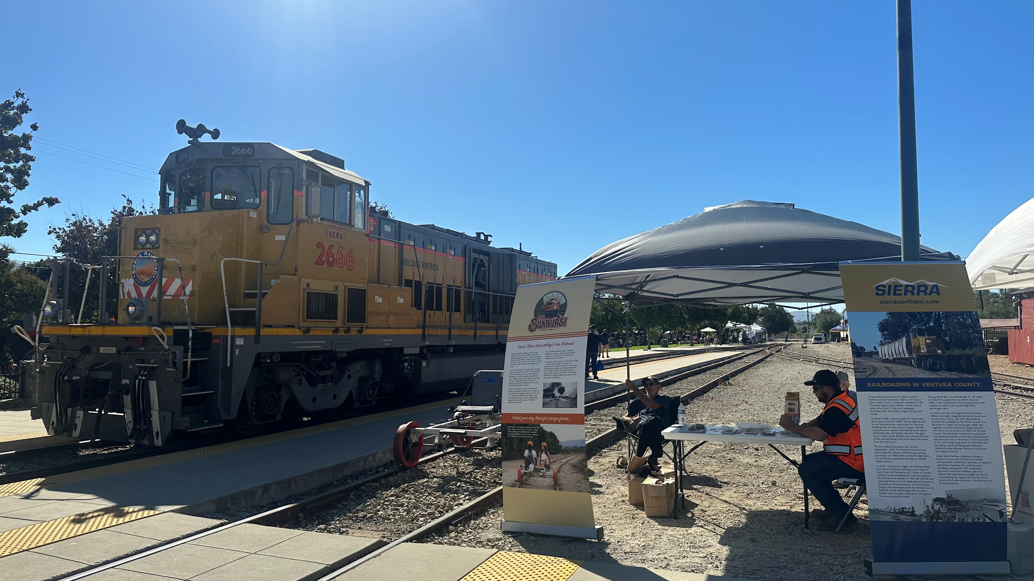
County of Ventura 150th Anniversary Celebration
Notes:
Finally, I will share that Sierra Northern and Mendocino Railway participated in the 150th Anniversary Celebration of the County of Ventura, with a locomotive, railbike, and information table during the event at the Agriculture Museum in Santa Paula.

Slide 9
QUESTIONS?
Notes:
With that, I will be happy to answer any questions you may have. I also understand that we have several public speakers on this item.

