Slide 1
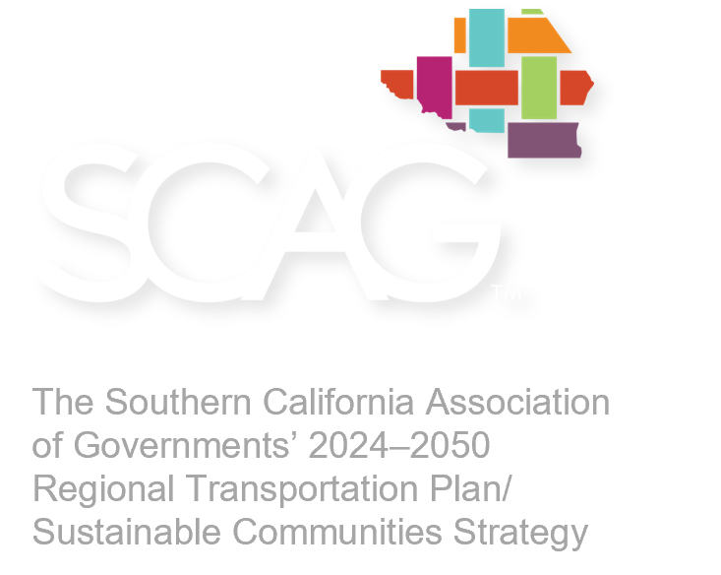
Connect SoCal 2024
Draft Plan for Review and Comment

Slide 2
The SCAG Region
6
COUNTIES
38,618
SQUARE MILES
VENTURA
$1.6T
REGIONAL GDP
16
TRIBAL GOVERNMENTS
LOS ANGELES
SAN BERNARDINO
16TH
LARGEST ECONOMY WORLDWIDE
191
CITIES
RIVERSIDE
ORANGE
IMPERIAL
18.7M
RESIDENTS
47.6%
OF STATE POPULATION
2

Slide 3
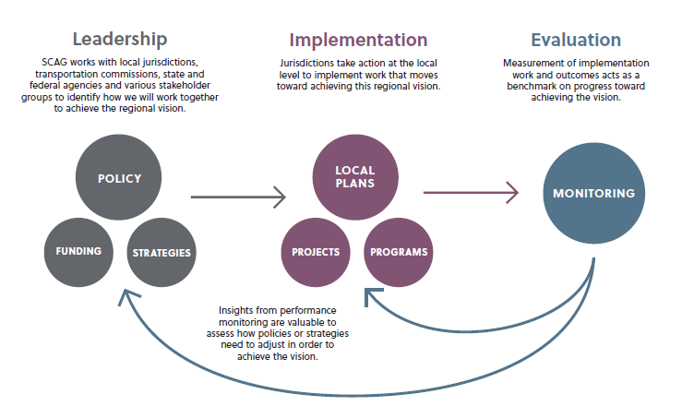
Our Role in the Region
Vision and Goals
Stachia – pls make sure header lines up with other slides; ok to leave the rest alone because we made changes with the project manager
SCAG leads the region by defining where we want to go and outlining strategies to get us there.
3

Slide 4
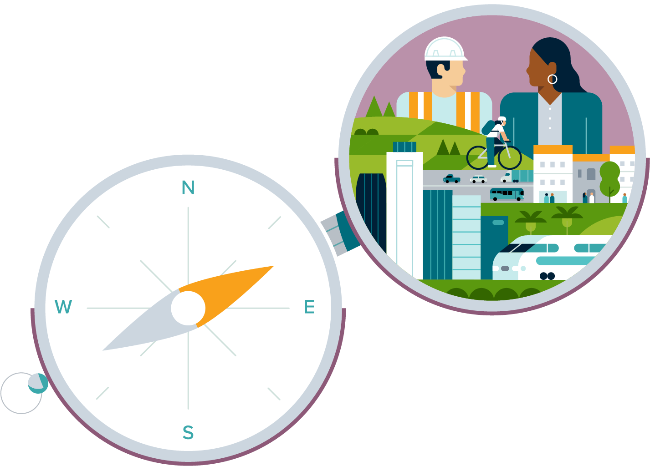
What is Connect SoCal?
4

Slide 5
Connect SoCal is:
A 20+ year plan with $750 billion in transportation investments, a regional development pattern and many supportive programs and strategies
A plan to meet federal and state requirements, which is critical for projects in the region to receive transportation funding or approval​
Stachia – please make the leading adjustments mentioned by the client. Looks like they adjusted the text box width too. I would model what they did. The text line breaks are different too.
A Regional
Transportation
Plan/Sustainable
Communities Strategy
(RTP/SCS)
5

Slide 6
Plan Elements
Regional Planning Policies​ Provide guidance for integrating land use and transportation
Project List
Details plan investments
Forecasted Regional Development Pattern
Demonstrates where the region can sustainably accommodate needed housing
Regional Strategic Investments
Address the gap between local plans and regional performance targets and goals
Implementation Strategies
Areas where SCAG will lead, partner or support plan implementation
6
Notes:
Describe RPPs and IS
Tie back to compass, we don’t implement ourselves
So what: local jurisdictions and agencies have made substantial progress in the last decade to invest in a multimodal transportation system and guide more sustainable development but we need continued collaboration to close the gap between where we go alone and where we can go together

Slide 7
HOW WE DEVELOP THE PLAN
7

Slide 8
A “continuing, cooperative and comprehensive” approach
2021
2022
2023
2024
Foundations and Frameworks
Data Collection and Policy Development
Outreach and Analysis
Draft Plan and Adoption
Plan development included many steps including:
90+ Working Group and Technical Advisory Committee meetings
3,600+ public outreach survey responses
100+ Staff Reports to SCAG’s Policy Committees and Regional Council
Input solicited from County Transportation Commissions for Plan Project List
Input solicited from local jurisdictions for Forecasted Regional Development Pattern
8

Slide 9
Plan CONTENT
9

Slide 10
Equity and Resilience as a Lens
Mobility
System Preservation and Resilience
Complete Streets
Transit and Multimodal Integration
Transportation Demand Management
Transportation System Management
Technology Integration*
Safety
Funding the System/User Fees
COMMUNITIES
Priority Development Areas
Housing the Region*
15 Minute Communities*
Equitable Engagement and Decision-Making*
Environment
Sustainable Development
Air Quality
Clean Transportation
Natural & Agricultural Lands Preservation
Climate Resilience*
ECONOMY
Goods Movement
Broadband *
Universal Basic Mobility*
Workforce Development*
Tourism
*New policy area for Connect SoCal 2024
10
Notes:
Describe RPPs and IS
Talking point on subcommittees

Slide 11
The Region in 2050
THE PLAN
POPULATION
20,883,000
+11%
THE PLAN
$750B OF INVESTMENTS
~60% Operations & Maintenance
~37% Capital Projects & Other Programs
~3% Debt Service
COST
BENEFIT
<
HOUSEHOLDS
7,798,000
+26%
$1
$2
EMPLOYMENT
10,248,000
+14%
50%
-30%
-2%
Homes & Jobs near transit
Reduced daily minutes delay per capita
Reduced commute time
PLAN REQUIREMENTS
Federal Conformity Requirements
State GHG emission reduction target
CHALLENGES REMAIN
State of Good Repair
11
Notes:
Talking points: After discussion with stakeholders and input from the public, here are the vision for the region and the goals. This speaks to the four categorical pillars of the plan: Mobility, Communities, Environment and the Economy.

Slide 12
Next Steps

Slide 13
Next Steps
Visit ConnectSoCal.org to read the draft Connect SoCal 2024
Submit
comments online or by mail by January 12, 2024
Contact SCAG
Government Affairs Officer:
Rachel Wagner
(213) 236-1960
wagner@scag.ca.gov

Slide 14
Draft and Final Plan Timeline
NOV
DEC
JAN
FEB
MAR
APR
SCAG Regional Council
Draft Plan Release
SCAG Regional Council
PEIR Certification and Final Plan Approval
Draft Plan Public Review &
Comment Period
Elected Official Briefings &
Public Hearings
Public Comment Periods Close January 12, 2024
Draft PEIR Public Review & Comment Period
SCAG Regional Council
Draft PEIR Release
2023
2024
Notes:
Now what: stakeholders and the public have until January 12 to provide us with comments on the draft plan

Slide 15
www.scag.ca.gov

