Slide 1
Metrolink SCORE – Simi Valley Double Track and Platform Project
RESOLUTIONS OF NECESSITY
FOR PROJECT RIGHT-OF-WAY
Presenters
Steven Mattas
Ventura County Transportation Commission
Danny Mendoza
Metrolink Right-of-Way Manager
Board of Commissioners
November 3, 2023
Ventura County Transportation Commission

Slide 2
VCTC is Requested to Make the Following Findings:
The public interest and necessity require the proposed project
The project is planned or located in a manner that will be most compatible with the greatest public good and the least private property injury
The real property to be acquired is necessary for the project
The offer of just compensation has been made to the property owner on May 5, 2023
RON Notice – Sent via mail on October 12, 2023
Simi Valley Double Track & Platform

Slide 3
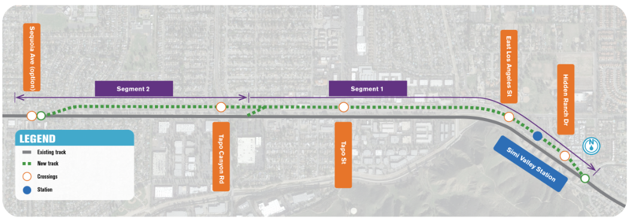
The key components of the Simi Valley Double Track Project are:
Install 2.13 miles of railroad siding track immediately adjacent to the existing track within the existing railroad ROW
Construct a new platform, and pedestrian underpass, at Simi Valley Station;
3. Upgrade five (5) existing at-grade crossings to enable a future Quiet Zone
Simi Valley Double Track & Platform

Slide 4
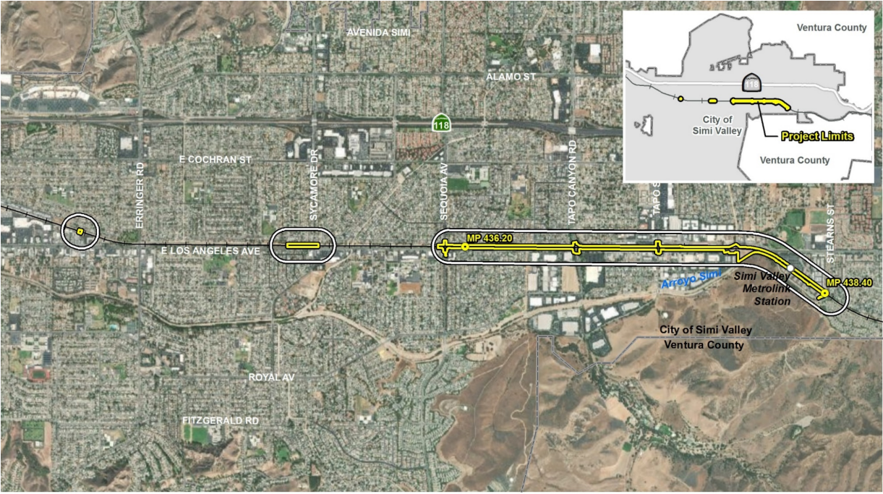
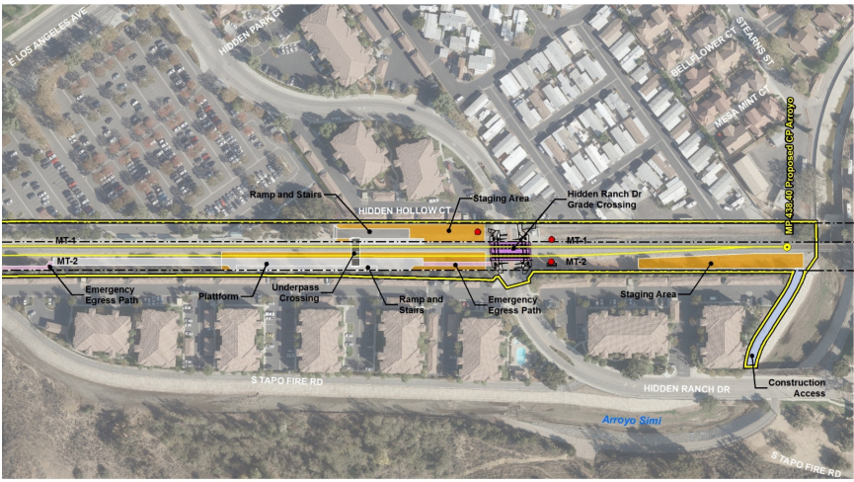
Location Maps
Simi Valley Double Track & Platform

Slide 5
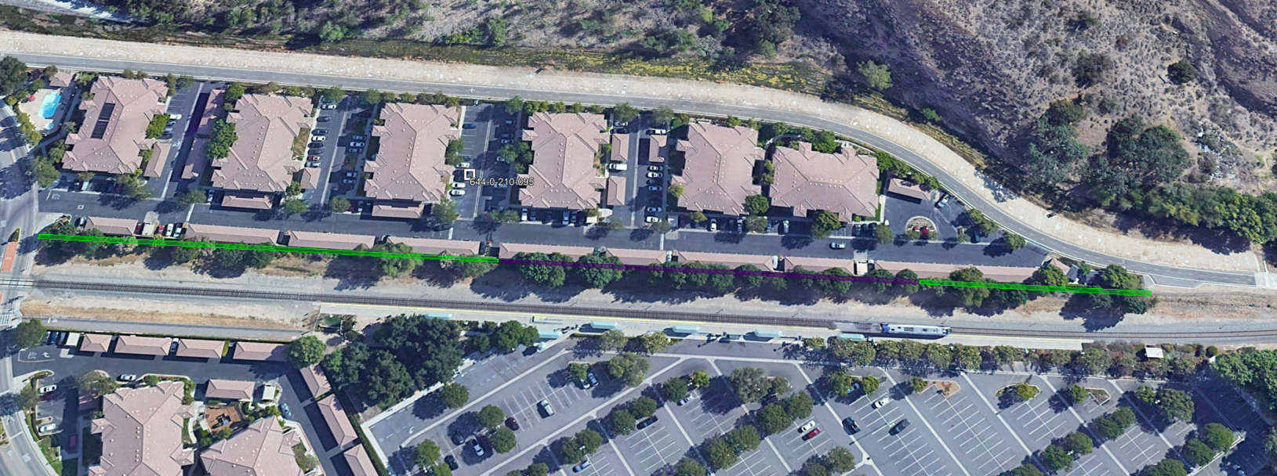
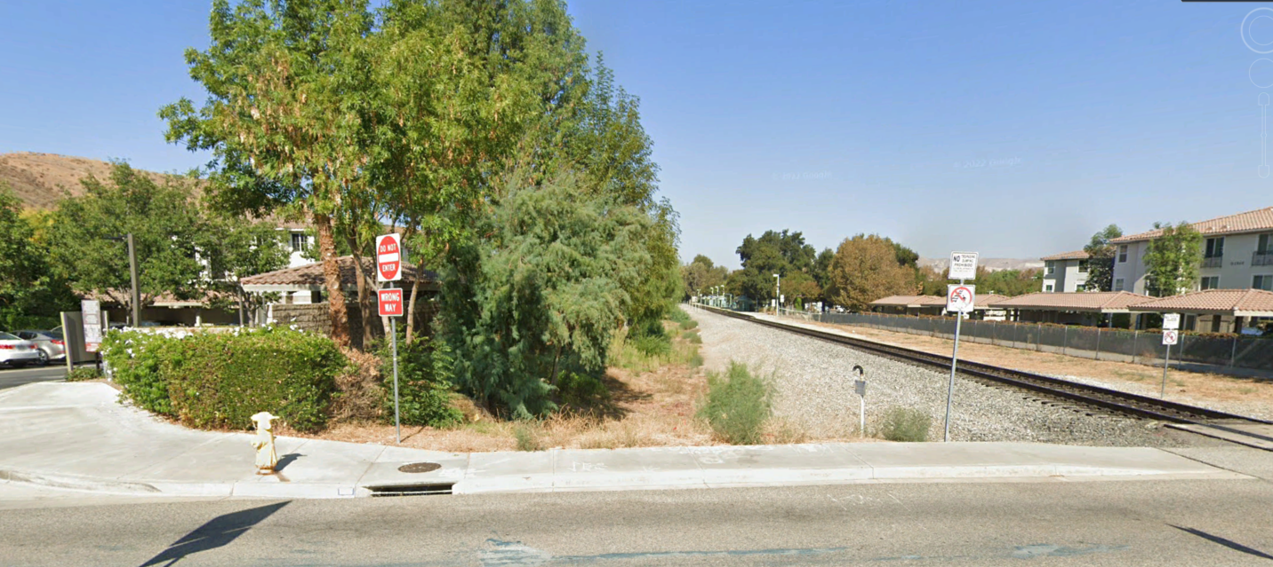
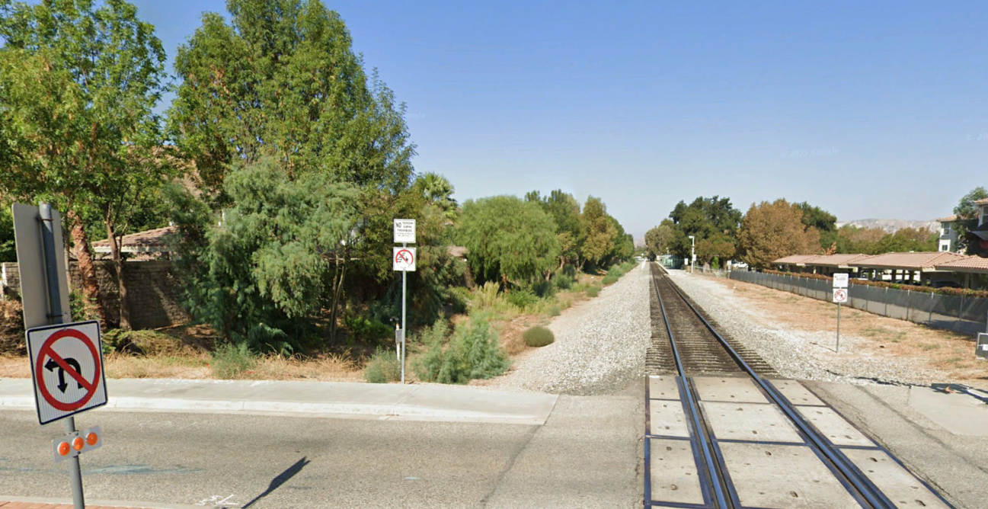
644-0-210-095
SV-TCE-013
SV-EST-002
SV-TCE-014
Delaware HVG Apts – 644-0-210-095
Temporary Construction Easement
SV:TCE-013 1,987 square feet
SV:TCE-014 6,181 square feet
Drainage Easement
SV:EST-002- 4,104 square feet
Simi Valley Double Track & Platform

Slide 6
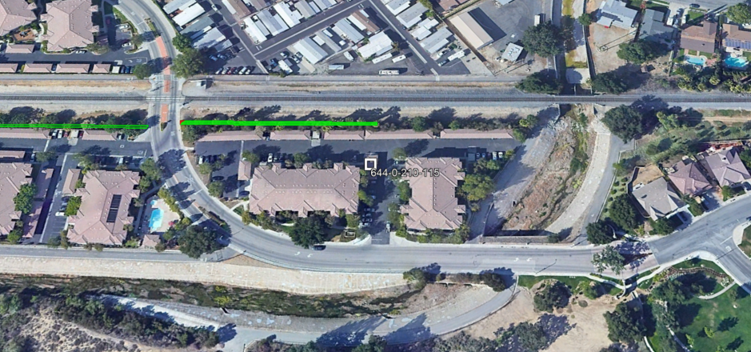
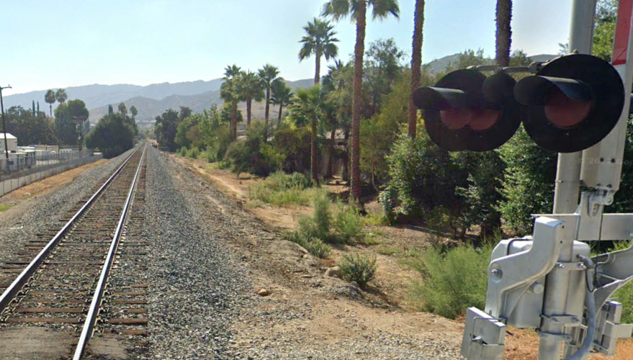
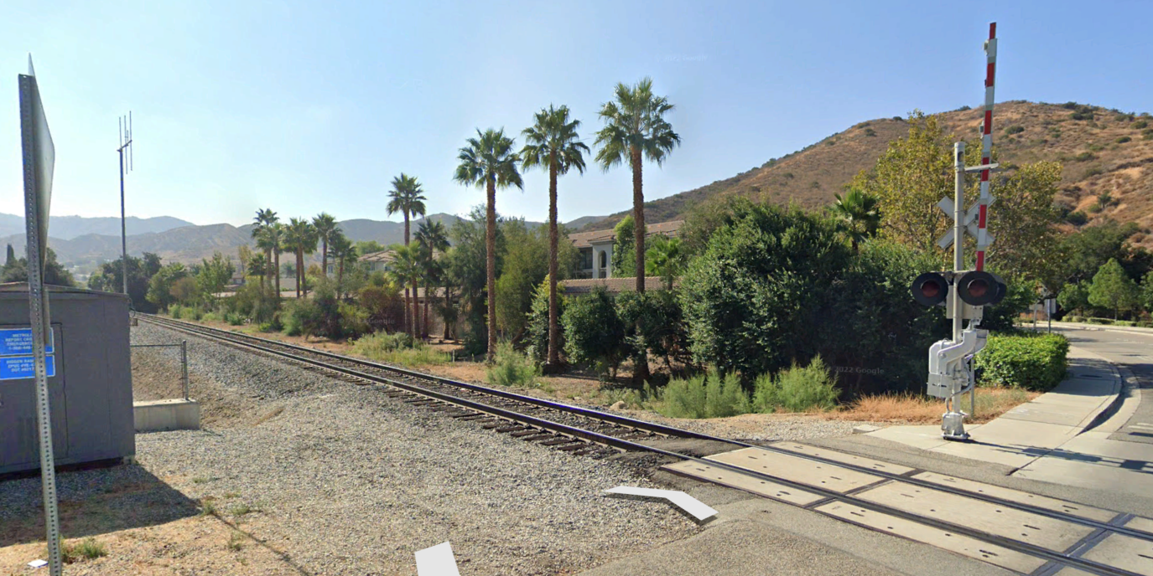
644-0-210-115
SV-Part-001
SV-TCE-004
Delaware HVG Apts – 644-0-210-095
Partial Acquisition
SV:Part-001 55 square feet
Temporary Construction Easement
SV:TCE-004 4,762 square feet
Simi Valley Double Track & Platform

Slide 7
Communication Summary
Take ID | Property Owner | Date of First Contact | Mailing | In Person / Virtual | Phone Contacts | Emails | Attorney Contact | Unsuccessful Contacts | Total Contacts
SV:EST-002 SV:TCE-013 SV:TCE-014 SV:Part-001 SV:TCE-004 | Delaware HVG Apts 644-0-210-095 644-0-210-115 | January 30, 2023 | 2 | 2 | 4 | 5 | 2 | 0 | 15
Offer of Just Compensation
Take ID | Property Owner | Date of Appraisal | Approval of Just Compensation | Date of Offer | Method of Delivery
SV:EST-002 SV:TCE-013 SV:TCE-014 SV:Part-001 SV:TCE-004 | Delaware HVG Apts 644-0-210-095 644-0-210-115 | April 3, 2023 | April 25, 2023 | May 8, 2023 | Via E-mail (Owner Request) & Certified Mail
Simi Valley Double Track & Platform

Slide 8
VCTC adopt the resolution of necessity based on the following findings:
The public interest and necessity require the proposed project
The project is planned or located in a manner that will be most compatible with the greatest public good and the least private property
The real property to be acquired is necessary for the project
The offer of just compensation has been made to the property owner
Simi Valley Double Track & Platform

Slide 9
Thank you
Simi Valley Double Track & Platform

