Slide 1
Ventura County Transportation Commission
FY2025-2034 Short Range Transit Plan Update Contract Award
October 6, 2023

Slide 2
What is a Short Range Transit Plan?
A Short Range Transit Plan or SRTP serves as a roadmap for transit agencies to guide their actions and investments over a 5 to 10-year timeframe.
SRTP’s are a crucial part of the broader transportation planning process and are important for ensuring the efficient and effective operation of public transit systems.
Typically updated regularly to adapt to changing circumstances and priorities
Notes:
A Short Range Transit Plan or SRTP serves as a roadmap for transit agencies to guide their actions and investments over a specified timeframe based on recommended adopted goals, strategies, and priorities over a 10-year timeframe.
As part of the SRTP update process, the transit system(s), fleet needs, capital and operating costs and revenues, and new transit services or projects are assessed, and recommendations made

Slide 3
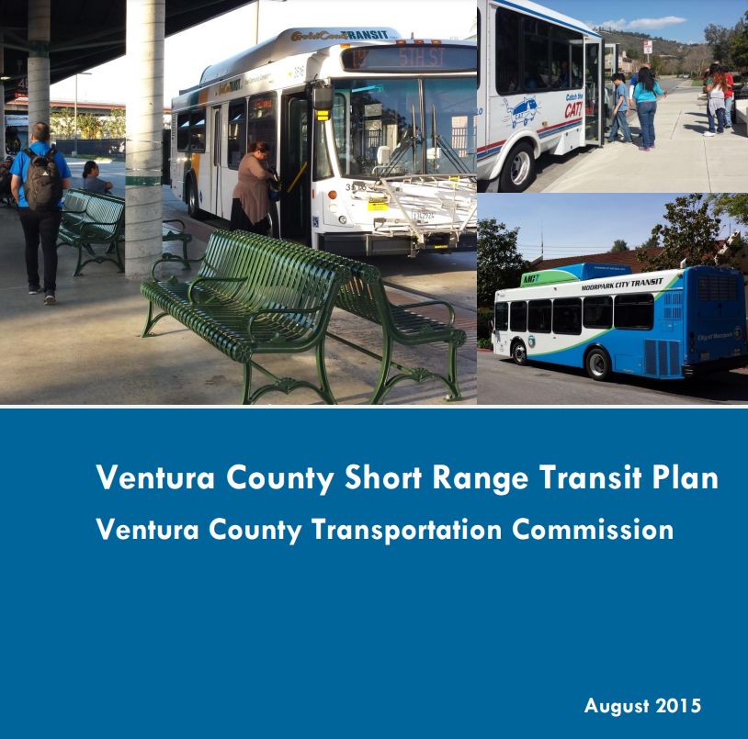
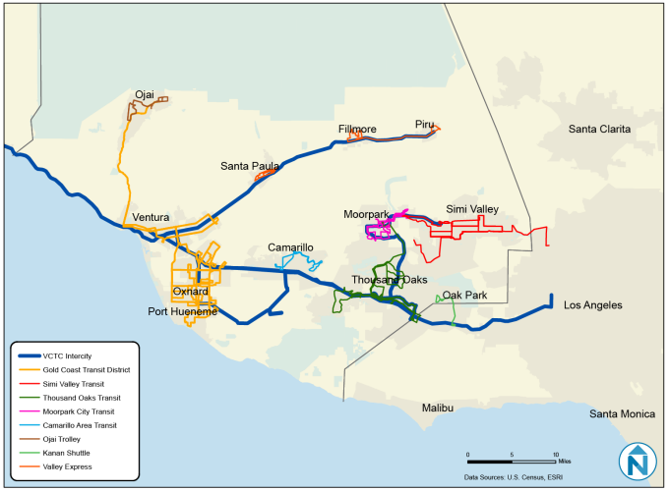
Background & Purpose
VCTC’s last SRTP was developed in 2015 and provided strategies to improve regional coordination/connectivity.
The 2015 SRTP also provided a framework for future transit ridership growth with the primary goal of enhancing customer experience and increasing the viability of transit within Ventura County.
Notes:
VCTC’s last SRTP was developed in 2015 and provided strategies to improve regional coordination/connectivity and to establish a cohesive and consistent set of transit services.
Many significant events have occurred since the last update, such as the COVID-19 pandemic, which has altered the transit service landscape.
New SRTP will analyze current service such as fixed route bus, Dial-A-Ride, microtransit, paratransit, and rail service.

Slide 4
Background & Purpose cont.
Will incorporate VCTC’s Strategic Plan and other relevant planning documents (i.e. TIES, Coordinated Plan, TEPP, CTP, etc.)
New SRTP will analyze current service and will serve as a tool to assess and prioritize expenditures, services, and funding to serve the County’s mobility needs
SRTP will include service planning analysis for all transit operators (except GCTD)
Paratransit integration analysis will follow up on recommendations highlighted in the Coordinated Plan and TIES
Notes:
Many significant events have occurred since the last update, such as the COVID-19 pandemic, which has altered the transit service landscape.
New SRTP will analyze current service such as fixed route bus, Dial-A-Ride, microtransit, paratransit, and rail service.
Paratransit integration analysis is awarded by REAP grant program via SCAG.

Slide 5
Evaluation Process
Notified eight (8) firms of opportunity in advance of RFP release
Received one proposal
Conducted outreach to other six (6) non-bidders to find out why they did not submit a proposal
Non-proposer responses consisted of:
Other project commitments during RFP/project timeframe and did not have the capacity to put together a proposal
Unfamiliarity with Ventura County
VCTC staff reviewed the scope of work and feedback from the non-proposers and determined the lack of proposals were caused by conditions beyond VCTC’s control

Slide 6
Project Team Qualifications & Experience
Consultant – Fehr & Peers
Extensive track record of transit planning in regions with similar operating environments as Ventura County.
Developed a strong and growing relationship with VCTC and the SRTP stakeholders during the development of the Transit Integration & Efficiency Study (TIES)
Subconsultant Firm – AMMA Transit Planning
Transit industry experts in equity and community engagement-driven service planning, including a specialization in paratransit.
Contributed to national research and best practices on paratransit policy, service delivery, and system integration.

Slide 7
SRTP Tasks
Task 1
Project Management
Task 5
Service Plan Development
Task 9
Fare Evaluation
Task 10
Countywide Paratransit Integration Analysis
Task 2
Existing Conditions
Task 6
Capital Plan
Task 3
Stakeholder Engagement
Task 7
Financial Plan
Task 11
Final Short Range Transit Plan
Task 4
Service
Evaluation
Task 8
Community Engagement and Partnerships Plan
IMPLEMENTATION
Notes:
Task 1 – Speaks to meetings and project reporting
Task 2 – Will include an overview of transit services within the County and a market assessment (e.g. demographic, economic (pre- and post-COVID conditions, etc.) as well as other VCTC’s recent plans (e.g. Strategic Plan, TIES, Coordinated Plan, ZEB Plan, TEPP, and CTP)
Task 3 – Robust stakeholder engagement that will include engaging with bus and rail operators, VCTC committees, community focus groups (human service organizations), community workshops in for each city as well as a couple virtual workshops, and an onboard and online surveys.
Task 4 – Evaluate each operator’s service
Task 5 – Develop service plan scenarios based for each operator (except GCTD
Task 6 – Develop a list that outlines capital needs of bus and rail operators
Task 7 – Develop financial plan that integrates projections of expenses and revenues (operating and capital) for each bus service (except GCTD)
Task 8 – Develop a plan for that will improve how VCTC organizes events, gathers and responds to feedback, and builds positive relationships with communities
Task 9 – Evaluate fare policies and structures and recommend for potential fare policy changes or adjustments
Task 10 – Conduct an analysis of service coordination and consolidation of paratransit services based on TIES recommendations
Task 11 – Covers Board review/approval and the final SRTP report

Slide 8
Staff Recommendation
Recommend approval award of contract for development of Short Range Transit Plan (SRTP) Update to Fehr & Peers for a not-to-exceed amount of $714,933
Authorize the Executive Director to negotiate all remaining terms of the contract for the SRTP Update in a form and substance approved by VCTC legal counsel.

