Slide 1
Presentation to Ventura County Transportation Commission
October 6, 2023
Notes:
See Word doc for notes/outline

Slide 2
TIES Objectives and Purpose
TIES was initiated by Commission in 2020
Response to national trends in declining ridership, advancing equitable transportation, and the COVID-19 Pandemic’s impact on transit
Additionally considered issues specific to Ventura County transit, such as a lack of regional fixed-route and paratransit service and variation between rider policies between communities
TIES seeks to improve efficiency and rider experience by identifying ways agencies can coordinate or consolidate activities, administration, operations, and programs.
Notes:
VCTC

Slide 3
What did the TIES Team do?
Analysis of existing conditions of transit service and how it is administered across Ventura County
Worked with staff, City leaders and Commissioners to identify concerns and opportunities
Identified strategies to improve an array of topics, and developed alternatives to group them by level of agency consolidation (minimal consolidation to full consolidation)
Notes:
VCTC

Slide 4
What has been accomplished since the TIES began?
Moorpark launched MCT On Demand (microtransit)
Camarillo began using TDA money for transit
More agencies provide service planning information through Google Maps (GTFS)
GCTD began operating the late-night safe rides on-demand program and South Oxnard microtransit program
VCTC organized the countywide Youth Ride Free program and expanded the College Ride program
VCTC increased joint procurements, including the SRTP and the upcoming paratransit scheduling software RFP.
Received grant funding for the Countywide Paratransit Integration Analysis and the Transit Stops and Stations Assessment and Capital Program.
Notes:
VCTC

Slide 5
Since the February Meeting
The following has occurred since the February Commission meeting:
Outreach to cities (city council meetings)
OWG meetings
Conducted a survey
Updated the final report
Notes:
VCTC

Slide 6
Final Report
Providing Guidance on Strategic Implementation of Recommended Actions
Notes:
Jeremiah

Slide 7
Incorporated Feedback from Communities
Changes from February 2023 plan reflect concerns from some communities with full implementation of Alternative 2
Incorporated an incremental approach from Alternatives 1 into 2
Reinforce with stakeholders that TIES is a framework, not a binding agreement
The TIES final report, particularly through the Implementation Plan, seeks to develop a “roadmap” to incremental integration by providing a framework and strategies to do so.
Notes:
VCTC

Slide 8
Strategic Implementation Plan Timeline
Outlines specific actions on an annual basis over the next decade
Prioritizes "low-hanging fruit" actions that are already underway
Actions incorporated into the upcoming SRTP (fare study, consistent route classifications, etc.)
Study to consolidate to a single paratransit provider
Recent bus stop improvement grant
Working towards joint procurement
Notes:
VCTC

Slide 9
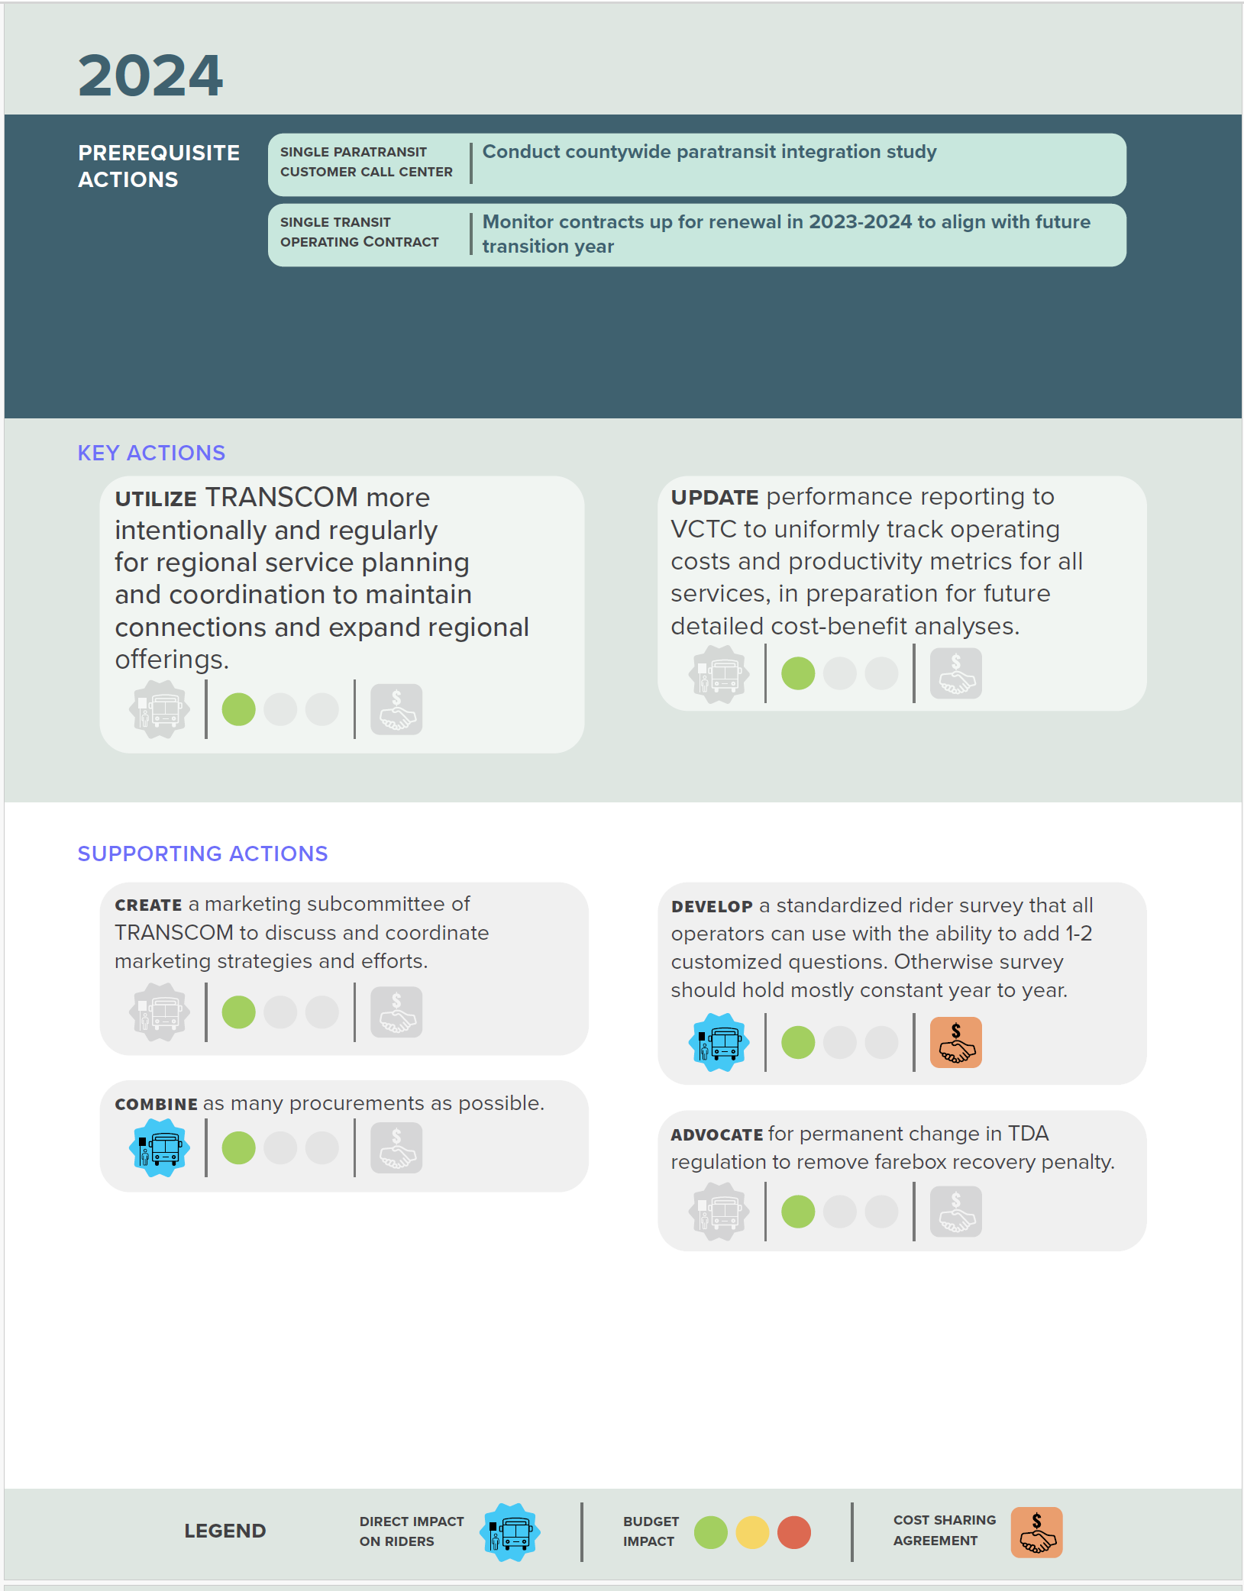
Strategic Implementation Timeline
Pre-requisite actions correspond to later key and supporting actions
Key and supporting actions correspond to recommendations from Alternatives 1 and 2
Actions are rated based on estimated budget impact, if they require a cost-sharing agreement, and if they directly impact riders
Notes:
VCTC

Slide 10
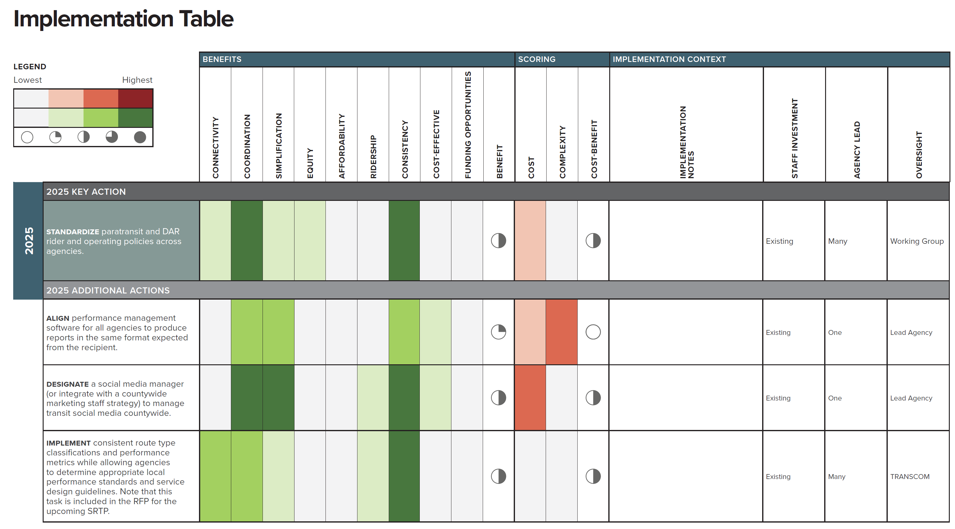
Strategic Implementation Timeline
Implementation Table provides further detail for each action
Notes:
VCTC

Slide 11
Next Steps
If approved:
Begin the Countywide Paratransit Integration Analysis
Begin implementing actions outlined for 2024
Begin implementing actions for later years as those years approach
Begin additional working groups within next three years
Notes:
VCTC

Slide 12
Questions?

Slide 13
Alternative 1
Subregional consolidation of demand-response service
Increased and formalized interagency coordination
Fixed-route service planning
Group procurements and operating contracts, where possible
Standardize rider policies
Regional marketing, surveying, institutional partnerships
Notes:
Jeremiah
Alternative 1 envisions a limited level of consolidation in the east county with further progress of the East County Transit Alliance to provide better subregional paratransit service. Another major component of alternative 1 is to centralize paratransit and demand-response call-taking and scheduling as a step towards more integrated operations. Most other actions rely primarily on formalizing coordination and collaboration between the stakeholders to work on intercity service planning, marketing, procurement and contracting. Agencies would otherwise remain independent as they currently are.

Slide 14
Alternative 2
Creation of a countywide demand-response agency
Includes all paratransit and dial-a-ride programs
Probably housed within another agency initially
Subregional consolidation of fixed-route service into two agencies
Gold Coast Transit + Camarillo, Ojai, Valley Express, VCTC (bus)
Thousand Oaks + Kanan Shuttle, Moorpark, Simi Valley
Three agencies simplifies coordination, focuses all staff on “transit” and subregional responsiveness
VCTC remains as RTPA, transfers all bus operations to Gold Coast
Notes:
Jeremiah
Alternative 2 takes a bigger step towards integrating agencies recognizing that there are literal geological divides in the county between the Santa Clara River Valley cities, and the East County and West County. All paratransit and demand-response programs would be rolled into a new countywide agency specializing on flexible reservation-based transit, with the ability to dynamically combine riders of the various programs into shared vehicles which improves cost efficiency. This is consistent with a recommendation from the recent Coordinated Services Plan. Secondly, fixed-route services would be integrated geographically with all Valley Express, Gold Coast, and Camarillo services administered and operated by Gold Coast, and all Simi Valley, Moorpark, Thousand Oaks, and Kanan Shuttle services operated by a new JPA agency building on the existing arrangement most east county cities have with Thousand Oaks.

Slide 15
Alternative 3
All public transit services integrated into Gold Coast Transit District
Board structure of GCTD changes to accommodate a more regional makeup
Most operating bases (Thousand Oaks, Simi Valley, Ojai, Valley Express) would remain as operating divisions
VCTC remains as RTPA, transfers all bus operations and transit planning to Gold Coast
Notes:
Jeremiah
Alternative 3 envisions a single countywide agency administering, planning and operating all transit services in Ventura County. A countywide agency would be better positioned to evaluate how local services could effectively connect to regional routes, and would gain the most administrative cost efficiency by reducing redundancy in activities like monitoring and reporting, and procurement. However, countywide integration is also not a perfect solution. Because of the geography and geology of the county, there are no clear opportunities to improve cost efficiency through actions like consolidating operating bases or maintenance garages – basically all of the existing infrastructure would remain in place as operating divisions of a new countywide agency. The main change would be in a more centralized mission and administration. Gold Coast Transit District is assumed to be the consolidated agency because it is legislatively structured for such an outcome.

Slide 16
Alternatives Comparison
Alt 1 requires an action plan and voluntary commitment to develop improvements
Alt 2 balances risk by relying on existing partnerships, creates subregional platform for change
Alt 3 is ambitious with the greatest ability for the resulting agency to enact regional change, but the most difficult to execute
Notes:
Jeremiah

Slide 17
Alternatives Comparison
Alt 1 likely has least benefit for cost efficiency, protects city revenues for transit and roads
Alt 2 could be more expensive than existing initially due to creation of 1-2 new agencies, will likely take some time to realize cost efficiencies
Alt 3 has greatest potential for administrative cost efficiency and increases revenue to transit through TDA, but has negative effect for some city budgets
Notes:
Jeremiah
Need to start somewhere and how ambitious do we want to be
Following slide explains roadmap concept
“Roadmap”

