Slide 1
Ventura County
FFA Last Mile Grant
Broadband Project
Project Update
Presented By:
Terry Theobald, CIO
Ventura County
October 6, 2023

Slide 2
Agenda
Background & Goals
Countywide Strategic Plan
California Middle-Mile Network
SB 156 Last Mile Grants
VCTC Project
Right Of Way Use License

Slide 3
Background & Goals
County-wide fiber distribution network
Distribution or “last mile” = providing internet to subscribers
“middle mile” = connecting to data centers for internet access (LA, SF, San Jose, etc.)
Enhance community access & affordability
Higher speeds (1+ Gbps)
More competition, lower pricing
Close the Digital Divide
County awarded $491,000 Local Agency Technical Assistance (LATA) broadband planning grant from CPUC for network design engineering
Partnering with Astound Networks for operations & retail services
Sept 30 - SB 156 Last Mile Federal Funding Account (FFA) grant application

Slide 4
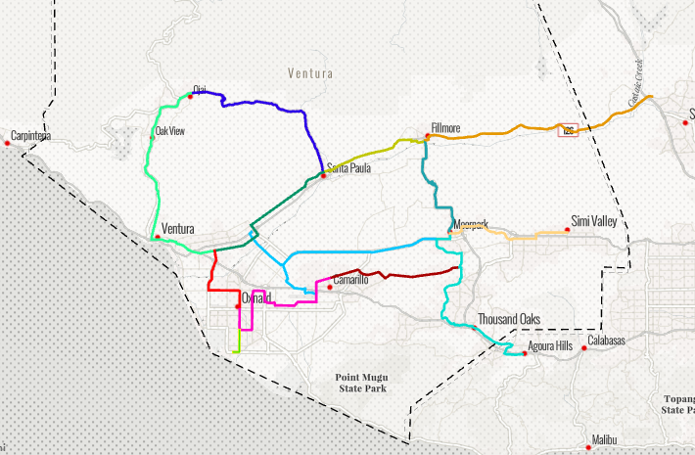
Countywide Strategic Plan

Slide 5
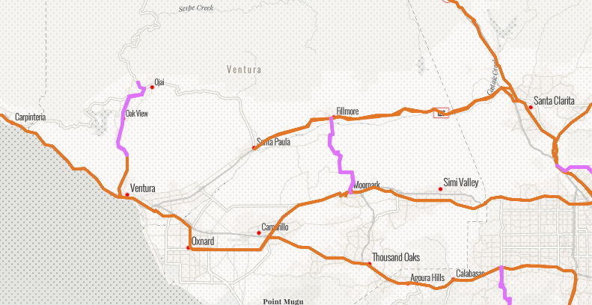
California Middle-Mile Network

Slide 6
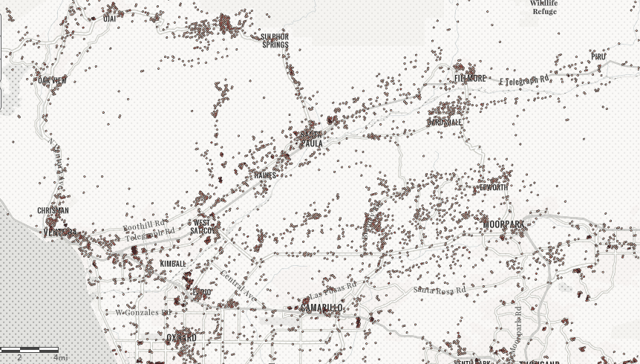
SB 156 Last Mile Grants
Targets unserved locations
Speeds <25 Mbps download/3 Mbps upload
- or -
Legacy copper phone is only internet option
$1 billion for urban counties
~$20.4 million allocated for Ventura County
9,365 unserved locations in VC

Slide 7
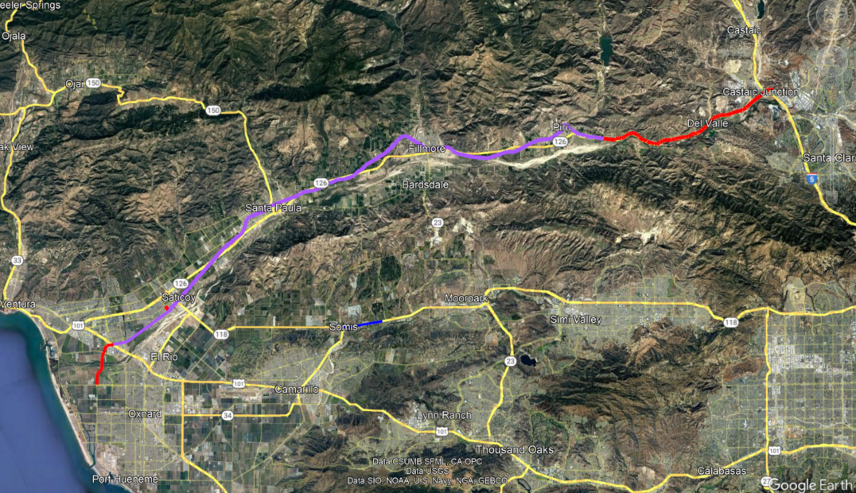
SB 156 Last Mile Grants
County Grant Application (submitted 9/29)
Phase 1 - County-wide fiber distribution network
Highway 126 – US 101 to I-5
Highway 118 – Somis area
Includes 27+ miles along VCTC rail ROW

Slide 8
VCTC PROJECT
County & VCTC developing a ROW license
Joint build with County, Astound, & State
VCTC route includes portions of the State Middle Mile Network
Fiber connectivity benefits for VCTC
Rail operations
Recreation trail
Communications
Traffic safety
Draft license agreement anticipated at November VCTC meeting

Slide 9
VCTC RIGHT OF WAY LICENSE
County and partners to install & operate fiber infrastructure within VCTC ROW
Initial license / application cost
Cover costs associated with plan review, permitting, other reasonable costs
Ongoing use costs - In-kind asset sharing
Option 1:
County provides “dark fiber” to VCTC at no charge for VCTC
VCTC provides end equipment to light & operate for any purpose
Cost/value of 4 strands of dark fiber along the ROW (27 miles) approximately $8,000/month or $96,000 annually
Option 2:
County provides and maintains lit fiber, including equipment, to specific sites/locations (rail safety monitors, security cameras, etc.)
Cost/value depends on scope of the connections envisioned by VCTC.

