Slide 1
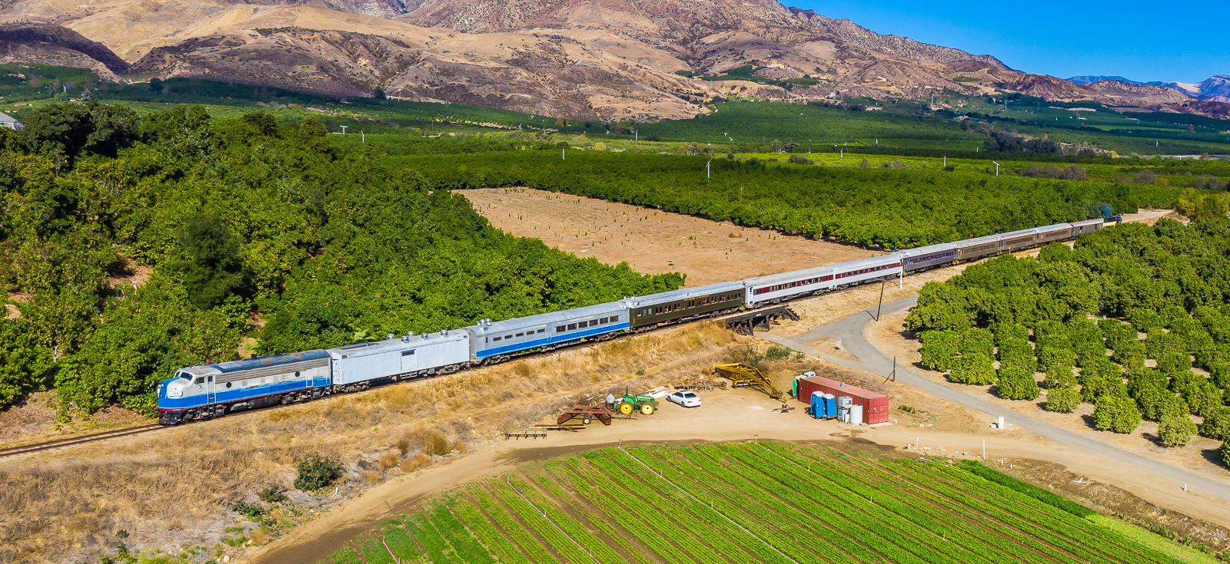
Santa Paula Branch Line Update
Presentation to the
Ventura County Transportation Commission
October 6, 2023
Notes:
Good Morning Chair MacDonald and Members of the Commission, for the record, my name is Amanda Fagan, and I serve as the Director of Planning and Sustainability here at VCTC.
Our most recent verbal update to the Commission took place in June, with monthly consent agenda written updates provided in July and September. With such recent discussion items presented, I will be focusing on the most recent activities and actions in the interest of time.

Slide 2
VCTC Strategic Plan FY 22/23 – 27/28 SPBL Related Strategies
A8. Update SPBL trail master plan, validate trail alignment, connections, and amenities, and update existing conditions to facilitate trail completion, with stakeholder engagement.
B21. Partner with Sierra Northern Railway, corridor cities and the County to operate, maintain, and improve the SPBL railroad and right-of-way corridor as a countywide community asset, ensuring outreach to stakeholders in the process.
B22. Continue to address encroachment into the SPBL right-of-way through leasing activities to ensure safety of operations and protection of the asset and infrastructure.
A-8
B-21
B-22
Notes:
The Commission adopted a Five Year Strategic Plan in May of this year. The Plan includes three Strategies related to the Santa Paula Branch Line, which guide our actions and priorities, including:
A8. Update the Santa Paula Branch Line (SPBL) trail master plan, validate trail alignment, connections, and amenities, and update existing conditions to facilitate trail completion, with stakeholder engagement.
B21. Partner with Sierra Northern Railway, corridor cities and the County to operate, maintain, and improve the Santa Paula Branch Line railroad and right-of-way corridor as a countywide community asset, ensuring outreach to stakeholders in the process.
B22. Continue to address encroachment into the Santa Paula Branch Line right-of-way through leasing activities to ensure safety of operations and protection of the asset and infrastructure.

Slide 3
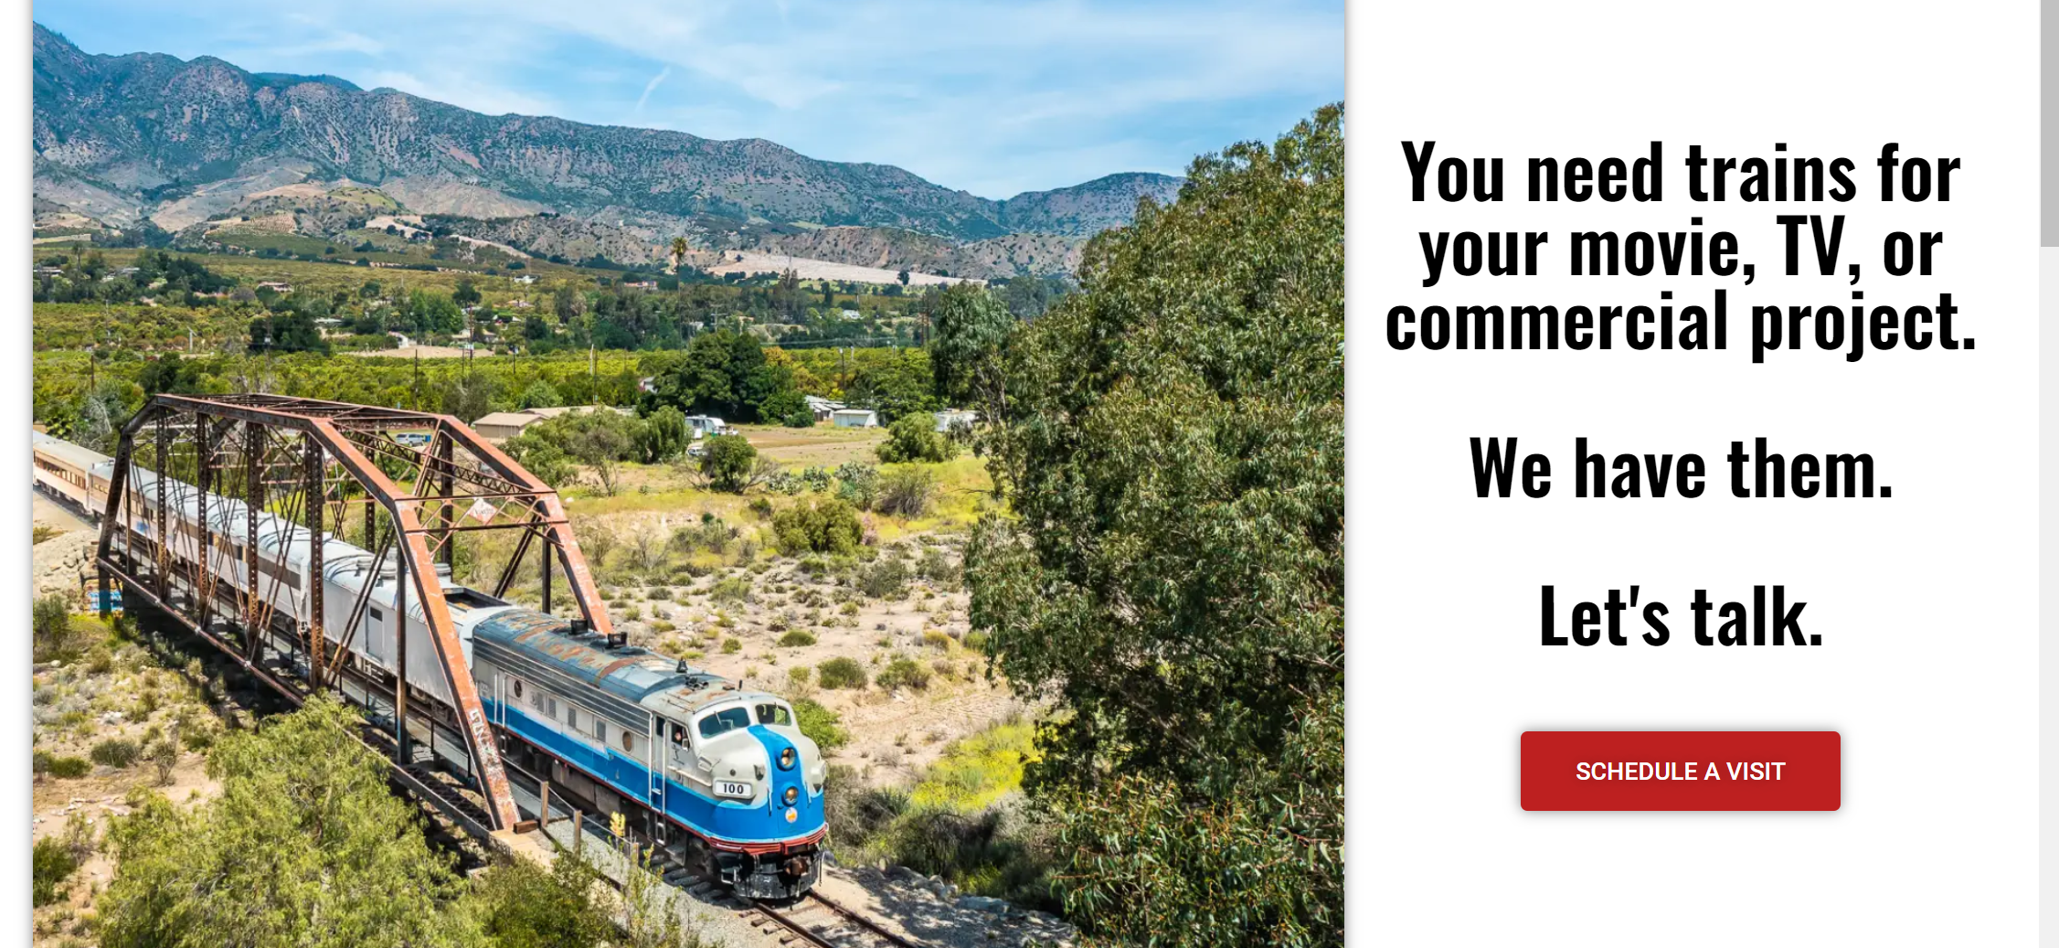
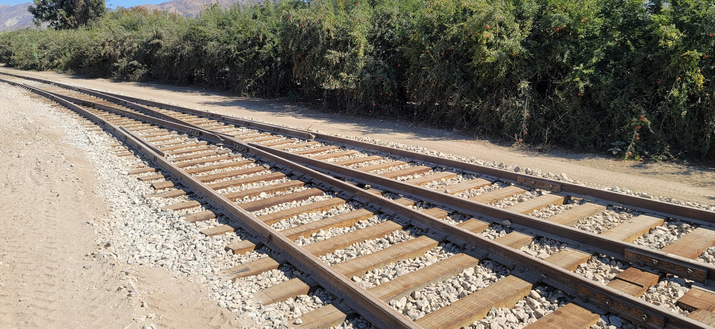
Ongoing Activities
Bi-weekly coordination meetings
Track inspections
Track repairs and investments
Weed abatement & vegetation management
Encampment removal & cleanup
Serving freight customers and expanding customer base
Railbikes tours
Notes:
Since beginning operations, Sierra Northern conducts periodic inspections, makes improvements to the condition of the signals and railroad tracks, conducts weed abatement and other right-of-way maintenance activities, and conducts rail operations on the SPBL. VCTC staff and Sierra Northern representatives continue to meet virtually on a bi-weekly basis to coordinate activities.
In the Fiscal Year 2022/2023, Sierra Northern replaced 381 railroad ties and 30 tons of ballast and continued to develop a new base of freight customers. Freight rail service reduces truck traffic at a rate of four trucks for every rail car and provides an opportunity to lower greenhouse gas emissions associated with goods movement. Also, in Fiscal Year 2022/2023, Sierra Northern expended over $1.4 million in labor, equipment, materials and services to maintain the Santa Paula Branch Line, with VCTC being responsible for reimbursing only $450,000 of that amount under the railroad lease, leveraging private investment in the Branch Line at a rate of 3 to 1.

Slide 4
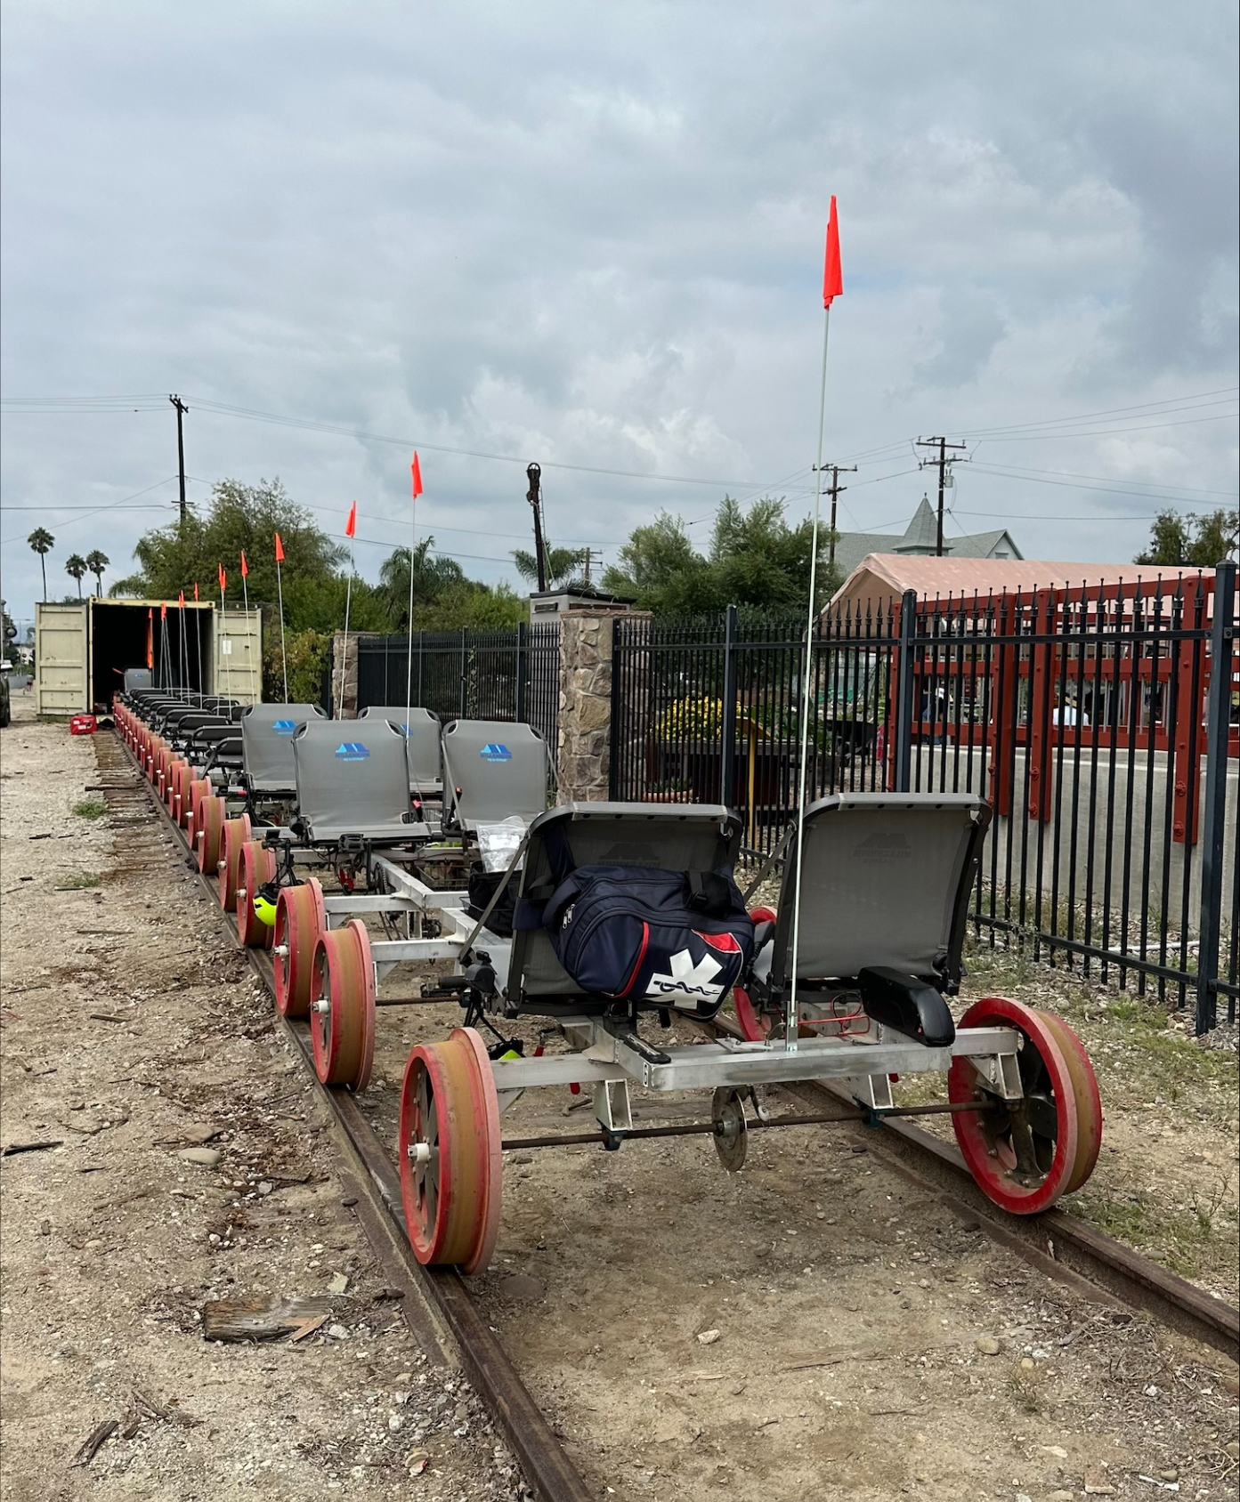
Railbikes Updates
In response to ag operator concerns, Mendocino Railway:
Added flags to railbikes to raise visibility
Agreed to shift scheduled tours start times to 10AM and 2PM to allow additional time in the mornings for ag operations (Beginning in 2024)
Inserted Right to Farm ordinance language into guest waiver
Notes:
In March, Mendocino Railway launched a railbike service on the Santa Paula Branch Line. Guided tours depart from and return to Santa Paula Depot, with a stop at Prancer’s Farm. The railbike tours operate much like an excursion train, on a set schedule, mounted on railroad tracks, with guides at the front and rear, or caboose, of the tour. Additional information on railbike operations is included in a Fact Sheet that has been posted to the SPBL web page.
In response to concerns raised by some of the agricultural operators near the line, railbikes operator Mendocino Railway added flags to the backs of the railbikes to increase visibility, agreed to shift the scheduled tour start times one hour later to 10am and 2pm to allow additional time for ag spraying operations in the morning, and inserted language from the Ventura County Right to Farm ordinance into the guest waiver, at the request of the Farm Bureau.

Slide 5
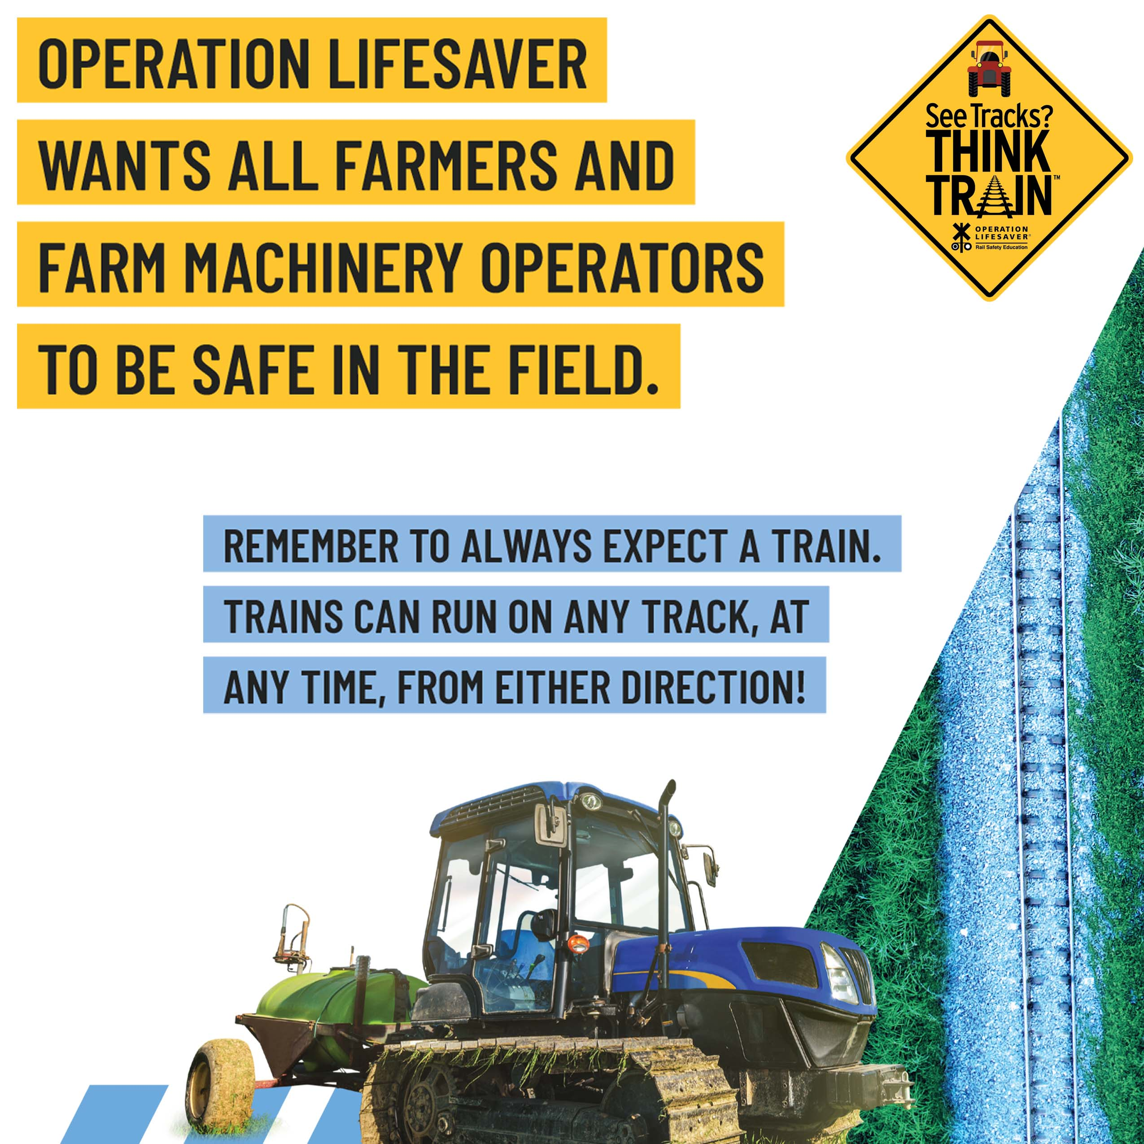
Rail Safety Week
Notes:
In recognition of Rail Safety Week September 18 – 24, VCTC and Sierra Northern Railway shared messages from Operation Lifesaver through social media and with corridor cities and community partners.

Slide 6
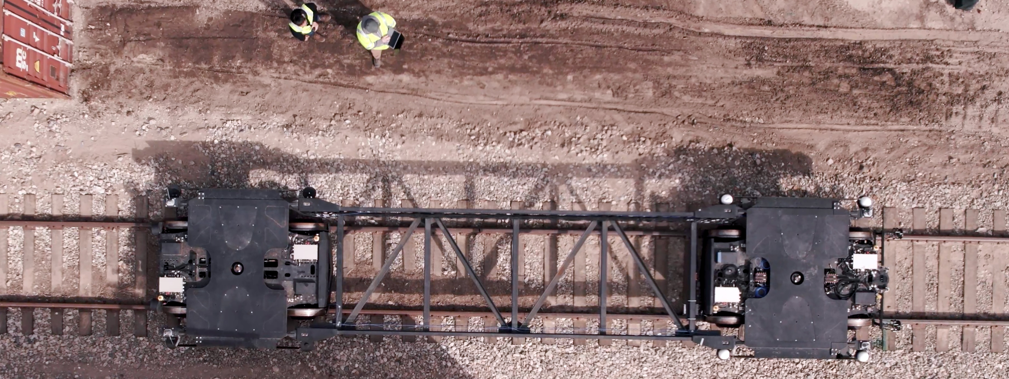
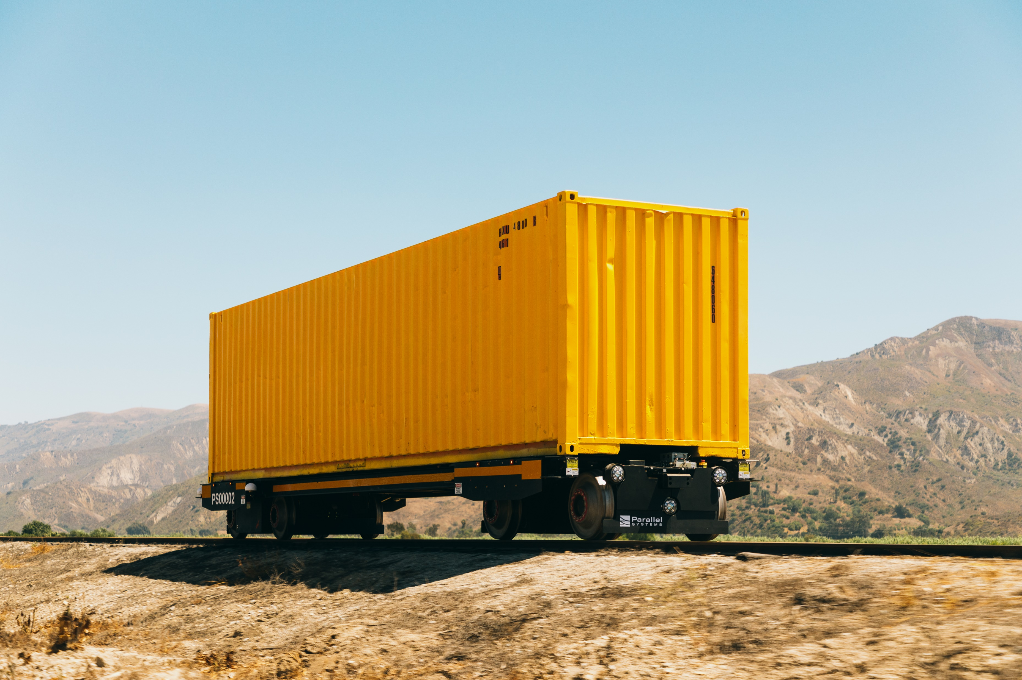
Parallel Systems
Autonomous battery-electric rail vehicles
Publicly introduced 2nd Generation rail vehicles
Plans to integrate system into existing rail network
Conducting testing to verify rail network compatibility and developing tools and software for customer operations
Notes:
On September 12, Santa Paula Branch Line tenant Parallel Systems, a company founded to create autonomous battery-electric rail vehicles, publicly introduced its second-generation rail vehicles with plans to integrate with the existing rail network alongside conventional freight trains. Parallel is conducting critical testing to verify the system’s ability to use the general rail network and developing tools and software to allow rail customers to operate Parallel vehicles from their existing dispatching and train control systems.

Slide 7
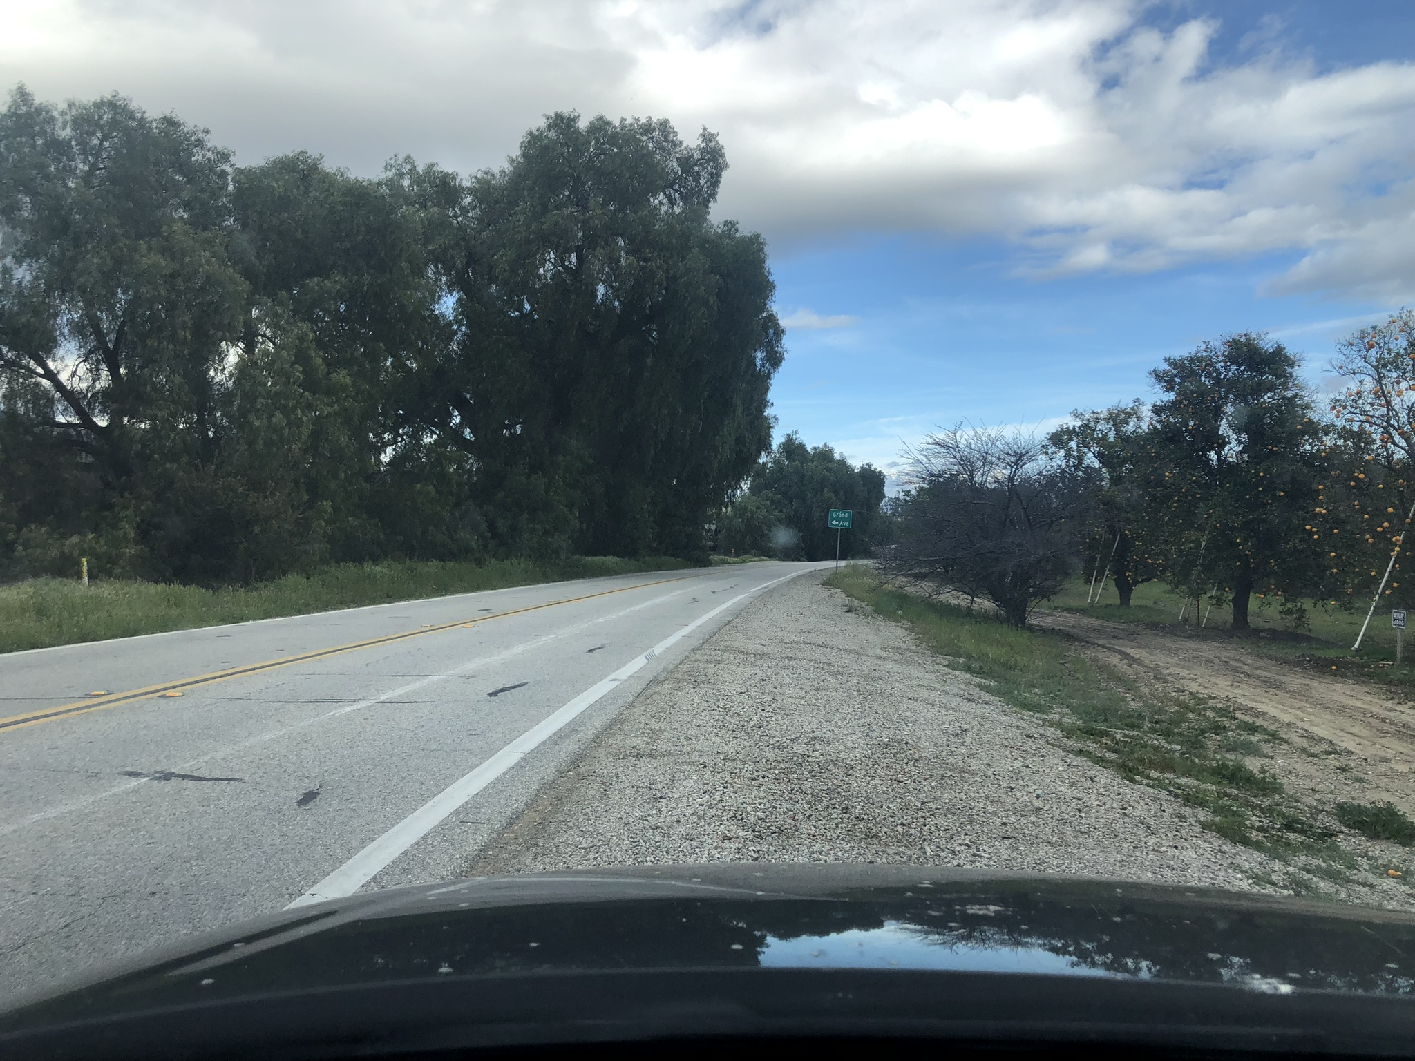
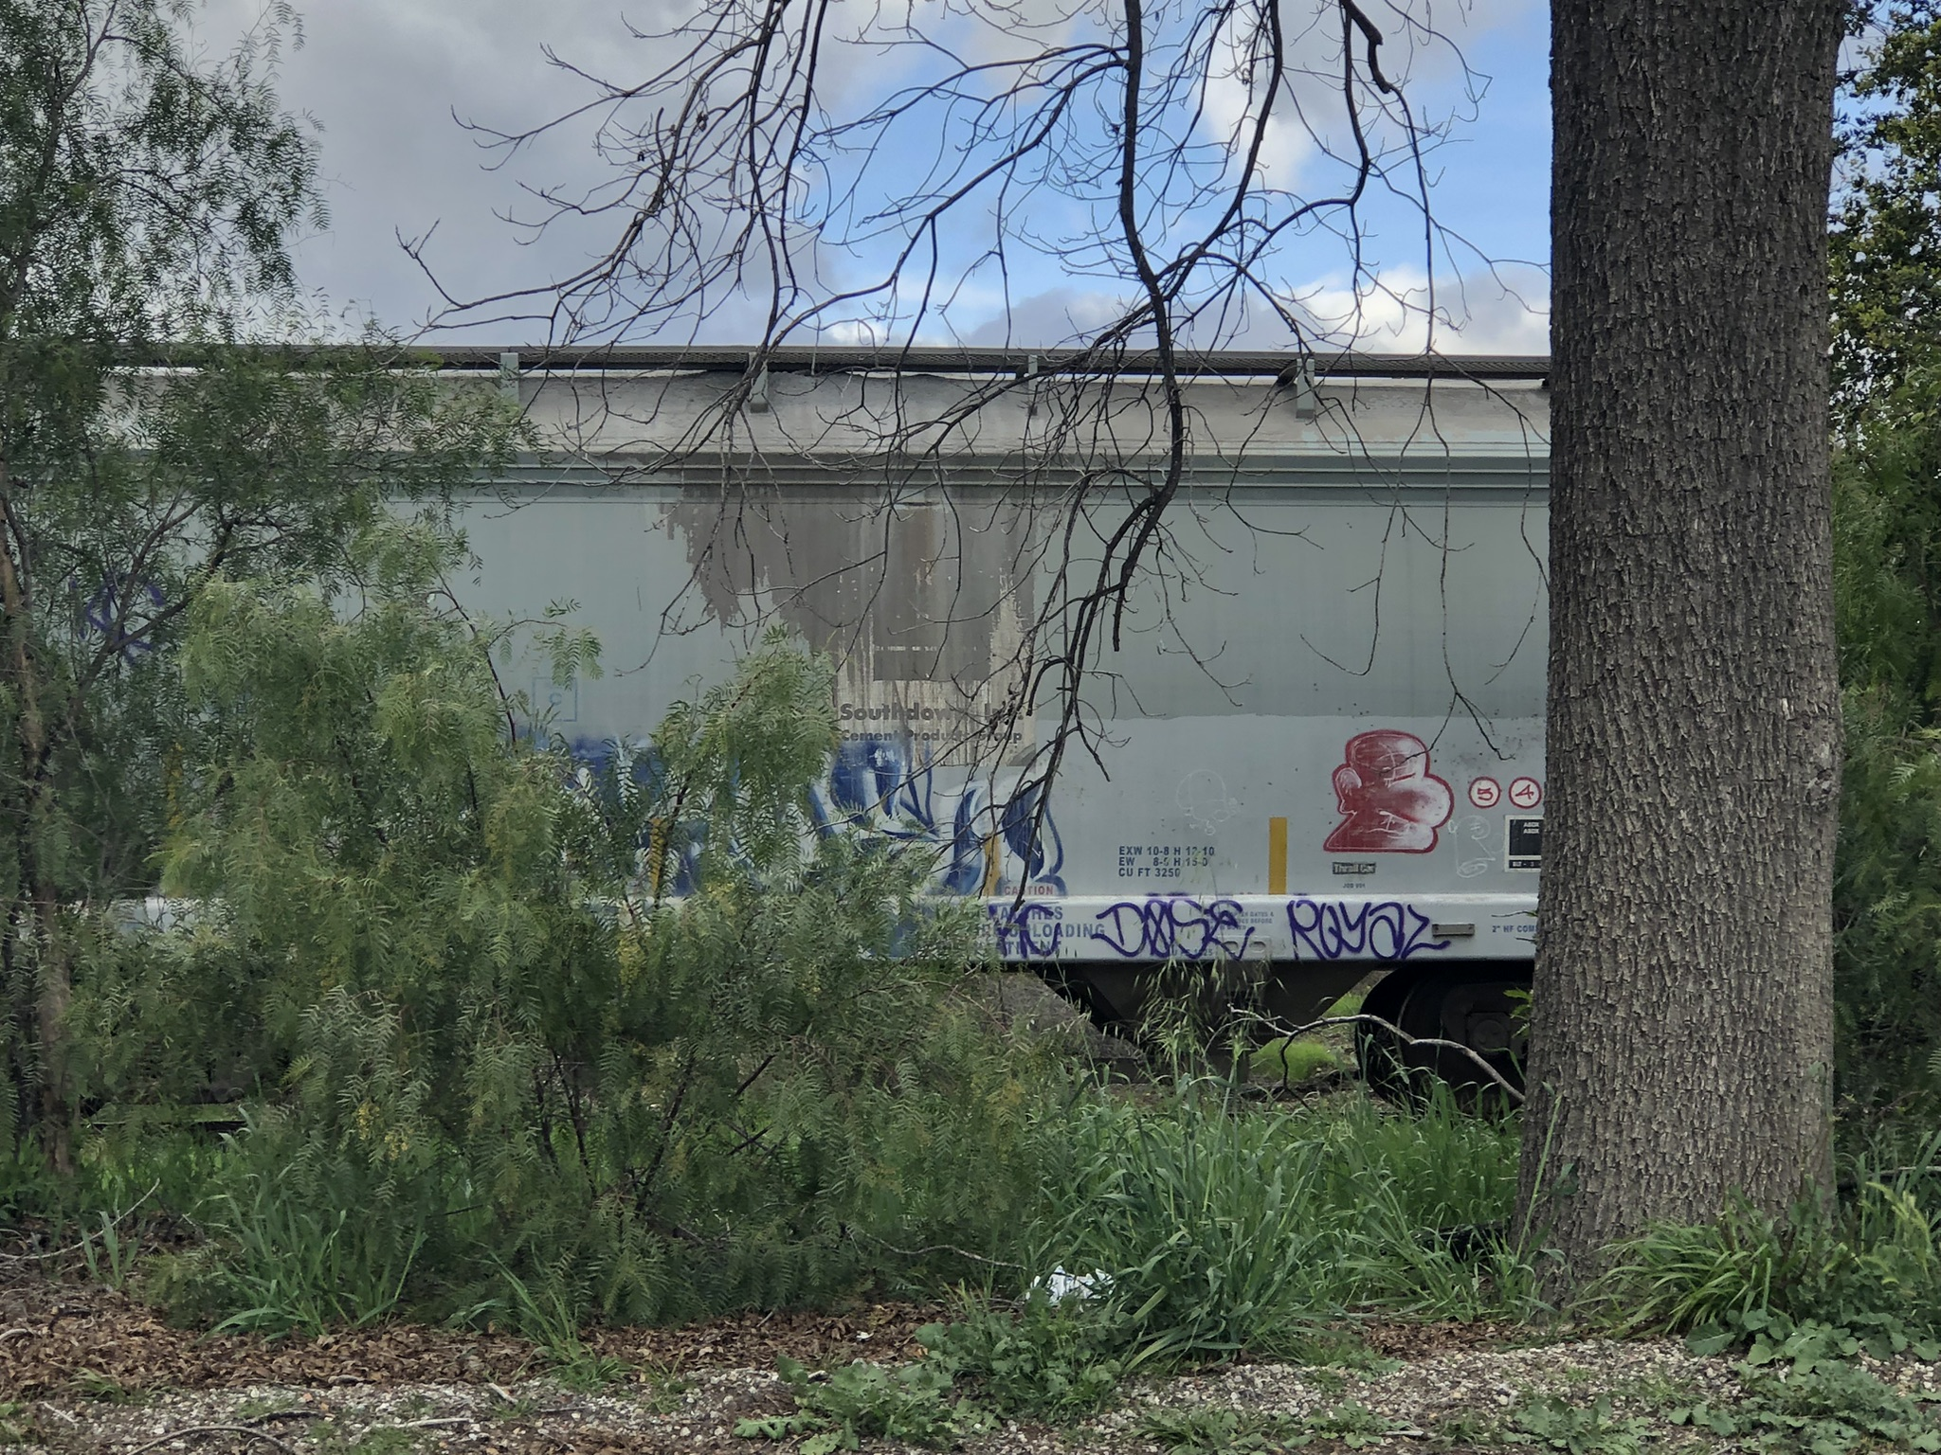
Rail Car Storage
Storage of third-party rail cars
Railroad Lease prohibits Rail Car Storage within incorporated cities and existing communities
Prohibits storage of rail cars containing hazardous materials
Revenue and operational benefits
Temporary storage west of Sespe Creek / Fillmore area
Notes:
At this time, approximately 84 rail cars are stored on the SPBL west of Sespe Creek. VCTC continues a dialogue with Sierra Northern to identify an alternative site for the rail cars until they can be placed back in service by the owner of the rail cars or until the Sespe Bridge reconstruction is completed. Earlier this week, VCTC staff and counsel met with Sierra Railroad, Sierra Northern, and Mendocino Railways to seek a path forward to address community concerns related to rail car storage.
BACKUP
Rail Car Storage refers to rail cars owned by a third party being stored on the SPBL. Rail Car Storage is anticipated to be used in the early stages of Sierra Northern operations to generate revenue while other business lines are further developed. To mitigate the impact of Rail Car Storage, the Agreement prohibits rail car storage within incorporated cities and existing communities as defined by the County of Ventura (namely Saticoy and Piru), or within 150 feet of legal public and private railroad crossings and prohibits Rail Car Storage of rail cars containing hazardous materials.
As a result of the severe winter storms in January 2023 and resulting damage to the Sespe Creek Overflow bridge, approximately 100 rail cars are currently being stored in an unincorporated area west of Fillmore. The storage of these cars is temporary, and every effort is being made to repair the bridge and restore service connectivity in a timely manner to allow the cars to be moved to another less visible location, until the rail cars are placed back in service by their owner.
Passenger and freight rail cars and locomotives owned by Sierra Northern Railway and its sister company, Mendocino Railway, may be parked on the railroad, including within incorporated cities, as part of regular railroad operations. These types of cars are not considered Railroad Car Storage.
Revenue from the storage of rail cars contributes to maintaining and improving the condition of the railroad and right-of-way. Rail car storage also contributes to efficient and safe operations of the national railroad network.

Slide 8
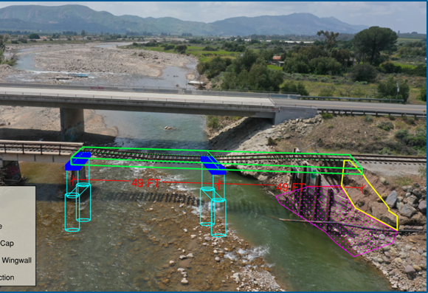
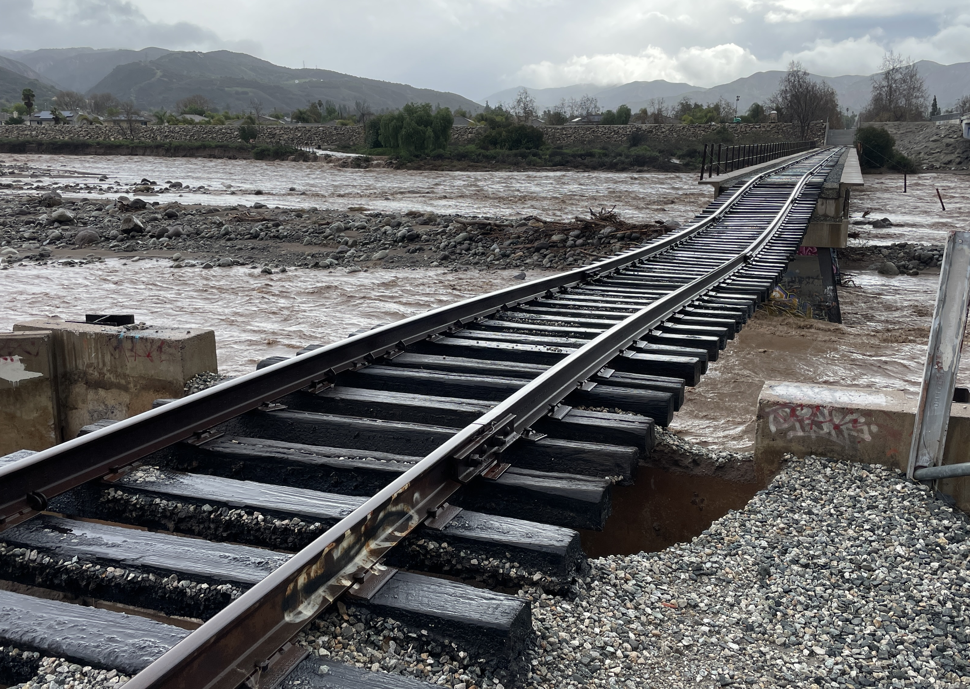
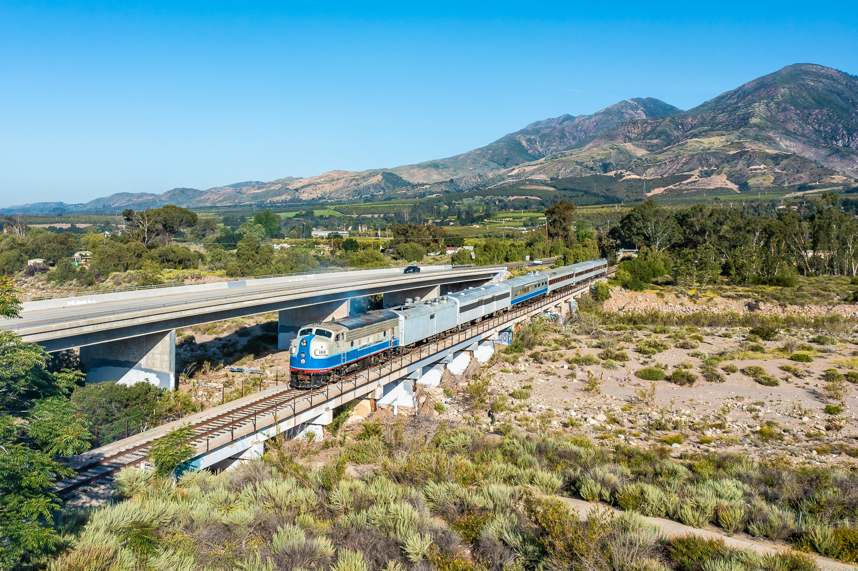
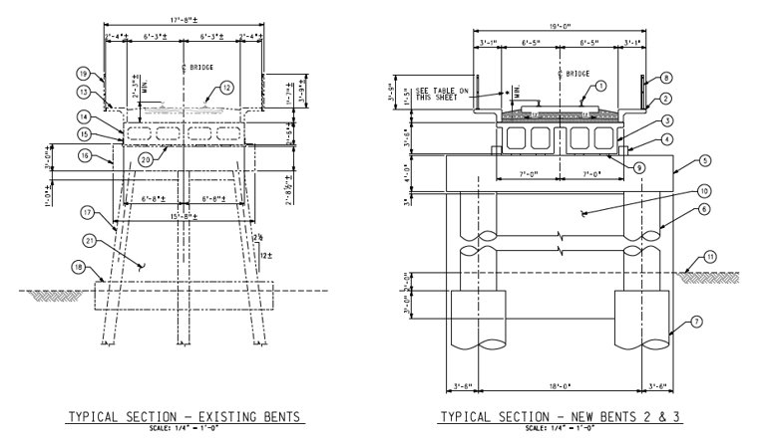
Sespe Creek Overflow Bridge Updates
Design team advancing to next design stage after 30% design review completed
Geotechnical and Hydrological Reports Completed
CEQA Notice of Exemption Filed with Clerk and Recorder on Aug. 24
35-day statute of limitations to challenge determination expired Sept. 28
VCTC & RailPros met with Ventura County Watershed Protection District and Roads & Transportation Department Sept. 25
Site visit with FEMA & CalOES inspectors conducted Sept. 27
Notes:
Planning, Design and Engineering to restore the pre-disaster design, capacity, and function of Sespe Creek Overflow railroad bridge is underway. Geotechnical and Hydrology reports have been completed, and the design team is advancing the design after completion of the 30% design review.
VCTC filed a CEQA Notice of Exemption with the Clerk and Recorder on August 24th. The 35-day statute of limitations to challenge the determination expired on September 28th, with no challenges having been received.
On September 25th, staff and the RailPros design team met with the Ventura County Watershed Protection District and the Public Works Agency Roads & Transportation Department to discuss access and permitting during the construction period.
On September 27th, VCTC staff and Sierra Northern participated in a site visit by the FEMA inspector and representatives of the FEMA and CalOES support teams.
The focus of the design and engineering process is to ensure safe and resilient bridge reconstruction that minimizes impacts to the environment and the community.

Slide 9
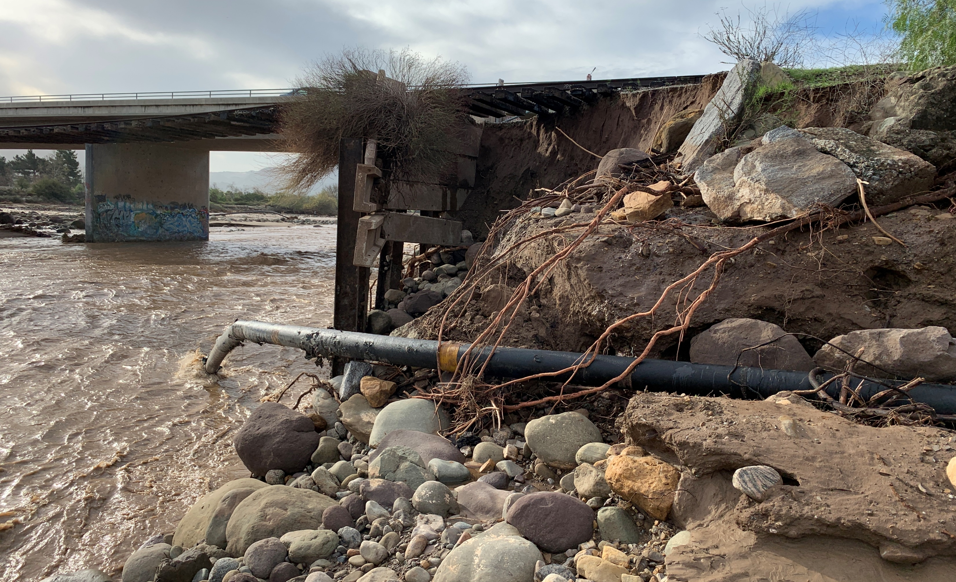
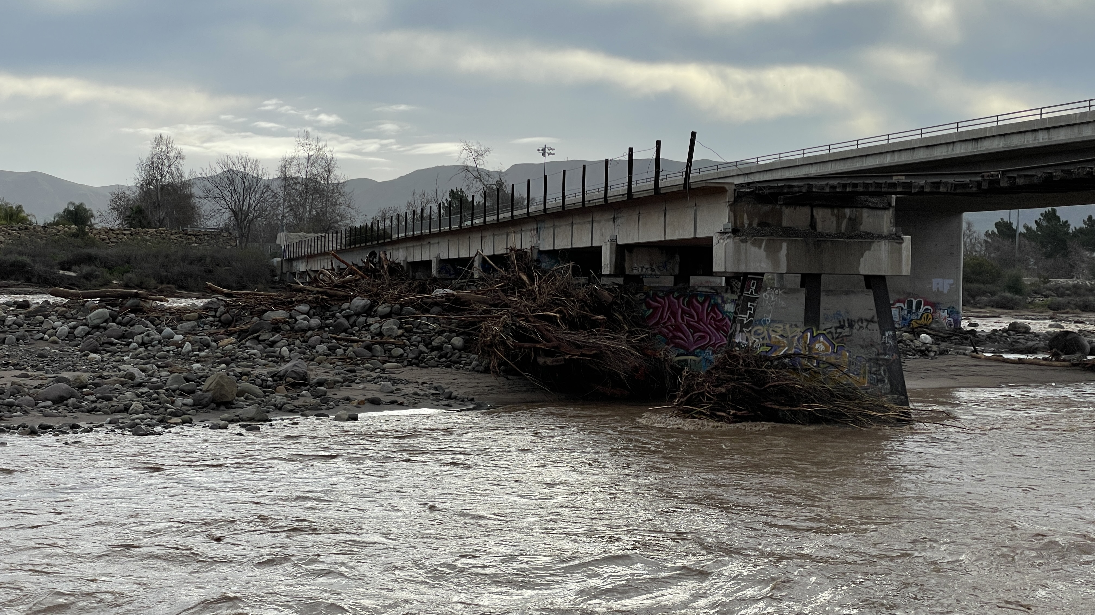
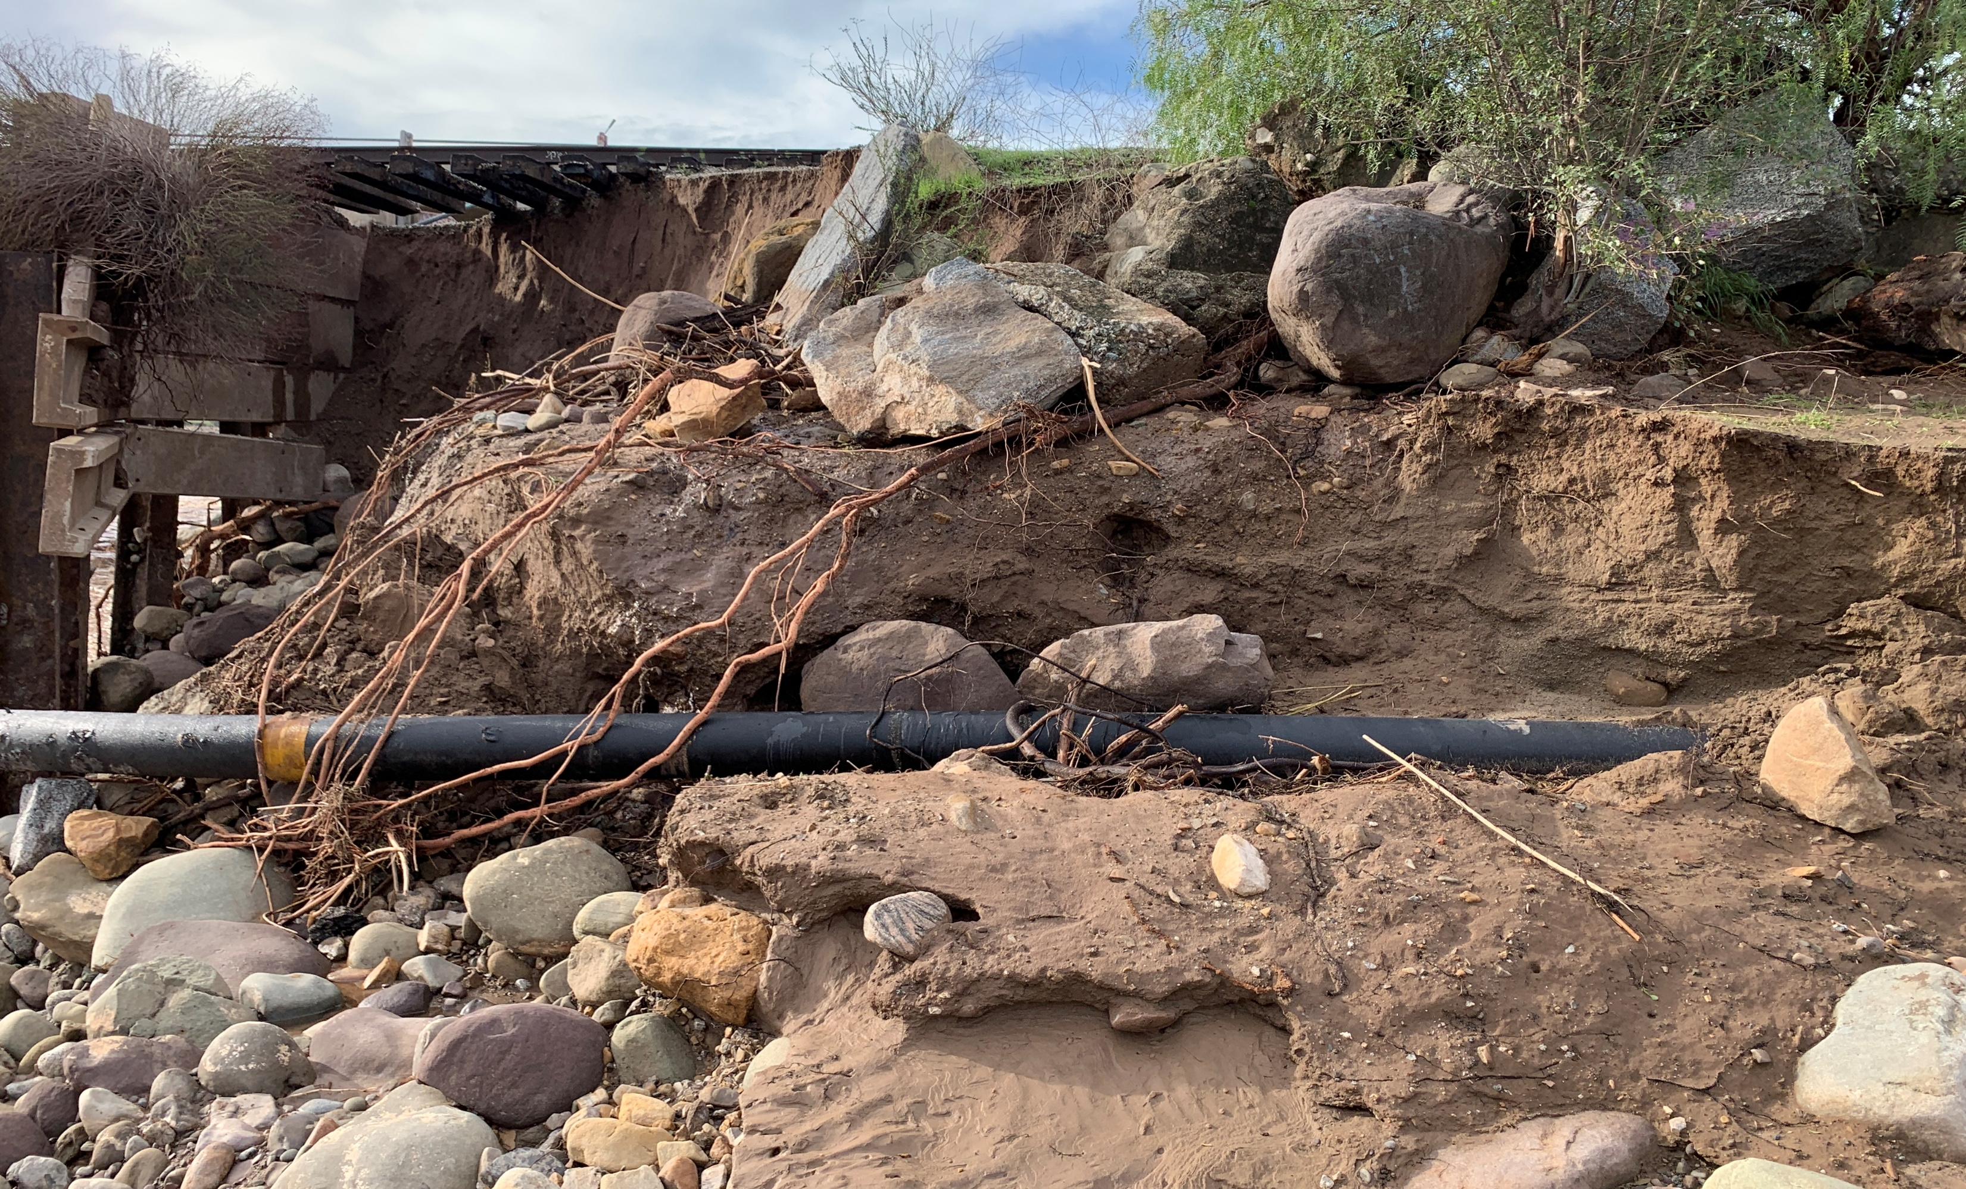
Sespe Overflow Bridge Reconstruction Timeline
Based on field study, environmental, geotechnical and hydrology findings, timeline to complete design with plans & specs (Fall 2023)
Release Request for Proposals for Construction Management Support: Nov./Dec. 2023
Release Request for Bids for Construction Firm: Dec. 2023/Jan. 2024
Construction period: May – Aug. 2024
Notes:
Given the urgent need to restore rail services and repair the bridge, VCTC is conducting an accelerated design and planning phase of the project. The current working schedule is to release a Request for Proposals for Construction Management support in November or December 2023, then to release the Request for Bids for a Construction Firm in the December/January timeframe. The goal is to commence on-site construction in May 2024 to allow construction to occur during the driest period of the year, to avoid and minimize impacts to the watershed. While we had initially hoped to complete reconstruction by the end of this calendar year, the hydrologic, geologic, and environmental conditions of the bridge and watershed are such that the construction window is from May – September.

Slide 10
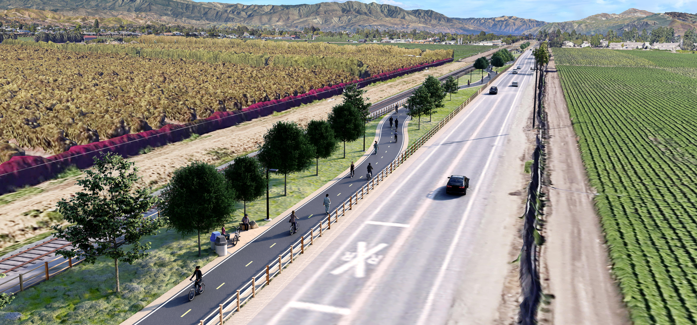
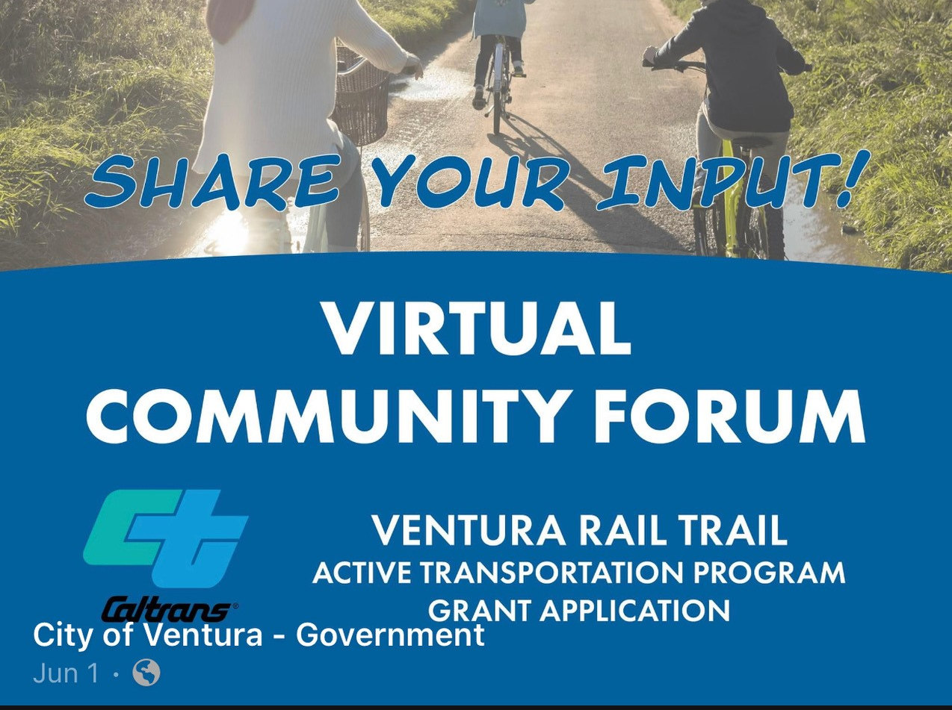
SPBL Trail Planning
April 2022 – Commission adopted goal to “Reinvigorate the process to complete the Santa Paula Branch Line bike trail.”
June 2022 – City of Ventura submitted grant application to Active Transportation Program (ATP) Cycle 6 to construct 4-mile segment from Montalvo to Saticoy; Planning & Design funded through Regional ATP Allocation
Funding to construct 4-miles Ventura trail segment part of successful Solutions for Congested Corridors grant
SCAG REAP 2.0 CTC Partnership Program award to update Master Plan & EIR/EIS
Notes:
In April 2022, the Commission adopted a goal to “Reinvigorate the process to complete the Santa Paula Branch Line bike trail,” and in June 2023, the Commission’s adopted Strategic Plan included an update to the Santa Paula Branch Line trail master plan.
Planning and design for the four-mile section from the East Ventura / Montalvo Metrolink station to Saticoy is included in the regional funding allocation for the Active Transportation Program (ATP) Cycle 6, and in late June, the California Transportation Commission approved funding to construct the trail section as part of a suite of projects that VCTC submitted through the Solutions for Congested Corridors program.
In July, the Southern California Association of Governments awarded a Regional Early Action Planning (REAP) County Transportation Commissions (CTC) Partnership Program grant to VCTC to update the Master Plan and EIR/EIS for the trail from Saticoy to Piru, looking at existing conditions, phasing plans, and cost estimates; trail alignment to better serve housing areas and improve access to transit connections; conduct outreach to disadvantaged communities and neighboring landowners to address any concerns and build support for the project; and to evaluate and make recommendations for lighting and other tools to improve safety, alleviate neighbor concerns, and encourage use of the trail and transit connections. We anticipate bringing a grant award Memorandum of Understanding with SCAG to the Commission for approval at the November meeting.
At yesterday’s Cycle Cal Coast quarterly meeting, the U.S. Department of Transportation’s Volpe Center shared a presentation on Rails with Trails, Mendocino Railway’s President and CEO Robert Pinoli Jr. spoke about the Skunk Train rails with trails project, and VCTC and City of Ventura staff shared updates on our own local rails with trails project along the Santa Paula Branch Line.
BACKUP:
Sierra Northern and its sister companies have a strong history and are supportive of what Sierra refers to as a “Trains with Trails” Approach, combining passenger tourist rail service with bicycle and hiking trails, and even developing trails to complement existing tourist train service. Rather than being an impediment to developing the Santa Paula Branch Line Recreational Trail, Sierra Northern and the proposed Agreement recognize the primacy of the recreational trail.

Slide 11
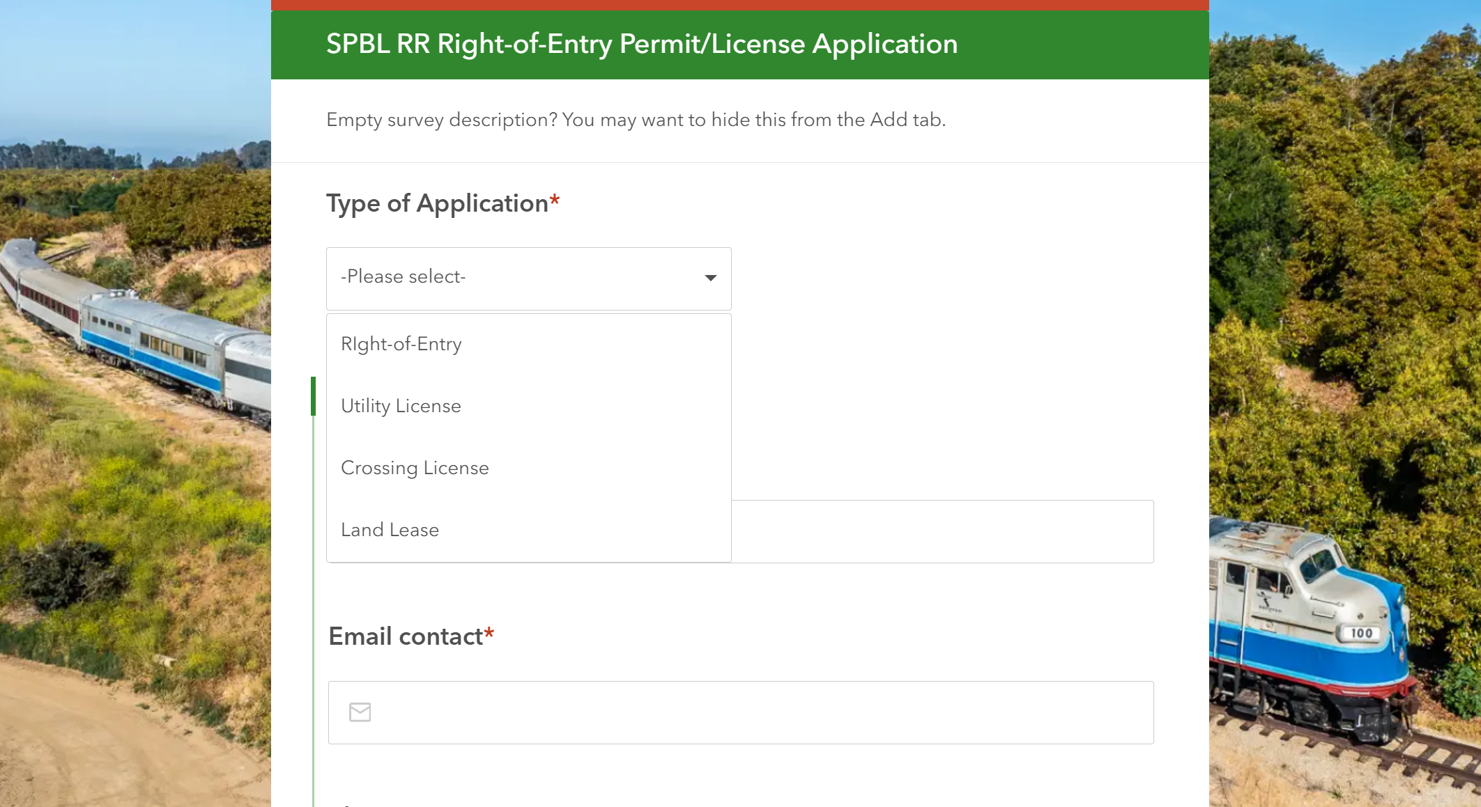
VCTC Administrative Actions for September 2023
7 ROE permits
2 lease reassignments
1 new crossing agreement
1 new utility license agreement
Processing FY 2022/2023 SNR O&M invoices
Coordinated responses by/with SNR to community comments/complaints
Developing new online tool for receiving, tracking, and processing real estate actions on SPBL
DRAFT
Notes:
On the administrative actions side, VCTC staff continue to process rights of entry permits, lease reassignments, crossing agreements, utility license agreements, and invoices. VCTC coordinated with Sierra Northern Railway to respond to reports of trash or weeds on the right-of-way.
Given an increase in the number and complexity of administrative and real estate actions, VCTC staff began development of a new online application to receive, track, and process real estate actions. We are using the same GIS-based software platform that we use for data collection for the Freeway Service Patrol and implementation of the Trespass Removal Policy. Our hope is that the tool will simplify and standardize the real estate process for the Branch Line.

Slide 12
SPBL Next Steps / To Do List
Complete review and payment of FY 2022/2023 invoices from Sierra Northern Railway
Review and approve Sespe Creek Overflow Bridge Design & Permits
Prepare SOW & RFP for Record of Deed Survey procurement
Finalize SOW & RFP for Sespe Creek Overflow Bridge Construction Management procurement
Prepare SOW & RFB for Sespe Creek Overflow Bridge Construction procurement
Continue to prepare and submit FEMA Project documentation and request for reimbursement
Multilingual rail safety outreach materials
Finalize MOU, SOW and Prepare RFP for SPBL Trail Master Plan Update & EIR/EIS
Secure Commission Approval of new Right of Entry Permit Template & Process
Continue to process ROE permits, leases, licenses, and crossing agreements
Continue to address neighbor complaints and encroachment issues along SPBL
Negotiate/execute any Commission-directed amendments to the Railroad Lease and Operations Agreement
Procure Plan Check & Engineering Review services for review of County Broadband project plans
Notes:
To give you a sense of ongoing and upcoming administrative and program management tasks for the Branch Line, this slide contains my running to-do list.

Slide 13
QUESTIONS?
Notes:
With that, I will be happy to answer any questions you may have. I also understand that we have several public speakers on this item.

