Slide 1
Ventura County Airport Land Use Commission
General Plan Amendment 2019-1
City of Camarillo
Airport Land Use
Consistency Determination
September 8, 2023
Responsible Staff: Amanda Fagan,
Director of Planning & Sustainability
Notes:
Good Morning Chair MacDonald and Members of the Commission. For the record, my name is Amanda Fagan, and I serve as the Director of Planning and Sustainability for VCTC.
The item before you includes Airport Land Use Commission review, public hearing, and consistency determination for the City of Camarillo General Plan Amendment 2019-1 Consistency Review and Determination.

Slide 2
Airport Land Use Commission
CAL. Pub. Util. Code 21670 calls for orderly development of CA airports and the surrounding areas and establishes the creation of Airport Land Use Commissions (ALUC)
VCTC was designated the ALUC by the Ventura County Board of Supervisors
2 Guidance Documents
Ventura County Airport Comprehensive Land Use Plan (ACLUP)
Caltrans Division of Aeronautics, California Airport Land Use Planning Handbook
Notes:
VCTC is the designated Airport Land Use Commission for the four public, private, and military airports in Ventura County. Two primary documents guide review and determinations by the Airport Land Use Commission, including the Ventura County Airport Comprehensive Land Use Plan or ACLUP, which serves as the airport land use compatibility plan for Ventura County, and the Caltrans Division of Aeronautics’ California Airport Land Use Planning Handbook.

Slide 3
Airport Land Use Commission Overview
State Aeronautics Act (SAA) requires general plan amendment or zoning ordinance adoption within airport influence area first be referred to the ALUC for a determination as to whether the proposed action is consistent with the ALUCP
SAA requires that County and City General Plans and applicable specific plans “shall be consistent” with an adopted ALUCP and any amendments within airport influence are must be referred to ALUC for consistency determination
If ALUC determines that proposed action is not consistent, local agency may only overrule with a 2/3 determination
Notes:
The State Aeronautics Act (SAA) requires that a general plan amendment or adoption of a zoning ordinance within the airport influence area must first be referred to the Airport Land Use Commission for a determination as to whether the proposed action is consistent with the adopted airport land use compatibility plan and requires that County and City General Plans and applicable specific plans “shall be consistent” with an adopted ALUCP. If the ALUC determines that a proposed action is not consistent, the local agency may overrule the decision with a 2/3 vote of its elected body.
As discussed in the Staff Report, Airports in the United States are part of a national system regulated and supported by the Federal Aviation Administration (FAA) known as the National Plan of Integrated Airport Systems. Airports within this system receive financial support from the FAA to operate and must meet grant assurances that include maintaining free and fair public access and taking reasonable action to prevent incompatible land uses surrounding the airport. Airport Land Use Commission review of local plans and proposed development is part of the process to prevent incompatible land uses.

Slide 4
Camarillo General Plan Amendment 19-1
August 16, 2023- City of Camarillo referred General Plan Amendment (GPA) 2019-1 to the ALUC for a consistency review on behalf of applicant RIC (Springville) LLC
Consists of 48.88 acres located north of Camarillo Airport
Bounded by Ventura Blvd to the west, Springville Rd to the east, U.S. 101 to the north and Camarillo Airport to the south
Notes:
The property is located within the Camarillo Airport influence area, which requires an analysis of the proposed land use according to Noise and Safety standards of the Ventura County Airport Comprehensive Land Use Plan. The following provides additional background and analysis of the proposed General Plan Amendment relative to the Ventura County ACLUP.

Slide 5
Existing and Proposed Land Uses
Property is currently vacant
In 2016, the property was rezoned from Limited Manufacturing (L-M) to Commercial Planned Development (CPD) and L-M
The proposed action (GPA 2019-1) would return the property to Limited Manufacturing zoning in both the General Plan and Airport North Specific Plan
The General Plan designation will remain Research & Development and does not change with the proposed action
No development plans are proposed at this time, and only the zoning is proposed to change
Notes:
The property is currently vacant. In 2016, the property was rezoned from Limited Manufacturing (L-M) to Commercial Planned Development (CPD) and L-M. The proposed action (GPA 2019-1) would return the property to Limited Manufacturing zoning in both the General Plan and Airport North Specific Plan. The General Plan designation will remain Research & Development and does not change with the proposed action. No development plans are proposed at this time, and only the zoning is proposed to change.

Slide 6
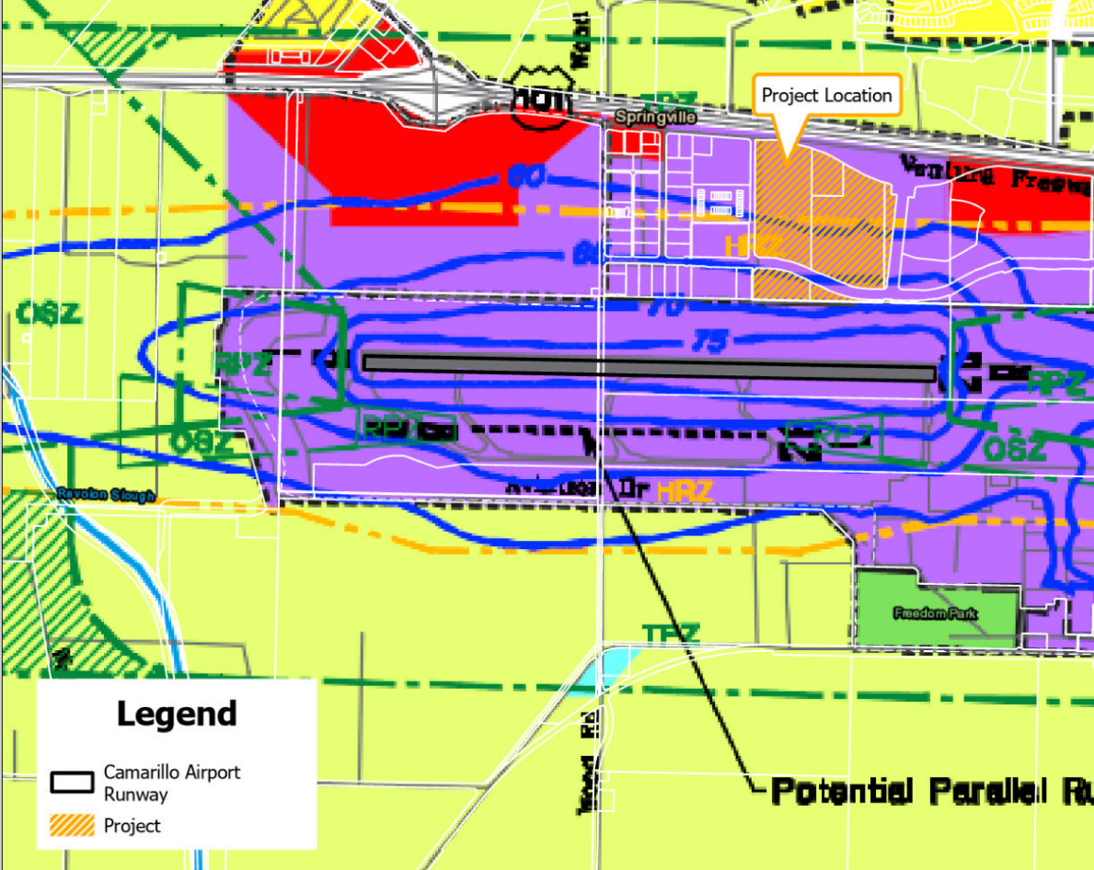
Noise Zone Compatibility
Southern portion (approx. ¼ of the property) of the property located within the 65-70 dB CNEL contour
Middle portion of the property within the 60-65 dB CNEL contour
Northern portion (approximately ½ of the property) beyond the 60 dB CNEL contour
Notes:
The property is located within the Camarillo Airport influence area, which requires an analysis of the proposed land use according to Noise and Safety standards of the Ventura County Airport Comprehensive Land Use Plan.
Airport land use compatibility with respect to Noise is measured in decibels (dB) and evaluated based on modeled Community Noise Equivalent Level (CNEL) contours.
The southern portion (approximately ¼ of the property) of the property is located within the 65-70 dB CNEL contour, with the middle portion of the property within the 60-65 dB CNEL contour, and the northern portion (approximately ½ of the property) beyond the 60 dB CNEL contour.
According to the Ventura County ACLUP, Manufacturing, Light Industrial, and Research and Development land uses are considered Acceptable within the 60-65 dB and 65-70 dB CNEL contours.
The General Plan land use and proposed zoning designation are consistent with the ACLUP from a noise perspective.

Slide 7
Safety Zone Compatibility
Entire property located within Traffic Pattern Zone (TPZ) for Camarillo Airport
Southern portion located within Height Restriction Zone (HRZ)
Manufacturing, Light Industrial, and Research and Development land uses considered Conditionally Acceptable within TPZ provided that max structural coverage not more than 50%
An avigation easement, fair disclosure agreement, and covenant to be recorded by the owner and developer of the property are also recommended
GPA 2019-1 does not propose development plans or structures at this time
Structural coverage defined as percent of building footprint area relative to total land area, inc. streets and greenbelts
Notes:
From a Safety standpoint, the subject property is located entirely within the Traffic Pattern Zone (TPZ), and the southern portion of the property is located within the Height Restriction Zone (HRZ) for Camarillo Airport..
Per the ACLUP, Manufacturing, Light Industrial, and Research and Development land uses are considered Conditionally Acceptable within the TPZ provided that the maximum structural coverage of the site is not more than 50 percent.
An avigation easement, fair disclosure agreement, and covenant to be recorded by the owner and developer of the property are also recommended. Structural coverage is defined as the percent of building footprint area relative to the total land area, including streets and greenbelts.
Within the Height Restriction Zone, future site planning would need to consider the “imaginary surfaces” surrounding the airport runway to establish a maximum height for structures to ensure safety of flight operations. Imaginary surfaces define an airport’s airspace and extend outward and upward at a defined slope from the airport’s runway. At a ratio of 7:1 (for every 7 feet of horizontal distance, maximum structure height would be 1 foot), the maximum structure height at the southern border would be approximately 85 feet tall. At 1,500 feet of horizontal distance, the maximum structure height would be approximately 215 feet. The existing Airport North Specific Plan and the L-M Zoning Code require any buildings within this property taller than 35’ in height to have a Conditional Use Permit and verified consistency with the Camarillo Airport HRZ.
GPA 2019-1 does not propose any development plans or structures at this time. However, future plans for the site should incorporate TPZ and HRZ considerations and include maximum structural coverage and maximum building heights to ensure consistency with the ACLUP. The City of Camarillo’s Zoning Code for the L-M zone allows no more than 50% structural coverage and is consistent with structural coverage limitations within the TPZ.

Slide 8
City of Camarillo Conditions of Approval
Conditions of approval for future development to ensure compatibility with the ACLUP may include:
Commercial / Industrial structural coverage of no more than 50 percent.
Grant an Avigation Easement to the County of Ventura.
Fair Disclosure agreement and covenant.
File FAA Form 7460-1 (and adhere to any recommendations), if applicable.
Notes:
Future development plans should include conditions of approval to address structural coverage limits, avigation easements and fair disclosure agreements and covenants to address overflights and any residual noise concerns, maximum building/structure heights, and to avoid other hazards to aviation (such as bird/wildlife attractants, light and glare, etc.).
The City of Camarillo routinely applies Project Conditions of Approval to all projects near the airport that require compliance with Camarillo Airport Master Plan and FAA regulations and requirements to ensure that compatibility with airport operations is maintained.

Slide 9
Agency Reviews
Date TBD - Project will next be considered for approval by the Camarillo Planning Commission and Camarillo City Council
Notes:
In addition to this review by the ALUC, the GPA will next be considered by the Camarillo Planning Commission and the Camarillo City Council.

Slide 10
Staff Recommendation
Proposed GPA zoning change meets noise and safety compatibility standards
Existing protections within the Airport North Specific Plan require compatibility with airport operations
Staff recommends that the ALUC determine that the proposed project is consistent with the ACLUP
Notes:
Given that the proposed action to rezone the property to Limited Manufacturing meets noise and safety compatibility standards, and existing protections within the Airport North Specific Plan require compatibility with airport operations as described in the staff report, staff recommends that the ALUC determine that the proposed action is consistent with the ACLUP.

Slide 11
Questions?
Notes:
Representatives of the City of Camarillo are here to help answer any questions you may have.
Thank you for your time and attention.

