Slide 1
Ventura County Transportation Commission
VCTC Intercity and Valley Express Rider Survey
July 2023

Slide 2
Project Summary
Survey objectives included:
Identify travel habits and trip characteristics;
Develop passenger demographic profiles;
Determine current levels of customer satisfaction; and
Identify passenger fare payment characteristics, including types of passes used.
837 Valid Surveys:
VCTC Intercity – 755
Valley Express - 82

Slide 3
VCTC Intercity Rider Survey Results
Key findings from the VCTC Intercity Rider Survey:
Most respondents (96.4 percent) indicated being satisfied with the Intercity service.
Most respondents indicated that they pay their fare using cash (39.8 percent)
The most preferred service improvement for Intercity riders is “more frequent service”. This was the same in 2019.
The majority of respondents are regular riders with 58.9 percent indicating they ride at least 3 days per week.
Most respondents were under the age of 35 (52.6 percent), identified themselves as Hispanic/Latino (54.7 percent), indicated speaking English very well (81.8 percent) and reported an annual income of less than $30,000 (51.9 percent).

Slide 4
VCTC Intercity Transit Service: Fare Payment Options

Slide 5
VCTC Intercity Transit Service: New Destinations
Are there any destinations not currently served by VCTC Intercity that you would like to see served in the future?
Los Angeles (Woodland Hills/Warner Center/Chatsworth) | 20 | 16.9%
Oxnard Transit Center | 12 | 10.2%
Ventura Harbor/Beach during the week | 10 | 8.5%
Santa Clarita | 7 | 5.9%
Ojai | 6 | 5.1%

Slide 6
VCTC Intercity Transit Service: How to Ride

Slide 7
VCTC Intercity Transit Service: Public Transit Use
Do you use other public transit in Ventura County?
No | 34.8%
Gold Coast Transit | 40.7%
Thousand Oaks Transit | 8.1%
Simi Valley Transit | 5.0%
Valley Express | 5.0%
Camarillo Area Transit | 8.2%
Moorpark City Transit | 3.2%
Metrolink/Amtrak | 32.5%
Ojai Trolley | 0.1%
Other | 1.7%

Slide 8
VCTC Intercity Transit Service: Passenger Age

Slide 9
Valley Express Rider Survey Results
Key findings from the Valley Express Rider Survey:
Most respondents (91.1 percent) indicated being satisfied with the Valley Express service.
Most respondents indicated that they pay their fare using cash (48.8 percent).
The most preferred service improvement for Valley Express riders is “more frequent service”.
The majority of respondents are regular riders with 31.6 percent indicating they ride every day and another 34.2 percent indicating they ride at least 3 days per week.
Slightly more than 40 percent (40.2) of Valley Express riders indicated they also ride VCTC Intercity.
Most respondents indicated being unaware of the VCbuspass program with only 12.2 percent stating that they use the card or app to pay for their fare.
Most respondents were over the age of 35 (50 percent), Identified as Hispanic/Latino (70.7 percent), and speak Spanish at home (59.2 percent) but speak English very well (75.8 percent) and reported an annual income of less than $30,000 (65.9 percent).

Slide 10
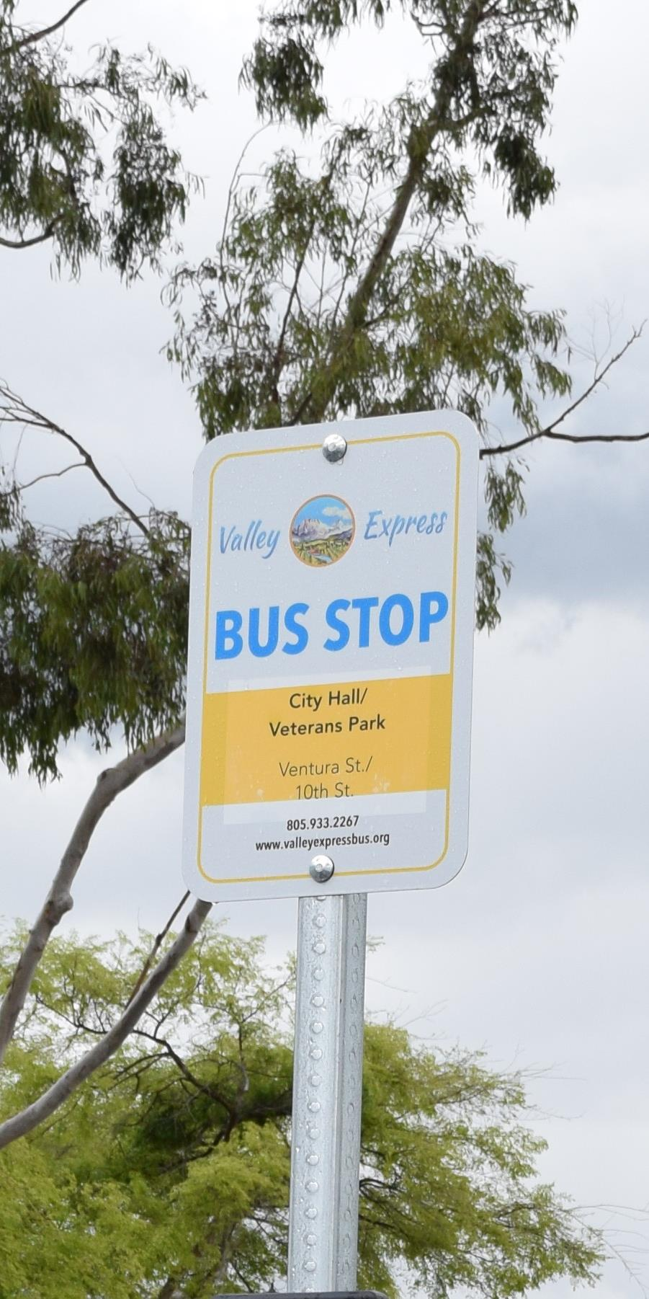
Valley Express: Fillmore to Moorpark Route

Slide 11
Valley Express: Reason for Riding

Slide 12
Valley Express: Passenger Age

Slide 13
Questions?

