Slide 1
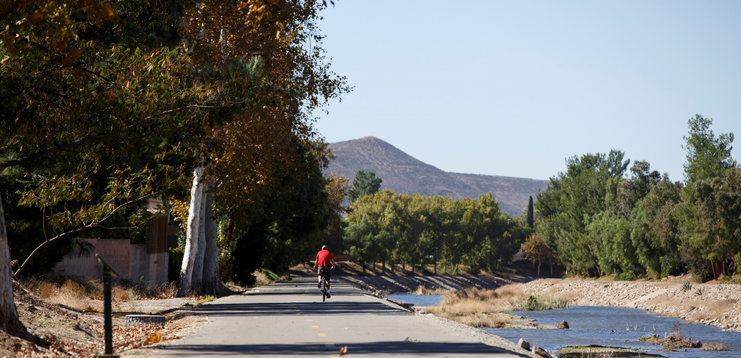
VCTC Rideshare Update
July 7, 2023

Slide 2
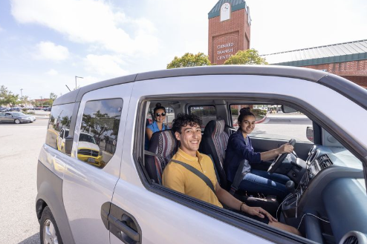
Rideshare
Rideshare program aims to reduce single occupancy vehicles through carpooling, vanpooling, teleworking, biking, and transit options
VCTC engages in the Regional Rideshare program, partnering with neighboring counties to provide resources, including the RideMatch database for ridematching and commuting data helpful for employees, employers, and VCTC
Teleworking resources and marketing campaigns, such as Bike to Work Week, are also part of the Rideshare program

Slide 3
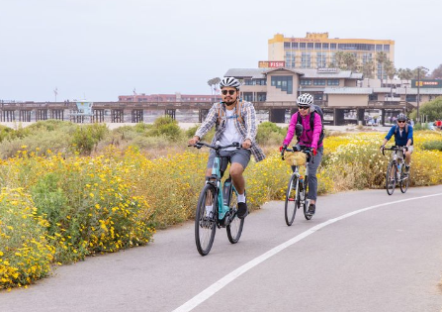
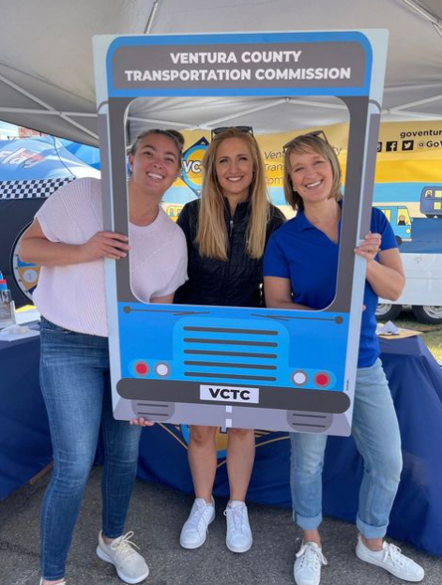
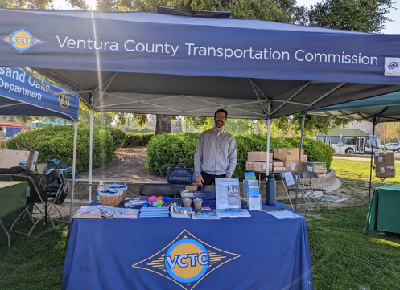
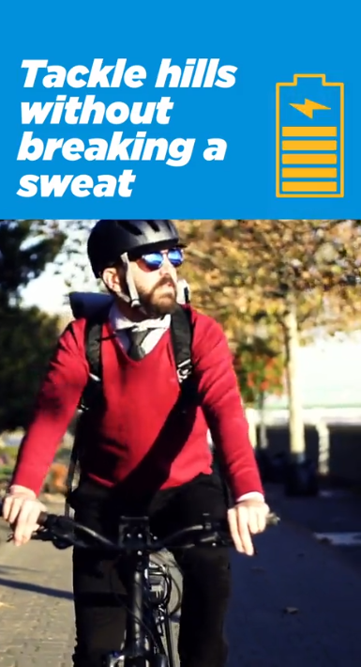
Marketing Efforts
Bike to Work Week
Rideshare Week
Teleworking resources and tips during the pandemic
Highlighting bike trails and ensuring driver-biker safety.
Upcoming bike safety campaign

Slide 4
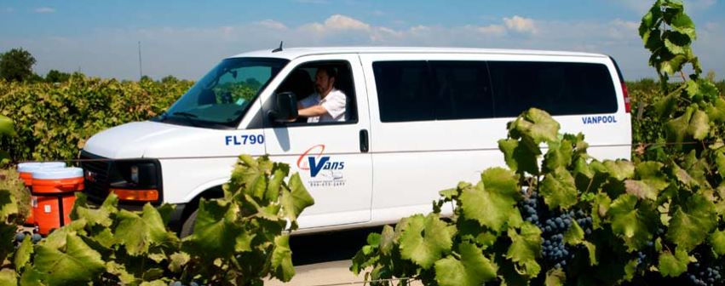
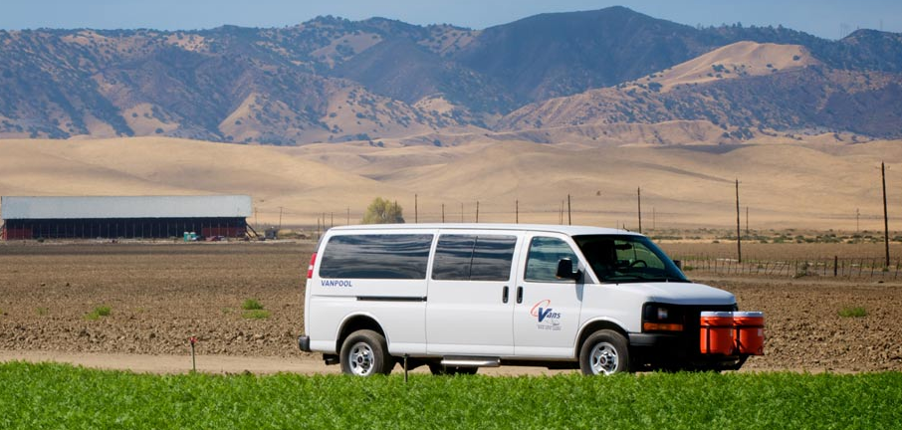
CalVans
VCTC supports vanpooling through CalVans JPA and plans to enhance vanpooling information in the RideMatch database. Provides comprehensive services, reducing congestion, pollution, and saving money.
Agricultural vanpool ridership has significantly recovered since the pandemic, with 81 vanpools currently running in Ventura County.
Exploring new vanpool opportunities with organizations like Oxnard College Cares and SwapMeet Justice.
CalVans is acquiring electric vans for residents of Many Mansions and Santa Buena Ventura Housing Authority facilities

Slide 5
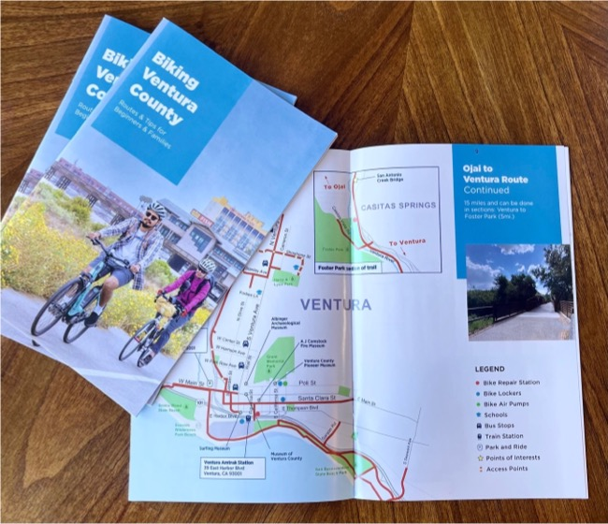
Bikes
Extensive Bike Lane Network: Ventura County offers over 550 miles of bike lanes, including 480 miles of Class 1 or 2 lanes.
Convenient Bike Repair Stations: There are 18 bike repair stations available throughout the county.
Beginner and family-friendly bike map with shared-use paths, separated bike lanes, and key destinations. Provides safety tips, instructions for bikes on transit, and e-bike rules
Most buses and passenger trains can accommodate bicycles, with fixed route buses typically offering space for 3 bikes

Slide 6
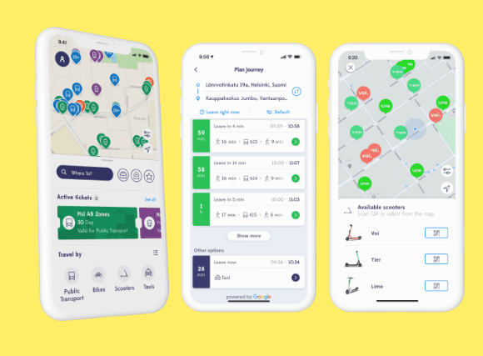
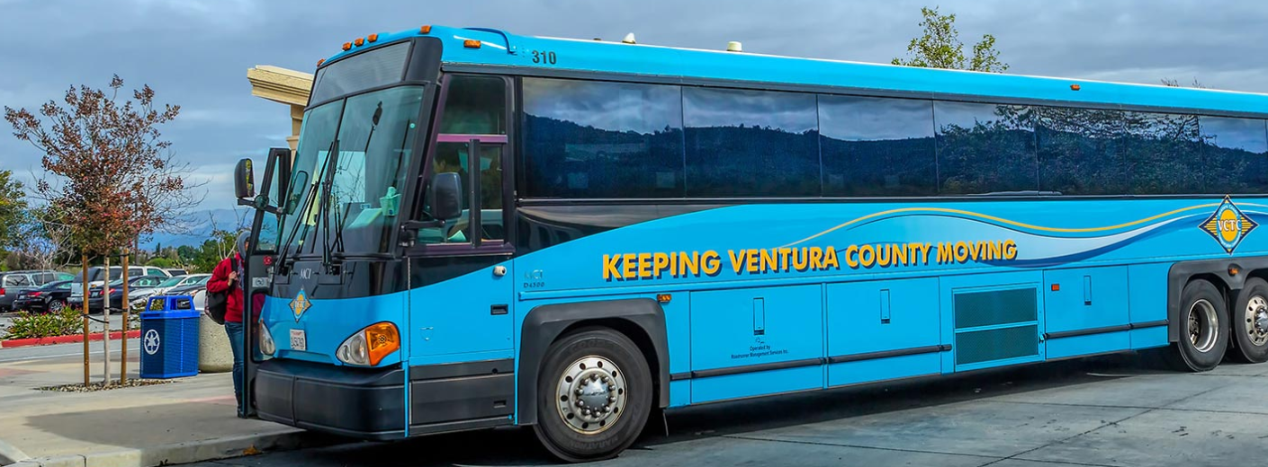
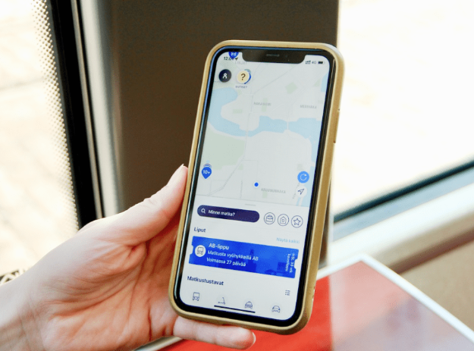
Mobility as a Service (MaaS)
Create an innovative approach to transit, addressing declining ridership and changing mobility needs in Ventura County
Comprehensive digital app for proposed Pilot Mobility Program: Trip planning, fare purchasing, multiple mobility choices. Integrates data from Google Maps and VCTC's Transportation Analytics Pilot Program. Book and pay for services, balanced fixed routes and demand response transit.
Benefits and goals are to increases public transit ridership, improve air quality, reduce congestion, and provides valuable trip data for better route planning
VCTC projects $1 million for the program, utilizing existing platforms, designing APIs, recruiting volunteers, implementing communication campaigns, and considering incentives to attract initial users
VCTC Represents entire Ventura County, strong partnerships, promotes public-private participation and rewards for non-SOV travel.

Slide 7
Guaranteed Ride Home (GRH)
The GRH program offers a free emergency ride home to ridesharers, ensuring peace of mind in case of unforeseen circumstances.
In July 2021, VCTC made updates to the program, including expanding allowable transportation options to include TNCs like Uber and Lyft, adding natural disasters as approved situations, and incorporating walking and biking as modes of travel.
Changes were made to the program's reimbursement process, discontinuing voucher payments and reimbursing rides directly to the payer (participant or employer)
VCTC plans to market the GRH program to the general public this fiscal year to raise awareness and encourage more people to participate in ridesharing.

Slide 8
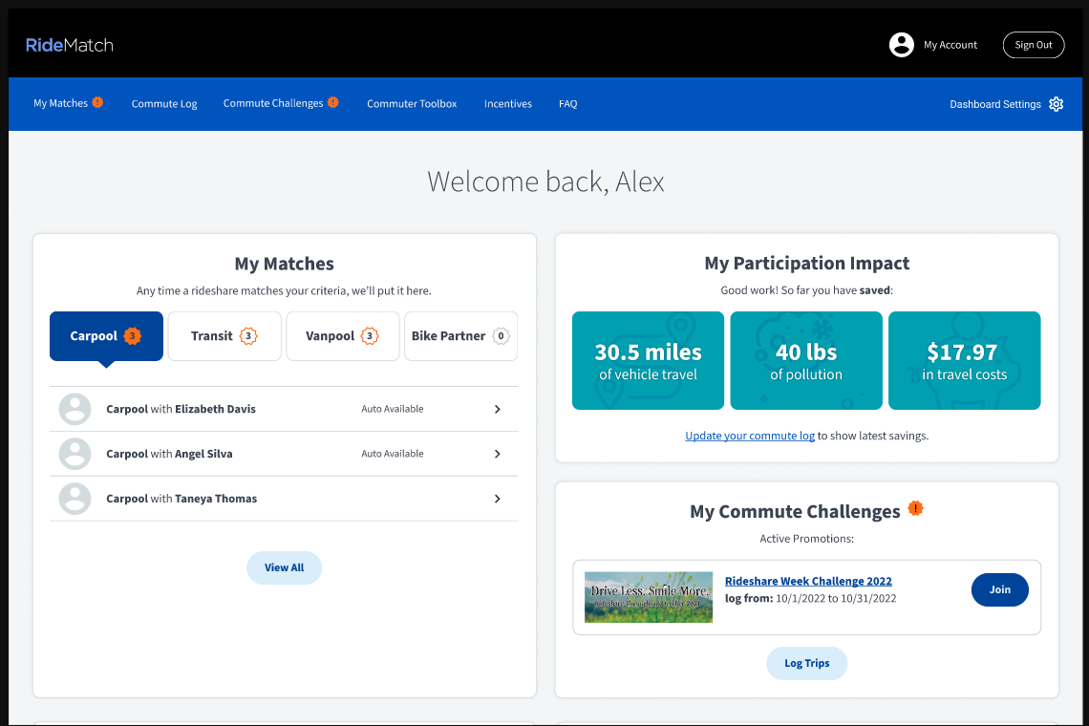
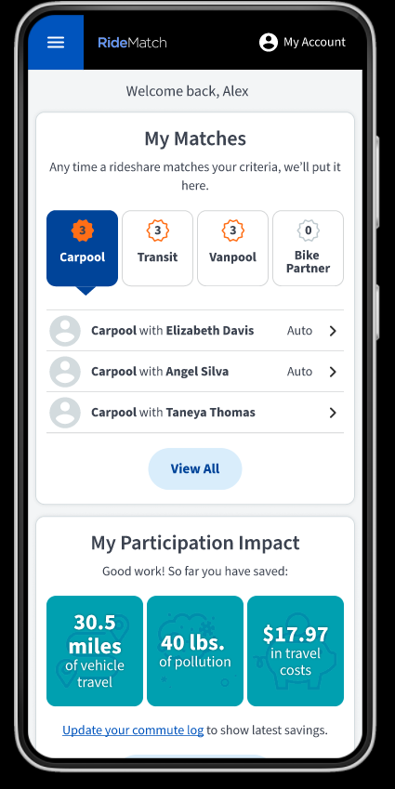
Support to Employers
VCTC supports employers through the RideMatch database, providing ridematching, biking partners, transit directions, and employee commuting data, helping employers comply with APCD Rule 211.
VCTC offers resources and webinars to support companies with teleworking policies and teleworkers, fostering flexible work arrangements

Slide 9
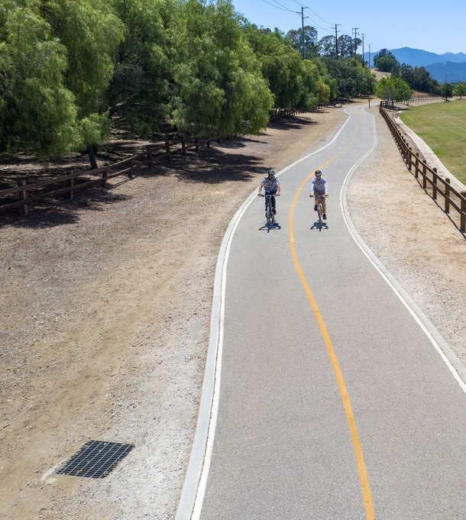
“You are one ride away from a good mood.”
Sarah Bentley, Cyclist
Biking
Ventura
County
Questions?

