Slide 1


Service Authority for Freeway Emergencies
  Freeway Service Patrol
  2nd Year Anniversary Report &
  Driver of the Year Recognition
  May 12, 2023
Notes:
Good Morning Chair MacDonald and Members of the Commission. Andrew Kent Planning Analyst for VCTC.
I have a brief presentation for you on FSP 2nd Year Anniversary Report & Driver of the Year Recognition for 2022

Slide 2
FSP Overview & Scope
24th California County to provide FSP services
Partnership between Caltrans, CHP, and SAFE
Fleet of continuously roving tow trucks
Operate during peak-traffic, morning and afternoon
Assist motorists, remove debris, tow disabled vehicles
Types of FSP services provided:
  Jump starts
  Provide a gallon of gas
  Refill radiators
  Change a flat tire
10 minutes per assist
Tow to an approved drop point
All services are provided at no charge to the motorist
Notes:
Two years ago, VCTC launched the Freeway Service Patrol, and Ventura county became the 24th program in CA
The program in partnership between Caltrans, California Highway Patrol and local SAFE
FSP consists of a fleet of continuously roving tow trucks on congested highway segments during peak traffic periods which provide rapid response to disabled vehicles, debris and collisions.
The programs' goal is to reduce congestion and secondary accidents
All services are provided at no charge to the motorist

Slide 3
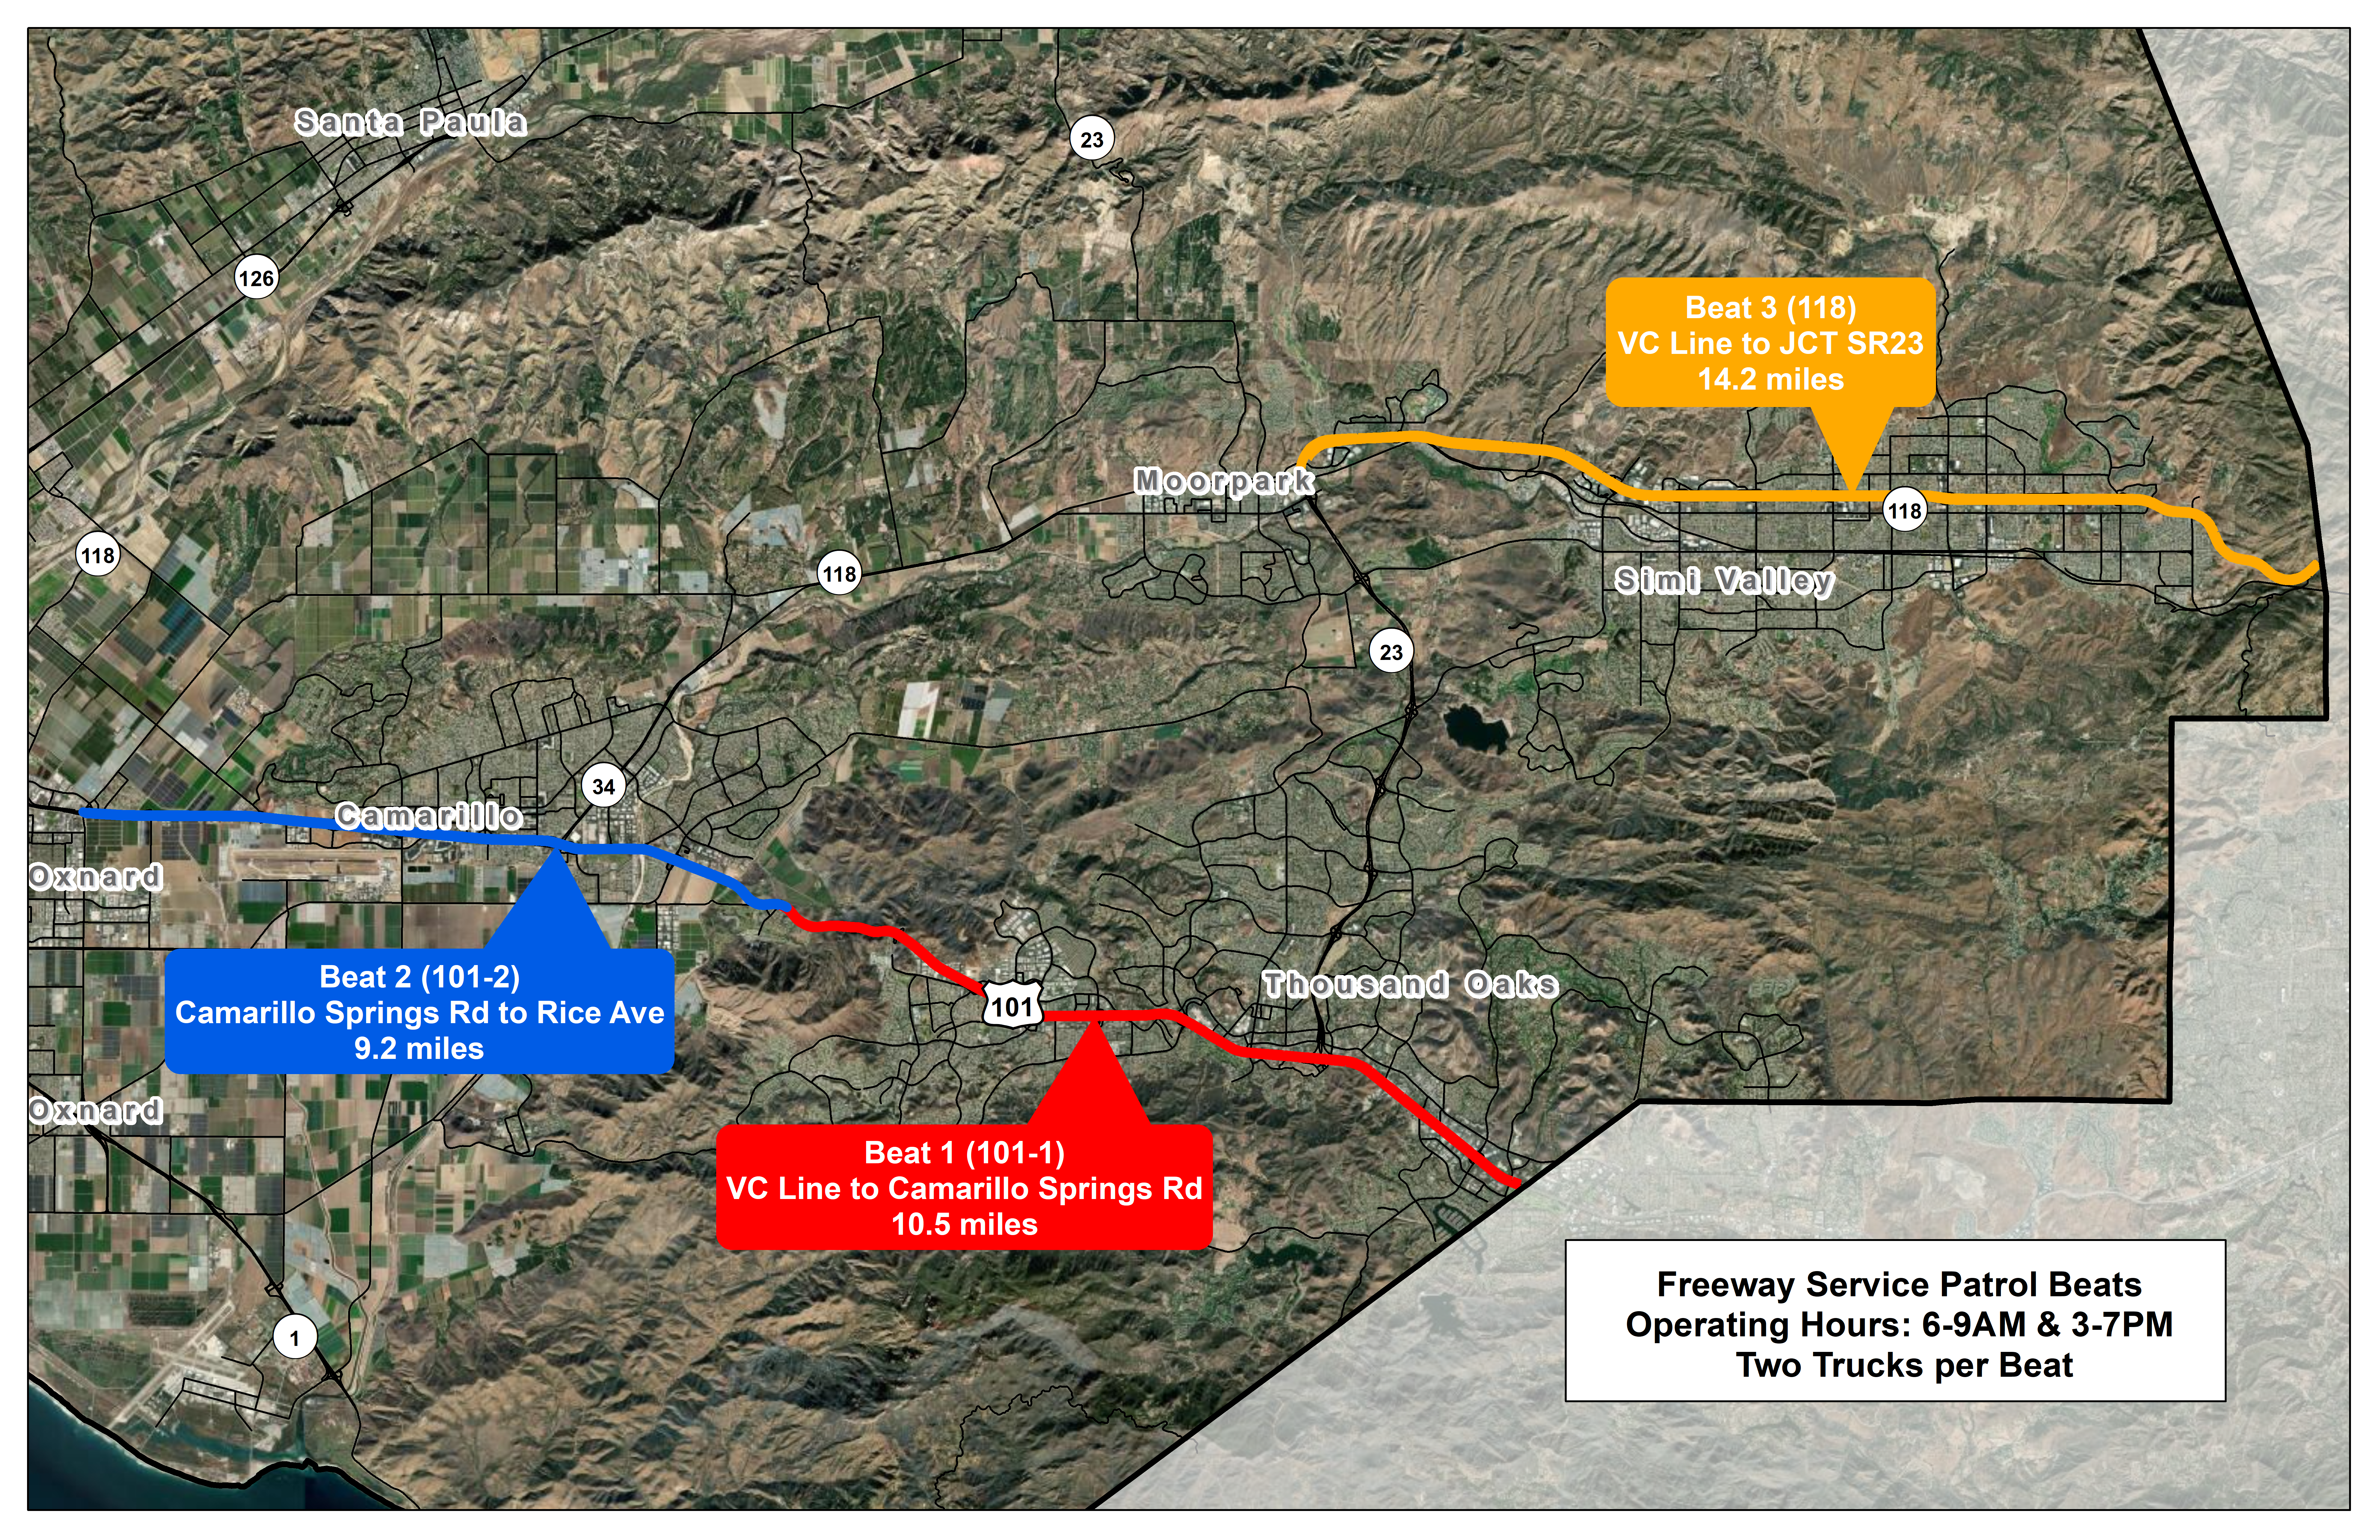
Ventura County FSP Beats
Notes:
This is map of the current FSP service
Currently we are covering SR118 from the LA County line to the SR23
And US101 from the LA County line to Rice Ave
The SAFE Board awarded contracts for 3 patrol “Beats” to Platinum Tow & Transport In Sept. 2020
Since service began in March of 2021
There have been six wrecker tow trucks patrolling the 3 “Beats”
Monday through Friday from 6:00 a.m. to 9:00 a.m., and from 3:00 p.m. to 7:00 p.m.
Temporary Patrol Beats 2022 to assist CHP with events:
Ventura County Fair
Point Mugu Air Show

Slide 4
Ventura County Highway Congestion
4,300,000 Hours of Annual Vehicle Delay
$112,640,000 Annual User Cost of Vehicle Delay
Notes:
The model of the FSP program is to provide rapid response to incidents to reduce congestion
To provide some context, motorists on Ventura County highways lose 4.3 million hours annually to highway congestion
The opportunity cost of that lost time is estimated at over $110,000,000 annually
According to Transportation Disruption and Disaster Statistics dashboard estimates that 16% of congestion on our local highways is non-recurrent incident related, or stemming from collisions, debris and other unanticipated incidents (non-weather events). Twice the rate on VC highways compared to the statewide average.
This really underscores the importance a rapid response to incidents as a mitigation of highway congestion in the County

Slide 5
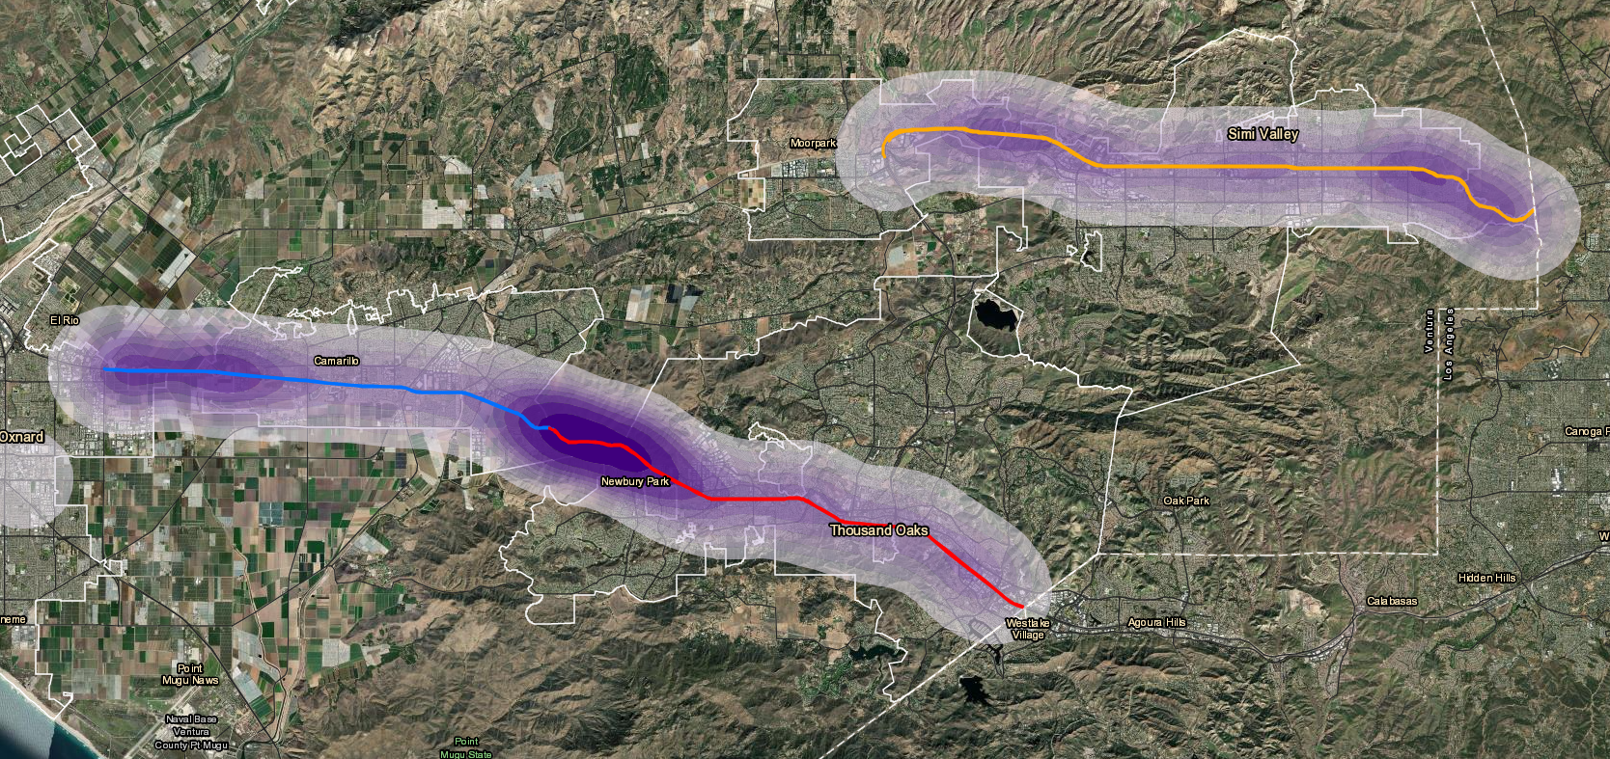
FSP Assist Data 2022
3,837 direct motorist assists & 5,880 total in 2022
Average 3.1 FSP responses per service hour
3/1 Benefit to Cost Ratio (Delay, Emissions, and Fuel Savings / ~$100 per Truck Hour)
Notes:
This map shows the density of recorded FSP assists, and not surprisingly the Cornejo Grade is the major hotsport
In 2022, FSP responded to 5,880 motorists stopped in the lanes, shoulders, medians and ramps of US-101 and SR-118, for an average of 3.1 FSP responses per service hour
Of those motorists approached by an FSP Driver, 3,837 were provided direct assistance to restart their vehicle or towed to a safe location off the highway.
The remainder were found using their mobile phones, sleeping or engaged in other activities and encouraged cleared the highway by FSP. Although not direct assistance, encouraging motorists to clear the shoulders still benefits congestion and safety.
Caltrans calculated 3/1 Benefit to Cost ratio for the Ventura County program in 2022

Slide 6
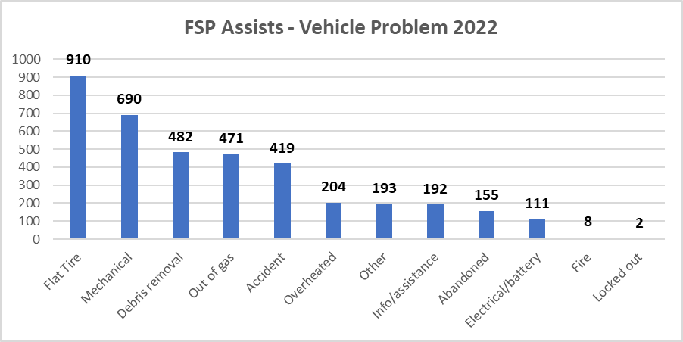
FSP Assists – Vehicle Problem
Notes:
The most common service provided by FSP in 2021 was fixing flat tires
Of the motorists assisted, FSP drivers were able to quickly restart vehicles in 75% of cases and the remaining 25% were towed to a safe location off the highway.
In addition to motorist assistance, FSP drivers cleared dangerous debris from highway lanes on 482 occasions and responded to 419 accidents
151 requests for assistance from the Ventura County Area CHP.

Slide 7
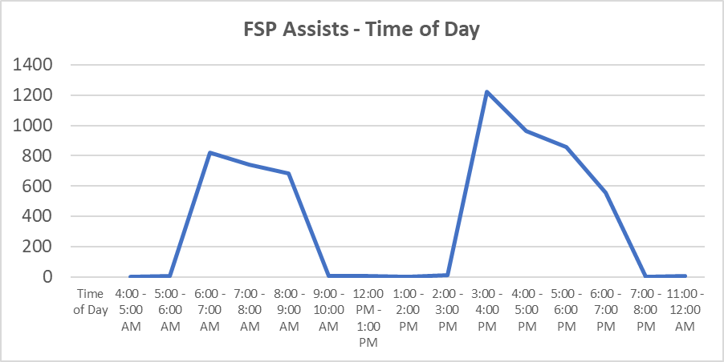
FSP Assists – Time of Day
Notes:
The busiest time of day for FSP was the first hour of the PM shift, between 3 and 4 pm.
Other programs have been experimenting with earlier starting times for the PM shift, as well as inclusion of midday service
This is something that we are watching closely as travel patterns have been stabilizing coming out of the pandemic

Slide 8
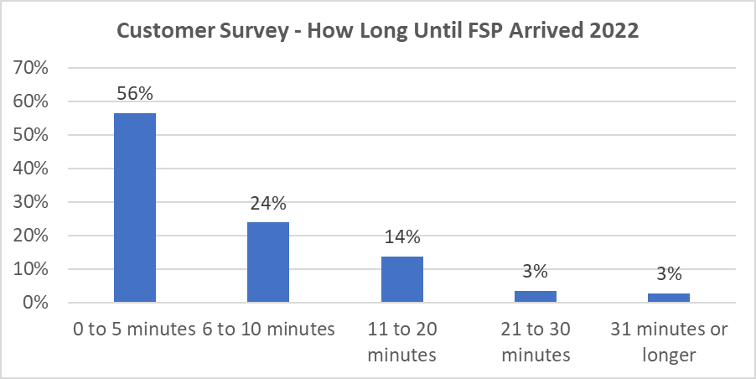
FSP Assists – Customer Surveys
Notes:
Due to the programs model of continuous patrolling, FSP trucks were able to reach motorists in under 5 minutes in 56% of reported cases and under 10 minutes in 80% of cases
The industry cites a 21-minute average response time for AAA roadside assistance and motorists assisted by FSP most commonly report the quoted wait time for AAA at 40 minutes
The program is significantly cutting down the time disabled vehicles are exposed to highway traffic

Slide 9
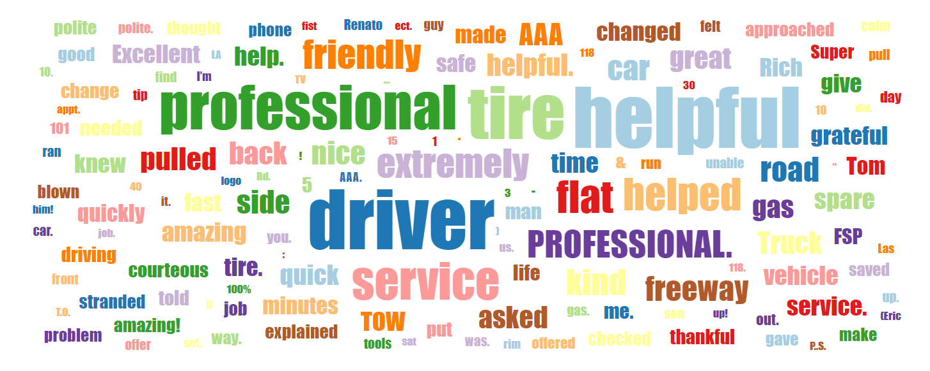
Customer Feedback
Notes:
Our customer assist surveys include a written response section which asks motorists to describe their experience, the helpfulness of their FSP driver and provide feedback on how to improve the program. The slide is a word cloud created from motorists written responses.
Public feedback from the survey has rated the service as “Excellent” in 146 of the 147 cases (and I am pretty sure the one case was a mistake).
.

Slide 10
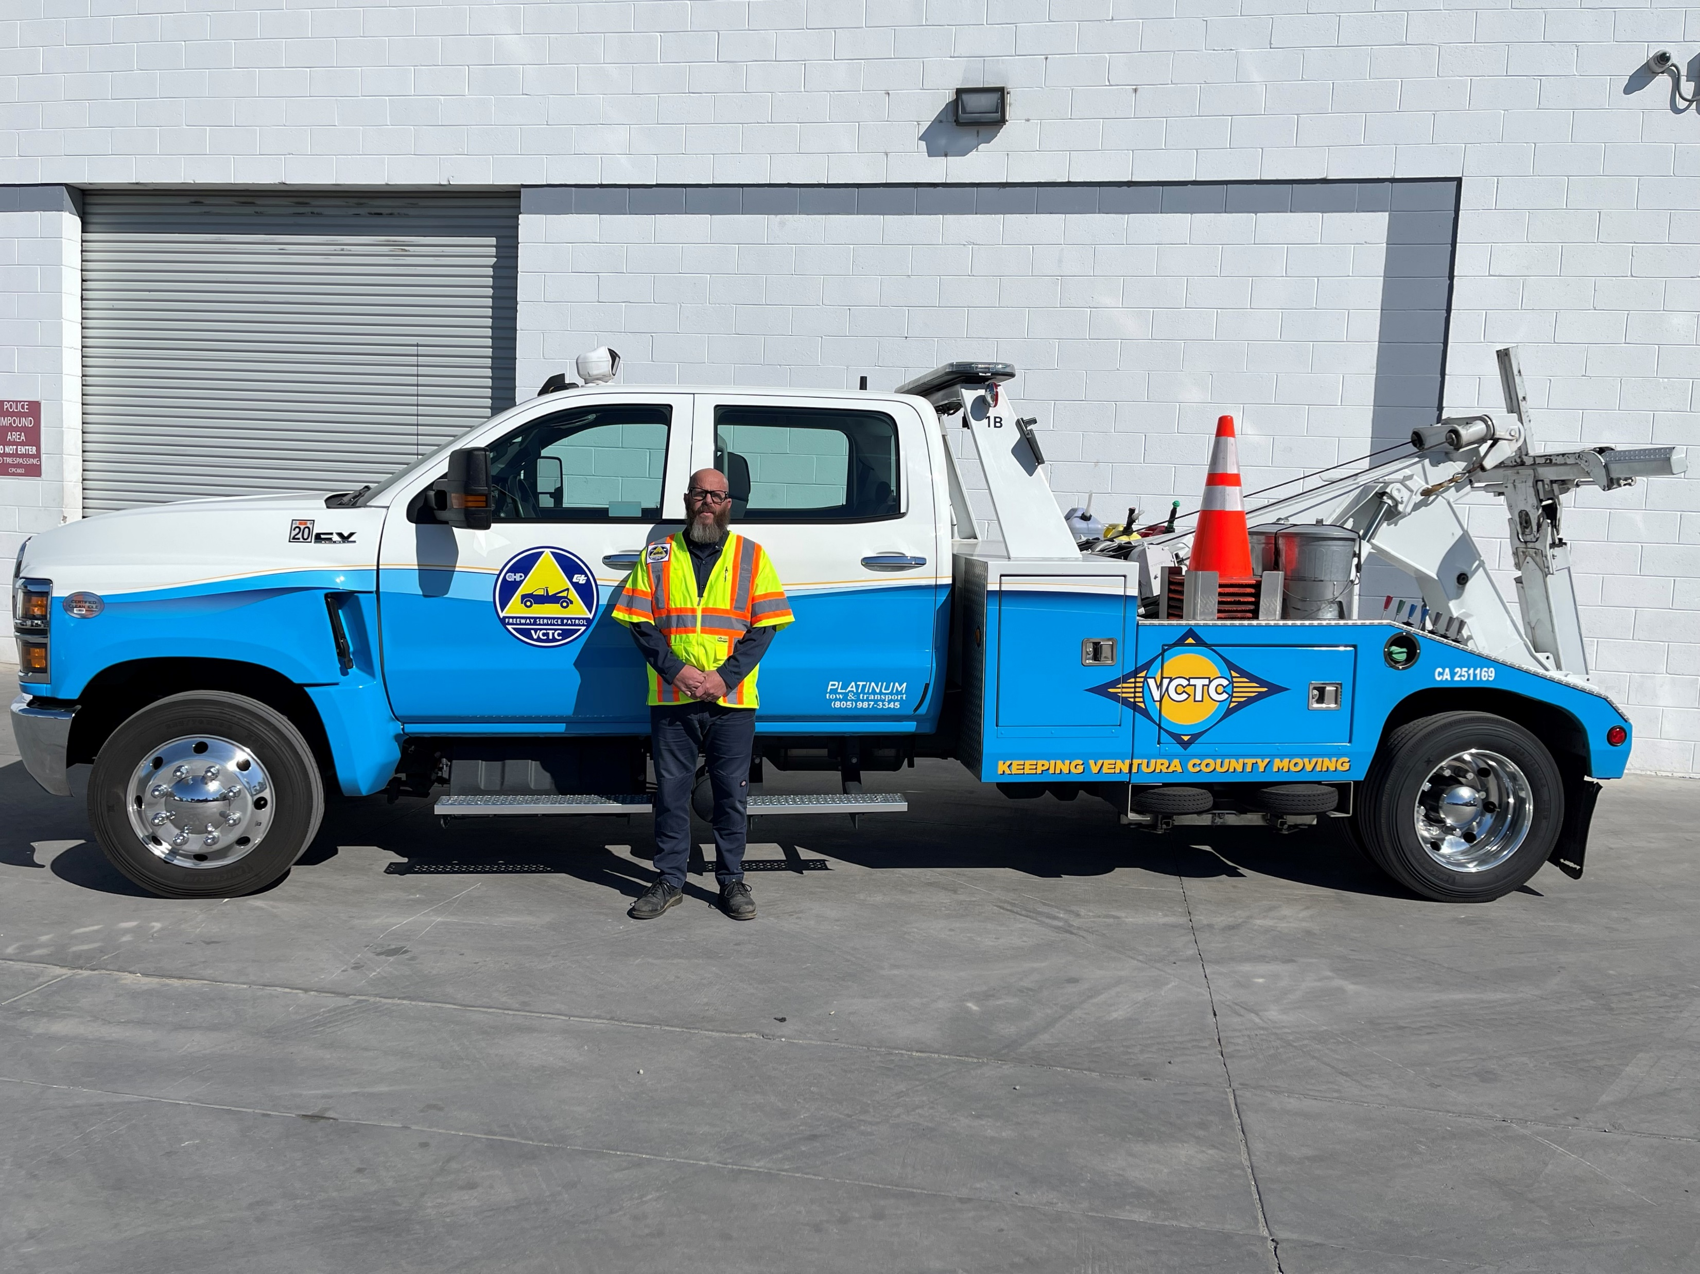
2022 Driver of the Year Recognition
Richard Henderson
Notes:
All FSP drivers have received excellent feedback from the motorists they have served, with common customer descriptions such as guardian angel and superman. In 2022, one driver stands out with about 40% of the positive feedback received from the public.
One of the many reason FSP programs do a Driver of the Year recognition is because great drivers are hard to hold onto. This is a difficult job, the split shift hours are taxing, drivers must regularly put themselves in harms way to aid motorists in all kinds of situations and weather conditions, they are often first on scene to collision events, and almost everyone they interact with is having a bad day.
We have been fortunate to have an experienced and dedicated tow truck contractor as a partner and we’d would like to extend our sincere appreciation to Bill Paymard and the entire team at Platinum Tow & Transport for running a top-notch service.

Slide 11
2022 Driver of the Year Recognition
“Rich was AMAZING!!!!!! He stopped by within 5 minutes to check on me. AAA was on their way but, in the end, were unable to help me. A friend came to help me get my flat tire off the vehicle to be repaired. Unknown to me at the time, Rich had driven by and saw the tire was off and was coming by to check on me knowing I would be back. He arrived when we got back. He then assisted in installing the new tire. Being a female on the road by myself, it was very comforting to know that he was watching out for my safety. He deserves an award! I was so frustrated with AAA and to find out I still had someone looking out for me was very reassuring. Rich, keep up the great work. You were a life saver, and we need more people like you on the road ready to assist. Thank you, thank you, thank YOU!
Notes:
At this time, I’d like to invite Richard and Bill up to the podium
Richard patrols the US101 Thousand Oaks Beat, he has been in the industry for 14 years and with Platinum for the last 8. Richard is described by his colleagues as a pro who has seen it all and in his customer surveys motorist often describe his demeanor as a calming presence in stressful situations. Outside of work he enjoys bicycle rides and spending time with his wife and four kids.
On behalf of VCTC, thank you for your service to the FSP program and community

Slide 12
Questions?
VCTC Staff
Amanda Fagan, Director of Planning & Sustainability, afagan@goventura.org
Drew Kent, GIS/Planning Analyst, akent@goventura.org
FSP Contractor
Bill Paymard, Platinum Tow & Transport
California Highway Patrol – Ventura & Moorpark Offices
Lieutenant Key, Officer Wren
Caltrans Motorist Aid Programs – Caltrans Headquarters
Lisa Davies
Notes:
I would also like to take this opportunity to extend my appreciation to our partners at the California Highway Patrol and Caltrans, who have provided invaluable guidance and support throughout program initiation and our first year of service.
Thank you to the Commission for supporting this program, and we look forward to future opportunities to serve the community.

