Slide 1
Ventura County Vehicle Miles Traveled Adaptive Management Program for CEQA Streamlining (VMT AMP)
May 12, 2023

Slide 2






Team
Funded by State Department of Housing and Community Development Regional Early Action Planning (REAP) 1.0 grant via SCAG to VCOG.
Managed by:
Consultants:

Slide 3
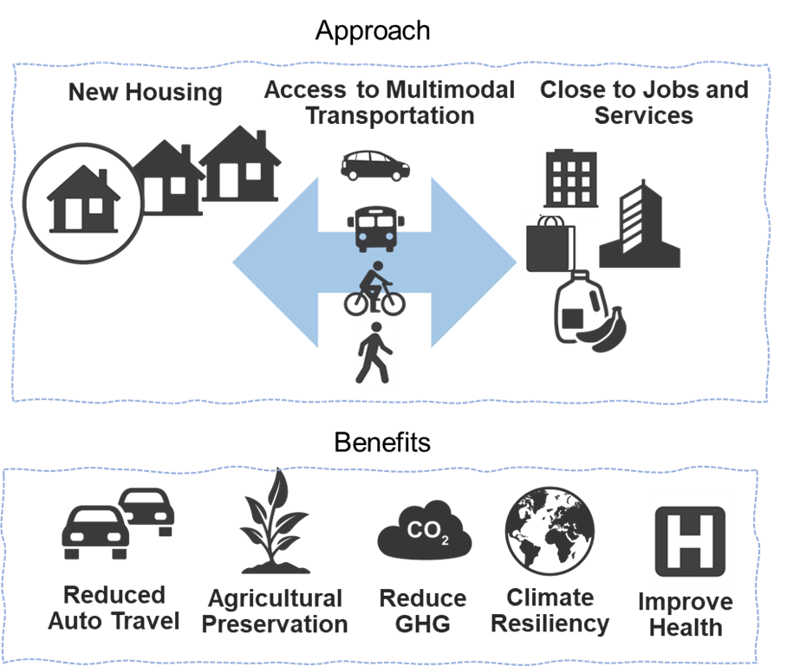
Integrating Land Use and Transportation

Slide 4
VMT as a New CEQA Metric
No More (Level of Service) Traffic Analysis for CEQA
Change CEQA Transportation Metric to Vehicle Miles Traveled (VMT)
Concerns about Additional CEQA Cost and Time:
  Could slow housing development
  Transportation impacts occur in different places than before
  Need effective and feasible mitigation options to reduce VMT
  EIR required to adopt Statement of Overriding Considerations
AMP to Assist by:
  Data for VMT metrics
  Standard VMT Assessment Methodology
  Choose from a range of VMT mitigations
  VCTC adoption gives legal credibility

Slide 5
CEQA VMT Adaptive Management Program
SCAG REAP 1.0 Grant with VCOG - Project 5:
Purpose to streamline CEQA process to help implement housing development by avoiding costs and time for a VMT-only EIR
CEQA VMT Adaptive Mitigation Program
Multifaceted, Capacity Building Guidance and tools for the County’s CEQA Lead Agencies

Slide 6
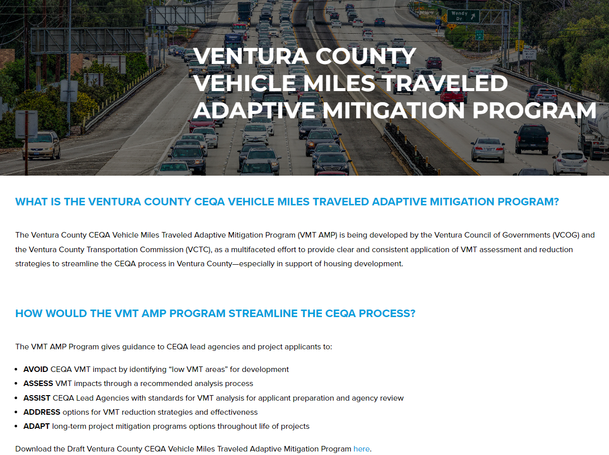
Ventura County CEQA Adaptive Mitigation Program
Website Resources
https://www.goventura.org/work-with-vctc/vmt-amp/
Impact and Mitigation Resources
  Standards for mitigation effectiveness/fair share contribution
  Standard CEQA requirements of nexus, additionality and mitigation monitoring
Lead Agency Information
  Thresholds and Contact Information

Slide 7
Ventura County CEQA Adaptive Mitigation Program
Training and Assistance task to help member agencies through the end of the year
Identify REAP 2.0 activities

