Slide 1
US 101 Improvement Project
Project Update
VCTC Commission Meeting
May 12, 2023

Slide 2
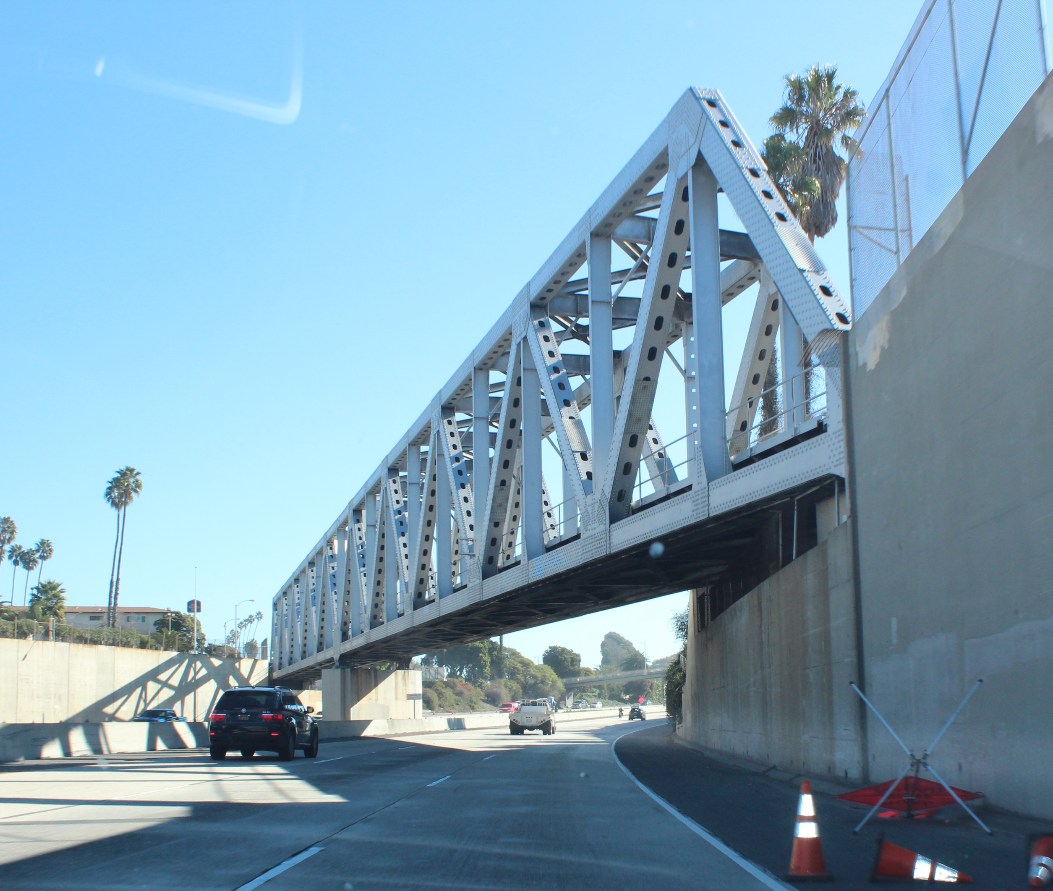

Agenda
Background and Overview
Public Involvement
Alternatives Analysis
Alternatives Under Study
Wildlife Movement Study
Ongoing Project Tasks
Early Action Project Determination

Slide 3
Background and Overview

Slide 4
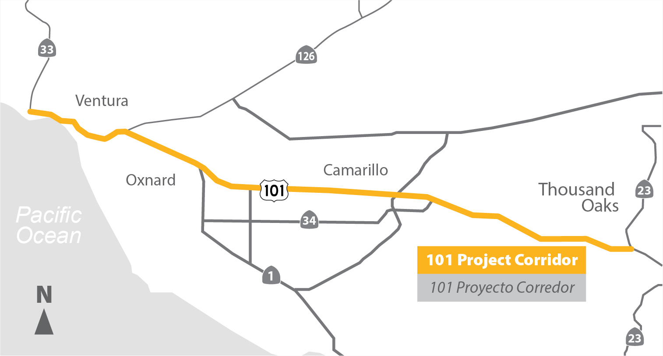
Study Area

Slide 5
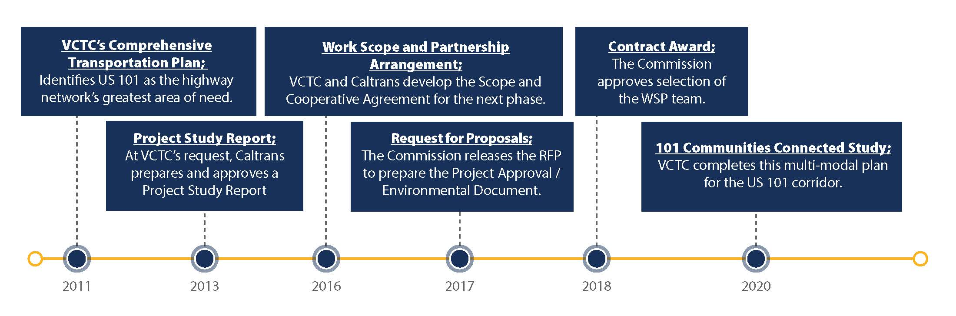
Prior Planning

Slide 6
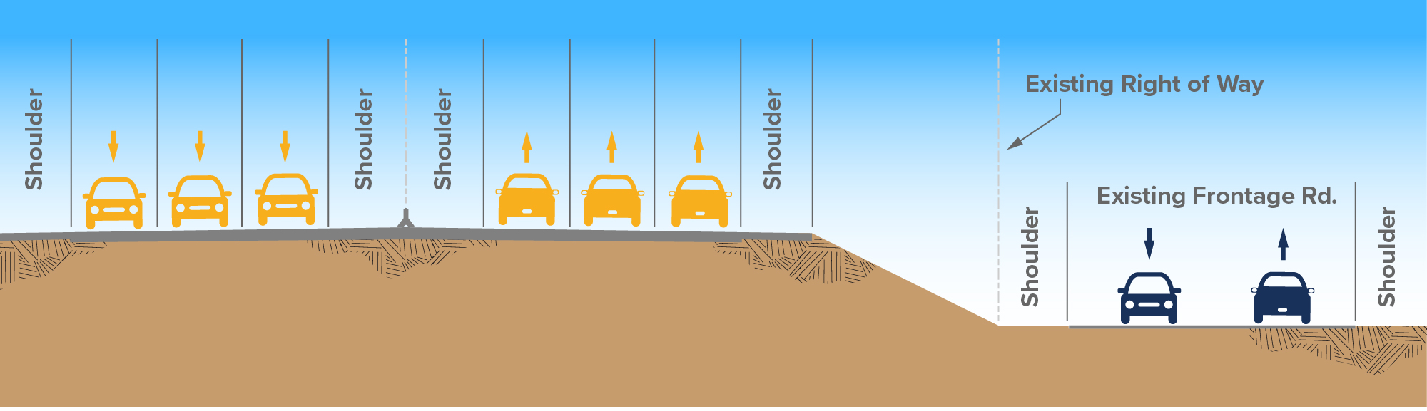
Existing Conditions
3 general purpose lanes (regular freeway lanes) in each
direction from Moorpark Road in Thousand Oaks to SR 33 in Ventura
2 general purpose lanes in each direction within the SR 126 interchange
Few auxiliary lanes – mainly in Thousand Oaks
No existing High Occupancy Vehicle (HOV)/Carpool lanes

Slide 7
Existing Conditions (2019)
Location | Daily Trips | Peak Hour Trips
Thousand Oaks | 200,000 | 19,000
Camarillo/Oxnard | 150,000 | 12,000
Ventura | 71,000 | 6,000
US 101 serves as both freeway and regional Main Street
Connects regional business districts; is the primary access for the Port of Hueneme
Buses/Express Buses and goods movement are impacted by the congestion

Slide 8
2060 Forecast
26.8 miles | Northbound |  | Southbound
Peak Hour | AM | PM | AM | PM
Average Travel Time (min) | 55 | 56 | 59 | 51
Average Speed (mph) | 33 | 33 | 31 | 36
Travel Time Index | 1.96 | 2.03 | 2.07 | 1.80
Improve travel time and trip time reliability
Address impact of congestion on person/goods movement
Address existing safety and operational issues caused by bottlenecks

Slide 9
Importance of the Project
US 101 identified by VCTC as the highway network’s greatest area of need.
Aging infrastructure: some segments of US 101 haven’t had significant improvements since the 1960s.
About half the jobs and residences in Ventura County are in the US 101 Corridor.
58% of corridor trips stay within the corridor.
There are no continuous alternate routes.
Peak period speeds are forecast to drop and travel time will increase.
Person and goods movement in the county will be constrained by the US 101 corridor.
Provide an alternative to “Opt Out of Congestion.”

Slide 10
Public Involvement

Slide 11

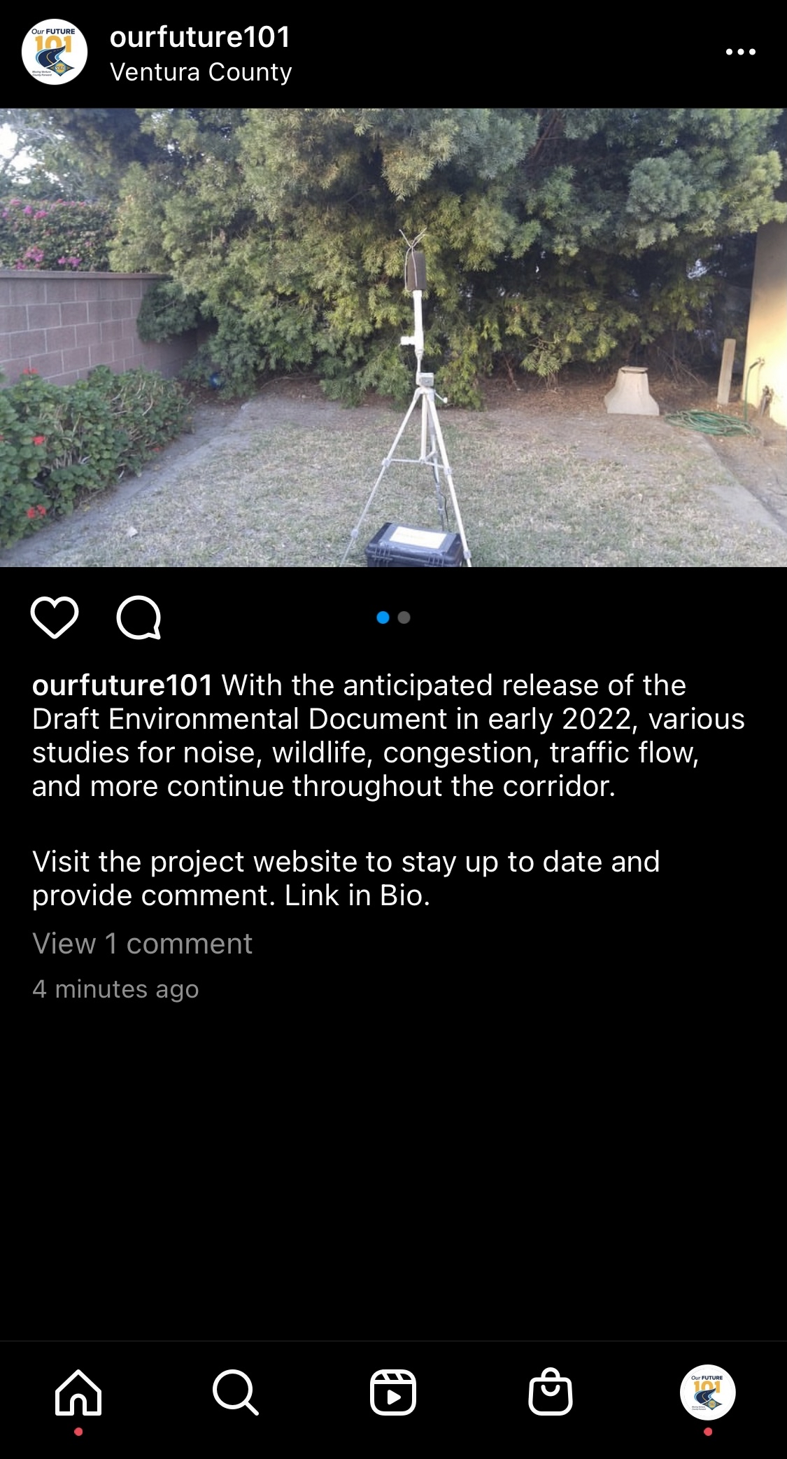
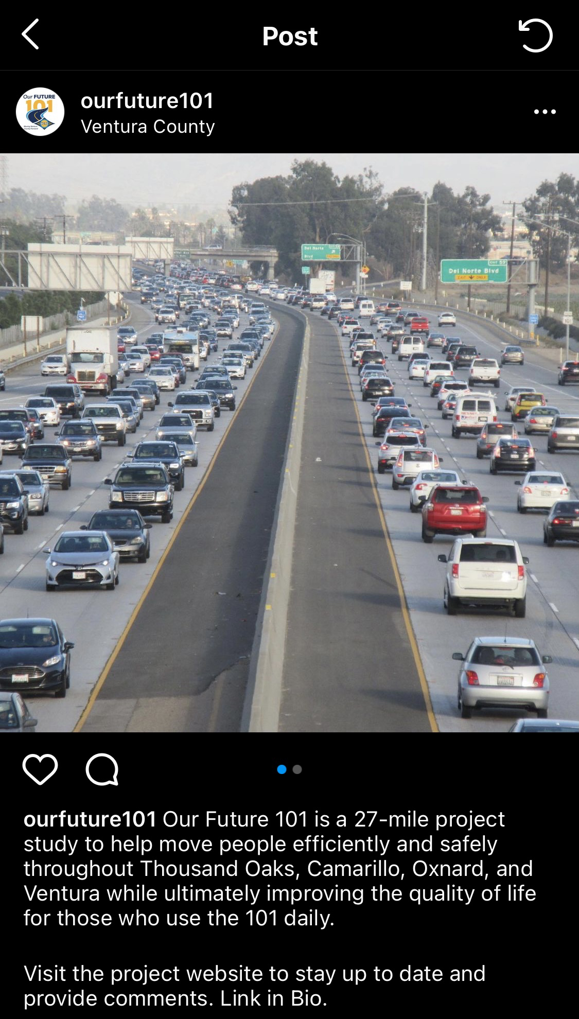
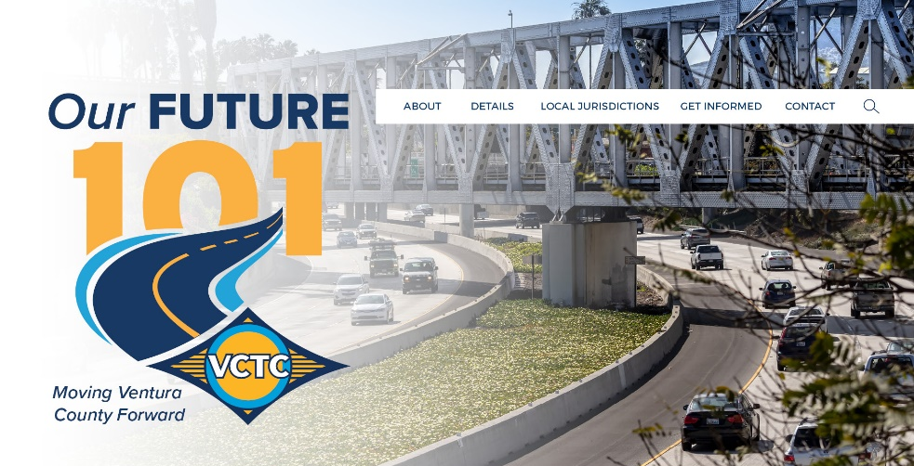
Ongoing Outreach
Website
www.ourfuture101.org
social media
Instagram.com/ourfuture101

Slide 12

Ongoing Outreach
  Four Project Scoping Meetings in 2019
  E-blasts and Website updates
  Instagram postings
  Project Updates at Commission Meetings

Slide 13
Alternatives Analysis

Slide 14
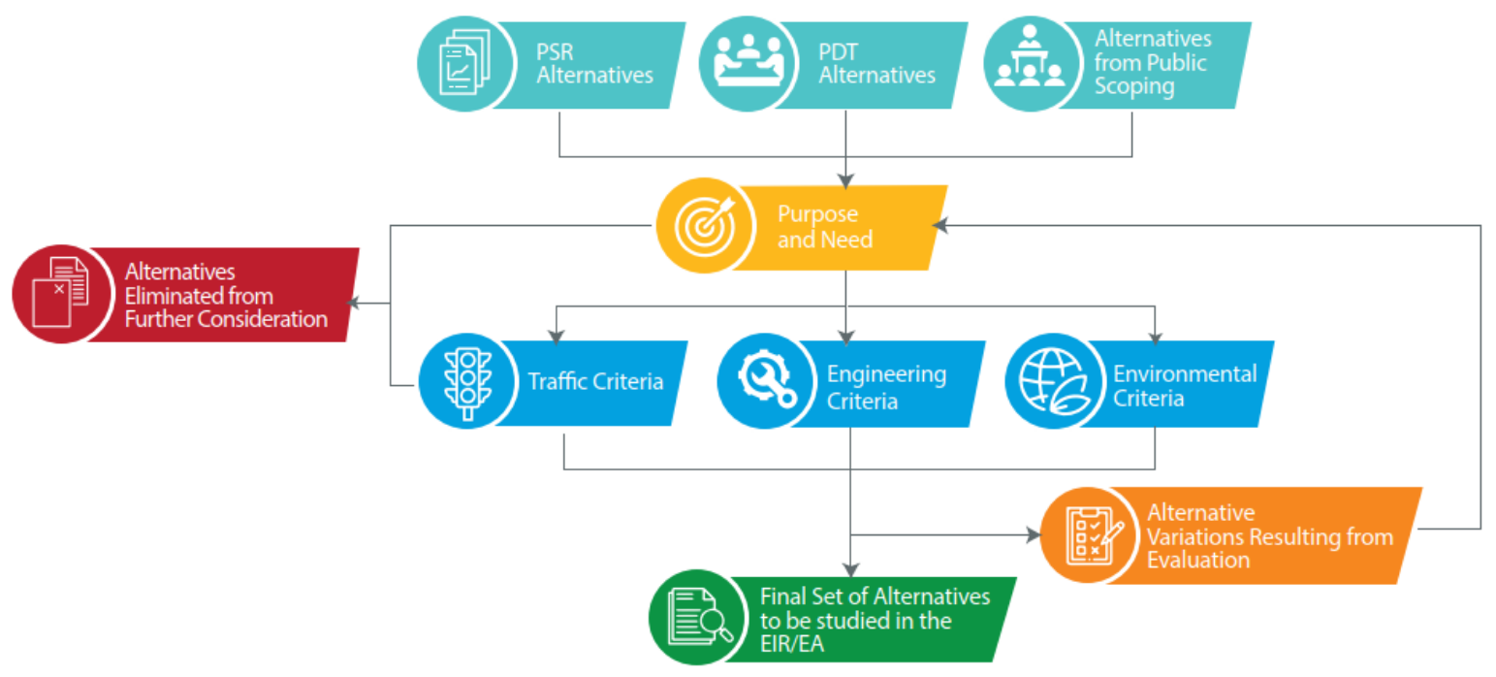
Alternatives Analysis Process

Slide 15
Alternatives Evaluated
No Build
HOV Lane Using Non-Standard Section
HOV Lane Using Non-Standard Section with Auxiliary Lanes
HOV Lane Using Standard Section with Auxiliary Lanes
HOV Lane Using Standard Section with Design Variations and Auxiliary Lanes
Two HOV Lanes Using Standard Section with Auxiliary Lanes
Reversible Lane
Elevated Dedicated Transit Way
General-Purpose Lane
Tolled Lanes
Combination of HOV Lane and General-Purpose Lane

Slide 16
Alternatives Under Study

Slide 17
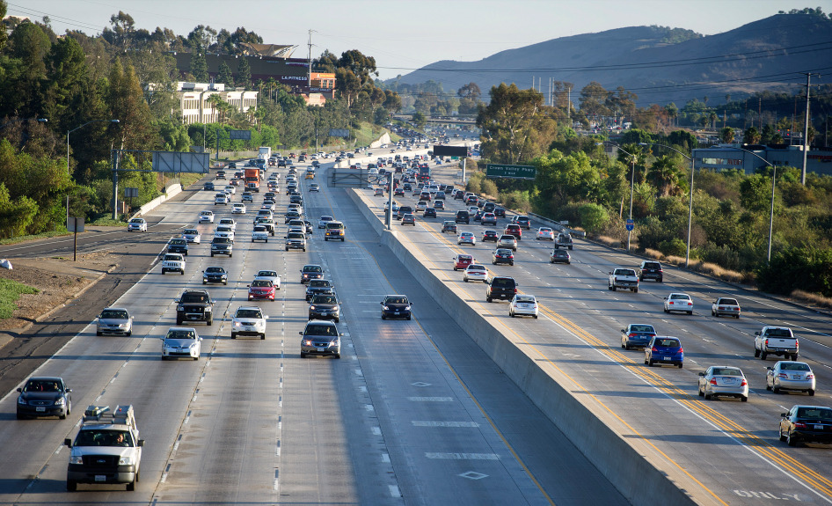
July 2020 Commission Presentation
No Build
HOV/Express Bus Lane with Auxiliary Lanes
HOV/Express Bus Lane with Auxiliary Lanes and Design Variations

Slide 18
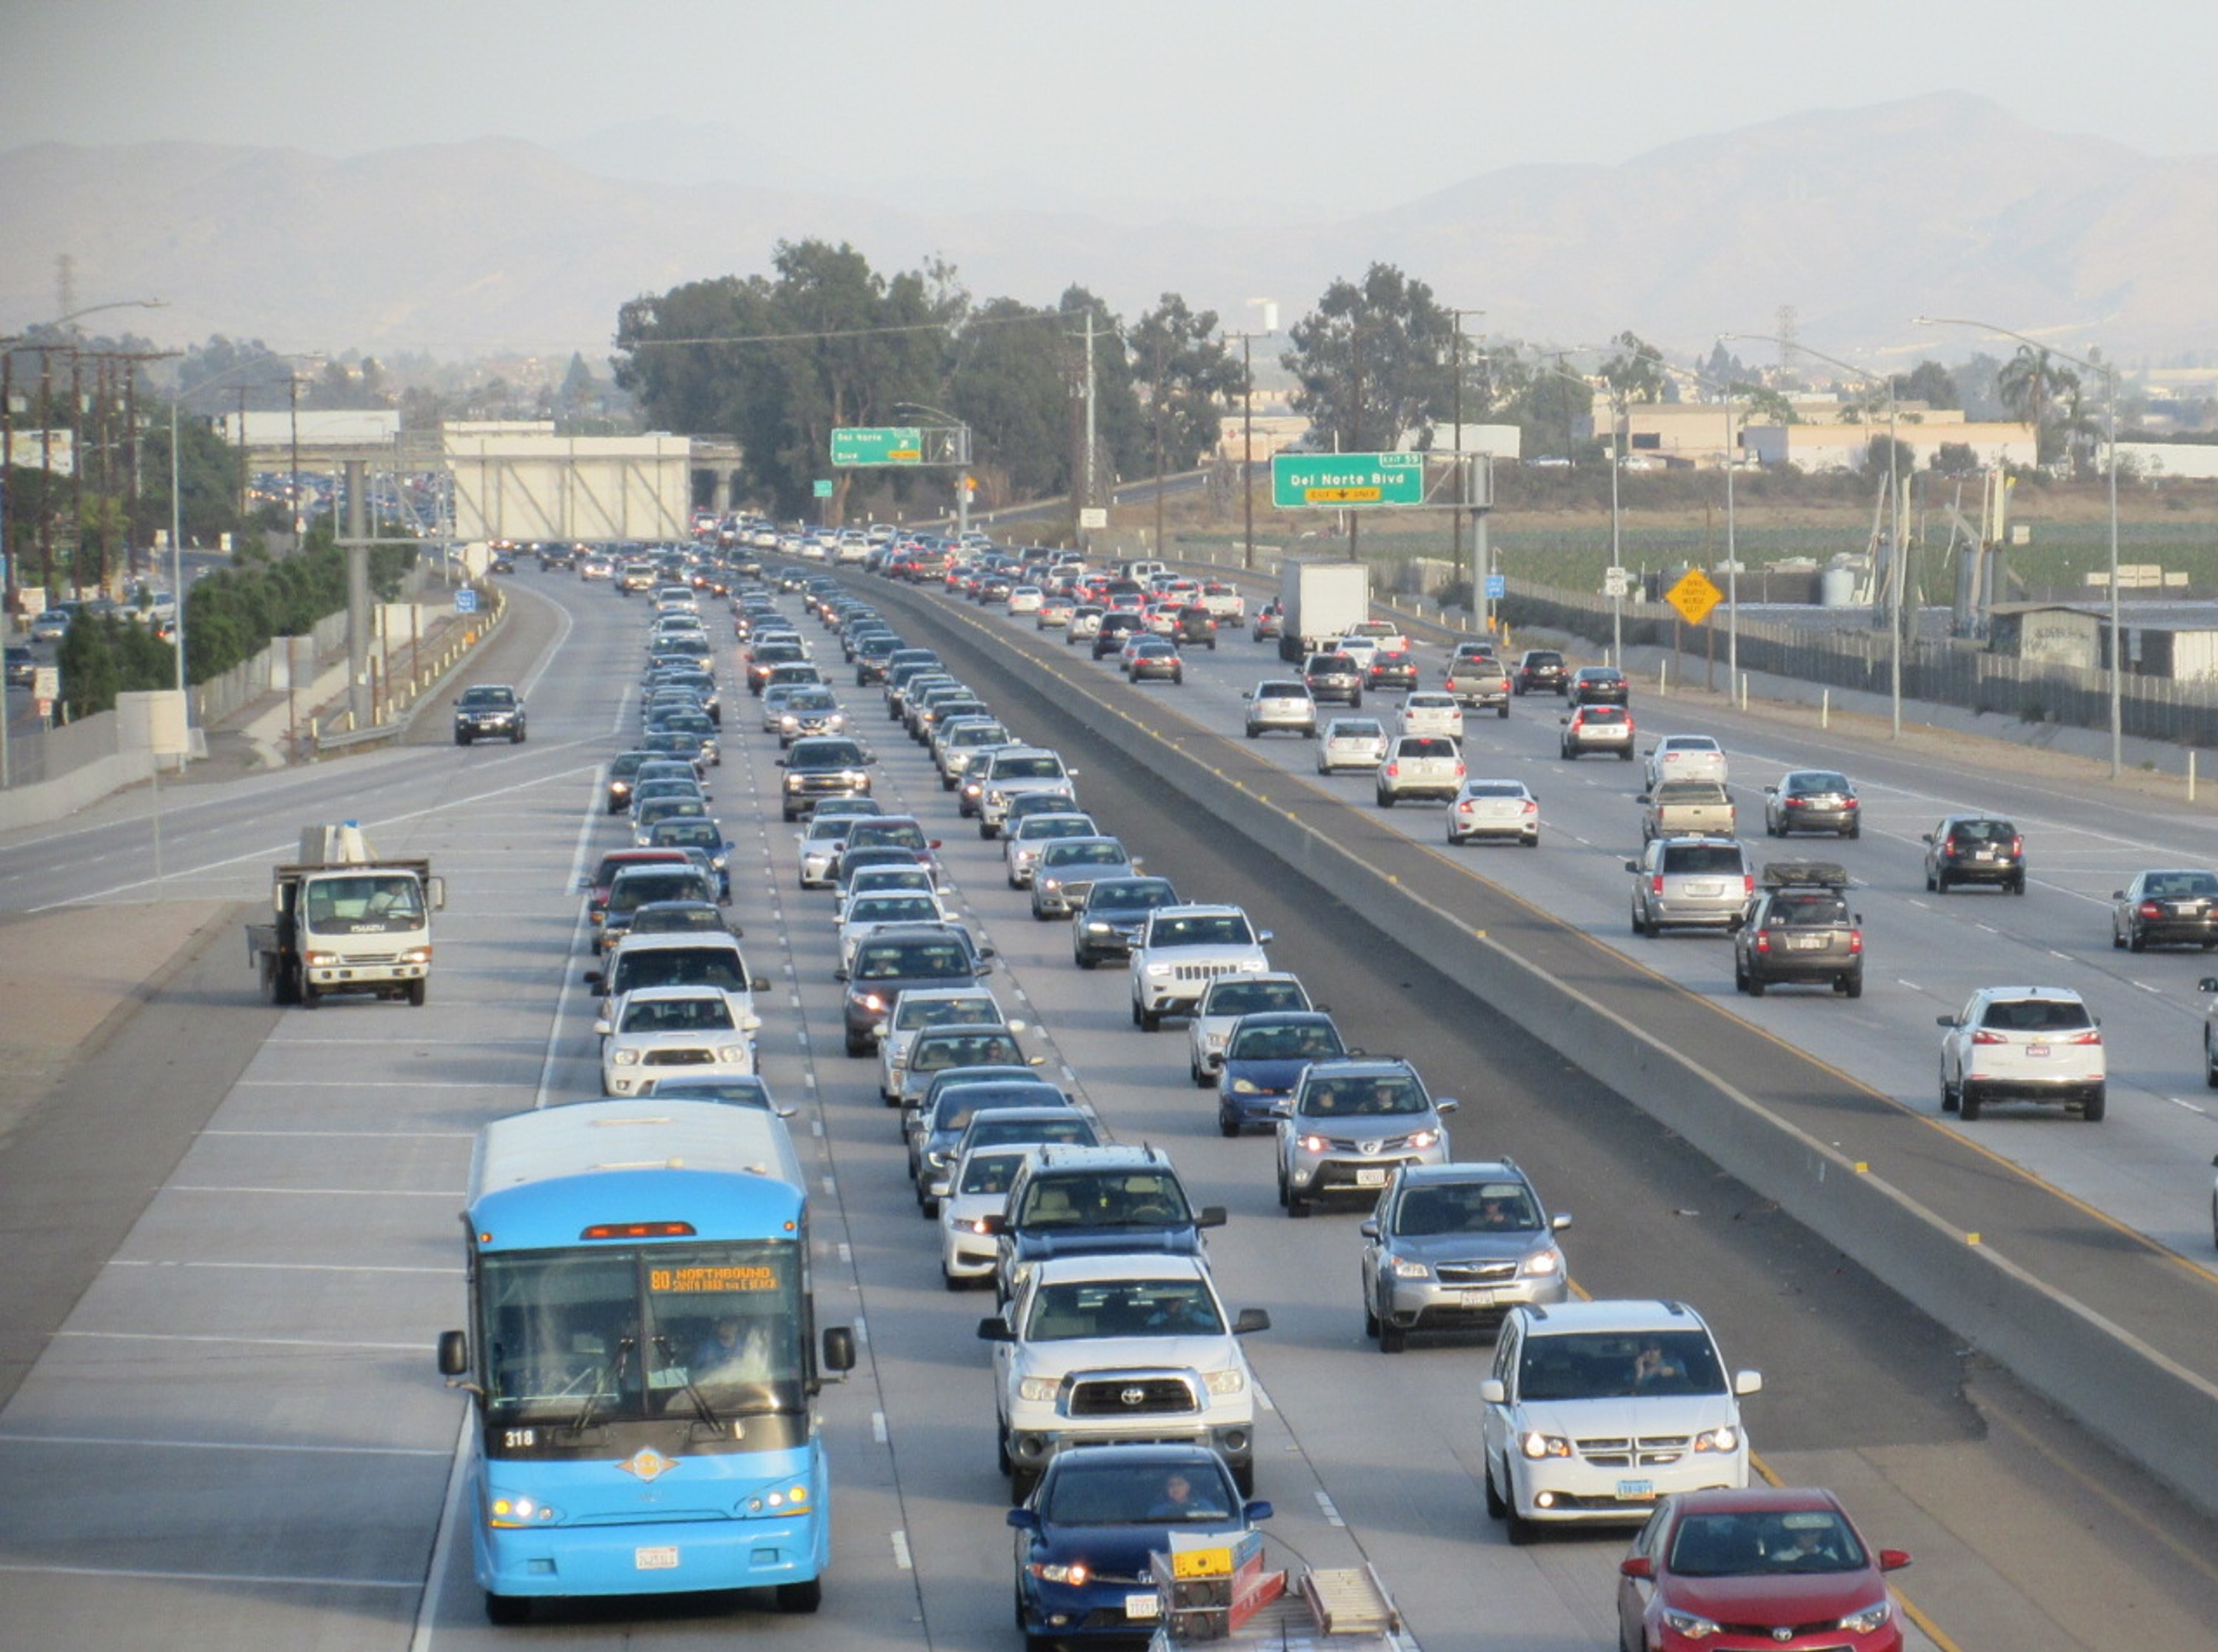
Alternative 1: No Build
No further improvements on US 101
Represents a baseline condition
Allows decision makers to compare the impact of build alternatives to the impact of doing nothing

Slide 19
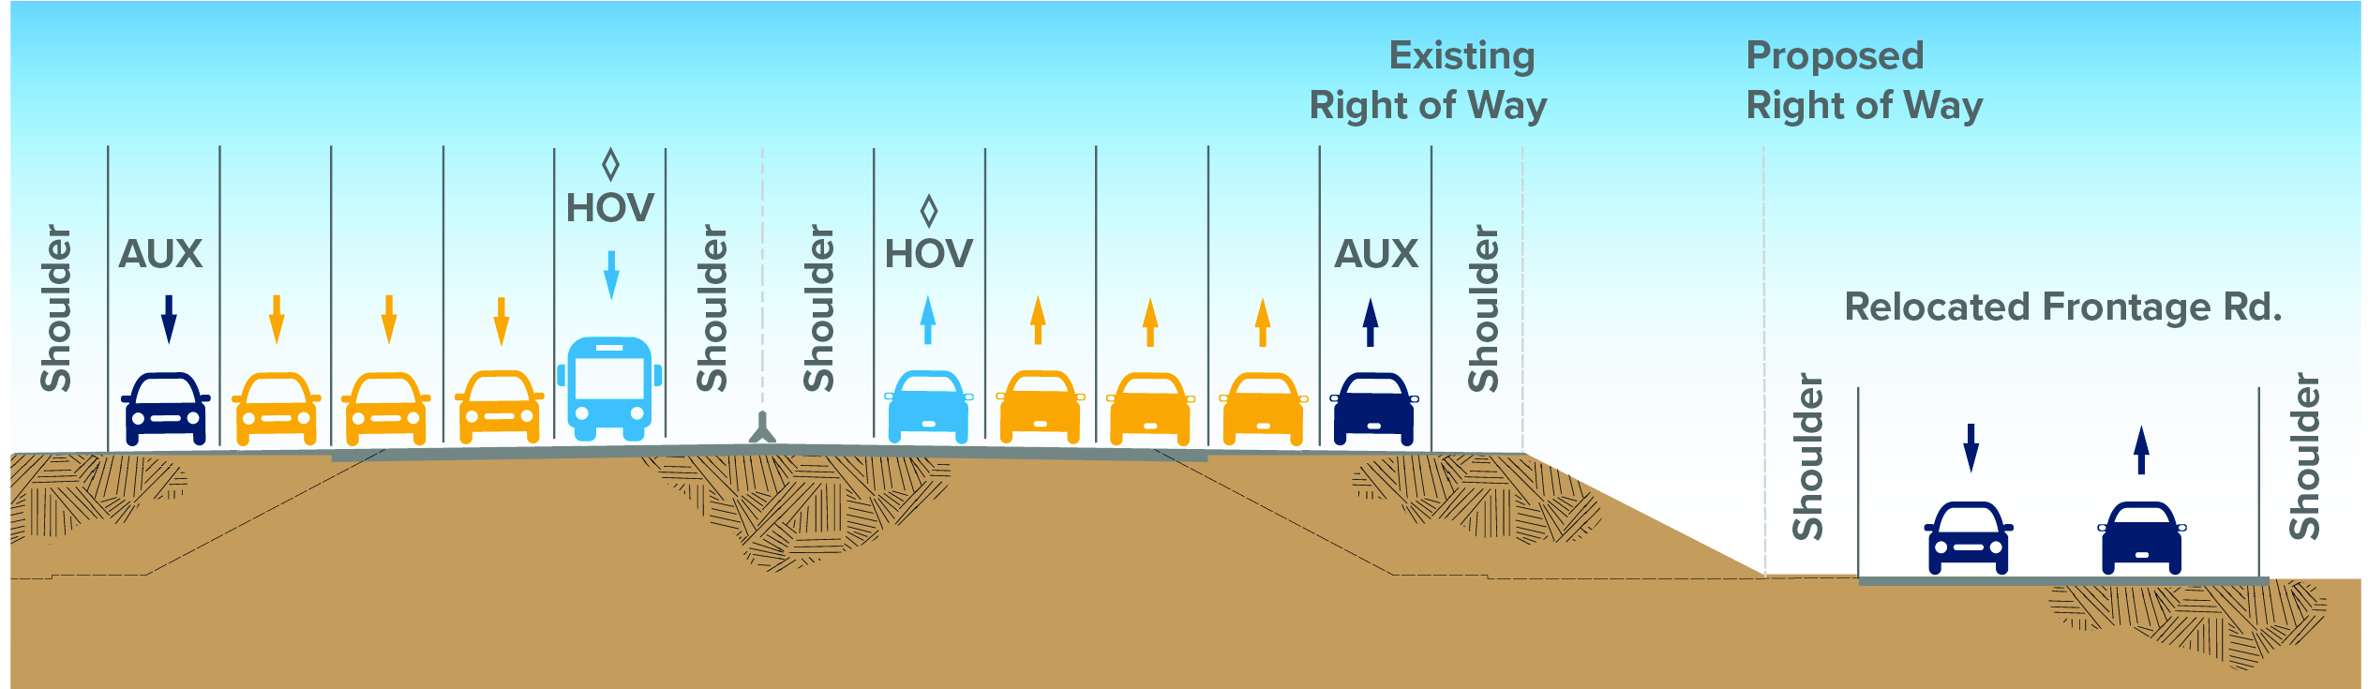
Alternative 2: HOV/Express Bus Lane with Auxiliary Lanes
Demonstrates the benefit of the HOV lane for carpools and express bus service
Improves freeway operations at busy on/off ramps with more auxiliary lanes
Uses the existing inside lane between Vineyard and Victoria to provide room for a standard width HOV lane and inside shoulder without widening the Santa Clara River bridge
Requires widening
freeway bridges
Impacts local streets
Requires some
property acquisition

Slide 20
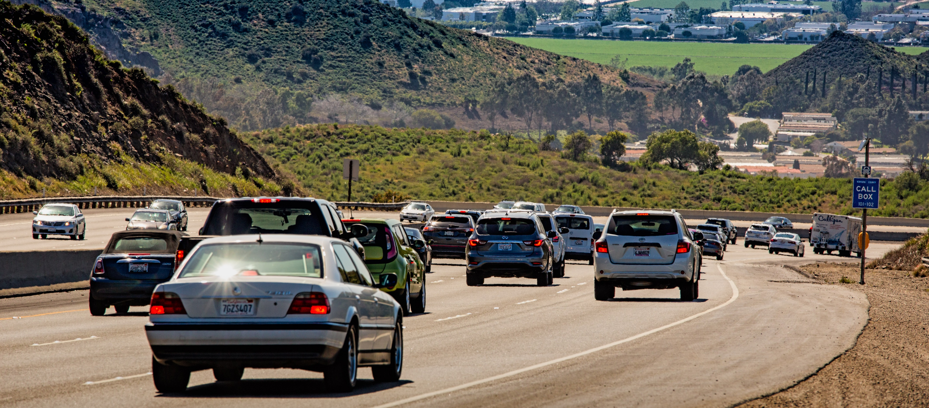
Alternative 3: HOV/Express Bus Lane with Auxiliary Lanes and Design Variations
Minimizes impact to south hillside on the Conejo Grade
Extends the southbound auxiliary lane at Dawson Drive
Ends the northbound lane at California Street rather than SR 33 to improve weaving
Maintains all existing general
purpose lanes from Vineyard
to Victoria by restriping the
inside lanes and shoulders

Slide 21
Wildlife Movement Study

Slide 22
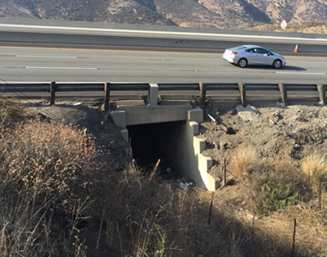
Wildlife Movement Study
As part of the US 101 Improvement Project, the need for data on the movement of wildlife in the Conejo Pass Area has been identified
VCTC applied for and received a Caltrans Sustainable Transportation Planning Grant Program—Sustainable Communities Competitive Grant in October 2021
The grant will be used to study wildlife movement and evaluate current wildlife connectivity

Slide 23
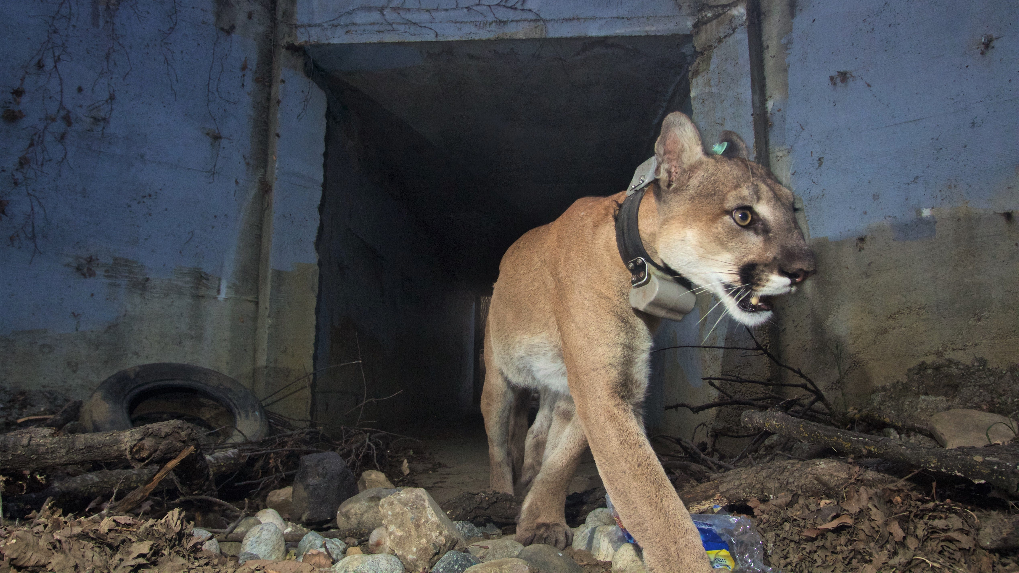


Wildlife Movement Study
The study will use GPS collars and remote cameras to monitor wildlife use of existing crossing points and areas in the vicinity of the freeway
Make recommendations for maintaining and improving wildlife connectivity in conjunction with the US 101 project
Grant amount = $326,890 to be used by the National Park Service, as a subrecipient to VCTC, to carry out the study
Application was approved March 22, 2022
National Parks Service Photo from VC Star

Slide 24
Ongoing Project Tasks

Slide 25
Ongoing Project Tasks
Engineering Evaluation of Alternatives
Environmental Technical Studies and Draft EIR/EA
Environmental Technical Studies
Fall 2022
Draft EIR/EA
Fall 2023
Public Circulation
Winter 2023/2024
Selection of Locally Preferred Alternative
Spring/Summer 2024
Engineering Technical Studies
Fall 2022
VMT Mitigation
Fall 2023
Draft Project Report
Fall 2023
Early Action
Phasing Strategy
Spring 2024

Slide 26
Potential VMT Mitigation Measures
US 101 Communities Connected
  Active Transportation Improvements
  Bike Trail from E. Ventura to Piru on SPBL
  Rail Improvements
Travel Demand Management
  Vanpool Pilot Program
  Mobility Hubs at Existing Park-and-Ride Lots
  Mobility as a Service (Maas) Pilot Program
Increased Transit
  Increase in 101 Commuter Bus Frequency
  Free/Reduced Fare Ride Programs (College, Youth, Low Income…)
VMT Adaptive Mitigation
  The most effective means of reducing VMT is providing convenient, safe and accessible bicycle, pedestrian, and transit improvements, a mix of land uses and a range of housing options near places of work
General Concept: New revenue measure needed for US 101 Improvement Project
would also incorporate the identified mitigation measures.

Slide 27
Early Action Project Determination

Slide 28
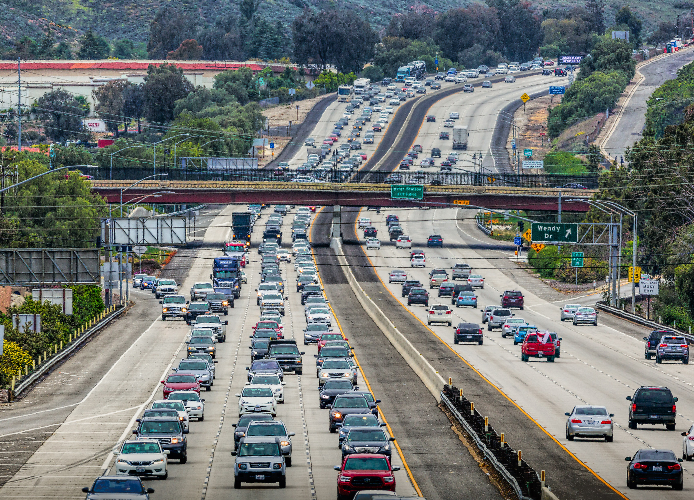
Early Action Project
VCTC to establish the availability of funds over the next 5 years, assuming existing funding sources.
Estimate the construction cost of various phases.
Evaluate the benefit of the phases.
Develop a phasing strategy of Early Action Project(s) based on a cost effectiveness assessment to provide the highest benefits for the least costs.

Slide 29
Next Steps
Complete all Technical Studies for the US 101 Improvement Project
Obtain Approval of the Draft Environmental Document (EIR/EA) and Draft Project Report
Release the Draft EIR/EA for Public Review and Comment
Based on the Data and Public Input, Determine the Preferred Alternative
Certify/Approve a Final EIR/EA and Project Report
ISSUE: If Caltrans & VCTC cannot identify sufficient mitigation,
could there be a Statement of Overriding Considerations?

Slide 30
Questions??
Thank You

