Slide 1
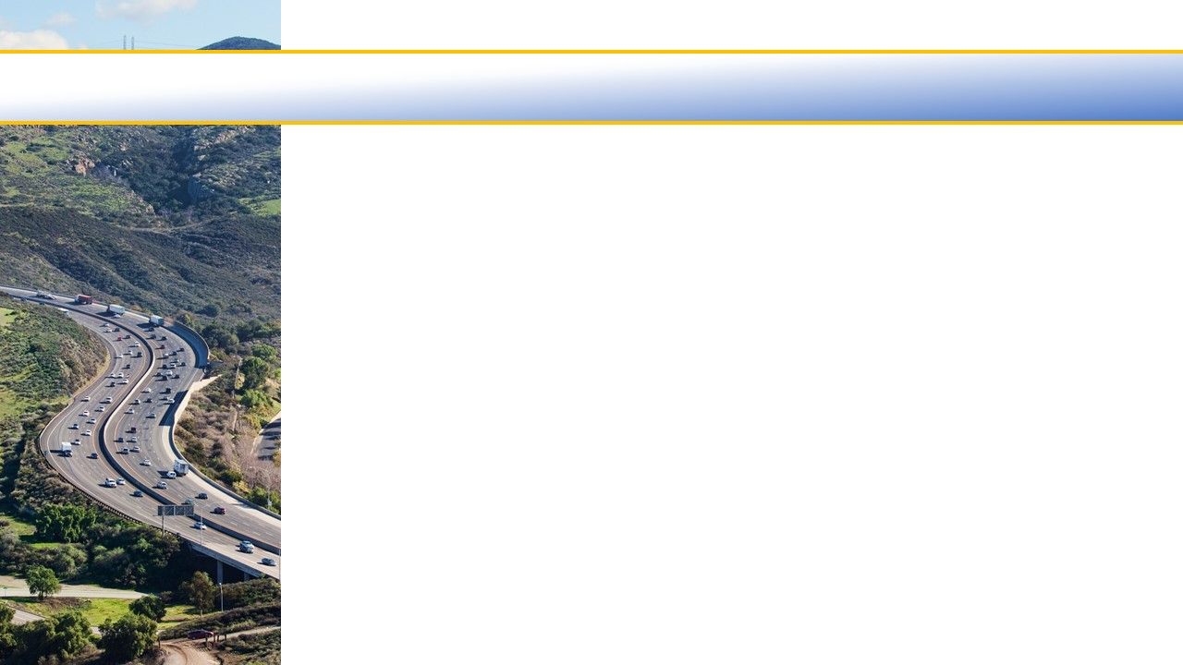

Ventura County Transportation Commission
Fiscal Year 2023/2024
Draft Budget
April 7, 2023

Slide 2
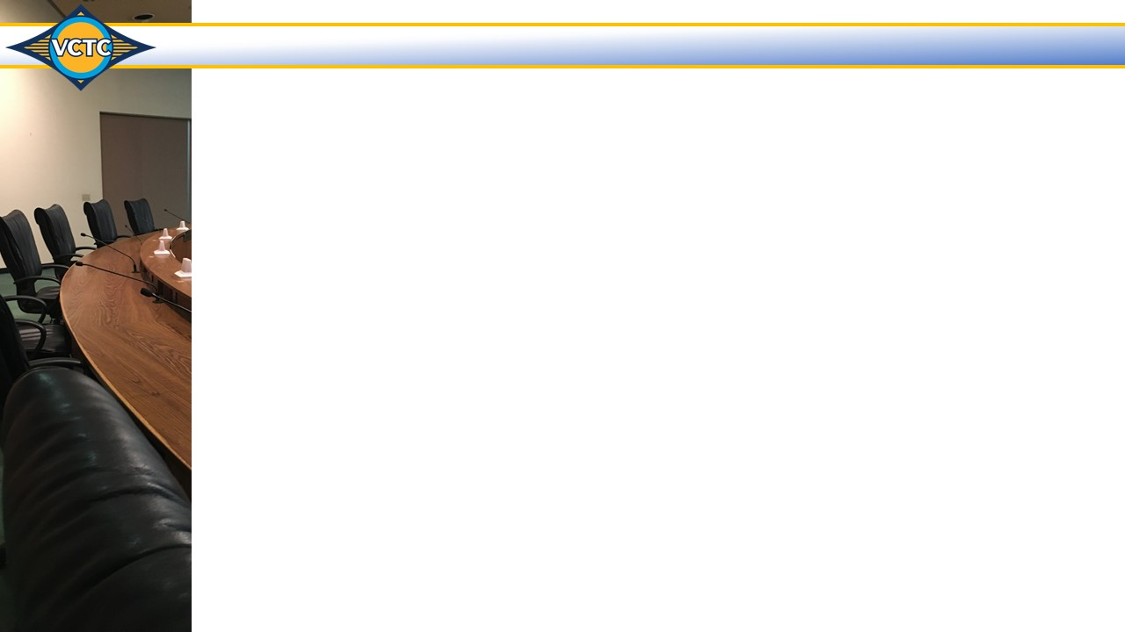
State of Transportation Funding
  Federal Funding:
  Infrastructure Investment and Jobs Act (IIJA) and Inflation Reduction Act (IRA)
    Funding disbursed through formula funding and grants
    New funding through Rebuild America’s Infrastructure with Sustainability and Equity grants
    2024 federal budget proposal proposes funds for public transit and flexibility in use of transit capital funds for operations
  COVID Emergency Legislation
    Monitor and address any barriers related to access and use of transportation funds

Slide 3
State of Transportation Funding
  State Funding:
  Expected State Budget shortfall of $22 billion
    Governor proposes cuts to transportation programs
    Cuts could lessen benefits of federal IIJA funding to California
    Efforts underway to establish short-term and long-term reforms to transit operations funding including possible “flex” funding
  COVID Relief
    Federal COVID relief funding for transit agencies running out
    Proposals to extend statutory relief provided to transit agencies during COVID

Slide 4
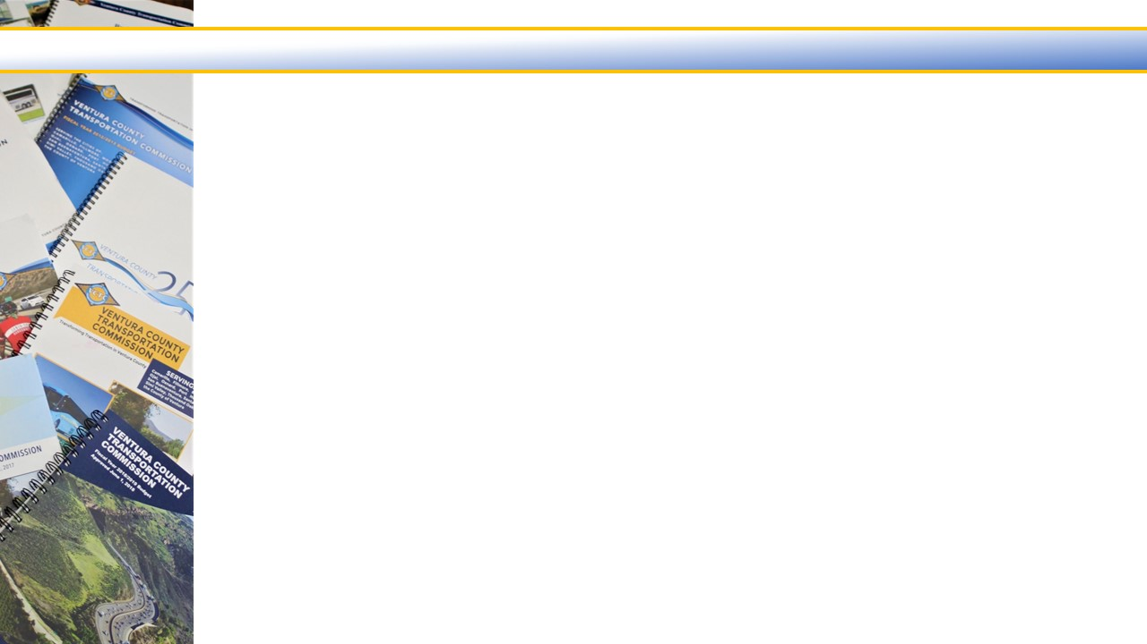

Fiscal Year 2023/2024 Revenue Overview
VCTC has no dedicated transportation funding, therefore all revenues are dependent on Federal and State programs and some Local contributions and fees
VCTC revenues are restricted use funds, each with a specific set of regulations, making it difficult, if not impossible, to transfer funds between uses
Unlike cities, VCTC has no general fund revenues that can be used to backfill shortfalls across its various activities
Federal 20%
Federal Transit Administration (FTA) | $13,869,467
Surface Transportation Program (STP) | 3,151,300
Congestion Mitigation and Air Quality (CMAQ) | 390,400
Total | $17,411,167
State 74%
Local Transportation Fund (LTF) | $46,000,000
State Transit Assistance (STA) | 11,556,909
State of Good Repair (SGR) | 1,552,466
Service Authority for Freeway Emergencies (SAFE) – VRF | 800,000
Planning, Programming and Monitoring (PPM) | 470,039
Access For All (AFA) | 294,000
LCTOP – Cap and Trade | 2,190,000
Regional Early Action Planning (REAP) – VCOG | 40,000
Sustainable Transportation Planning Grant (STPG) | 326,890
Freeway Service Patrol (FSP) – SHA | 550,200
Freeway Service Patrol (FSP) - SB1 | 475,500
Total | $64,256,004
Local 6%
Local Contributions | $3,368,388
Local Fees | 817,350
Investment Income and Other Revenues | 890,000
Total | $5,075,738

Slide 5
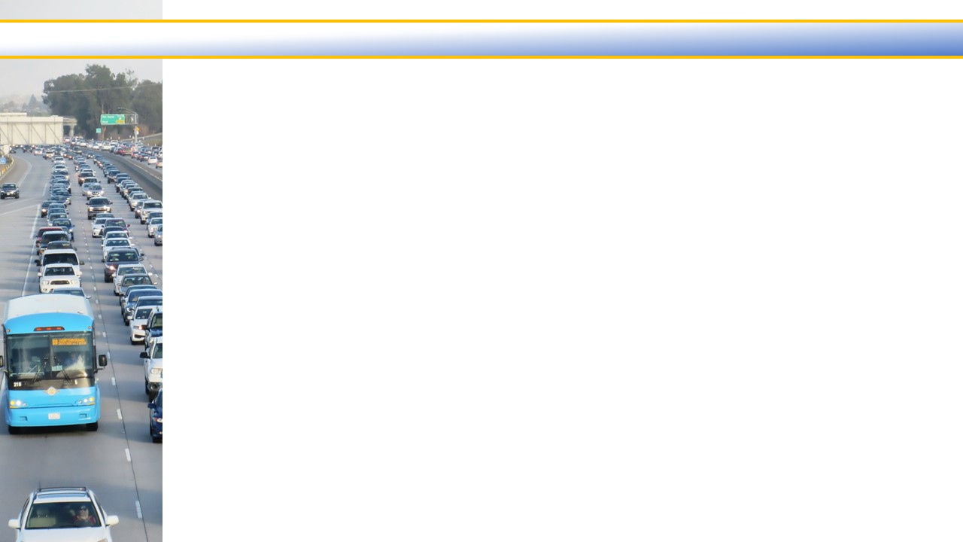
Local Transportation Fund (LTF) Revenues
  Fiscal Year 1998/1999 – 2023/2024
  LTF Revenues at $46 million are 53% of the Budgeted Revenues
  Estimated increase in LTF Revenues of $3.7 million from Fiscal Year 2022/2023 to 2023/2024
  LTF Local Agency Pass-through is $42.4 million – includes prior year carry-in 1x funds

Slide 6
State Transit Assistance (STA) Revenues
  Fiscal Year 1998/1999 – 2023/2024
  STA Revenues at $11.6 million are 13% of the Budgeted Revenues
  Estimated increase in STA Revenues of $2.5 million from Fiscal Year 2022/2023 to 2023/2024
  Funds Transit Operations and Transit Capital Projects
  Provides reserve for unanticipated transit related expenses

Slide 7
Fiscal Year 2023/2024 Balanced Budget
Draft Budget is $103,993,844
  $2.5 million lower than Fiscal Year 2022/2023 due to offsetting increases and decreases
    Largest decreases: -$3.5 million in Transit Grant Administration and -$2.3 in Highway Project Management budgets.
    Largest net increases: +$1.1 million in Regional Transit Technology and +$1.1 million in Metrolink budgets.
Total Revenues
Total Expenditures

Slide 8
Pass Through – Regional Services – Core and Countywide Services
Pass Through Services – 46% of the Budget at $47,970,318
  Transit Grant Administration – FTA Sub-recipients
  TDA Administration – LTF, STA and SGR Distributions
Core – Countywide
Services
$10,326,642
10%
Pass Through
$47,970,318
46%

Slide 9
Pass Through – Regional Services – Core and Countywide Services
Regional Services – 44% of the Budget at $45,696,884
  Accessibility Services
  Highway Project Management
  LOSSAN – Coast Rail Coordinating Council
  Metrolink Commuter Rail
  Regional Transit Information Center
  Regional Transit Technology
  Santa Paula Branch Line
  Valley Express
  VCTC Intercity Services
Core – Countywide
Services
$10,326,642
10%
Regional Services
$45,696,884
44%
Pass – Through
$47,970,318
46%

Slide 10
Pass Through – Regional Services – Core and Countywide Services
Core and Countywide Services – 10% of the Budget at $10,326,642
  Airport Land Use Commission
  Community Outreach
  Management and Administration
  Motorist Aid Services
  Regional Transit Planning
  Regional Transportation Planning
  Rideshare Programs
  State and Federal Government Relations
  TDA Administration
  Transit Grant Administration
  Transportation Programming
Core – Countywide
Services
$10,326,642
10%
Regional Services
$45,696,884
44%

Slide 11
Budgeted Expenditures by Program
Program Budget Categories | Fiscal Year 2021/2022 Actual | Fiscal Year 2022/2023 Budget | Fiscal Year 2023/2024 Budget | % of Change
Transit and Transportation | $20,088,846 | $25,671,574 | $23,914,600 | -6.8%
Highway | 3,788,702 | 7,689,605 | 5,568,400 | -27.6%
Rail | 6,833,511 | 22,066,678 | 23,512,284 | 6.6%
Commuter Assistance | 522,128 | 665,900 | 906,200 | 36.1%
Planning and Programming | 31,622,554 | 48,043,629 | 48,552,460 | 1.1%
General Government | 1,141,622 | 2,335,000 | 1,539,900 | -34.1%
Total Program Budget | $63,997,363 | $106,472,386 | $103,993,844 | -2.3%

Slide 12
Personnel Costs
  Salaries and Benefits at $4,165,800 or 4.0% of the budget
  24 Full-time positions
  Increase of $266,700 or 6.8% from Fiscal Year 2022/2023
    One new position, fully burdened
    Two reclassifications of staff
    $95,500 merit pool
    $102,200 proposed COLA (4%)
    $14,600 taxes and pension
    $39,500 insurances
    $2,000 OPEB contribution
  Pension funding level 96.9%
  OPEB funding level 106.9%
Expenses w/o
Personnel
$99,828,044
96%

Slide 13
Transit and Transportation Program
Budget Tasks | Fiscal Year 2021/2022 Actual | Fiscal Year 2022/2023 Budget | Fiscal Year 2023/2024 Budget | % of Change
Accessible Mobility Services | $ 401,333 | $ 513,000 | $ 466,300 | -9.1%
Regional Transit Technology | 604,126 | 899,500 | 2,004,300 | 122.8%
Transit Grant Administration | 6,502,319 | 8,932,674 | 5,412,300 | -39.4%
Valley Express | 1,688,165 | 2,294,400 | 2,671,500 | 16.4%
VCTC Intercity Services | 10,892,903 | 13,032,000 | 13,360,200 | 2.5%
Total Transit and Transportation Budget | $20,088,846 | $25,671,574 | $23,914,600 | -6.8%
  Changes from Fiscal Year 2022/2023 to 2023/2024
  Accessibility Services:
    - $46,700 for lower consultant costs
  Regional Transit Technology:
    + $1.1 million net increase for bus equipment replacements, improved signage, scheduling software and consultant costs reduced by staff time moved to another budget
  Transit Grant Administration:
    - $3.5 million for completed pass-through projects - New projects added with final budget.
  Valley Express:
  + $377,100 for increased bus contractor costs including Fillmore/Moorpark demonstration
  VCTC Intercity Services:
  + $328,200 net increase contractor costs offset by reduced consultant and staffing costs

Slide 14
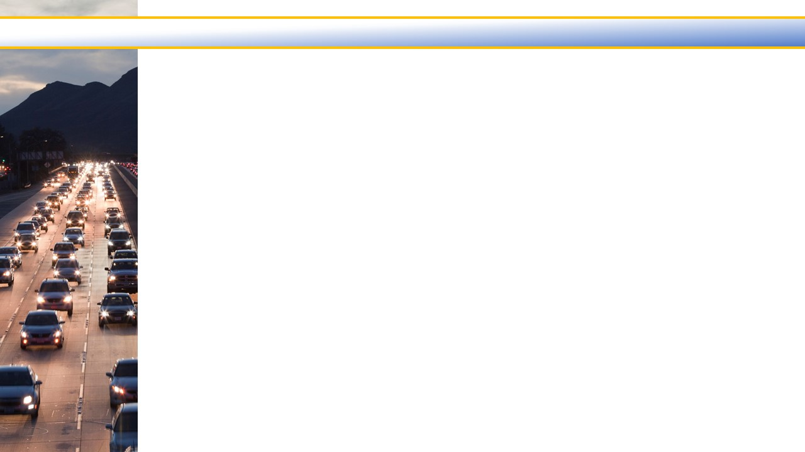
Highway Program
Budget Tasks | Fiscal Year 2021/2022 Actual | Fiscal Year 2022/2023 Budget | Fiscal Year 2023/2024 Budget | % of Change
Highway Project Management | $1,283,854 | $5,536,705 | $3,169,500 | -42.8%
Motorist Aid Services | 2,504,848 | 2,152,900 | 2,398,900 | 11.4%
Total Highway Budget | $3,788,702 | $7,689,605 | $5,568,400 | -27.6%
  Changes from Fiscal Year 2022/2023 to 2023/2024
  Highway Project Management:
    $2.3 million for U.S. 101 preliminary engineering and environmental documents
  Motorist Aid Services:
  + $246,000 for third cycle of the Incident Responder Grant and new 4th beat of Freeway
  Service Patrol offset by lower consultant costs related to SpeedInfo services sunsetting

Slide 15
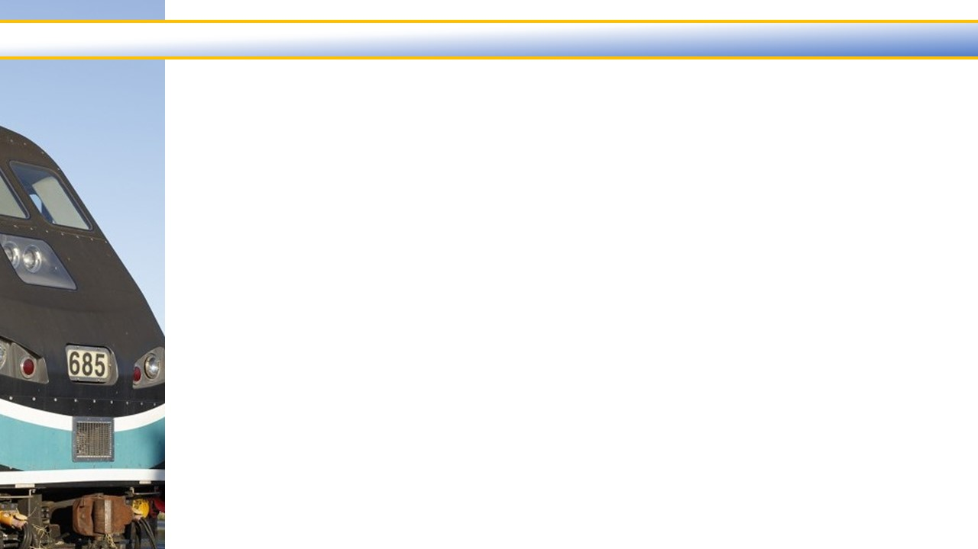
Rail Program
Budget Tasks | Fiscal Year 2021/2022 Actual | Fiscal Year 2022/2023 Budget | Fiscal Year 2023/2024 Budget | % of Change
LOSSAN - Coast Rail Coordinating Council | $ 33,860 | $ 51,000 | $ 71,400 | 40.0%
Metrolink Commuter Rail | 6,197,808 | 21,427,378 | 22,512,084 | 5.1%
Santa Paula Branch Line | 601,843 | 588,300 | 928,800 | 57.9%
Total Rail Budget | $6,833,511 | $22,066,678 | $23,512,284 | 6.6%
  Changes from Fiscal Year 2022/2023 to 2023/2024
  LOSSAN:
    + $20,400 for staffing costs related to studies and capital projects
  Metrolink Commuter Rail:
    + $1.1 million net increased operating costs, additional weekend service and Camarillo ADA
    Station improvements reduced by partial completion of prior year capital projects
  Santa Paula Branch Line:
  + $340,500 for consultant costs for right-of-way survey, storm damage response,
  and broadband deployment

Slide 16
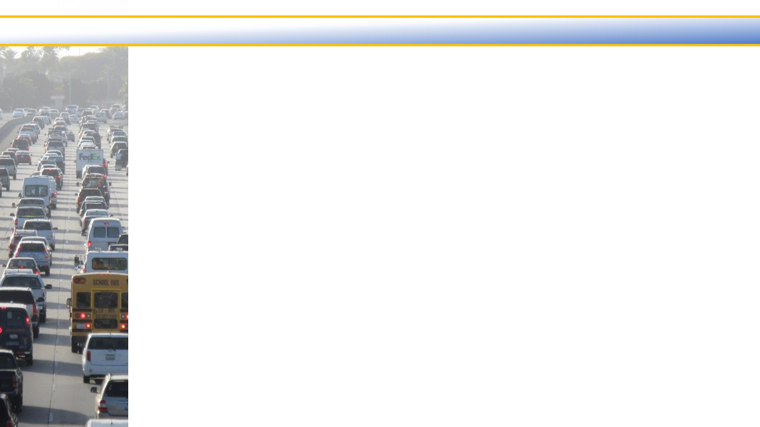
Commuter Assistance Program
Budget Tasks | Fiscal Year 2021/2022 Actual | Fiscal Year 2022/2023 Budget | Fiscal Year 2023/2024 Budget | % of Change
Regional Transit Information Center | $235,069 | $302,700 | $512,800 | 69.4%
Rideshare Programs | 287,059 | 363,200 | 393,400 | 8.3%
Total Commuter Assistance Budget | $522,128 | $665,900 | $906,200 | 36.1%
  Changes from Fiscal Year 2022/2023 to 2023/2024
  Regional Transit Information Center:
  + $210,100 for increased staffing costs moved from Regional Transit Technology and
  VCTC intercity Services
  Rideshare Programs:
  + $30,200 for increased consulting services and staffing costs

Slide 17
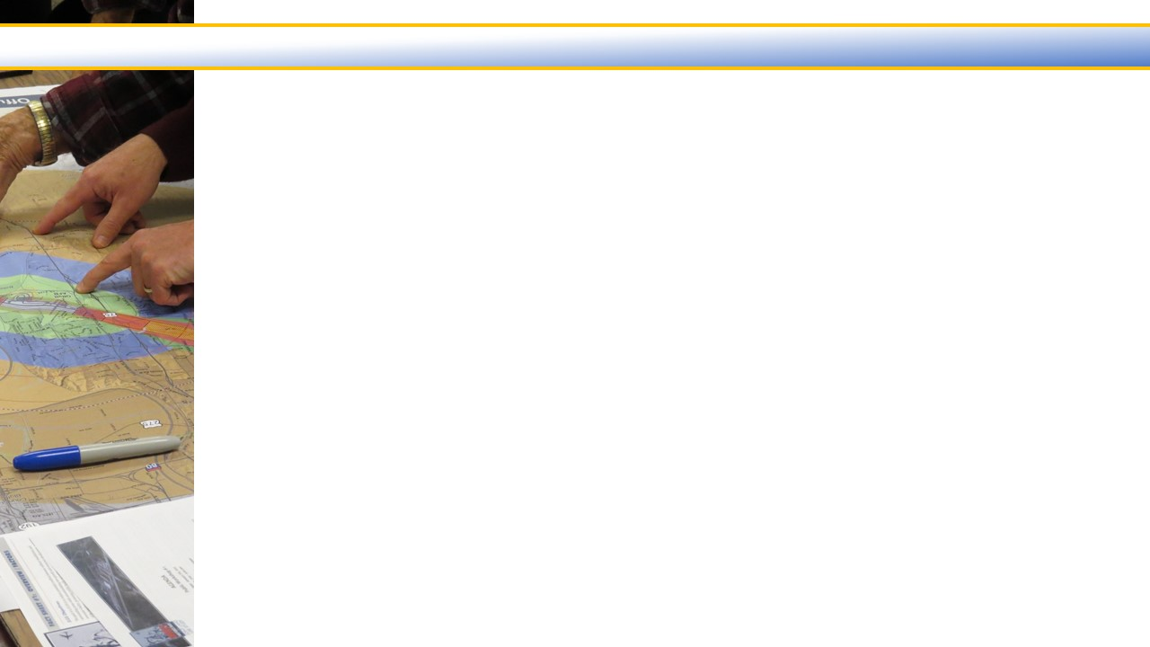
Planning and Programming Program
Budget Tasks | Fiscal Year 2021/2022 Actual | Fiscal Year 2022/2023 Budget | Fiscal Year 2023/2024 Budget | % of Change
Airport Land Use Commission | $ 8,859 | $ 44,900 | $ 50,300 | 12.0%
Regional Transit Planning | 897,603 | 2,316,400 | 2,651,400 | 14.5%
Regional Transportation Planning | 959,528 | 1,792,916 | 1,801,900 | 0.5%
Transportation Development Act | 29,180,035 | 43,264,228 | 43,198,360 | -0.2%
Transportation Programming and Reporting | 576,529 | 625,185 | 850,500 | 36.0%
Total Planning & Programming Budget | $31,622,554 | $48,043,629 | $48,552,460 | 1.1%
  Changes from Fiscal Year 2022/2023 to 2023/2024
  Regional Transit Planning:
    + $335,000 net increase for Youth Ride Free Program offset by completed studies
  Transportation Development Act (TDA) Administration:
  - $65,900 net decrease for increased LTF pass-through to local agencies reduced by the
  multi-year bicycle/pedestrian project allocations and reduced STA and SGR pass-through
  Transportation Programming and Reporting:
  + $225,300 for increased consultant and staffing costs

Slide 18
General Government Program
Budget Tasks | Fiscal Year 2021/2022 Actual | Fiscal Year 2022/2023 Budget | Fiscal Year 2023/2024 Budget | % of Change
Community Outreach | $ 405,795 | $ 488,200 | $ 519,100 | 6.3%
Management and Administration | 535,253 | 1,596,300 | 742,900 | -53.5%
State and Federal Governmental Relations | 200,574 | 250,500 | 277,900 | 10.9%
Total General Government Budget | $1,141,622 | $2,335,000 | $1,539,900 | -34.1%
  Changes from Fiscal Year 2022/2023 to 2023/2024
  Community Outreach:
    + $30,900 for increased staffing costs offset by reduced consultant costs
  Management and Administration:
    $0.9 million net decrease for prior year one-time pension unfunded liability payment
    increased by consultant costs for all staff salary survey (last one 2009)
  State and Federal Governmental Relations:
    + $27,400 for increased staffing costs

Slide 19
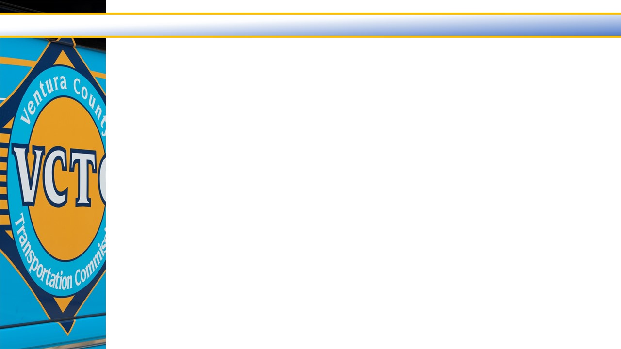
Where We End Up
  $103.99 million Balanced Budget
Estimated $25.8 million Fund Balance (after reserve adjustment)
  Available for ”general use”:
    GF $ 17,474 (Reserve $50,000)
  Restricted Fund Balances:
    LTF $ 442,915 (Reserve $4,100,000)
    STA $ 22,211,729 (Reserve $0)
      Anticipated uses for STA balance:
      Cash-flow (i.e., delayed grants and capital purchases)
      Metrolink capital projects
      VCTC Intercity bus purchases
      Implement recommendations out of the Transit Integration and Efficiency Study
    SAFE $ 1,695,984 (Reserve $1,515,000)
      Anticipated uses for SAFE balance:
      Additional Freeway Service Patrol Routes
      Additional Incident Responder Grants
    SGR $ 1,445,666 (Reserve $0)
    SPBL $ 25,367 (Reserve $0)

Slide 20
Fiscal Year 2023/2024 Proposed Budget
QUESTIONS?

