Slide 1
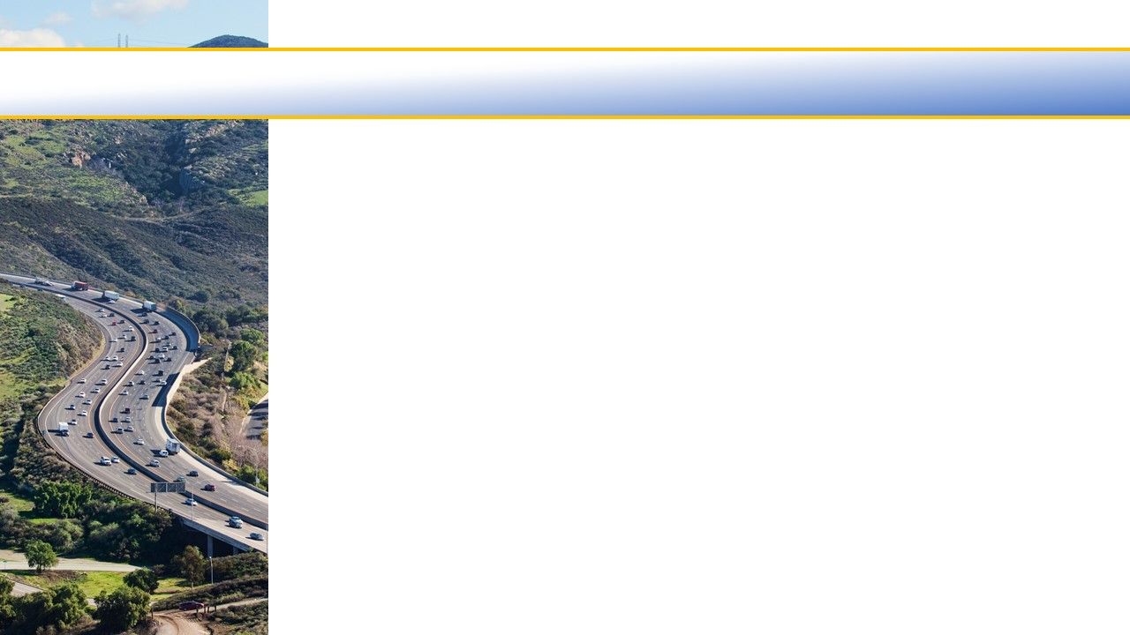
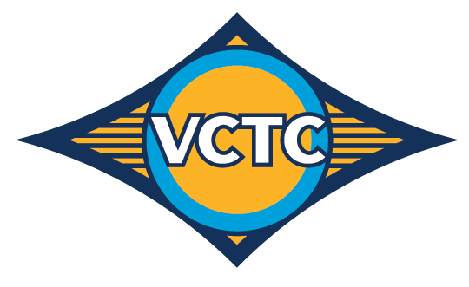
Ventura County Transportation Commission
Design and Project Management Services Support for Camarillo Rail Station ADA Improvements
April 7, 2023

Slide 2
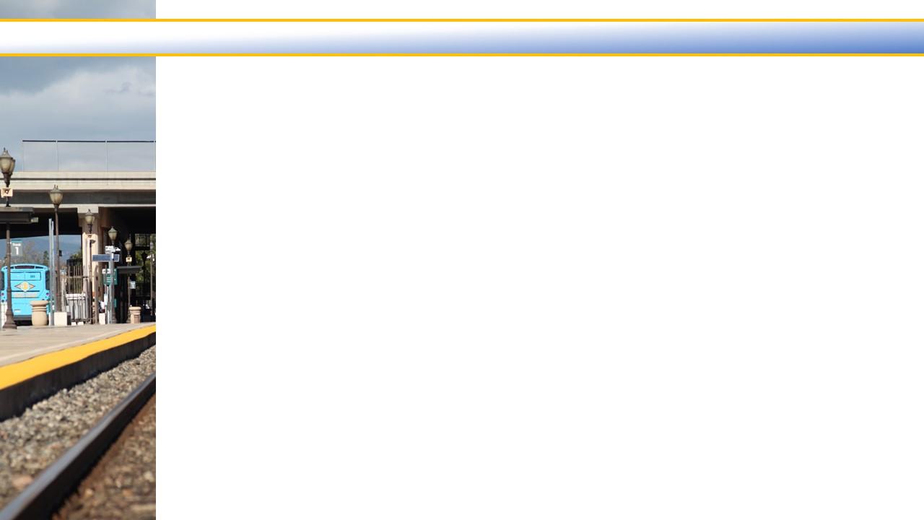
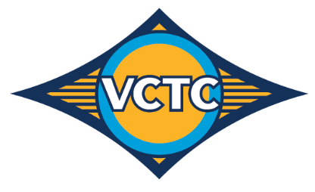
Background
2018 – US Attorney Office conducted an ADA compliance review and identified violations of Americans with Disabilities Act (ADA)
VCTC entered agreement with US Department of Justice (DOJ) to remedy issues
In 2021, VCTC commissioned an accessibility evaluation of the station
Staff currently working with Amtrak, LOSSAN, SCRRA, and City of Camarillo to replace non-compliant signage
Notes:
Independent Licensed Architect (ILA) surveyed the station for all components that are inaccessible to or unusable by individuals with disabilities

Slide 3
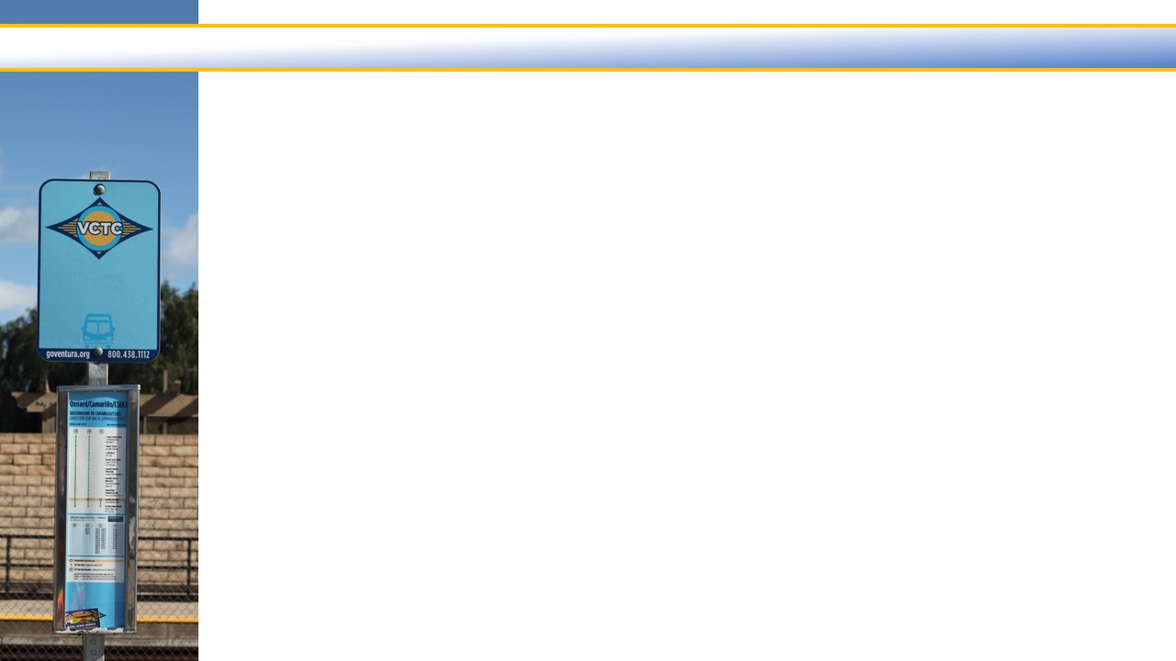
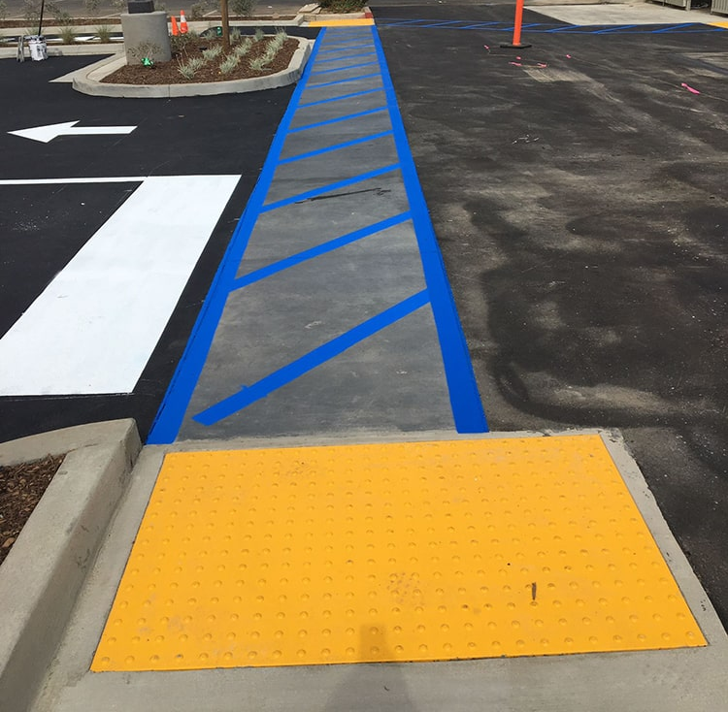
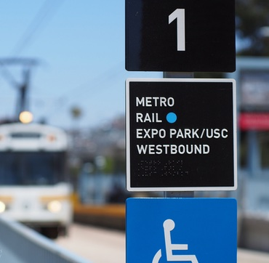
Accessibility Evaluation Report Findings
Increase accessibility on travel paths
Correct abrupt elevation changes and excessive slopes
Add detectable warnings at pedestrian/vehicular transition areas and passenger loading zones
Increase landing size for East side platform ramp
Improving information and directional signage to be ADA-compliant
Notes:
Increasing accessibility on travel paths from the public right-of-way, from public transit, from accessible parking, and from the passenger loading zones
Credit: Sunpeak Construction (https://sunpeak.com/ada-compliance-contractor/)

Slide 4
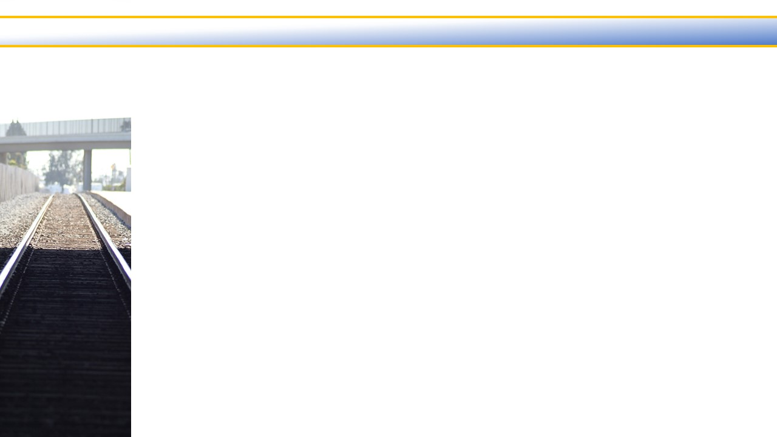
Camarillo Station ADA Improvements Project Overview
Design Phase
  Prepare design plans for construction bids
  Design services support through construction phase
  NTP anticipated April 7, 2023 with design services to be completed by March 2024
Construction Phase
  Construct improvements based on Final Design Plans
  NTP anticipated in Summer/Fall 2024 with completion in Fall 2026
Notes:
VCTC agreed to take remedial actions and a series of steps to make the Camarillo Station readily accessible to and usable by individuals with disabilities, including those who use wheelchairs

Slide 5
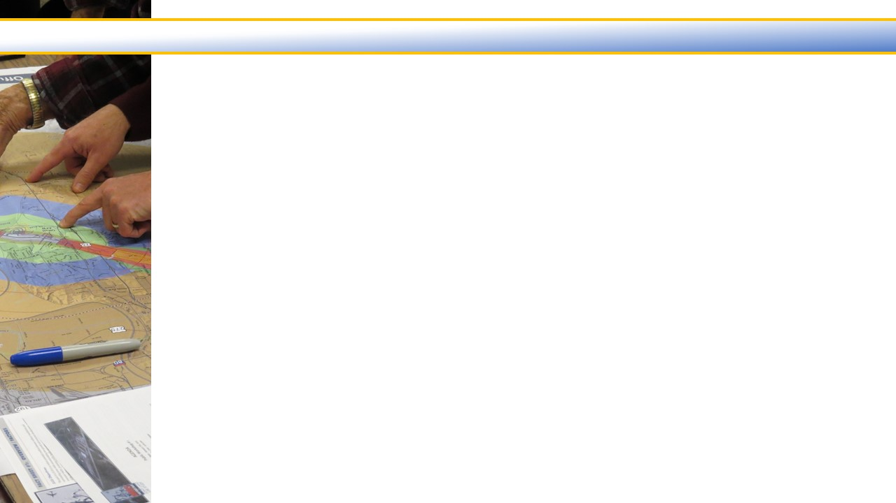
Design Project Tasks
Task 1 – Preliminary Engineering and Final Design
  Provide Project Management through Design Phase
  Conduct site visit and outline remedies needed to comply with ADA requirements
  Develop final design plans and construction bid documents
Task 2 – Bid Phase
  Provide bid support during construction bid solicitation
Task 3 – Design Support During Construction
  Review Construction contractor submittals for compliance
  Provide minor design modifications
  Review contractor change orders

Slide 6
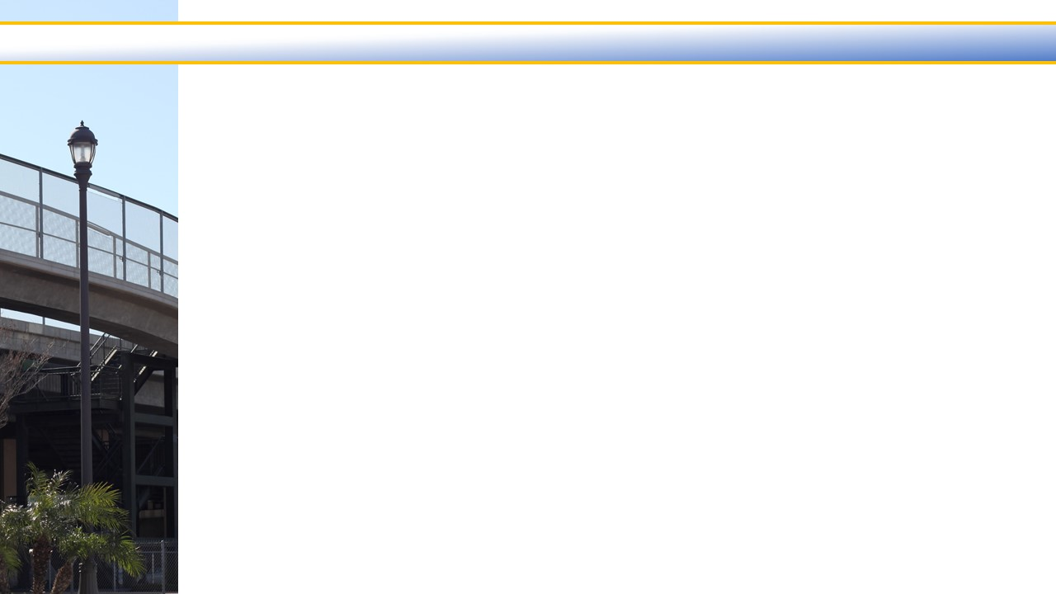
Other Ongoing/Planned Projects
Camarillo Train Station Pedestrian Undercrossing
  Construct pedestrian undercrossing to improve access between the two parking lots and improve train operations by utilizing both platforms
  Currently in pre-design phase
  VCTC staff is coordinating with City of Camarillo, LOSSAN, Amtrak, and SCRRA on this project
  Rail Pros, Inc. is the design consultant
Notes:
The underpass will replace the circuitous overcrossing that currently connects the two rail platforms at the station.
The new underpass will increase rail capacity and will significantly improve access for rail passengers, particularly those riders with mobility needs.
The current overcrossing requires passengers to either climb multiple flights of stairs or use long, winding ramps to access Platform 2.
The overcrossing does not meet current Americans with Disabilities Act (ADA) requirements, limiting platform access for riders with mobility needs
The rail station is also a pickup and drop-off spot for VCTC’s Intercity bus service and the City of Camarillo’s trolley service.
Increasing rail capacity at the station could lead to more riders choosing the bus and trolley for their trips to and from the station.

