Slide 1
BROADBAND STATUS
VCTC BOARD PRESENTATION
Ventura County IT Services
January 6, 2023

Slide 2
COUNTY PROJECT VISION
Objectives described in 2019:
  Economic Development (described in the County’s Economic Vitality Plan)
  Reduce County costs for internet access
  Facilitate interconnection of County and other government facilities at lower costs
  Provide communication redundancy and resiliency
  Close the digital divide to the underserved and disadvantaged
Approach:
  Phased build of redundant Middle-Mile fiber systems that connect to low-cost internet points of presence
  Government-owned and privately-operated fiber network funded by grants and public/public, public/private joint-build investments
Notes:
Benefits to economic development
Connect smaller businesses to the larger economy
Telework options
Safer and more vibrant communities through smarter, faster infrastructure
Online learning (workforce development)
Middle mile – like an actual freeway and the county highway system. These connect to local arteries (Vineyard, Rice, etc), which then connect to city and neighborhood streets.

Slide 3
PARTNERS
County Economic Vitality Steering Committee
Magellan Advisors – Broadband consulting experts specializing in public/private solutions
Broadband Consortium of the Pacific Coast
Economic Development Collaborative
Southern California Association of Governments
Cities, VCTC, CPUC, water districts and service providers

Slide 4
COUNTYWIDE COLLABORATION
City Managers
City and County IT Managers
City and County Public Works Directors
Utilities (Water, Gas, Electric)
Ventura County Transportation Commission
Public Safety Officials
CalTrans

Slide 5
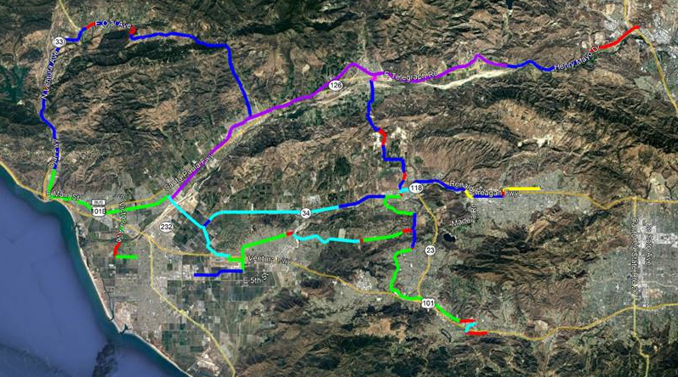
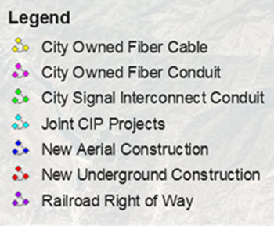
EXISTING AND PLANNED
GOVERNMENT-MANAGED FIBER
POP

Slide 6
PROPOSED MIDDLE MILE PROJECT ALIGNMENTS

Slide 7
VERY PRELIMINARY COST ESTIMATES
Highway 126 Alignment = $6.2 Million
Highway 118 Alignment = $5.0 Million
Highway 150/33 Alignment and Spurs = $8.8 Million
TOTAL ESTIMATED COSTS = $ 20 Million
Funding is expected to come from a combination of:
    Federal and State grants
    Use of existing underground and aerial assets and future public works and water district projects to further reduce costs
    Partnership joint efforts (share the trench)
    General Fund if necessary

Slide 8
VERY PRELIMINARY COST ESTIMATES
The cost of the last mile…
  Based on SCAG’s overall estimates ($8B) for SoCal
  And extrapolating those to Ventura County ($600M)
  And the cost of the planned Middle-Mile routes ($20M)
  The cost of the branch lines and the last mile infrastructure to the homes is estimated at $580M

Slide 9
NATIONAL, STATE, and LOCAL STATUS

Slide 10
NATIONAL, STATE, and LOCAL STATUS
FEDERAL
Economic Development Administration (EDA) Grants
FCC - Affordable Connectivity Program (ACP)
  $30/month subsidy for qualifying households

Slide 11
NATIONAL, STATE, and LOCAL STATUS
STATE
Open Access Middle-Mile Initiative
  Public Utilities Commission (CPUC) – Oversight of $6B in funding for State’s Open Access Middle-Mile
  Dept of Technology – Technical Design
  Golden State Network/CENIC – Administration
  CalTrans – Construction
State Grants
  Design and Planning – Awarded Local Agency Technical Assistance (LATA) $500K
  Last Mile Infrastructure Build – Applying for $20.4M Allocated to Ventura County
  Capital Projects – Applying for a portion of $580M

Slide 12
NATIONAL, STATE, and LOCAL STATUS
LOCAL
Pacific Coast Broadband Consortium
  Working on multi-county strategic plan
  Assisting with Letters of Support
  Digital Equity Coalition and ACP initiatives
Ventura Council of Governments (VCOG)
  Submitted for LATA grant funding

Slide 13
NATIONAL, STATE, and LOCAL STATUS
LOCAL
Local agencies awarded LATA grants
  County - $491,420
  Santa Paula - $192,050
  Ventura - $473,270
Local agencies submitting LATA grants
  Port Hueneme

Slide 14
NATIONAL, STATE, and LOCAL STATUS
LOCAL
CPUC/County partnership
  County has proposed partnering with the State for projects within the County
  The State would turn over the funds earmarked for the County routes
  The County would find the partner to perform the construction and manage the project
  The County would install conduit and fiber per the State’s requirements in addition to our own

Slide 15
VENTURA COUNTY UPDATE

Slide 16
LATA FUNDING FOR THE COUNTY OF VENTURA
Submitted and were approved for $491K
To complete detailed design work for the 126 and 118 routes

Slide 17
OBTAINING FUNDS AND A PARTNER
Obtain $6.2M for the 126 route through EDA grant funding (possibly multiple grants)
Require 25% matching funds
There are telecom providers willing to partner and provide matching funds
RFP to be released in January with a March target for proposals

Slide 18
DIGITAL EQUITY
Working with the Oxnard Union High School District on hurdles to parents signing up for internet at home
Now adding two specific disadvantaged neighborhoods
Working with Santa Barbara County to align efforts
Ongoing partnership with SCAG digital equity efforts
The launch of a Digital Equity Coalition coordinated by the Ventura County Community Foundation (VCCF) is planned for February 23, 2023

Slide 19
SANTA PAULA BRANCH RAILWAY
The railway aligns almost perfectly with the proposed 126 Middle-Mile segment
Due to the mostly unobstructed right of way, plowing can be used for substantial cost savings
Opportunity to generate a revenue stream by sharing the trench or by leasing County fiber
Small number of stakeholders

Slide 20
VENTURA COUNTY TRANSPORTATION COMMISSION
Opportunity for a partnership where the County and VCTC share the railway asset and potential revenue
Use of Middle-Mile to interconnect VCTC facilities
Use of Middle-Mile to replace aging communications infrastructure along the railway and other VCTC-managed transportation routes
Enable additional security/lighting
Enable new Internet of Things (IoT) devices such as sensors

Slide 21
NEXT STEPS

Slide 22
VENTURA COUNTY TRANSPORTATION COMMISSION
Request support from your Board to review and consider a County-produced contract between VCTC and the County for use of the Santa Paula Branch Line Right-of-Way for fiber installation

Slide 23


THANK YOU!
QUESTIONS?

