Slide 1


State Transportation Funding
Steven Keck
Chief Financial Officer, California Department of Transportation

Slide 2
Primary Transportation Fund Sources Flowing Through the State
Federal Funding
  Fuel taxes (gasoline and diesel)
  Federal “General Fund” funding
  Federal Truck and Tire fees
State Funding
  Gasoline and Diesel excise taxes
  Sales Taxes on Diesel
  State Commercial Vehicle Weight Fees
  Cap and Trade Revenues
  Transportation Improvement Fee
  Zero Emission Vehicle (ZEV) Fee

Slide 3
Senate Bill 1 - The Road Repair & Accountability Act
Also referred to as SB 1, was signed by Governor Brown on April 28, 2017.
Increased transportation funding by $54 billion over ten years.
New excise tax and fee increases are permanent and indexed for inflation.
Focuses on “Fix It First”.
Splits Funding equally between State and Local priorities.
Calls for accountability and transparency.
Constitutional Amendment to protect funds for transportation purposes.

Slide 4
SB1 State and Local Programs (in millions)

Slide 5
Primary Transportation Revenue
Gasoline = 72.3 cpg
  Federal Excise Tax – 18.4 cents per gallon (cpg)
  State Base Excise Tax – 53.9 cpg
Diesel = 65.4 cpg + 10.5% sales tax
  Federal Excise Tax – 24.4 cpg
  State Excise Tax – 41 cpg
  Sales taxes – 10.5%
Transportation Improvement Fee
  $28 - $196 (adjusted annually) due at time of annual registration based on value of vehicle as determined by Department of Motor Vehicles
Zero-Emission Vehicle Fee (Road Improvement Fee)
  $102 due at time of annual registration on zero-emission vehicles model year 2020 and later
Commercial Vehicle Weight Fees
  Used to service debt on transportation-related bonds

Slide 6
Federal Infrastructure Law
$1.2 trillion Infrastructure Investment and Jobs Act approved on November 15, 2021.
  Reauthorized surface transportation programs for five years
  $550 billion in new spending in addition to regular annual spending on infrastructure.
  Created new competitive transportation grant programs and increases funding for existing competitive programs.
California is estimated to receive the following formula funding over the five-year life of the bill:
  $25.7 billion — Federal-aid highway apportionment
    New Programs – EV Infrastructure, Carbon Reduction and PROTECT
  $4.2 billion — (New) Bridge replacement and repair
  $9.45 billion — Public Transportation

Slide 7

How Transportation Funding Works
https://vimeo.com/459031006/cdaba68b6e

Slide 8


…may come with problems

Slide 9
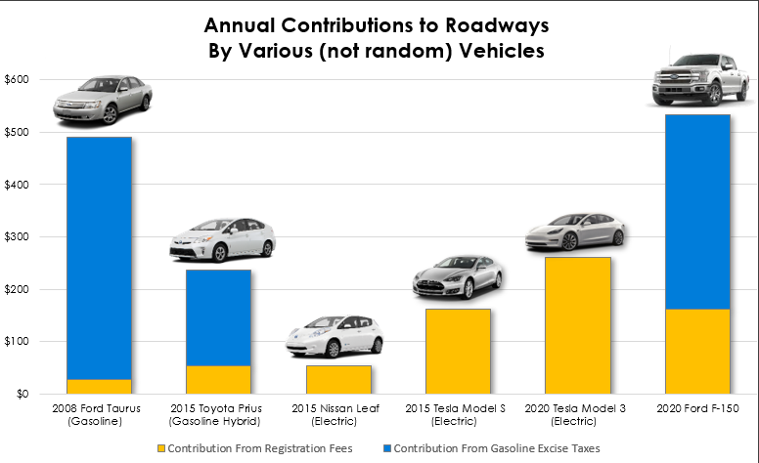
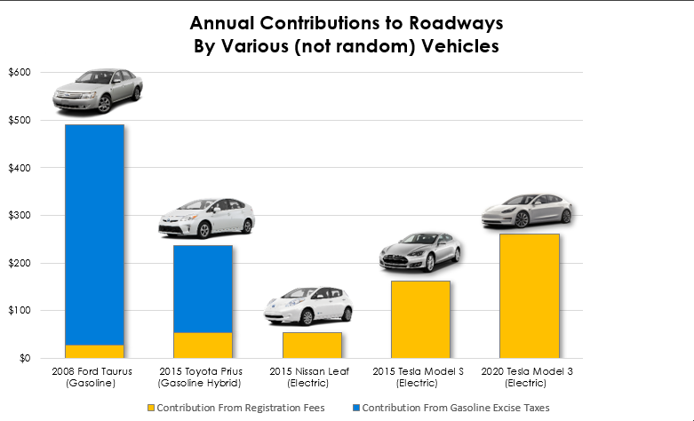
Imbalance in the Current System

Slide 10
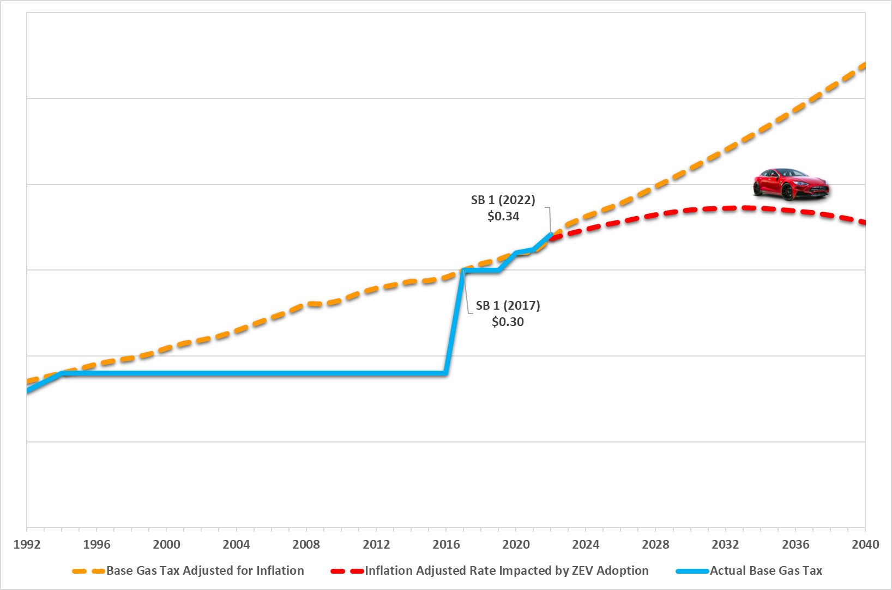
ZEV Adoption Impacts to the Effectiveness of the Gas Tax

Slide 11
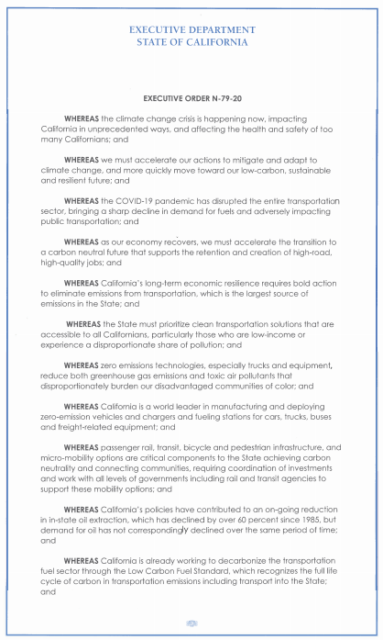
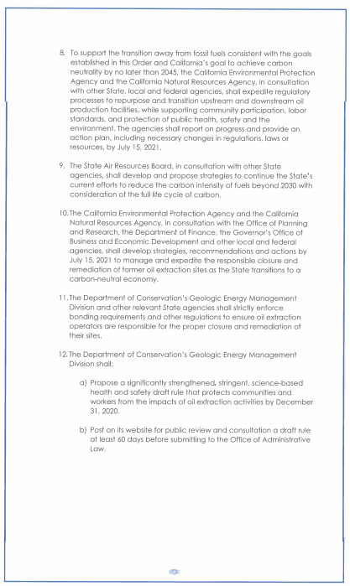
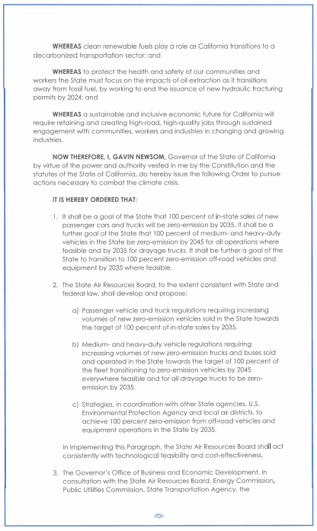
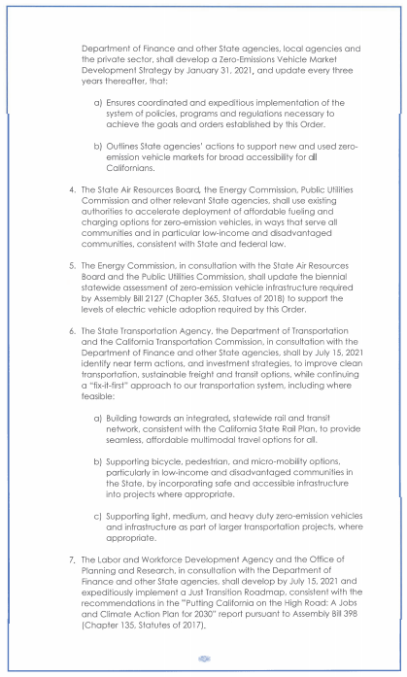
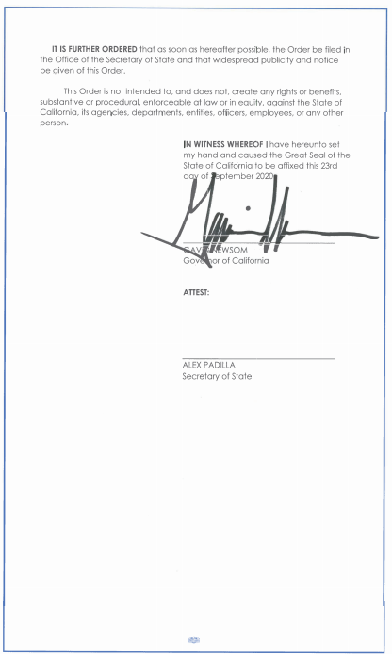
The Future is Closer Than You Think

Slide 12
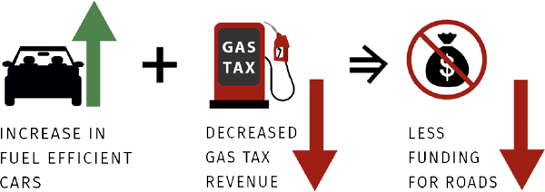
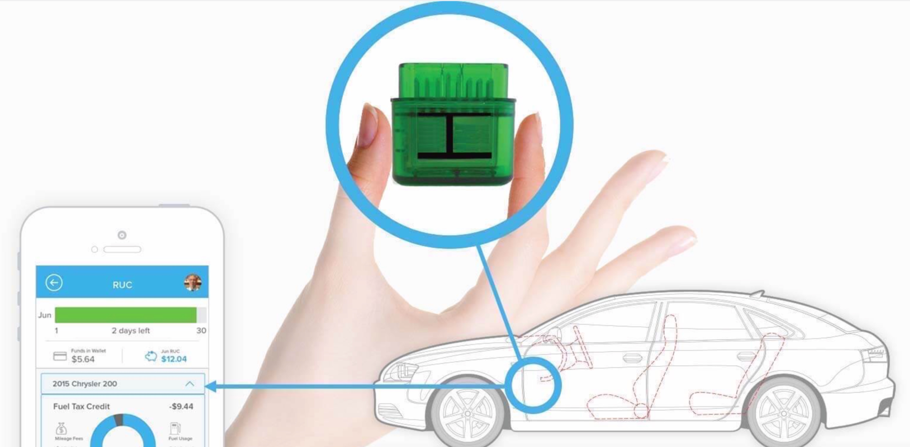
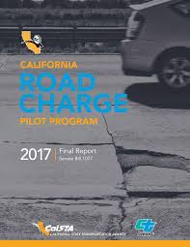
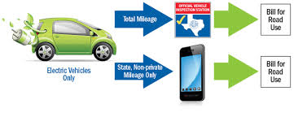
What Do We Need to Do?
Modernize the Transportation Funding System from the ground up
Address “Fair Share” issues
Take the opportunity to address equity issues
Communicate
Communicate
Communicate

Slide 13
What is a Road Charge?
Road Charge is an innovative funding mechanism intended to replace the current gas tax, and more accurately ensures that all drivers are paying their fair share to use the road. Road Charge allows drivers to support local road and highway maintenance based on how many miles they drive, instead of how many gallons of gas they use.
California is studying Road Charge as:
A replacement for the gas tax
One per mile rate for all passenger vehicles
Revenue neutral, not a tax increase
Aims to stabilize funding, not change behavior
No change in how funding is spent: existing formulas and programs remain

Slide 14
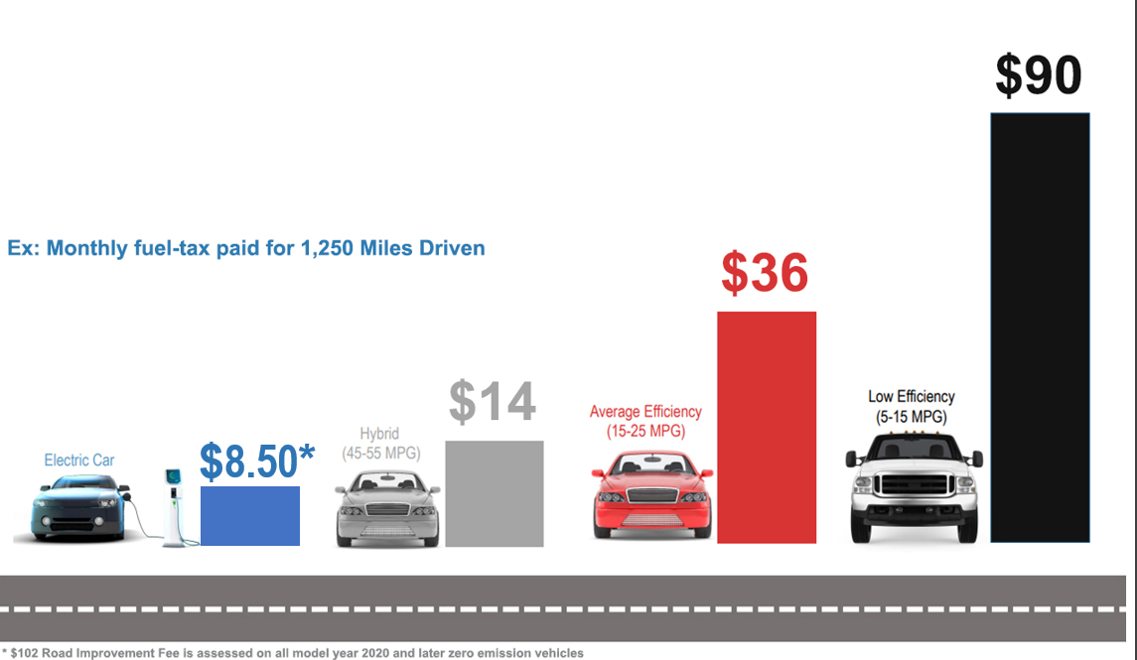
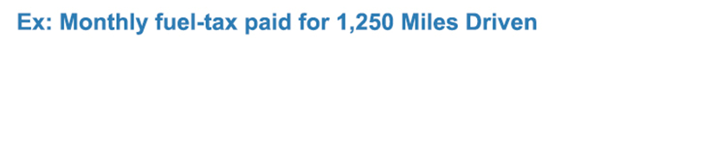
What drivers pay under the Gas Tax

Slide 15
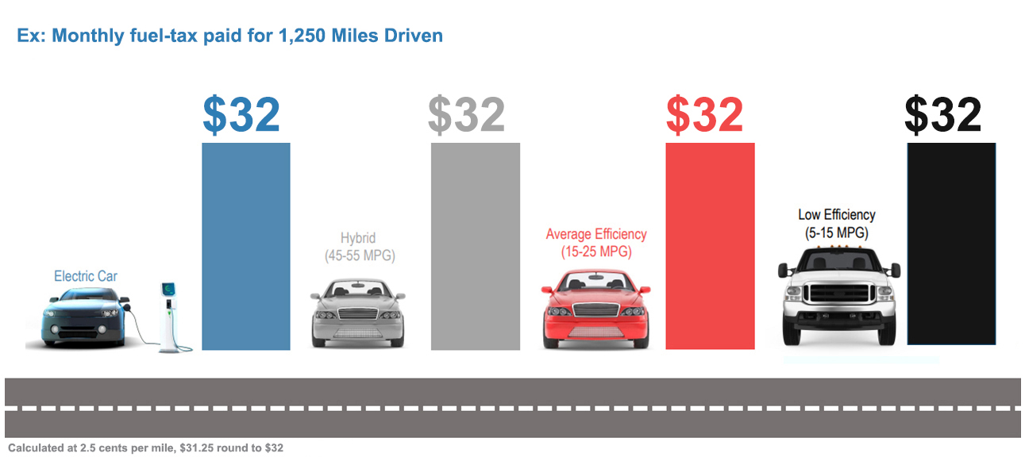
What drivers could pay under Road Charge

Slide 16
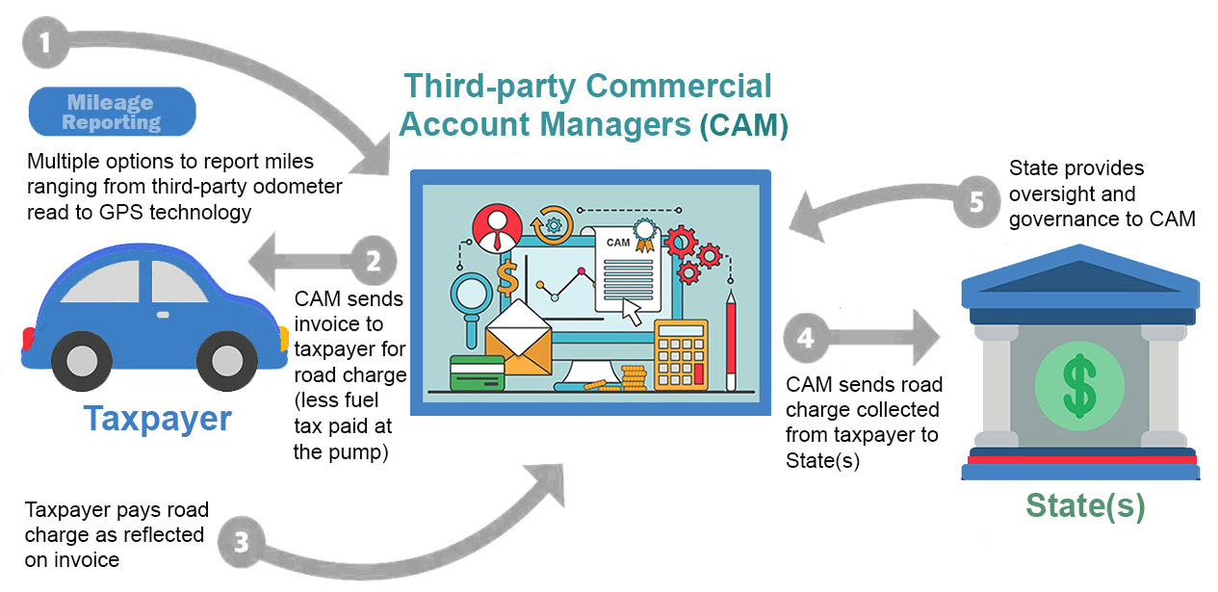
Road Charge System Structure

Slide 17

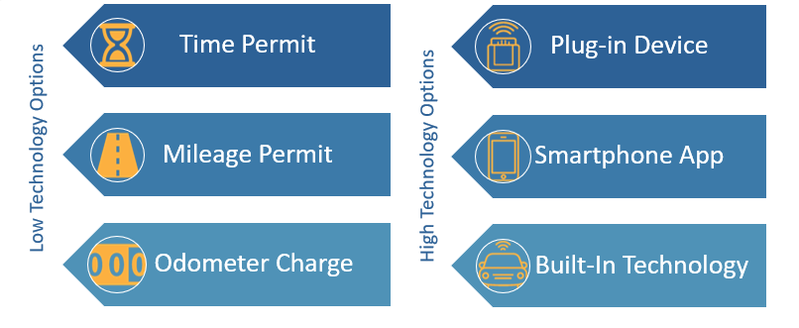
Mileage Reporting Methods

Slide 18
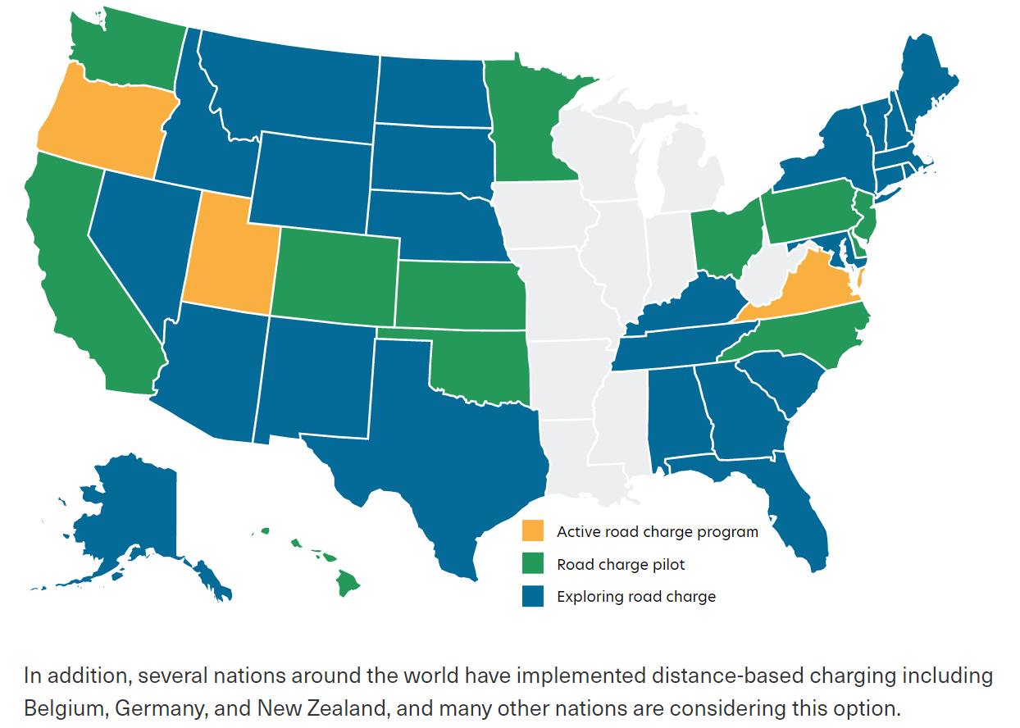
The National Picture

Slide 19
With the Governor’s Executive Order banning the sale of gas-powered vehicles in 2035, can a Road Charge be implemented in time?
Based on the experience of other states, and given the size and complexity of California, we expect the Legislature would want to explore a phased approach to potential implementation.
Such a phased rollout could likely be accomplished in 10-12 years.
As long as ZEVs are transitioned before 2035, there will not likely be long-lasting impacts to revenue.

Slide 20
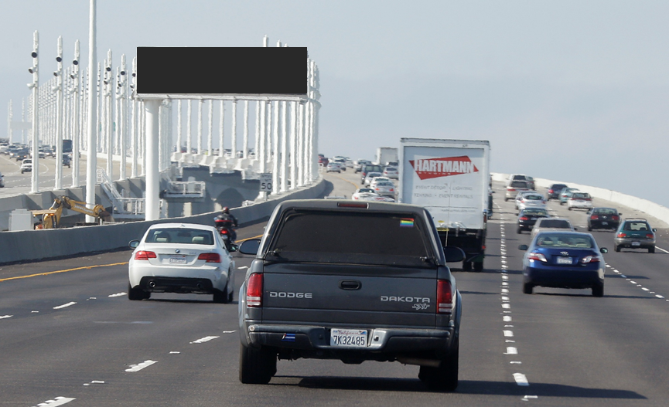

Questions
Questions?
THX 138

Slide 21
State Transportation Funding
Auxiliary Information – Slides cut for time, but interesting

Slide 22
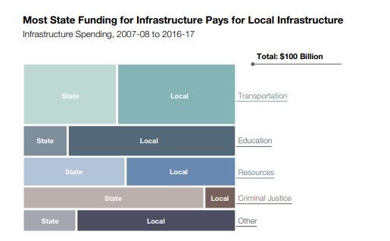
State Funding of State and Local Infrastructure
Excerpted from:
“CalFacts 2018”,
California Legislative Analyst’s Office
22

Slide 23
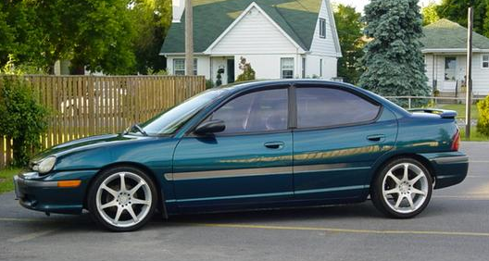

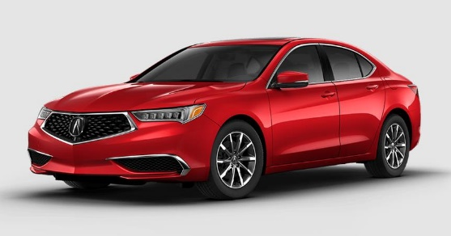
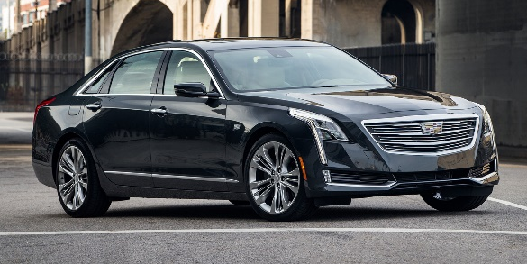

How the Transportation Improvement Fee Works

Slide 24
Impact of COVID-19
16B Gallons

