Slide 1
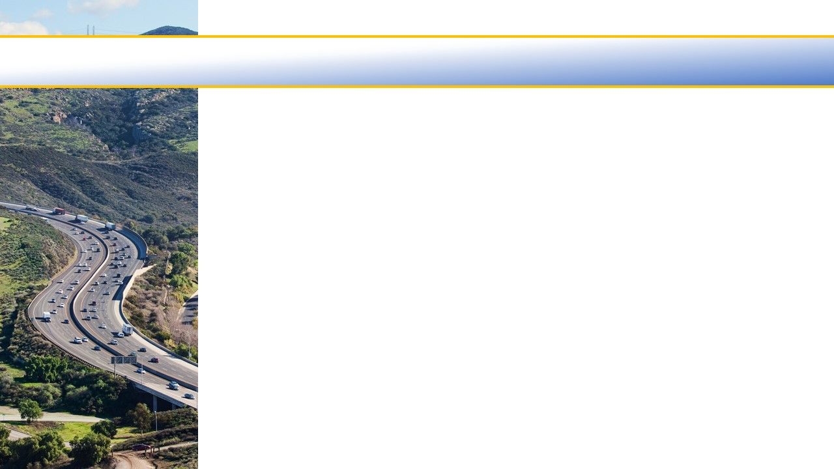

Ventura County Transportation Commission
Legislative Update
October 2022

Slide 2
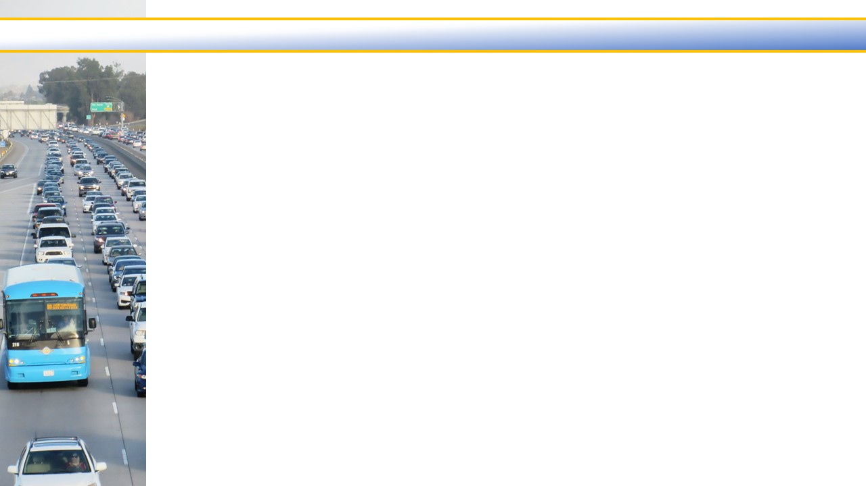

Bills monitored by VCTC
SB 922: CALIFORNIA ENVIRONMENTAL QUALITY ACT: EXEMPTIONS: TRANSPORTATION-RELATED PROJECTS
Summary:
  Expands California Environmental Quality Act (CEQA) exemptions for specified transit, bicycle, and pedestrian projects, and extends these exemptions from 2023 to 2030.
  Does not exempt projects that increase single-occupancy vehicle trips, add highway lanes or widen highways.
Status: Signed. Takes effect Jan. 1, 2023.
SB 942: LOW CARBON TRANSIT OPERATIONS PROGRAM: FREE OR REDUCED FARE TRANSIT PROGRAM
Summary:
  Extends use of Low-Carbon Transit Operations Program (LCTOP) for free and reduced-fare transit programs.
  After demonstrating compliance with certain requirements in the initial program application, transit agencies would not need to continue to demonstrate compliance to maintain the program on an ongoing basis.
Status: Signed. Takes effect Jan. 1, 2023.
2

Slide 3
Questions?
Thank you!
3

