Slide 1


Ventura County Transportation Commission
Executive Director’s Report
October 2022

Slide 2
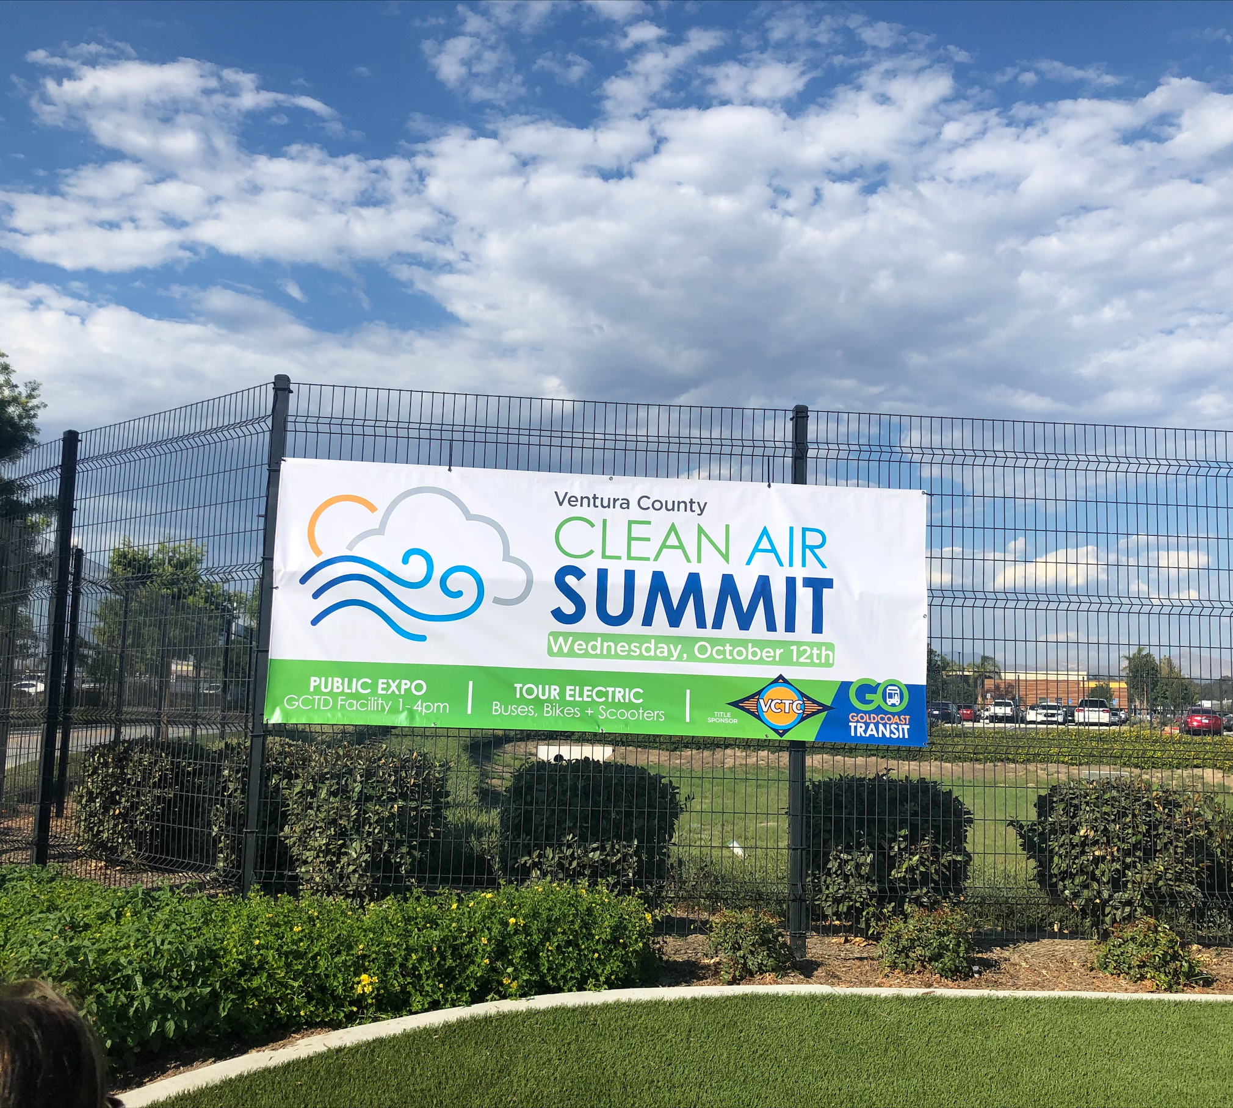
Ventura County Clean Air
Summit & Expo
Organized and hosted by Gold Coast Transit District
VCTC is event partner and sponsor
Wednesday, Oct. 12, at GCTD facility in Oxnard
Morning summit 8:30-noon (RSVP required)
Expo 1-4 p.m. featuring e-bike, e-scooters, buses (open to the public)

Slide 3
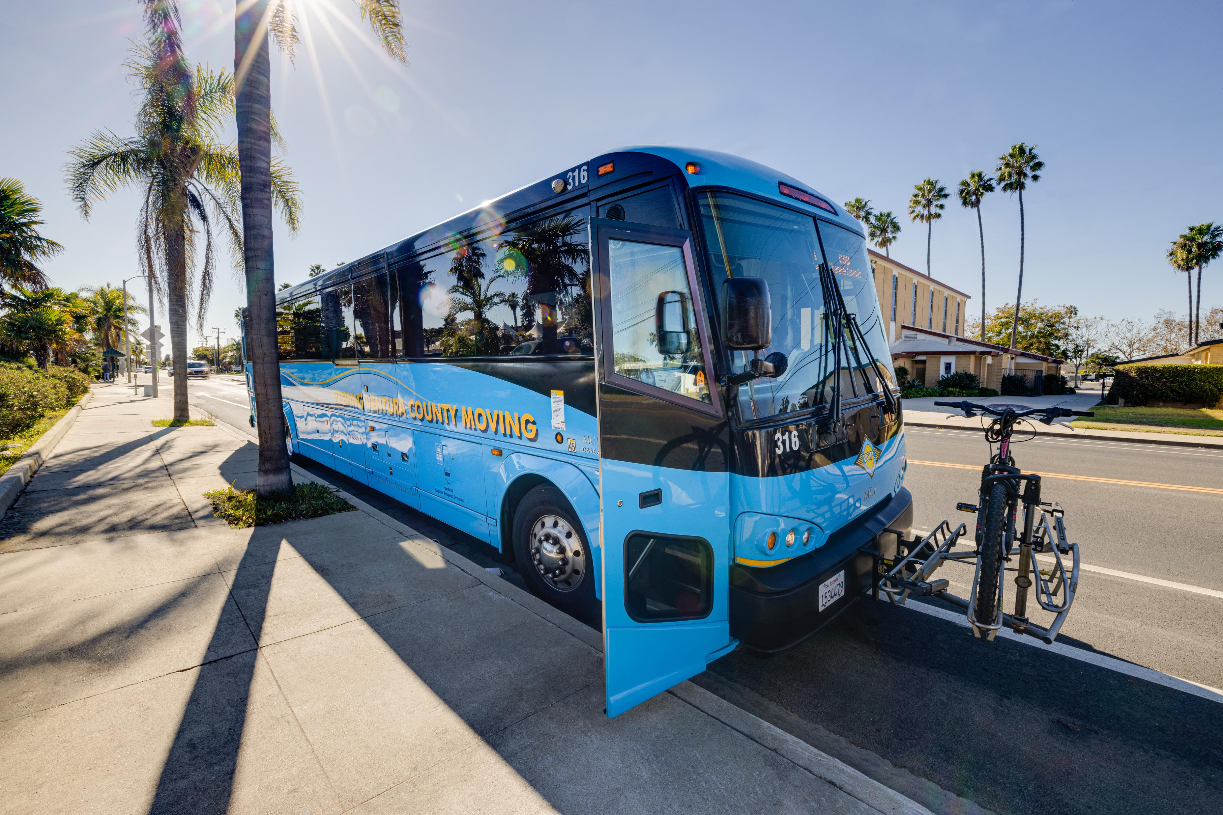
Rideshare Week 2022
Rideshare Week is Oct. 3-7
People are encouraged to use public transit, carpool, bike or walk to work
VCTC invites people to pledge to rideshare during the week
Goventura.org/pledge
Pledges accepted until Oct. 15

Slide 4
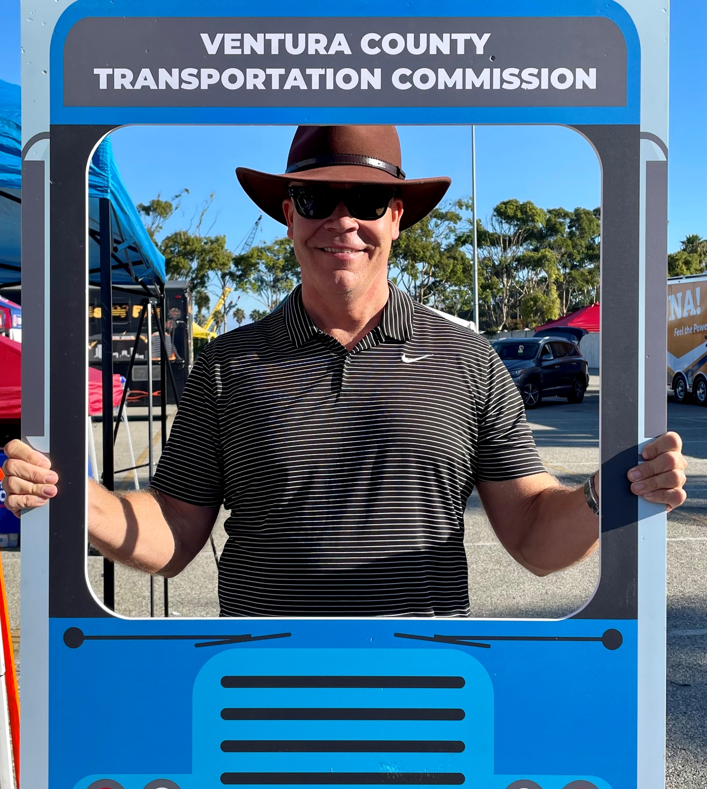
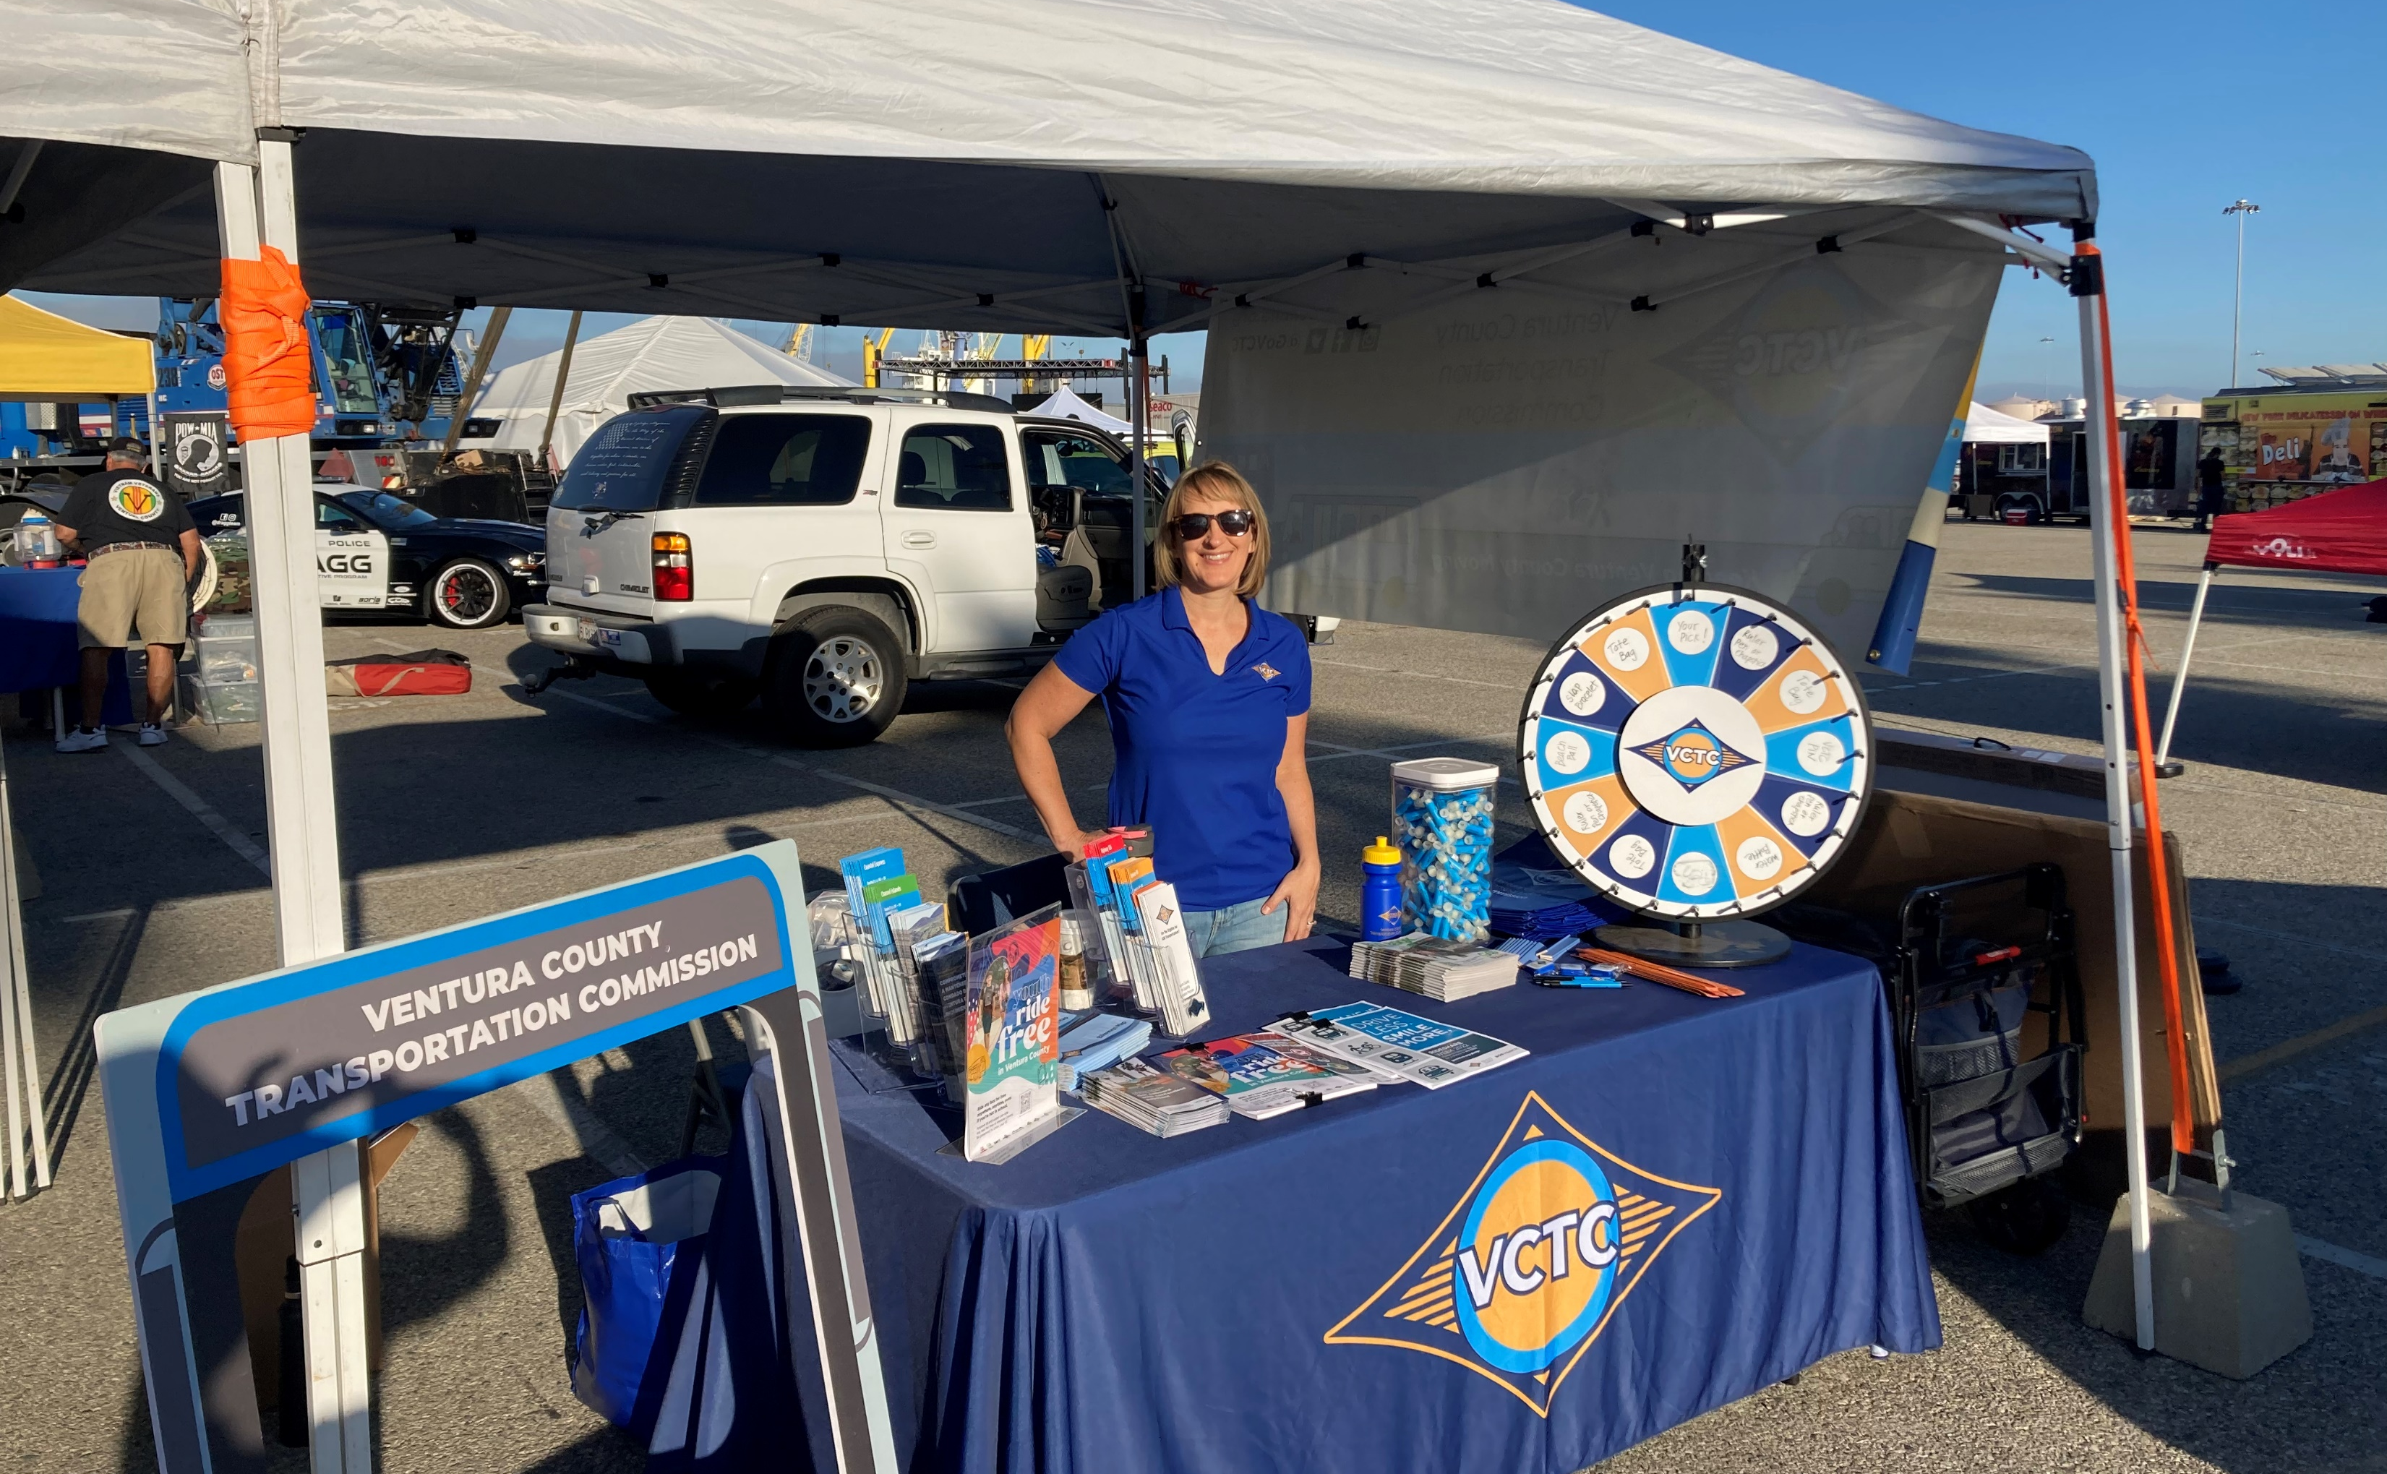
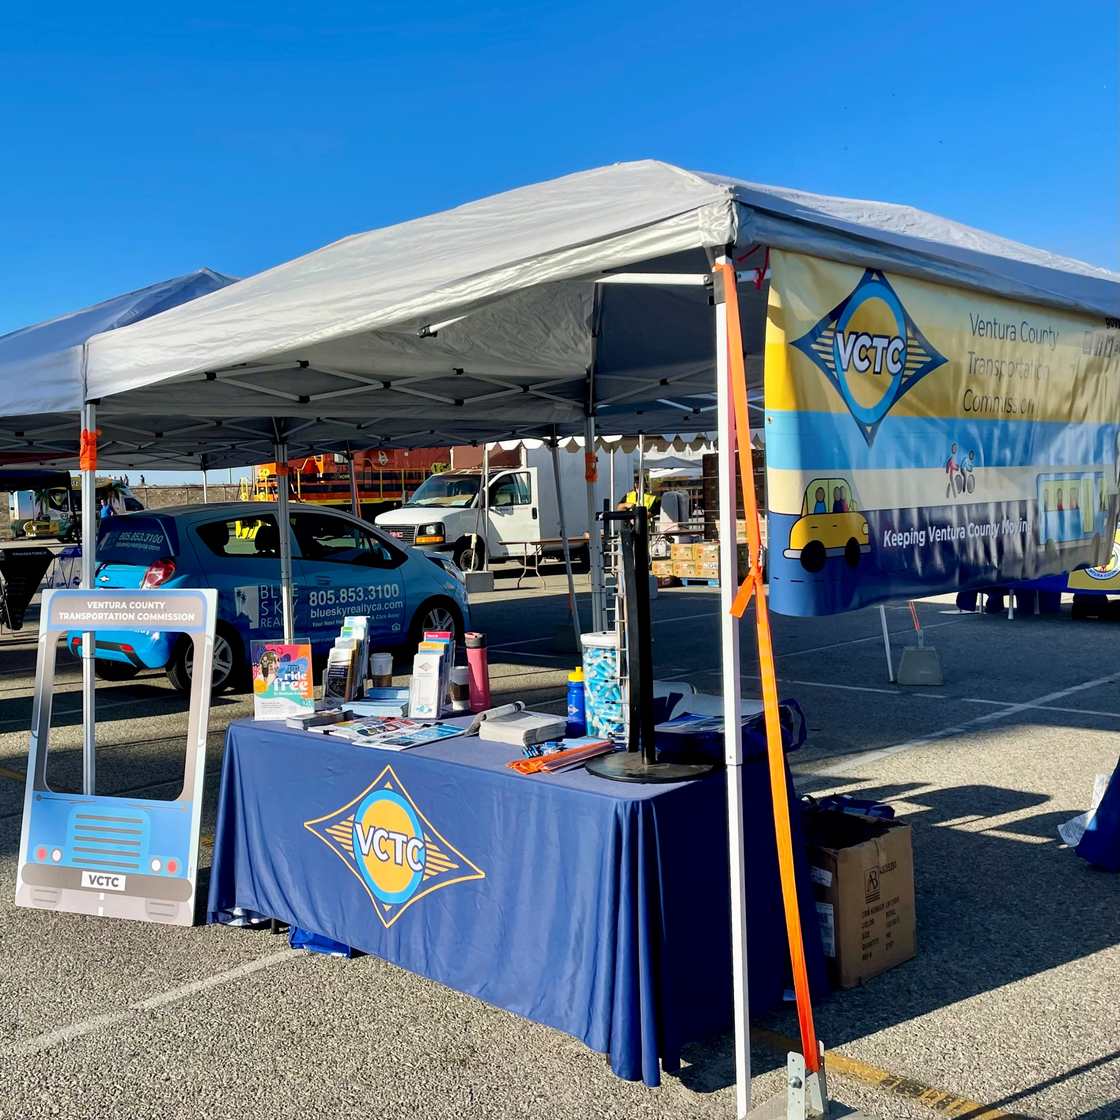
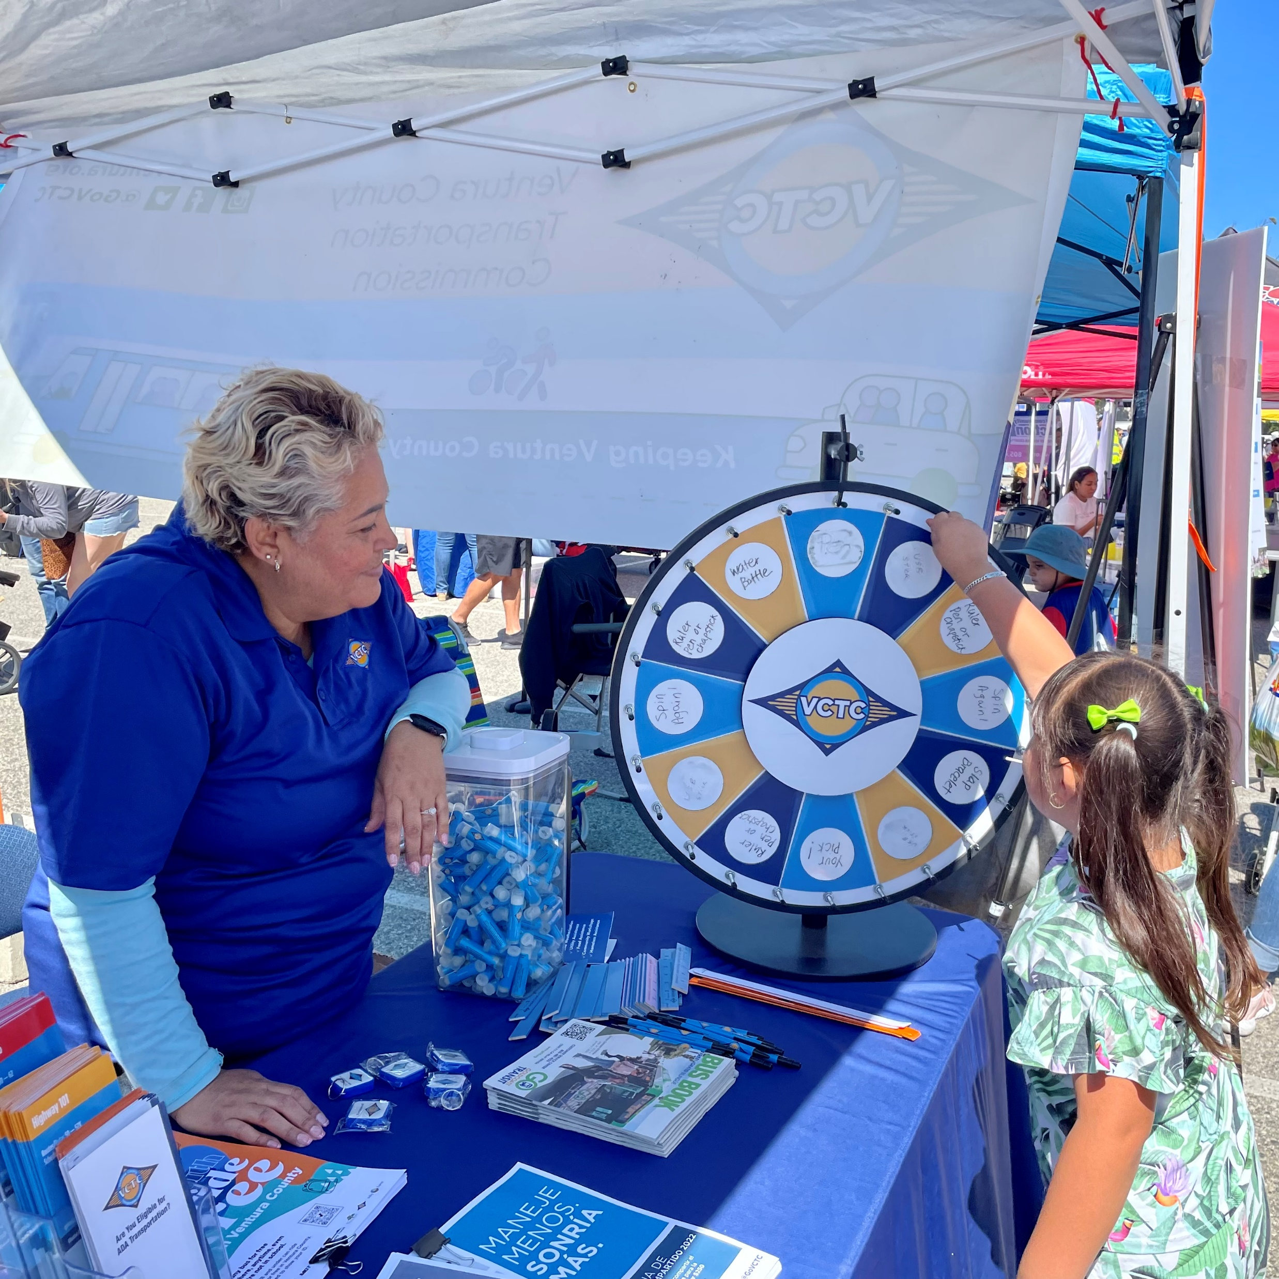

Port of Hueneme Banana Festival

Slide 5
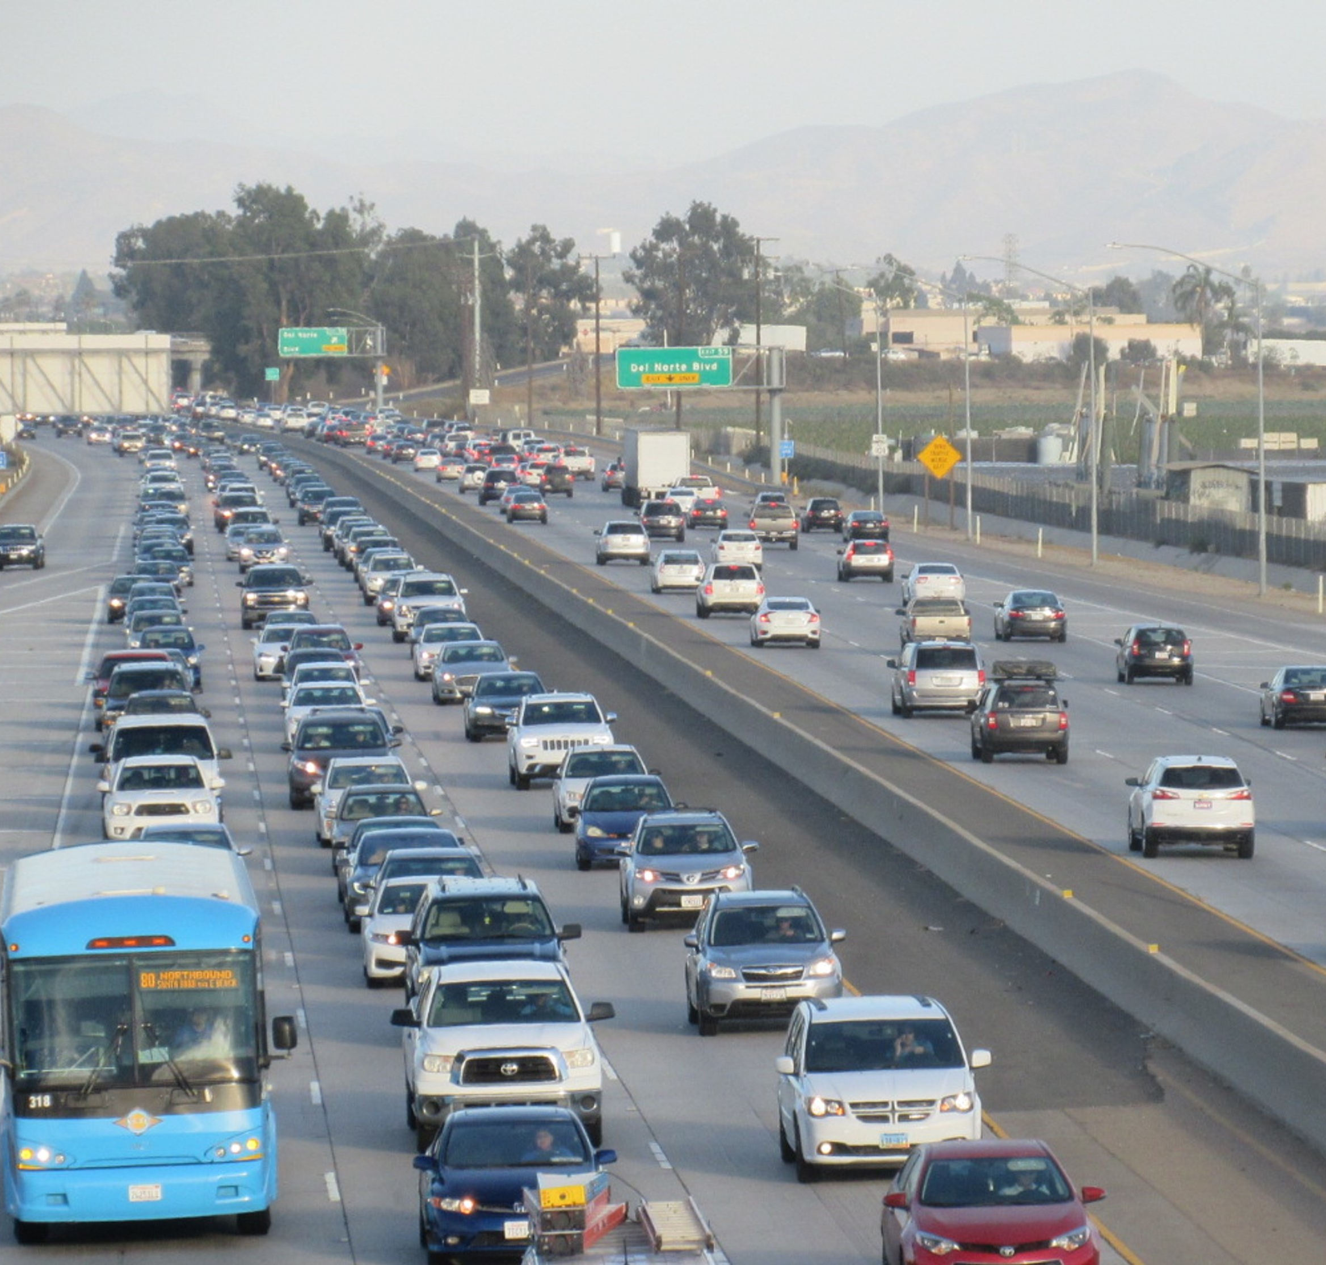
Thank you!

