Slide 1

Ventura County Transportation Commission
Item #10
FTA 5310 & FTA 5307/JARC CALL-FOR-PROJECTS
FY2022/23 – FY2023/24 CYCLE
PROJECT RECOMMENDATIONS

Slide 2
Fta section 5310 & 5307 jarc
FTA SECTION 5310
FTA SECTION 5307 JARC
enhance mobility for seniors and persons with disabilities
support special needs beyond traditional public transportation services
beyond that required by the Americans with Disabilities Act (ADA)
Job Access Reverse Commute
improve access to employment and employment related activities
eligible low-income individuals
to transport residents to suburban employment opportunities

Slide 3

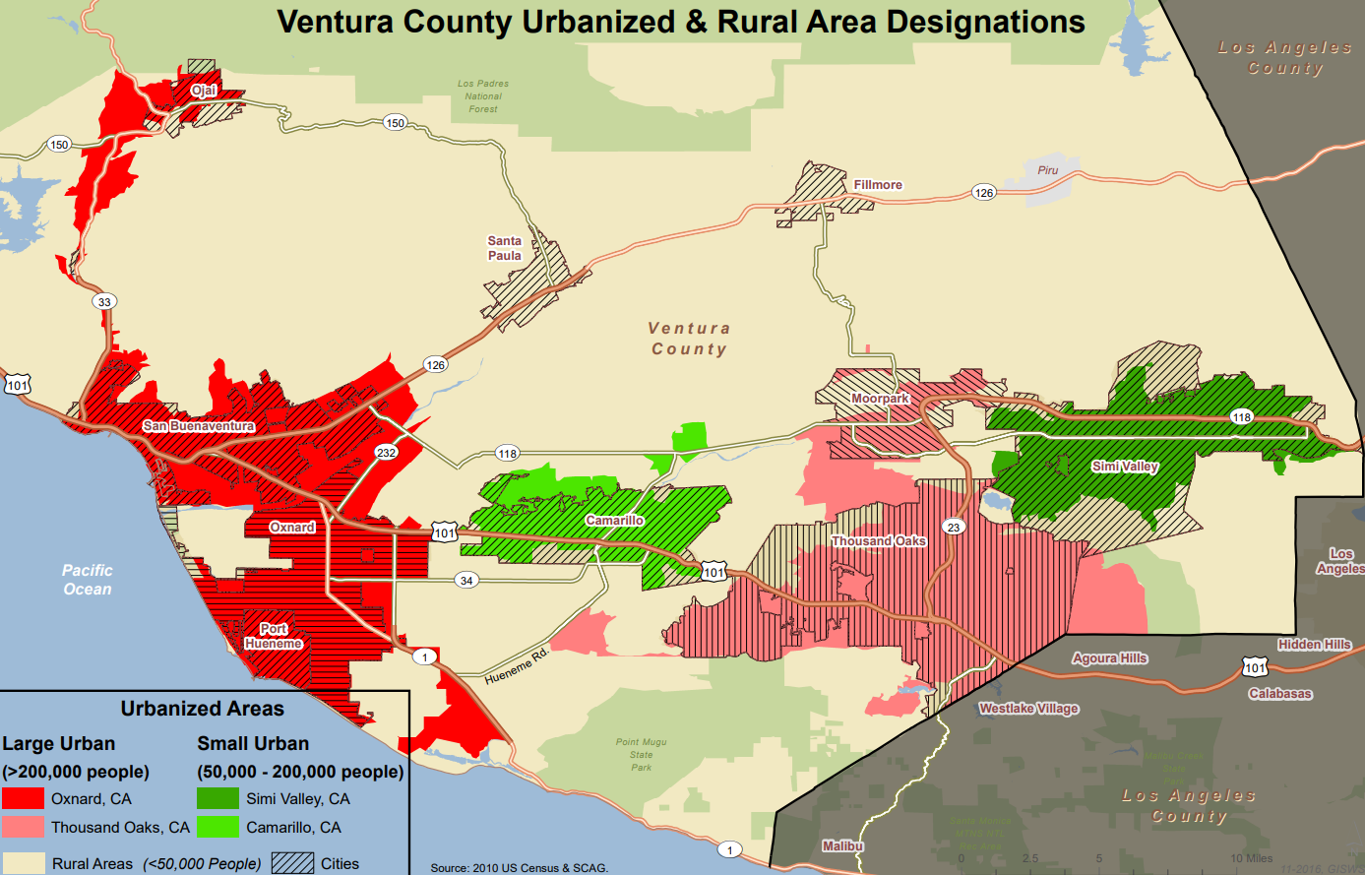
VCTC ROLE – FTA 5310 & JARC
LARGE URBANIZED AREA IN VENTURA COUNTY OXNARD/VENTURA AND THOUSAND OAKS/MOORPARK
PRIMARY FUNDING SOURCE FOR PROJECTS IDENTIFIED IN THE COORDINATED PLAN
  OPERATIONS & CAPITAL
ALLOCATED BY VCTC ON A COMPETITIVE CALL-FOR-PROJECTS

Slide 4
CALL FOR PROJECTS fund availability
Available Funding for Section 5310 and 5307/JARC Call for Projects 2022
Urbanized Area (UZA) | FTA 5310 Traditional | FTA 5310 Expanded | FTA 5307 JARC
Oxnard/Ventura | $ 876,923 | $ 577,892 | $ 658,360
Thousand Oaks/Moorpark | $ 413,238 | $ 379,892 | $ 175,139
TOTAL | $ 1,290,161 | $ 957,784 | $ 833,499
FY 22/23 & FY23/24
TOTAL FUNDING AVAILABILITY: $3,081,444

Slide 5
Call for projects applications
11 agencies
15 project applications
Total requested $5,626,113
Requests in excess of available funding by $2,544,669

Slide 6
Call for projects prioritization
TRANSCOM subcommittee
Ranked by funding type and urbanized area
Fund as many projects as possible
Average final score per project
Adopted 100-point criteria

Slide 7
Sponsor Agency | Proposed Project | Recommended Funding
VENTURA COUNTY HUMAN SERVICES AGENCY | RAIN TLC WORK RELIABILITY TRANSPORT | $ 148,000
EAST COUNTY TRANSIT ALLIANCE (T.O.) | SENIOR/ADA DAR VEHICLE LEASE | $ 200,000
EAST COUNTY TRANSIT ALLIANCE (T.O.) | SATURDAY SENIOR/ADA SERVICE | $ 40,000
CAMARILLO HEALTH CARE DISTRICT | CARE-A-VAN VEHICLE REPLACEMENT | $ 168,000
CITY OF THOUSAND OAKS | EMPLOYEE RIDESHARE OPERATIONS | $ 50,000
GOLD COAST TRANSIT DISTRICT | AGING ACCESSIBLE VEHICLE REPLACEMENT | $ 640,000
GOLD COAST TRANSIT DISTRICT | LATE NIGHT & SUN RISE DEMO PROJECT | $ 315,785
GOLD COAST TRANSIT DISTRICT | UNHOUSED EMPLOYMENT TRANSPORTATION (DEMO PROJECT) | $ 320,000
HELP OF OJAI | SENIOR & PARATRANSIT VEHICLE PURCHASE | $ 54,400
VENTURA COUNTY AREA AGENCY ON AGING | VCAAA'S ELDERHELP TRANSPORTATION PROGRAM | $ 690,000
CAREGIVERS | TRANSPORTATION FOR FRAIL, LOW-INCOME SENIORS | $ 150,000
INTERFACE CHILDREN & FAMILY SERVICES | 211 RIDE - ONE CALL/ONE CLICK | $ 224,000
FROM ATTACHMENT A

Slide 8
RECOMMENDATION
Approve programming $2,166,400 in Federal Transit Administration (FTA) Section 5310 Large Urbanized Area funds (Seniors and Disabled), and $833,785 in FTA Section 5307 Jobs Access/Reverse Commute (JARC) funds, for a total of $3,000,185 for projects listed in Attachment A.
TRANSCOM approved this item for recommendation on September 14, 2022.

