Slide 1
VCTC Coordinated Public Transit-Human Services Transportation Plan Update
Ventura County Transportation Commission (VCTC)
Claire Grasty
September 2022
Notes:
CTAC/SSTAC - 01.11.2022 - 1:30 p.m.
TRANSCOMM – 01.12.2022 - 1:30 p.m.
UTN – Countywide – Noon
UTN East County – 01.12-2022 – 6 p.m.
UTN Heritage Noon – 02.23.2022 - Noon
NOTE: As a reminder, this is in DRAFT mode. Following incorporation of feedback and confirmation of agenda times, we will create two separate slide decks for the two presentations.

Slide 2
Agenda
1
Project Purpose
2
What We've Learned
3
Plan Goals and Strategies
4
Changes to Draft Plan
5
Next Steps
6
Questions

Slide 3
Project Purpose
ABOUT THE PROJECT
Update of Coordinated Plan from FY 2016-2017
Required for Section 5310 funding
Document transportation access gaps, barriers, and opportunities for target communities (low-income, people with disabilities, seniors, youth, veterans)
Educate communities and human services on the full extent of available transportation services
Addresses similar issues as Transit Integration Efficiency Study (TIES), but greater emphasis on human services

Slide 4
Gaps & Needs Assessment
What we’ve learned
Trips involving multiple demand-response systems are complicated.
Some fixed-route stops remain difficult to access and are unprotected from the elements.
On-demand transportation options are limited for non-emergency medical transportation trips.
Older adults and people living with a disability have limited options for assistance to the front door of their destinations.
Cross-county & inter-county travel trips are hard to achieve, especially if outside larger population & transit centers.
People are generally satisfied with their local fixed-route service but want to see improved bus stop & station conditions.
People are unaware of the full range of transportation options offered in Ventura County.
Notes:
These are not presented in order of popularity or frequency in which the feedback came up during the community involvement process.
NOTE: For CTAC/SSTAC, we'll take questions at the end. For UTN -- If there is sufficient time, we can ask the public the extent they agree with these findings.
Also, as this project evolves and we refine these needs, we'll devote more time and slide space to each item.

Slide 5
Coordinated Plan Goals
Plan goals & STRATEGIES
The goals of the Coordinated Plan
(FY 2021 – 2022) include:
Enhance mobility of key communities (e.g., individuals with disabilities, seniors, people with low incomes, and veterans)
Improve connections and access to transit and services
Expand transportation options
Prioritize convenience

Slide 6
Coordinated Plan Strategies
Plan goals & STRATEGIES
Strategy | Priority | Category | Level of Implementation Effort
Document Accessibility of All Stations and Stops Countywide | High | Infrastructure | Medium
Continue Standardizing and Regularly Updating User Information on Existing Countywide Transportation Programs and Services | High | Policies | Medium
Continue Procuring Wheelchair-Accessible Vehicles | High | Infrastructure | Medium
Consolidate All ADA Paratransit Eligible Processes and Rider Databases | High | Policies | Medium
Expand Travel Training | High | Programs/Services | Medium
Pilot On-Demand Medical Rides | Medium | Programs/Services | Medium
Study Reduced/Free Fare Programs | Medium | Programs/Services | Low
Study Volunteer Driver Programs | Medium | Programs/Services | Low
One-Seat Demand-Response | Medium | Programs/Services | High
Feeder Services to Existing Regional and Inter-County Transit Hubs | Medium | Programs/Services | High
Notes:
There are some strategies that communities voted for that fell into the Medium Priority category.
Even though they are lower priority, VCTC and it's partners can still act on these now though the actual, more permanent implementation of these programs would take place a longer time
Implementation timeframe varies depending on funding availability, staffing, and resources though generally High Priority strategies can be implemented in the short-term (0-2 years) and Medium Priority Strategies can be implemented in the long-term (3-5 years) with short-term implementation steps that can be taken in the near

Slide 7
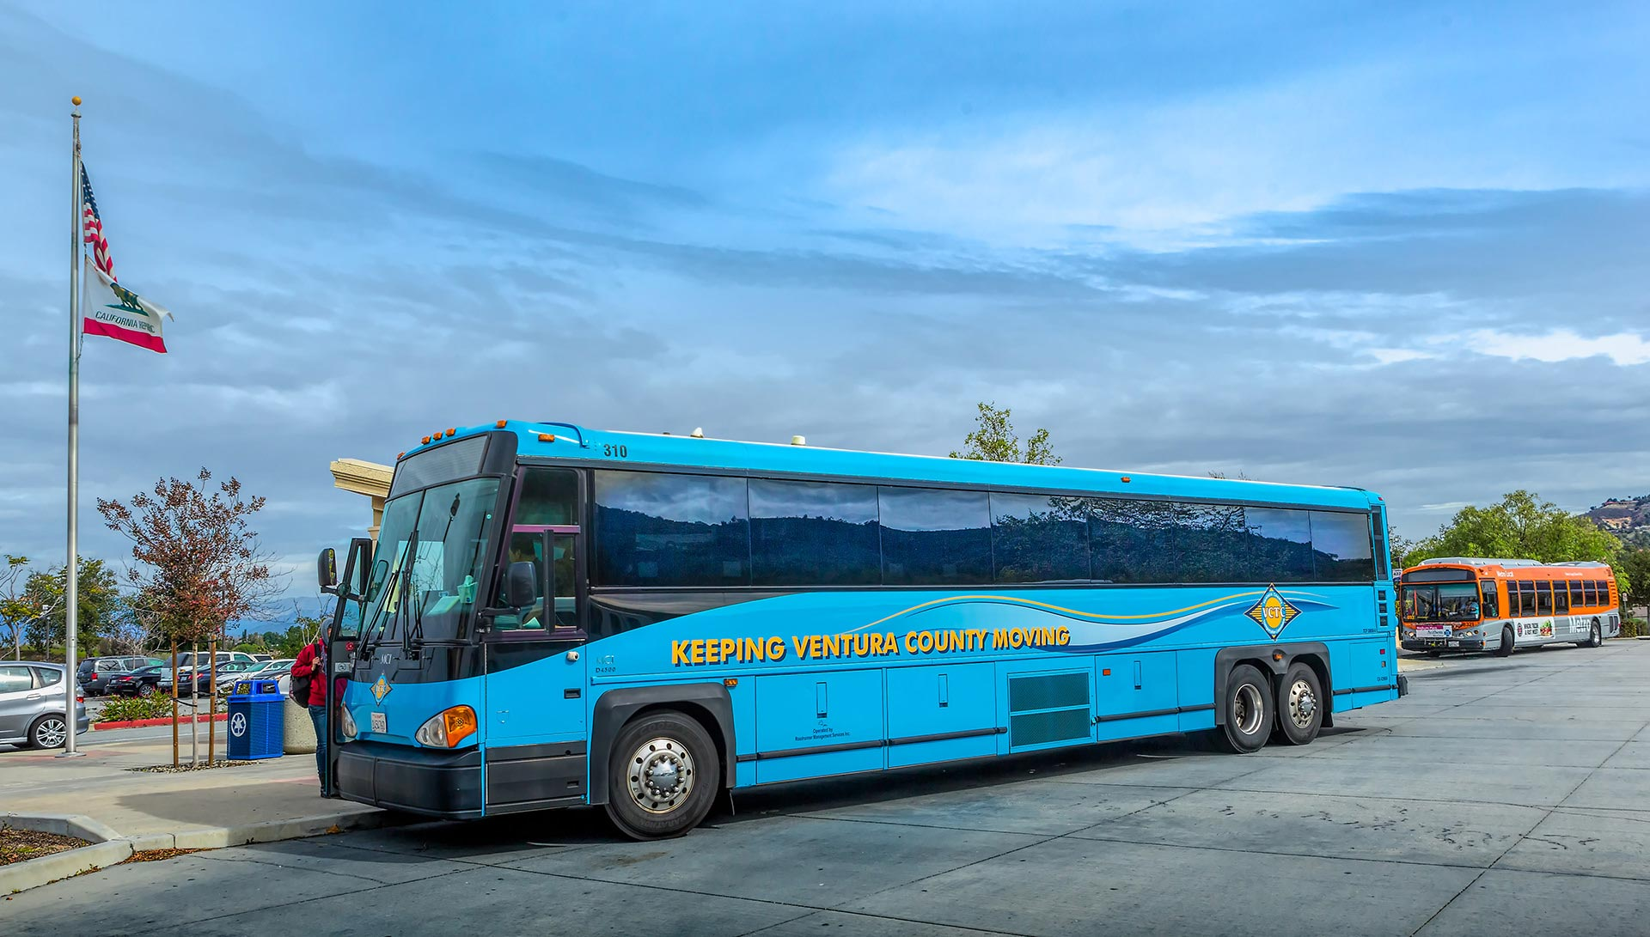
Changes to Draft Plan
Changes to draft plan
CTAC/SSTAC, Commission, and public comments integrated throughout Final Plan
Updated population and employment projections with more recent data
Updated provider info with latest fare and hours of operation details
Created appendices with detailed provider inventory, future funding opportunities, strategy development methodology, public comment log
Updated Consolidate All ADA Paratransit Eligible Processes and Rider Databases strategy
Notes:
EZRA
Conducted stakeholder survey, receiving feedback from 41 organizations
Had conversations with representatives of multiple organizations
Communitywide pop-up events: Ventura College Foundation Weekend Market, Oxnard Transit Center, and Simi Valley Senior Center

Slide 8
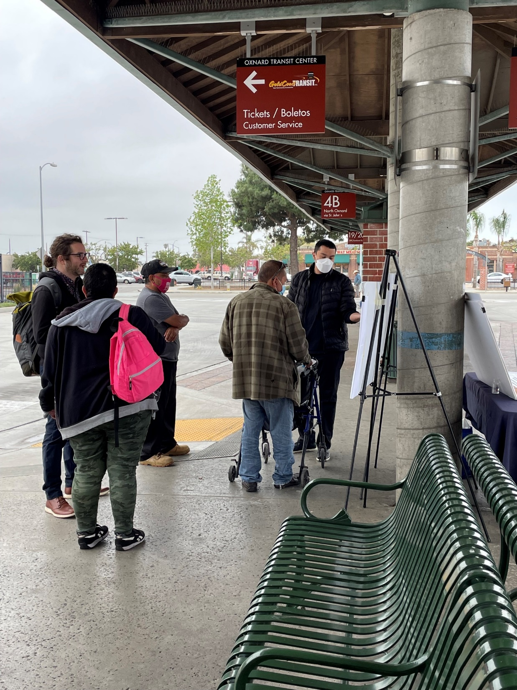
Next Steps
Next steps
Adapt strategies as needed while continuing the transition out of COVID restrictions
Identify potential funding and resources to implement high-priority strategies
Expand community involvement equitably
Coordinate strategy implementation with TIES as necessary
Notes:
EZRA

Slide 9
Thank you!
Claire Grasty
Director of Public Transit
cgrasty@goventura.org

Slide 10
What We've Done
What we’ve learned
Some Organizations We've Spoken With:
Gold Coast Transit District
Thousand Oaks Transit
Ventura County Area Agency on Aging
Ventura County Human Services Agency (Disaster Response)
Senior Concerns
The ARC
Mobility Management Partners
CSU Channel Islands
Ventura Adult and Continuing Education
211Ride
MV Transit
Independent Living Resource Center
Caregivers
Point Mugu Naval Base
Reviewed prior plans, current demographics, and available transit services
Presented to CTAC/SSTAC, UTN, and Commission
Received survey feedback from 41 organizations
Engaged with individuals representing multiple organizations (see table to right)
Facilitated communitywide pop-up events across Ventura County
Developed, presented, and revised plan strategies
Notes:
Communitywide Pop-Up Events at the Ventura College Foundation Weekend Market, Oxnard Transit Center, and Simi Valley Senior Center

