Slide 1
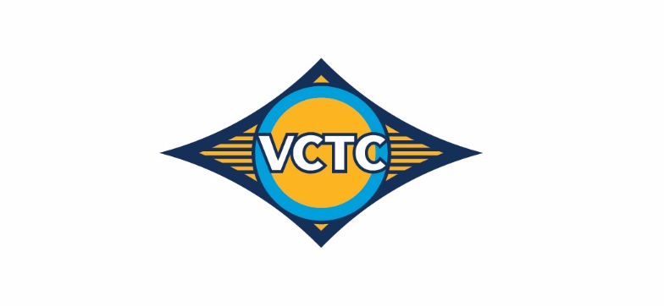
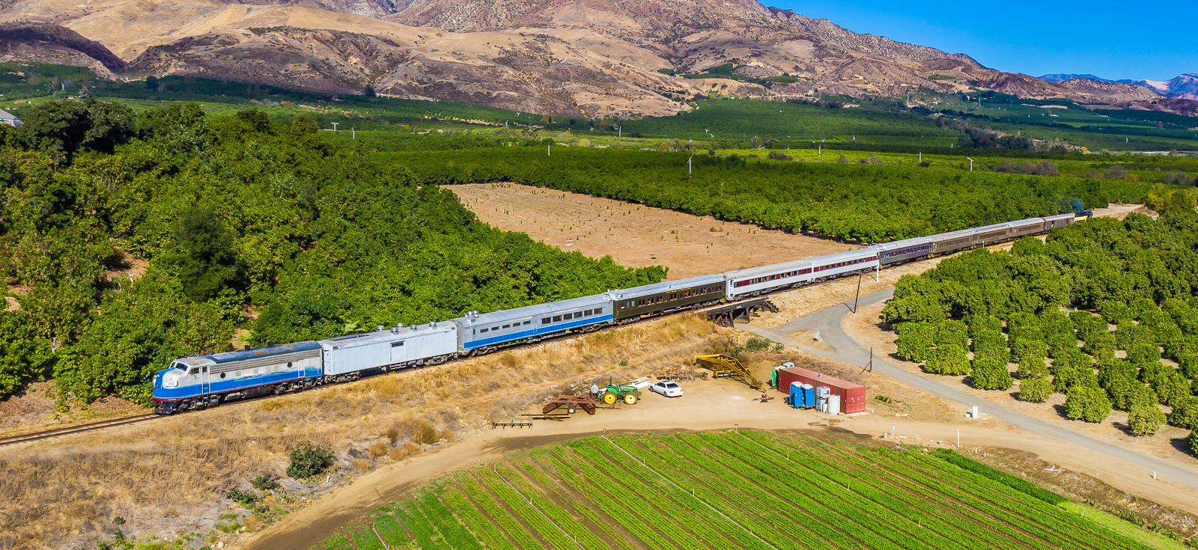
Santa Paula Branch Line Update
Presentation to the
Ventura County Transportation Commission
September 2, 2022
Notes:
Good Morning, Vice Chair MacDonald, and Members of the Commission, for the record, my name is Amanda Fagan, and I serve as the Director of Planning and Sustainability here at VCTC.
These past six months have been an eventful time for the Santa Paula Branch Line, and while not without challenges, any growing pains have been in pursuit of a successful future for the Heritage Valley and Ventura County beyond.

Slide 2

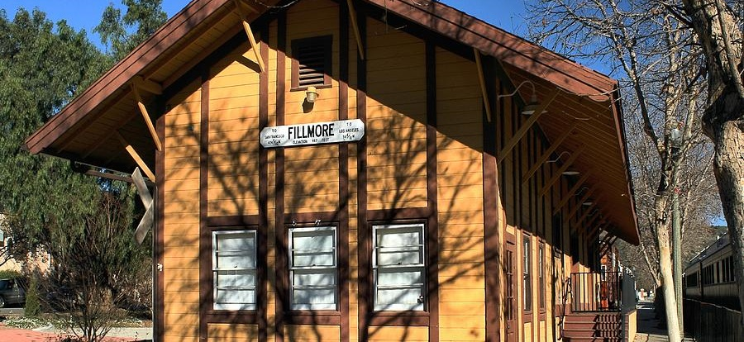
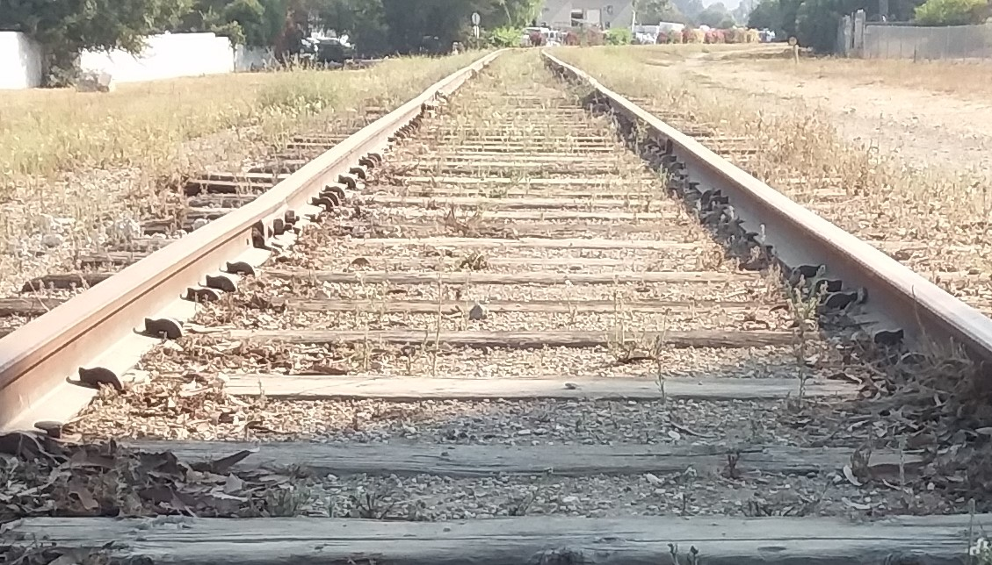
Santa Paula Branch Line History
1993: Joint application for Transportation Enhancement Activities (TEA) funds to purchase the rail right-of-way
1995: VCTC purchased SPBL and Ventura Branch Line from Southern Pacific for $8.5M
2001: VCTC executed 20-year operating lease with Fillmore & Western Railway (FWRY) for the operational ROW only (15’ of centerline)
2001 – 2021: FWRY operated railroad, including tourist excursion trains and movie production
June 30, 2021: FWRY Lease expired
Notes:
For context, VCTC acquired the 32-mile Santa Paula Branch Line railroad and right-of-way in 1995 for use as a multimodal corridor that includes a trail, freight, and preservation of the corridor for possible future commuter rail service. In 2001, VCTC entered a 20-year operating lease with Fillmore & Western Railway, during which Fillmore & Western operated tourist and movie trains, and was responsible for maintaining the operational right-of-way, the area 15’ of centerline from the railroad tracks. The lease with Fillmore & Western expired on June 30, 2021.

Slide 3

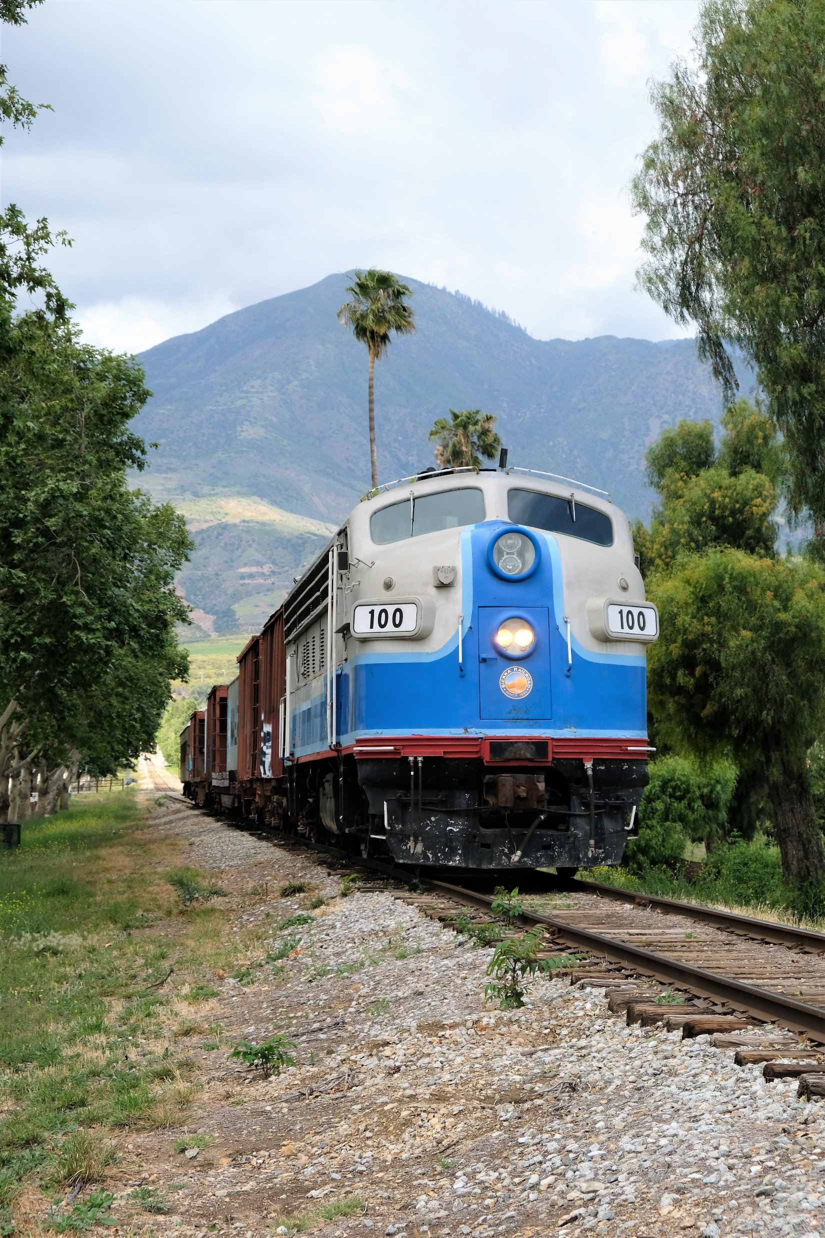
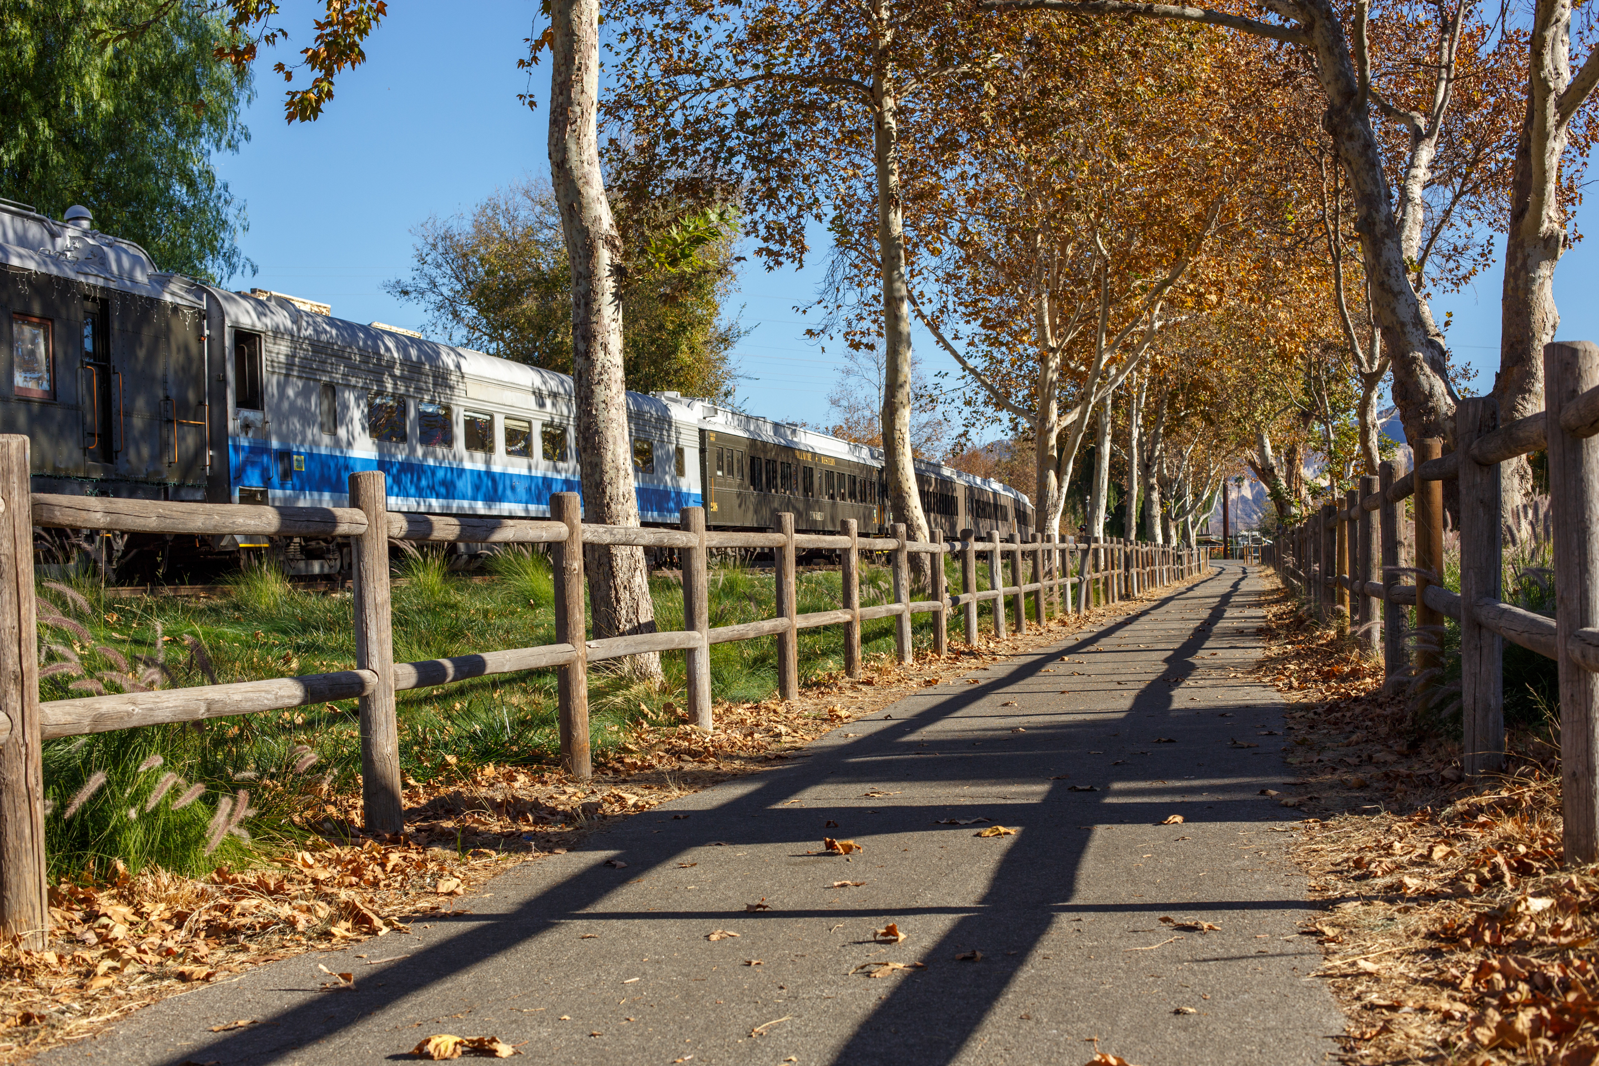
Railroad Lease and Operations Agreement: Basic Premise
Provide for economic activity in the Heritage Valley by continuing to support rail operations and preserving the corridor for a future trail by dedicating lease, license, and permit revenues to ongoing maintenance, while avoiding the continued expense of other transportation funds on the Santa Paula Branch Line
Notes:
In developing a new Railroad Lease and Operations Agreement, VCTC established and followed an underlying principle that the Agreement should provide for economic activity in the Heritage Valley by continuing to support rail operations and preserving the corridor for a future trail by dedicating the lease, license, and permit revenues generated by the Branch Line to the ongoing maintenance requirements, while avoiding the need to subsidize the operations of the Line through public transit funds.

Slide 4
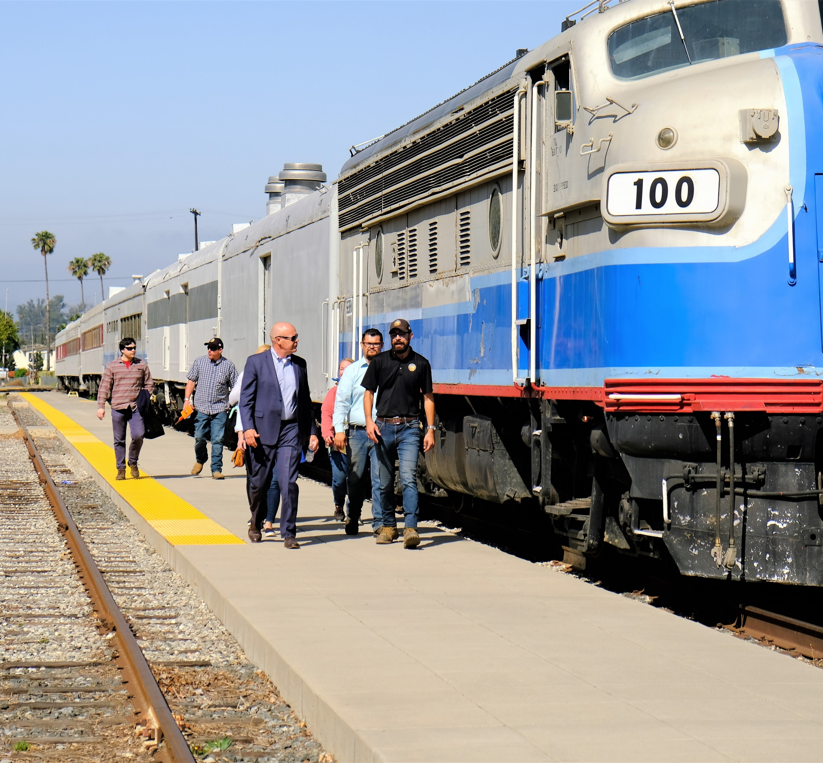
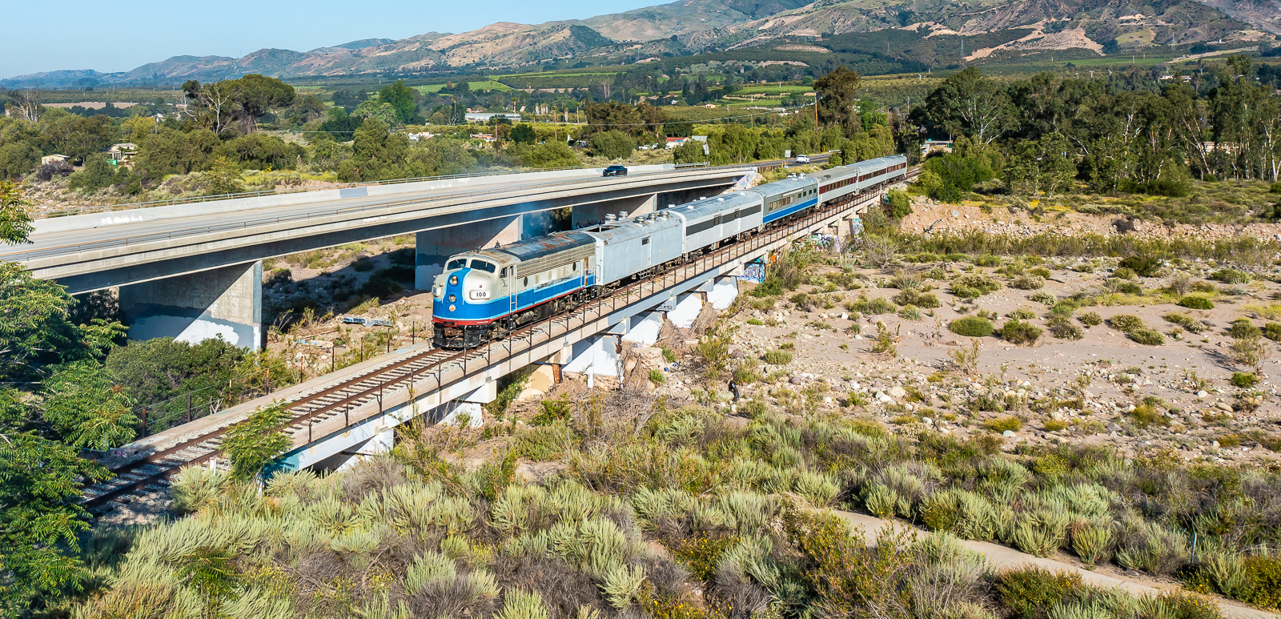
Railroad Lease & Operations Agreement Overview
Commission approved Agreement between VCTC and Sierra Northern Railway on December 16, 2021
Since January 1, 2022, Sierra Northern operates and maintains the Branch Line and provides freight and film service
Tourist & excursion service provided through sister company Mendocino Railway
35-year term with two 30-year extension options
Notes:
With this basic premise in mind, the Commission approved the Agreement with Sierra Northern Railway on December 16, 2021, and since January 1st, Sierra Northern has been responsible for operating and maintaining the Santa Paula Branch Line. Sierra Northern operates and maintains the railroad tracks and right-of-way and provides freight and film service. Tourist and excursion service will be provided through the cooperation of the sister company Mendocino Railway. The initial Agreement is for a 35-year term with two 30-year extension options.

Slide 5
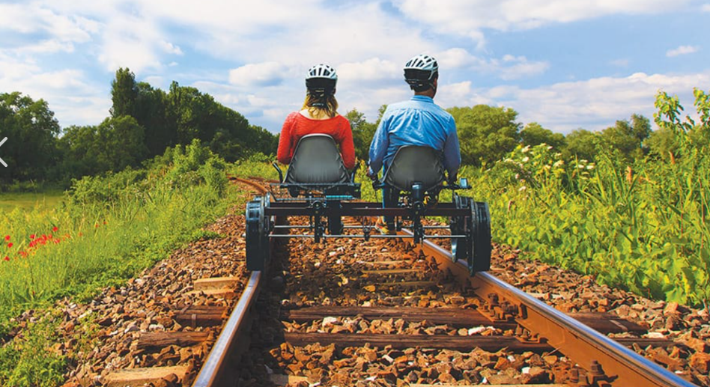
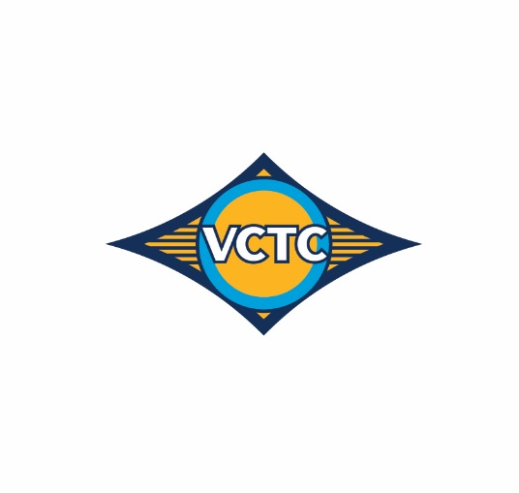

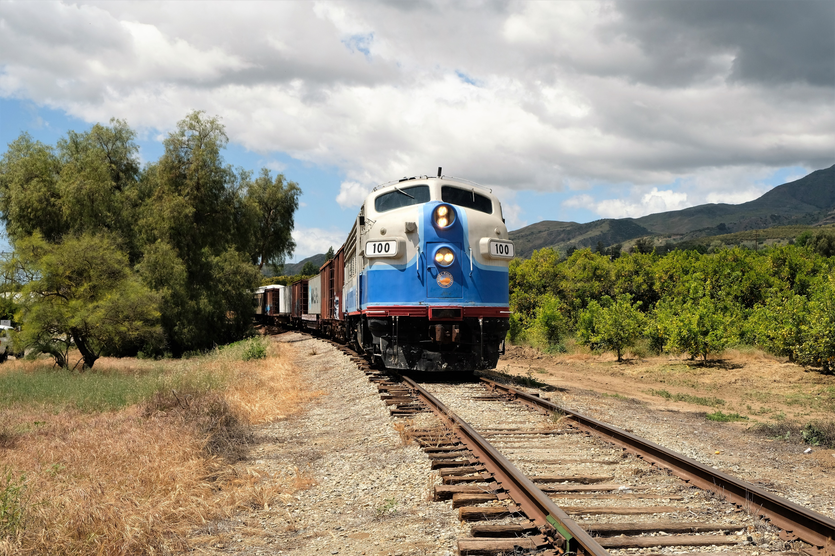
Service and Activities
Agreement defines use of Property for “Railroad Purposes”
Freight and transload services
Installing spur lines
Storing / switching rail cars
Services related to movie, film, television, commercial, media and entertainment
Tourism and seasonal passenger services
Notes:
The Agreement defines railroad purposes, including freight and transload, filming, and tourist and seasonal passenger services.

Slide 6
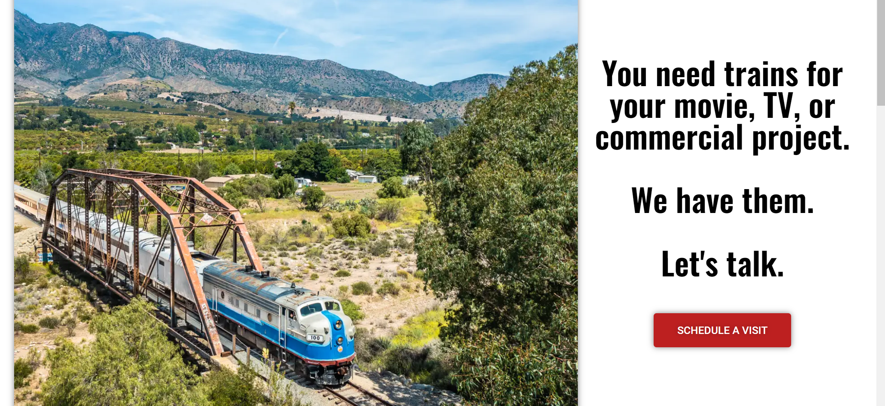
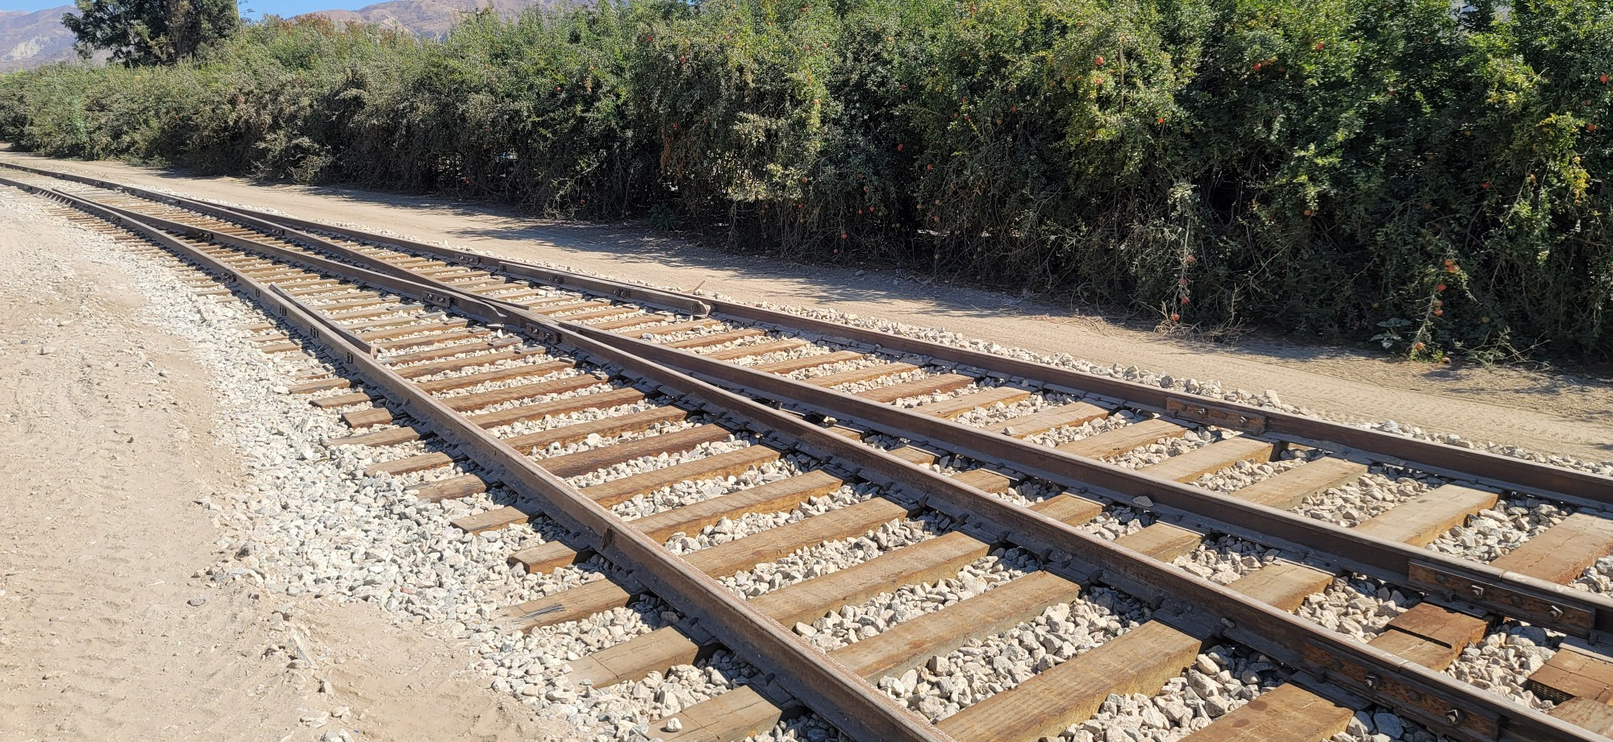
Activities & Accomplishments
Bi-weekly coordination meetings
Track inspections
Track repairs and investments
Weed abatement & vegetation management
Encampment removal & cleanup
Constructed new spur for Parallel Systems moveparallel.com
Building freight customer base
Purchased rolling stock and equipment from Fillmore & Western
Expanding Film & Television Production, inc. new movierailroad.com website
Notes:
Since January, Sierra Northern has begun railroad inspections, made improvements to the condition of the signals and railroad tracks, conducted weed abatement and other right-of-way maintenance activities, and begun rail operations on the SPBL. VCTC staff and Sierra Northern representatives meet virtually on a bi-weekly basis to coordinate activities.
A few of the accomplishments include placement of over 650 railroad ties, reaching out to local businesses and residents to share information and build relationships with the community, attracting two new railroad-related businesses, and working with local industries to develop freight rail services in the Santa Clara River Valley. Freight rail service reduces truck traffic at a rate of four trucks for every rail car and provides an opportunity to lower greenhouse gas emissions associated with goods movement .
Sierra Northern purchased remaining rolling stock and equipment from FWRY and assisted in the transport of sold items off the SPBL and Fillmore Rail Yard.
Sierra Northern constructed a new rail spur and siding track to serve Parallel Systems to expand its operations related to the development and testing of electric, autonomous train cars.
Sierra Northern is working to expand television and film business on the SPBL and has launched a new website, http://www.movierailroad.com.
In the first two quarters of operations and maintenance of the SPBL, SNR and its partners invested nearly $1M in labor, equipment, materials, and services into the SPBL. According to the terms of the Railroad Lease and Operations Agreement, VCTC is responsible for reimbursing SNR for up to $225,000 for this period.

Slide 7

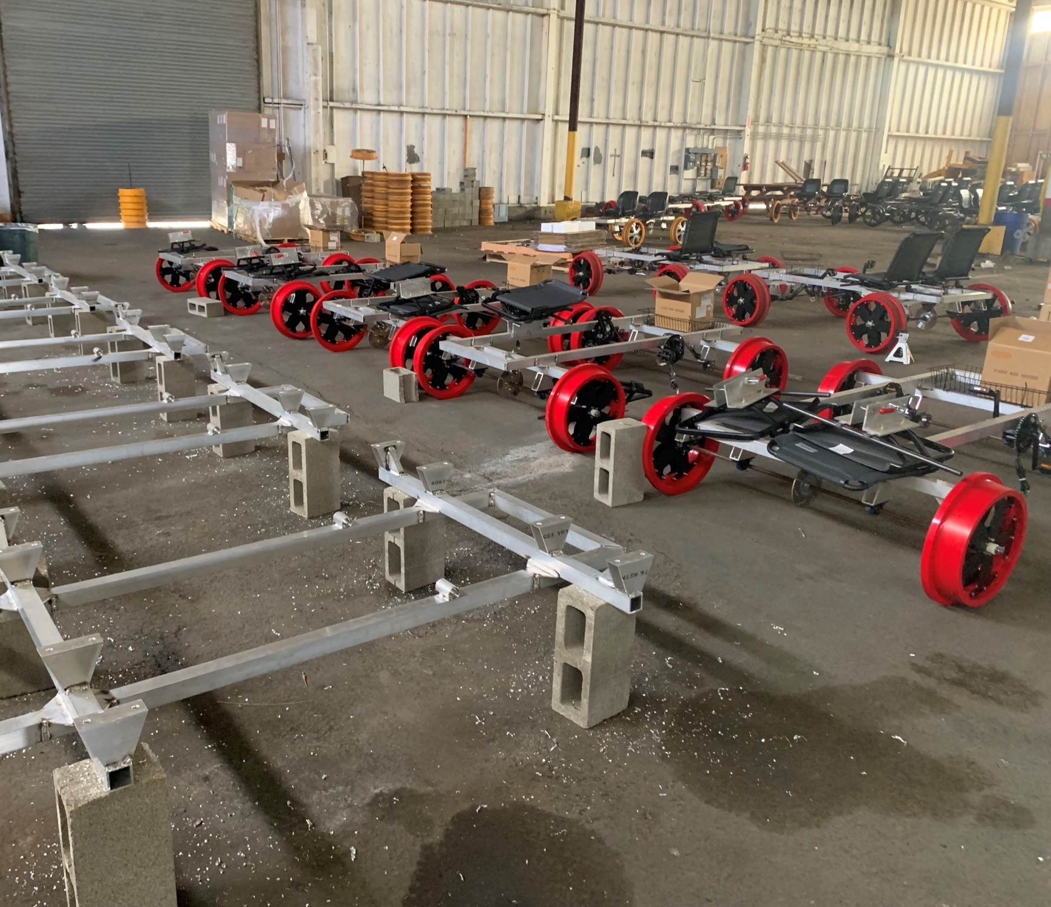
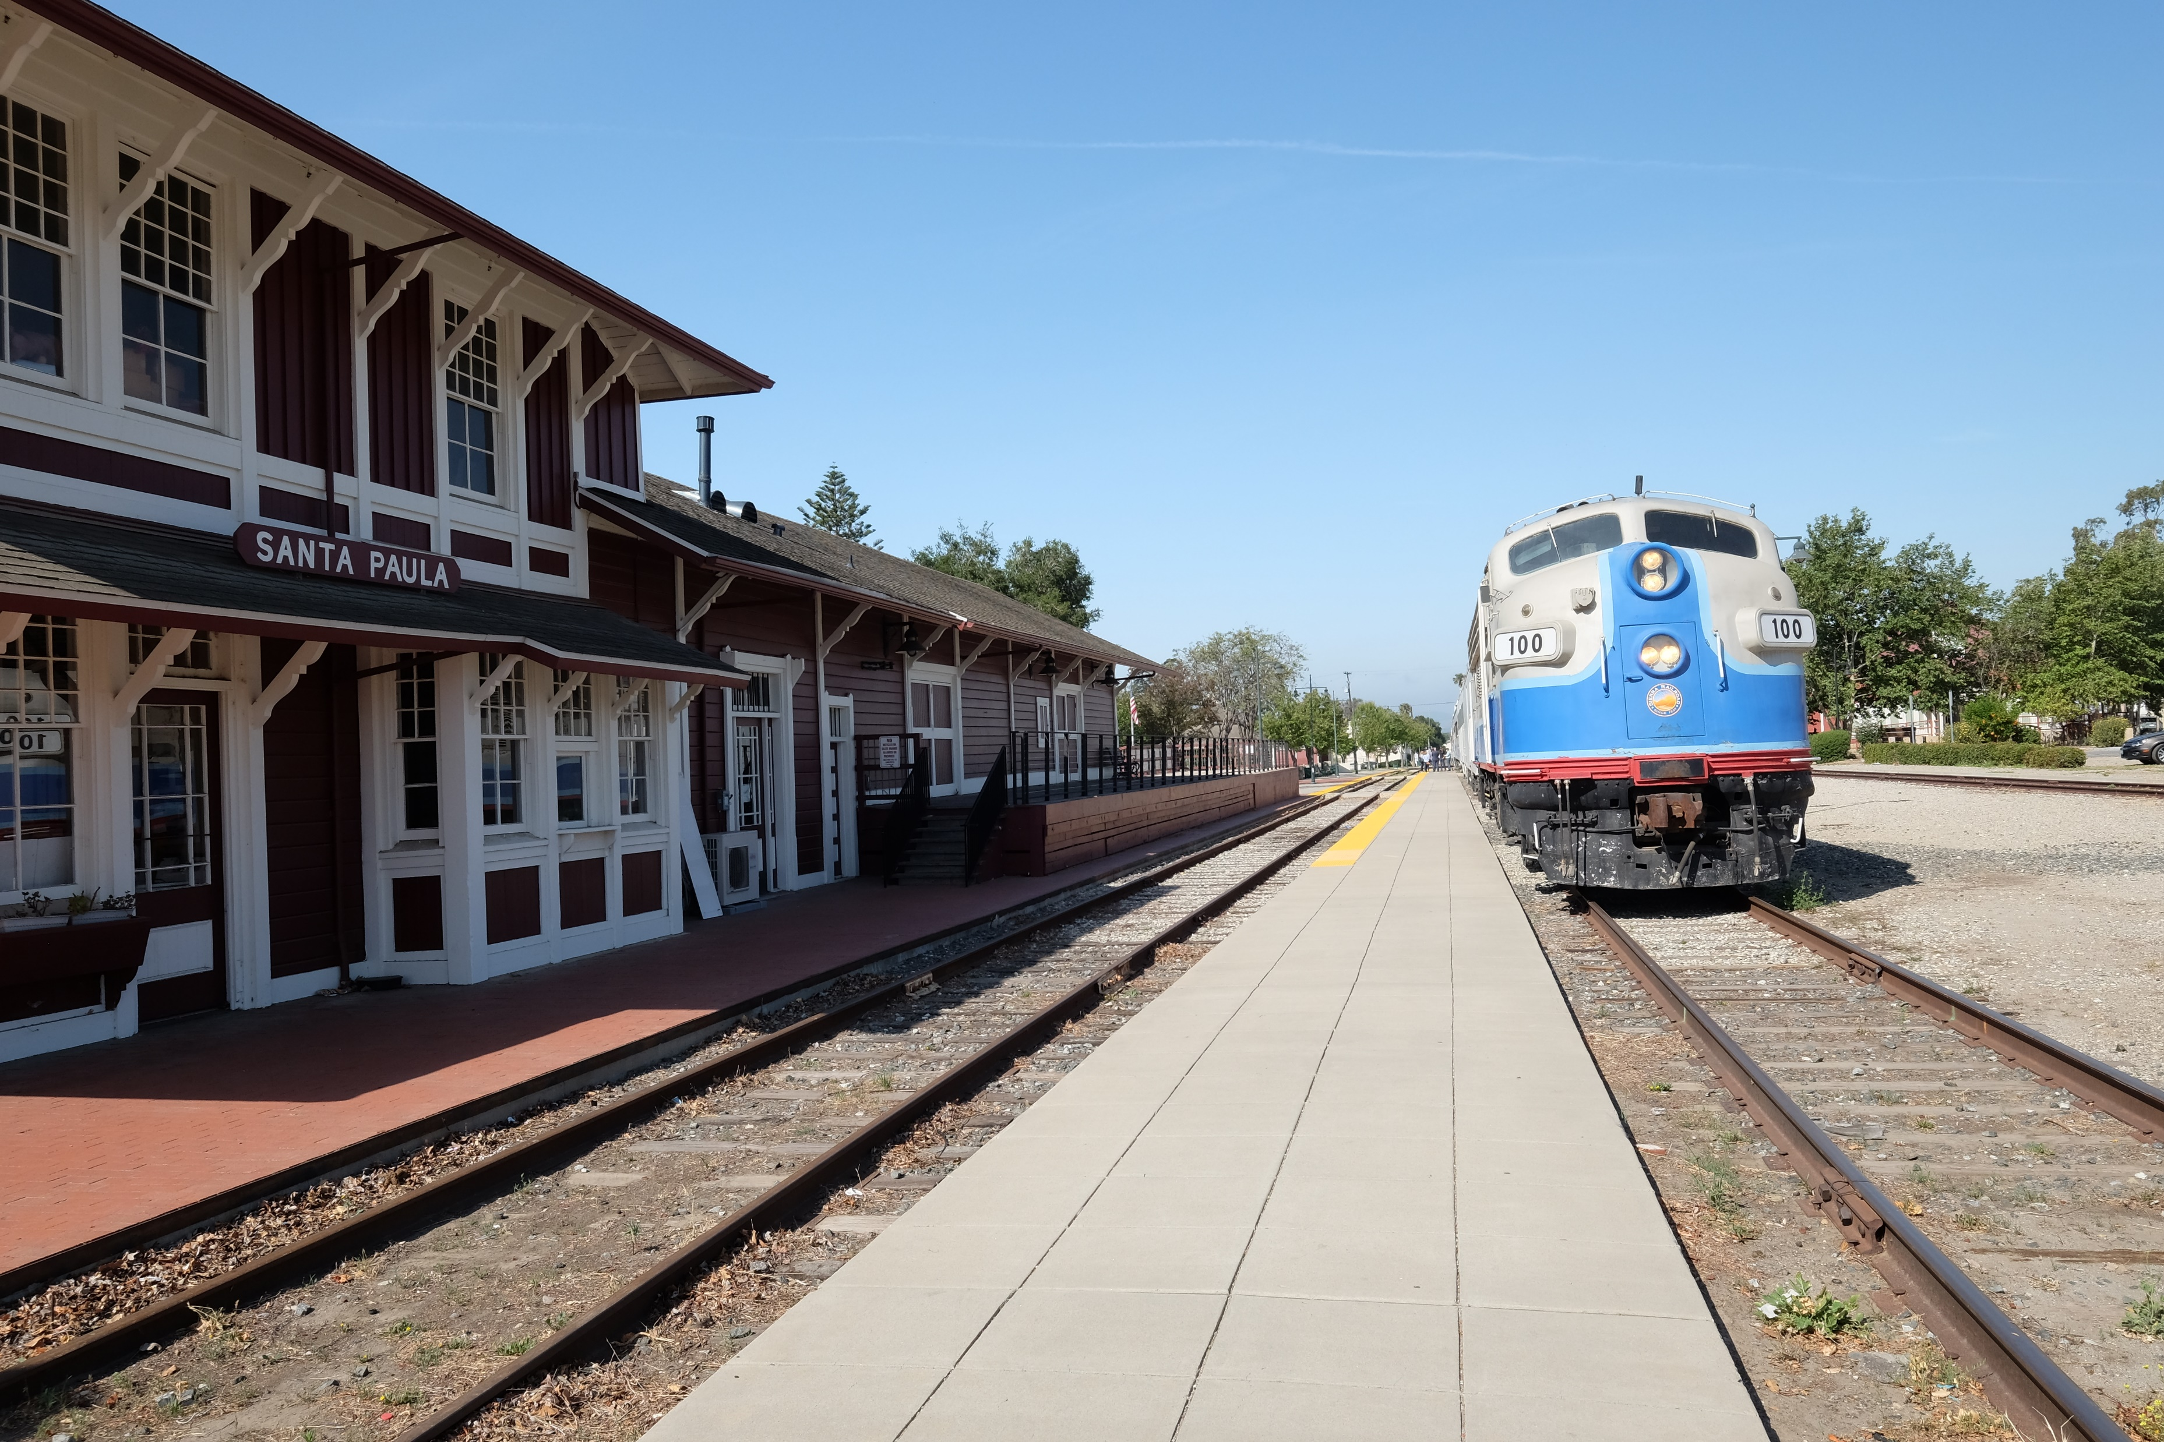
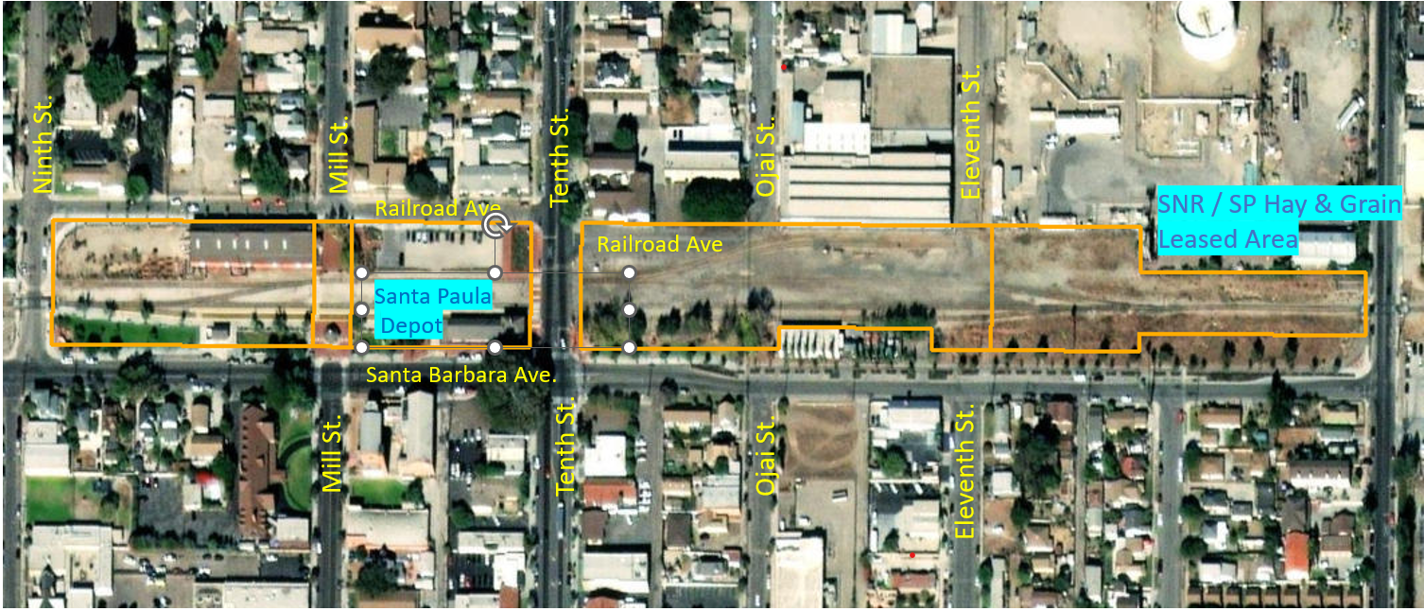
Base of Operations
Sierra Northern established local office, hired staff, and began operations in Heritage Valley
Santa Paula Hay & Grain temporary home (1-2 years) for equipment and operations
Santa Paula Depot Tourist/Excursion & Rail Bikes
Notes:
Sierra Northern has established a new base of operations with an office in Santa Paula, hired a local team of staff, and is working with local businesses for support contractors to supplement its workforce. The Santa Paula Hay & Grain lease is anticipated to support Sierra Northern operations for a period of one to two years, while Sierra Northern locates and prepares a site for a permanent home on the Branch Line.

Slide 8
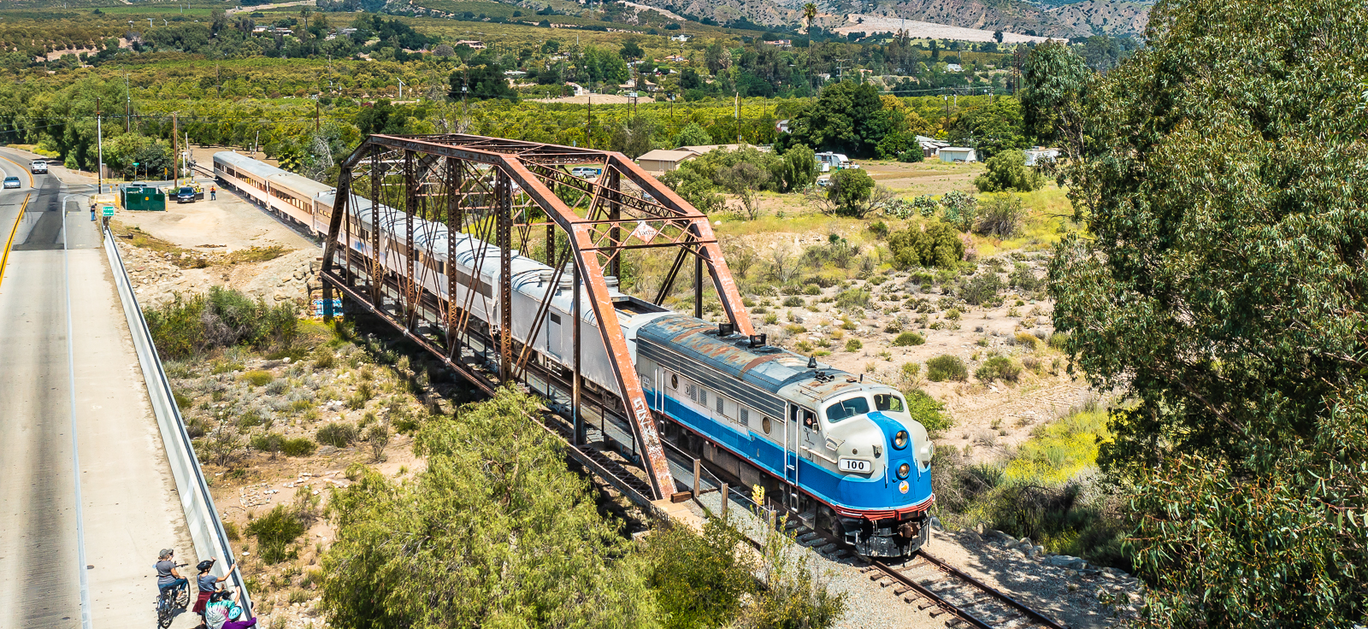
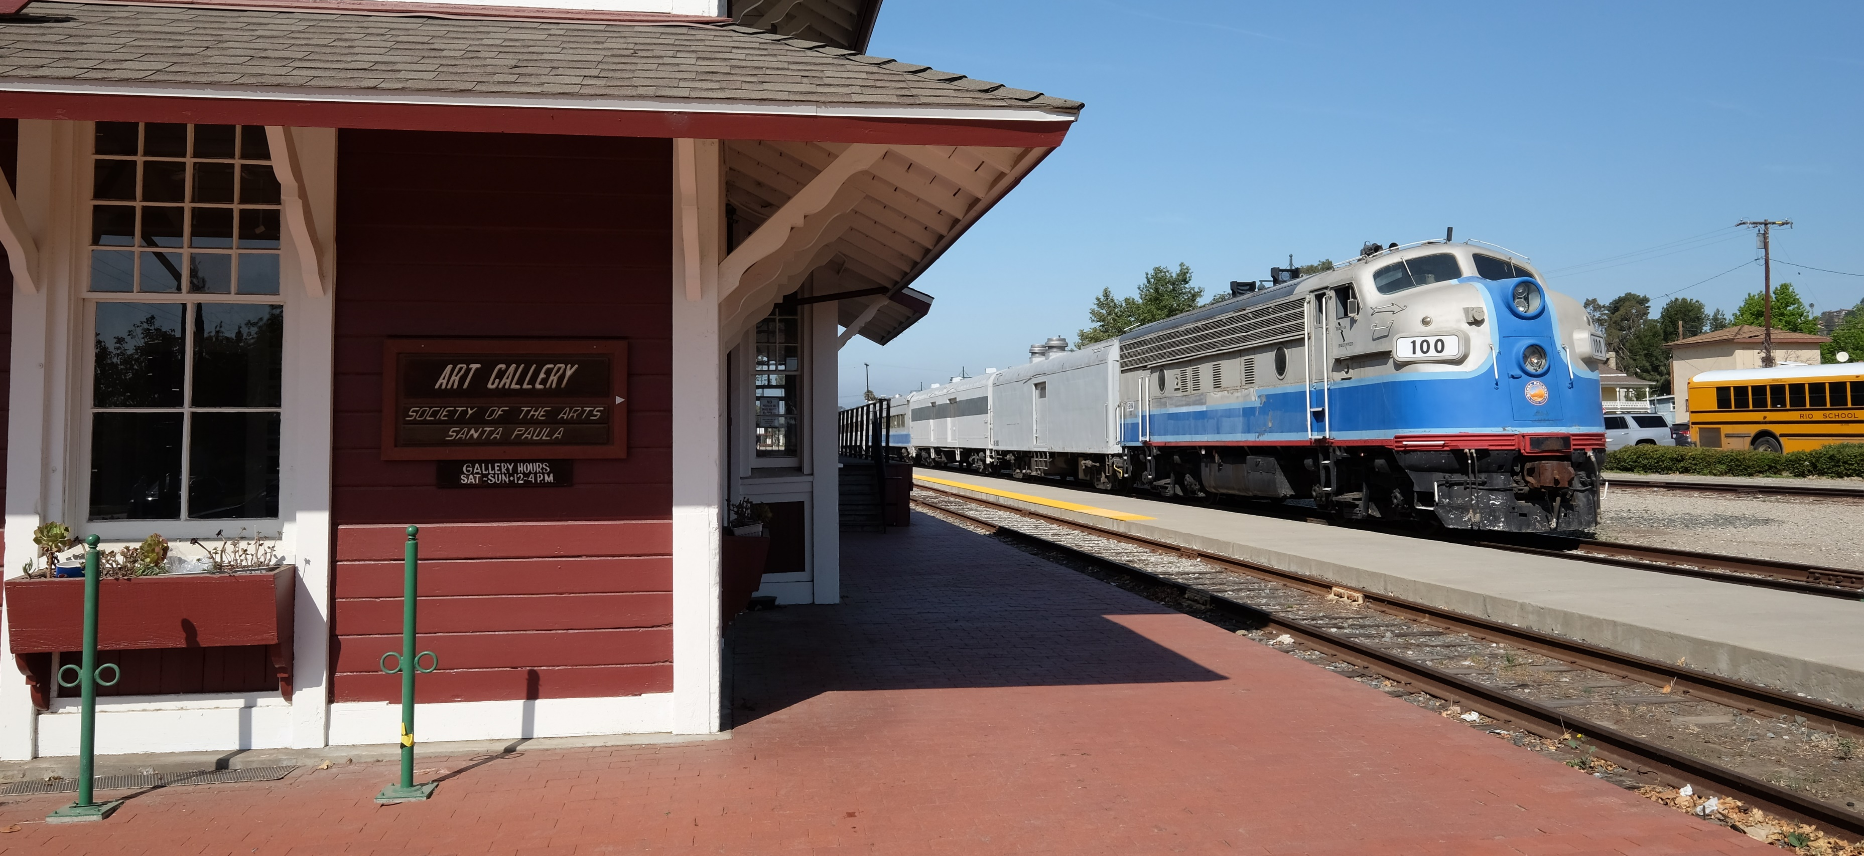
Agreement Benefits
Establishes long-term operations and maintenance presence
Aligns interests to facilitate investments in infrastructure and business development
Reduces VCTC’s financial obligations and over time eliminates need to subsidize rail operations with public transit funds
Shifts railroad right-of-way maintenance responsibilities
Reduces Truck Trips on SR 126 through freight service
Trains with Trails Approach
Brings Railbikes Service to SPBL
Notes:
Before I reintroduce the Sierra Northern and Mendocino Railway representatives and open the floor for questions, I would like to reiterate a few of the benefits associated with the Railroad Lease and Operations Agreement.
The Agreement reduces VCTC’s financial obligations to operate the railroad and to maintain the right-of-way, reducing and eventually eliminating the need to subsidize rail operations with public transit funds and leverages private sector investments to address deferred maintenance of the rail line, and activates the property to prevent and address trespass and other related issues.
While the transition to a new operator has not been without challenges for VCTC, Sierra Northern, or corridor cities, progress has been made towards the goal of an improved multimodal railroad corridor, with rail service, filmmaking, and trail planning.

Slide 9
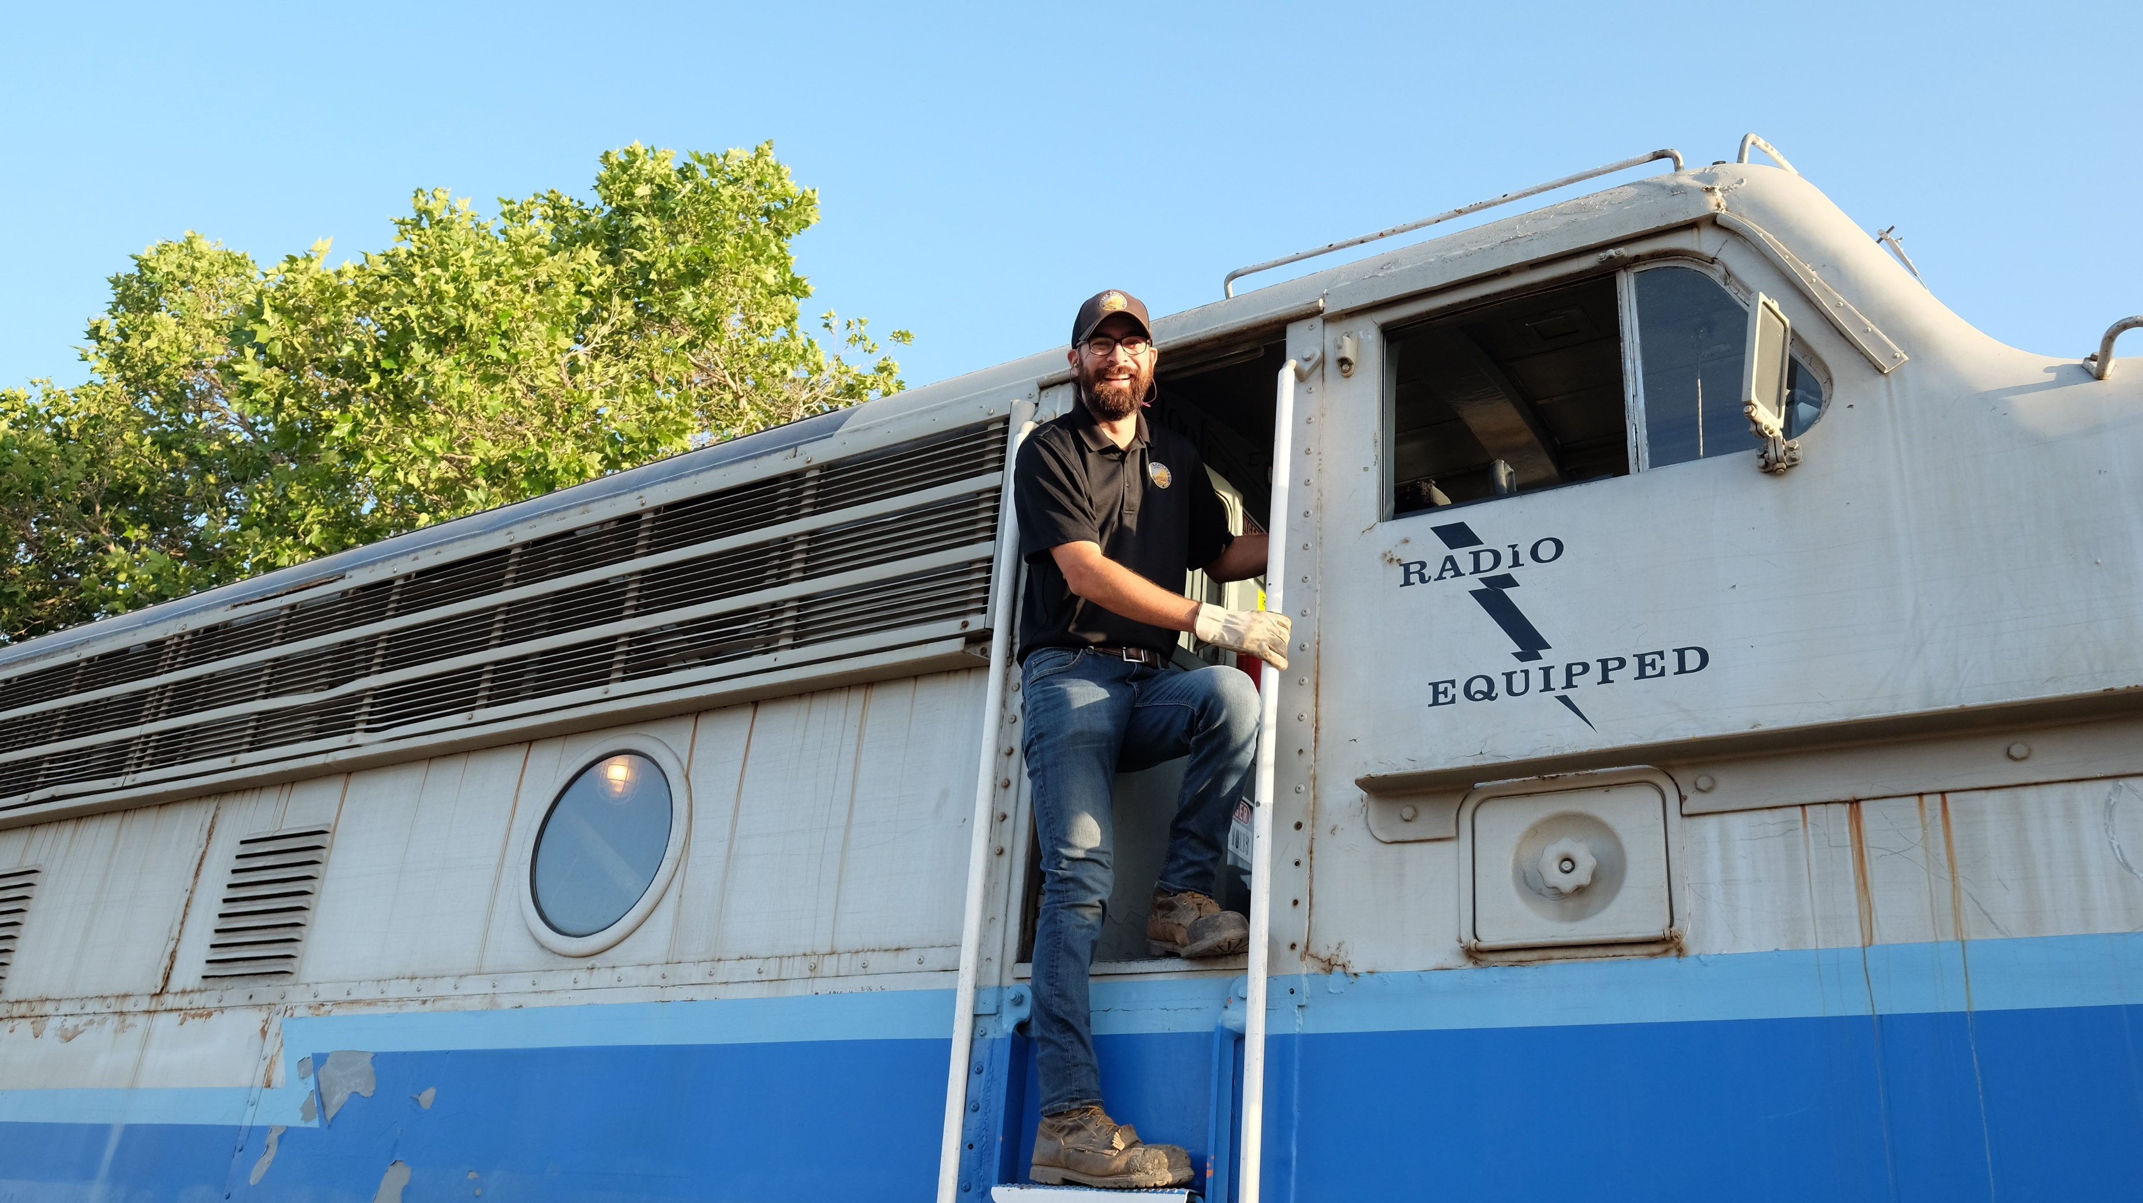
Sierra Northern Team
Sierra Northern Railway
Kennan (Ken) Beard, President and CEO
Matt Blackburn, General Manager – Ventura Division
Mendocino Railway
Robert Pinoli, Jr., President
Notes:
Representatives of Sierra Northern Railway and Mendocino Railway are here today to answer any questions and to share a big announcement on the future of the tourist and excursion rail service.
Ken Beard is the President and CEO of Sierra Northern Railway. Matt Blackburn is the General Manager of the Ventura Division for Sierra Northern Railway, and Robert Pinoli, Jr. is the President of Mendocino Railway.

Slide 10
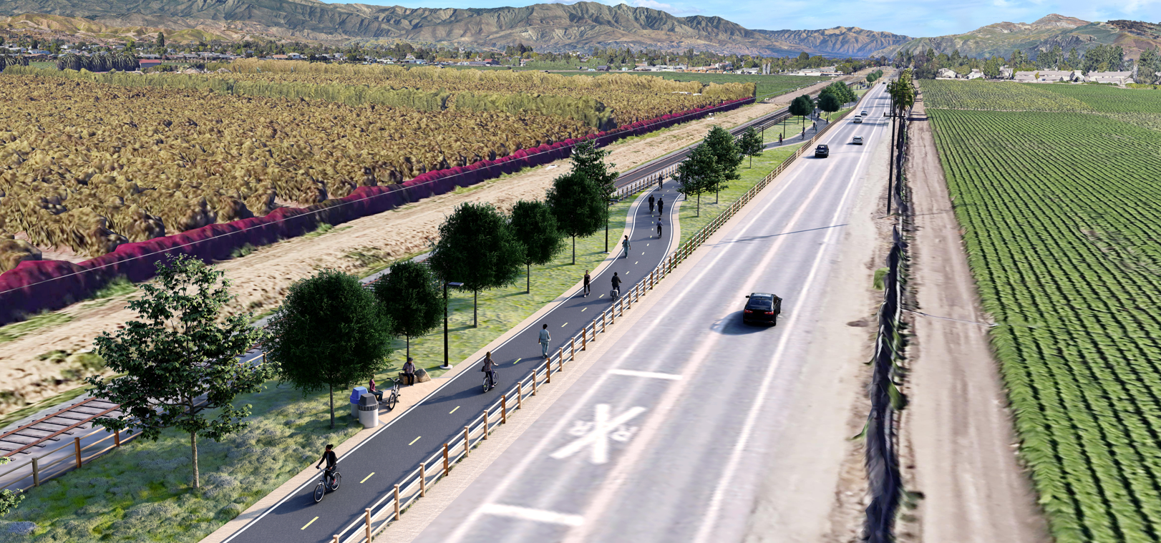

SPBL Trail Planning
April 2022 – Commission adopted goal to “Reinvigorate the process to complete the Santa Paula Branch Line bike trail.”
June 2022 – City of Ventura submitted grant application to Active Transportation Program Cycle 6 to construct 4-mile segment from Montalvo to Saticoy
Included trail segment also in Solutions for Congested Corridors grant concept
VCTC Staff developed scope of work for grant application to SCAG REAP 2.0 CTC Partnership Program to update Master Plan & EIR
Notes:
Before I turn the floor over, I would like to share a few trail planning and development updates.
In April, the Commission adopted a goal to “Reinvigorate the process to complete the Santa Paula Branch Line bike trail.”
In June, the City of Ventura submitted a grant application to Caltrans for the Active Transportation Program (ATP) Cycle 6 to design and construct the approximately four miles section of bike trail from the Montalvo-East Ventura Metrolink station to the Saticoy Depot. VCTC staff supported application development through data, site visits, and feedback on draft application materials. Statewide results from Cycle 6 are scheduled to be adopted by the California Transportation Commission in December 2022. The Montalvo to Saticoy section of the SPBL bike trail was also included in a larger, multi-modal project concept submitted by VCTC to Caltrans to partner on a Solutions for Congested Corridors grant application, stemming from the 101 Communities Connected Multimodal Corridor Study. Feedback from Caltrans was very positive, and Caltrans approved the request to partner on an application when guidelines are released later this year.
VCTC staff also developed a conceptual scope of work for a grant application to SCAG through the Regional Early Action Planning (REAP) County Transportation Commissions (CTC) Partnership Program. The project would update the Master Plan and EIR, looking at existing conditions, phasing plans, and cost estimates; trail alignment to better serve housing areas and improve access to transit connections; conduct outreach to disadvantaged communities and neighboring landowners to address any concerns and build support for the project; and evaluate and make recommendations for lighting and other tools to improve safety, alleviate neighbor concerns, and encourage use of the trail and transit connections. Staff will return to the Commission for approval to submit a grant application once SCAG releases the Call for Projects in October 2022.
BACKUP:
Sierra Northern and its sister companies have a strong history and are supportive of what Sierra refers to as a “Trains with Trails” Approach, combining passenger tourist rail service with bicycle and hiking trails, and even developing trails to complement existing tourist train service. Rather than being an impediment to developing the Santa Paula Branch Line Recreational Trail, Sierra Northern and the proposed Agreement recognize the primacy of the recreational trail.

Slide 11

QUESTIONS?
Notes:
I’m happy to answer any questions you may have from the VCTC staff perspective and will turn the floor over to Ken Beard from Sierra Northern, and Robert Pinoli from Mendocino Railway.
BACKUP:
The Agreement with Sierra Northern establishes a long-term operations and maintenance presence on the Branch Line where the interests of VCTC and Sierra Northern are aligned to facilitate infrastructure and business development investments, and to ensure active use for Railroad Purposes, while also preserving the corridor and improving the rail line for future passenger rail service and completion of the Recreational Trail.

