Slide 1
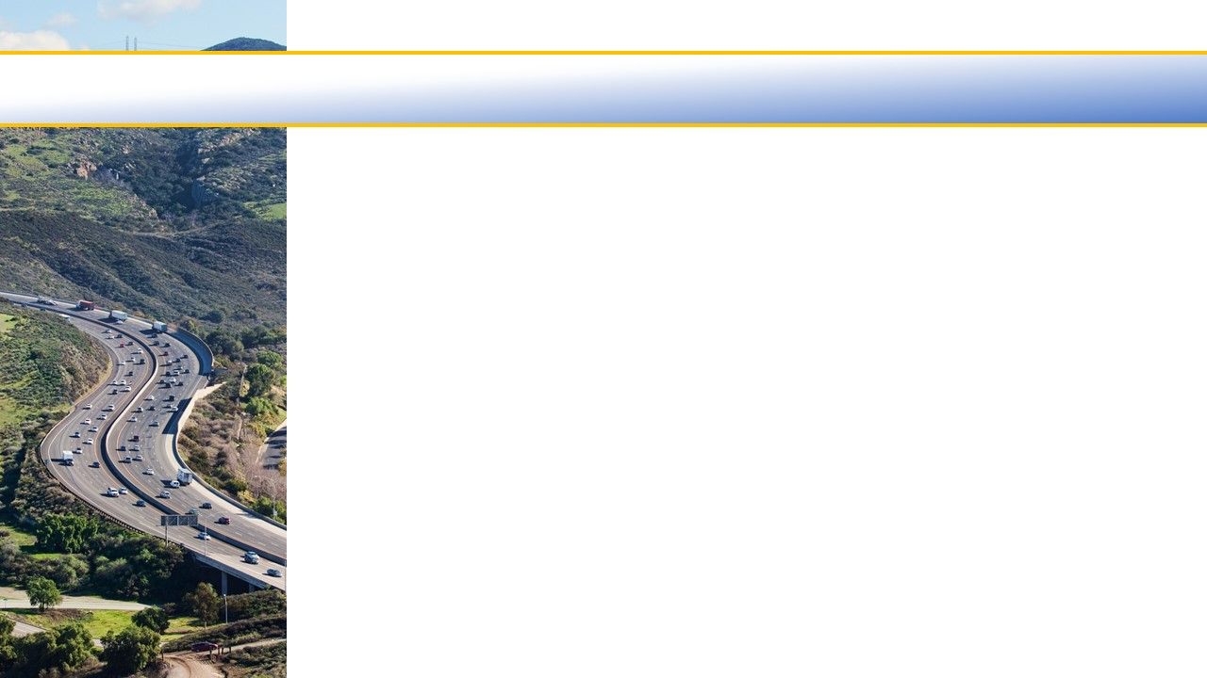

Ventura County Transportation Commission
UNMET TRANSIT NEEDS findings
May 6, 2022

Slide 2
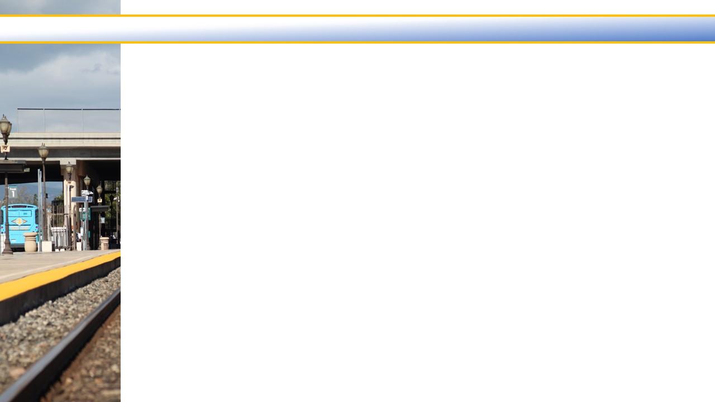


Unmet Transit Needs
Analyze, respond and evaluate feedback
Public Hearing
Implement recommendations
Continually taking feedback
Collect all feedback
Recommend findings to Commission

Slide 3
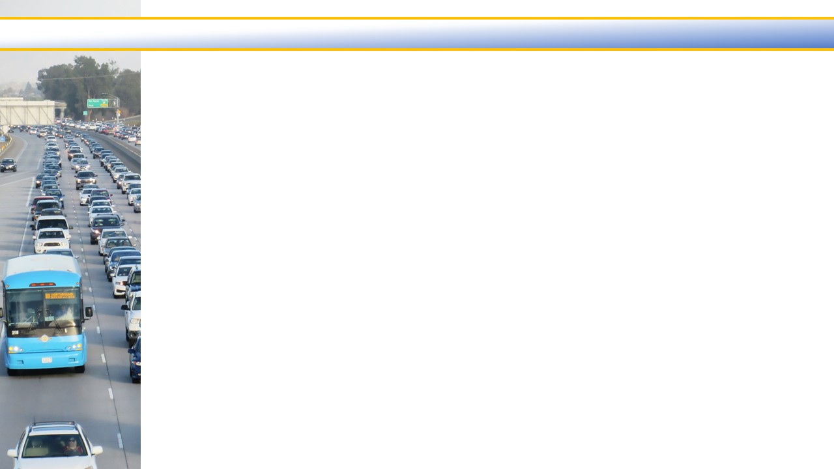
Unmet Transit Needs
Unmet needs definition: New service or Expanded service
An item must meet the 15-comment threshold for fixed-route service or the 10-comment threshold for dial-a-ride service in order to be considered an unmet need
Reasonable to Meet criteria: a service request is considered reasonable if passes muster of adopted criteria, including enough vehicles available, the service won't cause reductions in existing service, and a transit vehicle can safely navigate the streets, among others
If service is instituted, farebox is evaluated using the passenger fare ratios in the reasonable to meet criteria (the ratios are compliant with TDA statute)

Slide 4
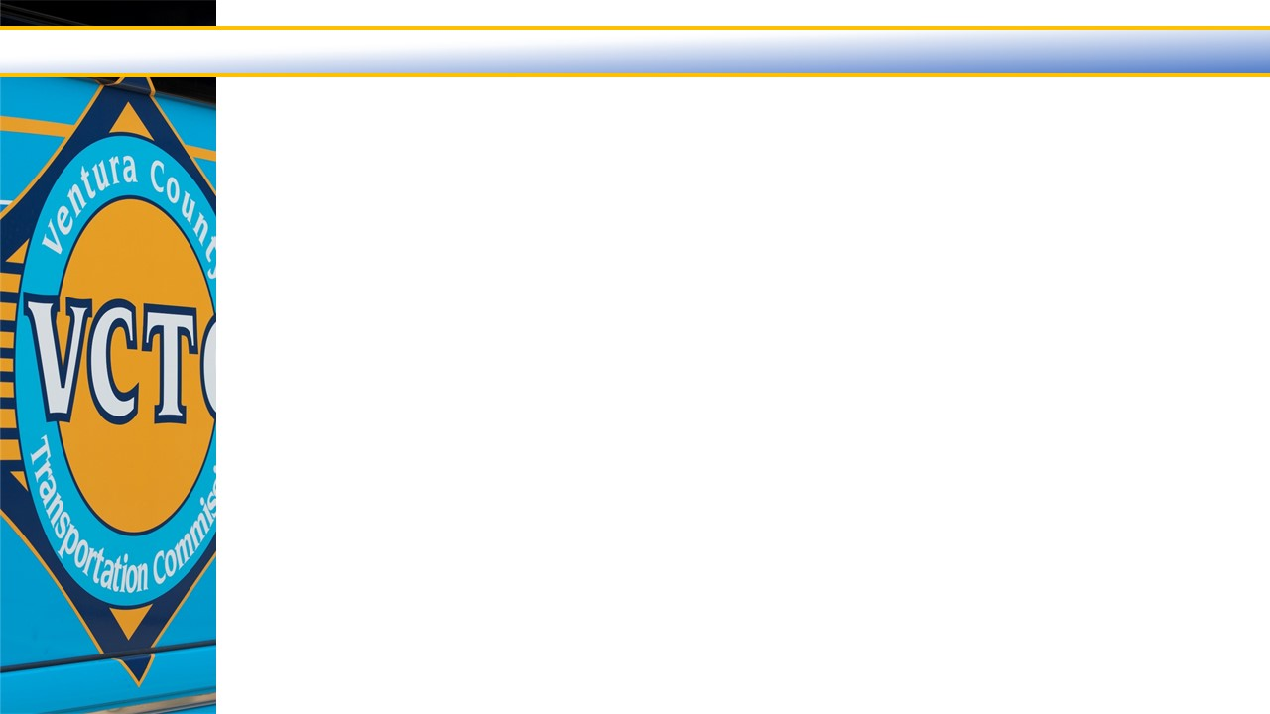

Unmet Transit Needs
Feedback is collected year-round:
Website
Email
Social media - Facebook, Instagram, Nextdoor Twitter
Phone
Community events
Additional outreach during the Unmet Transit Needs process (Dec-Feb):
Online Survey (bilingual)
2 Virtual Community Meetings
Public Hearing
Social media push

Slide 5
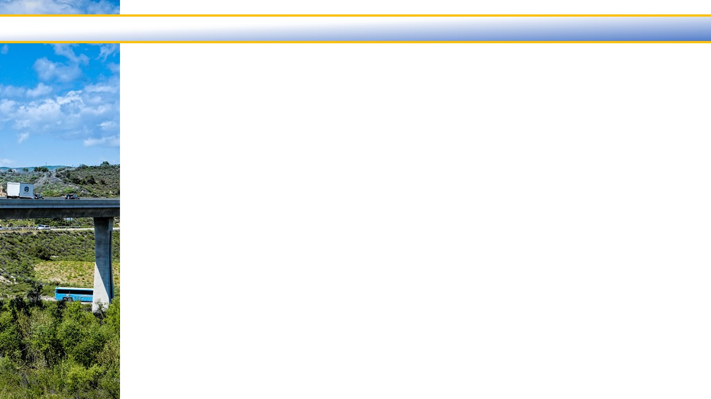
Unmet Transit Needs
Feedback and Results:
Comments from 90 people
Top UTN requests:
  Service from Santa Clara River Valley to Santa Clarita
  Service between Fillmore and Moorpark
Top other requests:
  Expanded service to LA County, including Metrolink and Pacific Surfliner service
  Varying improvements to the VCTC Intercity service
  Varying improvements to the Gold Coast Transit District service
STA
LTF
Findings
No findings
No requests met the 15-comment threshold for fixed-route service this year
Will continue to plan for requests that received 15 comments last year
  Service to Santa Clarita
  Service between Fillmore and Moorpark

Slide 6
Unmet Transit Needs
Progress Made
Over the last five years, comments received have led to the following improvements to the transportation network and public information:
Metrolink Saturday service
Extended the Coastal Express route to Camarillo
Multiple bus stop improvements
Began planning for service between Fillmore and Moorpark
Began planning for service to Santa Clarita
Added information to the website
Increased follow up and sent out an eblast
STA
LTF

Slide 7
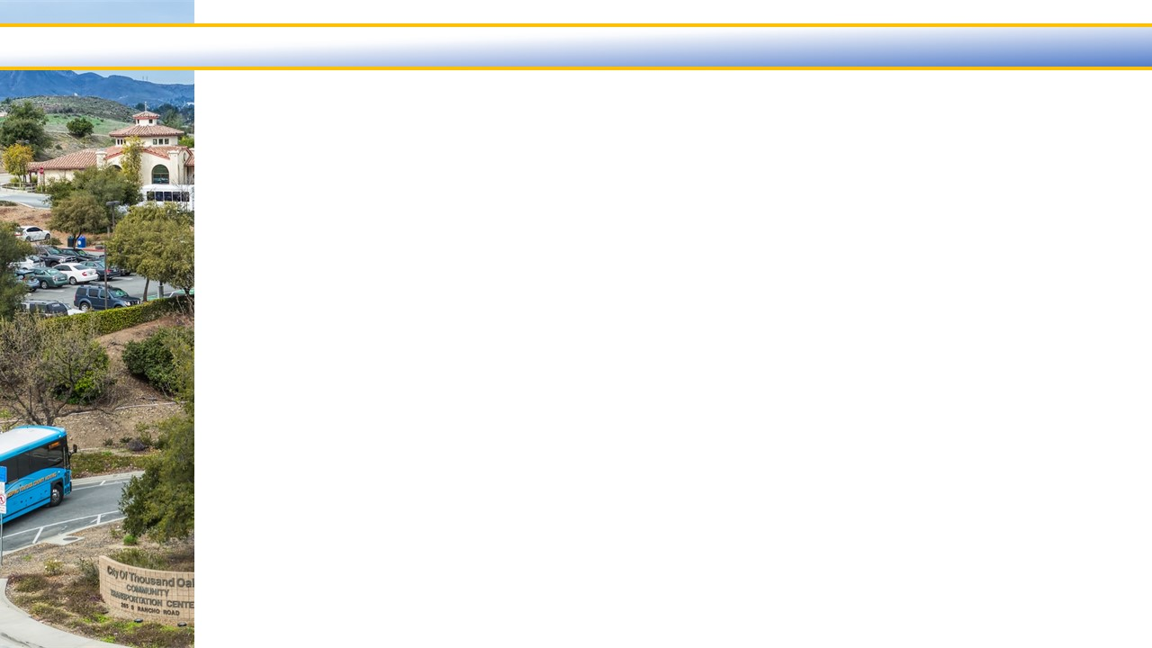
QUESTIONS?

