Slide 1
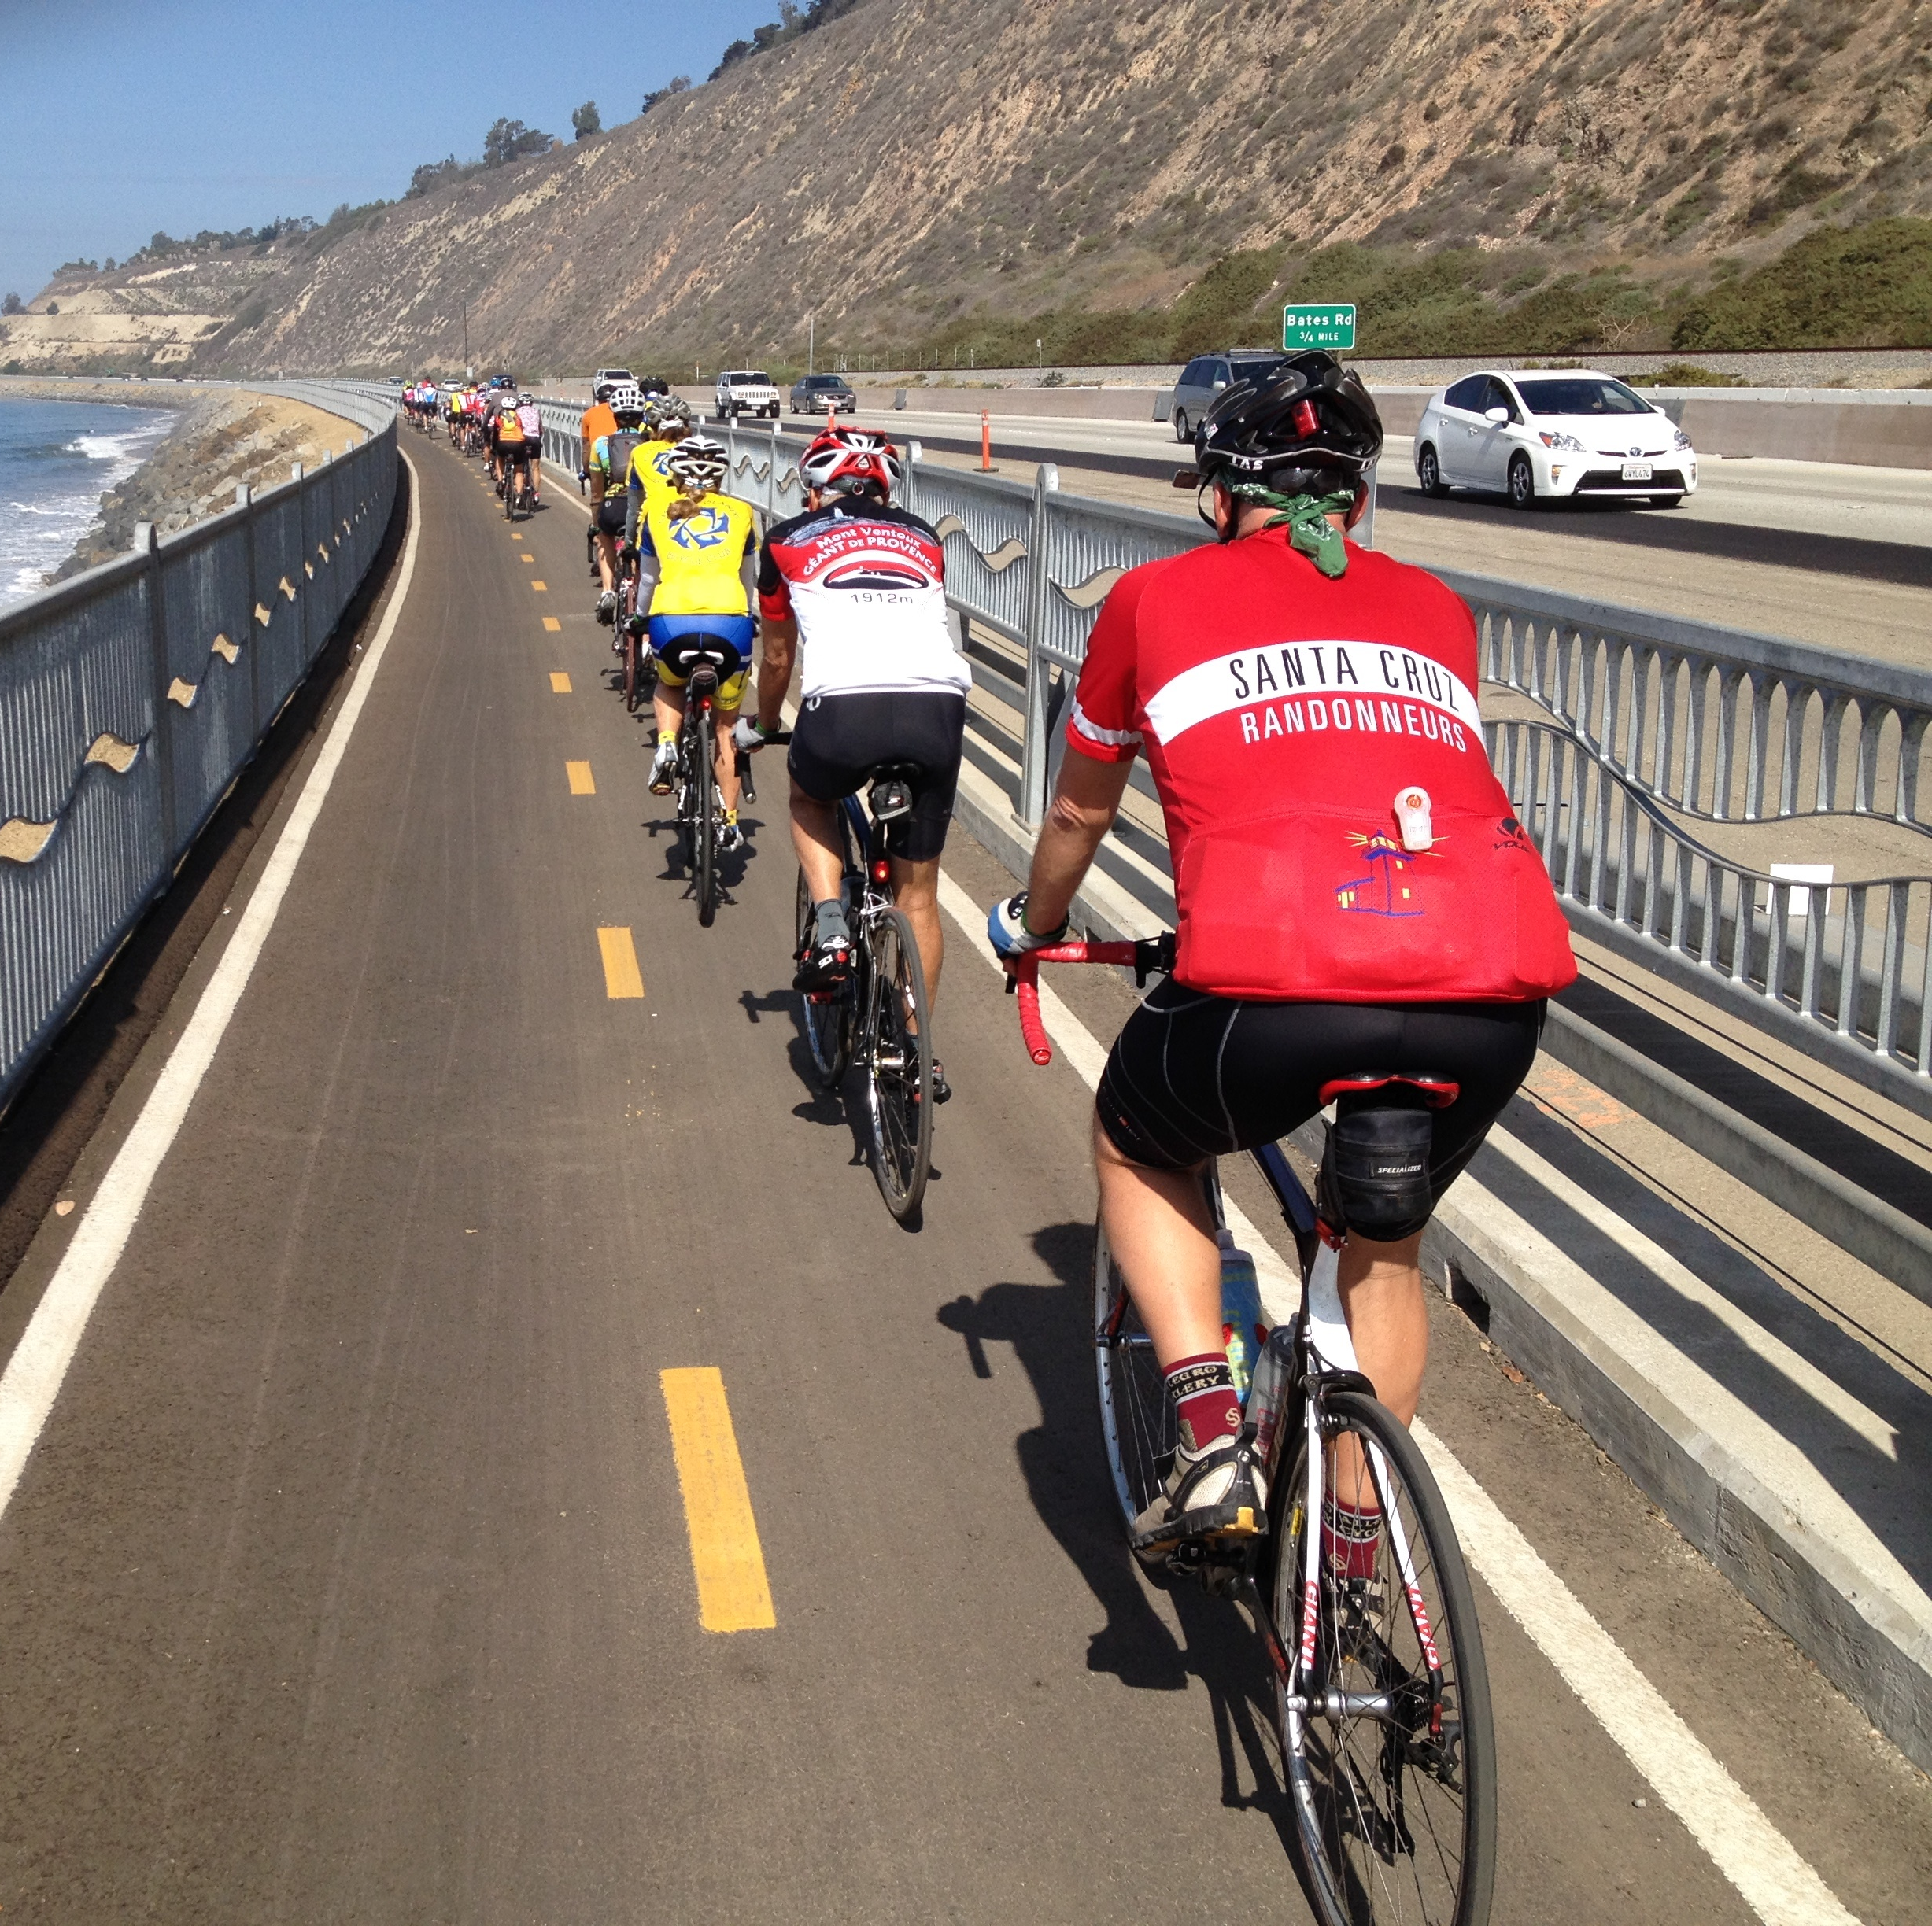
Active Transportation Overview
Planning, Outreach, and Programming
May 6, 2022
Notes:
Good Morning, Chair Trembley and Members of the Commission, For the record, my name is Amanda Fagan, and I am the Director of Planning and Sustainability here at VCTC.
This presentation provides an overview of planning, outreach, and programming related to Active Transportation in Ventura County, and is intended as a follow-up to the Goal Setting session on April 13th, during which many Commissioners and the public expressed a strong interest in bicycle and pedestrian improvements.

Slide 2
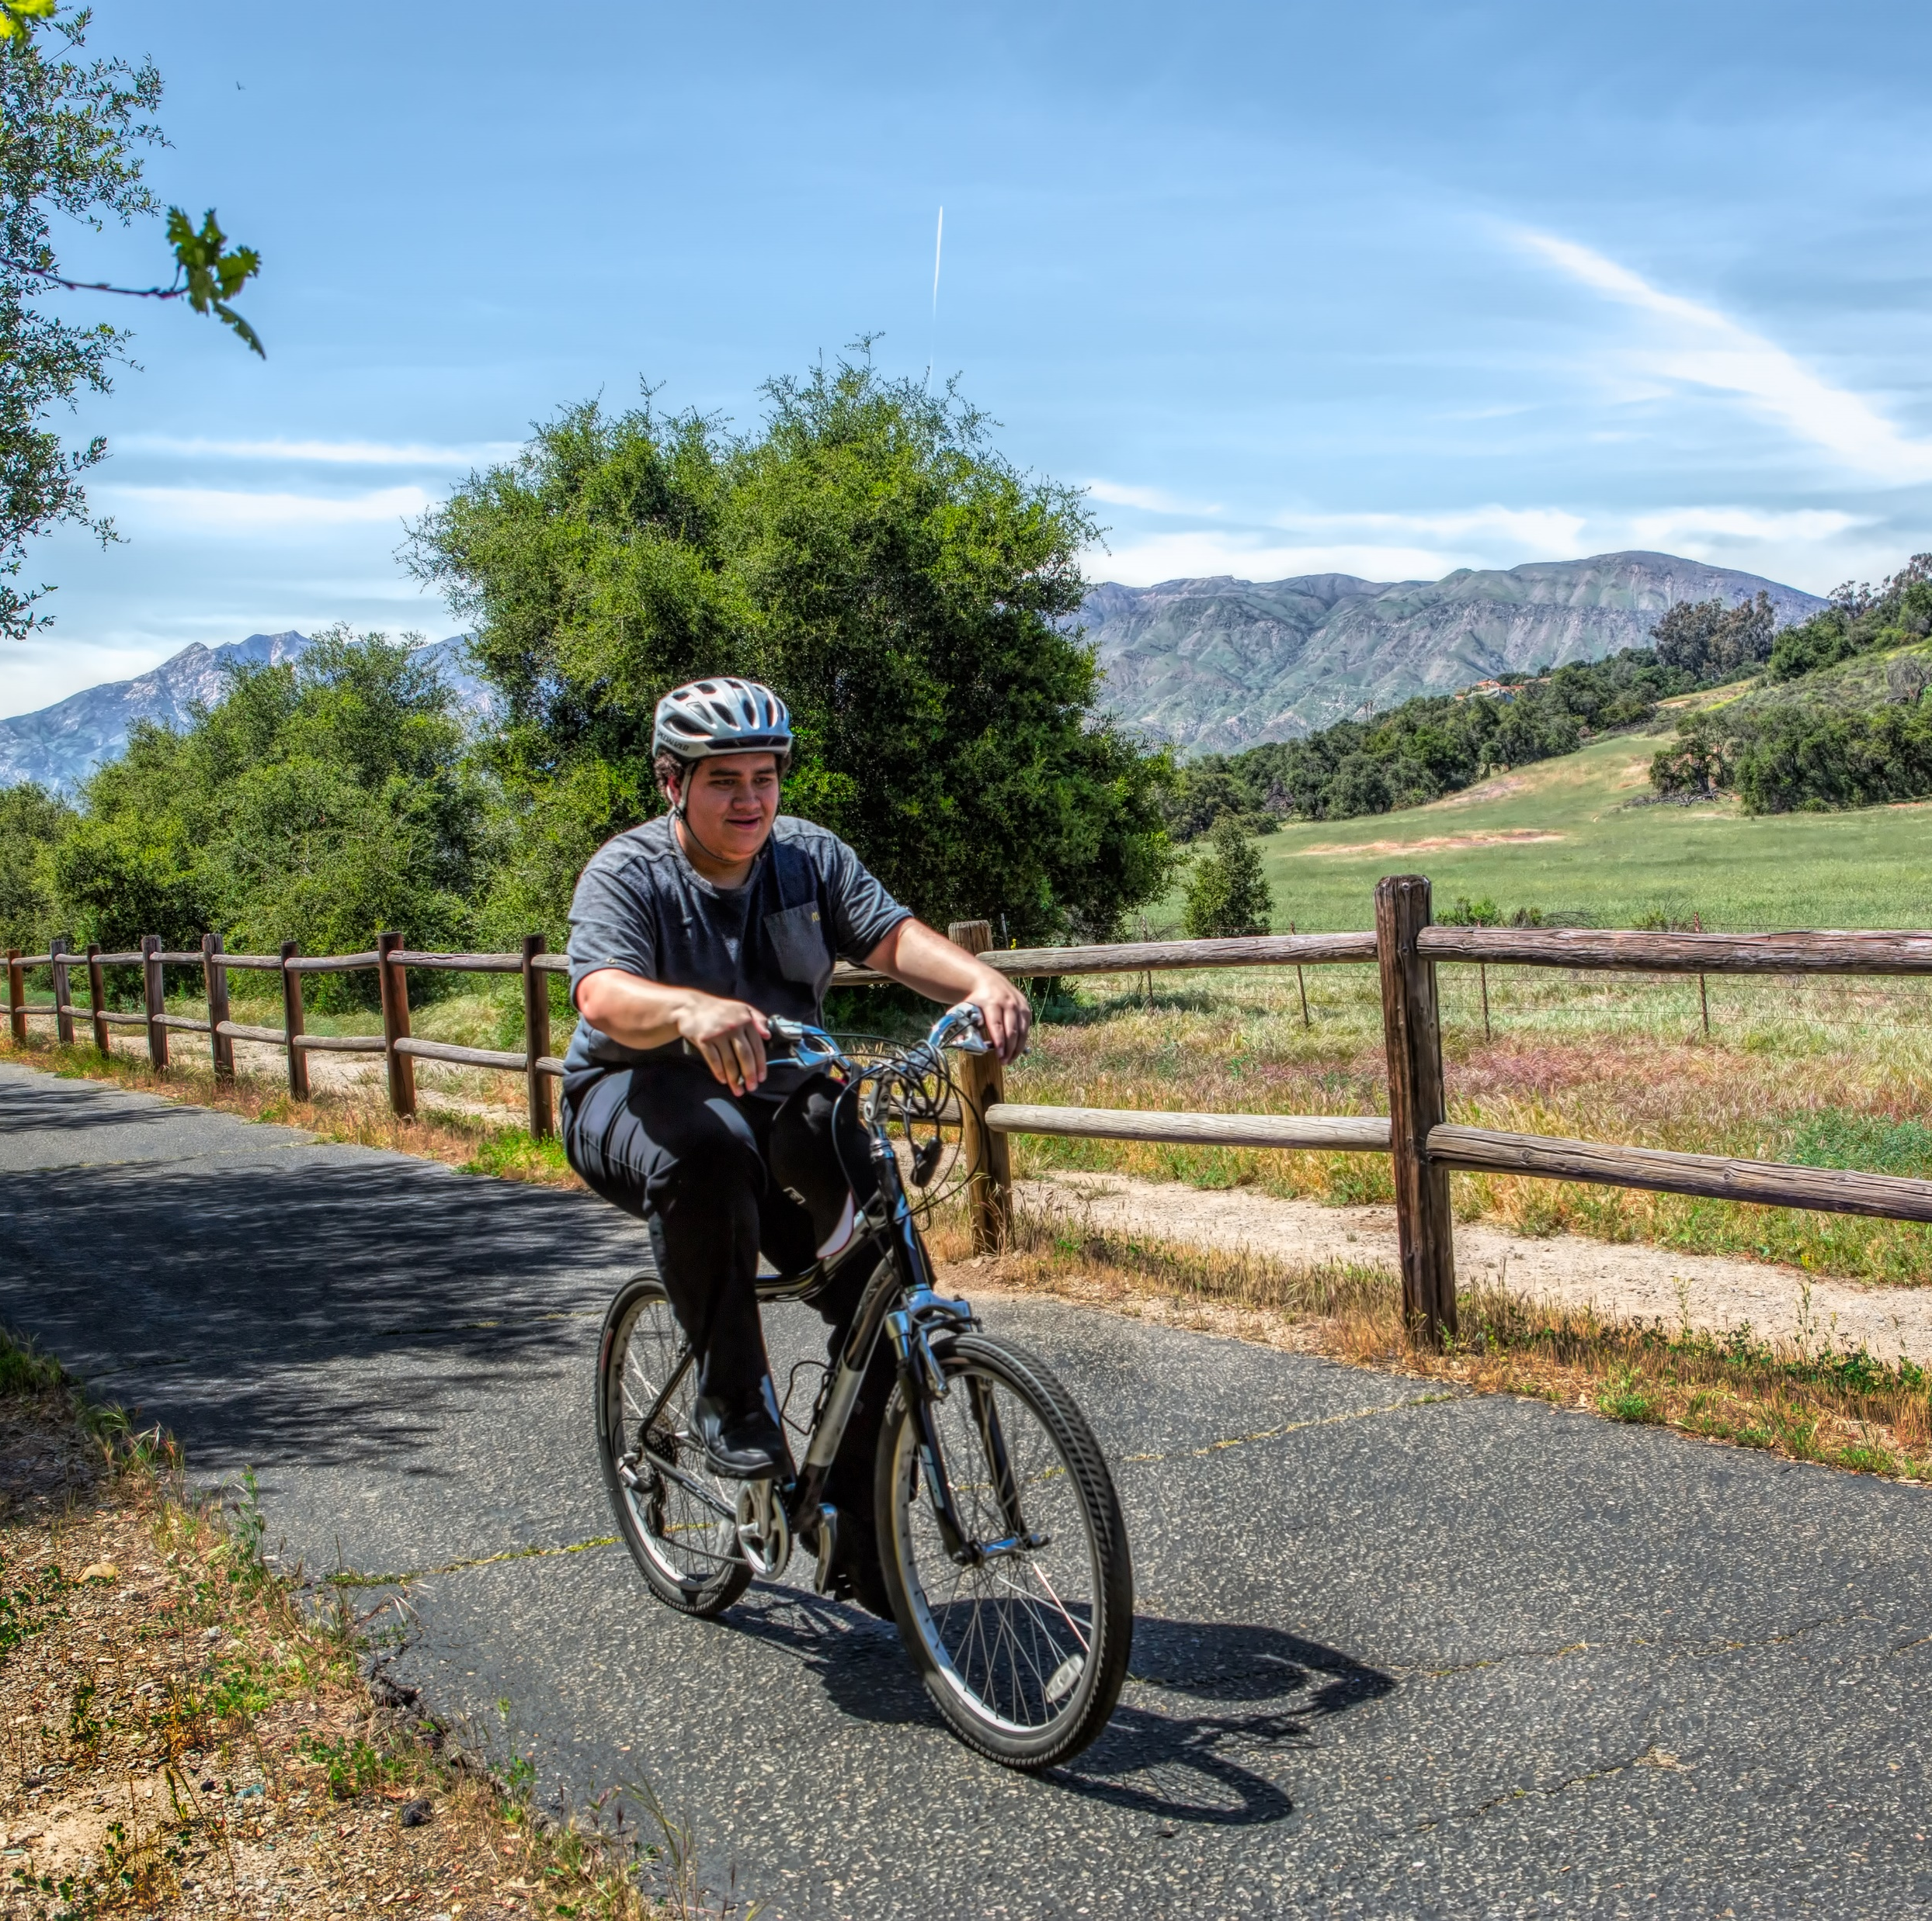
Ventura Countywide Bicycle Master Plan (2008)
Blueprint for bicycle transportation and recreation
Purpose
Maximize funding sources for bicycle improvement projects
Improve safety and encourage cycling
Expand the network and support facilities
Enhance the quality of life
Resulted in Caltrans-compliant bicycle transportation plans for all cities and unincorporated county
Since completed in 2008, total bike lane miles increased by 35%
Notes:
Adopted by VCTC in 2008, the Ventura Countywide Bicycle Master Plan provided a blueprint for bicycle transportation and recreation in Ventura County. The Master Plan was intended to maximize funding, improve safety and encourage cycling, expand the bicycle network, and enhance the quality of life in Ventura County. The Plan resulted in Caltrans-compliant bicycle transportation plan documents for all 10 incorporated cities and unincorporated areas. Since the Bicycle Master Plan was completed, total bike lane mileage has increased by approximately 35%, which I will address more fully later in the presentation.

Slide 3
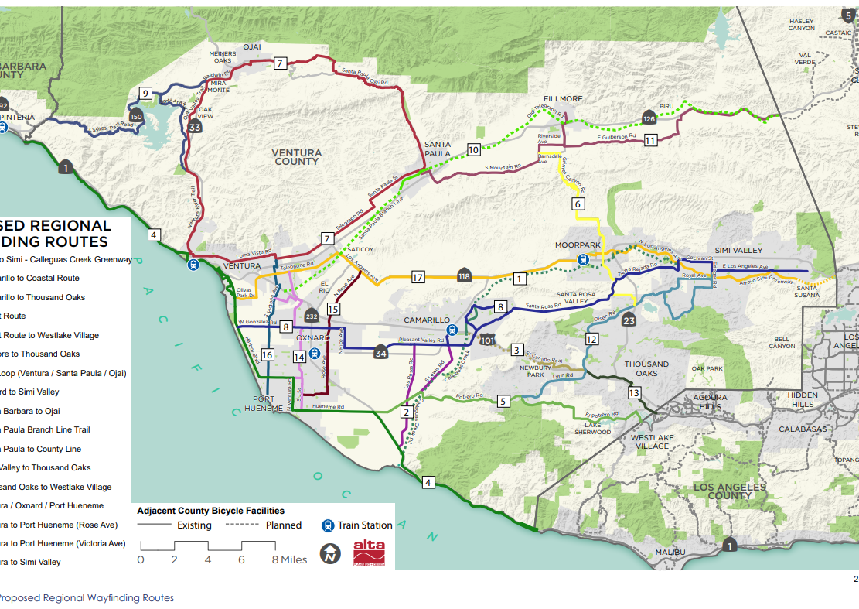
Bicycle Wayfinding Plan (2017)
Identified and prioritized intercounty and intercity bicycle routes and developed common signage
Regional plan, not designed to replace local bicycle plans, safe routes to school, or other local efforts
Notes:
In 2017, the Commission approved the Bicycle Wayfinding Plan to identify and prioritize intercounty and intercity bicycle routes and to develop common signage. The Wayfinding Plan is intended as a regional plan and is not designed to replace local bicycle plans, safe routes to school, or other local efforts.
A subcommittee of the Transportation Technical Advisory Committee oversaw Plan development and provided direction for route selection, ranking, sign design and placement. The Bicycle Wayfinding Plan reflects where people currently ride and where they want to ride, rather than tying together existing bike lanes.
Routes were identified through various outreach efforts, including the development of a bike wiki, an online tool which allowed the public to draw routes on the existing network and make comments on where they want to ride and what is of interest along the way. Outreach and data sources also included online surveys, booths at local events, direct outreach to bike clubs and other organizations, and data from electronic apps that track bicycle rides, such as Strava and MapMyRide. Bike rides were then organized to analyze differences between parallel routes or to look at specific decision points on a route to determine the best alternative. Once all data was collected, weighting criteria was applied to the public input to come up with the recommended routes, ranking, and sign recommendations.
Key Recommendations included 17 routes that provide for regional connectivity, a family of bicycle wayfinding signs and placement plans to facilitate a consistent wayfinding experience for people riding bikes across Ventura County, and sign placement plans for implementation by local jurisdictions (Figure 1). The proposed routes were evaluated according to a series of prioritization criteria (Route Readiness, Need, Safety/Comfort/Skill Level, Regional Connections, Community Support), resulting in a prioritized list of the Top 10 Bicycle Routes, shown in Figure 2.
DO WE HAVE A SENSE OF WHAT HAS BEEN DONE TO DATE / PROGRESS MADE?

Slide 4
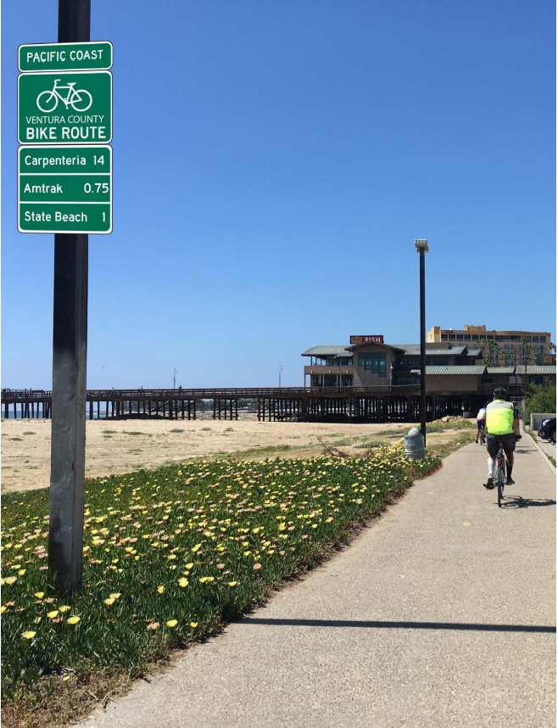
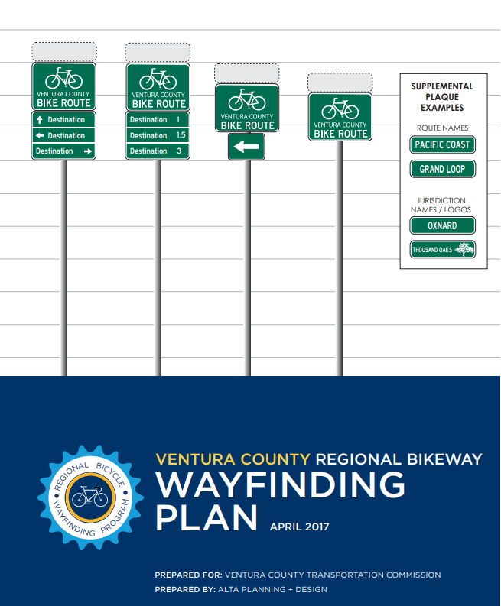
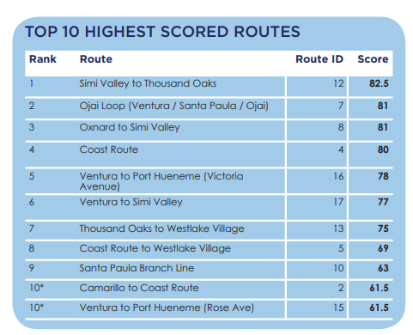
Bicycle Wayfinding Plan (2017)
Notes:
Key recommendations
17 routes for regional connectivity
Bicycle wayfinding sign designs
Sign placement plans
The proposed routes were evaluated according to a series of prioritization criteria (Route Readiness, Need, Safety/Comfort/Skill Level, Regional Connections, Community Support), resulting in a prioritized list of the Top 10 Bicycle Routes, shown in Figure 2.

Slide 5
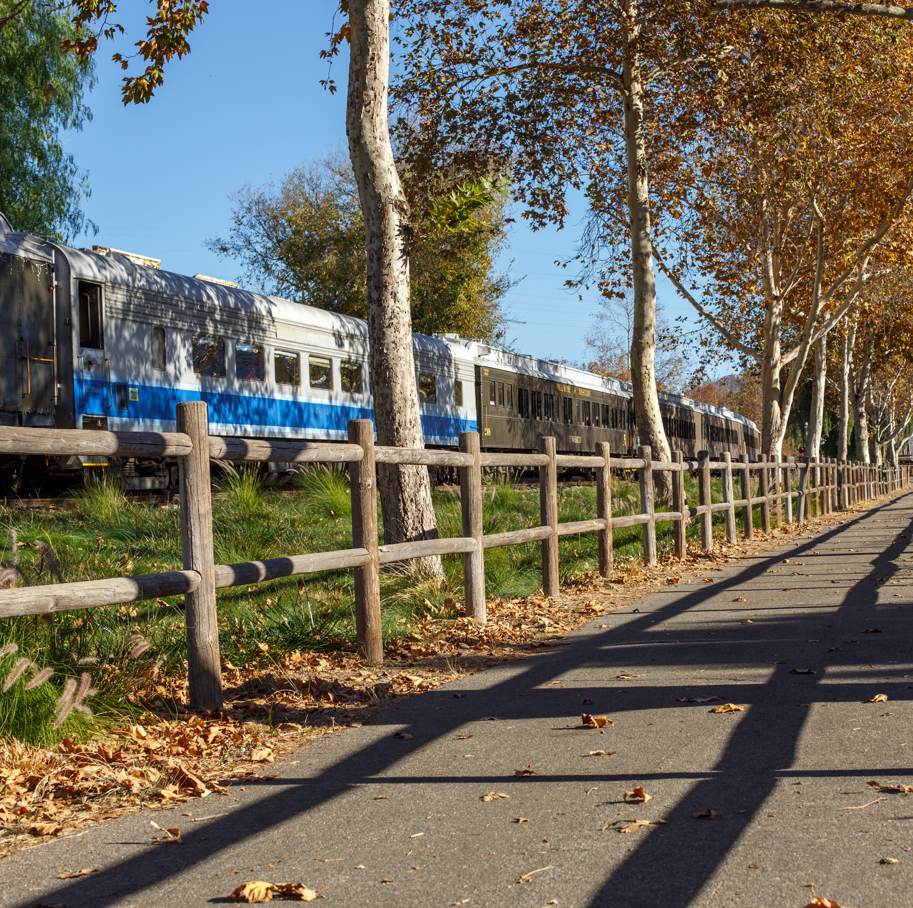
Santa Paula Branch Line
Bike Trail
Purchased in 1995 with intent to construct multi-use path for active transportation and recreation
SPBL Recreational Trail Master Plan and Environmental Impact Report (2000)
Master Plan defines roles and responsibilities for partners (County and Cities of Ventura, Santa Paula, and Fillmore) for construction and maintenance
Notes:
VCTC acquired the 32-miles Santa Paula Branch Line railroad in 1995 with the intent to construct a multi-use path for active transportation and recreation through the Santa Clara River Valley from Ventura to Piru. VCTC adopted the Santa Paula Branch Line Recreational Trail Master Plan and Environmental Impact Report in 2000, which established roles and responsibilities for VCTC, the County, and corridor cities. Sections of the trail have been constructed in the cities of Santa Paula, Fillmore and unincorporated community of Piru. The SPBL trail is included on the Top 10 high priority corridors for the Bicycle Wayfinding Plan. Renewed efforts to build out remaining sections of the SPBL are anticipated to begin during Fiscal Year 2022/2023.

Slide 6
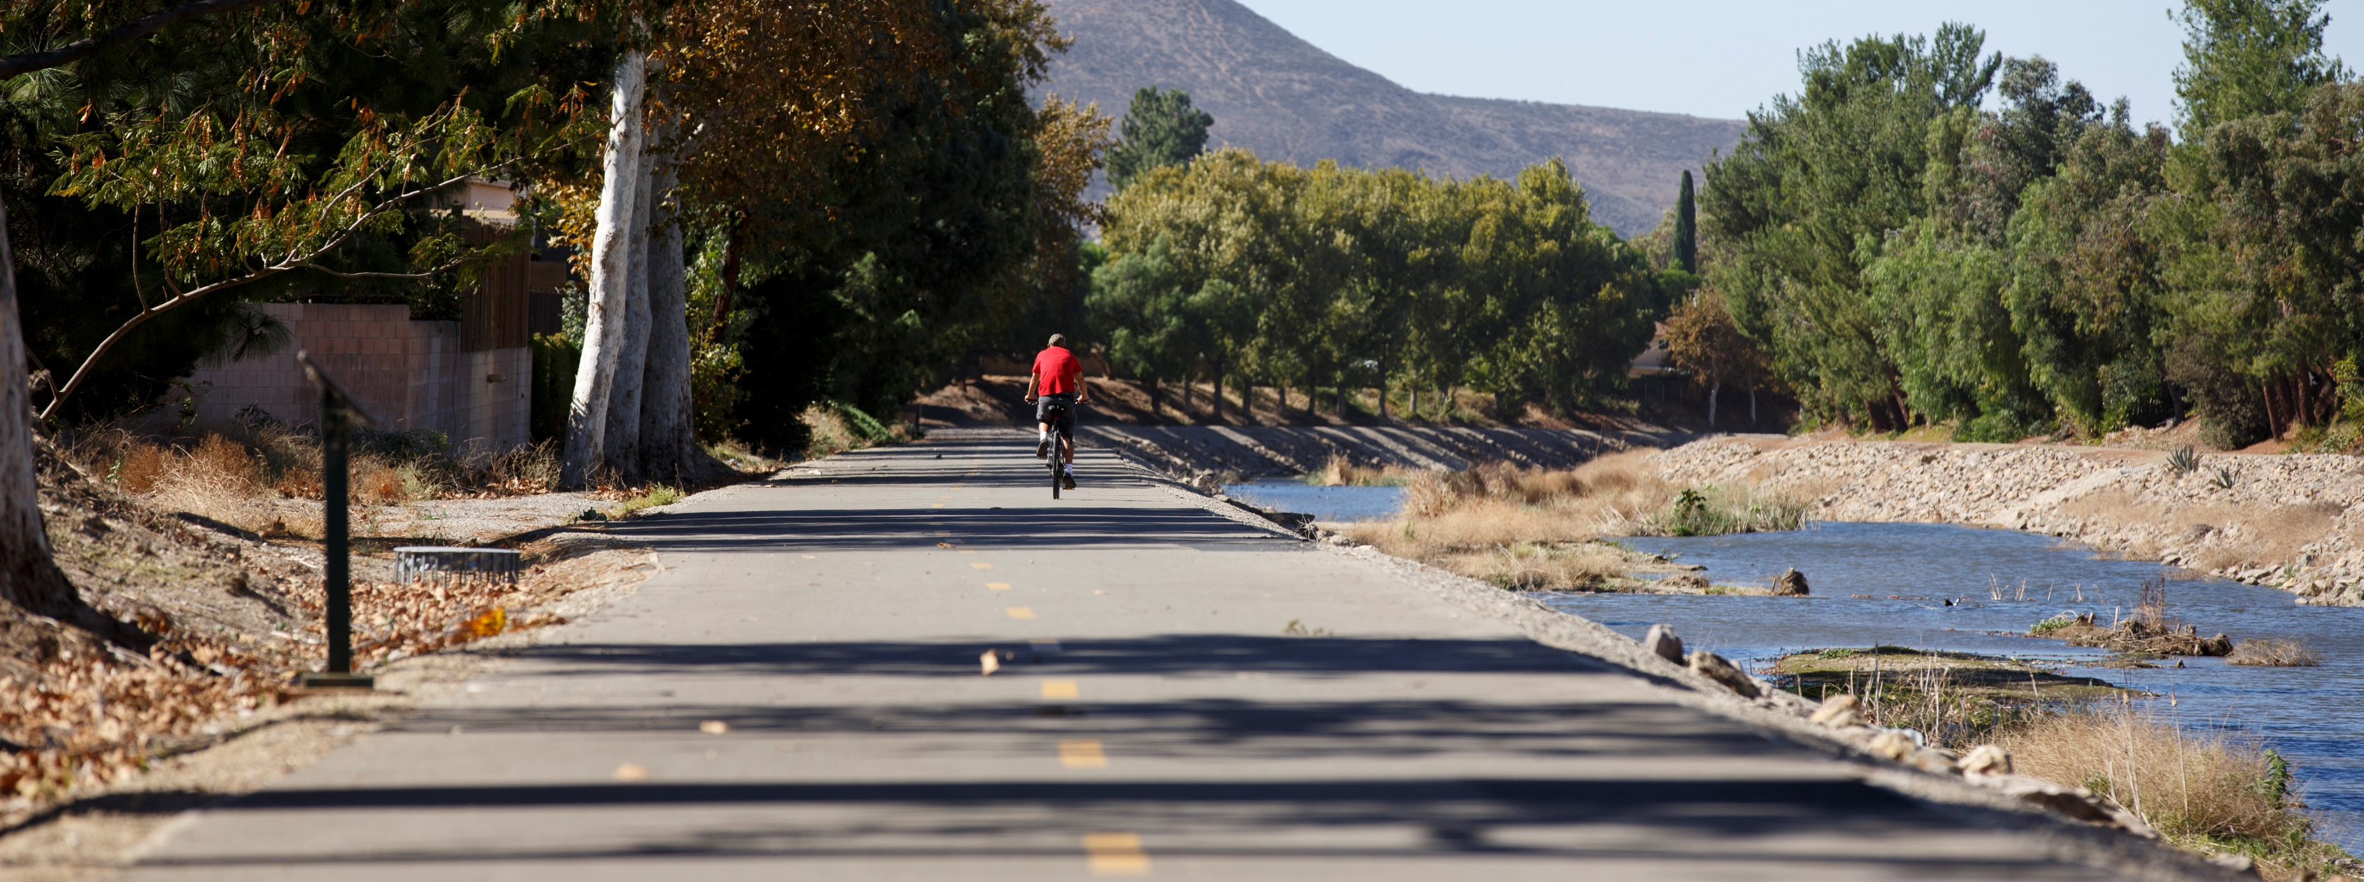
Jurisdiction | Active Transportation Plan Status
Camarillo | City of Camarillo Bikeway Master Plan (2017)
Fillmore | N/A
Moorpark | City of Moorpark Bicycle Transportation Plan (2008)
Ojai | Ojai Complete Streets Master Plan (2017)
Oxnard | City of Oxnard Bicycle & Pedestrian Facilities Master Plan (2011) Sustainable Transportation Plan (Ongoing – Anticipated 2023)
Port Hueneme | N/A
Ventura | City of Ventura Bicycle Master Plan (2011) Ventura Active Transportation Plan (Ongoing – Anticipated 2023)
Santa Paula | Bicycle Mobility Plan within Santa Paula 2040 General Plan (2020)
Simi Valley | Simi Valley Bicycle Master Plan (2009)
Thousand Oaks | City of Thousand Oaks Active Transportation Plan (2019)
County of Ventura | Active Transportation Plan (Ongoing – Anticipated 2023)
Partner Agency Active Transportation Planning
Notes:
VCTC’s Ventura County Comprehensive Transportation Plan (CTP) Update will synthesize and incorporate active transportation infrastructure, plans, and policies from the County of Ventura and the incorporated cities and make recommendations to improve active transportation infrastructure, facilities, policies, and programs. The CTP Draft Existing Conditions Technical Memorandum identifies the status of active transportation plans by jurisdiction as shown in Table 1 below:
As noted in Table 1, the County of Ventura and the Cities of Oxnard and Ventura are currently updating their respective Active Transportation Plans. As with the VCTC CTP Update, each of these Active Transportation Plans are funded through Caltrans Sustainable Transportation Planning Grants from the Fiscal Year 2020/2021 cycle, with completion dates in February 2023. VCTC staff participate as requested in the development of these Plans, have shared data from the CTP engagement efforts with our County and City partners, and are looking for opportunities to coordinate public outreach where possible to benefit our respective planning efforts.
Through the Southern California Association of Governments Disadvantaged Communities Planning program, an Active Transportation Plan for the Saticoy community was also completed in November 2020. The Vision of the Saticoy Active Transportation Plan is for Saticoy to be “a walking- and biking-friendly community that provides safe, comfortable, convenient, and healthy mobility for people of all ages and abilities.” The Saticoy Plan recommends a mix of shared-use paths, bicycle lanes, routes, greenways, and separated bikeways that facilitate biking and walking throughout the neighborhood and provide connectivity to neighboring communities.

Slide 7
Comprehensive Transportation Plan Update
CTP Update Active Transportation Assessment
Walk Audits
Recommendations and Gap Closure
Notes:
VCTC’s Ventura County Comprehensive Transportation Plan (CTP) Update will synthesize and incorporate active transportation infrastructure, plans, and policies from the County of Ventura and the incorporated cities and make recommendations to improve active transportation infrastructure, facilities, policies, and programs.
I should also mention that recent VCTC studies have emphasized the importance of investments in Active Transportation. For example, the 101 Communities Connected Multimodal Corridor Study found that Active Transportation projects generally receive a high score through the Communities Connected Index performance metrics. Of the 24 projects with the highest Communities Connected Index score, over 60 percent of those projects were active transportation projects.

Slide 8
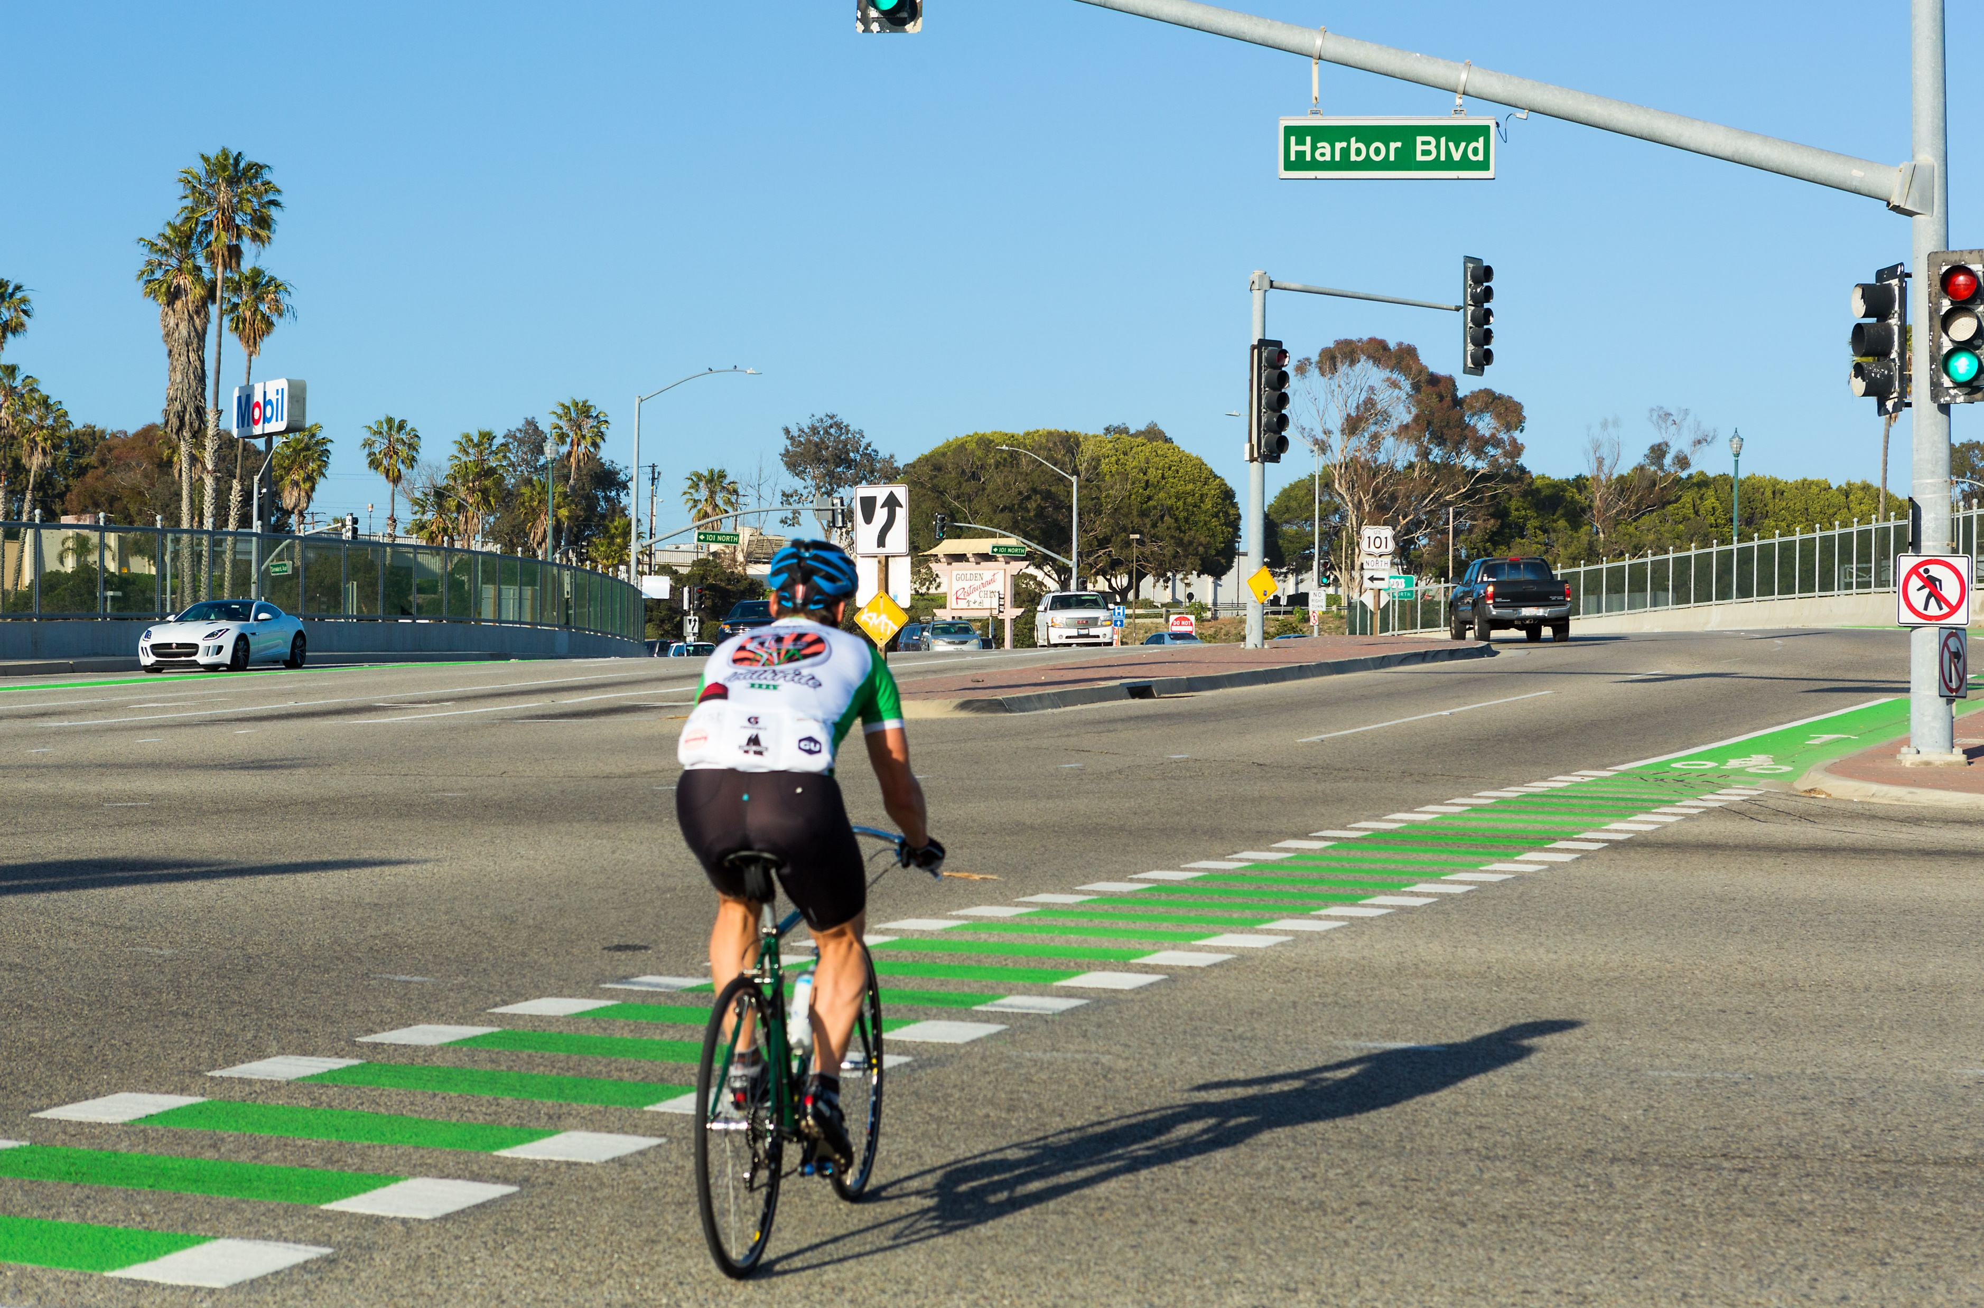
Countywide Bike Lane Production
(Total Lane Miles, 2008 - 2022)
35% increase in total lane miles
Year | Class I | Class II | Class III | Total | Net Change 2008 - 2015
2008 | 56.3 | 250.8 | 55.6 | 362.7 | N/A
2022 | 84.3 | 379.9 | 76.3 | 559.5 | 196.8
Notes:
Relative proportion of total lane miles of autos compared to bikes (percentage increase)?
In January 2022, VCTC staff conducted a survey of each of the Cities and County to update the Bike Lane Inventory data. As of February 2022, there are a total of 84.3 miles of Class I shared use paths, 379.9 miles of Class II bike lanes, 76.3 miles of Class III bike routes, and 1.1 miles of Class IV bikeways, for a total of 559.5 centerline miles of bicycle facilities countywide. This reflects an increase of 196.8 centerline miles of bicycle infrastructure countywide between 2008 and 2022, an average increase of 14 miles per year (Table 2).

Slide 9
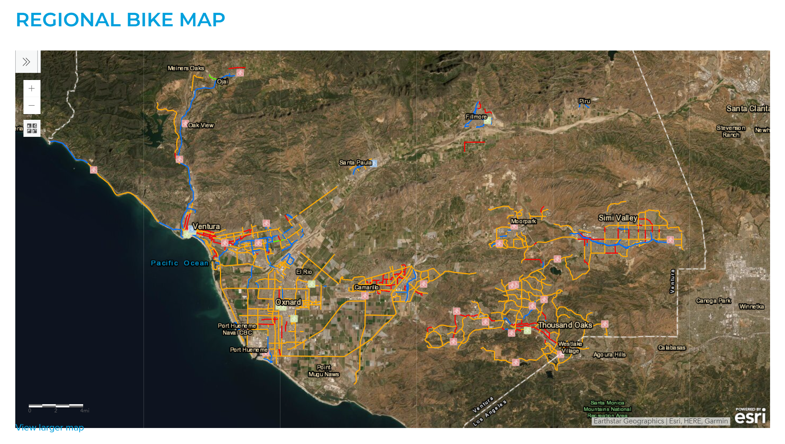
Bicycle Inventory – Updated February 2022
GIS Map Available Online at https://www.goventura.org/getting-around/bike/
Printed Updated Bike Maps coming soon- May 2022
Biking VC: Routes & Tips for Beginners & Families
Mapping & GIS
Notes:
Based on the updated Bicycle Lane Inventory data, VCTC worked with Maps.com to update the Regional Bike Map for release concurrent with Bike Month in May 2022. Updated data is available online at https://www.goventura.org/getting-around/bike/. Fold out printed bike maps will be distributed to local bike shops, at community events, and available upon request from VCTC.

Slide 10
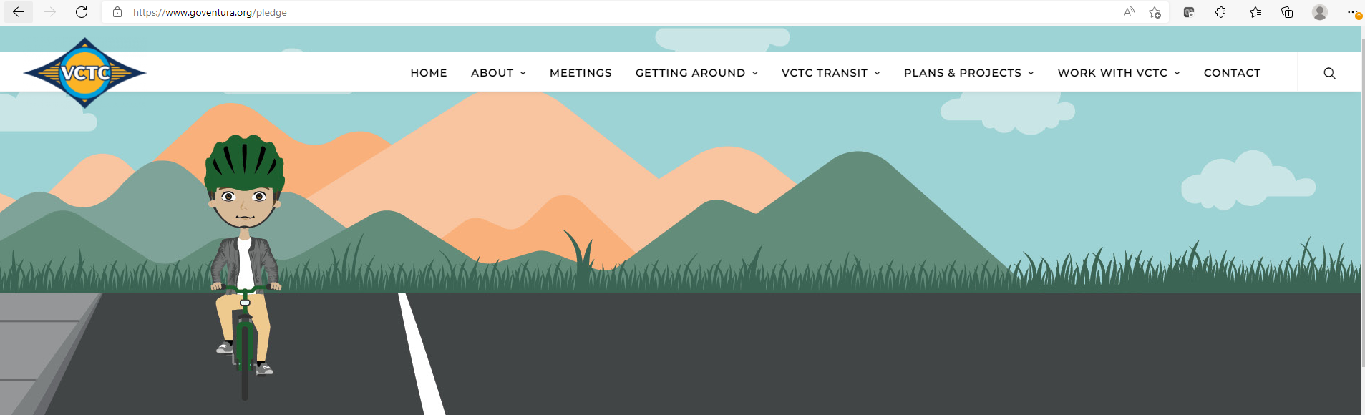
May is Bike Month!
Bike to Work Week & Day
Bike Safety Social Media Campaign
Upcoming Updates to Goventura Bike Web Page
Outreach
Notes:
Every year, VCTC does significant outreach for Bike to Work Week and Bike to Work Day. In response to the COVID-19 pandemic, VCTC has shifted to Bike Week, focusing outreach on getting the community to bike for any reason, understanding that many people were working from home and not commuting. This year, like most of our regional partners, VCTC has expanded the outreach to Bike Month, trying to leverage the increase in biking since the beginning of the pandemic. Anyone who pledges to bike in the month of May is eligible to win a $250 gift card. Outreach will also include recognition of Bike to Work Week and Bike to Work Day. Finally, VCTC will participate in events organized by the County of Ventura to encourage county employees to consider biking and is sharing our social media graphics with the Cities and County.
With the increase in biking since the beginning of the pandemic, VCTC has done significant bike outreach to the community, promoting two separate bike safety social media campaigns, one reminding motorists to be aware of cyclists on the road and one focusing on safety tips for cyclists. VCTC staff worked with local bicycle coalitions to develop messaging for the campaign. The bike safety campaign was the third most engaging social media campaign in recent VCTC history, in terms of the number of people who liked, shared and commented on the social media posts. VCTC also conducted outreach highlighting the Class I bike trails (shared use paths) throughout the county. Future efforts include updating the VCTC bike webpage to promote these safety tips and list these trails.

Slide 11
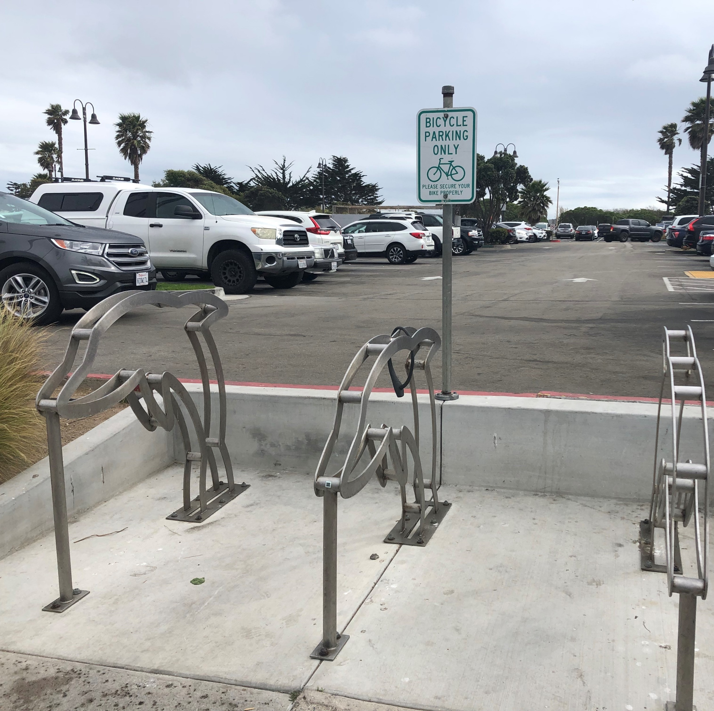
Active Transportation Program
California Transportation Commission / Caltrans
6th Cycle Applications Due June 15th
50% of available funds distributed on statewide competitive basis
Remaining funds distributed at regional level with VCTC input
Notes:
Active Transportation Program – Cycle 6
The State Legislature established the Active Transportation Program (ATP) in 2013 to support projects to encourage active transportation, such as walking and biking. There have been five application cycles thus far, with the last cycle awarded in 2021. The California Transportation Commission (CTC) issued the Cycle 6 Call for Projects on March 16, 2022, with applications due June 15th. Eligible projects include preparation of Active Transportation plans, and design and construction of specific projects. No match is required for the ATP, but projects with larger proposed matches receive more points in the project selection process.
Half of the available funds are distributed on a statewide basis to projects selected by the CTC, based on assigned project scores of up to 100 points. Once the top scoring projects have received half of the funds, the remaining funds are subdivided, with 10% of the total funds available on a statewide basis allocated to projects in smaller counties, and 40% of the total funds being distributed by population to larger regions, such as Ventura County. During the most recent cycle, the Ventura County share was $3,969,000 for the two-year program period. The CTC also awarded $6,195,000 of the statewide funds to the El Rio Pedestrian Improvement and Safe Routes to School Project, to build over four miles of sidewalk in the El Rio Community, representing the first time that statewide ATP funds went to a project in Ventura County.
In the SCAG region, each county transportation commission can add up to 20 points to the previously-assigned CTC score of up to 100 points. The projects are then ranked using the resulting scores, with the share of funds for each county going to the highest-ranked projects.

Slide 12
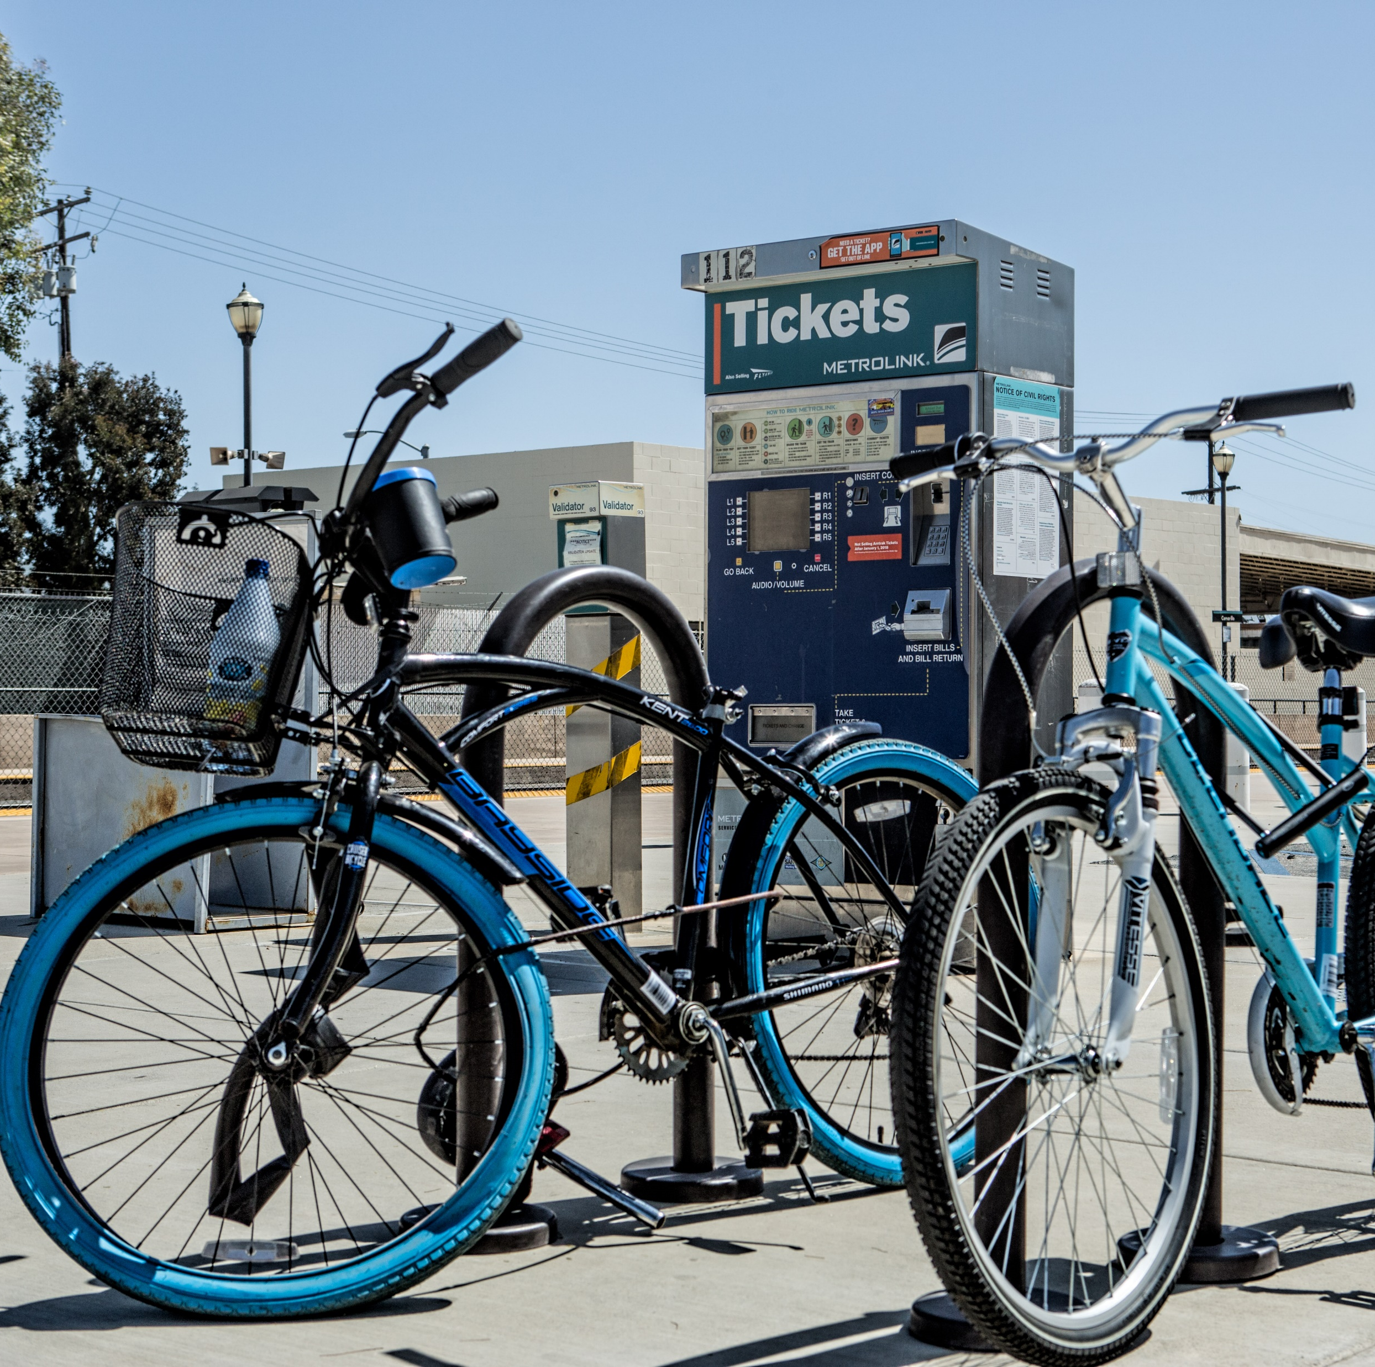
Congestion Mitigation and Air Quality (CMAQ)
Funds transportation projects that improve air quality, inc. bike/pedestrian improvements, transit system improvements, and alternative-fueled vehicles
VCTC apportionment approximately $11.8M per year
Distributed through Call for Projects
Guidelines to Commission in Sept. 2022

Slide 13
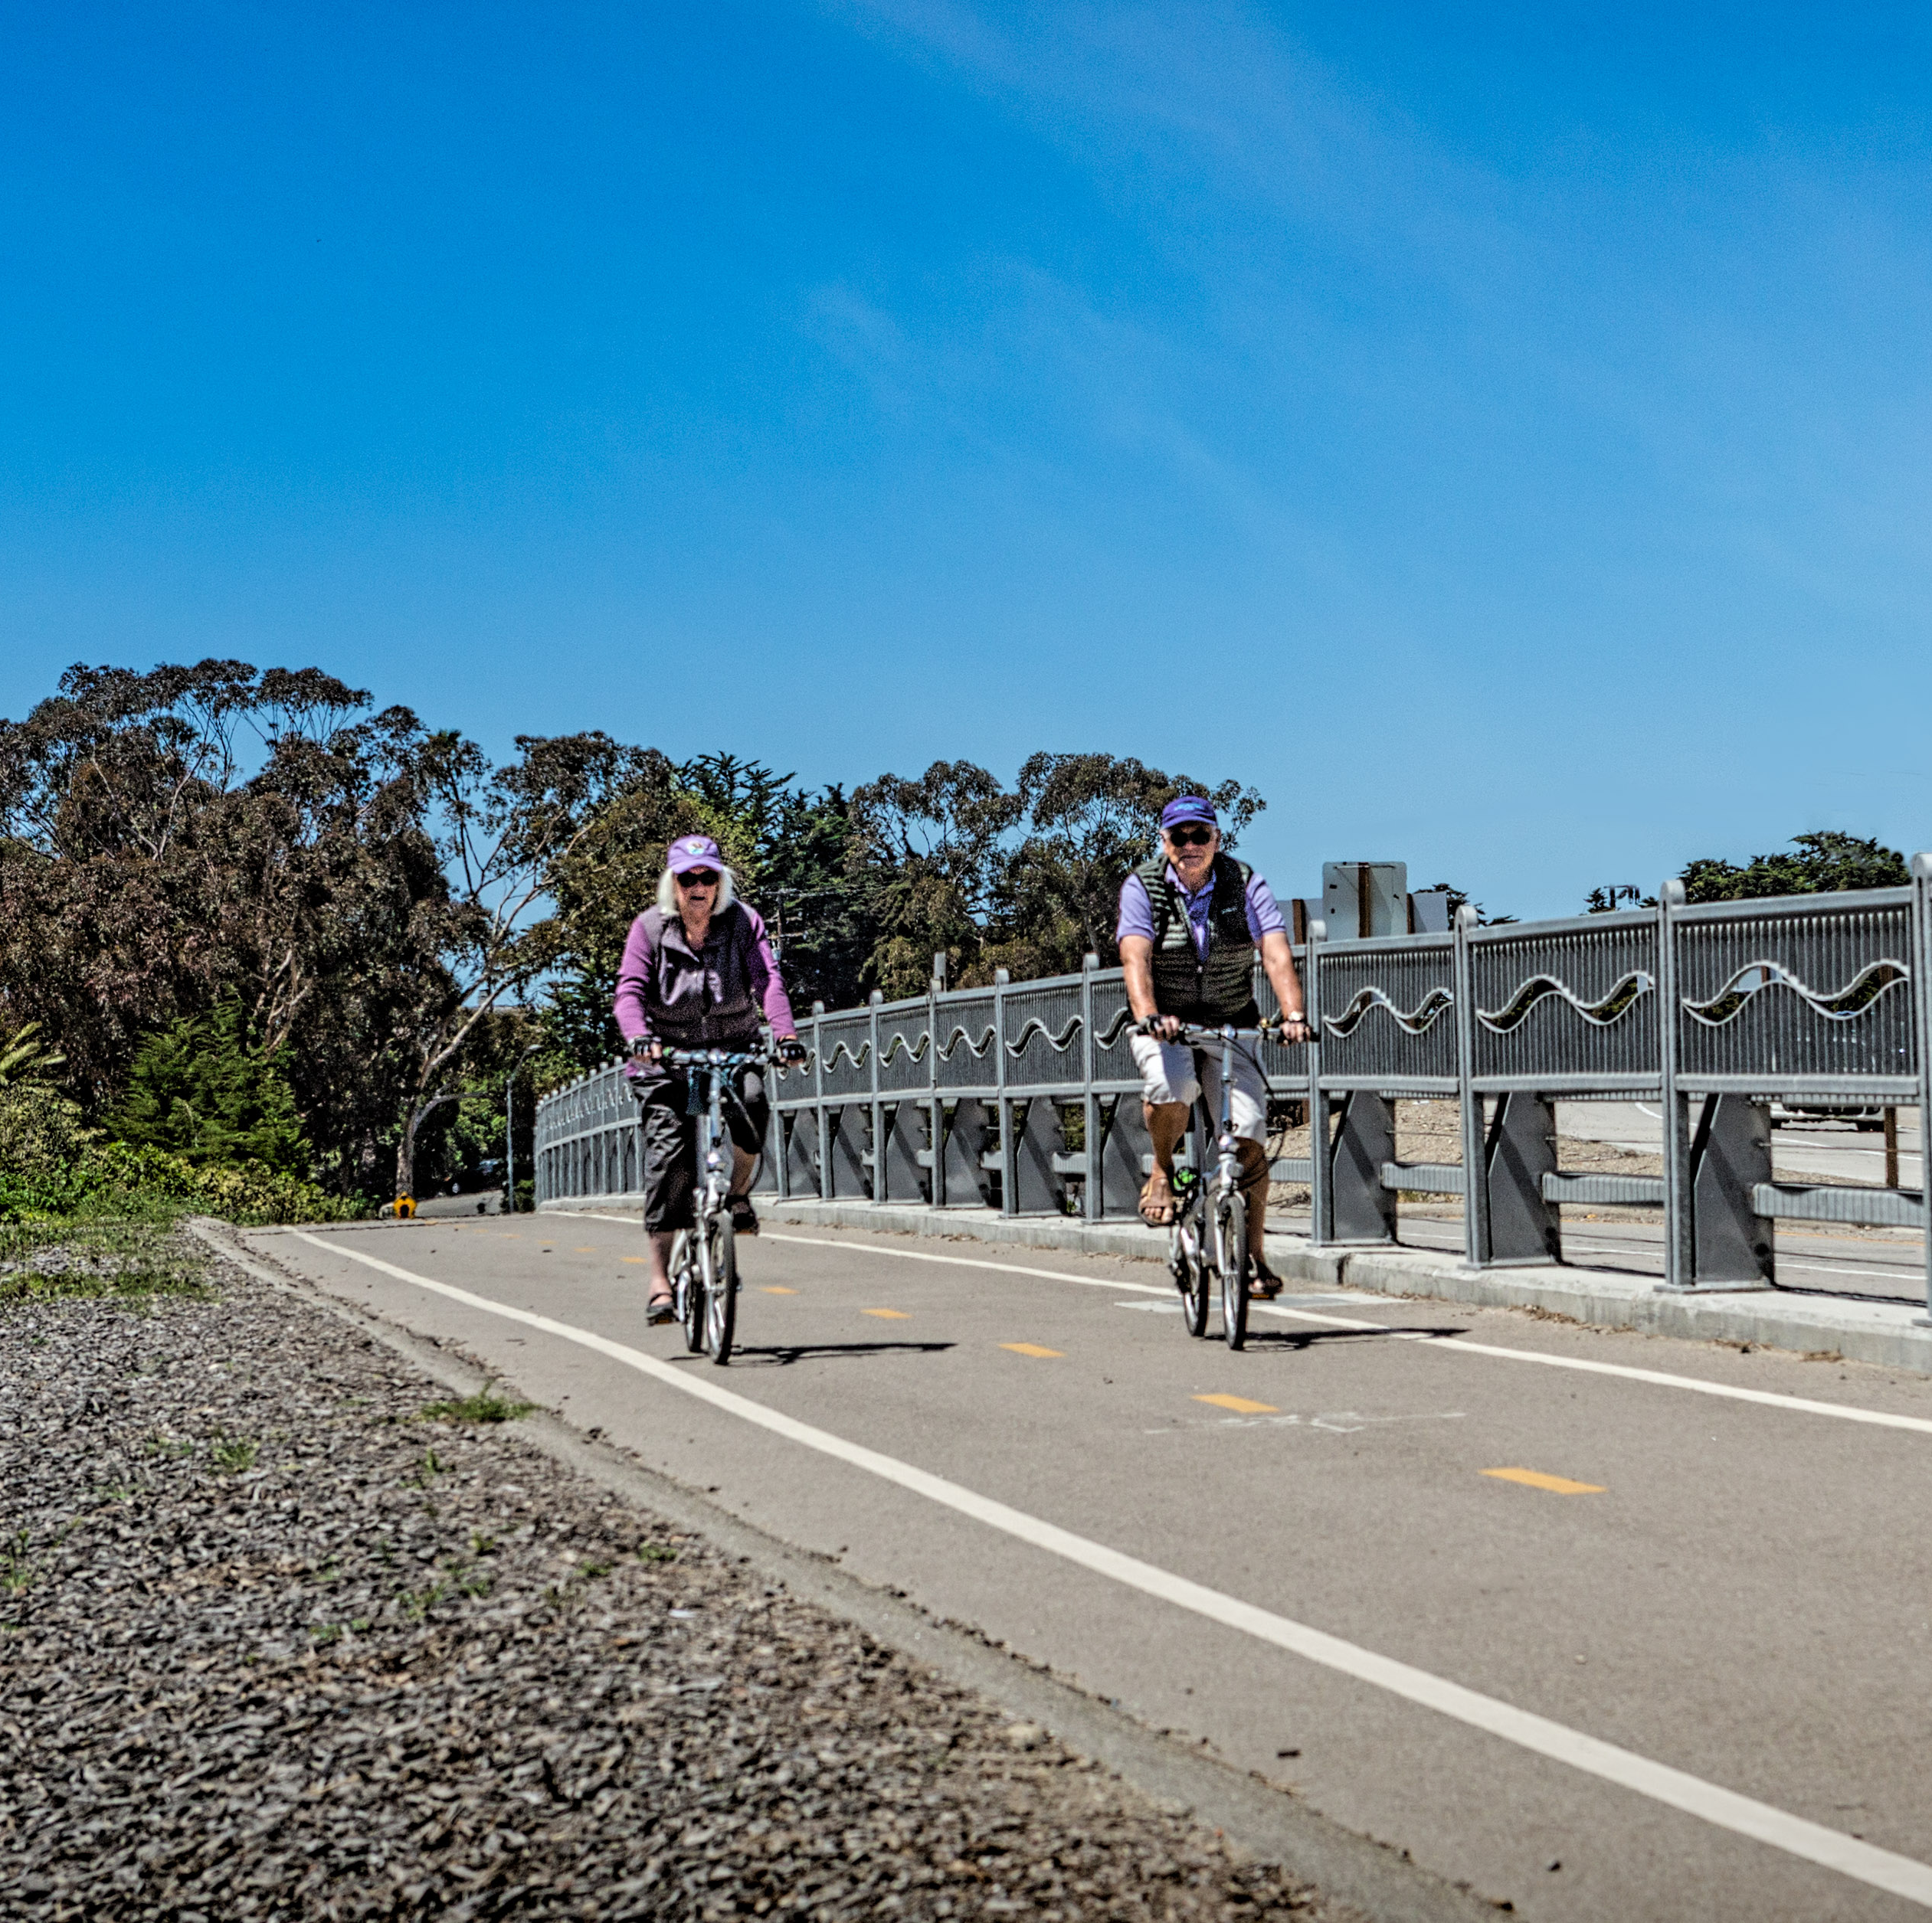
Transportation Development Act (TDA) Article 3
State Program
2% of annual revenues set aside for bicycle and pedestrian expenditures
Both maintenance and capital expenditures
25% distributed to local jurisdictions for off-street bike path maintenance
75% distributed via Call for Projects along with CMAQ funds

Slide 14
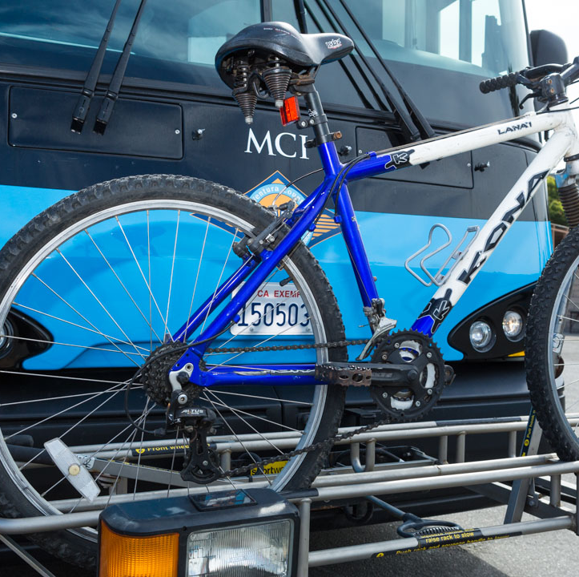
General Philosophy
Incorporate active transportation improvements into projects and grant applications where possible

Slide 15
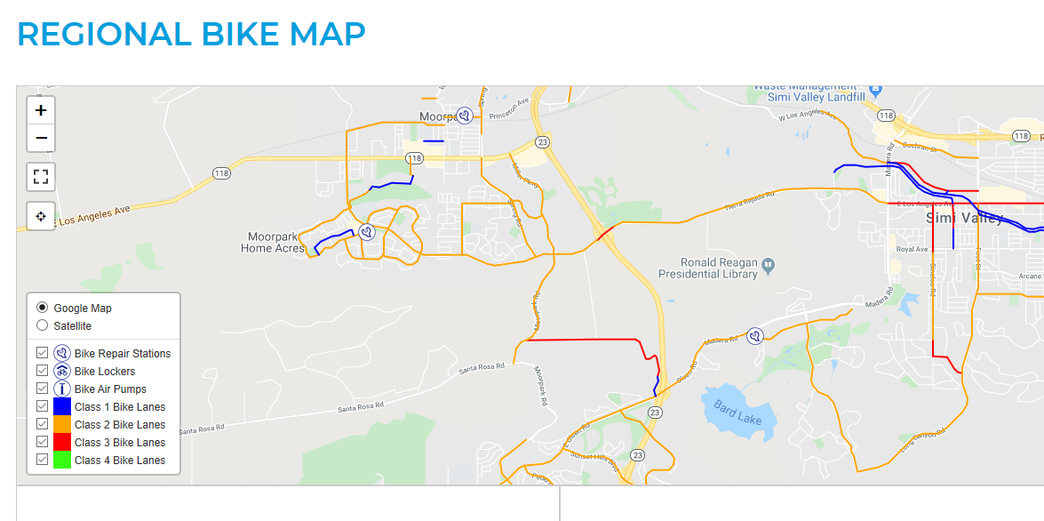
Questions?

