Slide 1
US 101 Improvement Project
Project Update VCTC Commission Meeting
May 6, 2022

Slide 2
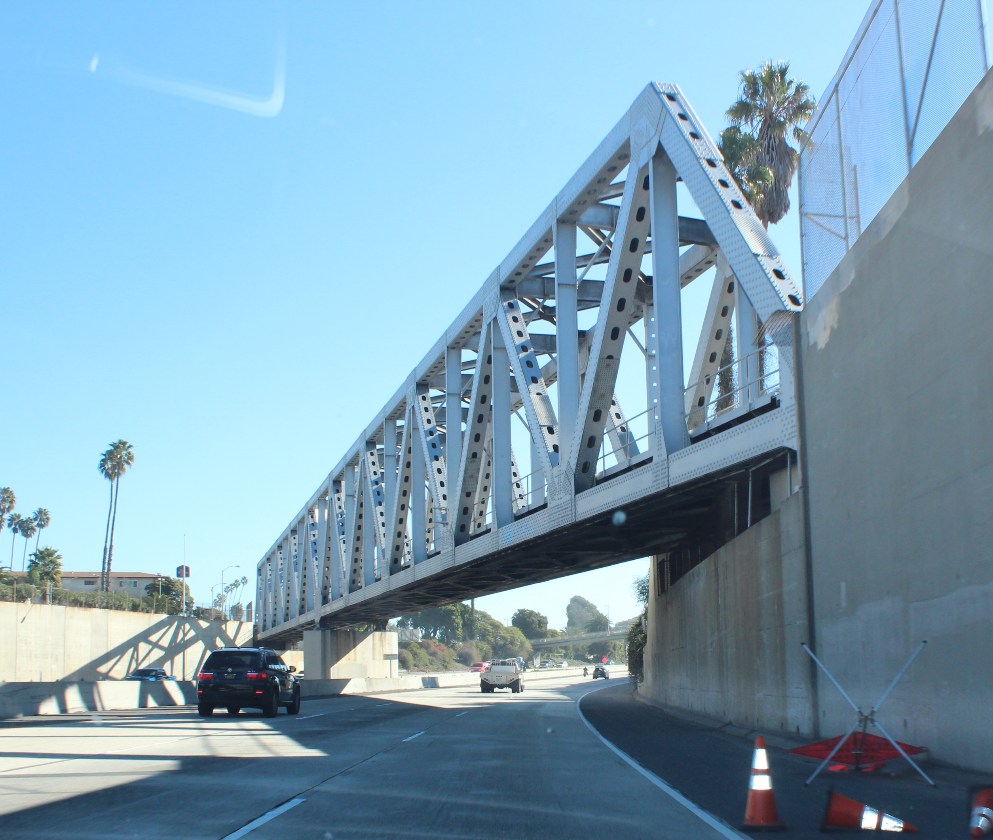
Agenda
Background and Overview
Public Involvement
Alternatives Analysis
Alternatives Under Study
Wildlife Movement Study
Ongoing Project Tasks
Early Action Project Determination

Slide 3
THANK YOU
Background and Overview

Slide 4
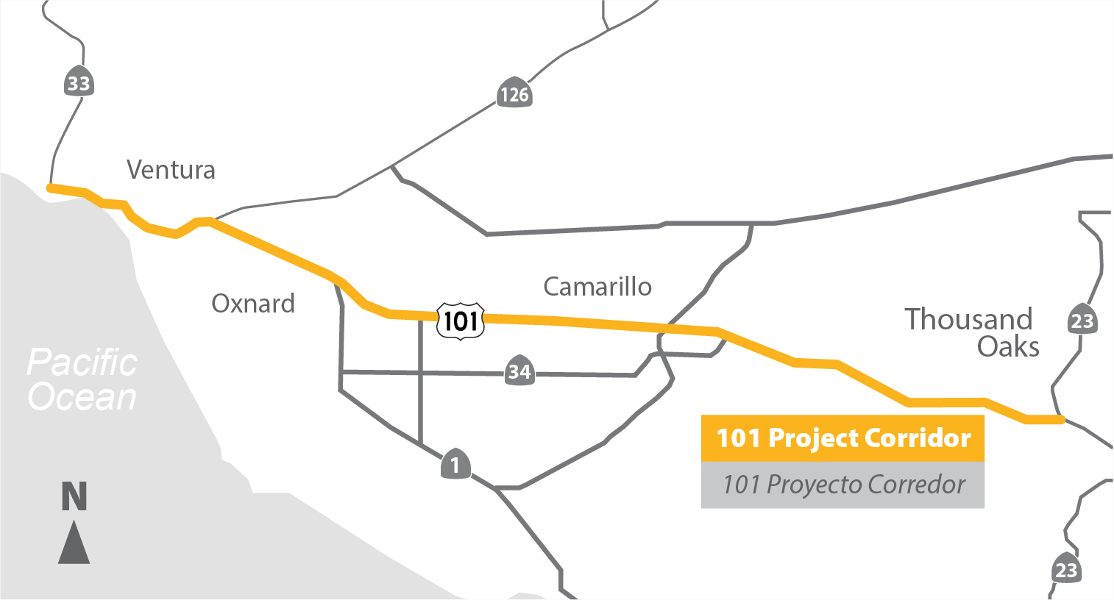
Study Area

Slide 5
Prior Planning

Slide 6
Existing Conditions
3 general purpose lanes (regular freeway lanes) in each direction from Moorpark Road in Thousand Oaks to SR 33 in Ventura
2 general purpose lanes in each direction within the SR 126 interchange
Few auxiliary lanes – mainly in Thousand Oaks
No existing High Occupancy Vehicle (HOV)/Carpool lanes

Slide 7
Existing Conditions (2019)
Location | Daily Trips | Peak Hour Trips
Thousand Oaks | 200,000 | 19,000
Camarillo/Oxnard | 150,000 | 12,000
Ventura | 71,000 | 6,000
US 101 serves as both freeway and regional Main Street
Connects regional business districts; is the primary access for the Port of Hueneme
Buses/Express Buses and goods movement are impacted by the congestion

Slide 8
2060 Forecast
26.8 miles | Northbound |  | Southbound
Peak Hour | AM | PM | AM | PM
Average Travel Time (min) | 55 | 56 | 59 | 51
Average Speed (mph) | 33 | 33 | 31 | 36
Travel Time Index | 1.96 | 2.03 | 2.07 | 1.80
Improve travel time and trip time reliability
Address impact of congestion on person/goods movement
Address existing safety and operational issues caused by bottlenecks

Slide 9
Importance of the Project
US 101 identified by VCTC as the highway network’s greatest area of need.
Aging infrastructure: some segments of US 101 haven’t had significant improvements since the 1960s.
About half the jobs and residences in Ventura County are in the US 101 Corridor.
58% of corridor trips stay within the corridor.
There are no continuous alternate routes.
Peak period speeds are forecast to drop and travel time will increase.
Person movement and goods movement in the county will be constrained by the US 101 corridor.
Provide an alternative to “Opt Out of Congestion.”

Slide 10
Public
Involvement

Slide 11
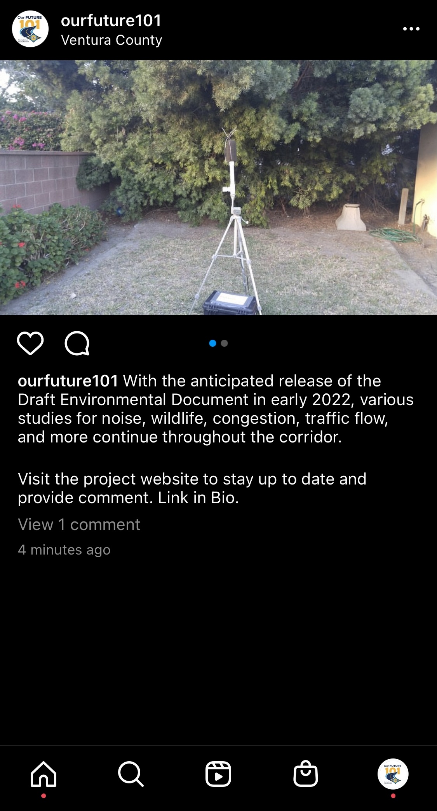
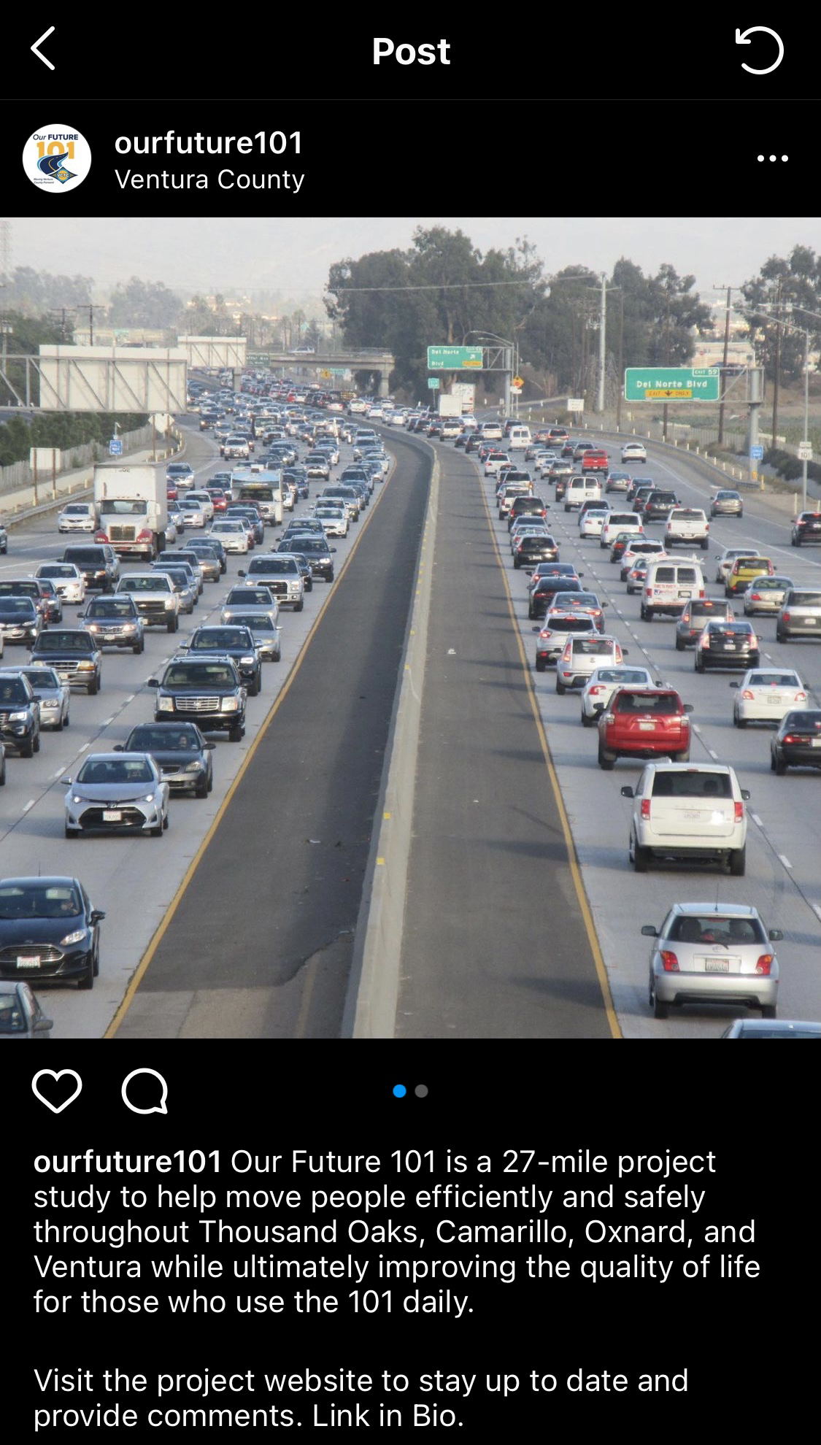
Ongoing Outreach
Website
www.ourfuture101.org
social media
Instagram.com/ourfuture101

Slide 12
Ongoing Outreach
Four Project Scoping Meetings in 2019
E-blasts and Website updates
Instagram postings
Project Updates at Commission Meetings

Slide 13
Alternatives
Analysis

Slide 14
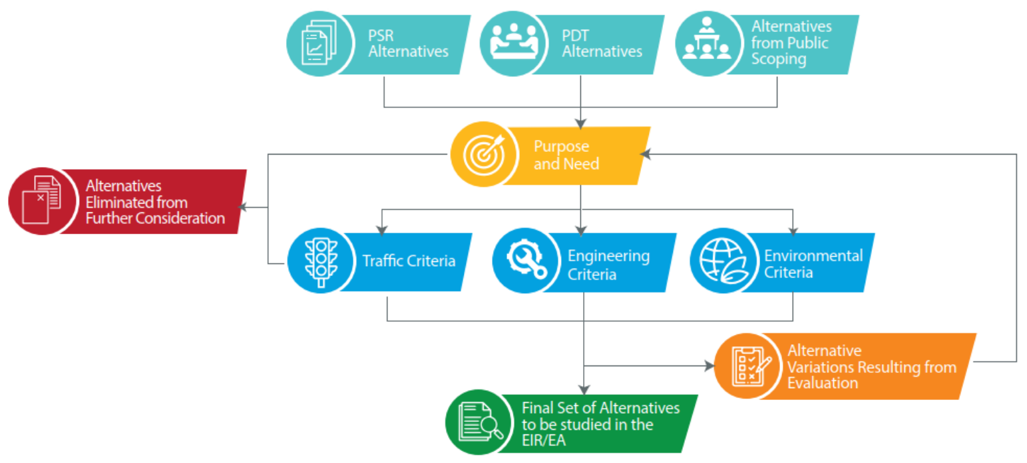
Alternatives Analysis

Slide 15
Alternatives Analysis
Alternatives Evaluated
No Build
HOV Lane Using Non-Standard Section
HOV Lane Using Non-Standard Section with Auxiliary Lanes
HOV Lane Using Standard Section with Auxiliary Lanes
HOV Lane Using Standard Section with Design Variations and Auxiliary Lanes
Two HOV Lanes Using Standard Section with Auxiliary Lanes
Reversible Lane
Elevated Dedicated Transit Way
General-Purpose Lane
Tolled Lanes
Combination of HOV Lane and General-Purpose Lane

Slide 16
THANK YOU
Alternatives Under Study

Slide 17
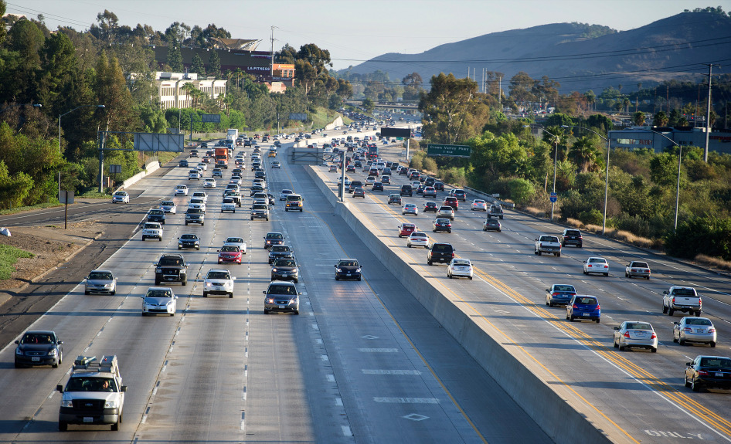
Final Set of Alternatives
July 2020 Commission Presentation
No Build
HOV/Express Bus Lane with Auxiliary Lanes
HOV/Express Bus Lane with Auxiliary Lanes and Design Variations

Slide 18
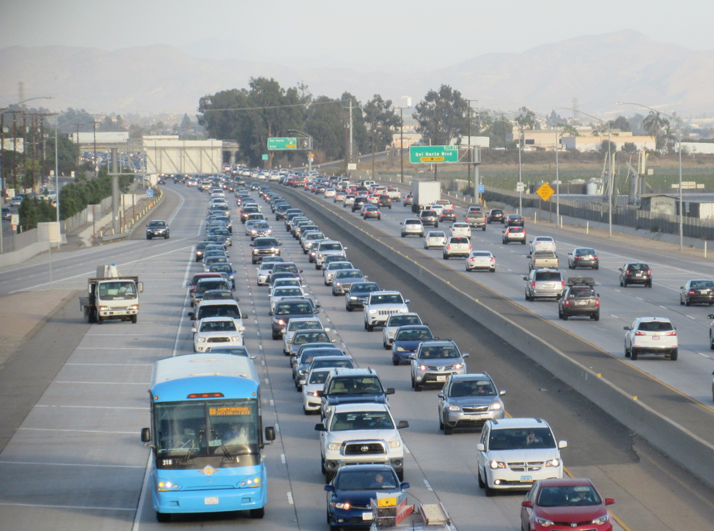
Final Set of Alternatives
Alternative 1: No Build
No further improvements on US 101
Represents a baseline condition
Allows decision makers to compare the impact of build alternatives to the impact of doing nothing

Slide 19
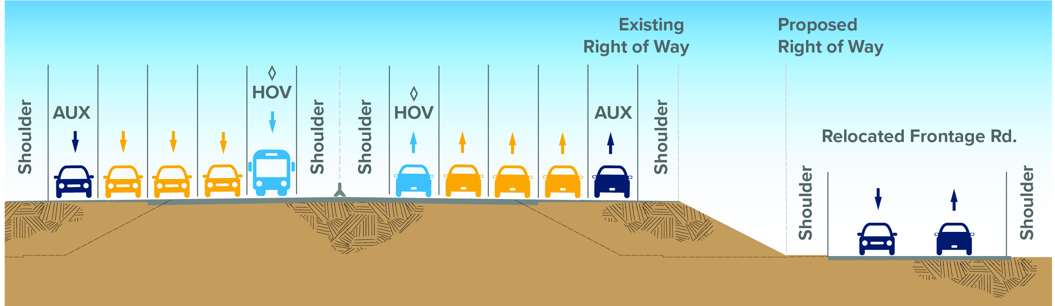
Final Set of Alternatives
Alternative 2: HOV/Express Bus Lane with Auxiliary Lanes
Demonstrates the benefit of the HOV lane for carpools and express bus service
Improves freeway operations at busy on/off ramps with more auxiliary lanes
Uses the existing inside lane between Vineyard and Victoria to provide room for a standard width HOV lane and inside shoulder without widening the Santa Clara River bridge
Requires widening freeway bridges
Impacts local streets
Requires some property acquisition

Slide 20
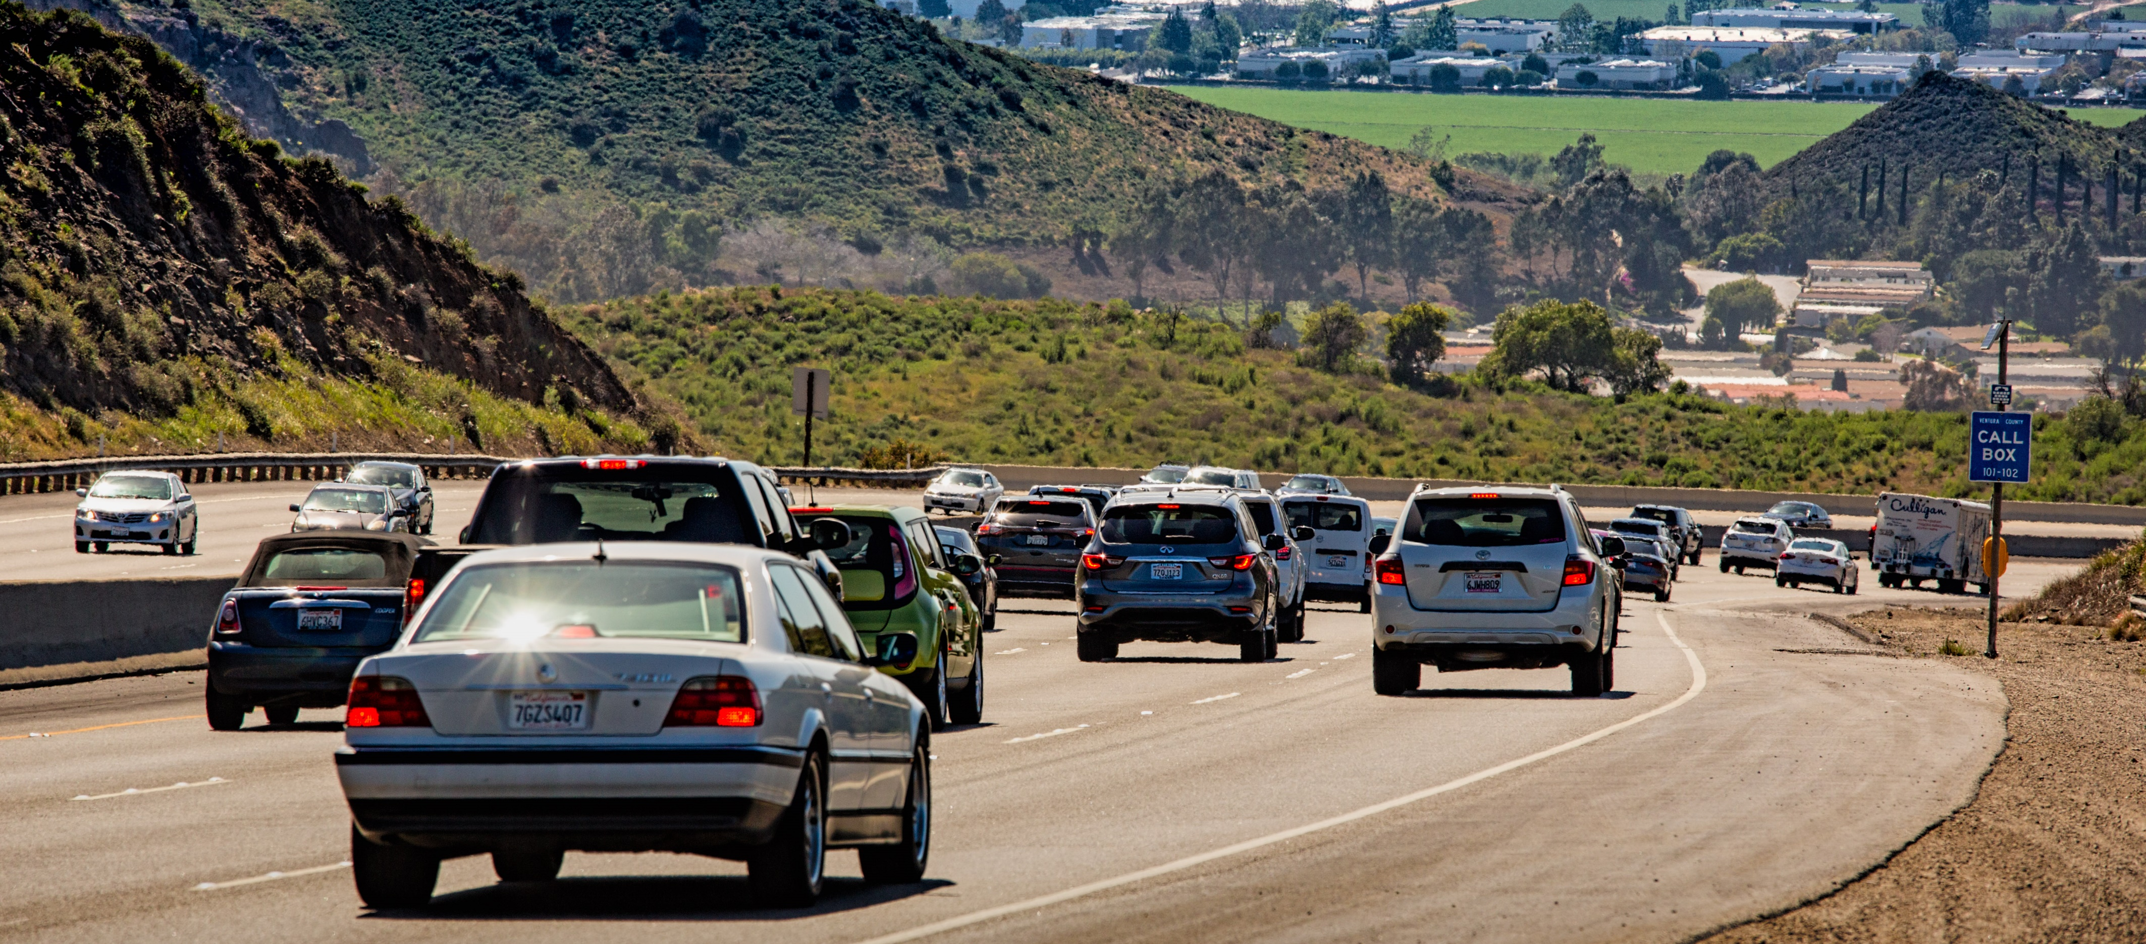
Final Set of Alternatives
Alternative 3: HOV/Express Bus Lane with Auxiliary Lanes and Design Variations
Minimizes impact to south hillside on the Conejo Grade
Extends the southbound auxiliary lane at Dawson Drive
Ends the northbound lane at California Street rather than SR 33 to improve weaving
Maintains all existing general purpose lanes from Vineyard to Victoria by restriping the inside lanes and shoulders

Slide 21
THANK YOU
Wildlife Movement Study

Slide 22
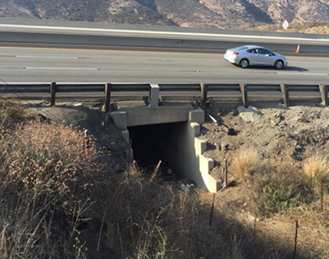
Wildlife Movement Study
As part of the US 101 Improvement Project, the need for data on the movement of wildlife in the Conejo Pass Area has been identified
VCTC applied for and recently received a Caltrans Sustainable Transportation Planning Grant Program—Sustainable Communities Competitive Grant in October 2021
The grant will be used to study wildlife movement and evaluate current wildlife connectivity

Slide 23
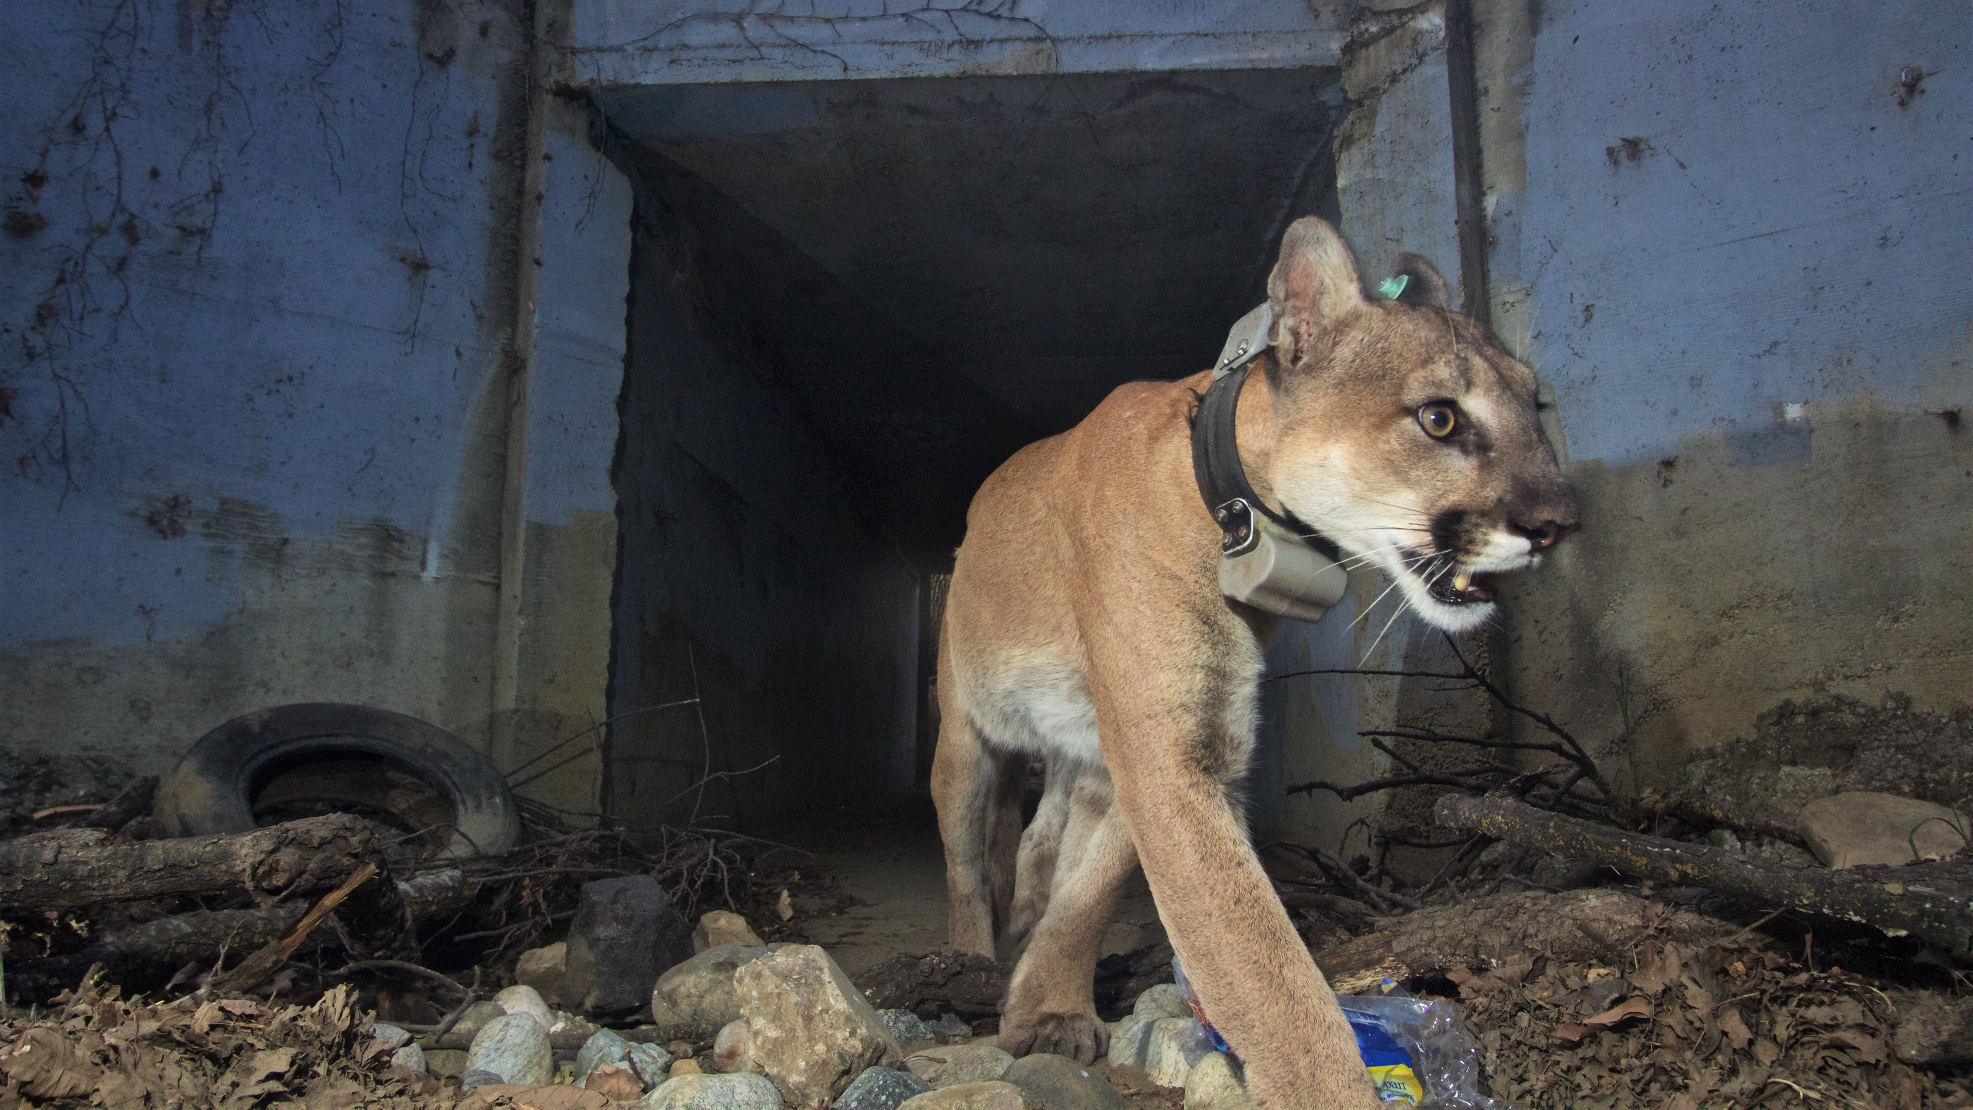
Wildlife Movement Study
The study will use GPS collars and remote cameras to monitor wildlife use of existing crossing points and areas in the vicinity of the freeway
Make recommendations for maintaining and improving wildlife connectivity in conjunction with the US 101 project
Grant amount = $326,890 to be used by the National Park Service, as a subrecipient to VCTC, to carry out the study
Application was approved March 22, 2022
National Parks Service Photo from VC Star

Slide 24
THANK YOU
Ongoing Project Tasks

Slide 25
Ongoing Project Tasks
Engineering Evaluation of Alternatives
Environmental Technical Studies and Draft EIR/EA
Environmental Technical Studies
Fall 2022
Draft EIR/EA
Fall 2022
Public Circulation
Winter 2022/2023
Selection of Locally Preferred Alternative
Late Winter/ Early Spring 2023
Engineering Technical Studies
Fall 2021
Draft Project Report
Fall 2022
Early Action Phasing Strategy
Spring 2023

Slide 26
THANK YOU
Early Action Project Determination

Slide 27
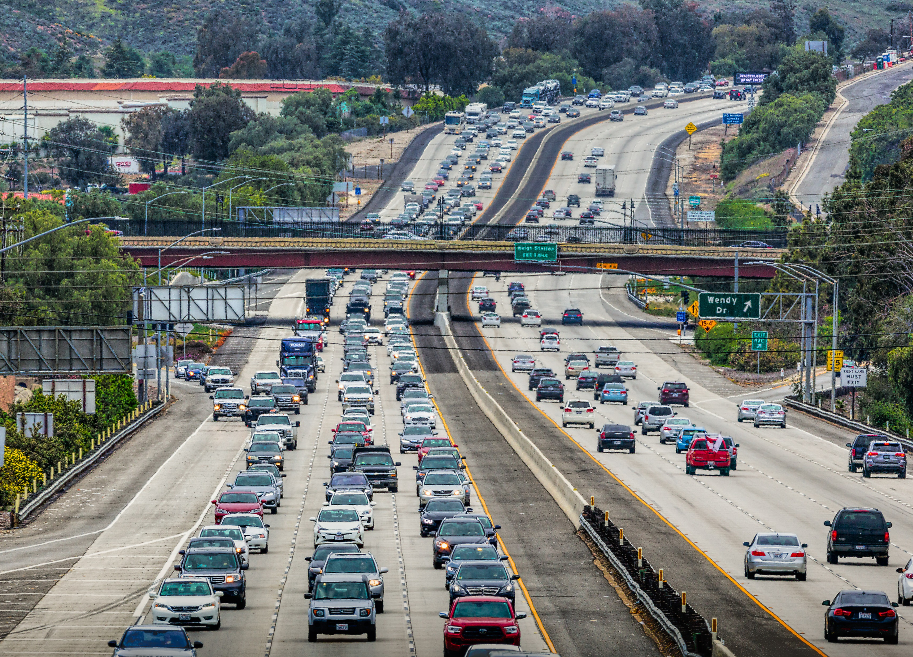
Early Action Project
VCTC to establish the availability of funds over the next 5 years, assuming existing funding sources.
Estimate the construction cost of various phases.
Evaluate the benefit of the phases.
Develop a phasing strategy of Early Action Project(s) based on a cost effectiveness assessment to provide the highest benefits for the least costs.

Slide 28
THANK YOU

