Slide 1

Ventura County Transportation Commission
Low Carbon Transit Operations Program (LCTOP)
FY 2021-2022 Allocation

Slide 2

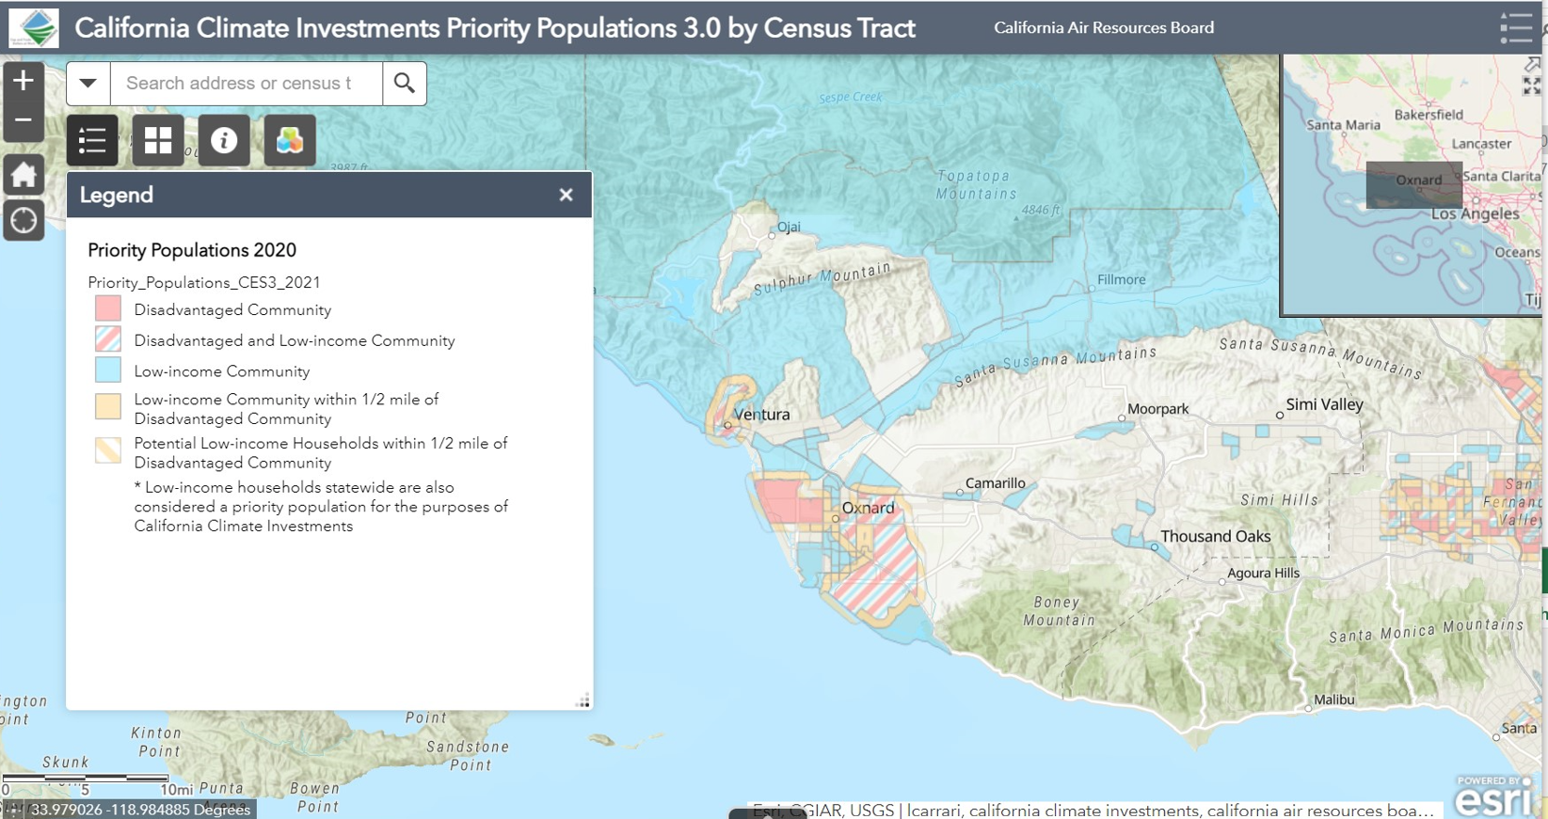
Low Carbon Transit Operations Program
The Low Carbon Transit Operations Program (LCTOP) is a cap-and-trade program established in 2014 by the California Legislature that provides funds to public transportation agencies for investments in capital projects and service that reduce greenhouse gas (GHG) emissions and improve mobility.
50% of the total moneys received shall be expended on projects that will benefit Disadvantaged Communities (DACs)

Slide 3
LCTOP FY 2021-2022 Allocations
Due to the volatility of auction proceeds, LCTOP funding is unpredictable. This year’s apportionment is more than double last year’s allocation, totaling more than $2 million to Ventura County.
The State Controller’s Office (SCO) allocates 50% of funds to regional entities (e.g., VCTC) based on county population and 50% of funds to transit agencies based on revenue service.

Slide 4


VCTC Current LCTOP-funded Regional Projects
Over the years, VCTC has sponsored several regional projects, including Intercity demonstration routes, the College Ride Program and Metrolink Saturday Service.
The intent of the LCTOP program is to introduce new services or programs that achieve LCTOP goals. Once projects are established and proven viable, it is expected that LCTOP funding will be replaced with other funding sources. Therefore, there is a 5-year maximum to requesting additional funds for any one project.
Passage of SB 942 could potentially extend funding of free or reduced fare programs beyond the 5 years.

Slide 5
Recommended Regional Projects
Youth Ride Free Pilot Program
  Provides free fares for all youth aged 18 and younger (and enrolled high school students that may be older) on countywide fixed route and general dial-a-ride services.
Based on LCTOP funding of just over $1M, projected levels of ridership, and reimbursement rates (similar to College Ride), the pilot program is anticipated to last two years with a start date of August 2022.
The cities of Camarillo, Moorpark, Simi Valley and Thousand Oaks will contribute local LCTOP shares to the project as well as transit services participating in the program.
Anticipated benefits align with LCTOP goals including increased public transit use,
reduced auto trips/VMT, lower emissions, and economic benefits to low-income households.

Slide 6
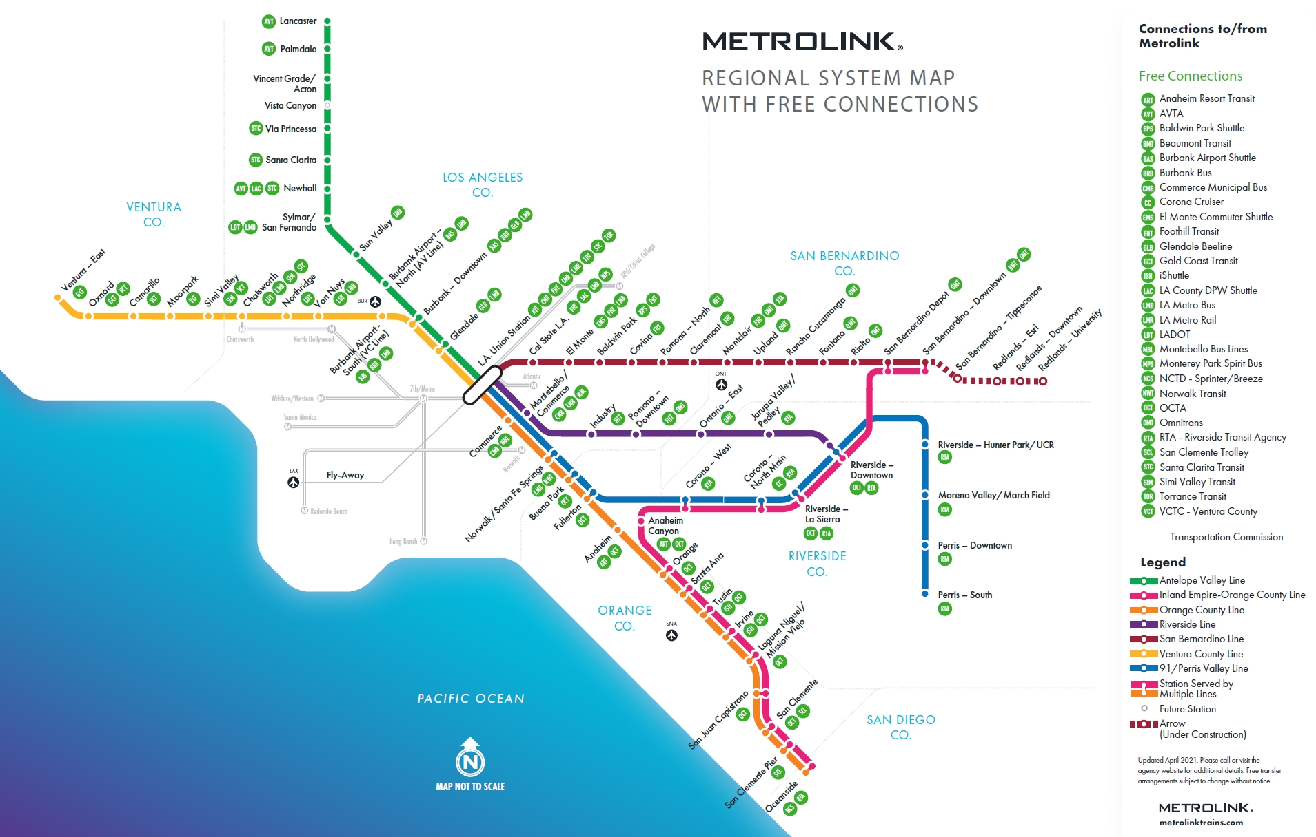
Recommended Regional Projects
Metrolink Weekend Service
on the Ventura County Line
  Currently one Saturday AM Metrolink train from East Ventura station to Los Angeles Union Station with stops at stations in between and a return PM trip.
  New service adds an AM trip from LA to Ventura with a return PM trip. The new service would also be offered on both Saturday and Sunday and extend trips to the Ventura Station at the Fairgrounds.
Metrolink Regional System Map illustrates potential connections to a wider network of transit services in the region.

Slide 7
Thank you!
Questions?

