Slide 1
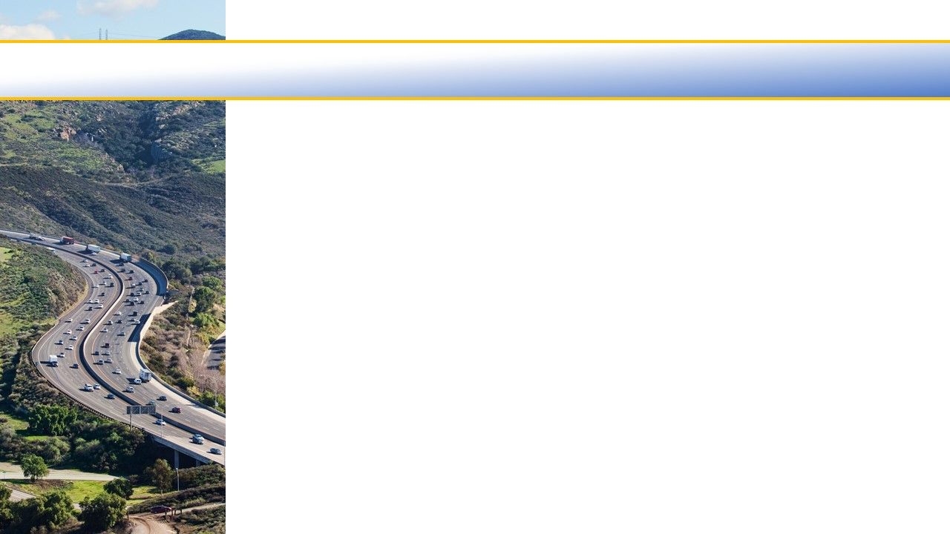

Ventura County Transportation Commission
Legislative Update
April 2022

Slide 2
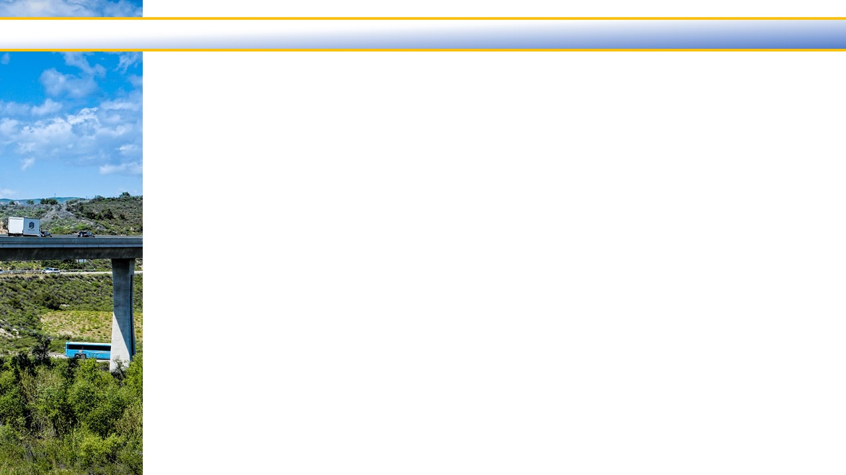
Gov. Newsom Relief Package Proposal
Overview – Gov. Gavin Newsom has released an $11 billion relief package intended to help Californians facing higher gas prices. The proposal has six components.
$9 billion for tax rebates sent to registered vehicle owners in California.
$750 million in incentive grants to local transit and rail agencies to offer free fares.
Pause on the gas tax increase scheduled for July 1.
Pause on a portion of the sales tax rate on diesel.
$500 million for Active Transportation Program projects.
Accelerate $1.75 billion of the governor’s $10 billion zero-emissions vehicle proposal.

Slide 3
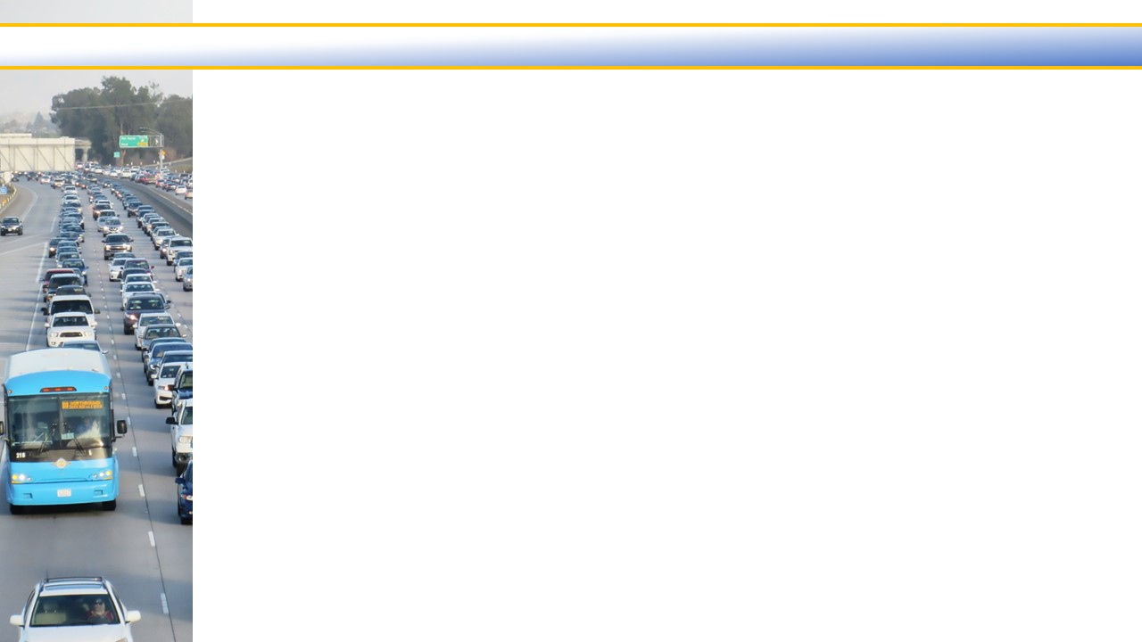
Thank you
Questions?
3

