Slide 1
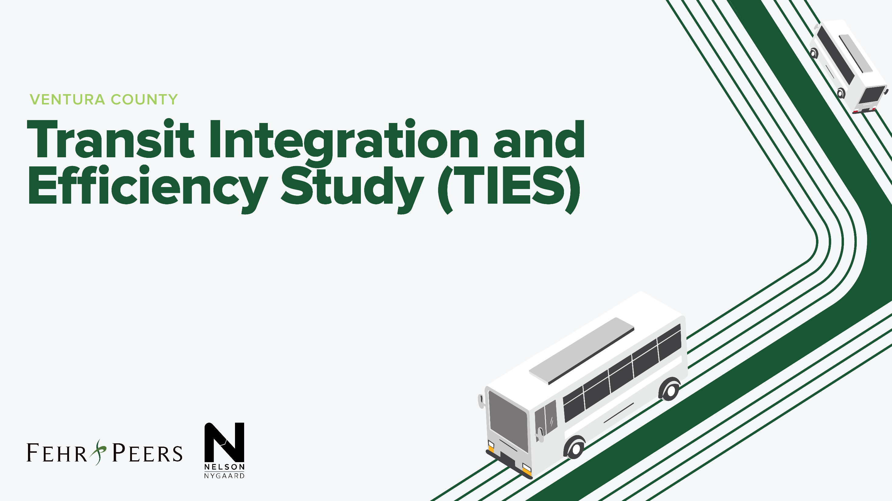
VCTC Commission Update #2
July 9, 2021

Slide 2
Meeting Agenda
Project Update: Gaps and Opportunities
Project Goals and Objectives
Transit Industry Trends
Next Steps

Slide 3
Project Update
Gaps & Opportunities Chapter In progress
  Revenue and Expenses
  Physical Assets
  Technologies
  Labor and Staffing
  Governance and Coordination
  Fixed Route Services
  Paratransit Services
  Customer Service and Marketing
  Customer Experience
Agency interviews Complete
Commissioner interviews In progress
Notes:
Talk only high level bullets

Slide 4
Polling Exercise | Project Goals and Priorities
Both Agency Staff and Commissioners responded
Commissioner responses generally consistent on priorities, but varied on perspective of current performance and probable hurdles
Agency staff somewhat more varied responses throughout most topics
Notes:
Revisualize priorities by individual ranking (stacked bars)

Slide 5
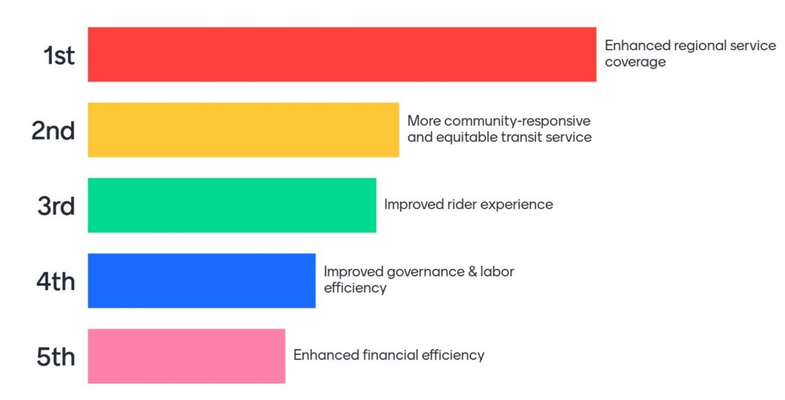
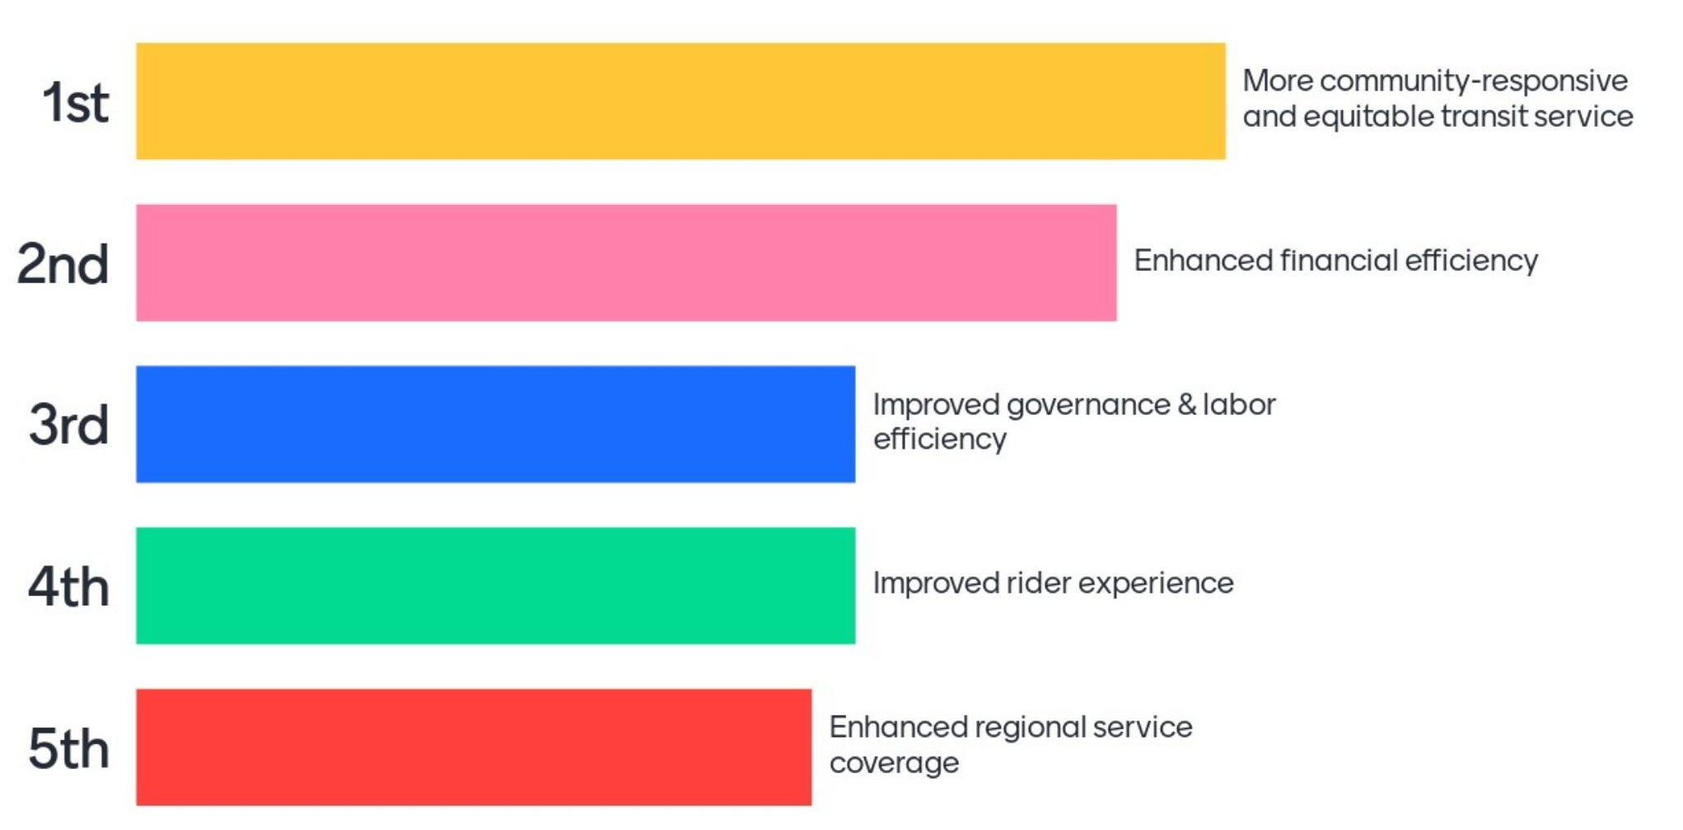
How would you rank the following as goals and priorities of TIES?
Commission
Agency Staff
Equity is a high priority for both groups
Agency staff see funding as a priority to achieve expanded regional coverage

Slide 6
Key Themes | Project Goals and Priorities
Commissioners consistently prioritized regional coverage
Agency staff prioritized service headways, rider experience
Other high-ranking “priority” areas:
    Access to funding
    Expanded service coverage and service span
    Simplified fare policies and fare collection
Top “challenge” areas:
    Building consensus
    Developing revenue & cost-sharing structures

Slide 7





Industry Trends
Recovering Ridership
Increased Focus on Equity
Evolving Service Options
Funding and Fare Policy
Accelerated Electrification

Slide 8




Industry Trends
Recovering Ridership
Reduction and return varies by region, provider, service type, and market group
Fewer unique riders and fewer trips per rider
Picture is still unclear due to service adjustments
Notes:
Ridership – recovery varies by region, service type, market group, etc. In general, low-wage employees riding local service have continued riding and returned to transit at a higher rate than office commuters and students. Fewer unique riders. Fewer trips per rider.

Slide 9

Industry Trends
Increased focus on equity
Going beyond Title VI/Environmental Justice (EJ) analyses
Broader focus on mobility impacts on equity (e.g. travel time, access to employment, education, healthy food, etc.)
Notes:
Equity – Going beyond Title VI/EJ (race/minority/low income/nationality). Equity analysis leaders. Increased metrics. Examples: travel time, access to employment, education, healthy food, etc.

Slide 10

Industry Trends
Evolving Service Options
Response to changes in rider needs
Exploration of emerging mobility solutions
Emphasis on the complete rider experience
Perceptions of travel safety on transit
Notes:
Not a one-size-fits all approach
Technology – implementation varies based on baseline tech, staffing, budget, etc.
Service Options – Rethinking service offerings and design. Local vs. Commuter.
Design and allocation of service in response to evolving rider needs.
Agile

Slide 11
Industry Trends
Funding and Fare Policy
CA Transit Development Act uncertainties
Anticipation of FTA grant opportunities
Fare free campaigns, pilots, and policy changes
Creative funding opportunities and partnerships
Notes:
Funding and Fare Policy – Uncertainties >> opportunities. Discount pass programs. Fare free days/pilots/policies. Community partners. Operator availability and retention has continued to be a concern
Marketing strategy

Slide 12
Industry Trends
Accelerated Electrification
CA Innovative Clean Transit program
CA Integrated Travel Project
Potential CA Electric Vehicle authority
FTA Low-No Emission Program
Notes:
Electrification - Zero-emission buses are coming with the Innovative Clean Transit program
Opportunities for coordinated procurements
The Innovative Clean Transit Regulation (adopted in December 2018 to replace the Fleet Rule for Transit Agencies) requires all public transit agencies to gradually transition to a 100-percent zero-emission bus fleet and encourages them to provide innovative first and last-mile connectivity and improved mobility for transit riders.
Cal-ITP is pursuing three initiatives:
1. Assisting transit providers produce reliable information about available transportation options and their prices
2. Reducing friction in payment, promoting contactless fare collection, and introducing open loop payments
3. Providing a seamless process for transit riders to verify eligibility for discounts
https://dot.ca.gov/-/media/dot-media/cal-itp/documents/cal-itp-carb-market-sounding-final-020921-a11y.pdf

Slide 13
What are the implications and opportunities for Ventura County?
Update countywide goals, objectives, and benchmarks
Focus on travel time, access, facilities, and amenities
Rethink service design, offerings, allocation, and delivery
Relaxed TDA requirements? Countywide fare policy?
Fleet modernization; coordinated procurement and maintenance
Notes:
What is ridership going to look like?
Who are your riders and what are their needs?
How do you serve them?
How to pay for it?
Fleet and facilities to support?

Slide 14
Next Steps
Project Team
Draft goal statements
Existing services review
Stakeholder engagement
Operator Working Group
One-on-one interviews
CBO and HHS provider lists

Slide 15

QUESTIONS?

