Slide 1

Transit Integration & Efficiency Study (TIES)
Martin R. Erickson Public Transit Director
February 5, 2021
Background
Selection Process
Recommendation to approve agreement with Fehr & Peers

Slide 2
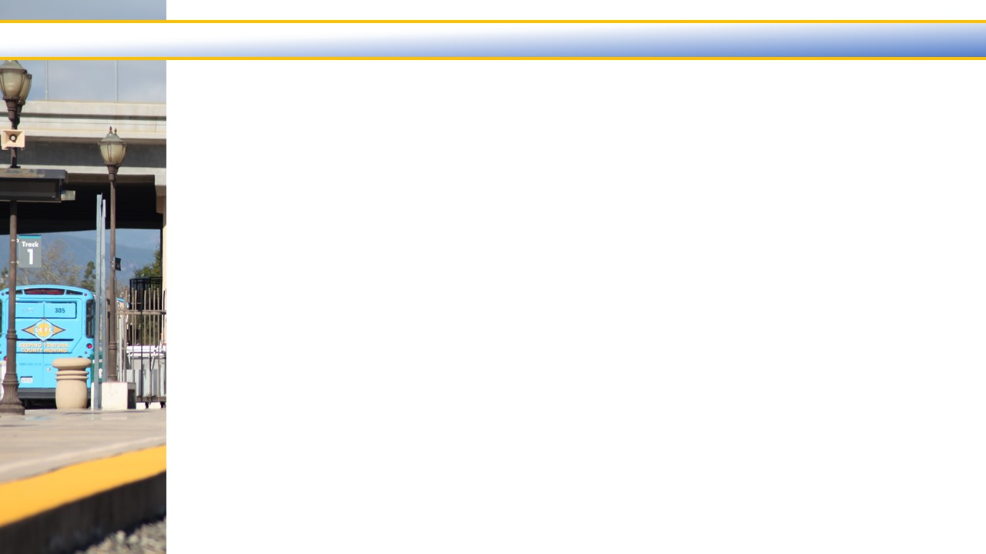

Transit Integration & Efficiency Study -- Background
In September 2020 Commission approved a comprehensive Request for Proposal (RFP) for a Transit Integration Efficiency Study (TIES).
RFP anticipated that the following documents would serve as effective points of departure and reference for the TIES study:
  2012 Ventura County Regional Transit Study
  2018 Ventura LAFCo Municipal Service Review (MSR) recommendations on transit

Slide 3
Transit Integration & Efficiency Study
VCTC received responses to the RFP from these three consultant teams:
    Cambridge Systematics with Celtis Ventures, Inc. and Capitol GCS
    Fehr & Peers in association with Nelson/Nygaard
    Stantec with Kearns & West
Selection Committee included representatives from County of Ventura, Gold Coast Transit District, City of Thousand Oaks, City of Moorpark, and VCTC.

Slide 4
Transit Integration & Efficiency Study
Evaluators scored the teams on a combination of their written proposals and oral interviews. As described in the RFP, proposers were evaluated on five equally weighted criteria:
    Qualifications and experience of key personnel
    Qualifications and experience of the lead firm
    Experience in conducting similar projects
    Clarity of the approach
    Project Understanding
The evaluators were unanimous in their rankings of the teams. While each of the teams could perform the work, the Fehr & Peers team garnered the best score.

Slide 5
Transit Integration & Efficiency Study
Some important questions the study will examine are the following:
    How has the impact of the pandemic affected the current and future delivery of transit?
    What other peer communities have effectively re-structured their transit operations, and how do they operate?
    What level of change, if any, should occur to transit operations and structure in Ventura County?

Slide 6
Recommendation
Approve an agreement with Fehr & Peers not to exceed $300,000 for development of a Transit Integration & Efficiency Study.
Approve a budget amendment to the VCTC Fiscal Year 2020/2021 Regional Transit Planning budget by increasing the State Transit Assistance (STA) revenues and consultant services expense line items by $300,000 each. The funding source is STA fund balance which requires a budget amendment to increase the transfer-out funds by $300,000.

Slide 7
Transit Integration & Efficiency Study
QUESTIONS?

