Slide 1
BROADBAND STATUS
VCTC BOARD PRESENTATION
Ventura County IT Services May 7, 2021

Slide 2
COUNTY PROJECT VISION
Objectives described in 2019:
  Economic Development (described in the County’s Economic Vitality Plan)
  Reduce County costs for internet access
  Facilitate interconnection of County and other government facilities at lower costs
  Provide communication redundancy and resiliency
  Closing the digital divide to the underserved and disadvantaged
Approach:
  Build redundant middle mile fiber systems that connect to low cost internet points of presence
Notes:
Benefits to economic development
Connect smaller businesses to the larger economy
Telework options
Safer and more vibrant communities through smarter, faster infrastructure
Online learning (workforce development)
Middle mile – like an actual freeway and the county highway system. These connect to local arteries (Vineyard, Rice, etc), which then connect to city and neighborhood streets.

Slide 3
PARTNERS
County Economic Vitality Steering Committee
Magellan Advisors – Broadband consulting experts specializing in public/private solutions
Pacific Coast Broadband Consortium
Economic Development Collaborative
Southern California Association of Governments

Slide 4
COUNTYWIDE COLLABORATION
City Managers
City and County IT Managers
City and County Public Works Directors
Utilities (Water, Gas, Electric)
Ventura County Transportation Commission
Public Safety Officials
CalTrans

Slide 5
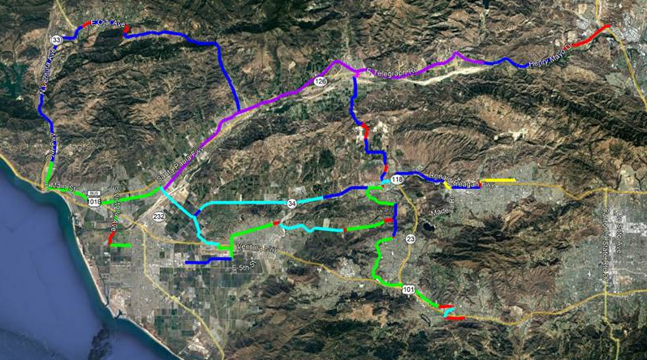
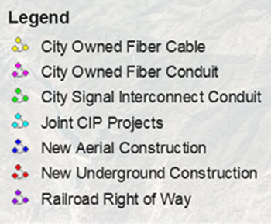
EXISTING AND PLANNED
GOVERNMENT MANAGED FIBER
POP

Slide 6
PROPOSED MIDDLE MILE PROJECT ALIGNMENTS

Slide 7
IMPACTS OF COVID
Massive efforts at federal, state and local levels to fund closing the digital divide
Governor Newsom’s Executive Order for broadband at a minimum of 100Mb (County looking at 1 Gb)
State legislation: AB14, SB4 and others
Federal infrastructure legislation

Slide 8
SCAG DIGITAL DIVIDE GROUP
Developed a resolution for Counties to adopt
Working on simplified permitting for broadband related construction
Requesting a total of $8 Bn ($4 Bn federal and $4 Bn state) to provide internet to every dwelling in the 7 So Cal counties
Estimating $600 Mil for Ventura County if successful
Requires strong public governance to oversee RFPs and project funds distribution to service providers
Municipal projects may be necessary to reach all dwellings

Slide 9
VENTURA COUNTY PLANNING

Slide 10
COUNTY FINANCIAL OBJECTIVES
Seek out federal and state grants
Share existing capital improvement projects (Dig Once)
Use partners to share construction costs
SCAG Digital Divide Group
CSAC Collaborative

Slide 11
VERY PRELIMINARY COST ESTIMATES
Highway 126 Alignment = $6.2 Million
Highway 118 Alignment = $5.0 Million
Highway 150/33 Alignment and Spurs = $8.8 Million
TOTAL ESTIMATED COSTS = $ 20 Million
Funding is expected to come from a combination of:
    Federal and State grants
    Use of existing underground and aerial assets and future public works and water district projects to further reduce costs
    Partnership joint efforts (share the trench)
    General fund if necessary

Slide 12
VERY PRELIMINARY COST ESTIMATES
The cost of the last mile…
  Based on SCAG’s overall estimates ($8 Bn)
  And extrapolating those to Ventura County ($600 Mill)
  And the cost of the planned middle mile routes ($20 Mill)
  The cost of the branch lines and the last mile infrastructure to the homes is estimated at $580 Mill.

Slide 13
NEXT STEPS

Slide 14
REQUEST FOR INFORMATION AND RFP
Issued RFI for alternative routes, technical solutions and partnership interest
Over 30 service providers registered and downloaded the RFI
14 service providers responded
Awaiting preliminary vetting of responses by Procurement
Based on questions at the RFI information conference meeting, most providers are treating this like an RFP
RFP will be issued for at least the 126 alignment and possibly the 118 alignment

Slide 15
SANTA PAULA BRANCH RAILWAY
The railway aligns almost perfectly with the proposed 126 middle mile segment
Due to the mostly unobstructed right of way, plowing can be used for substantial cost savings
Opportunity to generate a revenue stream by sharing the trench or by leasing County fiber
Small number of stakeholders

Slide 16
VENTURA COUNTY TRANSPORTATION COMMISSION
Opportunity for a partnership where the County and VCTC share the railway asset
Other potential transportation right of ways
Requesting the VCTC Board to consider this partnership and the exclusive use of the SPBR for the County’s fiber project

Slide 17


THANK YOU!
QUESTIONS?

