Slide 1
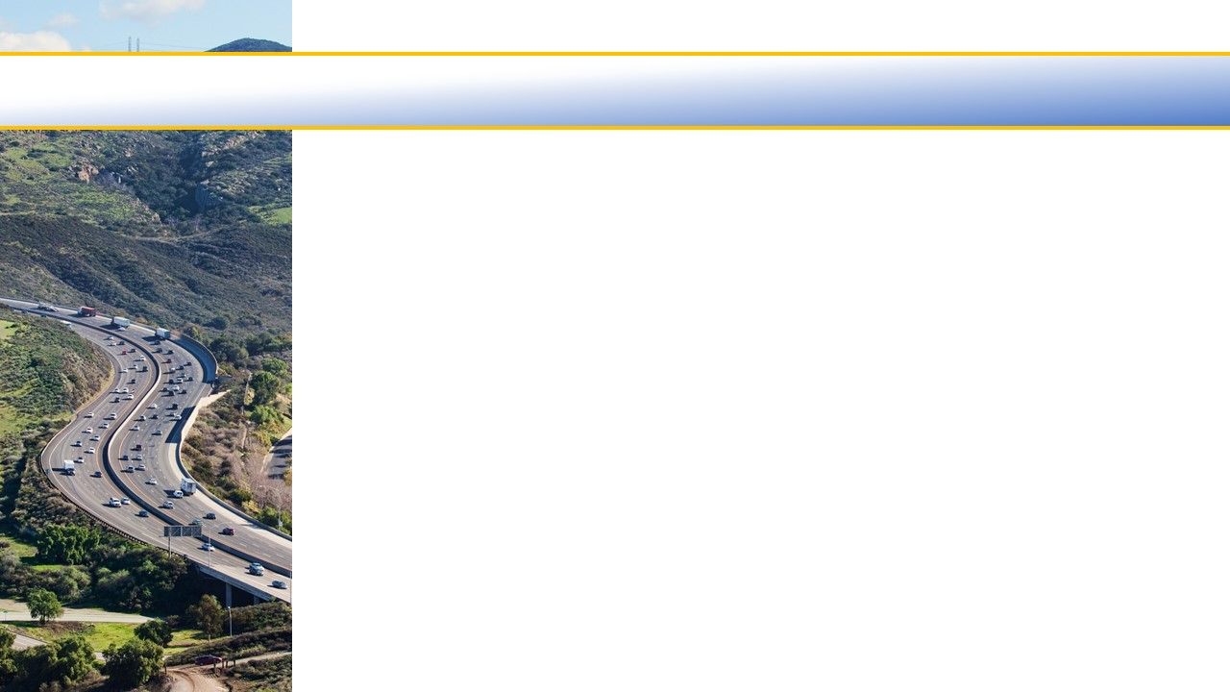

Ventura County Transportation Commission
Fiscal Year 2020/2021
Draft Budget
March 25, 2020

Slide 2
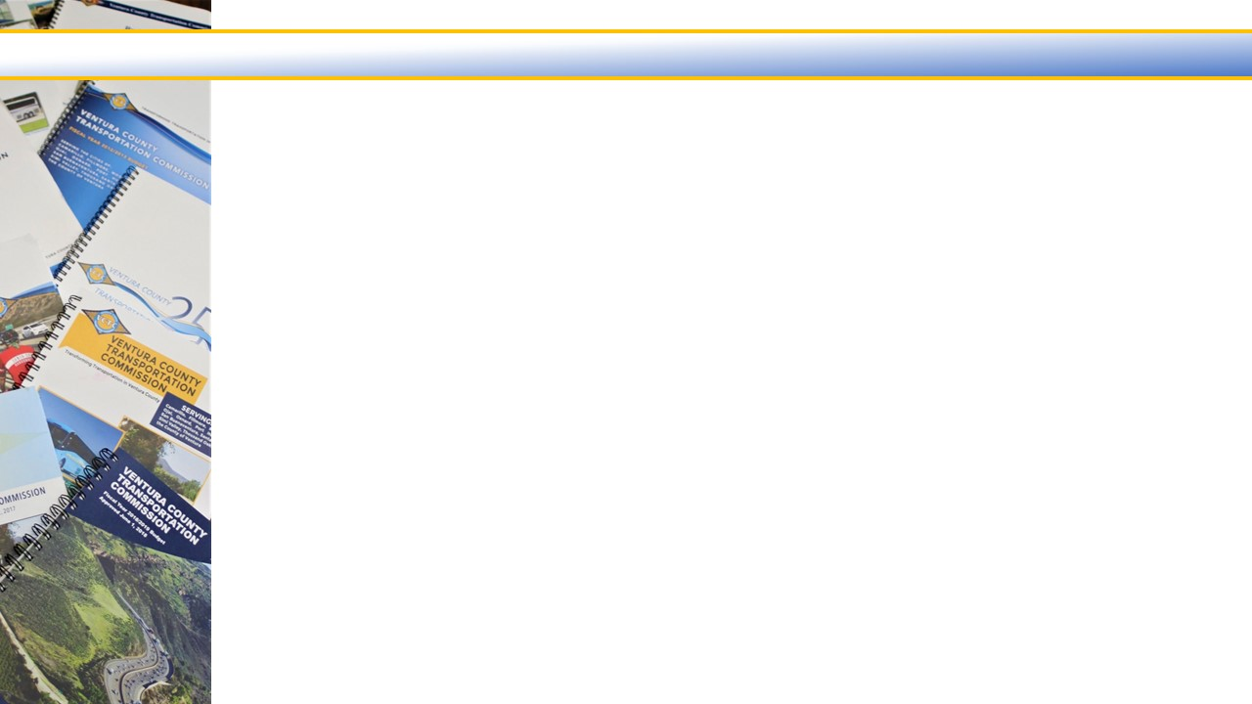

Fiscal Year 2020/2021
?

Slide 3
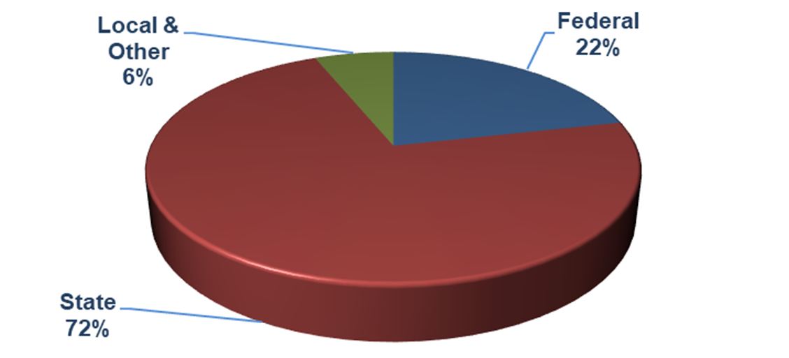
Fiscal Year 2020/2021 Revenues
Proposed Budget contains $74.75 million in revenues
$6.8 million lower than Fiscal Year 2019/2020
Revenue Sources

Slide 4
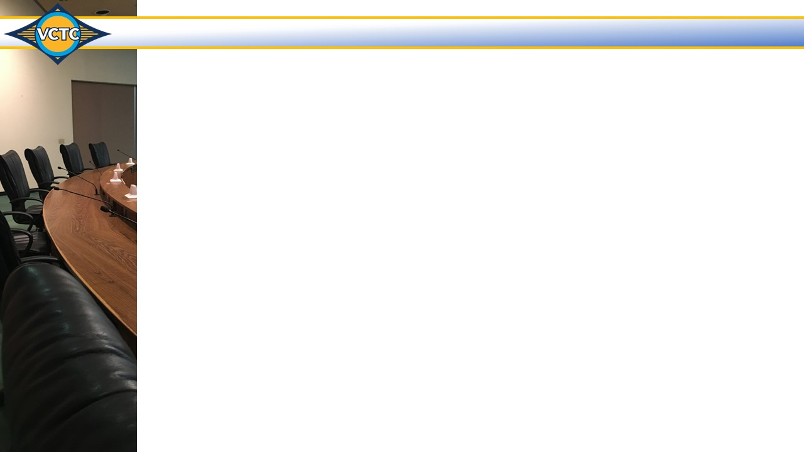
State of Transportation Funding
  Federal Funding:
  Fixing America’s Surface Transportation (FAST Act)
  - 2015-2020
  Continued borrowing to keep Federal Highway Trust Fund solvent
    Only approved through 2020
  Fiscal Year 2019/2020 Federal Budget
    Transportation formula funds approved at higher level for
    a third year in a row
  Administrations Infrastructure Proposal
  - Still nothing on how to pay for it
  Bottom Line
    Do not expect anything new from Federal Government except maybe as
    part of emergency legislation
  Coronavirus Aid, Relief and Economic Security (CARES) Act
  - $ 68 million to VCTC for transit services

Slide 5
State of Transportation Funding
  State Funding:
  SB 1 (Beall), Road Repair and Accountability Act of 2017
  - Fix It First
  - Significant Revenue loss with Free Fare Bills:
      AB 1350 – Requires free fares for youth
      AB 2012 – Requires free fares for seniors
      AB 2176 – Requires free fares for college/university students
  State Budget “unknowns”

Slide 6
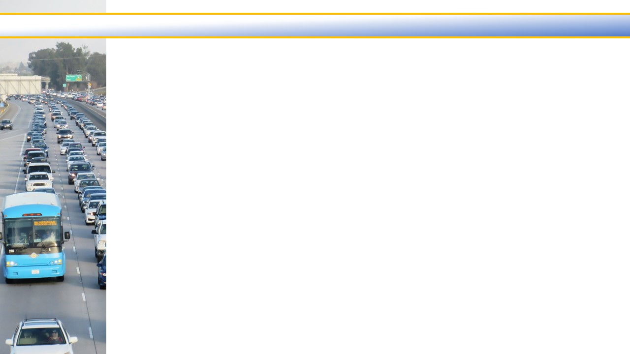
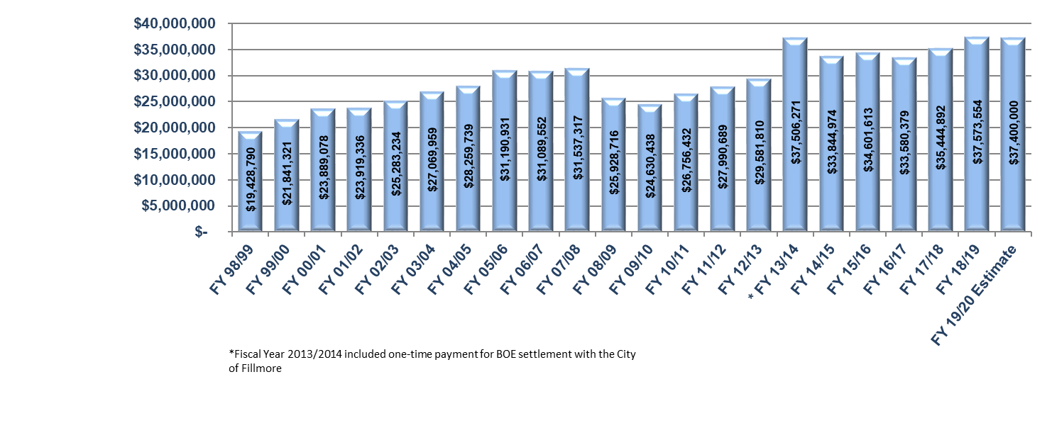
Local Transportation Fund (LTF) Revenues
  Fiscal Year 1998/1999 – 2020/20201
  $1.1 million increase in Sales Tax Receipts originally anticipated – but awaiting revision
  VCTC needs approximately $400,000 higher than previous fiscal year
    ADA certification no longer FTA eligible
    Two new positions
    New studies

Slide 7
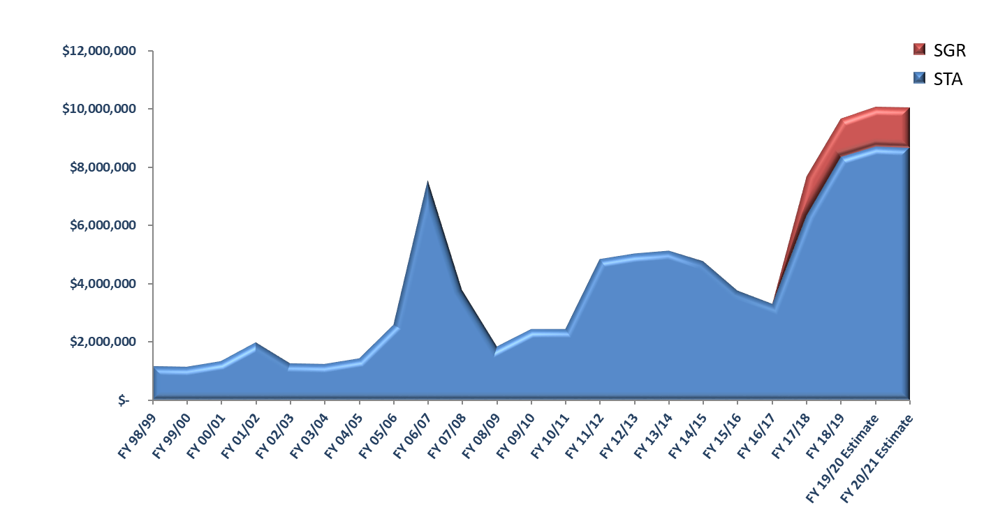
State Transit Assistance (STA) Revenues
  Fiscal Year 1998/1999 – 2020/20201
  STA revenue estimate is $8.6 million
  SGR revenue estimate is $1.3 million
  Sustains Transit Operations and Transit Capital

Slide 8
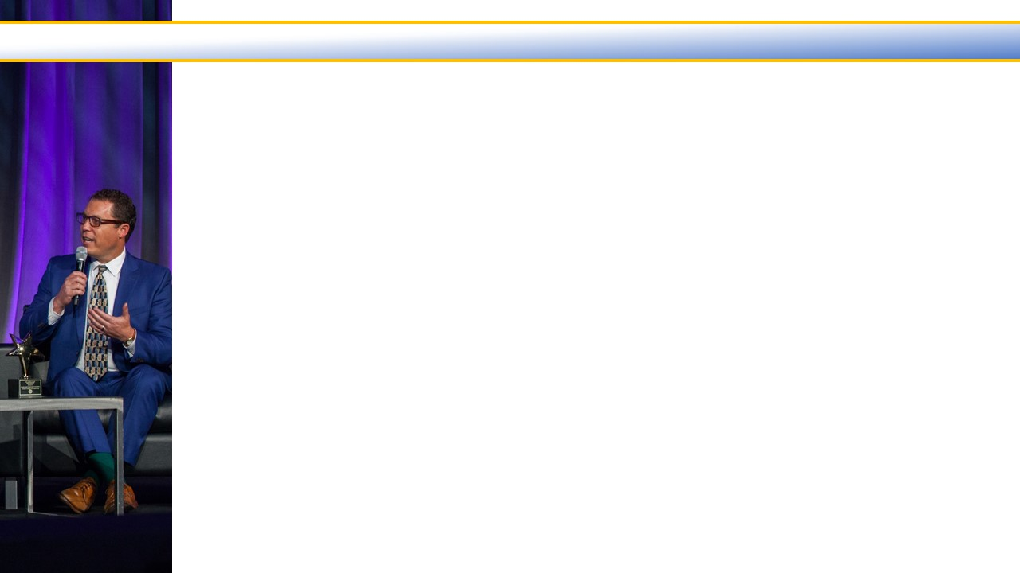
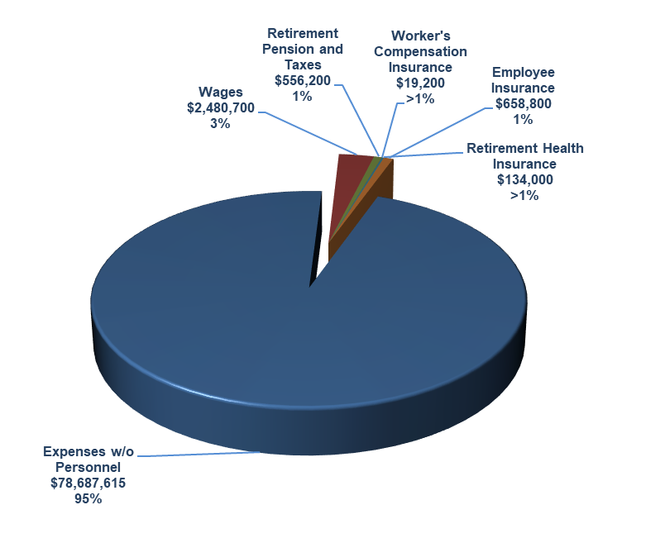
Personnel Costs
  Salaries and Benefits at $3,848,900 or 4.7% of the budget
  23 Full-time positions
    ?
  Increase of $614,200 or 19% from Fiscal Year 2019/2020
    Two new positions
      ?
    Three budgeted positions fully burdened
      ?
    $70,500 merit pool
    $68,900 benefit placeholder
      ?
    $74,600 for taxes and pension
      ?
    $190,800 for insurances
      ?
    $25,000 for OPEB
  Pension and OPEB funding levels 79%

Slide 9
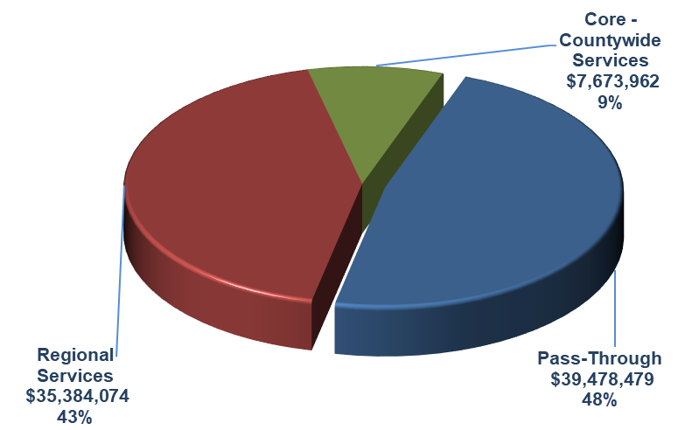
Pass Through – Regional Services – Core and Countywide Services
Pass Through – 48% of the Budget at $39,478,470
  Transit Grant Administration – FTA Sub-recipients
  TDA Administration – LTF, STA and SGR Distributions

Slide 10
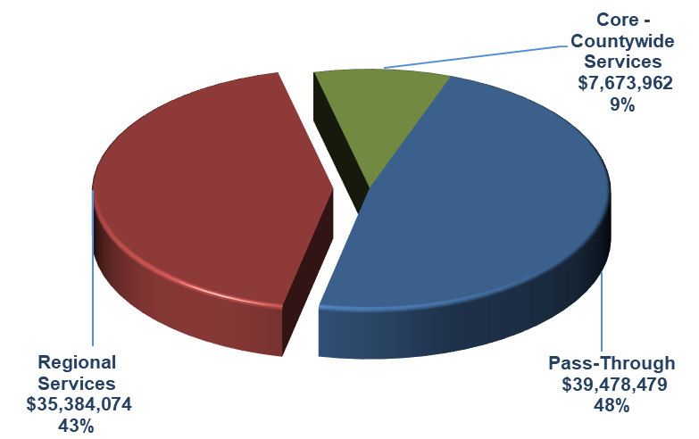
Pass Through – Regional Services – Core and Countywide Services
Regional Services – 43% of the Budget at $35,384,074
  Highway Program Management
  LOSSAN – Coast Rail Coordinating Council
  Metrolink Commuter Rail
  Regional Transit Information Center
  Regional Transit Technology
  Santa Paula Branch Line
  Senior & Disabled Transportation
  Valley Express
  VCTC Intercity Services

Slide 11
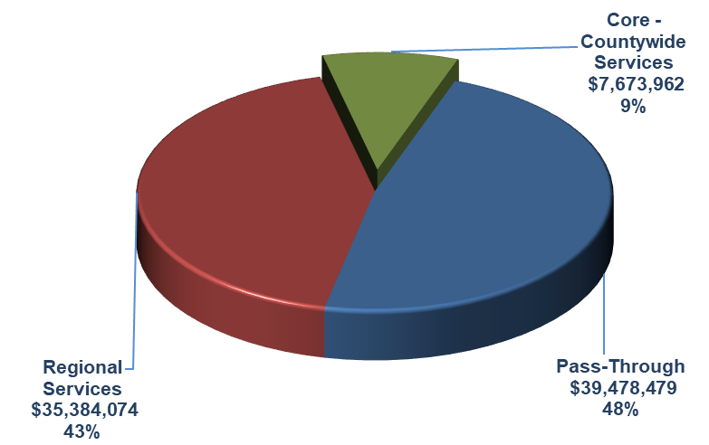
Pass Through – Regional Services – Core and Countywide Services
Core and Countywide Services – 9% of the Budget at $7,673,962
  Airport Land Use Commission
  Community Outreach
  Management and Administration
  Motorist Aid Services
  Regional Transit Planning
  Regional Transportation Planning
  Rideshare Programs
  State and Federal Government Relations
  TDA Administration
  Transit Grant Administration
  Transportation Programming

Slide 12
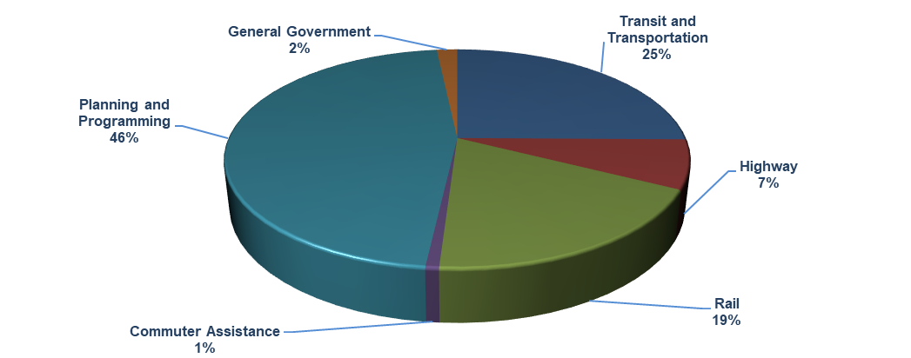
Budgeted Expenditures by Program
Program Budget Categories | Fiscal Year 2018/2019 Actual | Fiscal Year 2019/2020 Budget | Fiscal Year 2020/2021 Budget | % of Change
Transit and Transportation | $21,430,489 | $28,485,251 | $20,798,500 | -27.0%
Highway | 3,114,572 | 11,621,103 | 5,954,500 | -48.8%
Rail | 4,352,690 | 13,833,974 | 15,364,474 | 11.1%
Commuter Assistance | 459,912 | 621,400 | 650,300 | 4.7%
Planning and Programming | 33,240,367 | 36,850,272 | 38,361,741 | 4.1%
General Government | 1,081,422 | 1,780,100 | 1,407,000 | -21.0%
Total Program Budget | $63,679,452 | $93,192,100 | $82,536,515 | -11.4%

Slide 13
Transit and Transportation Program
Budget Tasks | Fiscal Year 2018/2019 Actual | Fiscal Year 2019/2020 Budget | Fiscal Year 2020/2021 Budget | % of Change
Regional Transit Technology | $ 772,685 | $3,053,817 | $ 912,800 | -70.1%
Senior and Disabled Transportation Services | 275,247 | 345,600 | 499,700 | 44.6%
Transit Grant Administration | 5,572,446 | 7,100,200 | 5,567,100 | -21.6%
Valley Express | 1,685,580 | 1,937,600 | 2,006,800 | 3.6%
VCTC Intercity Services | 13,124,531 | 16,048,034 | 11,812,100 | -26.4%
Total Transit and Transportation Budget | $21,430,489 | $28,485,251 | $20,798,500 | -27.0%
  Changes from Fiscal Year 2019/2020 to 2020/2021
  Regional Transit Technology:
    $2,141,017 for completion of the AVL project.
  Senior and Disabled Transportation Services:
  + $154,100 for consultant.
  Transit Grant Administration:
  - $1,533,100 for completed pass-through projects and new projects not yet identified.
  Valley Express:
  + $69,200 for bus contractor costs.
  VCTC Intercity Services:
  - $4,235,934 for bus purchase in prior year offset by budgeted depreciation expense.

Slide 14
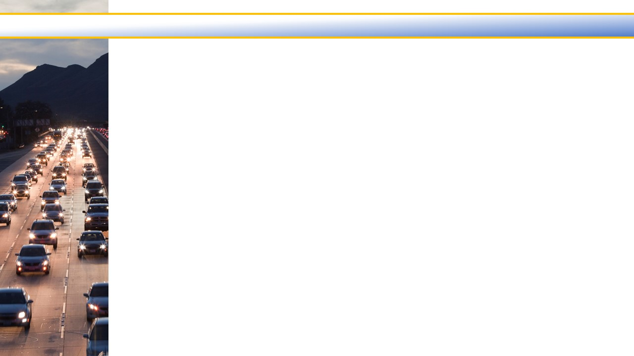
Highway Program
Budget Tasks | Fiscal Year 2018/2019 Actual | Fiscal Year 2019/2020 Budget | Fiscal Year 2020/2021 Budget | % of Change
Highway Program Management | $2,416,685 | $ 9,918,683 | $4,482,100 | -54.8%
Motorist Aid Services | 697,887 | 1,702,420 | 1,472,400 | -13.5%
Total Highway Budget | $3,114,572 | $11,621,103 | $5,954,500 | -48.8%
  Changes from Fiscal Year 2019/2020 to 2020/2021
  Highway Program Management:
    $5,436,583 for U.S. 101 preliminary engineering and environmental documents.
  Motorist Aid Services:
  + SpeedInfo budget is now included in the Motorist Aid Services budget.
  - $230,020 for payment on one-time Incident Responder Grant offset by 9 months of
  the new Freeway Service Patrol program.

Slide 15
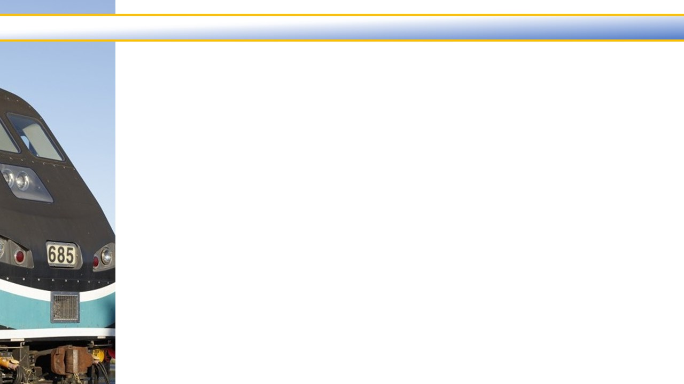
Rail Program
Budget Tasks | Fiscal Year 2018/2019 Actual | Fiscal Year 2019/2020 Budget | Fiscal Year 2020/2021 Budget | % of Change
LOSSAN - Coast Rail Coordinating Council | $ 37,435 | $ 43,900 | $ 53,900 | 22.8%
Metrolink Commuter Rail | 3,601,617 | 12,850,974 | 14,373,874 | 11.9%
Santa Paula Branch Line | 713,638 | 939,100 | 936,700 | -0.3%
Total Rail Budget | $4,352,690 | $13,833,974 | $15,364,474 | 11.1%
  Changes from Fiscal Year 2019/2020 to 2020/2021
  Metrolink Commuter Rail:
    + $1,522,900 for capital rehabilitation projects carried-over from the prior year.

Slide 16
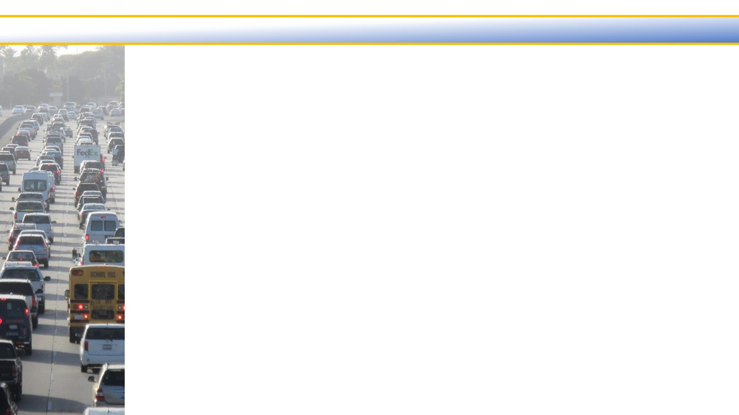
Commuter Assistance Program
Budget Tasks | Fiscal Year 2018/2019 Actual | Fiscal Year 2019/2020 Budget | Fiscal Year 2020/2021 Budget | % of Change
Regional Transit Information Center | $209,615 | $293,900 | $306,100 | 4.2%
Rideshare Programs | 250,297 | 327,500 | 344,200 | 5.1%
Total Commuter Assistance Budget | $459,912 | $621,400 | $650,300 | 4.7%
  Changes from Fiscal Year 2019/2020 to 2020/2021
  Regional Transit Information Center:
    + $12,200 for staffing costs.
  Rideshare Program:
  + $16,700 for staffing costs.

Slide 17
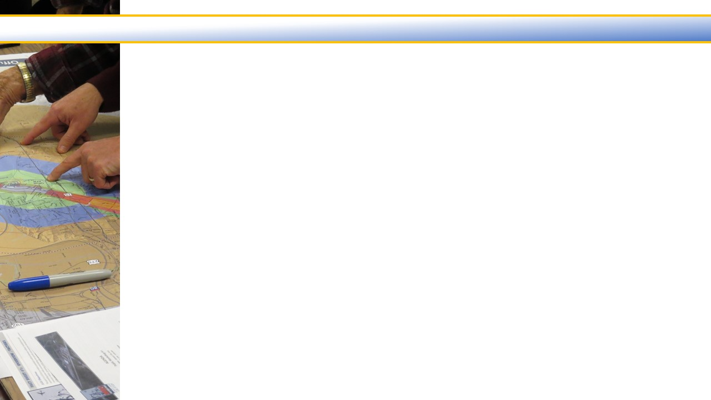
Planning and Programming Program
Budget Tasks | Fiscal Year 2018/2019 Actual | Fiscal Year 2019/2020 Budget | Fiscal Year 2020/2021 Budget | % of Change
Airport Land Use Commission | $ 5,811 | $ 29,600 | $ 39,100 | 32.1%
Regional Transit Planning | 1,208,124 | 1,974,406 | 1,857,262 | -5.9%
Regional Transportation Planning | 485,070 | 1,087,600 | 1,540,900 | 41.7%
Transportation Development Act | 31,245,298 | 33,401,166 | 34,461,979 | 3.2%
Transportation Programming and Reporting | 296,064 | 357,500 | 462,500 | 29.4%
Total Planning & Programming Budget | $33,240,367 | $36,850,272 | $38,361,741 | 4.1%
  Changes from Fiscal Year 2019/2020 to 2020/2021
  Regional Transit Planning:
    $117,144 for completion of consultant studies.
  Regional Transportation Planning:
  + $453,300 for Congestion Management Plan and Comprehensive Transportation Plan.
  TDA Administration:
  + $1,060,813 for additional pass-through to local agencies.
  Transportation Programming and Reporting:
  + $105,000 for additional staff costs including the new program analyst.

Slide 18
General Government Program
Budget Tasks | Fiscal Year 2018/2019 Actual | Fiscal Year 2019/2020 Budget | Fiscal Year 2020/2021 Budget | % of Change
Community Outreach | $ 455,628 | $ 520,000 | $ 495,000 | -4.8%
Management and Administration | 408,801 | 1,019,700 | 618,800 | -39.3%
State and Federal Governmental Relations | 216,993 | 240,400 | 293,200 | 22.0%
Total General Government Budget | $1,081,422 | $1,780,100 | $1,407,000 | -21.0%
  Changes from Fiscal Year 2019/2020 to 2020/2021
  Management and Administration:
    - $400,900 for office relocation expenditures occurring in the prior year.

Slide 19
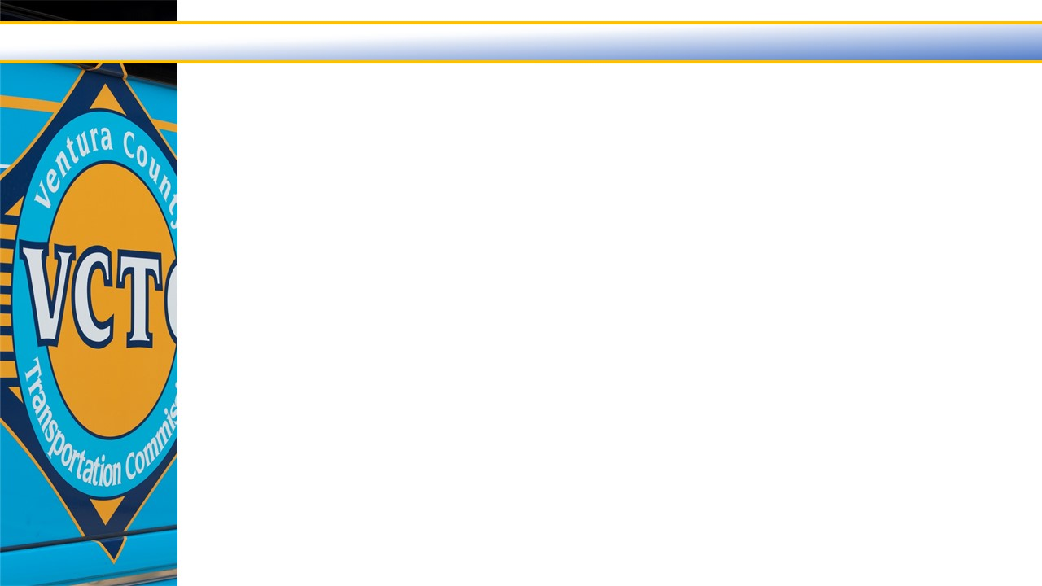
Where We End Up
  $82.5 million Balanced Budget
Estimated $16.8 million Fund Balance (after reserve adjustment)
  Available for ”general use”:
    GF $ 58,968
  Restricted Fund Balances:
    LTF $ 79,332
    STA $13,638,082
    SAFE $ 2,971,690
    SGR $ 101,697
    SPBL $ 25,362
  Anticipated uses for STA balance:
    Cash-flow (i.e. delayed grants and capital purchases)
    Metrolink capital projects
    VCTC Intercity bus purchases
    Sustain transit activities during the economic downturn
  Anticipated uses for SAFE balance:
    Freeway Service Patrol
    Additional Incident Responder Grants

Slide 20
Fiscal Year 2020/2021 Proposed Budget
QUESTIONS?

