Slide 1


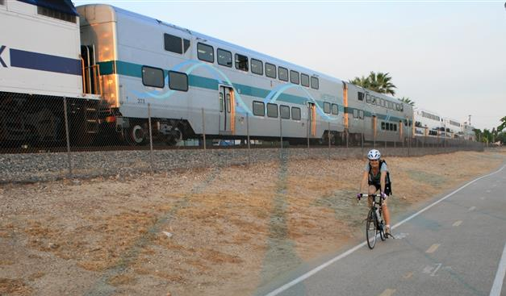
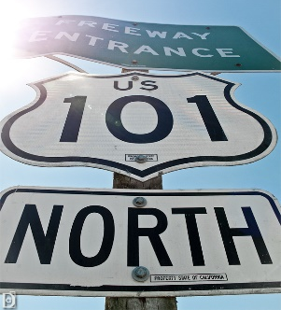
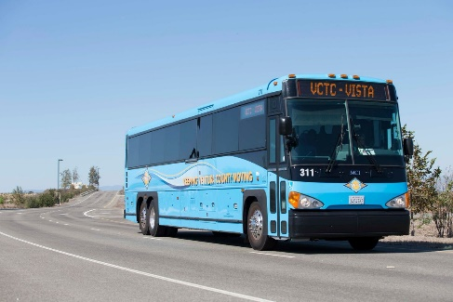




Presented by:
US 101 Multi-Modal Corridor Study
March 6, 2020

Slide 2

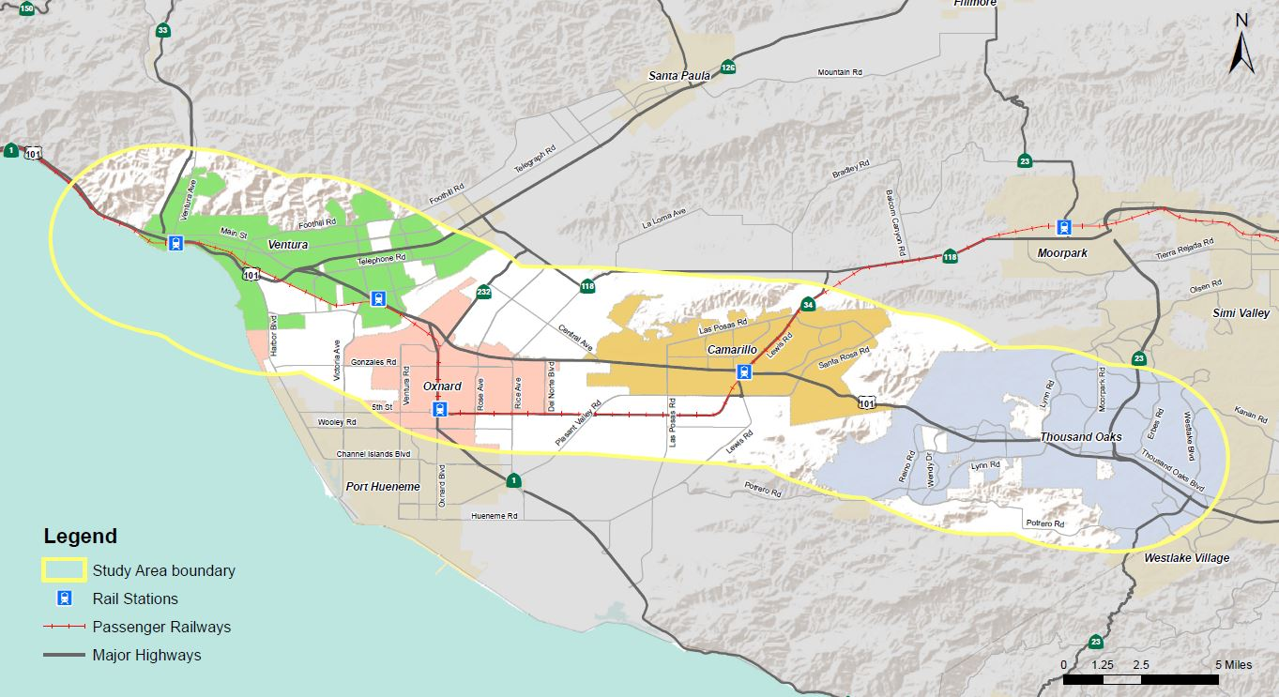
Background Information
Examine the US 101 Corridor (3-Mile Buffer) Mobility in a Multi-modal Context
  Informed by CTC’s Comprehensive Multimodal Corridor Plan Guidelines
Include local, regional and state agencies
Input from stakeholders and public
Balance infrastructure, livability, economy and sustainability
Position projects for SB-1 “Solutions for Congested Corridors Programs (SCCP)” funding

Slide 3
Approach
Goals and Objectives
Existing Mobility Conditions
Identify Multi-modal Improvements
(Funded and Unfunded Projects)
Public Workshops and Stakeholder Outreach

Slide 4
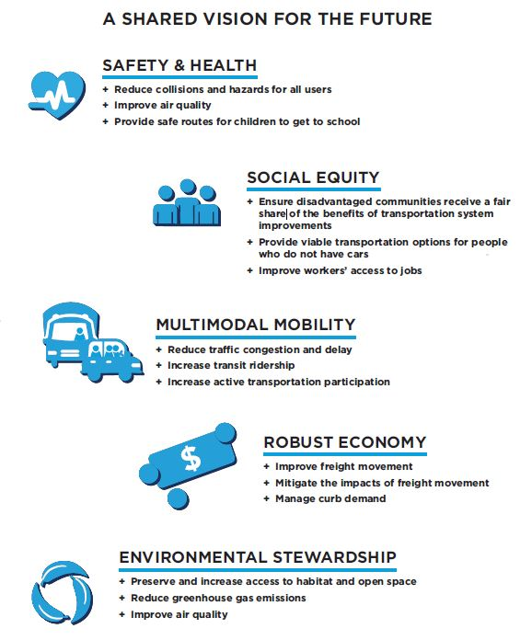
Goals and Objectives
Safety and Health
Social Equity
Multimodal Mobility
Robust Economy
Environmental Stewardship

Slide 5
Existing Mobility Conditions
Land Use / Population / Employment
Disadvantaged Communities
Travel Patterns
Congestion
Transit / Rail Passengers
Collisions

Slide 6
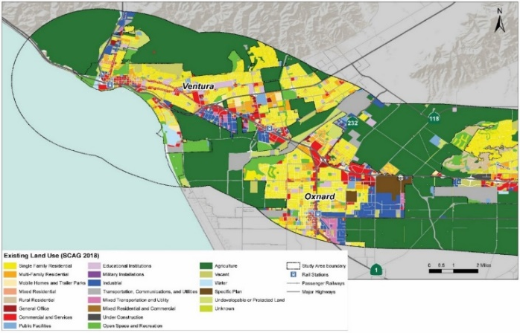
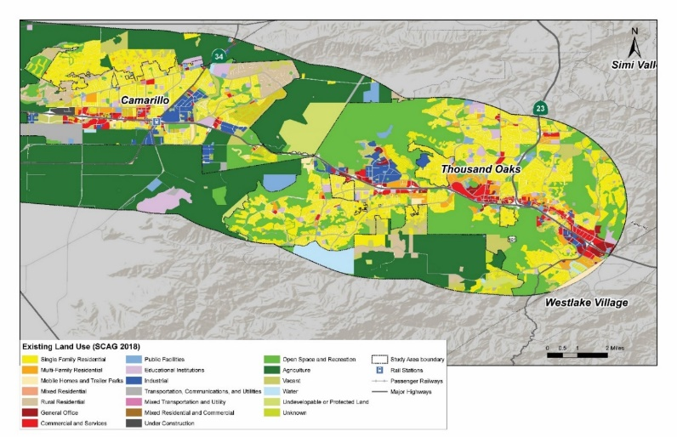
Land Use
 | EXISTING LAND USE | CITY OF VENTURA |  | CITY OF OXNARD |  | CITY OF CAMARILLO |  | CITY OF THOUSAND OAKS |  | UNINCORPORATED VENTURA COUNTY
 |  | Acres | % of Total | Acres | % of Total | Acres | % of Total | Acres | % of Total | Acres | % of Total
 | Residential
 | Single-family Residential | 5,565.7 | 36.5% | 3,414.8 | 29.3% | 3,465.4 | 22.1% | 10,842.9 | 31.9% | 4,734.5 | 6.4%
 | Multi-Family Residential | 1,171.9 | 7.7% | 891.3 | 7.6% | 587.7 | 3.8% | 1,329.8 | 3.9% | 34.1 | 0.0%
 | Mobile Homes and Trailer Parks | 280.2 | 1.8% | 107.0 | 0.9% | 174.2 | 1.1% | 211.2 | 0.6% | 2.2 | 0.0%
 | Mixed Residential | 93.8 | 0.6% | 4.3 | 0.0% |  |  |  |  | 170.1 | 0.2%
 | Rural Residential | 8.3 | 0.1% |  |  | 1,833.9 | 11.7% |  |  | 764.6 | 1.0%
 | Commercial and Office
 | Commercial and Services | 1,290.0 | 8.5% | 1,088.8 | 9.3% | 579.7 | 3.7% | 1,191.8 | 3.5% | 37.3 | 0.1%
 | General Office Use | 287.8 | 1.9% | 186.9 | 1.6% | 91.8 | 0.6% | 694.1 | 2.0% | 15.0 | 0.0%
 | Institutional Facilities
 | Facilities | 447.7 | 2.9% | 284.9 | 2.4% | 286.1 | 1.8% | 645.3 | 1.9% | 1,038.1 | 1.4%
 | Educational Institutions | 613.2 | 4.0% | 406.7 | 3.5% | 490.2 | 3.1% | 819.5 | 2.4% | 971.3 | 1.3%
 | Military Installations | 7.4 | 0.0%
 | Industrial | 931.9 | 6.1% | 1,709.5 | 14.7% | 1,007.9 | 6.4% | 787.7 | 2.3% | 529.2 | 0.7%
 | Transportation, Communications, and Utilities | 470.8 | 3.1% | 427.0 | 3.7% | 1,189.3 | 7.6% | 354.7 | 1.0% | 2,549.8 | 3.5%
 | Mixed Uses
 | Mixed Commercial and Industrial | 124.1 | 0.8% | 331.5 | 2.8% | 28.1 | 0.2% | 10.7 | 0.0% | 25.8 | 0.0%
 | Mixed Residential and Commercial | 1.1 | 0.0% | 1.4 | 0.0% | 1.9 | 0.0% | 0.3 | 0.0% | 3.8 | 0.0%
 | Undeveloped Space
 | Open Space & Recreation | 1,796.3 | 11.8% | 1,327.7 | 11.4% | 1,846.6 | 11.8% | 15,020.0 | 44.2% | 627.4 | 0.9%
 | Vacant | 830.1 | 5.4% | 210.9 | 1.8% | 977.1 | 6.2% | 1,602.1 | 4.7% | 1,649.6 | 2.2%
 | Agriculture | 378.5 | 2.5% | 45.1 | 0.4% | 1,680.5 | 10.7% | 0.1 | 0.0% | 44,534.3 | 60.5%
 | Water | 382.5 | 2.5% | 4.4 | 0.0% | 75.7 | 0.5% | 96.5 | 0.3% | 991.5 | 1.3%
 | Undevelopable or Protected Land | 315.5 | 2.1% | 326.2 | 2.8% | 129.6 | 0.8% |  |  | 2,800.4 | 3.8%
 | Specific Plan |  |  | 887.3 | 7.6%
 | Under Construction |  |  |  |  |  |  | 12.5 | 0.0%
 | Unknown | 254.9 | 1.7% | 4.7 | 0.0% | 1,222.7 | 7.8% | 371.0 | 1.1% | 12,072.3 | 16.4%
 | Total | 15,251.8 |  | 11,660.3 |  | 15,668.5 |  | 33,990.1 |  | 73,551.4

Slide 7
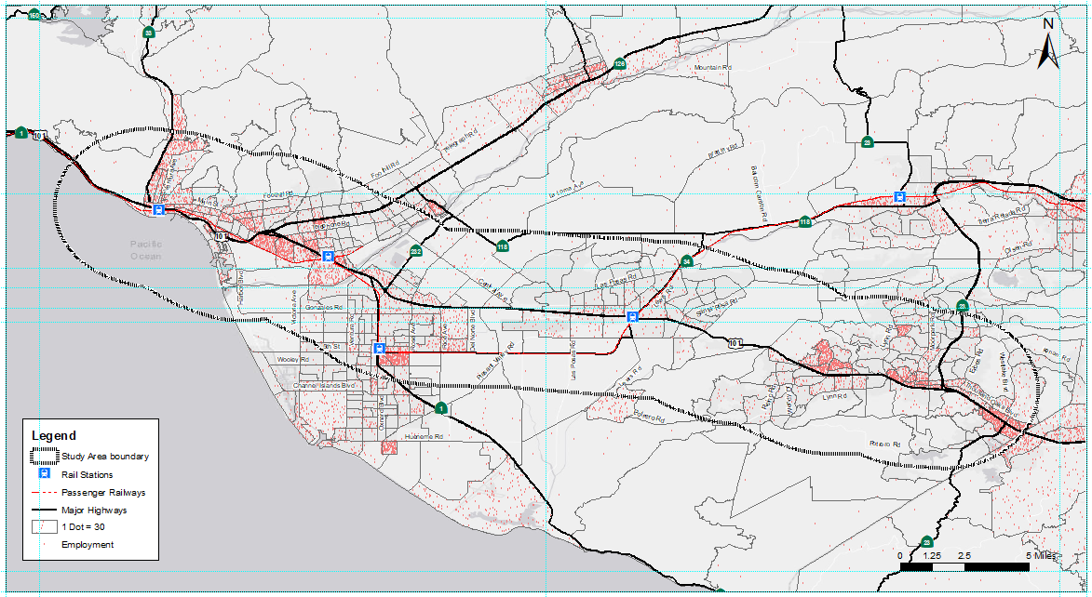
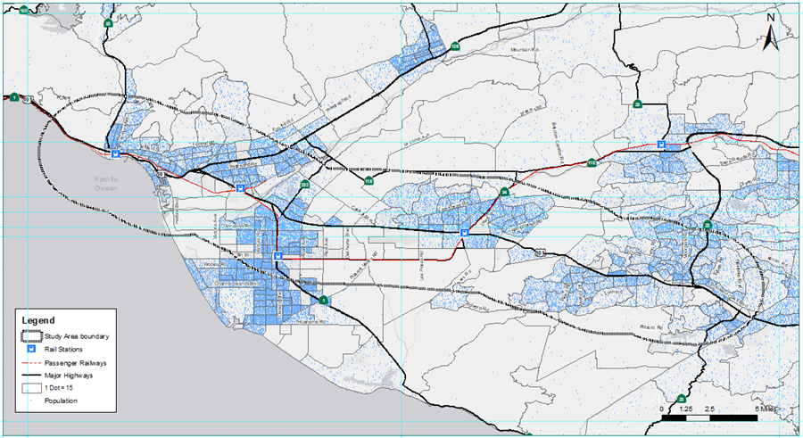
Population / Employment
CITY OR COUNTY | POPULATION | HOUSEHOLDS | EMPLOYMENT | POP/EMPLOYMENT RATIO
Ventura | 94,317 | 36,033 | 71,992 | 1.31
Oxnard | 105,359 | 26,795 | 30,889 | 3.41
Camarillo | 61,284 | 23,020 | 9,282 | 6.60
Thousand Oaks | 115,240 | 41,431 | 69,024 | 1.67
Unincorporated | 45,257 | 14,659 | 17,274 | 2.62
Total | 421,457 | 141,938 | 198,461 | 2.12
Note: Population figures are based on Ventura County Traffic Model (2012 baseline), and will be updated with the revised Existing Conditions Report.
Employment
Population

Slide 8
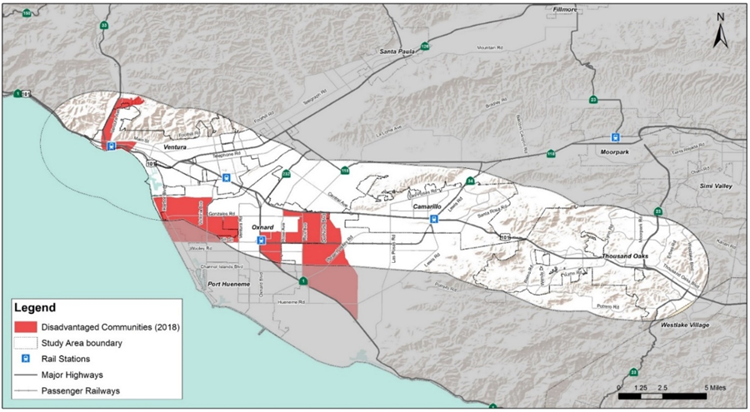
Disadvantaged Communities
Source: 2018 CalEnviroScreen 3.0

Slide 9
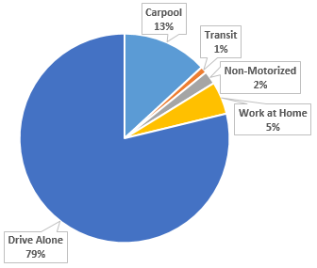
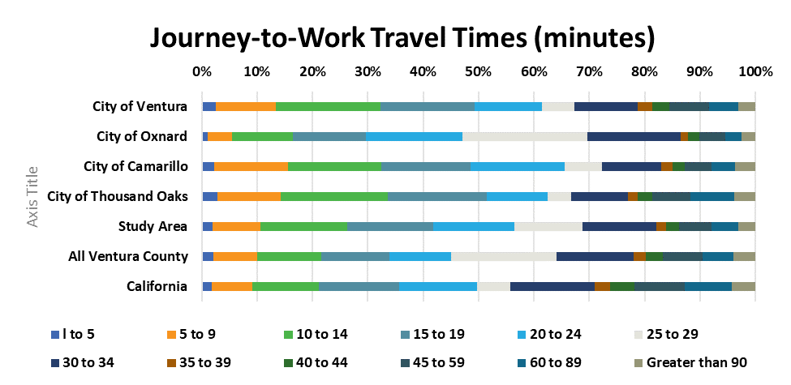
Travel Patterns
Mode Share
Commute Time
Daily Flow Patterns

Slide 10
Travel Patterns
(~296,273 people)
(~68,409 people)
(~12,167 people)
(~4,502 people)
Source: ACS 2012-2016 via CTPP (Census Transportation Planning Products) County to County Flows
Note: This data includes all of Ventura County (including outside of the study area)

Slide 11
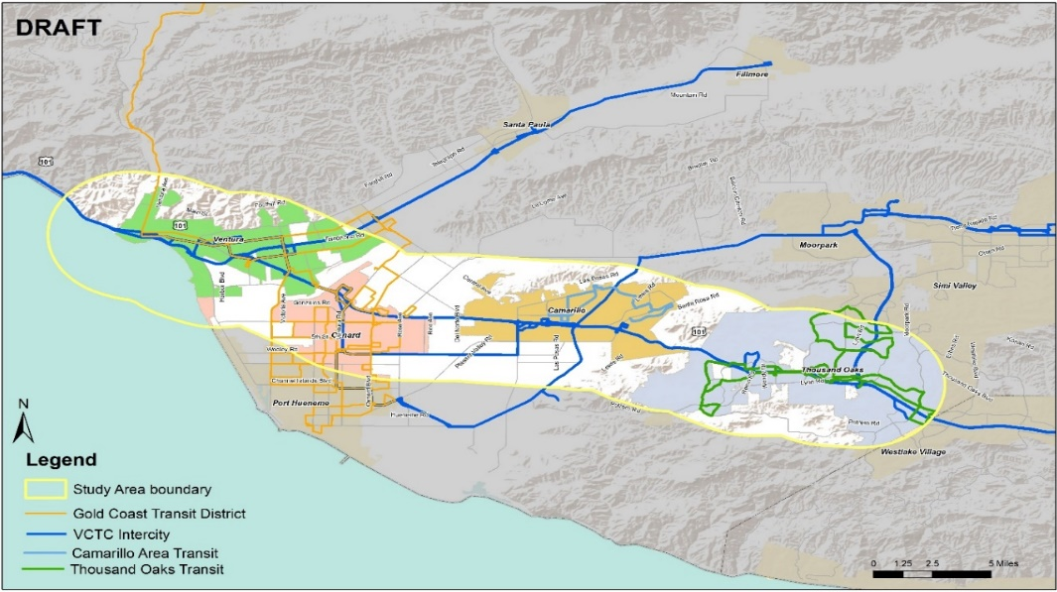
Transit
Fixed–Route Transit (Bus)
Demand Response Services
Passenger Rail
Ridership
Park and Ride Facility
OPERATIONAL CHARACTERISTICS | GOLD COAST | VCTC INTERCITY | THOUSAND OAKS | CAMARILLO
Boardings | 3,616,387 | 795,830 | 156,478 | 82,501
Total Revenue Miles | 2,192,066 | 1,781,057 | 372,036 | 54,274
Total Revenue Hours | 203,536 | 70,285 | 24,908 | 5,402
Operating Cost | $18,924,544 | $8,585,041 | $2,403,475 | $369,788
Operating Speed (mph) | 10.8 | 25.3 | 14.9 | 10.0
Passengers per Rev Hr | 17.8 | 11.3 | 6.3 | 15.3
Cost per Passenger | $5.23 | $10.79 | $15.36 | $4.48
Peak Vehicles | 47 | 35 | 10 | 2
Notes:
3-mile Buffer

Slide 12
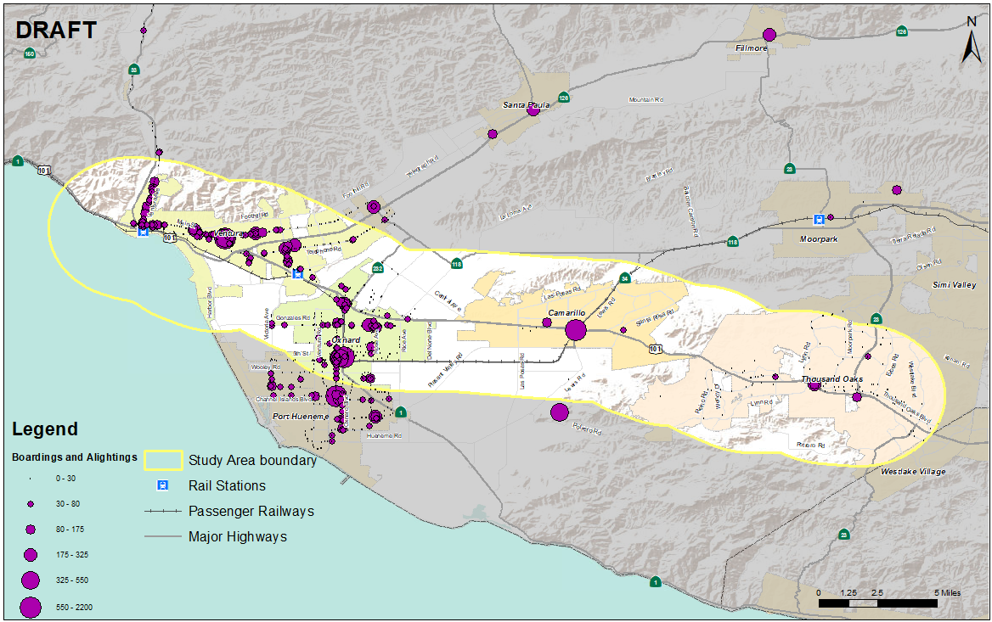
Transit Continued

Slide 13
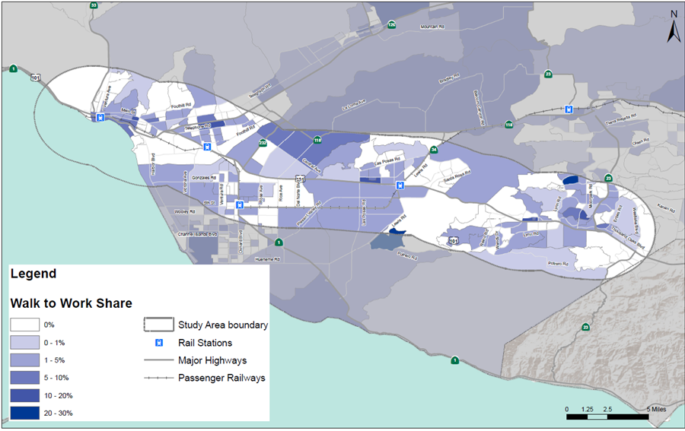
Active Transportation
Bikeway Facilities
Non-Motorized Commutes

Slide 14
Multi-Modal Projects
Type of Projects:
  Auxiliary Lanes
  Capacity Enhancement
  Grade Separation
  Interchange Improvement
  Intersection Improvement
  Transit
  Active Transportation
Funded and Unfunded

Slide 15
Next Steps
Solicit Feedback on Existing Conditions
Future Growth, Challenges and Opportunities
Identify Additional Multi-modal Projects
Project Evaluation in Multi-modal Context
Identify Potential Funding Sources
2nd Round of Public Workshops in Oxnard/Thousand Oaks in May
TTAC Review & Feedback of Full Study
Present Study to VCTC for Commission Approval in July

