Slide 1
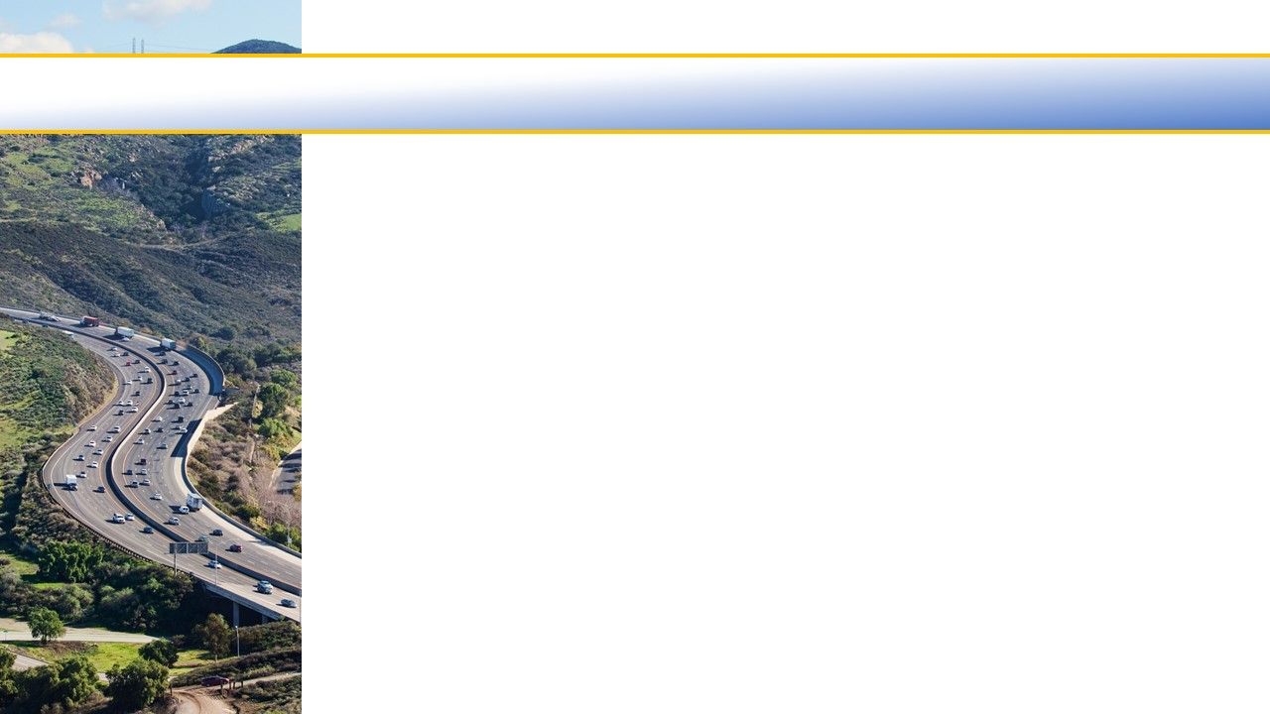

Ventura County Transportation Commission
  AMERICANS WITH DISABILITIES ACT PARATRANSIT CERTIFICATION SERVICES March 6, 2020

Slide 2
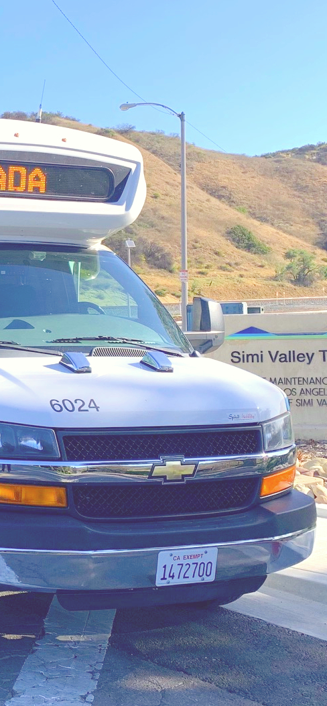
ADA & Paratransit
Americans with Disabilities Act (ADA)
The Americans with Disabilities Act requires transit agencies to provide “paratransit” services to people with disabilities who cannot use fixed route bus or rail service due to a disability or disability-related condition. [49 CFR 37]
Paratransit service
The ADA requires that paratransit rides be provided to all eligible riders if requested any time the previous day, within an hour of the requested time.
Eligibility
Due to the many fixed route operators in Ventura county, to streamline the process for both applicants and the operators, VCTC operates a county-wide program for paratransit eligibility certification services.
Notes:
Describe ADA… 1991 Civil rights legislation, Federal regs were developed to implement requirements of ADA, improving access and mobility to people who are unable to take traditional fixed route or rail service.
Paratransit is an on-demand door-to-door or curb-to-curb service (i.e. “dial-a-ride”) that is mandated by federal regulations and as a result is resource intensive to ensure compliance. Certain types of train services or bus services are exempt, such as commuter and intercity
§ 37.131 Service criteria for complementary paratransit.
The following service criteria apply to complementary paratransit required by § 37.121 of this part.
(a) Service Area -
(1) Bus.
(i) The entity shall provide complementary paratransit service to origins and destinations within corridors with a width of three-fourths of a mile on each side of each fixed route. The corridor shall include an area with a three-fourths of a mile radius at the ends of each fixed route.
(ii) Within the core service area, the entity also shall provide service to small areas not inside any of the corridors but which are surrounded by corridors.
(iii) Outside the core service area, the entity may designate corridors with widths from three-fourths of a mile up to one and one half miles on each side of a fixed route, based on local circumstances.
(iv) For purposes of this paragraph, the core service area is that area in which corridors with a width of three-fourths of a mile on each side of each fixed route merge together such that, with few and small exceptions, all origins and destinations within the area would be served.
(2) Rail.
(i) For rail systems, the service area shall consist of a circle with a radius of 3/4 of a mile around each station.
(ii) At end stations and other stations in outlying areas, the entity may designate circles with radii of up to 1 1/2 miles as part of its service area, based on local circumstances.
(3) Jurisdictional boundaries. Notwithstanding any other provision of this paragraph, an entity is not required to provide paratransit service in an area outside the boundaries of the jurisdiction(s) in which it operates, if the entity does not have legal authority to operate in that area. The entity shall take all practicable steps to provide paratransit service to any part of its service area.
(b) Response time. The entity shall schedule and provide paratransit service to any ADA paratransit eligible person at any requested time on a particular day in response to a request for service made the previous day. Reservations may be taken by reservation agents or by mechanical means.
(1) The entity shall make reservation service available during at least all normal business hours of the entity's administrative offices, as well as during times, comparable to normal business hours, on a day when the entity's offices are not open before a service day.
(2) The entity may negotiate pickup times with the individual, but the entity shall not require an ADA paratransit eligible individual to schedule a trip to begin more than one hour before or after the individual's desired departure time.
(3) The entity may use real-time scheduling in providing complementary paratransit service.
(4) The entity may permit advance reservations to be made up to 14 days in advance of an ADA paratransit eligible individual's desired trips. When an entity proposes to change its reservations system, it shall comply with the public participation requirements equivalent to those of § 37.137 (b) and (c).
(c) Fares. The fare for a trip charged to an ADA paratransit eligible user of the complementary paratransit service shall not exceed twice the fare that would be charged to an individual paying full fare (i.e., without regard to discounts) for a trip of similar length, at a similar time of day, on the entity's fixed route system.
(1) In calculating the full fare that would be paid by an individual using the fixed route system, the entity may include transfer and premium charges applicable to a trip of similar length, at a similar time of day, on the fixed route system.
(2) The fares for individuals accompanying ADA paratransit eligible individuals, who are provided service under § 37.123 (f) of this part, shall be the same as for the ADA paratransit eligible individuals they are accompanying.
(3) A personal care attendant shall not be charged for complementary paratransit service.
(4) The entity may charge a fare higher than otherwise permitted by this paragraph to a social service agency or other organization for agency trips (i.e., trips guaranteed to the organization).
(d) Trip purpose restrictions. The entity shall not impose restrictions or priorities based on trip purpose.
(e) Hours and days of service. The complementary paratransit service shall be available throughout the same hours and days as the entity's fixed route service.
(f) Capacity constraints. The entity shall not limit the availability of complementary paratransit service to ADA paratransit eligible individuals by any of the following:
(1) Restrictions on the number of trips an individual will be provided;
(2) Waiting lists for access to the service; or
(3) Any operational pattern or practice that significantly limits the availability of service to ADA paratransit eligible persons.
(i) Such patterns or practices include, but are not limited to, the following:
(A) Substantial numbers of significantly untimely pickups for initial or return trips;
(B) Substantial numbers of trip denials or missed trips;
(C) Substantial numbers of trips with excessive trip lengths.
(ii) Operational problems attributable to causes beyond the control of the entity (including, but not limited to, weather or traffic conditions affecting all vehicular traffic that were not anticipated at the time a trip was scheduled) shall not be a basis for determining that such a pattern or practice exists.
(g) Additional service. Public entities may provide complementary paratransit service to ADA paratransit eligible individuals exceeding that provided for in this section. However, only the cost of service provided for in this section may be considered in a public entity's request for an undue financial burden waiver under §§ 37.151-37.155 of this part.
§ 37.121 Requirement for comparable complementary paratransit service.
----- (c) Requirements for complementary paratransit do not apply to commuter bus, commuter rail, or intercity rail systems.

Slide 3
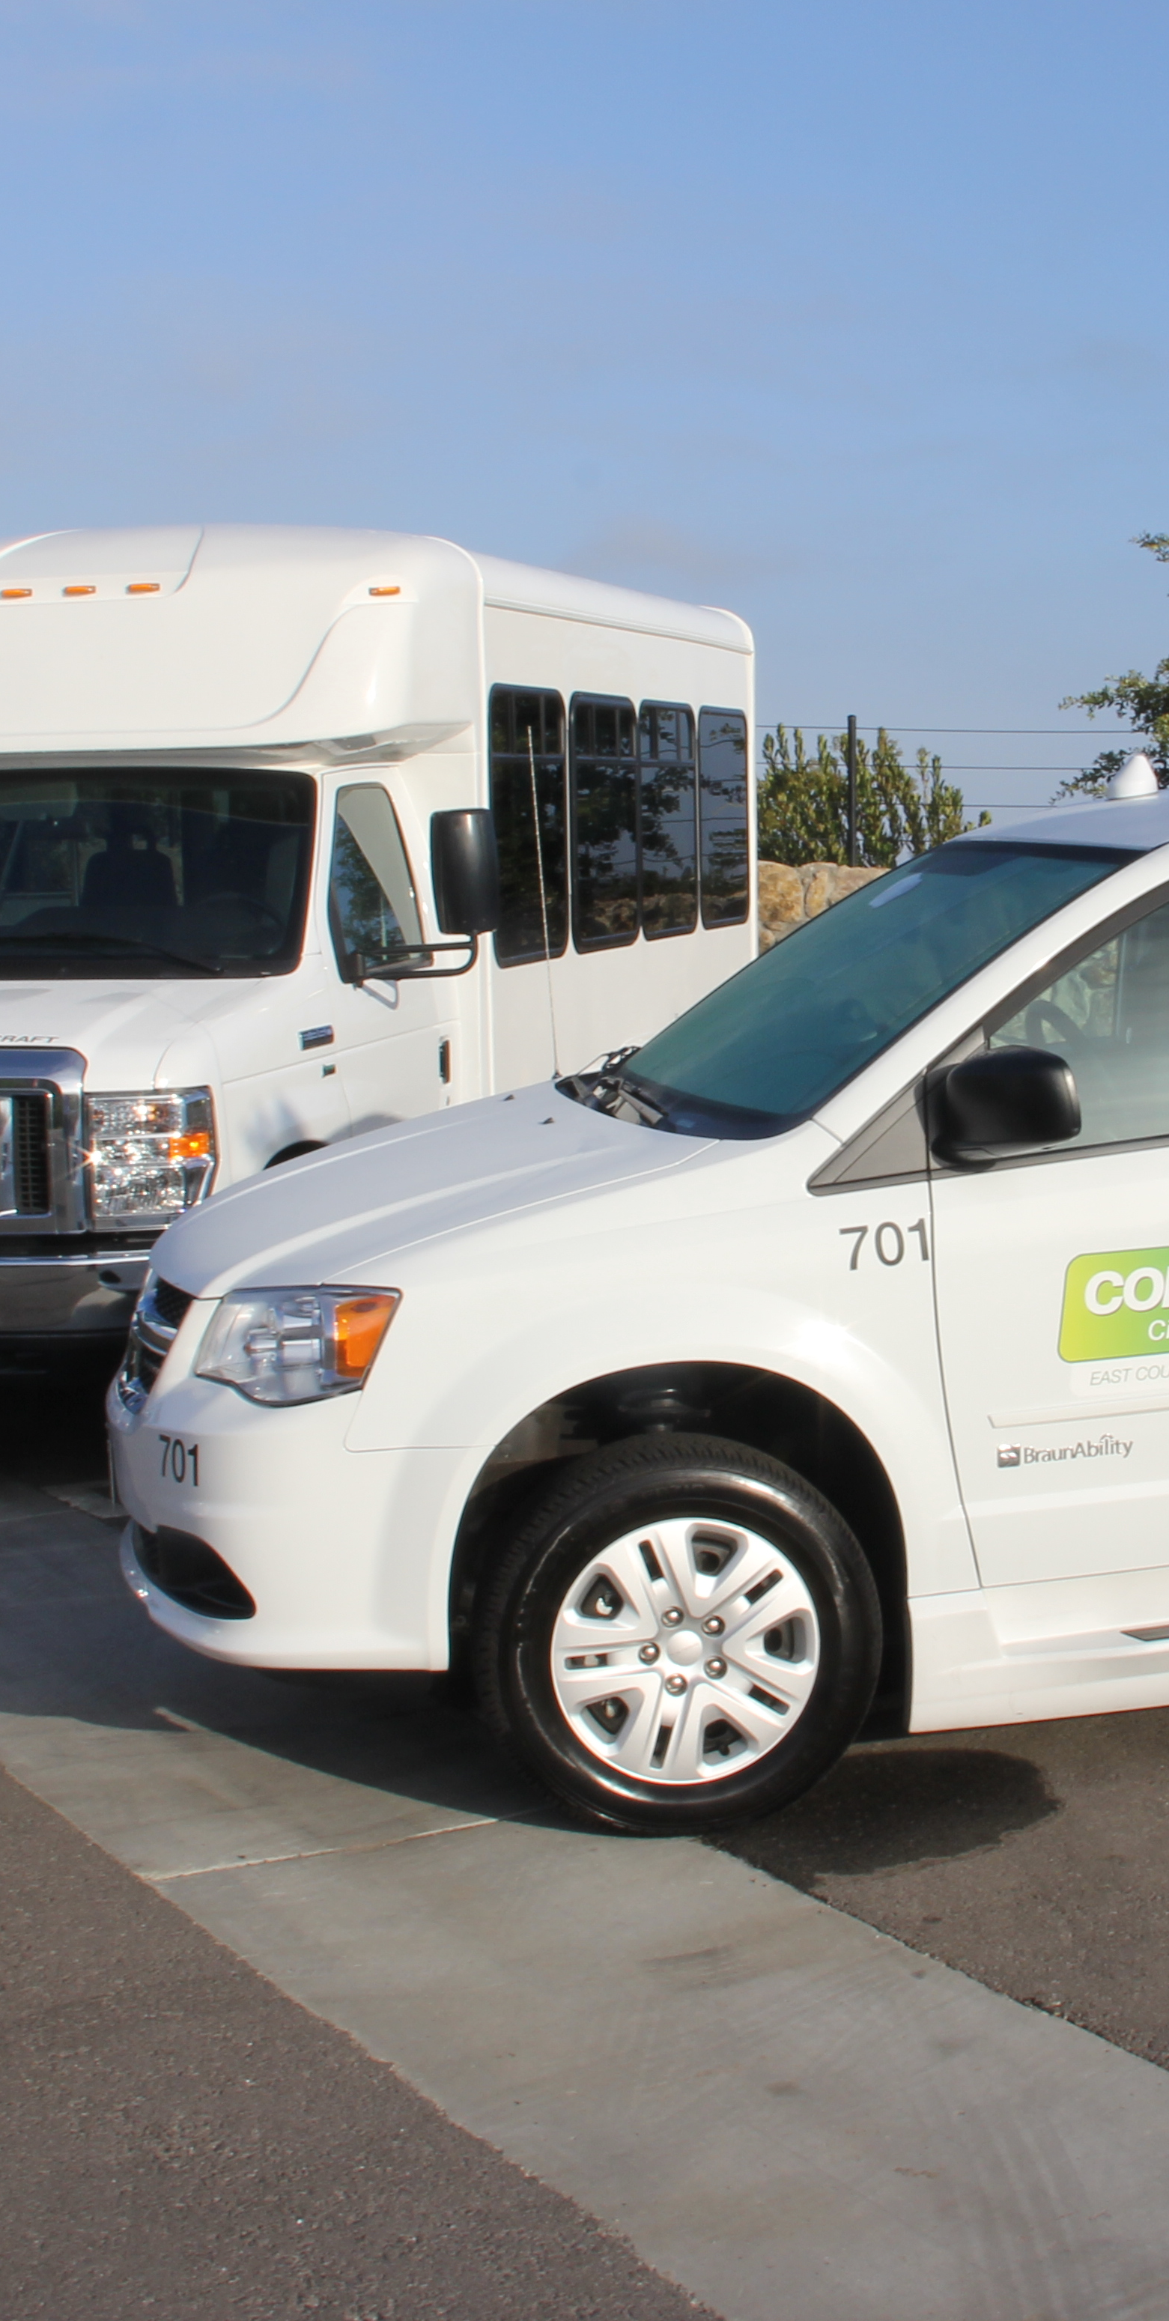
Eligibility
US DOT regulations provide 3 categories of paratransit eligibility:
Category 1 = People who can’t travel on the bus or train, because of a disability
Category 2 = People who need an accessible bus or train
Category 3 = People who have a specific health or disability-related condition
Notes:
What is paratransit eligibility, how is it determined. Industry standa Evaluations can include functional assessment or review of materials provided by applicant’s doctors and/or licensed care providers.
Determinations regarding eligibility must be completed within 21 days.
The eligibility determination travels with the applicant and is recognized across the country, e.g. Hawaii to Maine.
Eligibility lasts three years before recertification, unless temporary.

Slide 4










Current Program
Covers all residents of Ventura county or those non-residents who take local paratransit at least 3 weeks a year.
Approximately 1,500 applications processed annually. Submitted by mail and online.
Growth in applicants approximately 7% year over year.
Distribution of applications by fixed route service:
  Gold Coast = 35%
  Simi Valley Transit = 25%
  Thousand Oaks/Kanan = 20%
  Camarillo Area Transit = 10%
  Valley Express = 5%
  Moorpark City Transit = 5%

Slide 5
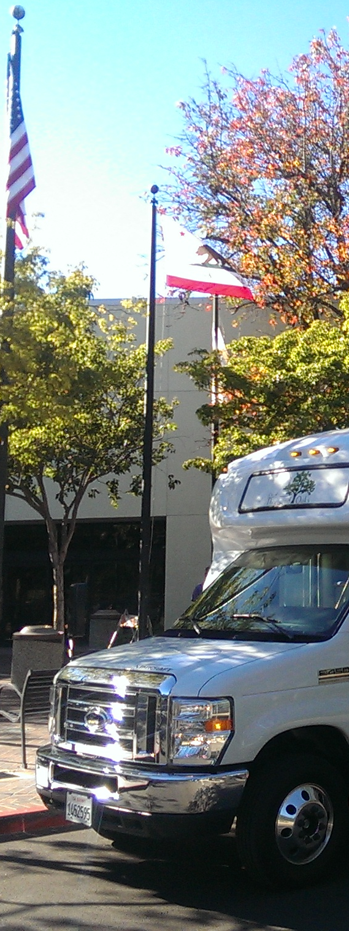
Certification Provider
Contract service provider, Mobility Management Partners, selected through a competitive bid process, Request for Proposals. Scoring committee included representatives by City of Moorpark, Simi Valley and Ventura County Area Agency on Aging as well as VCTC.
Field staff and administrative staff to facilitate the program: conduct interviews, process intake and maintain eligibility database.
Assessments are conducted multiple ways: via review of materials, over the phone or in-person, if needed.
Five interview locations distributed across county – VCTC’s offices, senior centers, libraries and community centers.
Bilingual staffing – approx. 25% of applicants identified preference for Spanish-only materials/communication.
Contract term: three years with two one-year options to extend; year one not to exceed $349,454, year two $359,939, year three $370,739, for a total not to exceed of $1,080,132 for the three-year term.

Slide 6
Ventura County Transportation Commission
Questions

