Slide 1
VCTC Metrolink Update
January 10, 2020
Notes:
Hello Chair Minjares and Commissioners. I’m Stephanie Wiggins, CEO of Metrolink, and I’m honored to be invited here to provide an update on Metrolink service and initiatives benefiting Ventura County.

Slide 2
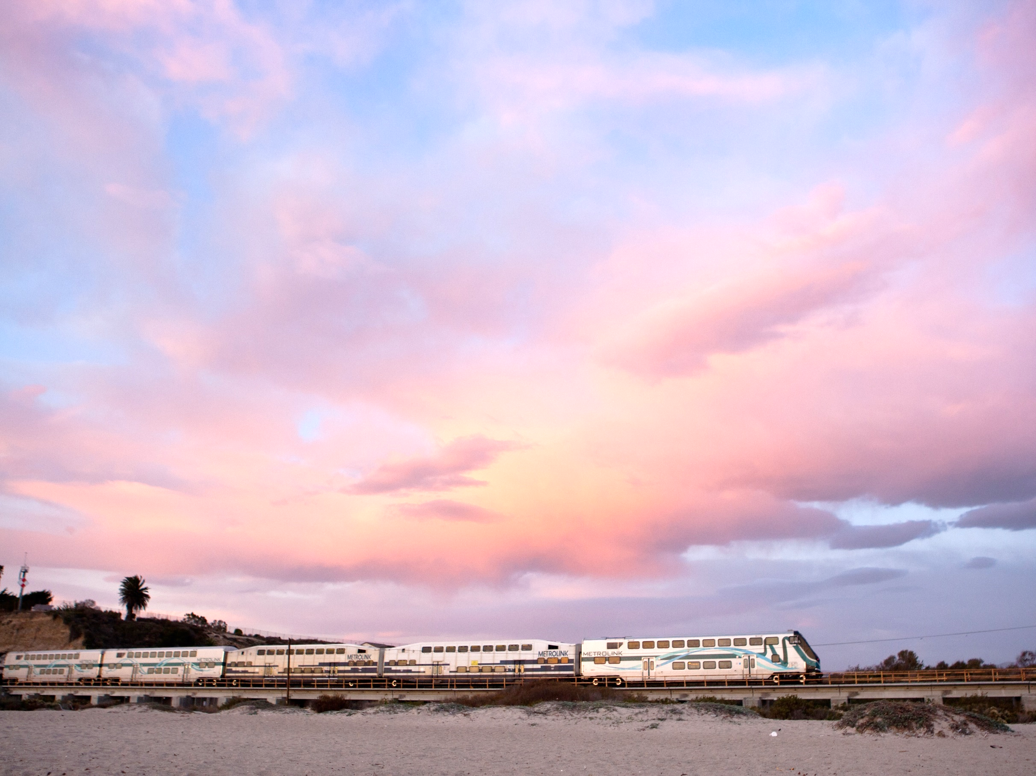
CEO VISION
Customer-First Orientation
Safety & Security
Integrated System
Modernized Business Practices
Create Value, Exceed Expectations
Notes:
When I joined Metrolink a little over a year ago, on January 2, I introduced to my board and staff a customer-focused vision with three pillars
Safety & Security
An Integrated System
Modernized Business Practices
And our vision statement is Create Value, Exceed Expectations… for our customers, our employees, our member agencies, our contractor partners … all of our valued stakeholders.
My intention is to double ridership, from five years from the time that I joined the agency. It’s an ambitious goal, but with the support of member agencies and by creating value and exceeding expectations, we can get there.

Slide 3
Notes:
…as I was saying… my goal of doubling ridership is ambitious, but we have momentum. While many other commuter rail providers are seeing sharp declines in ridership, our ridership is increasing and has been for the past five years.

Slide 4
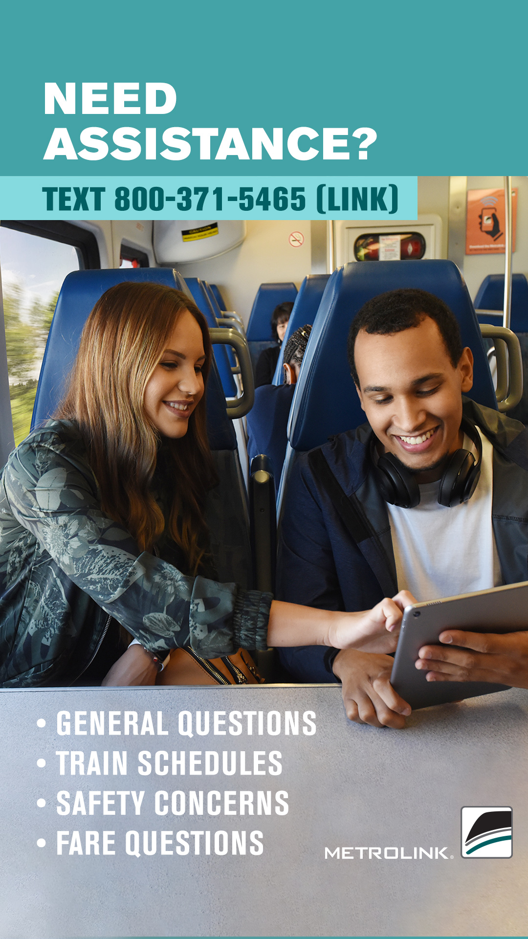
A New Way to Communicate
Texting for Customer Service
Launched February 14, 2019
6,476 customers contacted us with a total of 12,391 text messages
Texting for Safety/Security:
Launched July 8, 2019
Encourages riders to immediately report incidents
Texts go to Metrolink Security Operations Center for immediate response
Notes:
On February 14, 2019 we introduced a customer-focused initiative, giving our riders the opportunity to text us
In 2019, 6,476 customers contacted us with customer service-related inquiries for a total of 12,391 text messages.
These text messages ranged from questions about schedules to requests for service changes
We expanded our texting program on July 8 when we launched direct texting to our Security Operations Center. This initiative allows riders to discreetly report a non-emergency safety or security concern.

Slide 5
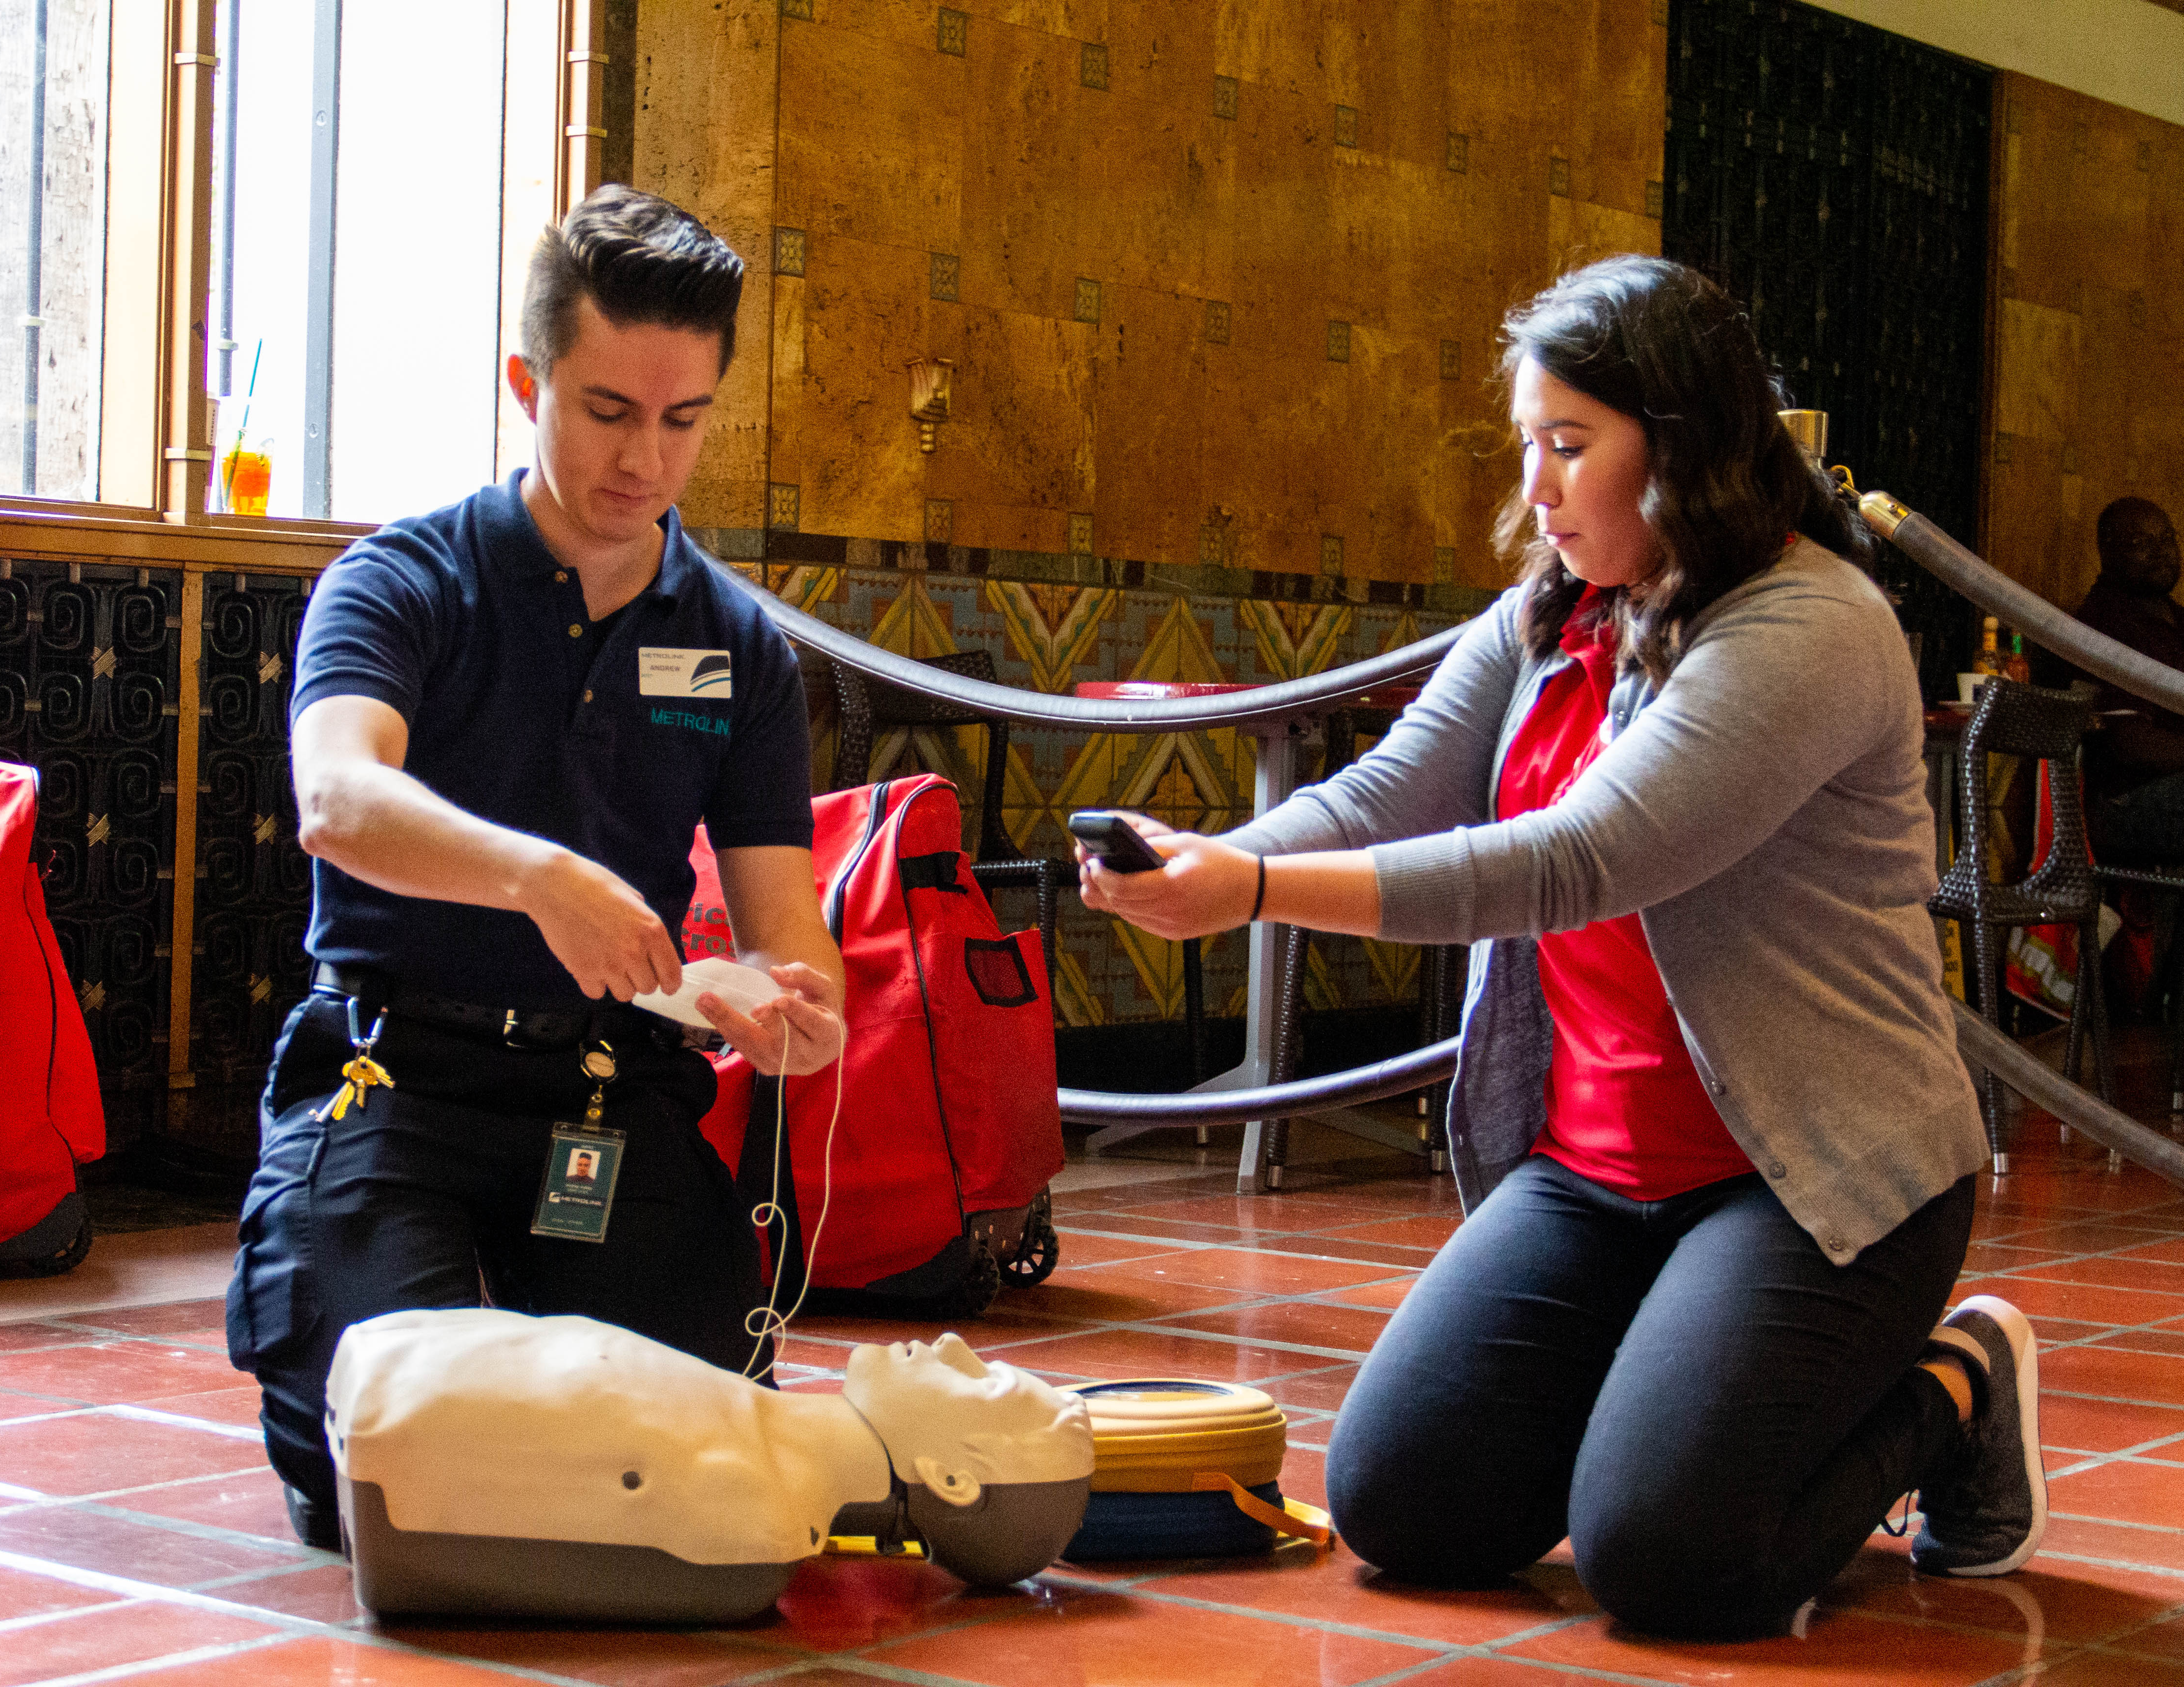
Automated External Defibrillators (AED)
We added these life-saving devices well ahead of the state-mandated July 2020 deadline
Held press event with American Heart Association during February (American Heart Month) to announce this milestone and train employees and riders on how to use them
Notes:
On February 15 we installed Automated External Defibrillators (AEDs) on all trains and provided hands-on and online resources to demonstrate the life saving technology to employees, riders and the public.
California Legislature passed Senate Bill (SB) 502, which required installation of AEDs on commuter rail systems in California by July 1, 2020.

Slide 6
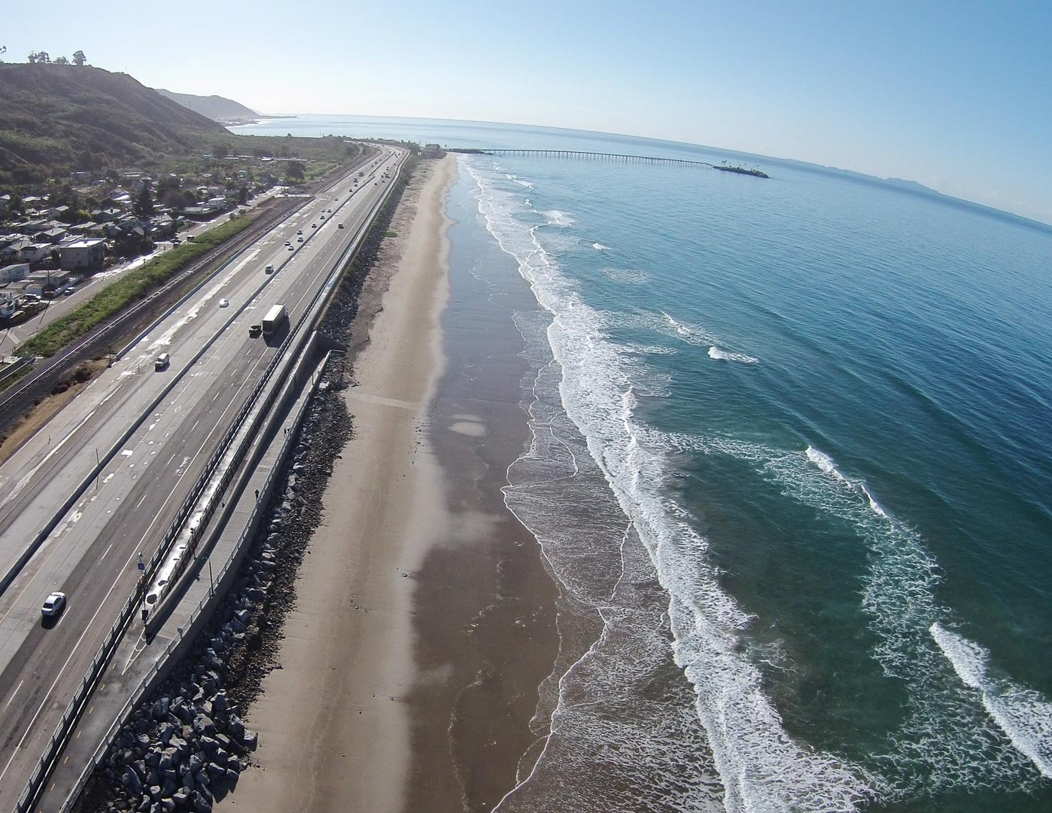
Go Local and Get Active Metrolink Destination App
Federal grant application for development of destination app
If funded, the app will:
Provide user-friendly information on Ventura County Line station cities and communities
Introduce new riders to the Metrolink system by promoting Metrolink’s unique station-area destinations
Encourage existing riders to use the service more often supporting local businesses
Decrease area congestion and parking demand
Notes:
In August of 2019, we submitted our application for the Go Local and Get Active Metrolink Destination App with the Federal Transit Administration Integrated Mobility Innovation Demonstration Program
Federal grant application for development of destination app:
Will provide user-friendly information on Ventura County Line station cities and communities
To bring new riders to the Metrolink system by promoting Metrolink’s unique station-area destinations
Will encourage existing users to use the service more often supporting local businesses
Will decrease area congestion and parking demand
We hope to hear something soon from the FTA

Slide 7
September Safety Summit
Rail Safety Month Centerpiece
Keynote speech provided by NTSB Member Jennifer Homendy
KNBC reporter Conan Nolan was Master of Ceremonies
Featured more than 200 leaders in safety and transportation
Notes:
On September 12, 2019 Metrolink hosted a national Rail Safety Summit, which was the centerpiece of the agency’s September Rail Safety Month campaign.
More than 200 leaders, including keynote speaker NTSB member Jennifer Homendy and emcee Conan Nolan, in safety and transportation convened to engage in important dialogue about ensuring rail safety.
The event also featured panel discussions on the latest technology innovations that reduce incidents along the right-of-way, Positive Train Control and the many ways mental health influences rail safety and security.

Slide 8
Wi-Fi Pilot
November 2 – January 2
w/ AT&T
New Partners in 2020
141
Average daily clients
3,413
Total clients
56.42%
Riders reported no problems
429
Comments, with the majority positive
70.82%
Ride 4-7 days/week
47.24%
Ride with monthly passes
Notes:
141
Average daily clients
3,413
Total clients
56.42%
Riders reported no problems
429
Total comments, the majority of which reported positive experiences
70.82%
Ride 4-7 days/week
47.24%
Have monthly passes
3,776
Hits on the Wi-Fi Test page, indicating users connected to the Wi-Fi test equipment multiple times
Next steps: We will continue the Wi-Fi Test with new partners, including Sprint who will join the next phase.
Sources:
Google Analytics, metrolinktrains.com
Metrolink Wi-Fi Test SurveyMonkey
For the first time in Metrolink history, we tested onboard Wi-Fi. This feature is the most popular customer request for the past decade.
The pilot test was 60 days on two sets of equipment, provided by AT&T/Cradlepoint.

Slide 9
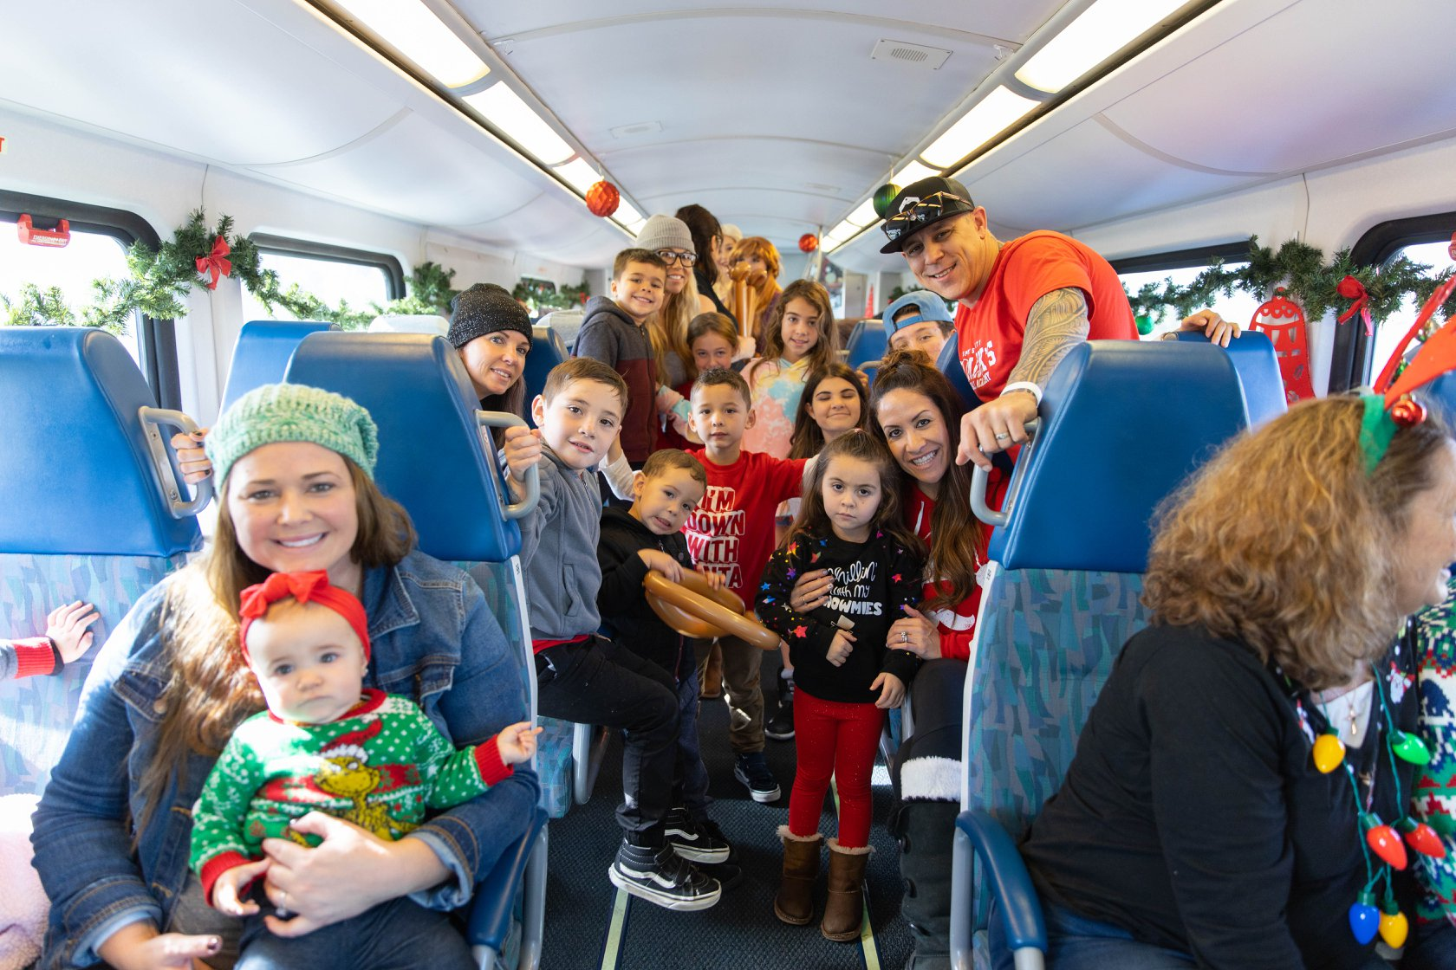
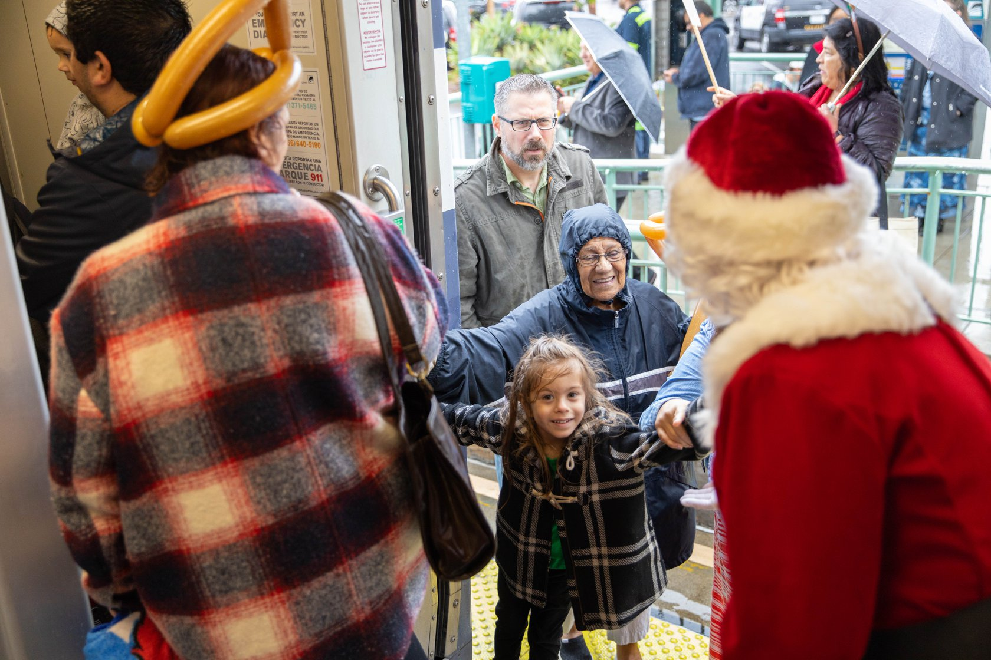
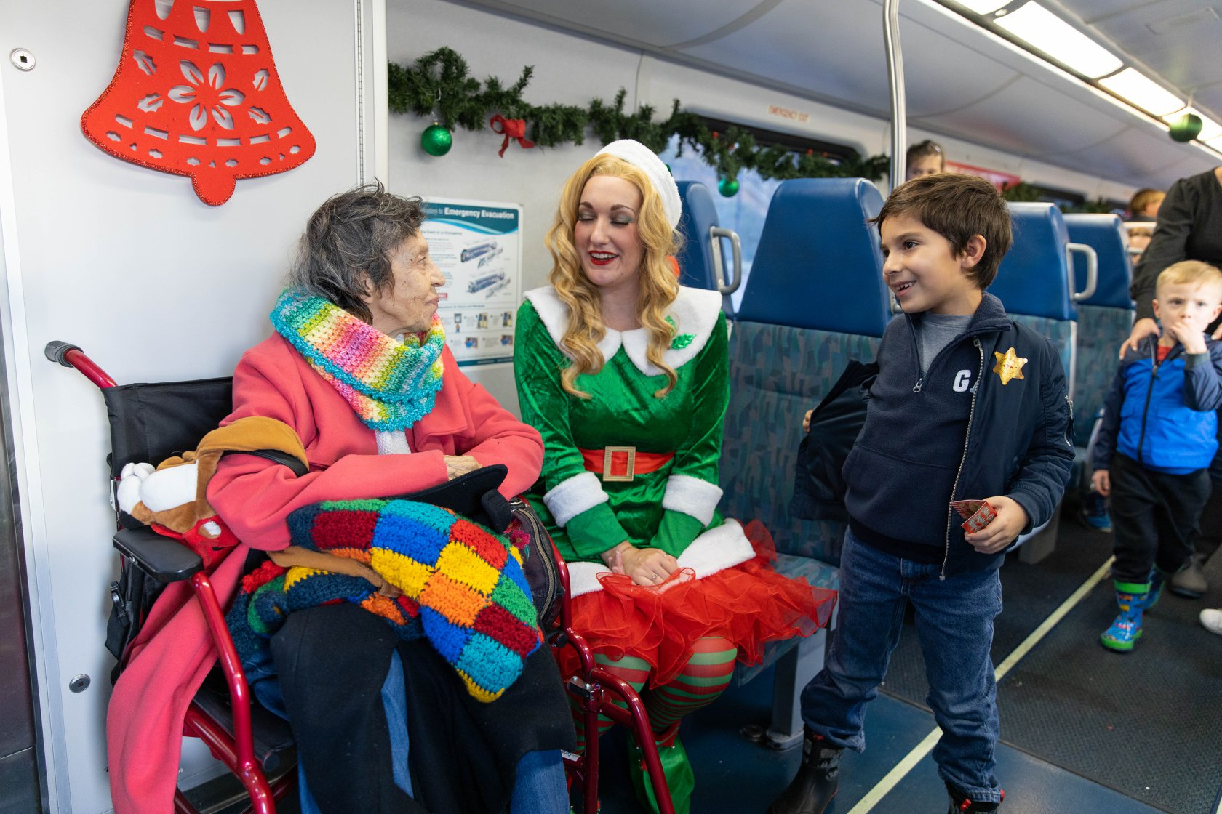
Holiday Express Train
4 Events: More than 3,000 tickets sold
Simi Valley event 97% sold out (756 tickets)
Funded by ticket purchases
Notes:
This year, we brought back a holiday train. We had four events – one in LA County, one in San Bernardino County, one in Orange County and one in Ventura County. With all four events, we sold over 3,000 tickets and were able to fund the operations with fares.
At the Ventura County event in Simi Valley, we sold 756 tickets. This is about 97% of the 777 available tickets. ​
​
We were also honored to have Simi Valley City Councilmember Elaine Litster and Simi Valley Mayor Keith Mashburn in attendance at our Simi Valley event.​
​
After successes like the event in Simi Valley we know we are onto something with our onboard holiday experiences.​

Slide 10
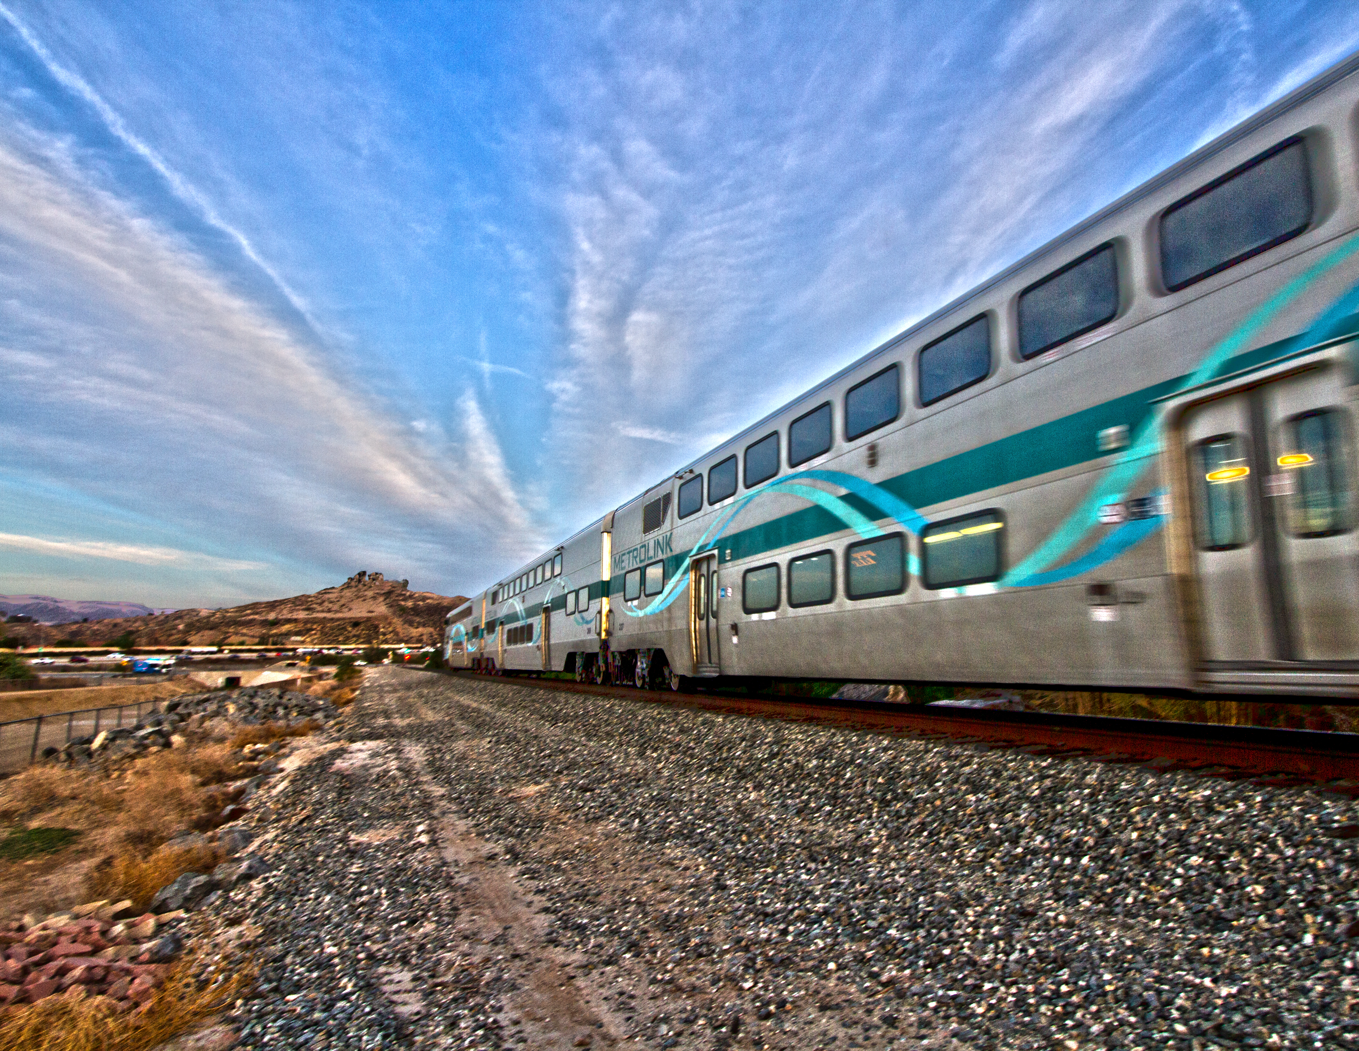
April 2020 Ventura County Line Weekend Pilot
Back by popular demand: Weekend service on the Ventura County Line starting in April 2020
Great opportunity to bring riders to Ventura County and take residents to Los Angeles County
Marketing the Ventura County Line service will be a priority
Thanks to VCTC for funding this service
10
Notes:
Back by popular demand: Weekend service on the VC Line
Great opportunity to bring riders to Ventura County and take VC residents to Los Angeles County
Thanks to VCTC for funding this service
Marketing the VC Line service will be our priority

Slide 11
Notes:
Click to start video

Slide 12
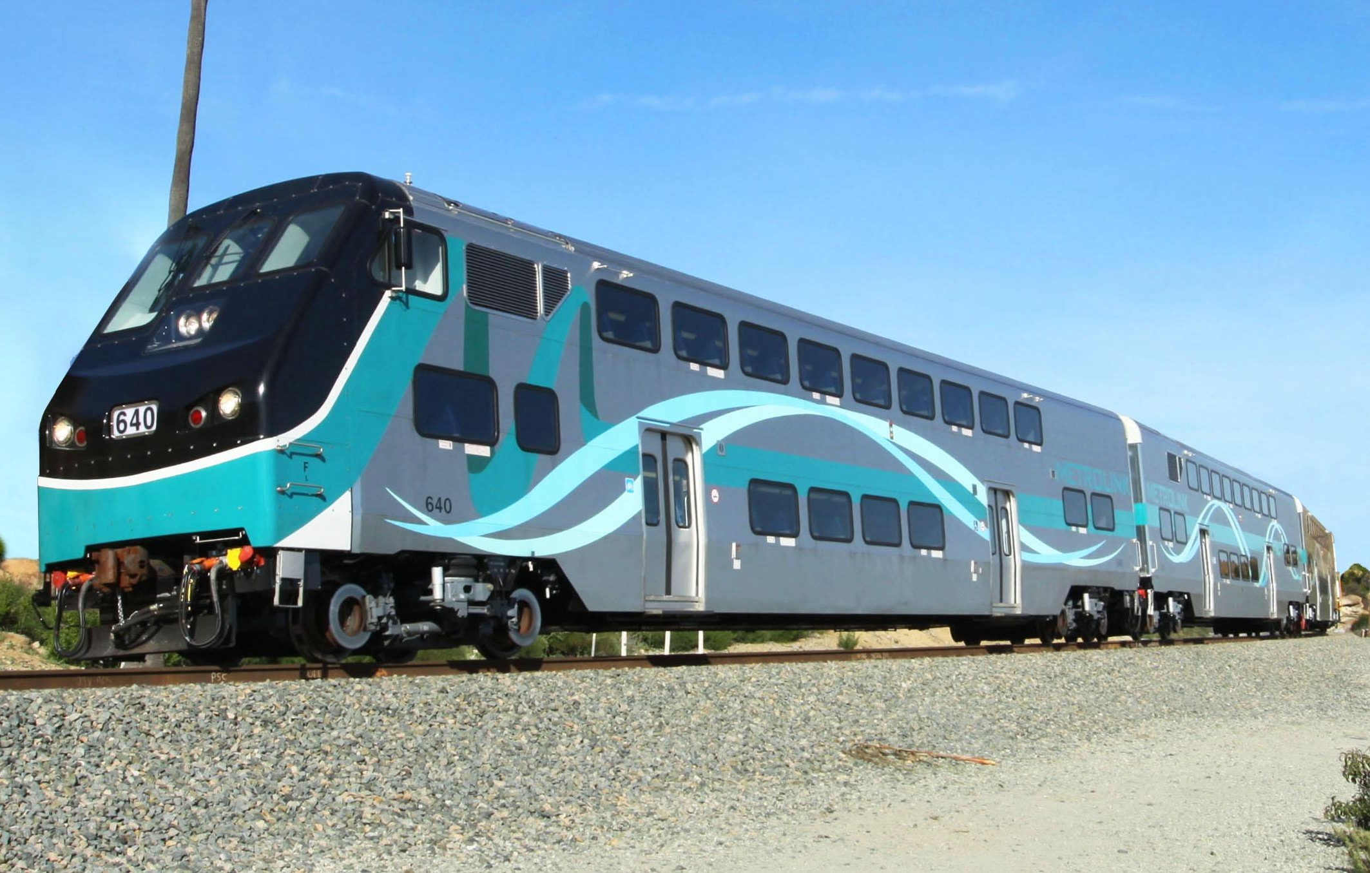
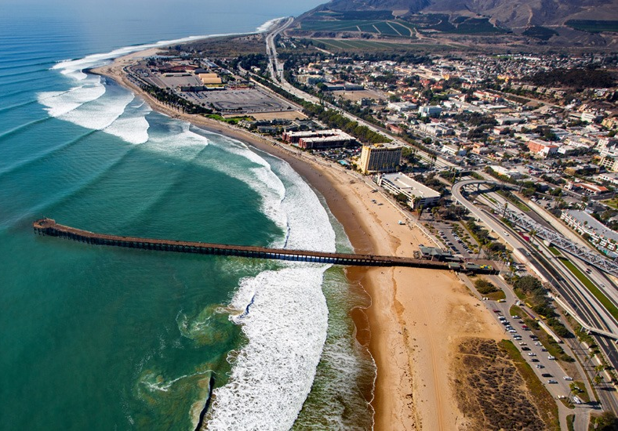
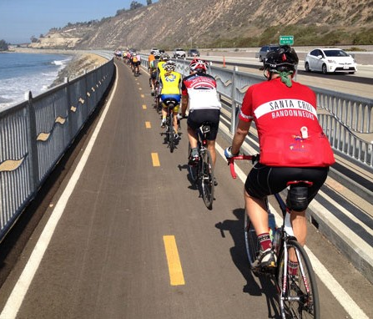
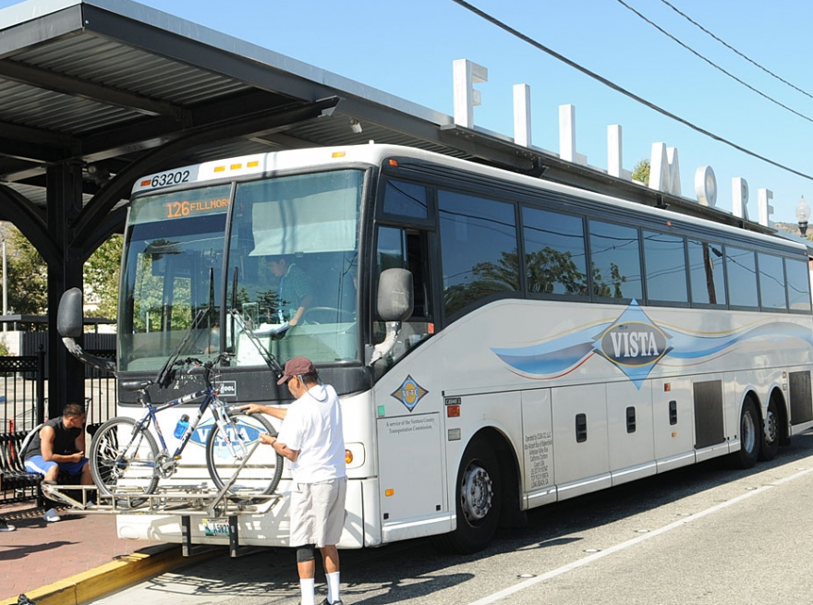
SCORE: Ventura County Benefits
Economic Benefits
2028:
4,800 jobs
$912 million in GDP
By 2050:
77,600 jobs
33.7 billion in GDP
More Riders
More bi-directional service to attract additional riders
LinkUS enables one-seat rides between Ventura and Orange counties
Better First Mile/ Last Mile
Trains at regular headways means improved transfers to other transit providers (six in Ventura County)
Fights Climate Change
Reduces up to 51.7 million metric tons of GHG across Southern California
Removes 3.4 billion of regional VMT
Leverage Connectivity for Future Growth
Improves access to VC Line stations
Timeline
12
Notes:
Economic Benefits
2028:
4,800 jobs
$912 million in GDP
By 2050:
77,600 jobs
33.7 billion in GDP
In addition to the economic benefits, there will be additional benefits to VCTC's service area such as:
More Riders: We anticipate adding 35.5 million additional riders as a result of the SCORE upgrades to the system. These riders will live, eat, play and work in Ventura County.
With LinkUS allowing one-seat rides between OC and VC, we anticipate more riders having seamless access to destinations in both counties and destinations in between.
Trains at regular headways will provide connectivity and better first mile/last mile connections
Fights climate change by taking cars off the road (3.4 million VMT removed) resulting in 51.7 million metric tons of GHG reductions.
Timeline:
SCORE was developed in 2017,
Got a major boost from the State with an $876 million TIRCP grant in 2018.
We will be working to complete 30% design and start environmental clearance processes, then we’ll start construction in 2022.
We’ll have some projects coming on line in 2023 and then the entire program complete by 2028 Olympic and Paralympic Games, pending funding.

Slide 13
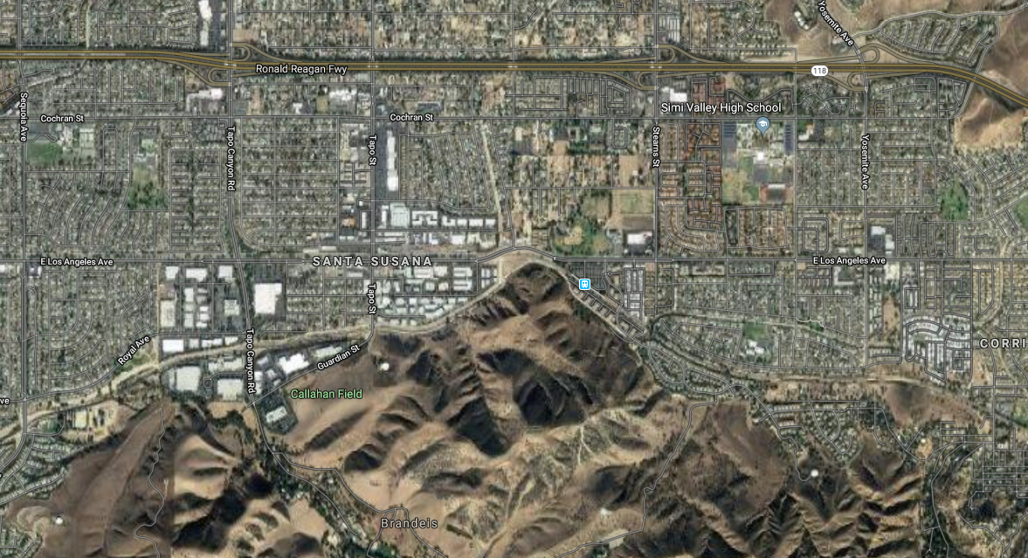
Simi Valley Station & Double Track
East Los Angeles St.
Tapo Cyn Rd.
Tapo St.
Hidden Ranch Dr.
Simi Valley Station
Adds capacity to allow future 30 minute frequencies
Upgrades 4 crossings to be Quiet Zone ready (only 1 crossing in Simi Valley outside of project limits)
Updates all signals, warning devices & track panels
Add 2.6 miles of new track
Shifts 1,400 feet of existing track
Notes:
The only SCORE Phase 1 project located in Ventura County is the Simi Valley Station and Double Track project.
This project adds capacity to allow a future increase in frequencies. Additionally, it upgrades 4 of the 5 crossings in Simi Valley to be quiet zone ready so the city can apply for a quiet zone which is a popular community request.
[click to animate]
So here you see the existing line of track, running through Simi Valley
[click]
With SCORE, we would
shift 1,400 feet of existing track to accommodate a second track, adding 2.6 miles of new track to facilitate bi-directional travel.
[click]
Update all signals, warning devices, and track panels to improve safety
And create quiet zone ready crossings at the starred locations

Slide 14
Thank you!
Notes:
Thank you so much for having me today. I want to let you know that it has been a pleasure having Mr. Humphrey as my Chair and Darren has been especially involved and helpful, as well.

