Slide 1
I-105 Corridor Sustainability Study
Naresh Amatya, P.E.
Manager of Transportation Planning and Programming
Nov. 1, 2019

Slide 2
Background
2016 Caltrans Sustainable Transportation Planning Grant
Purpose of the Study:
  Examine multi-modal I-105 corridor conditions
  Go beyond traditional freeway planning
  Integrate Caltrans Smart Mobility Framework
  Include key stakeholders

Slide 3
Multi-Modal Corridor Plan Guidelines
  Caltrans Corridor Planning Guidebook
  To replace Transportation Concept Report (TCR) guidelines
  Public draft released in December, 2018
  CTC Comprehensive Multi-Modal Corridor Plan Guidelines
  California Transportation Commission guidelines for eligibility of plans under Congested corridors program (SB1)
  Final guidelines approved December 5, 2018
  Agencies beginning to create plans now

Slide 4
Project Objectives
Not simply Level of Service for Autos!
  Reduce delay per capita
  Reduce vehicle miles traveled (VMT) per capita
  Improve connectivity between modes
  Increase mode share for transit, walking, and bicycling
  Improve system conditions (preservation)
  Improve system efficiency (operations)
  Reduce serious and fatal collisions
  Support Senate Bill 375 and greenhouse gas reduction

Slide 5








Overall Process
Develop Evaluation
Framework
Assess Existing +
Future Conditions
Evaluate Projects
Final I-105 Plan
Stakeholder Input

Slide 6
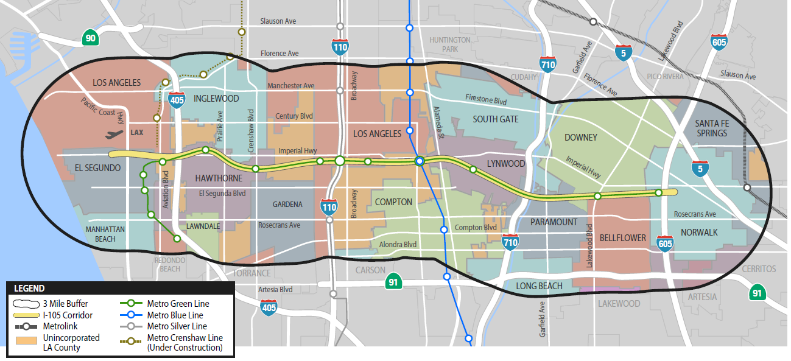
Project Study Area
  3 Miles around all sides of I-105 Freeway

Slide 7
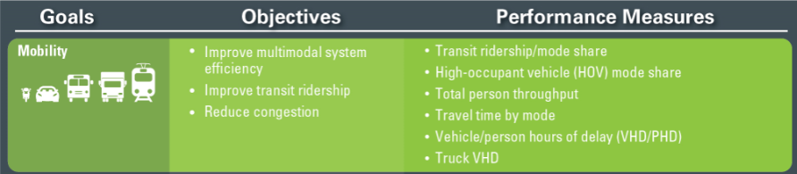
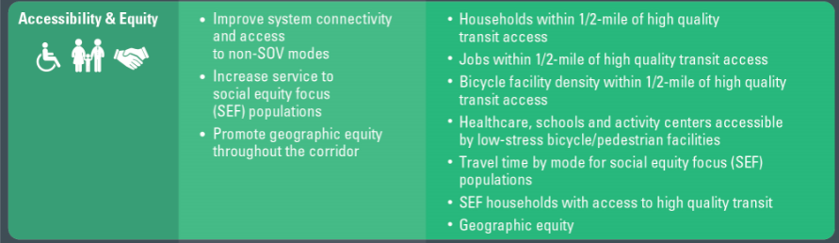
Evaluation Framework

Slide 8
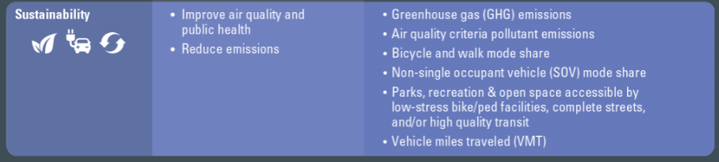
Evaluation Framework

Slide 9



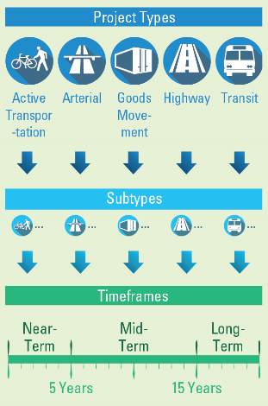
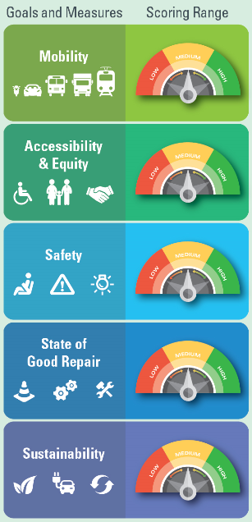
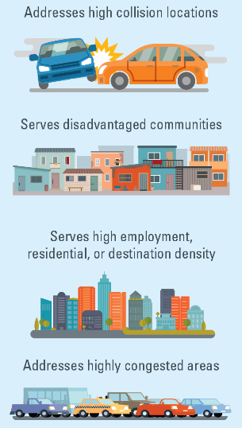
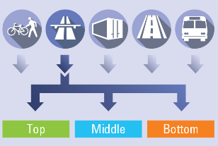
Evaluation Process
Evaluation Process

Slide 10

Significant Stakeholder Outreach Effort
Project Develop Team
  SCAG, Caltrans, Metro
Technical Advisory Committee
  Cities/county
  Transit providers
  Interest groups
Stakeholder Interviews
  Transit providers,
  Active transportation groups
  Cities
Infographics
Project Website
Online Public Survey

Slide 11
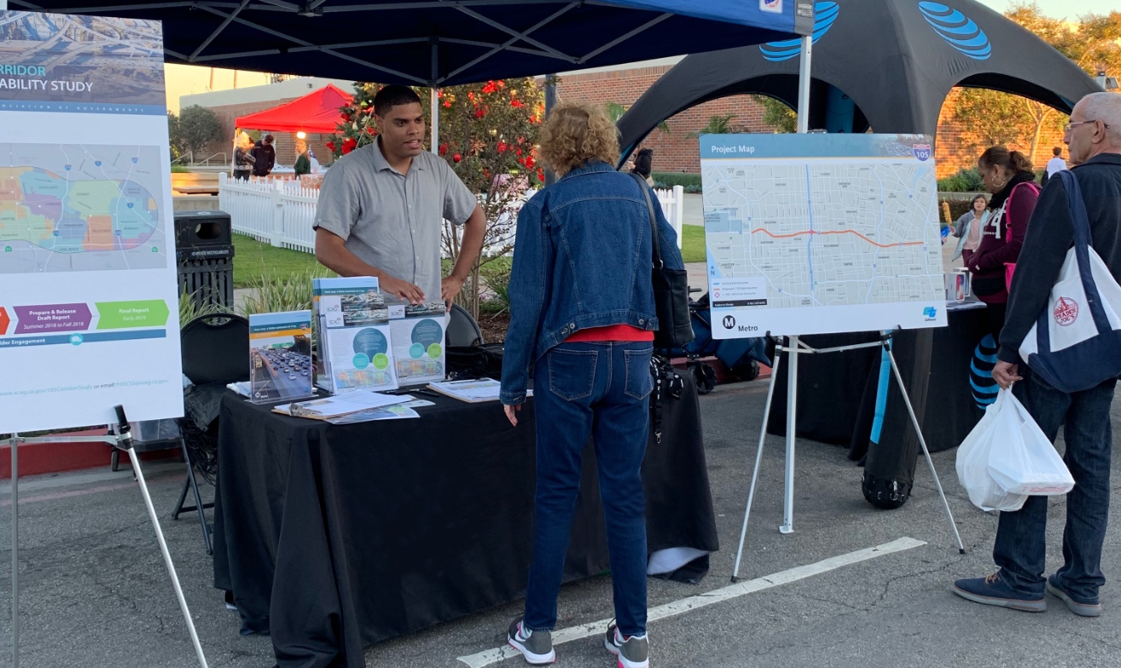
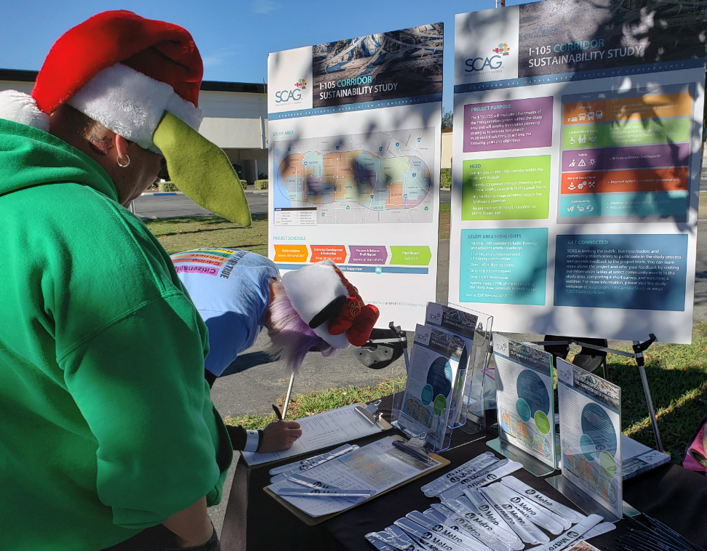
Public Engagement
Four Public Events
  Downey
  El Segundo
  Lynwood
  Hawthorne
  Public Survey: 124 Responses

Slide 12
Results
Projects By Type
Projects By Timeframe

Slide 13
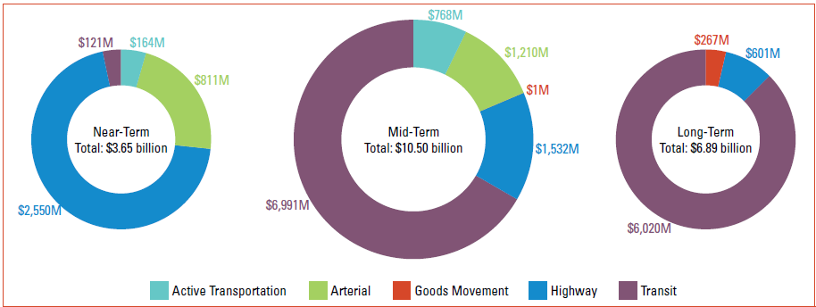
Funding Need

Slide 14
Next Steps
Shared the report with key stakeholders, including LA Metro and Caltrans
The study findings and process highlighted in Connect SoCal or 2020 RTP/SCS as a best practice
Stakeholders can use the study findings to support application for ‘Congested Corridors Program’ under SB 1 for relevant projects
Stakeholders can use the study findings to implement projects supported by the study

Slide 15
Thank you
Please visit
http://scag.ca.gov/I-105-Corridor-Study
For more information

