Slide 1


Print Advertising – Seniors (FY19)

Slide 2


Social Media – Youth Snapchat Campaign (FY19)
$ 550 Budget
260,668 Impressions
3,107 Swipes to the website
$ 392 Budget
170,068 Impressions
1,733 Swipes to the website

Slide 3
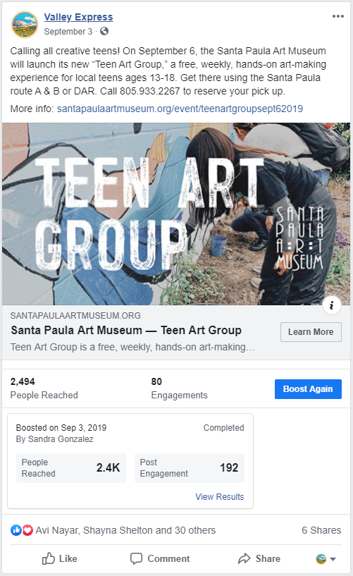
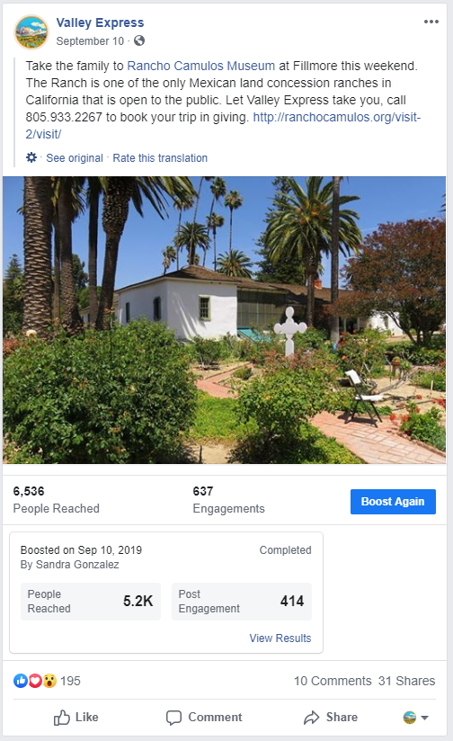
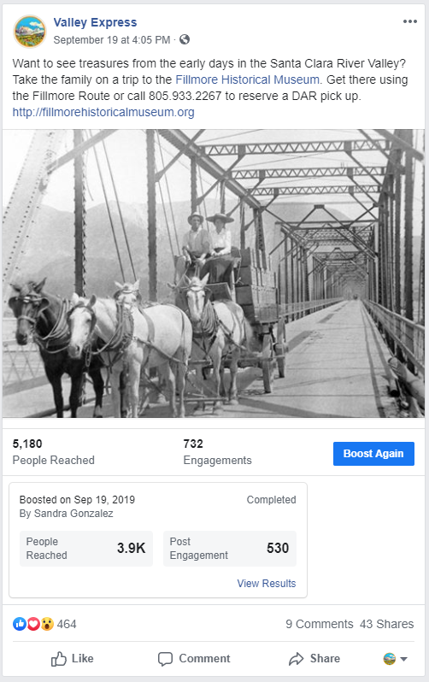
Social Media – Events/Destinations Campaign

Slide 4
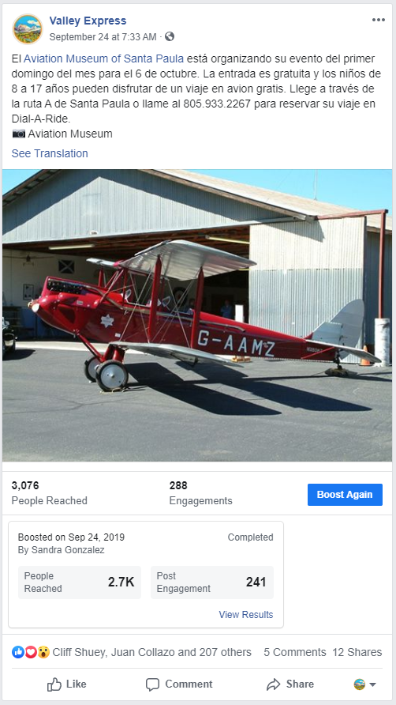
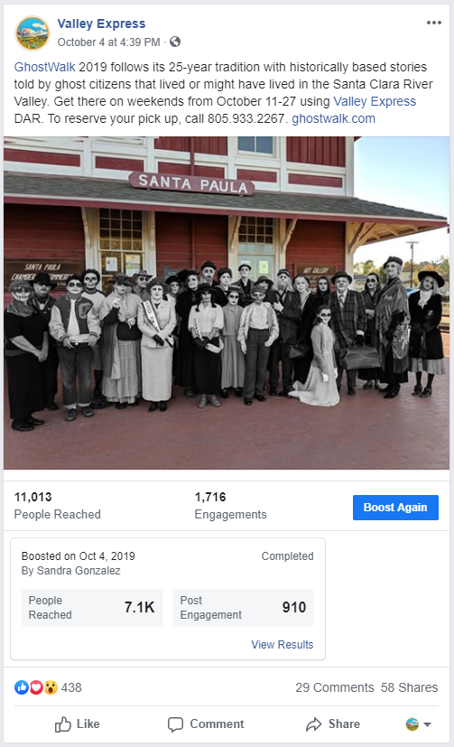
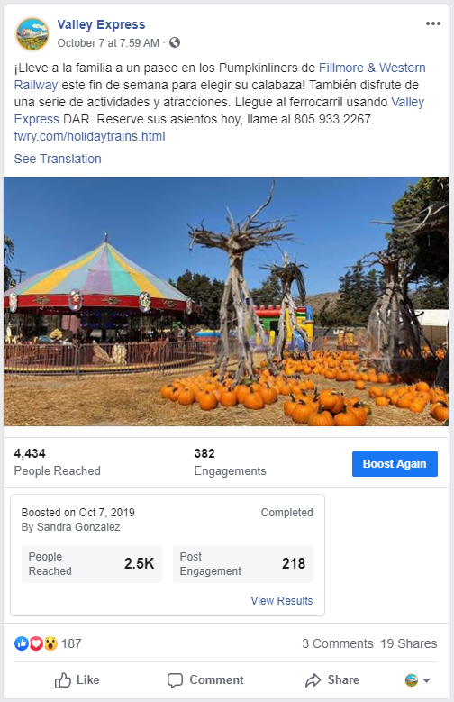
Social Media – Events/Destinations Campaign (continued)

Slide 5


Social Media – Youth Snapchat Campaign (FY20)
$ 333 Budget
138,908 Impressions
1,291 Swipes to the website
Currently In progress

Slide 6
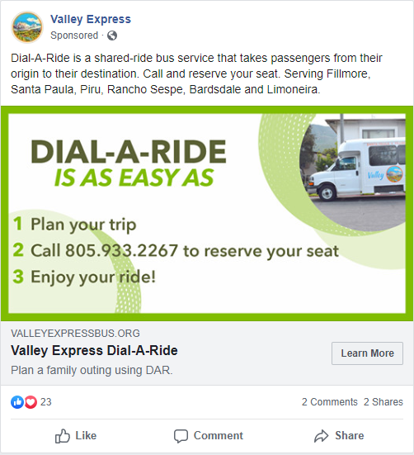
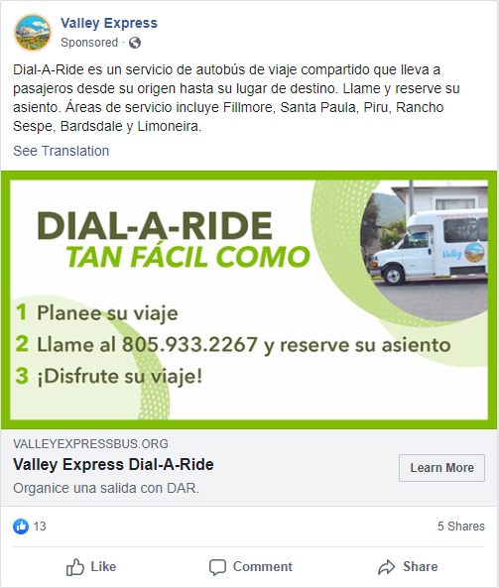
Social Media – How to Use Dial-A-Ride on Weekends
English
$ 100 Budget
3,029 Reach
5,911 Impressions
26 Clicks
Spanish
$ 38 Budget
1,835 Reach
3,761 Impressions
24 Clicks

Slide 7
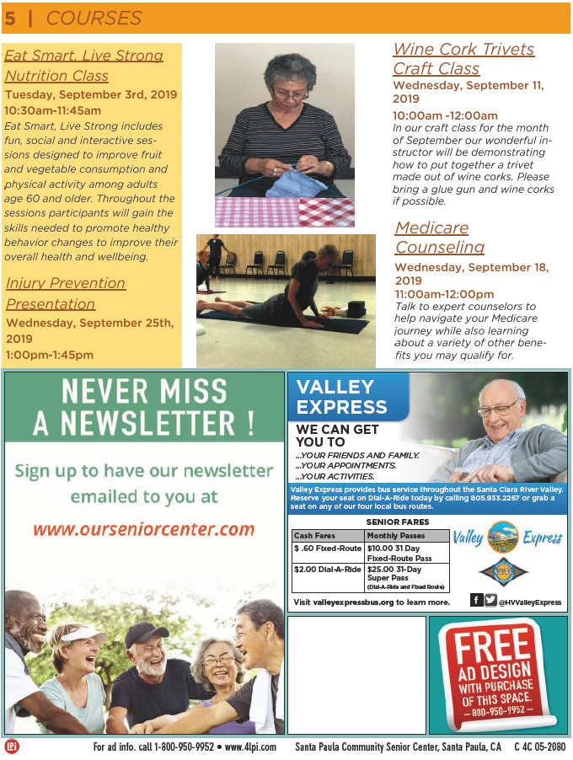
Santa Paula Senior Center Newsletter – Seniors (FY20)

Slide 8
Social Media – Santa Paula vs. Fillmore High School Rival Game
<<< RIVALRY GAME
$ 333 Budget
138,908 Impressions
7,831 Impressions/Day
1,291 Swipes to the website
HOMECOMING GAME >>>
In Progress

