Slide 1
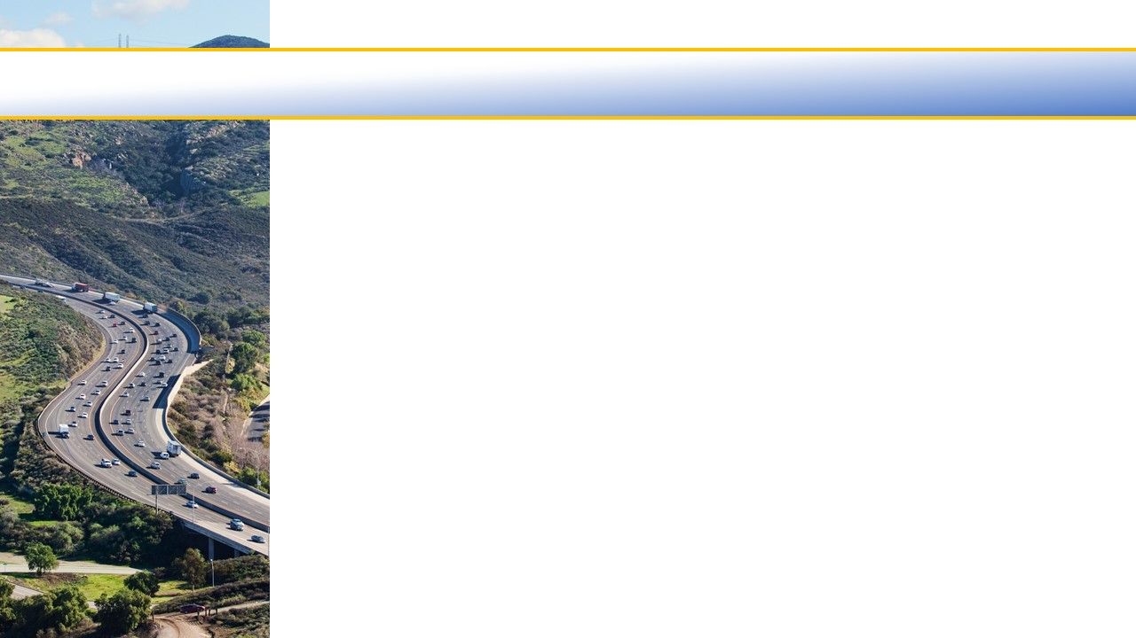

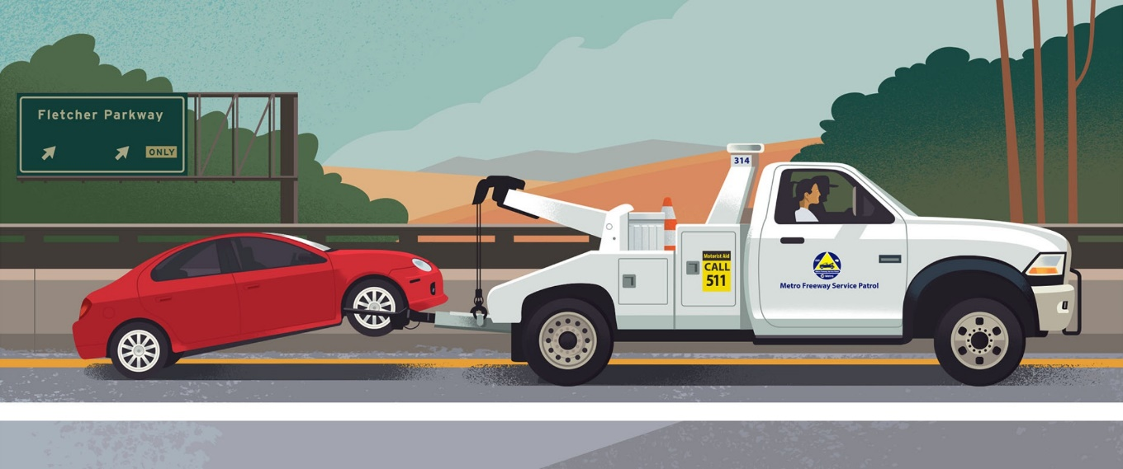
Service Authority for Freeway Emergencies
Freeway Service Patrol (FSP) Application
&
25% Local Match Resolution 2019-07
December 6, 2019

Slide 2
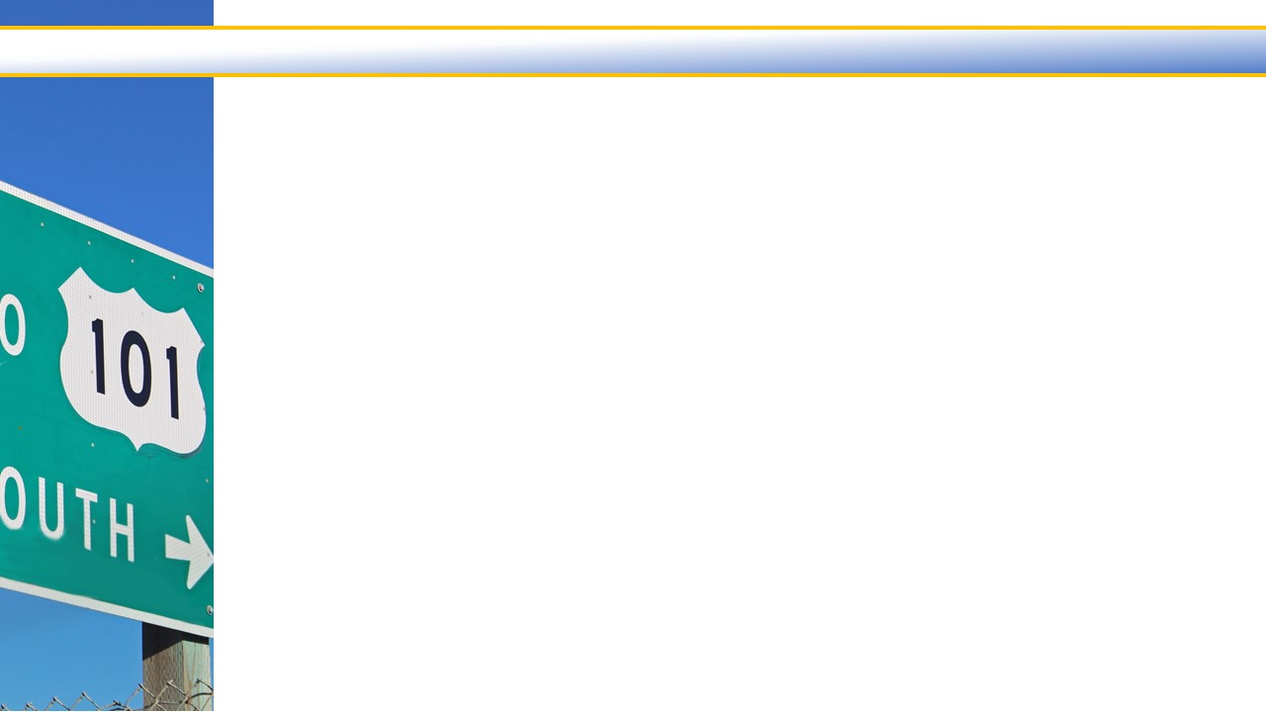
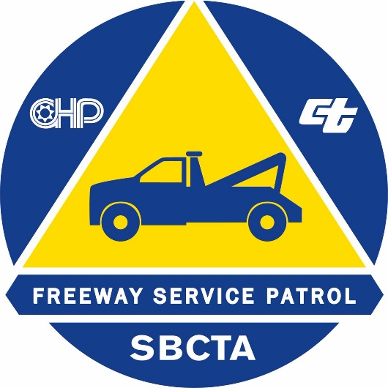
Freeway Service Patrol
A FSP program provides roving tow and/or service trucks on the highway network during peak traffic periods for rapid clearing of disabled vehicles and motorist assistance.
The implementation of FSP is through a partnership between Caltrans, the California Highway Patrol (CHP), and a local transportation agency such as SAFE.
To obtain funding for FSP requires demonstrating a 3:1 Benefit/Cost ratio and committing to a 25% local match for state funds.
SAFE

Slide 3
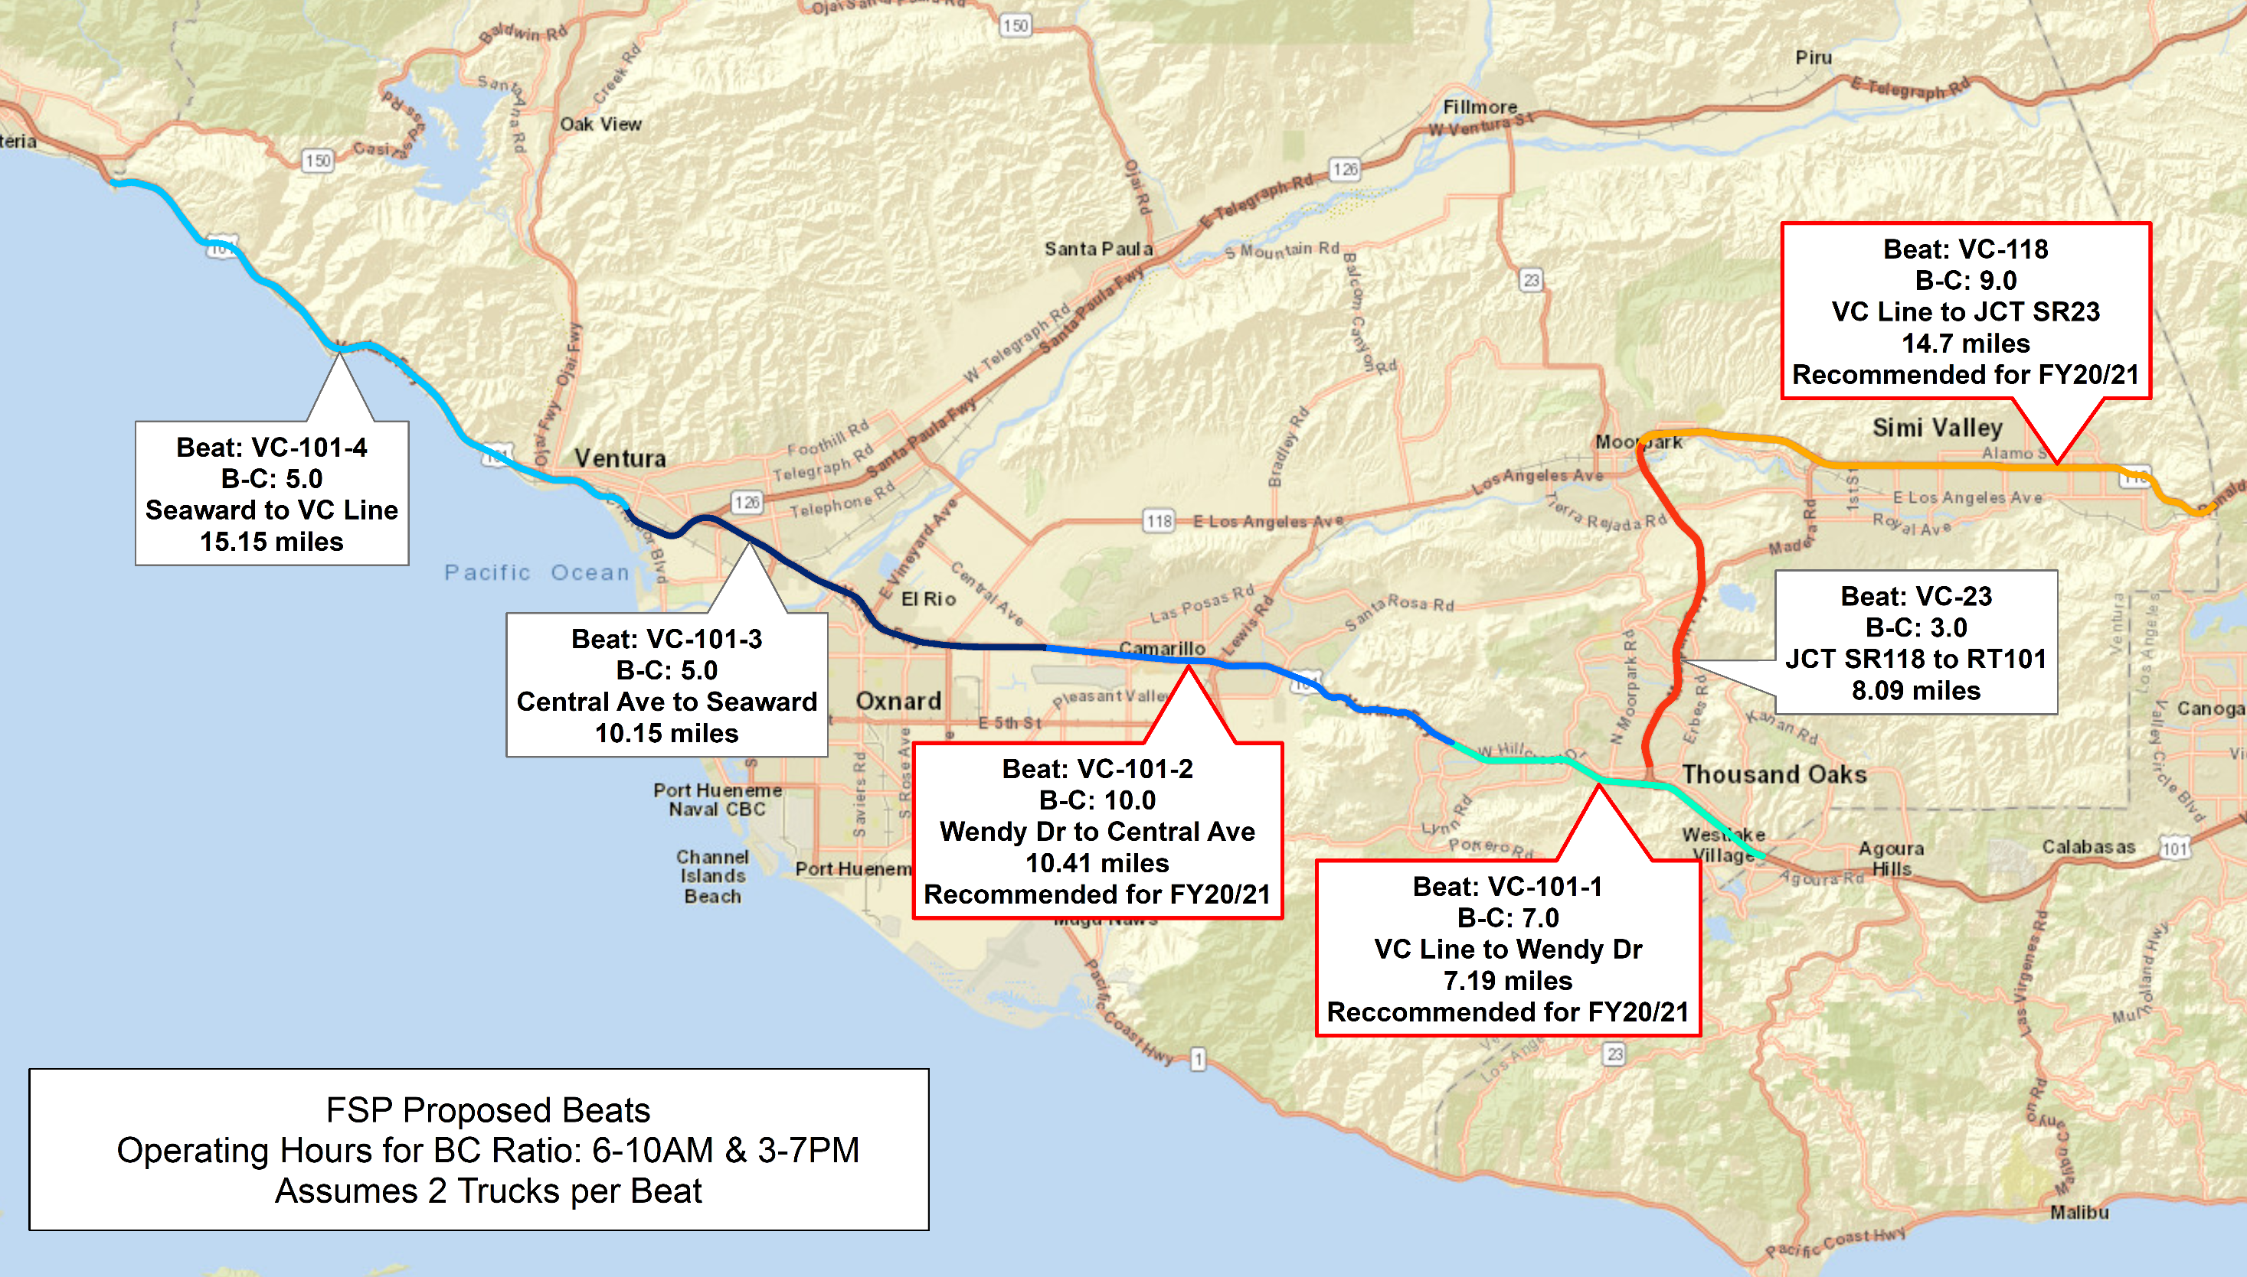
FSP Beat Design

Slide 4
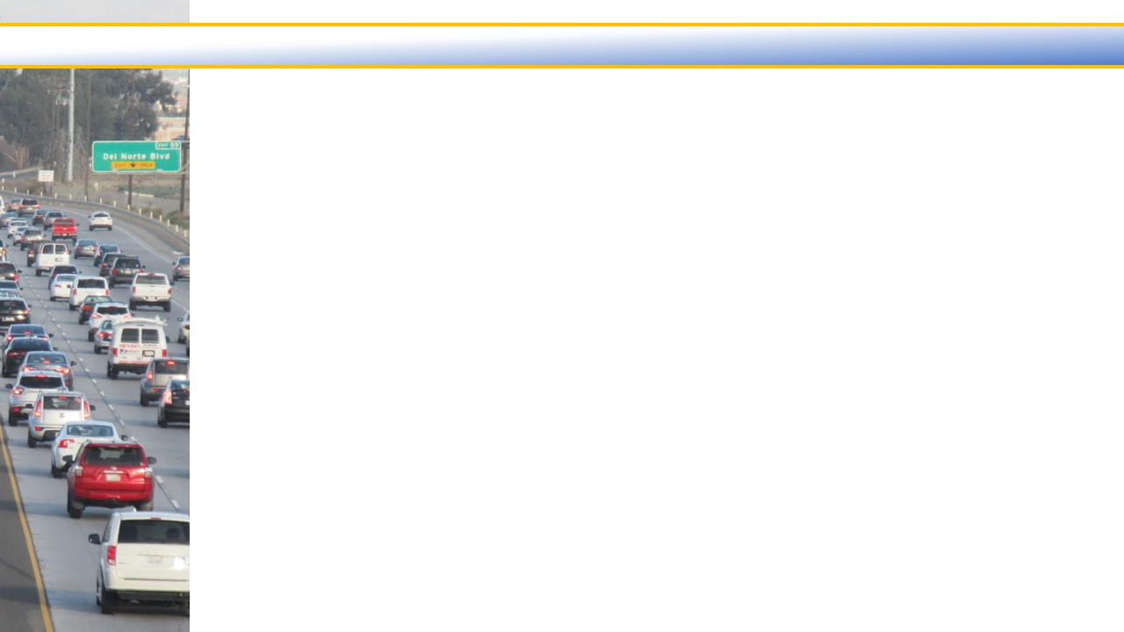
FSP Benefit/Cost Analysis

Slide 5
Next Steps

Slide 6
Service Authority for Freeway Emergencies
Freeway Service Patrol (FSP) Application
&
25% Local Match Resolution 2019-07
December 6, 2019

