Slide 1
Microtransit and TNC Partnerships
Philip Law
Manager, Transit/Rail
October 10, 2019

Slide 2
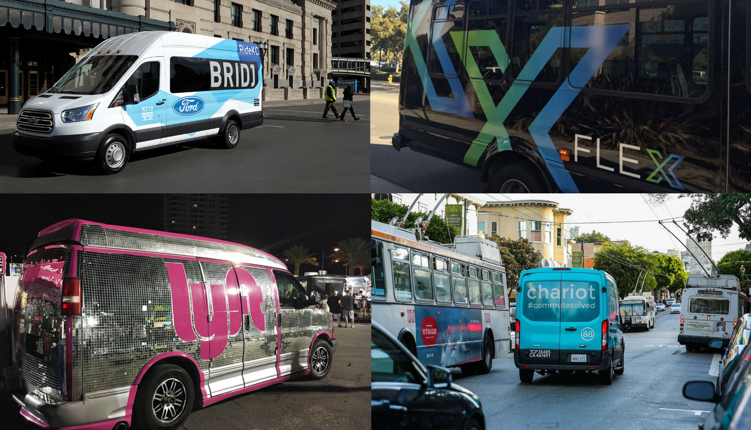
Presentation Outline
Microtransit
  Early Private Ventures and Public Pilots
  Analysis and Areas for Further Study
Transportation Network Companies
    Benefits and Impacts
    Partnerships
Photo credit: TransitCenter

Slide 3
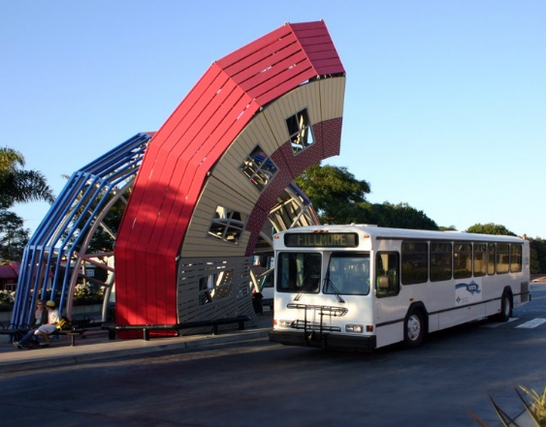
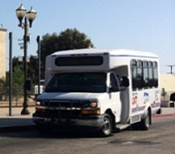
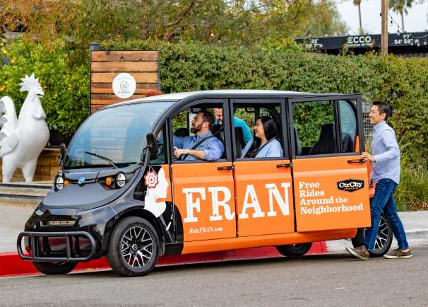


Continuum of Transportation Services
Fixed Route Transit
Bus
Rail
Demand Responsive Transit
Dial-a-Ride
ADA Paratransit
Deviated Fixed Route
Private shuttles
Microtransit
Bridj, Chariot
Flex LA
OC Flex
FRAN
Ridesharing,
Dynamic Carpool
Uber Pool
Lyft Line
Waze
Taxi or TNC
Yellow Cab
Uber X
Lyft
Photo credits: VCTC, Camarillo Area Transit, Autonomous Vehicle Technology, UC Davis, NY Post

Slide 4
What is Microtransit?
A service model that sits between traditional fixed-route transit and services provided by taxis and transportation network companies (TNCs) like Uber and Lyft
Technology enables flexibly created routes and on-demand scheduling
Ad-hoc pickup and drop-off points, within a few minutes’ walk of multiple customers
Generally limited service zones
Vehicles can range from large SUVs to vans to shuttle buses
Vendors include Transloc, DemandTrans, Via, Transdev
Shared-Use Mobility Center
https://sharedusemobilitycenter.org/what-is-shared-mobility/

Slide 5
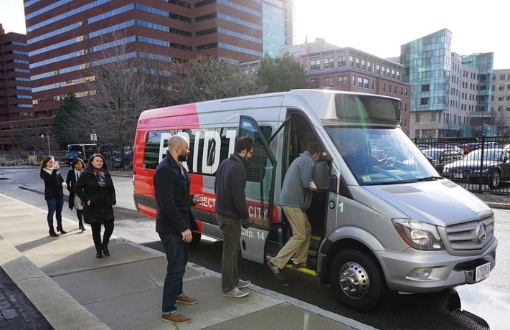
Bridj
Began in 2014 in Boston to provide options in underserved parts of city
In 2016, chosen to operate RideKC pilot in Kansas City
  $1.3 million
  Used Bridj app with transit agency vehicles and drivers
  Only 1,480 riders in one year pilot
Ceased US operations in 2017 but now operating in Sydney, Australia
Photo credit: Mobility Lab

Slide 6
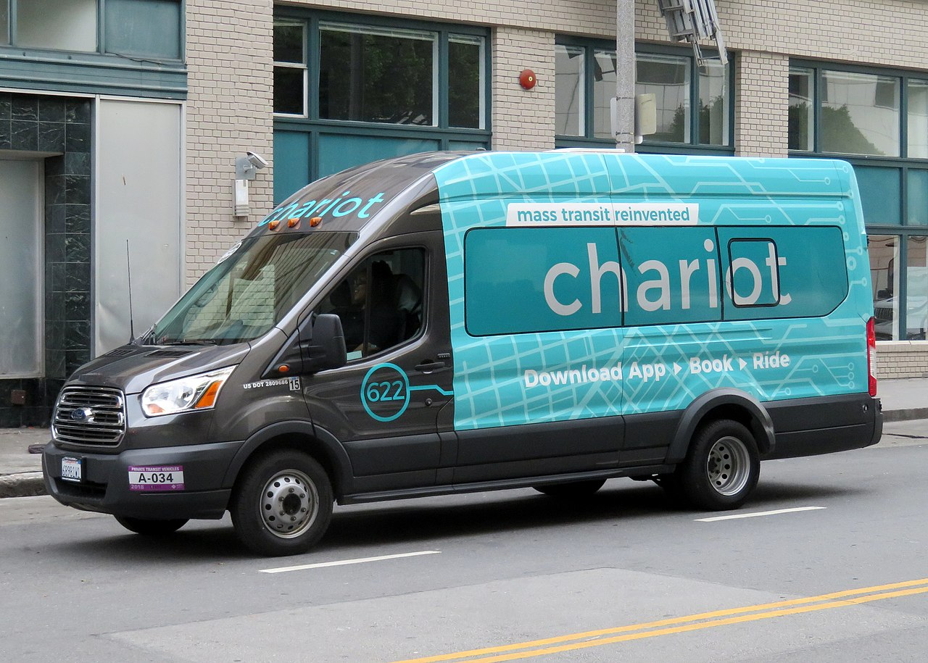
Chariot
Began in 2014 in San Francisco
Weekday morning and evening commute hours
14-seat vans on fixed routes
New routes determined based on demand
Ran in 10 metro areas including Austin, Chicago, Denver and New York
Acquired by Ford in 2016 for reported $65 million
Ceased operations in February 2019
Photo credit: Wikipedia user Pi.1415926535

Slide 7
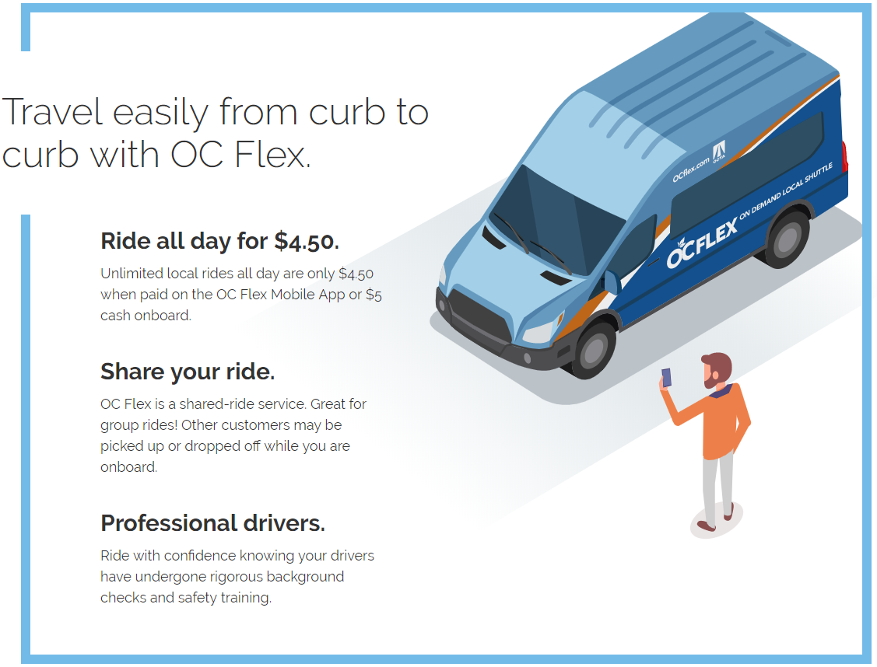
OC Flex
Began October 2018
One-year pilot, $1.15 million
Two service zones
Vans carry up to 8
$4.50 app/$5 cash
Free connections to/from OC Bus and Metrolink
Goals:
  Coverage & equity
  Reduce costs, VMT
  Extend reach of fixed route/Metrolink
  Meet customer needs
Photo credit: OCTA

Slide 8
OC Flex – Key Metrics in First Six Months
In March 2019:
Goal | Measure | Target | Outcome
Productivity | Boardings per revenue hour | 6 | 1.7
Cost Effectiveness | Subsidy per boarding | $9 | $30.30
Shared Rides | % of bookings share a vehicle | 25% | 23%
Connecting Transit Trips | % of trips transfer to/from OC Bus or Metrolink | 25% | 29%
Customer Satisfaction | % of survey respondents “likely” or “extremely likely” to recommend OC Flex | 85% | 89%

Slide 9
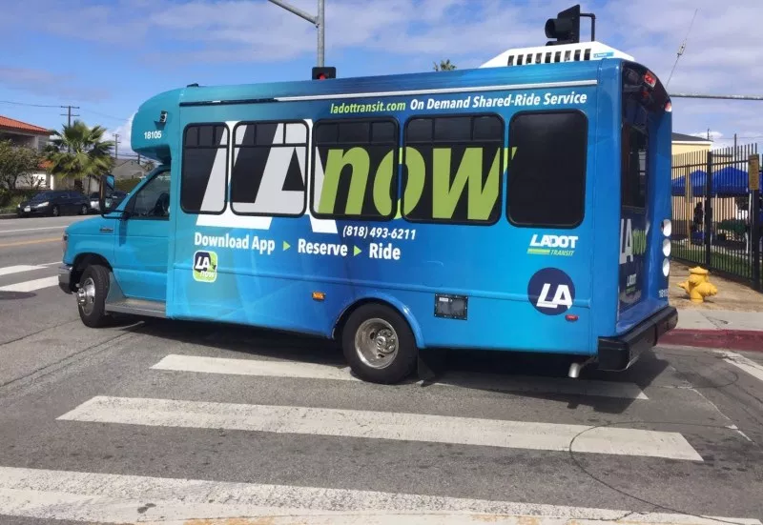
LAnow
Began March 2019
Serving Palms/Mar Vista/Venice, Expo Line station
M-F, 6am-7pm
$1.50 one-way, $0.75 seniors/disabled
Book on mobile app, website or call
Pools riders at pick-up/drop-off locations
Photo credit: Streetsblog LA

Slide 10
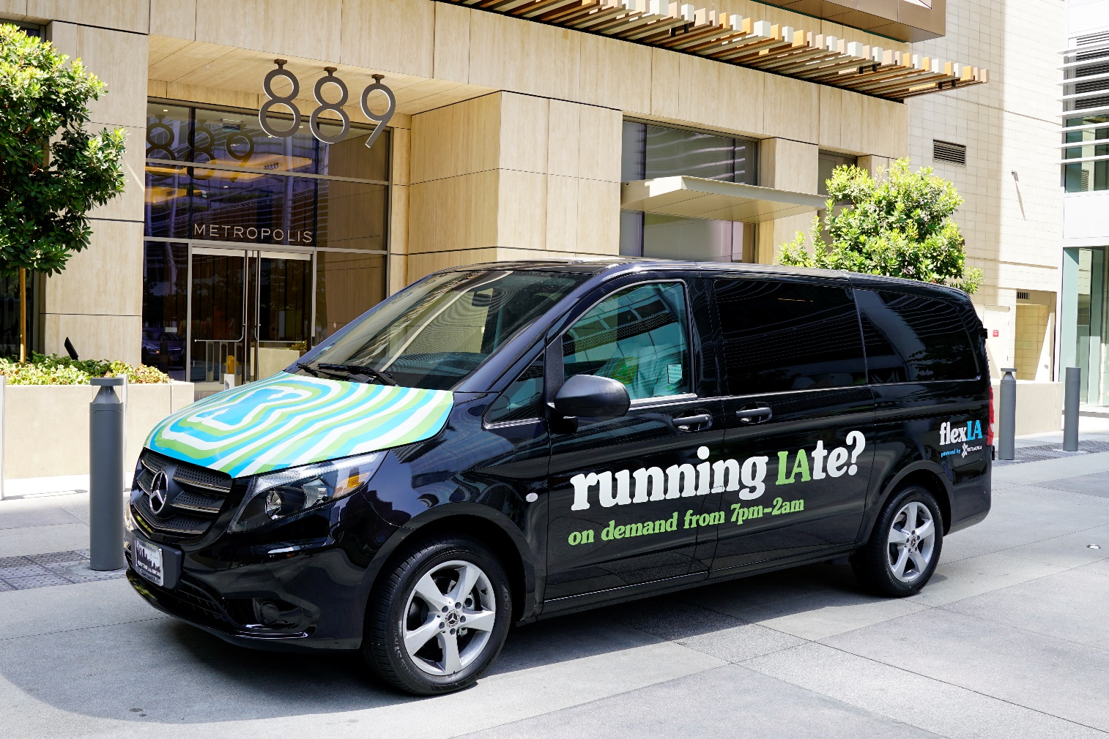
FlexLA
Began October 2018 in Downtown LA
FASTLinkDTLA in partnership with moovel
$2 per ride
4pm to 2am
Butterfli provides wheelchair accessible rides
Low income users can register to ride free
Photo credit: TaaS Magazine

Slide 11



LA Metro – Three Microtransit Pilots
  Pilots to begin Winter 2019
  Three vendors – RideCo, TransDev, NoMad/Via
  Short trips 1-6 miles and 20 minutes long
  Test different neighborhood typologies
  Goal to replace SOV and SOV TNC trips, act as feeder to fixed route
  Vehicles to seat 4-14, some retrofitted for ADA compliance

Slide 12
“Microtransit is a Coverage Tool, Not a Ridership Tool”
Jarrett Walker
https://humantransit.org/2018/02/is-microtransit-a-sensible-transit-investment.html
Service Type | Typical Passenger Trips/Service Hour
Urban subway | >200
Urban light rail | >100
Urban frequent bus | 40-100
Ridership-justified suburban bus | 15-40
Coverage-justified suburban bus | 10-15
General public dial-a-ride | 0-3
Microtransit pilots to date | 0-3 (3-5)*
Paratransit (senior-disabled) | 0-2
* based on more recent pilot results

Slide 13
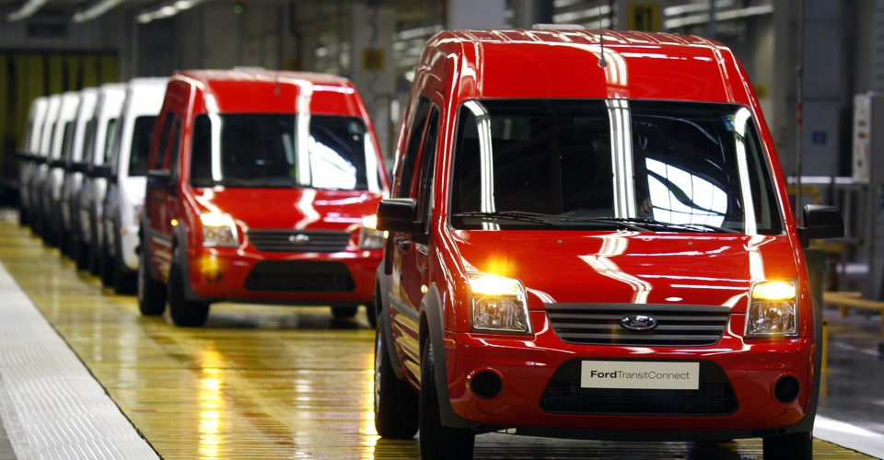
Strengths and Opportunities
Fills gaps and extends reach of transit – serving locations or times of day with lower demand
Complements fixed route transit by providing first/last mile service
Addresses jurisdictional equity, connects more communities to the regional network
Improves customer experience; introduces new riders to transit
Data represents user needs - can adjust service to better meet demand
Could become critical component of mobility-as-service
Photo credit: CityLab

Slide 14
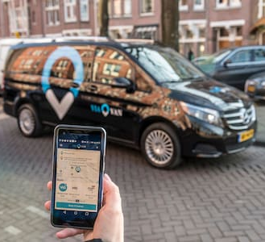
Planning and Design
Tradeoff between flexibility and productivity
  Formalizing route pattern or stops can increase riders but reduces flexibility
  Subscription services versus on-demand services
Considerations for service area size
  Cycle time (for first/last mile or feeder service)
  Number of vehicles operated
  Minimum wait time and travel time
Consider reporting requirements, e.g. NTD, when developing software specifications
Photo credit: Via

Slide 15
Lessons Learned
Microtransit or General Public Demand-Response Transit Services: State of the Practice, TCRP Synthesis 141
  Set realistic goals – low ridership service for low-density and low-demand areas/times
  Establish clear, measurable objectives
  Set small service zones – 5-7 square miles if focused on a schedule point at a major hub
  Plan for the market – understand travel patterns and configure service to meet needs
  Maintain control over the mobile app data
  Use same fare structure and fare media as fixed route service; fare integration
  Marketing and user training are critical

Slide 16
Other Resources and Notable Microtransit Pilots
AC Transit Flex (Oakland) http://www.actransit.org/flex/
SmaRT Ride (Sacramento) https://www.sacrt.com/apps/smart-ride/
APTA Mobility Innovation Hub https://www.apta.com/research-technical-resources/mobility-innovation-hub/
“The Delicate Balance of Microtransit,” APTA Passenger Transport, August 19, 2019
Eno webinar, Microtransit 2.0 – From Pilot to Transit System Integration, https://www.enotrans.org/events/webinar-microtransit-2-0-from-pilot-to-transit-system-integration-part-1/
UpRouted: Exploring Microtransit in the United States, Eno report, January 2018, https://www.enotrans.org/etl-material/uprouted-exploring-microtransit-united-states/

Slide 17

Transportation Network Companies (TNCs)
A term used by the California Public Utilities Commission; also called ridehailing
TNCs provide on-demand, pre-arranged services via mobile app/online platform
Passengers matched with drivers (using personal vehicles)
Sharing economy – vehicle is “shared” among sequential users
Gig economy – drivers work part-time, on-demand
Can involve ridesharing or pooled trips (Lyft Line, UberPool)
Photo credit: MIND-SETS Knowledge Centre (MSKC)

Slide 18
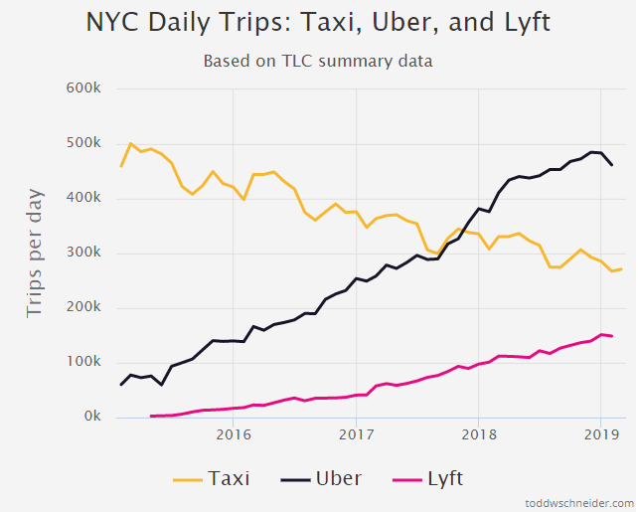
TNC Services are Popular and Growing
Uber
41.8 million US users in March 2018
10 billion trips worldwide
14 million rides per day
$82.2 billion valuation (IPO, May 2019)
Lyft
23 million users (US & Canada)
1 billion trips worldwide
1 million rides per day
$17.2 billion valuation (market cap, May 2019)
Source: Todd W. Schneider

Slide 19
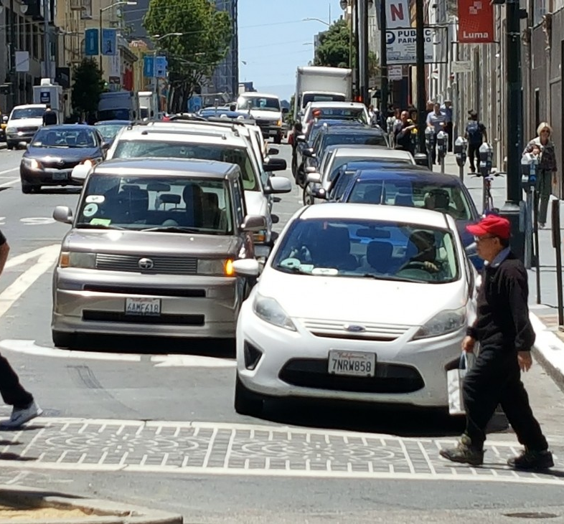
Negative Impact of TNCs
San Francisco County Transportation Authority found that TNCs accounted for roughly 50% of the increase in traffic congestion between 2010 and 2016
  Various studies report that between 43% and 61% of TNC trips substitute for transit, walk or bike travel, or would not have been made at all
University of Kentucky found Uber and Lyft decrease rail ridership by 1.3% per year and bus ridership by 1.7% per year
Photo credit: SFCTA

Slide 20
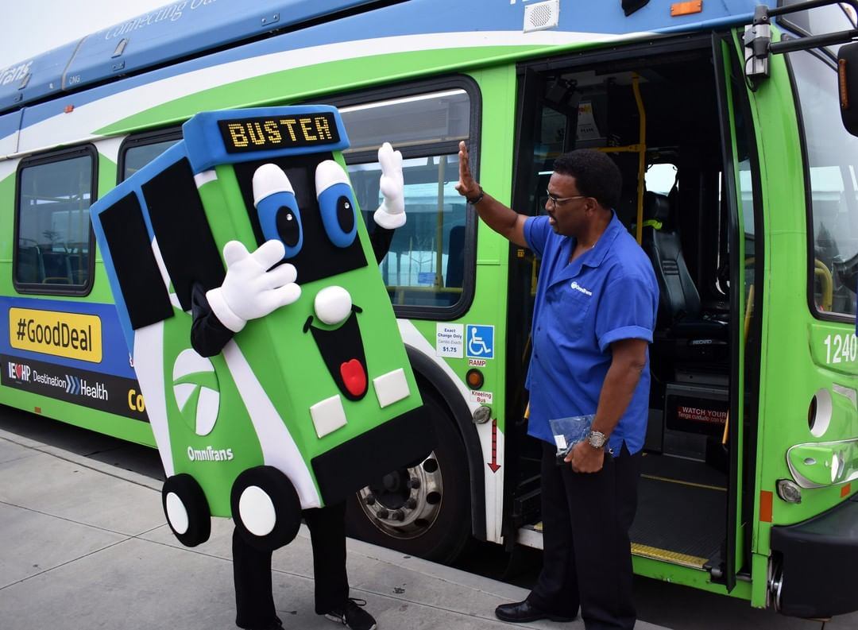
Omnitrans RIDE Taxi & Lyft Program
Provides same-day service for seniors and people with disabilities – application required
Partnership with Lyft and local taxi company, but no formal contract or agreement
$40 monthly subsidy on $80 worth of Lyft or taxi trips
Pilot began July 2016 and is ongoing
Program expenses totaled $11,000 in 2017
Photo credit: Omnitrans

Slide 21

Big Blue Bus – Mobility on Demand Every Day (MODE)
Shared-ride service for older adults and persons with disabilities
Replaces dial-a-ride program, budget remains same (approx. $600,000)
Must register with WISE & Healthy Aging, nonprofit social services organization
Cost was 50 cents per ride but increased to $1.50 in September, then $2 in January 2020 and $2.50 in 2021
Wheelchair and door-through-door members can call to schedule same day pickup in a wheelchair van

Slide 22

LA Metro – FTA Mobility on Demand Sandbox Grant
  Pilot with Via launched January 2019
  Goal to make TNC type service more accessible to all riders
  Via drivers using personal passenger vehicles
  $1.75 initially, currently free (to test price elasticity)
  No fare integration – must pay again when transferring
  Week 12 – 1.1 trips per vehicle hour, but seeing week over week increases
  Meeting KPI of 30% shared rides

Slide 23
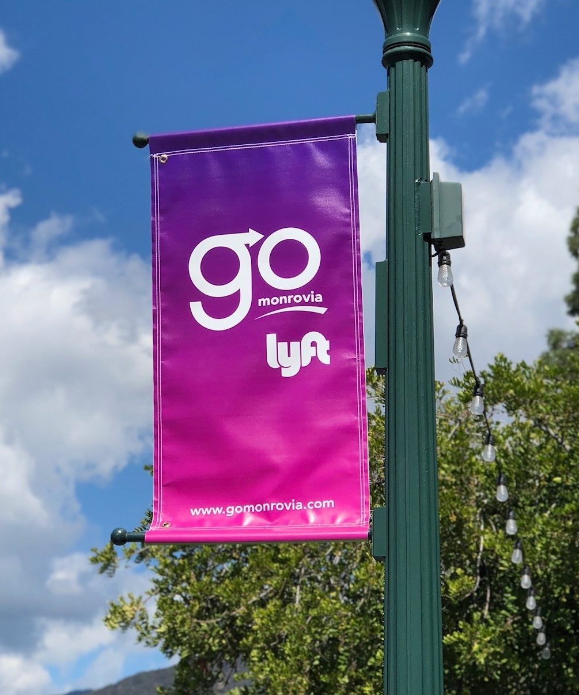
Go Monrovia
Partnership where City subsidizes Lyft rides within limited service area.
Subsidies funded by reallocated dial-a-ride operating budget ($905,000 annual)
Peaked at 70,000+ rides per month in early 2018, before price adjusments
Shared rides cost $2.50, classic rides $5
Shared rides that start/end in Old Town or Gold Line Station cost $0.50
Dial-a-ride service for ADA-related needs is available
Photo credit: Ready Artwork

Slide 24

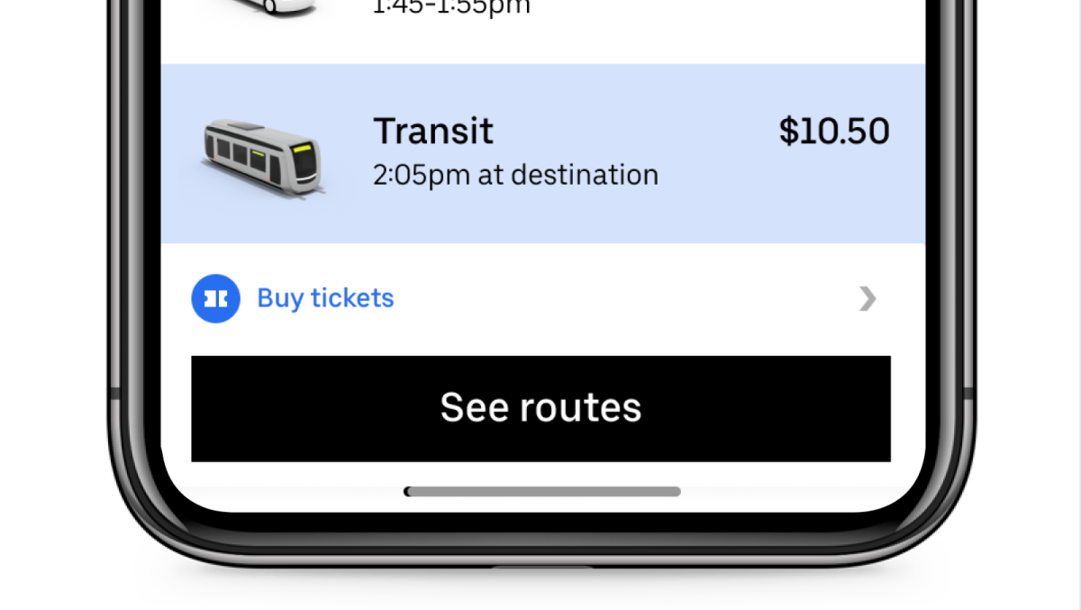
Denver RTD – Uber Collaboration
Program began January 2019, allowing users to choose transit as an option directly through the Uber app
Starting in June, program allows users to purchase and activate tickets within the Uber app
1,200 RTD tickets sold as of July, averaging 42% growth per week
Uber trips starting/ending at transit have grown 11.6%
Photo credit: RTD

Slide 25
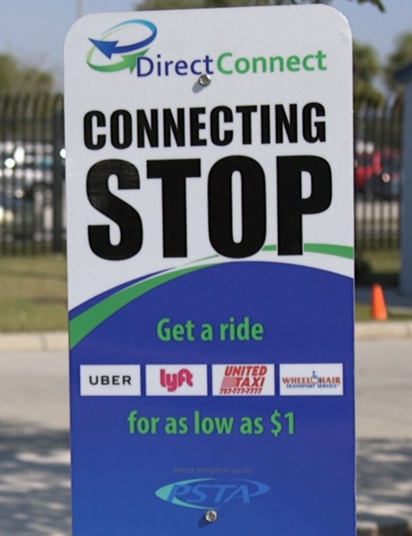
Partnerships between Transit Agencies and TNCs
TCRP Research Report 204 http://www.trb.org/Main/Blurbs/179005.aspx
Target markets – first/last mile, paratransit/dial-a-ride, suburban mobility, late night/special events, guaranteed ride home
Partnership design – mostly agency-subsidized trips, some marketing
Regulatory/policy issues – ADA equivalent service, Title VI (cash/phone options), NTD, sunshine laws, drug & alcohol testing
Photo credit: Medium

Slide 26
Other Resources
FTA Shared Mobility https://www.transit.dot.gov/shared-mobility
  FAQs re: funding eligibility, ADA compliance, etc.
Mobility On Demand On-Ramp https://sharedusemobilitycenter.org/mobility-on-demand-on-ramp-program-description/
  Free technical assistance for public transportation agencies developing innovative mobility projects
TCRP Research Report 195: Broadening Understanding of the Interplay among Public Transit, Shared Mobility, and Personal Automobiles http://www.trb.org/Main/Blurbs/177112.aspx
Partners in Transit https://las.depaul.edu/centers-and-institutes/chaddick-institute-for-metropolitan-development/research-and-publications/Documents/Partners%20in%20Transit_Live1.pdf

Slide 27
Thank You
Philip Law, Transit/Rail Manager
law@scag.ca.gov
213-236-1841

