Slide 1
Natural Gas – Part of a Balanced Energy Approach that Can Work for Everyone
Ventura County Transportation Commission
April 5, 2019
Ken Chawkins, SoCalGas Business Policy Manager
Notes:
Main Points:
California is a leader on climate change, specifically GHG emissions and renewable energy
There is an important debate happening right now about how to achieve our 2030 and 2050 emission reduction goals.
The choices we make about energy policy today will effect every Californian family and business.
Addressing this global challenge will require us to use all of the tools and resources at our disposal—including electricity and natural gas.
I’m excited to talk about how a balanced energy policy in CA that takes into account existing infrastructure, customer choice, affordability and reliability can help us make an impact here in our backyard and across the globe.

Slide 2
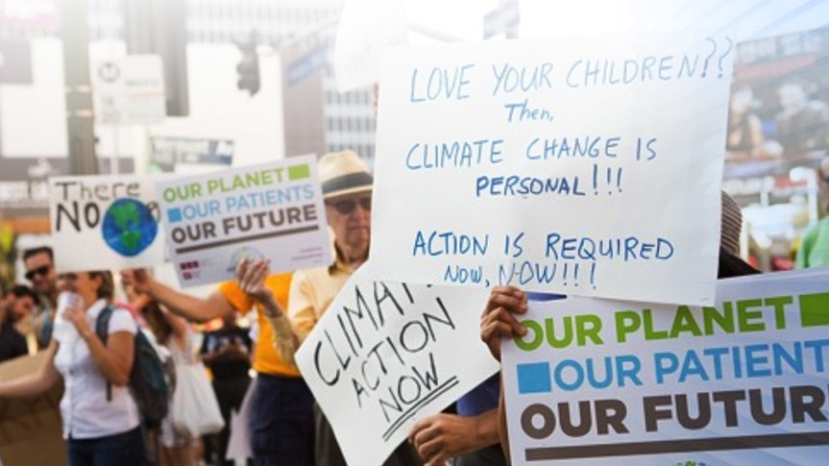
California leads the nation in setting
climate goals and policy
Governing Law – SB100
Governing Law – SB1383
Executive Order B-55-18
By 2030, obtain
60%
of electricity from
renewable sources
By 2030, reduce
methane emissions
40%
below 1990 levels
By 2045, economy-wide, become
Carbon
Neutral
2
Notes:
California leads the nation in setting the most aggressive climate goals and policies.
The state met its 2020 GHG goals ahead of time and is not slowing down.
Recently, the state established even more ambitious GHG reduction targets.
Earlier this month, Governor Brown signed into law SB100, which sets a 60% Renewable Portfolio Standard (RPS) for the state’s electricity sources by 2030; that target increases to 100% renewable electricity by 2045.
The state is also focused on Short-Lived Climate Pollutants—like methane—which represents a significant portion of the state’s plans to reduce GHG—achieving a 40% reduction by 2030.
And perhaps most significantly, this month Governor Brown also issued an executive order, committing California to total, economy-wide carbon neutrality by 2045.
We support these goals—but the state needs a viable path to achieve them.
CA is a bit unique, in that our policy environment is more aggressive than other states.
How that’s playing out is that unlike other states where natural gas is replacing coal and is seen as a positive tool in battling climate change—in California, that’s not the case. There is an active, growing effort to eliminate natural gas.

Slide 3
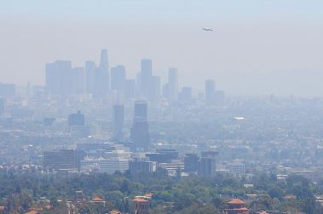
But First – Good Old Fashioned SMOG
  Two (2) Air Basins in Extreme Nonattainment for Ozone Pollution
    Extreme: 8 hour Ozone >0.175 ppm
    South Coast & San Joaquin Valley
  Pollution
    NOx => O₃ (Ozone) = Smog
    Particulate Matter (PM) – get trapped deep in lungs and potentially blood
    Causing
      Asthma
      Heart/lung disease
  Sources?
https://www.arb.ca.gov/consprod/geninfo/cpsmog.htm
Notes:
So, what does Nonattainment mean? Any area that does not meet (or that contributes to ambient air quality in a nearby area that does not meet) the national primary or secondary ambient air quality standard for a National Ambient Air Quality Standard. How do we get to ozone? The ozone is produced in our atmosphere from a reaction of nitrous oxide emissions from certain types of combustion. This pollution is not just unsightly, it is a large contributor to health problems, especially for the young and elderly. So where is all of this pollution coming from?

Slide 4
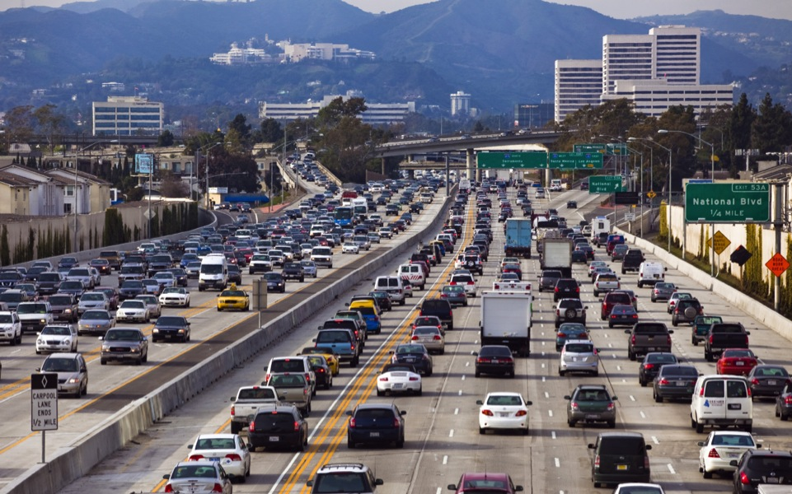
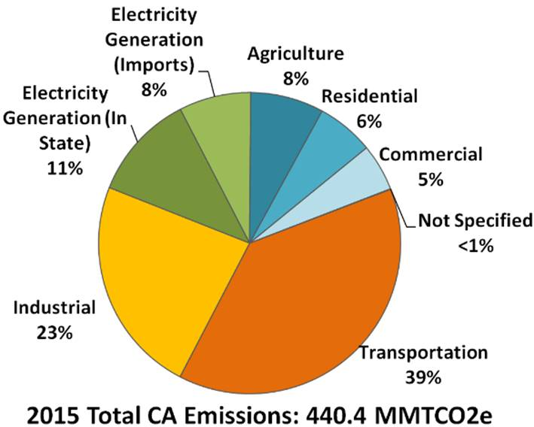

We have a
CLEAR FOCUS: Transportation
80%
of the region’s SMOG
Major Ozone (NOx) Emissions Sources
Nearly 40%
of its GHG emissions
Notes:
It’s Transportation!
The other good news is…we know what we need to do to meet the goals—we have a clear focus.
The TRANSPORTATION SECTOR is California’s biggest emissions challenge and opportunity…
More than 80% of the region’s NOx emissions or air pollution comes from the transportation sector.
This sector also contributes more than 40% of the region’s GHG emissions—the emissions that lead to climate change.
When you take a step back and think about it, it makes sense—we love our cars. Southern California’s cities were built and backed by the great industrialists of the 20th Century, who saw the automobile as the symbol of the future.
What’s less obvious, is that the largest portion of emissions in this sector come from commercial applications—big rig trucks, cargo ships and railways. If we want to make a dent in emissions, we need to think across consumer and commercial applications. And that means we have to reduce emissions without crippling commerce and our economy.

Slide 5
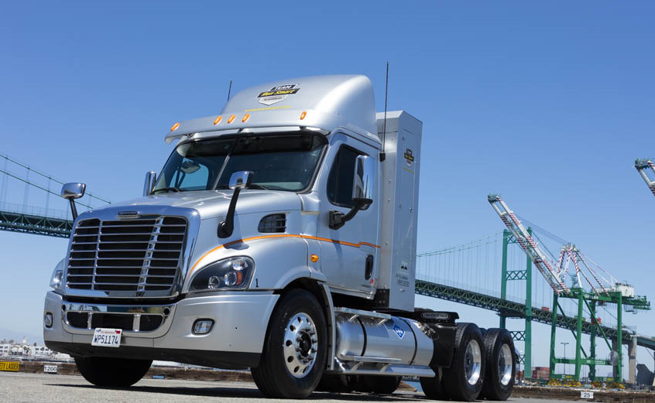
NGV Game Changer:
NEW “NEAR-ZERO” TRUCK ENGINE IS READY FOR PRIME TIME
  Heavy Duty truck engine with 90% lower NOx emissions TODAY
  Tailpipe emissions are the same as emissions from generating electricity to run a similar electric truck
For Goods Movement, this truck will meet California’s ambitious 2050 targets decades before any other technology
  RNG already delivering greatest GHG reductions from diesel TODAY
Near-Zero Emissions
Natural Gas Engine
<0.02 g NOx
90% NOx reduction
Renewable Natural Gas as Transportation Fuel
> 80% GHG reduction
Notes:
NGV Game Changer: New “Near-Zero” Truck Engine to be Ready for Prime Time

Slide 6
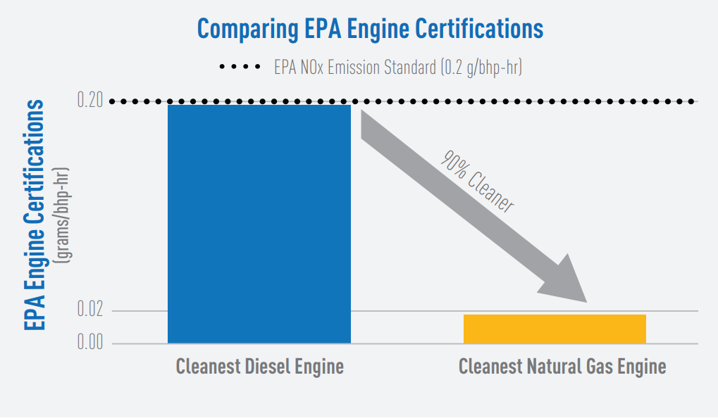
Switching Away from Diesel
Source: http://www.cert.ucr.edu/research/efr/NOx-Fact-Sheet.pdf
Notes:
This figure comes from UC Riverside, and it shows just how much NOx we can avoid by switching away from dirty diesel engines to the cleanest burning engines using natural gas. The same fuel that heated the water for your shower this morning, and you use in your house for cooking and space heating can power the heavy duty engines traveling on our highways delivering goods and people.

Slide 7
Now – Let’s talk about GHG reduction…and Renewable Gas
Cap & Trade
37.9%
Short Lived Climate Pollutant Plan
34.9%
Stated Objective:
Methane
62%
“Reduce the use of heating fuels while concurrently making what is used cleaner by minimizing fugitive methane leaks, prioritizing natural gas efficiency and demand reduction, and enabling cost-effective access
to renewable gas.”
Energy Efficiency 10.3%
Biofuels (LCFS)
4%
Mobile Sources 10.3%
50% RPS
2.6%
  Source: Percentages reflect reductions proposed in California Air Resources Board, AB 32 Updated Scoping Plan (2017)
Notes:
Main Points;
CARB recognizes this challenge in their current Scoping Plan—it’s the state’s roadmap to achieve the 2030 emissions reduction targets.
More than a third of the state’s plan to reach the 2030 goals relies on reducing short-lived climate pollutants like black carbon (released from wildfires) and methane (from agriculture, dairies and landfills)
In fact, 62% of the SLCP goal comes from reducing methane. So clearly, we need a way to address emissions from the sectors emitting the most methane emissions.
RNG gives us an actionable way to meet CA’s environmental law while also harnessing that waste for clean, renewable fuel.

Slide 8

And RNG gives us a clear path to address CA’s
biggest methane
emitters
Source: CARB 2015 Greenhouse Gases Emissions Inventory, 2013 Methane Emissions
Notes:
Main Points:
That’s important because these emissions are a huge part of CARB’s scoping plan.
Over 80% of the state’s current methane emissions come from dairies, landfills and wastewater.
Capturing 40% these emissions is required by CA law SB1383 and is a key part of CARB’s scoping plan.
RNG gives us an actionable way to meet CA’s environmental law while also harnessing that waste for clean, renewable fuel.

Slide 9
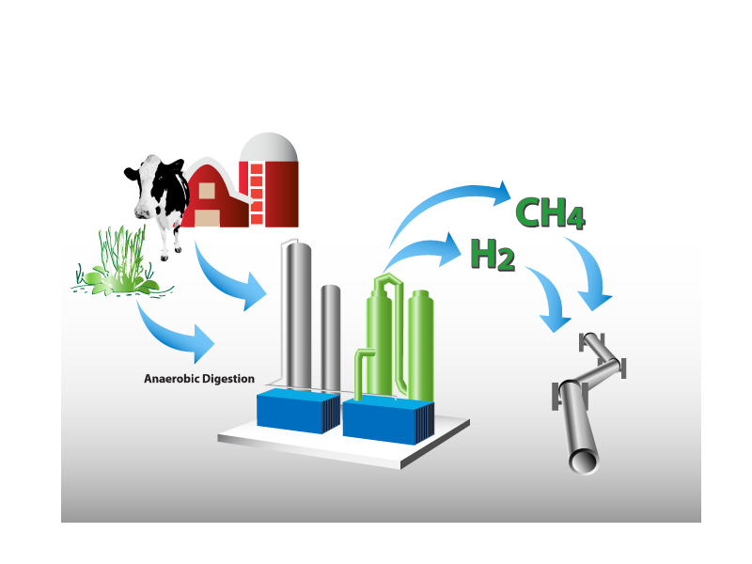
Biogas to Renewable Gas Pathways:
De-carbonizing the Pipeline
Notes:
Decarbonizing the Pipeline: Biomethane/Renewable Natural Gas.
Moving from geologic to biologic gas supply.
This shows digester gas production, with the extra step of injection into the existing natural gas pipeline system and mixed with the other gas supplies.
First focus is on moving existing biological resources into the pipeline in the short- to mid- term. The next focus is on purpose grown crops – switch grasses and algae – in the mid- to long-term. This longer-term approach is consistent with ARB’s bio diesel pathway in the AB 32 Scoping Plan.
Studies suggest current available biological resources – dairies, agricultural waste, woodland waste, urban waste, landfills, waste water treatment – could potentially displace 20% of our throughput. That’s effectively 20% de-carbonization. Currently probably 5% is economic, so we have a long way to go to solve the problems of moving biogas into the pipeline. Key problems include heat content – BTUs, constituent elements and location
– needed pipeline infrastructure to connect biologic supply with the pipeline system.
Studies indicate that the longer-term pathway – purpose grown crops on non arable land
– could also displace up to 20% of our throughput.

Slide 10
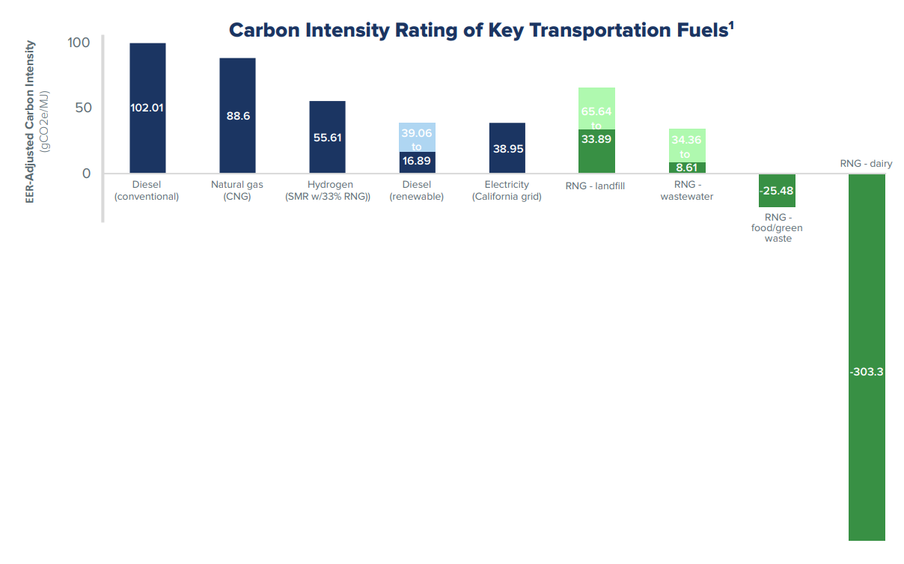
Renewable Natural Gas: a Game Changer Fuel
  Technology available now to reduce NOx and CO₂
RNG has the lowest carbon intensity rating of key transportation fuels and can reduce greenhouse gas emissions by 40 to 125% or more.
RNG is over 60% of the supply of CNG used in transportation
1: http://www.arb.ca.gov/fuels/lcfs/fuelpathways/pathwaytable.htm, CARB, February 2017.
Adjusted for heavy-duty truck applications, Adapted from https://cdn.ngvgamechanger.com/pdfs/game-changer-technical-fact-sheet.pdf
Notes:
Here’s another way to look at the ARB data. RNG from dairy feedstocks has the lowest carbon intensity. And since California is home to 1.73 million milk cows, we have a pretty good feedstock for dairy RNG.
Now for an interesting fact: in 2016, the University of California-Davis in conjunction with the U.S. EPA found that anaerobic digestion of readily available California organic waste (dairy manure, landfill gas, municipal solid waste and wastewater) could potentially produce nearly 675 million DGE per year of RNG, or enough RNG to fuel 31 percent of California’s Class 8 heavy-duty trucks. This means that California has a path to replace nearly a third of the fuel for our heavy duty trucks before we need to import RNG form other sources. As an investment in California RNG, SB 1383 directed the California natural gas utilities to work on 5 pilot projects in the state to connect a cluster of dairy farms to a RNG processing facility, and inject the RNG into the natural gas system. From poop to pipeline!
http://www.californiadairypressroom.com/sites/default/files/CA_Dairy_leader_fact_sheet_May2018_v1.pdf

Slide 11
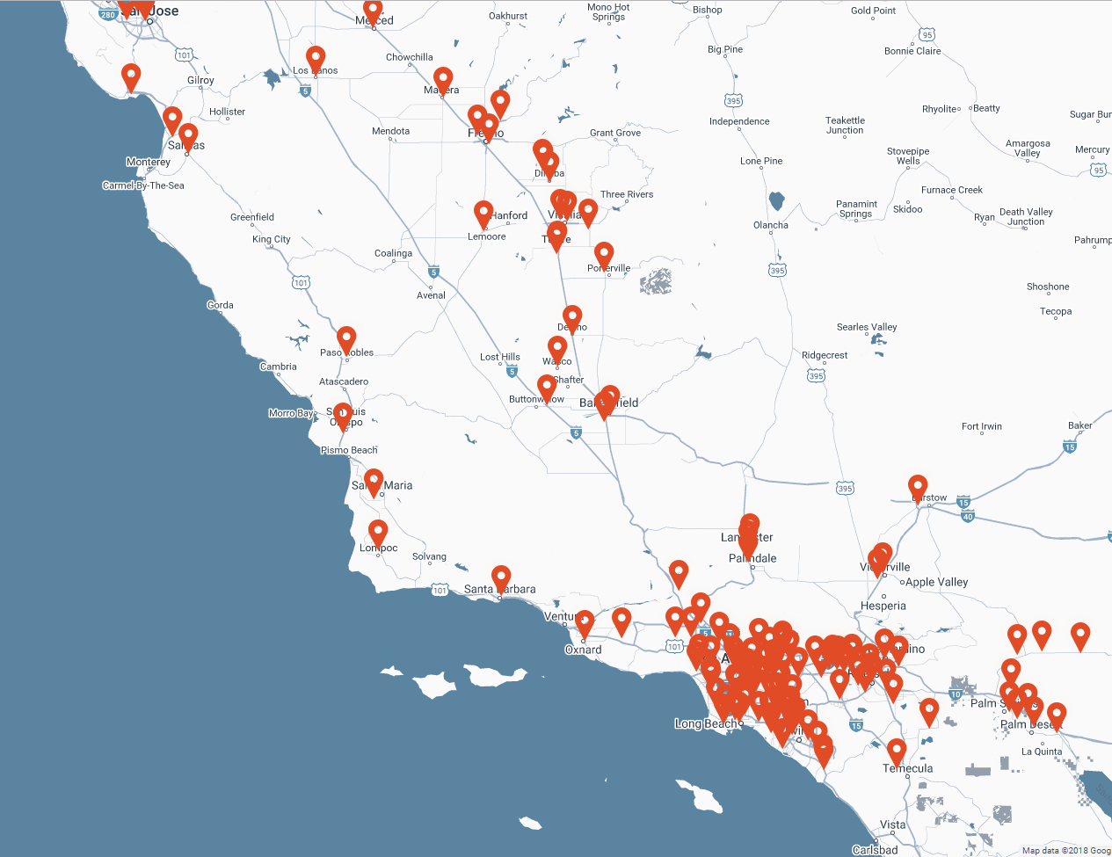
CNG Fueling Infrastructure
378 stations in CA
165 are open to the public
Grant financing available for CNG station building
CNG does not have time dependent premium pricing
Map source: https://maps.cngnow.com/search/california
Notes:
Finally I’d like to show you just where these stations are located, because one of the biggest concerns we all have with alternative fuels is range anxiety. I’ve personally made a trip from Los Angeles, to Fresno, to San Diego, and home in a CNG Honda Civic.

Slide 12
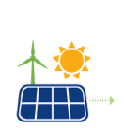
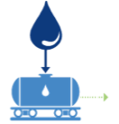
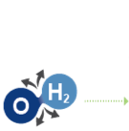
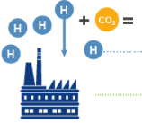
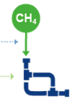

Power-to-gas
converts excess renewable electricity
into renewable natural gas
excess
renewable energy
goes through
electrolysis
which splits
the molecule
hydrogen & carbon combine through methanization
methane can be
stored in the pipeline for future use
carbon captured from factories and plants
Notes:
MAIN POINTS:
Power-to-Gas technology offers a solution to the storage challenge.
Here’s how power-to-gas works.
Currently, CA frequently overproduces electricity from solar and wind generation during the day and has to either dump it or pay other states to take it from us.
Rather than losing the excess electricity that is generated from wind and solar fields, we combine it with water and put it through electrolysis.
The electrolysis process converts the electrical energy into chemical energy and splits the molecules into pure Hydrogen and Oxygen. The Oxygen can be sold and used for other applications—such as healthcare.
The hydrogen gas can be used as a fuel. Or, some of it can be stored in our existing pipelines. Or, we can combine the Hydrogen with CO2 and run it through the process of methanization to create methane—and store this renewable energy in our natural gas pipeline.
Here’s another cool aspect of this process. The CO2 can be supplied through carbon capture technologies—so CO2 emissions from industrial plants that would normally be released into the air can be repurposed in this process to form clean, renewable natural gas. Again, we have a case of double the environmental benefit.
The clean, renewable methane produced through the power-to-gas process can be stored in our existing pipeline system for use when people need it. That means the infrastructure is already in place to store and deliver the renewable energy.

Slide 13
Power-to-gas
provides green hydrogen pathway and grid storage
70 Projects Now Launched In Europe
40 Projects Launched in Germany, with more in development
30 MW of
installed capacity
Operational
Planned
Project Finished
Hydrogen
Methane
Hydrogen/Methane
Notes:
Main Points:
We’re confident in Power-to-Gas technology because Europe—mainly Germany—is ahead of the curve and demonstrated its value.
In Europe, countries are looking at renewable electricity and renewable gas to deliver the energy needs of the building sector.
Right now there are more than 70 projects launched in Europe.
The UN Climate Change Council and the World Green Building Council are setting goals for buildings to achieve net zero carbon – NOT net zero energy or zero emissions – by 2050.
They are demonstrating the tremendous potential when you integrate your energy system and look at opportunities across the whole.

Slide 14
Recap
  Natural Gas in Transportation
  Environmental advantages over diesel / NOx and GHG
  Next-generation Low-NOx CNG engines – Available NOW
  CNG range and performance equivalent to diesel
  RNG – from zero to negative carbon
  Power To Gas – Uses NG pipelines as grid scale storage and enables renewable energy
Notes:
While you think of your questions I’d like to just go over what we discussed. First of all, diesel and all of that pollution has to go. We can do that with natural gas engines. These brand new low-NOx engines can replace the power and the range all with the same emissions we get coming out of the power plants in California. If these vehicles are fueled with RNG, which can be bought today, these vehicles can be carbon neutral or even carbon negative. In California today, RNG is over 60 percent of the transportation natural gas consumed. So when you are working with customers who are considering construction projects, contracting for services, or even their own heavy duty vehicle operations, consider natural gas vehicles, or companies who are operating natural gas vehicles. CNG vehicles are a smart sustainability solution that is affordable and available right now.
Lastly, I want to thank you, the Southern California chapter of AEE for the opportunity to share this exciting new sustainable transportation story.

Slide 15
What can you do?
  Ask hard questions about environmental directives.
    What’s the goal? What are the impacts? What’s BEST way to get there?
  Challenge assumptions – Is electrifying everything the best use of public $?
  Pursue “All of the Above” approach as most effective way to achieve goals.
  Ask your constituents what they want in terms of policy/energy use.
  Ask what else is happening in the rest of the world.
  You don’t have to choose between good solution and affordability!

Slide 16

Thank
You
Notes:
Thanks for listening and I’m happy to take any questions you have for me.

