Slide 1

Ventura county transportation commission
Item #13: 2019 COMBINED CALL-FOR-PROJECTS FOR FTA SECTION 5310 LARGE URBAN AREA (SENIORS AND DISABLED) & SECTION 5307 JOBS ACCESS/REVERSE COMMUTE (JARC) FUNDS

Slide 2
Federal Transit Administration Funding
Section 5310 $816,000 – Enhance mobility for seniors & persons with disabilities beyond traditional public transportation services and beyond requirements of ADA
Section 5307 Jobs Access/Reverse Commute (JARC) $526,000 - improve access to employment and employment related activities for eligible low-income individuals
STA
LTF

Slide 3
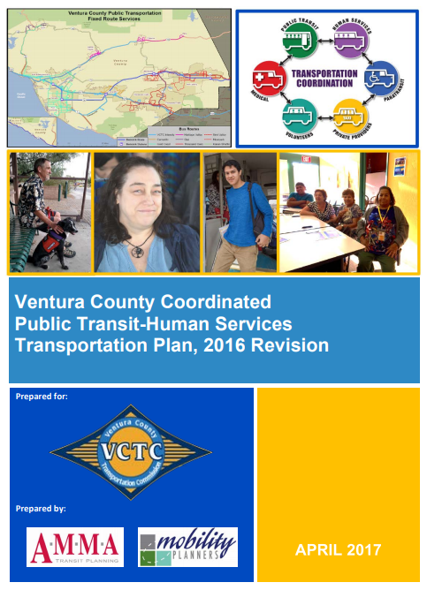
Project Eligibility
Projects must fall within the recommendations of VCTC’S Coordinated Public Transit-Human Services Plan

Slide 4
One-Call/One-Click Program
High Priority in the Coordinated Plan
Purpose: to enable customers to make one phone call or search one website to receive information about all transportation services available in the County
Program Scope: VCTC has been working with Interface Children and Family Services (Ventura County’s 211 operator) to define a scope of work and cost estimate for the program that meets Ventura County’s needs
Recommendation:
  Reserve $437,000 for the one-call/one-click program to be operated by Interface Children and Family Services contingent upon an approved application

Slide 5
2019 Competitive Call-for-Projects
Available Funding:
  Section 5310 -- $379,000
  Section 5307 -- $526,000
Projects must meet Screening Criteria:
    Project Eligibility
    Planning Consistency
    Financial Feasibility
Projects will be ranked based upon the scoring criteria included in the 2019 Call-for-Projects Guidelines in the agenda

Slide 6
Call-for-Projects Schedule
April 11, 2019 | Call-for-Projects Announced
May 21, 2019 | Applications Due to VCTC
July 11 , 2019 | Review by Transit Operators Committee
July 12, 2019 | Approval by VCTC
December 31, 2019 | FTA Grant Approval

Slide 7
QUESTIONS?

