Slide 1

Ventura County transportation Commission
Fiscal year 2019/2020 draft budget
April 5, 2019

Slide 2
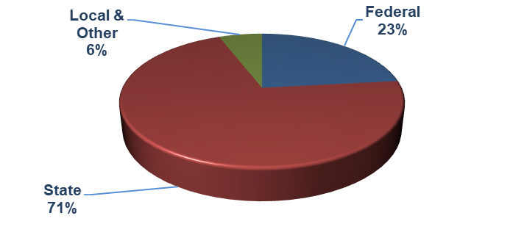
Budget Highlights
  $77.4 million Balanced Budget using reliable and sustainable revenues
  Revenue Sources

Slide 3
State of Transportation Funding
Federal Funding:
  Fixing America’s Surface Transportation (FAST Act)
  - 2015-2020
  Continued borrowing to keep Federal Highway Trust Fund solvent
    Only approved through 2020
  Fiscal Year 2018/2019 Federal Budget
    Transportation formula funds approved at higher level for
    a second year in a row
  Administrations Infrastructure Proposal – No traction
  - $1.5 billion investment leveraged from $200 million federal funding
  Bottom Line
    - Do not expect anything new from Federal Government

Slide 4
State of Transportation Funding
State Funding:
  Proposition 1B funds
  - Completely allocated – No new funding
  SB 1 (Beall), Road Repair and Accountability Act of 2017
  - $52.4 billion statewide over 10 years in new transportation revenues
    “Fix it First” emphasis with significant shares going to Caltrans, Counties
    and Cities for road repair
      Proposed AB 1568 would make local funds contingent on housing
  - State Transportation Improvement Program (STIP) is stabilized but no
  significant increases
  - Funding for Transit Operations and State of Good Repair for capital assets
    Establishes Competitive Grant Programs including:
      Congested Corridors
      Trade (Freight) Corridors
      Active Transportation (bicycle and pedestrian)
    Local Partnership
      VCTC not eligible due to lack of transportation sales tax measure

Slide 5
State of Transportation Funding
What SB 1 means to VCTC’s Budget:
  Direct Impacts:
    Transit Operations - $2.8 million
      Funds to sustain existing VCTC Intercity Bus services levels
    State of Good Repair - $1.1 million
      VCTC/Metrolink owned railroad track and bridge repairs
    Planning Programming and Monitoring (PPM) $140,000
      Perform VCTC core functions
  Indirect Impacts:
    State Rail Assistance Program - $4 million
      Metrolink Commuter Rail Operations
    Local Agency State Transit Assistance increase - $800,000
      Camarillo, Moorpark, Simi Valley, Thousand Oaks, GCTD, SCRRA
  Other Investments:
  - Rice Avenue/SR 34 Railroad Bridge - $69 million
    Transit and Inter-city Rail Capital Program - $94 million
      Simi Valley and Camarillo/Oxnard double tracks
    Active Transportation Grants $1.5 million
    Coastal Express - $9.6 million

Slide 6
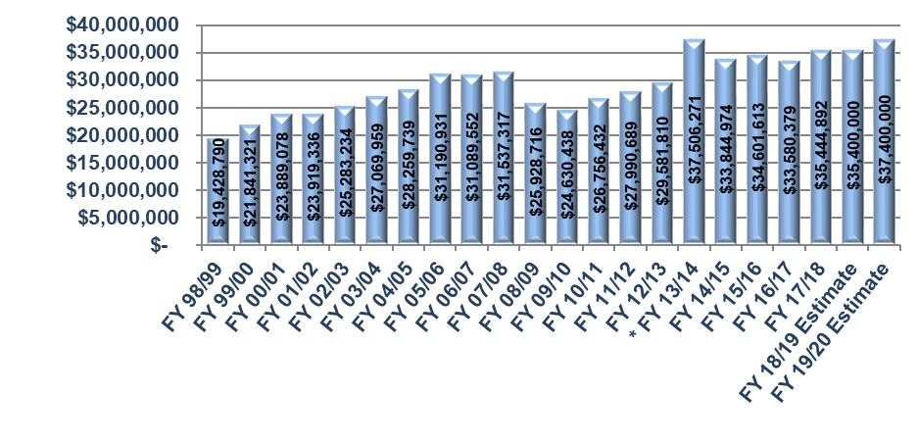
Local Transportation Fund (LTF) Revenue
Fiscal Year 1998/1999 – 2019/2020
$2 million increase in Sales Tax Receipts anticipated
*Fiscal Year 2013/2014 included one-time payment for settlement

Slide 7
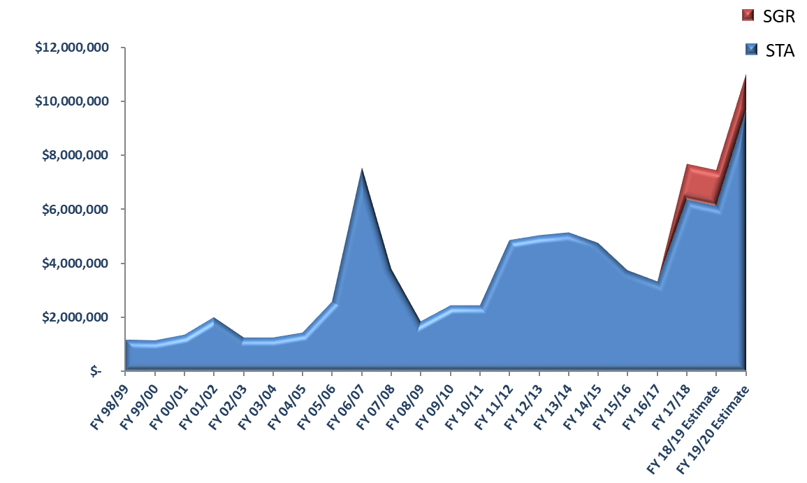
State Transit Assistance (STA) Revenue
Fiscal Year 1998/1999 – 2019/2020
STA revenues increased (with SB 1) now at $9.6 million
State of Good Repair (SGR) portion of revenues at $1.3 million
Sustains Transit Operations and Transit Capital

Slide 8
Personnel Costs
Salaries and Benefits = $3,168,200 or 4.1% of budget
21 full-time employees
Costs up $101,300 or 3.3% from Fiscal Year 2018/2019
Funded Status – Pension 80% and OPEB 75%

Slide 9
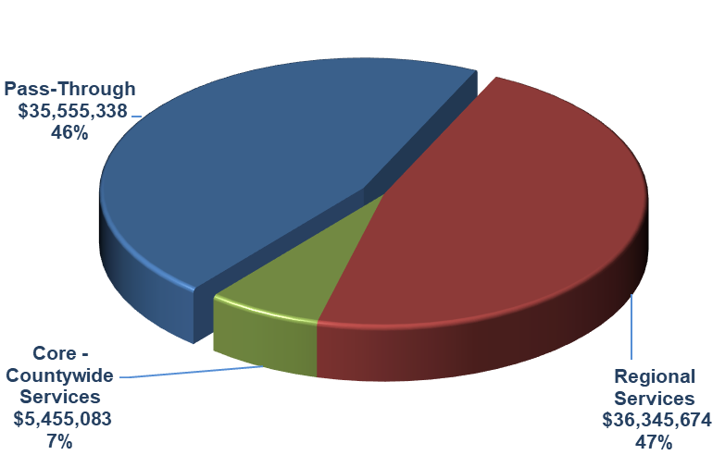
Pass Through – Regional Services – Core & Countywide Services
Pass Through – 46% of Budget at $35,555,338
TDA Administration – LTF Distribution
Transit Grant Administration – FTA sub-recipients

Slide 10
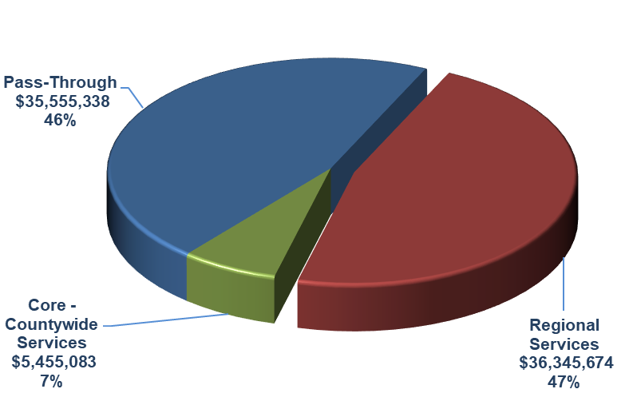
Pass Through – Regional Services – Core & Countywide Services
Regional Services – 47% of Budget at $36,345,674
Highway Program Management
LOSSAN - Coast Rail Coordinating Council
Metrolink Commuter Rail
Regional Transit Information Center
Regional Transit Technology
Santa Paula Branch Line
Senior & Disabled Transportation Services
SpeedInfo Highway Speed Sensors
Valley Express
VCTC Intercity Services

Slide 11
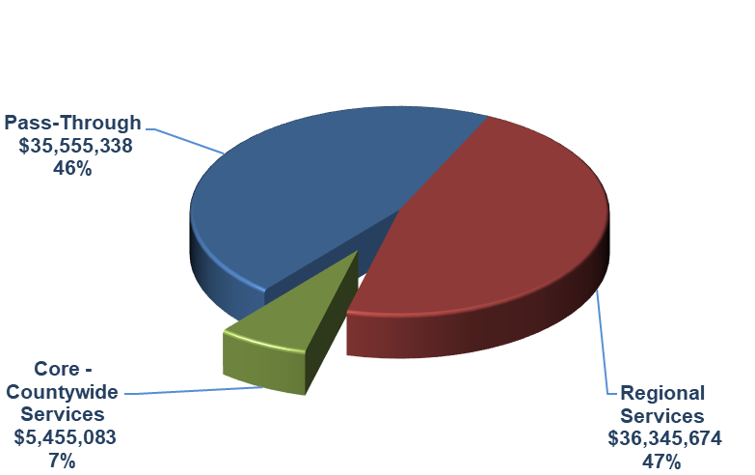
Pass Through – Regional Services – Core & Countywide Services
Core & Countywide Services – 7% of Budget at $5,455,083
Airport Land Use Commission
Community Outreach
Freight Movement
Management and Administration
Motorist Aid Services
Regional Transit Planning
Regional Transportation Planning
Rideshare Programs
State and Federal Governmental Relations
TDA Administration
Transit Grant Administration
Transportation Programming and Reporting

Slide 12
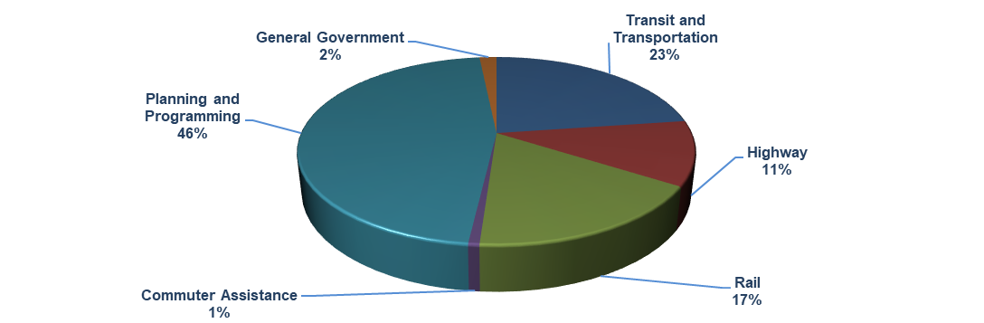
Budgeted Expenditures by Program
Program Budget Categories | Fiscal Year 2017/2018 Actual | Fiscal Year 2018/2019 Budget | Fiscal Year 2019/2020 Budget | % of Change
Transit and Transportation | $16,539,852 | $25,948,745 | $17,651,800 | -32.0%
Highway | 469,973 | 6,434,320 | 8,590,000 | 33.5%
Rail | 3,563,132 | 10,456,951 | 13,309,574 | 27.3%
Commuter Assistance | 471,333 | 548,300 | 589,900 | 7.6%
Planning and Programming | 31,377,414 | 35,593,318 | 35,930,921 | 0.9%
General Government | 1,010,038 | 1,147,900 | 1,283,900 | 11.8%
Total Program Budget | $53,431,742 | $80,129,534 | $77,356,095 | -3.5%

Slide 13
Transit and Transportation Budget Tasks
Budget Tasks | Fiscal Year 2017/2018 Actual | Fiscal Year 2018/2019 Budget | Fiscal Year 2019/2020 Budget | % of Change
Regional Transit Technology | $ 1,082,785 | $ 2,967,016 | $ 848,400 | -71.4%
Senior and Disabled Transportation Services | 256,368 | 307,800 | 304,400 | -1.1%
Transit Grant Administration | 4,188,547 | 8,573,203 | 3,166,700 | -63.1%
Valley Express | 1,876,318 | 1,943,400 | 1,937,600 | -0.3%
VCTC Intercity Services | 9,135,834 | 12,157,326 | 11,394,700 | -6.3%
Total Transit and Transportation Budget | $16,539,852 | $25,948,745 | $17,651,800 | -32.0%
Changes from Fiscal Year 2018/2019 to 2019/2020
Regional Transit Technology:
- $2,118,616 for anticipated CAD/AVL project completion.
Transit Grant Administration:
- $5,406,503 for completed pass-through projects and new projects not yet identified.
VCTC Intercity Services:
- $762,626 for completion of bus purchases offset by budgeted depreciation expense.

Slide 14
Highway Budget Tasks
Budget Tasks | Fiscal Year 2017/2018 Actual | Fiscal Year 2018/2019 Budget | Fiscal Year 2019/2020 Budget | % of Change
Motorist Aid Services | $271,815 | $ 901,000 | $ 320,000 | -64.5%
Highway Program Management | 87,078 | 5,380,320 | 8,120,400 | 50.9%
SpeedInfo Highway Speed Sensors | 111,080 | 153,000 | 149,600 | -2.2%
Total Highway Budget | $469,973 | $6,434,320 | $8,590,000 | 33.5%
Changes from Fiscal Year 2018/2019 to 2019/2020
Motorist Aid Services:
- $581,000 for completion of ADA upgrades and compliance project.
Highway Program Management:
+ $2,740,080 for U.S. 101 preliminary engineering and environmental documents.

Slide 15
Rail Budget Tasks
Budget Tasks | Fiscal Year 2017/2018 Actual | Fiscal Year 2018/2019 Budget | Fiscal Year 2019/2020 Budget | % of Change
LOSSAN - Coast Rail Coordinating Council | $ 37,498 | $ 35,400 | $ 40,900 | 15.5%
Metrolink Commuter Rail | 2,738,776 | 9,580,551 | 12,421,874 | 29.7%
Santa Paula Branch Line | 786,858 | 841,000 | 846,800 | 0.7%
Total Rail Budget | $3,563,132 | $10,456,951 | $13,309,574 | 27.3%
Changes from Fiscal Year 2018/2019 to 2019/2020
Metrolink Commuter Rail:
+ $2,841,323 for carried-over SB1 and State of Good Repair funds capital rehabilitation projects.

Slide 16
Commuter Assistance Budget Tasks
Budget Tasks | Fiscal Year 2017/2018 Actual | Fiscal Year 2018/2019 Budget | Fiscal Year 2019/2020 Budget | % of Change
Regional Transit Information Center | $221,689 | $272,200 | $281,000 | 3.2%
Rideshare Programs | 249,644 | 276,100 | 308,900 | 11.9%
Total Commuter Assistance Budget | $471,333 | $548,300 | $589,900 | 7.6%
Changes from Fiscal Year 2018/2019 to 2019/2020
Rideshare Programs:
+ $32,800 for increased data base administration and staffing costs.

Slide 17
Planning and Programming Budget Tasks
Budget Tasks | Fiscal Year 2017/2018 Actual | Fiscal Year 2018/2019 Budget | Fiscal Year 2019/2020 Budget | % of Change
Airport Land Use Commission | $ 9,502 | $ 27,800 | $ 24,700 | -11.2%
Freight Movement | 43,479 | 42,900 | 42,900 | 0.0%
Regional Transit Planning | 566,248 | 2,041,274 | 1,694,583 | -17.0%
Regional Transportation Planning | 500,562 | 1,152,500 | 991,000 | -14.0%
Transportation Development Act | 29,898,625 | 31,985,844 | 32,822,738 | 2.6%
Transportation Programming and Reporting | 358,998 | 343,000 | 355,000 | 3.5%
Total Planning & Programming Budget | $31,377,414 | $35,593,318 | $35,930,921 | 0.9%
.
Changes from Fiscal Year 2018/2019 to 2019/2020
Regional Transit Planning:
- $346,691 for completion of consultant studies.
Regional Transportation Planning:
- $161,500 for partial completion of consultant studies.
Transportation Development Act:
+ $836,894 for additional pass-through funds to local agencies.

Slide 18
General Government Budget Tasks
Budget Tasks | Fiscal Year 2017/2018 Actual | Fiscal Year 2018/2019 Budget | Fiscal Year 2019/2020 Budget | % of Change
Community Outreach | $ 464,226 | $ 514,500 | $ 520,000 | 1.1%
Management and Administration | 367,131 | 408,800 | 546,600 | 33.7%
State and Federal Governmental Relations | 155,074 | 224,600 | 217,300 | -3.3%
VCTC Office Building | 23,607 | - | - | -
Total General Government Budget | $1,010,038 | $1,147,900 | $1,283,900 | 11.8%
Changes from Fiscal Year 2017/2018 to 2018/2019
Management and Administration:
+ $137,800 placeholder for VCTC Office relocation-FFE and reconciliation of ICAP.

Slide 19
Where We End Up
  Estimated $15.6 million Total Fund Balance (after reserve)
  Available for “general use”
  - GF $48,345
  Restricted Fund Balances
  - LTF $43,517
  - STA $12,013,306
      Used for cash-flow (i.e. grants & capital purchases)
      Anticipated uses for STA balance:
        Metrolink capital rehabilitation
        VCTC Intercity bus purchases
        VCTC Office relocation related costs (i.e. tenant improvements & FFE)
  - SAFE $3,531,309
      Anticipated uses for SAFE balance:
        First Responders Grant
        Freeway Service Patrol
  $77.4 million balanced budget

Slide 20
QUESTIONS?

